Slide 1
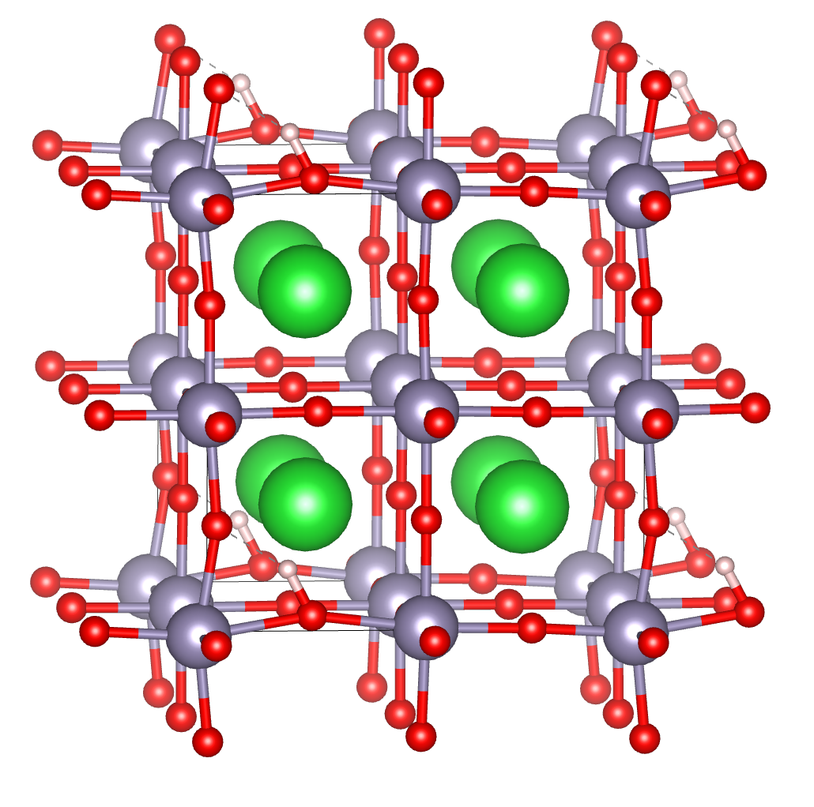
ΔX = (X_{init}+X_{fin}) - X_{TS}
Phonon mode eigenvector – matrix of complex numbers Nx3
Multiply phonon eigenvector by the 1/sqrt(masses) to find the actual displacements of atoms;
Find the length of the projection of ΔX onto all phonon modes, plot the squared projection length (since energy is proportional to squared displacement)

Slide 2
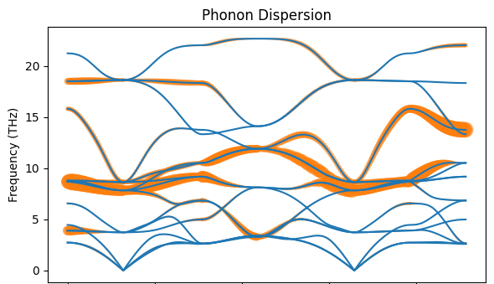
X
G
M
R
G
X
M

Slide 3
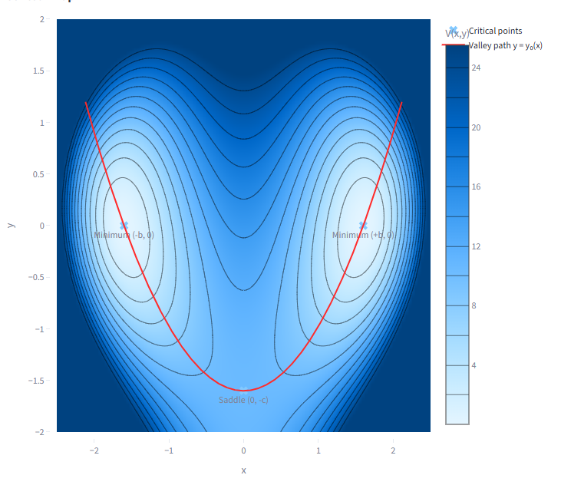


Vineyard formalism:
The calculations are based on the taylor expansions around the equilibruim and saddle point, according to the theory of small vibrations.
IMO, it leads to significantly underestimated partition function around equilibrium due to anharmonicity: the isolines in the figure would be ellipses in harmonic approx, but are stretched towards saddle point. Therefore, they are anharmonic and are larger, meaning the denominator in the formula above should be larger, and total Г smaller. Hence, the traditional Vineyard formula overestimates the barrier.

Slide 4
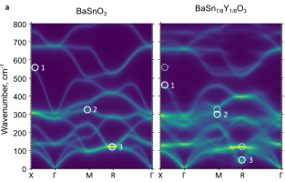
X
G
M
R
G
X
M

