Slide 1



Identifier Namespaces in Mathematical Notation
Master Thesis by
Alexey Grigorev
Advisers: Moritz Schubotz, Juan Soto
Supervisor: Prof. Dr. Volker Markl

Slide 2
Outline
Motivation
Namespace Discovery
Implementation
Evaluation
Conclusions

Slide 3
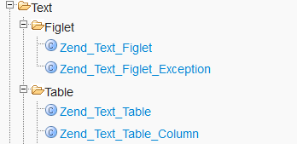
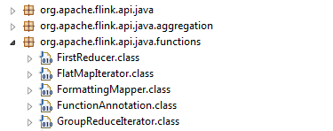
[[Namespace]]
“
In programming, namespaces are employed to group symbols and identifiers around a particular functionality and to avoid name collisions between multiple identifiers that share the same name
“
No namespaces (C, old PHP)
With namespaces (C++, Java, C#, Python)
$foo = new Zend_CodeGenerator_Php_Class();
import o.a.f.api.java.ExecutionEnvironment;
ExecutionEnvironment.getExecutionEnvironment()
http://framework.zend.com/apidoc/1.11/
https://flink.apache.org/

Slide 4
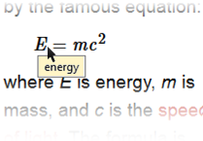
Namespaces in Mathematics
What is it?
Energy
Elimination matrix
Expected Value
Can resolve it by introducing namespaces to Mathematics
  import Physics/General/Relativity and Gravitation/{E, m, c}
It can give:
  identifier disambiguation
  better user experience
  additional context
credit: [MLP]
Notes:
Обязательно сказать что такое неймспейс в мат-ке
The concept of namespaces can be benefitial for math as well. There are many one-letter identifiers that are hard to understand immediately
By adding namespaces mathematicians can benefit from knowledge organization the same way as programmers. And structure will make it easier to understand
Look at the problem of assigning each identifier in all documents to some namespace
No special dataset at the moment where identifiers are grouped, so need to create this dataset ourselves
Manual creation requires a lot of time and effort
Here we propose a method for automatic namespace discovery from a collection of documents

Slide 5
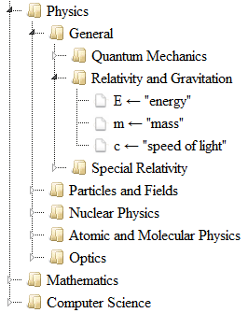

Namespaces in Mathematics
Problem: How to organize identifiers into namespaces?
Manual assignment would take a lot of time
Our approach: employ automatic namespace discovery from a collection of documents
“energy”
“mass”
“speed of light”
import Physics/General/Relativity and Gravitation/{E, m, c}

Slide 6
Outline
Motivation
Namespace Discovery
Implementation
Evaluation
Conclusions
Notes:
Discussed why introducing namespaces to math is useful. Now we’ll talk how we can extract namespaces

Slide 7
Definition Extraction
How to get the definitions? Extract them!
[[Mass–energy equivalence]]
“
The equivalence of energy E and mass m is reliant on the speed of light c and is described by the famous equation:
“
ID | Definition
E | energy
m | mass
c | speed of light
[MLP]
Notes:
Word Sense Disambiguation is a problem of identifying in which sense a word is used.
Identifier disambiguation is same but for IDs: when we have a formula, we need to know what these identifiers mean
Solved by extracting definitions from the surrounding text
To do that we need Part-of-Speech tagging
Then we select definition candidates

Slide 8
Namespace Discovery
Want to find groups of documents that use identifiers in the same way
Relativity
“Namespace-defining” clusters
Optics
Cluster analysis
E: energy
m: mass
c: speed of light
λ: wavelength
v: speed
Notes:
We want to extract namespaces from a collection of documents
To do that we can use cluster analysis and look for clusters where all documents use identifiers in the same way
Usual CA methods maximize the within-cluster similarity
But it doesn’t always result in clusters that are good namespaces
Hence we use the cohesion principle and look for cohesive clusters
In our case cohesive means that all documents are from the same category

Slide 9
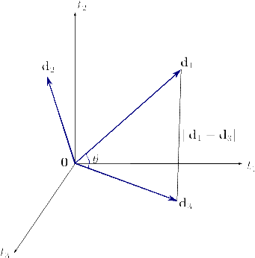
Vector Space Model (VSM)
Terms are dimensions
Documents are vectors indexed by terms
Euclidean distance
Cosine similarity
Weights w are TF or TF-IDF
[IR]
Notes:
VSM is a retrieval model in IR where documents and queries are represented by terms they contain
It’s a VS where dimensions are termns,
So if there are d words, then documents are d-dim vectors
Once the docs are expressed in vectors, can calculate similarity between then
TF-IDF – two components
TF favors high-frequency terms
IDF favors descriptive/discriminative terms
They balance each other
The more documents contain a term, the less desr it becomes
Illustrate similarity measures on the graph

Slide 10
Identifier VSM
 | Definition
E | energy
m | mass
c | speed of light
 | Definition
m | mass
c | speed of light
 | Definition
E | energy
 | Definition
m | integer
c | constant
Build identifier-document matrix
TF of terms
No definitions
“Weak” association
“Strong” association
Notes:
3 options to include definitions: don’t include them, include as separate dimensions, or form new dimensions with id_def concatenated

Slide 11
Document Clustering
Once documents are represented using vectors we can cluster them
We can employ:
K-Means [IR]
DBSCAN [SNN]
LSA [LSI]
Notes:
Everybody knows K-Means – partitioning algo: the idea is to minimize distance between documents of a cluster and its centroid. Uses Euclidean distance
Its iterative, with two stems: cluster assignment, centroid recompution, repreat until no cluster reassignment happens or some number of iterations
Usual K-Means looks at entire dataset at each step
It’s expensive
MiniBatch K-means is a different way of optimizing the K-Means cost function – by looking only at a portion of data – it uses Batch GD
DBScan – desnity based algo. Looks for core points and builds clusters around them. Some points are discarded as noise. Can use any distance and sim. function
There’s good sim. Func that works well in high dimensions – SNN Similarity

Slide 12
Outline
Motivation
Namespace Discovery
Implementation
Evaluation
Conclusions

Slide 13



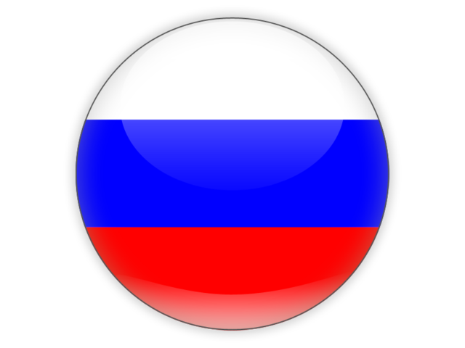
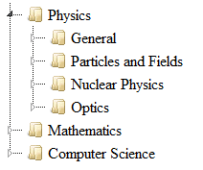

Implementation
Definition extraction
Namespace discovery
our contribution
Images: [[File:Wikipedia-logo-en-big.png]]
https://flink.apache.org/material.html
http://www.freeflagicons.com
http://scikit-learn.org/stable/
Notes:
We want to apply these methods to English/Russian WIki
Apache Flink was used to do def extraction – represent each document as a bag of identifiers
Prior to that we keep only math-related pages
Extract IDs with XPath
Use StanfordNLP with maxEnt POS tagger for English and simple rule-based POS tagger for Russian
Additionally, Links are good definition candidates
Then we rank candidates
This is based on work done by Robert who opensourced it

Slide 14
Definition extraction
Namespace discovery
wikiFilter
Filter pages with <math>
Output
[[Mass-energy equivalence]]
Extract identifiers
XPath
IDs: [E, m, c, μ, ...]
 | Def | Score
E | enegy | 0.99
m | mass | 0.99
c | speed of light | 0.90
Standford NLP
POS Tagging
Rank definition candidates
MLP Ranking
[MLP]
Based on open source project by Robert Pagel
Notes:
We want to apply these methods to English/Russian WIki
Apache Flink was used to do def extraction – represent each document as a bag of identifiers
Prior to that we keep only math-related pages
Extract IDs with XPath
Use StanfordNLP with maxEnt POS tagger for English and simple rule-based POS tagger for Russian
Additionally, Links are good definition candidates
Then we rank candidates
This is based on work done by Robert who opensourced it

Slide 15
Data Cleaning
Definition extraction
Namespace discovery
Discard font features
Discard false identifiers
Filter pages with <math>
Operators
Stop words
Extract identifiers
cos
sin
exp
max
min
trace
cos
sin
exp
max
min
trace
if | если
iff
when | когда
then | тогда
or | или
and | и
POS Tagging
Rank definition candidates
Notes:
We want to apply these methods to English/Russian WIki
Apache Flink was used to do def extraction – represent each document as a bag of identifiers
Prior to that we keep only math-related pages
Extract IDs with XPath
Use StanfordNLP with maxEnt POS tagger for English and simple rule-based POS tagger for Russian
Additionally, Links are good definition candidates
Then we rank candidates
This is based on work done by Robert who opensourced it

Slide 16
Definition extraction
Namespace discovery
Represent using a VSM
Output
Cluster analysis
Filter clusters
Extract namespaces
Organize to hierarchy
Notes:
We want to apply these methods to English/Russian WIki
Apache Flink was used to do def extraction – represent each document as a bag of identifiers
Prior to that we keep only math-related pages
Extract IDs with XPath
Use StanfordNLP with maxEnt POS tagger for English and simple rule-based POS tagger for Russian
Additionally, Links are good definition candidates
Then we rank candidates
This is based on work done by Robert who opensourced it

Slide 17
Definition extraction
Namespace discovery
Represent using a VSM
TfidfVectorizer(min_df=2)
Cluster analysis
Filter clusters
Kmeans and MiniBatchKMeans
DBSCAN
Extract namespaces
randomized_svd and NMF
Organize to hierarchy
Notes:
We want to apply these methods to English/Russian WIki
Apache Flink was used to do def extraction – represent each document as a bag of identifiers
Prior to that we keep only math-related pages
Extract IDs with XPath
Use StanfordNLP with maxEnt POS tagger for English and simple rule-based POS tagger for Russian
Additionally, Links are good definition candidates
Then we rank candidates
This is based on work done by Robert who opensourced it

Slide 18
Definition extraction
Namespace discovery
All obtained clusters are “homogenous”: within-cluster similarity is maximal.
Represent using a VSM
We keep those clusters whose documents correspond to the the same category.
Otherwise, we discard uncategorised clusters.
Cluster analysis
Optics
Relativity
???
Filter clusters
Extract namespaces
Organize to hierarchy
“namespace-defining” clusters
Notes:
We want to apply these methods to English/Russian WIki
Apache Flink was used to do def extraction – represent each document as a bag of identifiers
Prior to that we keep only math-related pages
Extract IDs with XPath
Use StanfordNLP with maxEnt POS tagger for English and simple rule-based POS tagger for Russian
Additionally, Links are good definition candidates
Then we rank candidates
This is based on work done by Robert who opensourced it

Slide 19
Definition extraction
Namespace discovery
 | Def | S
E | energy | 0.99
m | mass | 0.99
c | speed of light | 0.90
c | speed of light | 1.00
Represent using a VSM
Relativity
Cluster analysis
 | Def | S
E | energy | 0.99
m | mass | 0.99
c | speed of light | 3.70
 | energy | 0.99
 | mass | 1.94
 | energy | 1.89
c | energy | 0.80
 | Def | S
 | energy | 0.90
 | mass | 0.99
c | speed of light | 0.90
Filter clusters
Extract namespaces
 | Def | S
 | energy | 0.99
 | mass | 0.95
c | speed of light | 0.90
c | energy | 0.80
Organize to hierarchy
Notes:
We want to apply these methods to English/Russian WIki
Apache Flink was used to do def extraction – represent each document as a bag of identifiers
Prior to that we keep only math-related pages
Extract IDs with XPath
Use StanfordNLP with maxEnt POS tagger for English and simple rule-based POS tagger for Russian
Additionally, Links are good definition candidates
Then we rank candidates
This is based on work done by Robert who opensourced it

Slide 20
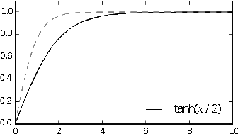
Definition extraction
Namespace discovery
 | Def | S
E | energy | 0.99
m | mass | 0.99
c | speed of light | 0.90
c | speed of light | 1.00
Represent using a VSM
Relativity
Cluster analysis
 | Def | S
E | energy | 0.46
m | mass | 0.46
c | speed of light | 0.87
 | energy | 0.46
 | mass | 0.60
 | energy | 0.57
c | energy | 0.20
 | Def | S
 | energy | 0.90
 | mass | 0.99
c | speed of light | 0.90
Filter clusters
Extract namespaces
 | Def | S
 | energy | 0.99
 | mass | 0.95
c | speed of light | 0.90
c | energy | 0.80
Organize to hierarchy
Notes:
We want to apply these methods to English/Russian WIki
Apache Flink was used to do def extraction – represent each document as a bag of identifiers
Prior to that we keep only math-related pages
Extract IDs with XPath
Use StanfordNLP with maxEnt POS tagger for English and simple rule-based POS tagger for Russian
Additionally, Links are good definition candidates
Then we rank candidates
This is based on work done by Robert who opensourced it

Slide 21
Definition extraction
Namespace discovery
Represent using a VSM
 | Def | S
E | energy | 0.99
m | mass | 0.99
c | speed of light | 3.70
c | speed of light in vacuum | 0.99
m | mass | 1.94
m | total mass | 1.89
Cluster analysis
 | Def | S
E | energy | 0.99
c | *speed of light | 4.69
m | *mass | 4.82
Filter clusters
Extract namespaces
Fuzzy grouping
Organize to hierarchy
FuzzyWuzzy https://github.com/seatgeek/fuzzywuzzy
Notes:
We want to apply these methods to English/Russian WIki
Apache Flink was used to do def extraction – represent each document as a bag of identifiers
Prior to that we keep only math-related pages
Extract IDs with XPath
Use StanfordNLP with maxEnt POS tagger for English and simple rule-based POS tagger for Russian
Additionally, Links are good definition candidates
Then we rank candidates
This is based on work done by Robert who opensourced it

Slide 22
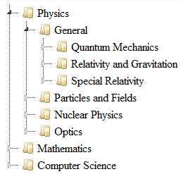
Definition extraction
Namespace discovery
A reference hierarchy: drawn from what source?
Represent using a VSM
Cluster analysis
PACS
Filter clusters
MSC
Extract namespaces
ACM
Organize to hierarchy
Notes:
We want to apply these methods to English/Russian WIki
Apache Flink was used to do def extraction – represent each document as a bag of identifiers
Prior to that we keep only math-related pages
Extract IDs with XPath
Use StanfordNLP with maxEnt POS tagger for English and simple rule-based POS tagger for Russian
Additionally, Links are good definition candidates
Then we rank candidates
This is based on work done by Robert who opensourced it

Slide 23
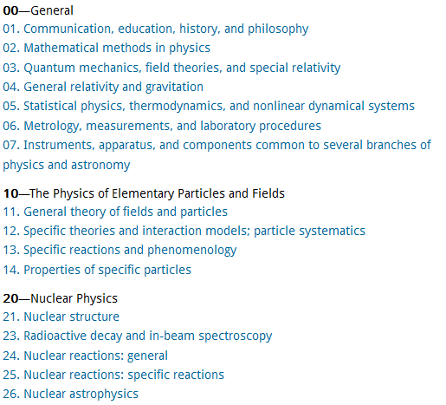
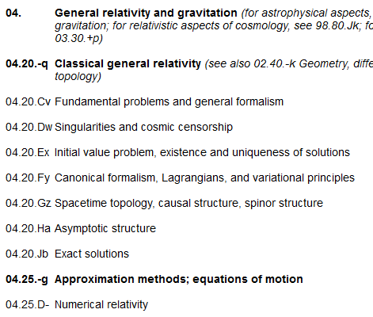
Definition extraction
Namespace discovery
PACS
Represent using a VSM
Cluster analysis
Filter clusters
Extract namespaces
Organize to hierarchy
https://www.aip.org/publishing/pacs/pacs-2010-regular-edition
Notes:
We want to apply these methods to English/Russian WIki
Apache Flink was used to do def extraction – represent each document as a bag of identifiers
Prior to that we keep only math-related pages
Extract IDs with XPath
Use StanfordNLP with maxEnt POS tagger for English and simple rule-based POS tagger for Russian
Additionally, Links are good definition candidates
Then we rank candidates
This is based on work done by Robert who opensourced it

Slide 24
Definition extraction
Namespace discovery
 | Def | S
E | energy | 0.99
c | *speed of light | 0.96
m | *mass | 0.87
Represent using a VSM
Cluster analysis
Filter clusters
 | Def | S
λ | wavelength | 0.99
k | wavenumber | 0.89
f | frequency | 1.0
Extract namespaces
Organize to hierarchy
Extract keywords from namespaces
Extract keywords from categories
Calculate cosine between them
Notes:
We want to apply these methods to English/Russian WIki
Apache Flink was used to do def extraction – represent each document as a bag of identifiers
Prior to that we keep only math-related pages
Extract IDs with XPath
Use StanfordNLP with maxEnt POS tagger for English and simple rule-based POS tagger for Russian
Additionally, Links are good definition candidates
Then we rank candidates
This is based on work done by Robert who opensourced it

Slide 25
Outline
Motivation
Namespace Discovery
Implementation
Evaluation
Conclusions

Slide 26

Java Language Processing
How to evaluate the quality?
Hard! No ground truth, unsupervised settings
Use data where ground truth is known: source code!
package org.apache.flink.api.java.functions;
public class FirstReducer<T> implements ... {
private final int count;
// ...
@Override
public void reduce(Iterable<T> values, Collector<T> out) {
int emitCnt = 0;
for (T val : values) {
out.collect(val);
// ...
}
}
}
“definition” identifier
[[File:Java_logo_and_wordmark.svg]]

Slide 27

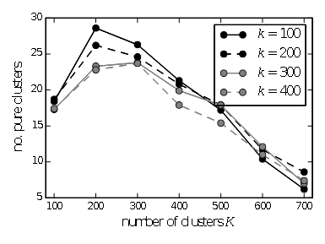
Java Language Processing
Apache Mahout
1560 Java Classes
46k variable declarations
150 packages
Namespace-defining clusters in Mahout
AST Tree
extracted with JavaParser*
Namespace discovery
✓
Method works
http://mahout.apache.org/images/
* https://github.com/javaparser/javaparser

Slide 28
Experimental Setup
Definition extraction
Namespace discovery
Objective: want to find as many namespace-defining clusters as possible
Cluster is namespace-defining if it
has at least purity p and
contains at least n documents
Represent using a VSM
Cluster analysis
Relativity, Gravitation
Gravitation, Relativity, Physics
Relativity, Einstein
Physics, Relativity
Physics, Gravitation
Filter clusters
Purity p vs size n tradeoff:
Larger p – only pure clusters, smaller p – allow some slack
Larger n – only big well-connected clusters are taken into account
Extract namespaces
Organize to hierarchy
Our settings: p ≥ 80% and n ≥ 3
Notes:
We want to apply these methods to English/Russian WIki
Apache Flink was used to do def extraction – represent each document as a bag of identifiers
Prior to that we keep only math-related pages
Extract IDs with XPath
Use StanfordNLP with maxEnt POS tagger for English and simple rule-based POS tagger for Russian
Additionally, Links are good definition candidates
Then we rank candidates
This is based on work done by Robert who opensourced it

Slide 29
Parameter Tuning
Definition extraction
Namespace discovery
Identifier VSM: no-def, weak, strong
Weighting: TF, TF-IDF, logTF-IDF
Represent using a VSM
Cluster analysis
DBSCAN
  base similarity function, ε, MinPts
K-Means
  number of clusters K
Latent Semantic Analysis
  matrix decomposition: SVD or NMF
  rank of reduced matrix k
Filter clusters
Extract namespaces
Organize to hierarchy
Notes:
We want to apply these methods to English/Russian WIki
Apache Flink was used to do def extraction – represent each document as a bag of identifiers
Prior to that we keep only math-related pages
Extract IDs with XPath
Use StanfordNLP with maxEnt POS tagger for English and simple rule-based POS tagger for Russian
Additionally, Links are good definition candidates
Then we rank candidates
This is based on work done by Robert who opensourced it

Slide 30
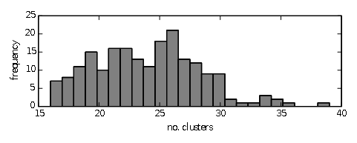
Baseline
Definition extraction
Namespace discovery
Random cluster assignment
Algorithm:
let k = 0
take three unseen documents at random
assign them to cluster k
increment k
repeat until no documents left
Represent using a VSM
Cluster analysis
Filter clusters
Extract namespaces
Performance of random clustering
Organize to hierarchy
Notes:
We want to apply these methods to English/Russian WIki
Apache Flink was used to do def extraction – represent each document as a bag of identifiers
Prior to that we keep only math-related pages
Extract IDs with XPath
Use StanfordNLP with maxEnt POS tagger for English and simple rule-based POS tagger for Russian
Additionally, Links are good definition candidates
Then we rank candidates
This is based on work done by Robert who opensourced it

Slide 31
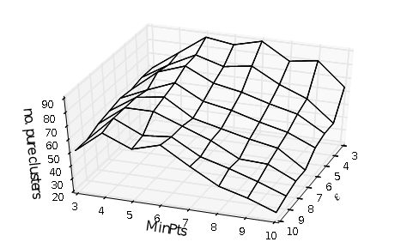
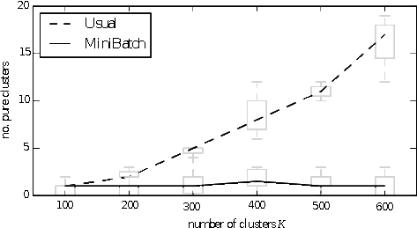
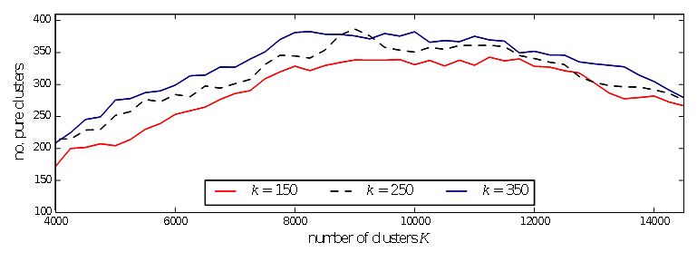
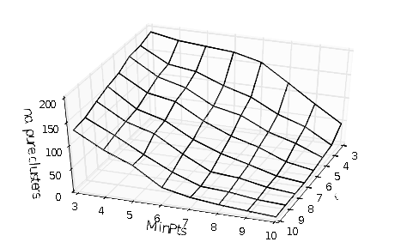
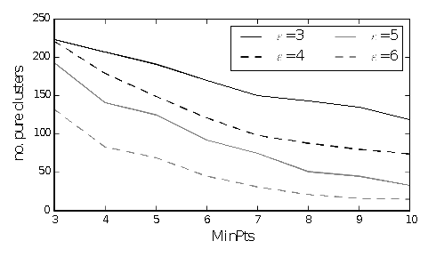
Parameter Tuning
Best result is obtained with:
Weak association
LSA via SVD with k = 350 + K-Means with K = 9750
n=15
Performance of K-Means with LSA via SVD

Slide 32
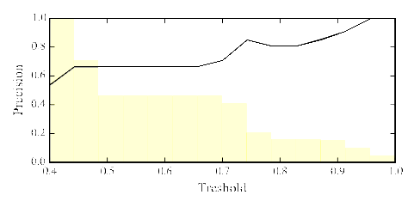
Evaluation & Results
Results: bitly.com/1fWIbO2
Evaluation:
  draw 100 relations at random
  verify if they are correct or not manually

Slide 33
What is it?
Energy
Elimination matrix
Expected Value
 | E | m | c | λ | σ | μ
Linear algebra | matrix | matrix | scalar | eigenvalue | related permutation | algebraic multiplicity
General relativity | energy | mass | speed of light | length | shear | reduced mass
Coding theory | encoding function | message | transmitted codeword |  | natural isomorphisms
Optics |  | order fringe | speed of light in vacuum | wavelength | conductivity | permeability
Probability | expectation | sample size |  | affine parameter | variance | mean vector
http://www.freeflagicons.com

Slide 34
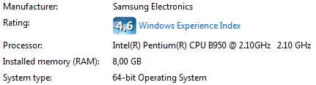
Experiments
Available on Github:
  github.com/alexeygrigorev/namespacediscovery
Software used for experiments
  Apache Flink 0.8.1
  numpy 1.9.2, scipy 0.15.1, scikit-learn 0.16.1
  IPython notebook 3.1.0
Hardware used for experiments:

Slide 35
Russian Wikipedia
Use algorithm that works best for English wiki:
  Weak association
  MiniBatch K-Means with LSA via SVD
Best result: 105 clusters, K = 3000, k = 250

Slide 36
Outline
Motivation
Namespace Discovery
Implementation
Evaluation
Conclusions

Slide 37
Conclusions
We are the very first to approach the problem of namespace discovery
Automatic namespace discovery is possible
We can employ established methods such as VSM and Document Clustering
Best result: 414 namespaces, 10 times better than random guessing
Suitable for other natural languages, besides English

Slide 38
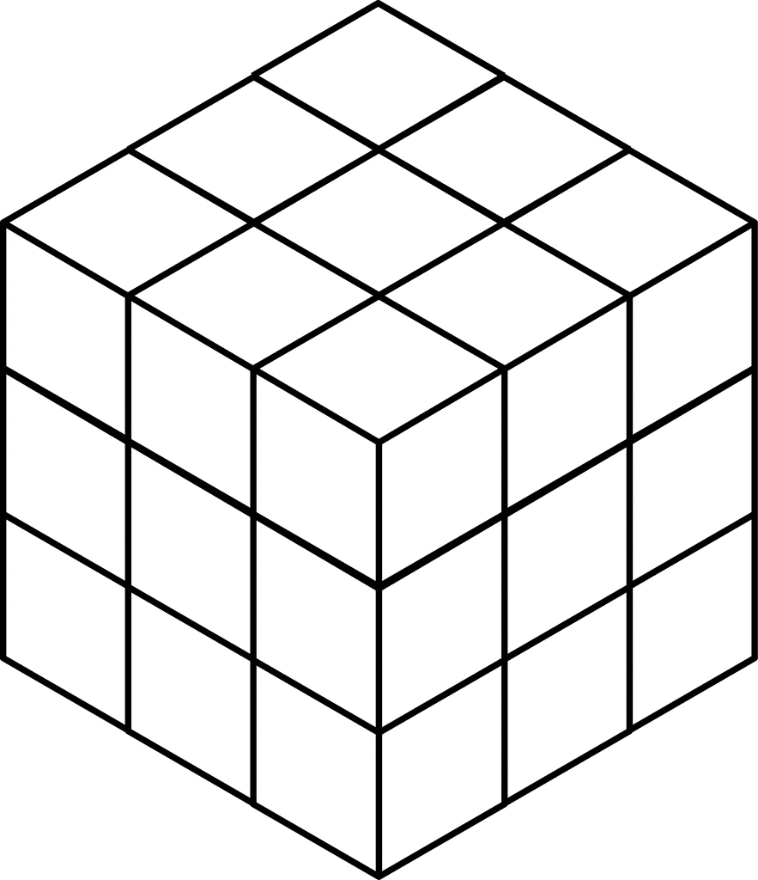
Future Work
Other datasets:
  arXiv
  StackExchange Q/A network: mathematics, cross-validated, physics, …
ML methods for identifier extraction may give better results
Other ways to embed definitions: 3-D tensors
Expect advanced clustering algorithms to perform better
  Split and Join operations in Scatter/Gather
  Spectral Clustering
  Cluster Ensembles
  Topic Modeling: LDA
Definition extraction
energy
Namespace discovery
mass
doc1
doc2
doc3

Slide 39
Acknowledgments
My adviser Moritz Schubotz
Sergey Dudoladov and Juan Soto
All IT4BI teachers from ULB, UFRT, TUB
  especially teachers of IR and DM courses

Slide 40
References
[MLP] Pagel, Robert, and Schubotz, Moritz. "Mathematical Language Processing Project.", 2014.
[IR] Manning, Christopher et al. “Introduction to Information Retrieval”, 2008.
[SSN] Ertöz, Levent, et al. "Finding clusters of different sizes, shapes, and densities in noisy, high dimensional data.", 2003.
[LSI] Deerwester, Scott, et al. "Indexing by Latent Semantic Analysis.", 1990.

Slide 41
Questions?

Slide 42
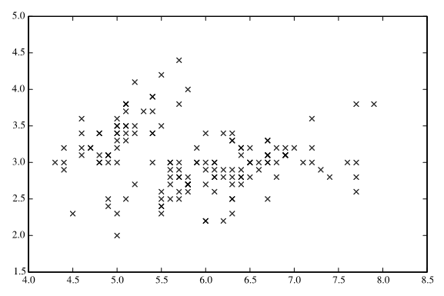
Back-up slide: Clustering Algorithms
Iris dataset
y
x

Slide 43
Back-up slide: LSA
Natural language data is “noisy”
  Synonymy: “graph” vs “chart”
  Polysemy: “trunk” (part of elephant vs part of car)
Denoise with dimensionality reduction
  SVD:
  NMF:
Not only denoises but also reveals the latent structure in data
Notes:
LSA is a method that deals with noisy NLP data
Use approximate matrix decomposition to denoise data

