Slide 1
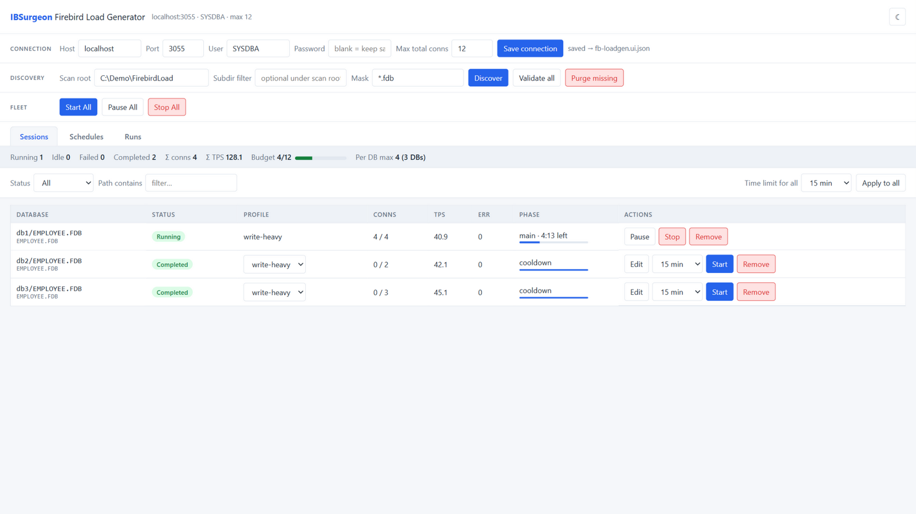
IBSurgeon Firebird Load Generator
Load testing for Firebird — from a one-shot CLI to a scheduled, multi-database fleet with a full REST API.
EMPLOYEE-schema workloads · ramp + spike profiles · schedules · run history · Prometheus & webhooks
Multi-database control plane — live status, one click per database
Notes:
Single Go binary; drives real Firebird workloads against the classic EMPLOYEE sample schema. Screenshot: sanitized demo rig (C:\Demo\FirebirdLoad).

Slide 2
Executive summary
1
4
10+
100%
Go binary — CLI, UI and API in one executable
workload profiles: write-heavy, read-heavy, spike, oltp-emul
databases per control plane, one worker = one connection
API-first: schedules, runs and metrics without the UI
TWO WAYS TO RUN
One-shot CLI
Control plane
fb-loadgen --profile write-heavy \
--dsn "localhost/3055:./EMPLOYEE.FDB" \
--warmup 30 --main 120 --cooldown 20
fb-loadgen --ui # UI + REST API + schedules
curl $BASE/api/sessions/$ID/start \
-d '{"timeLimitMin": 15}'
Ramp, measure, report — one database, one run
Discover many databases, run and schedule a fleet
IBSurgeon Firebird Load Generator | 2
Notes:
Facts: profiles in profile/ (write-heavy, read-heavy, spike); 10+ concurrent sessions exercised in the demo rig; API surface in API.md.

Slide 3
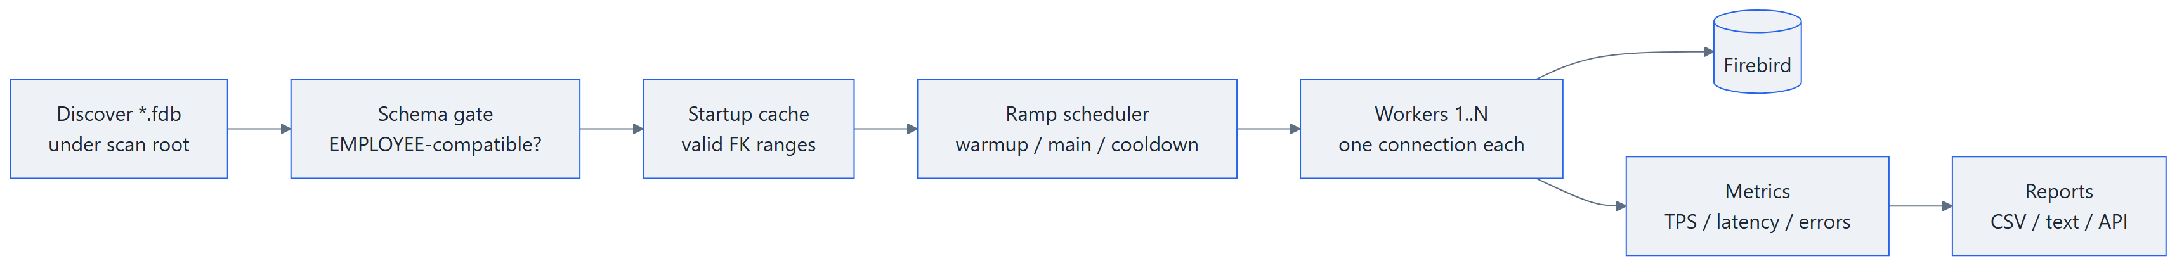
How it works — the life of one run
One process, one worker = one dedicated connection. Gate and cache run at every start.
Discover *.fdb
Schema gate
Cache warm-up
Ramp workers
Measure
Report
Everything runs inside one Go binary — the same executable is the CLI, the control plane and the load generator.
IBSurgeon Firebird Load Generator | 3
Notes:
Simplification note: discovery is the control-plane view; schema gate + cache happen per session start (session/manager.go startInternal).

Slide 4
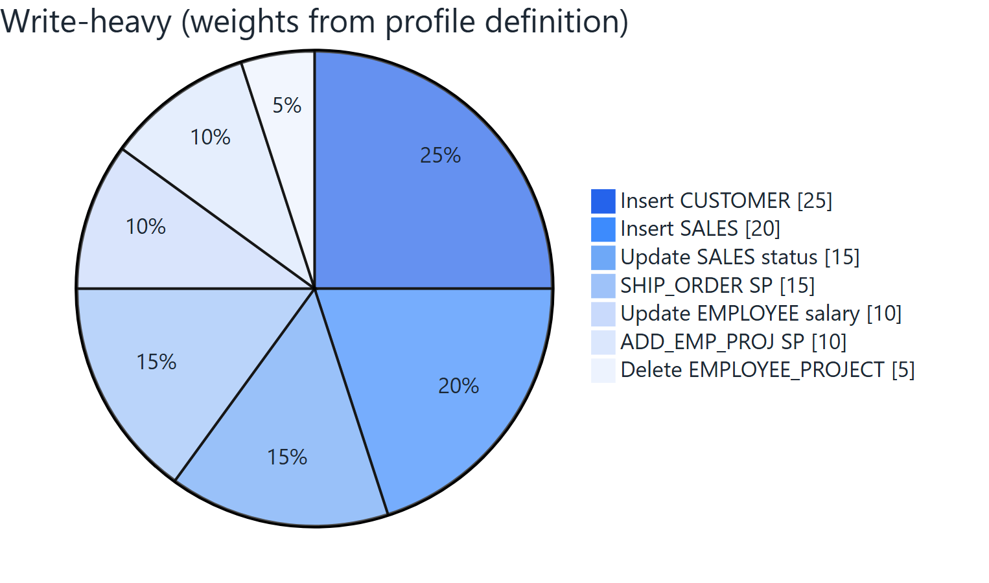
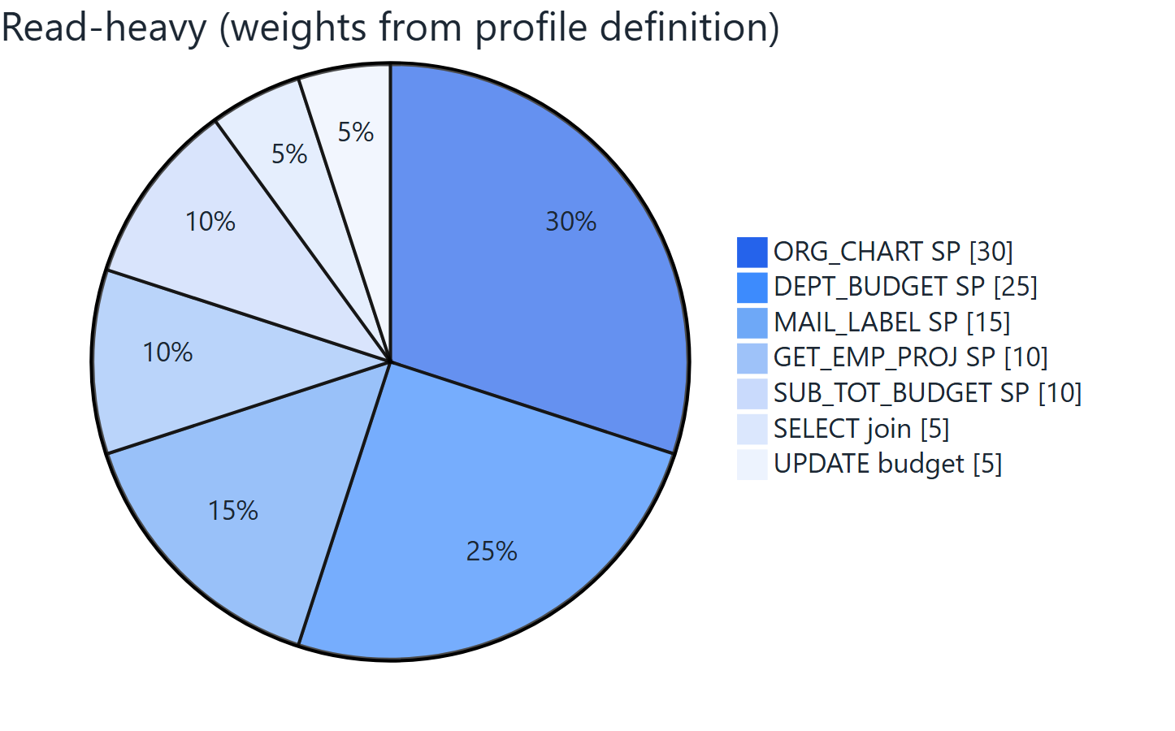
Workload model — real operation weights
Schema-aware operations: inserts respect FKs, updates follow state transitions, expected business exceptions are not errors.
Respects EMPLOYEE constraints (PO_NUMBER, salary bounds, status transitions)
Business exceptions like order_already_shipped tracked separately
IBSurgeon Firebird Load Generator | 4
Notes:
Weights are the profile definitions, not estimates: write-heavy profile/write_heavy.go:18-66, read-heavy profile/read_heavy.go (7 ops each, from the technical task).

Slide 5
Connection ramp
Warmup (linear up) → main (random walk between min and max) → cooldown (linear down). A time limit rescales all phases.
Warmup 0 → 30 s
linear ramp to the peak
Main 30 → 150 s
random walk between min/max
Cooldown 150 → 170 s
graceful ramp down
spike profile = sawtooth cycles
no-limit mode: 60 s warmup, then steady until stopped
IBSurgeon Firebird Load Generator | 5
Notes:
Defaults 30/120/20 s (config/config.go:89-91). No-limit mode: fixed 60 s warmup, then steady until stopped. Spike profile: sawtooth cycles in main.

Slide 6
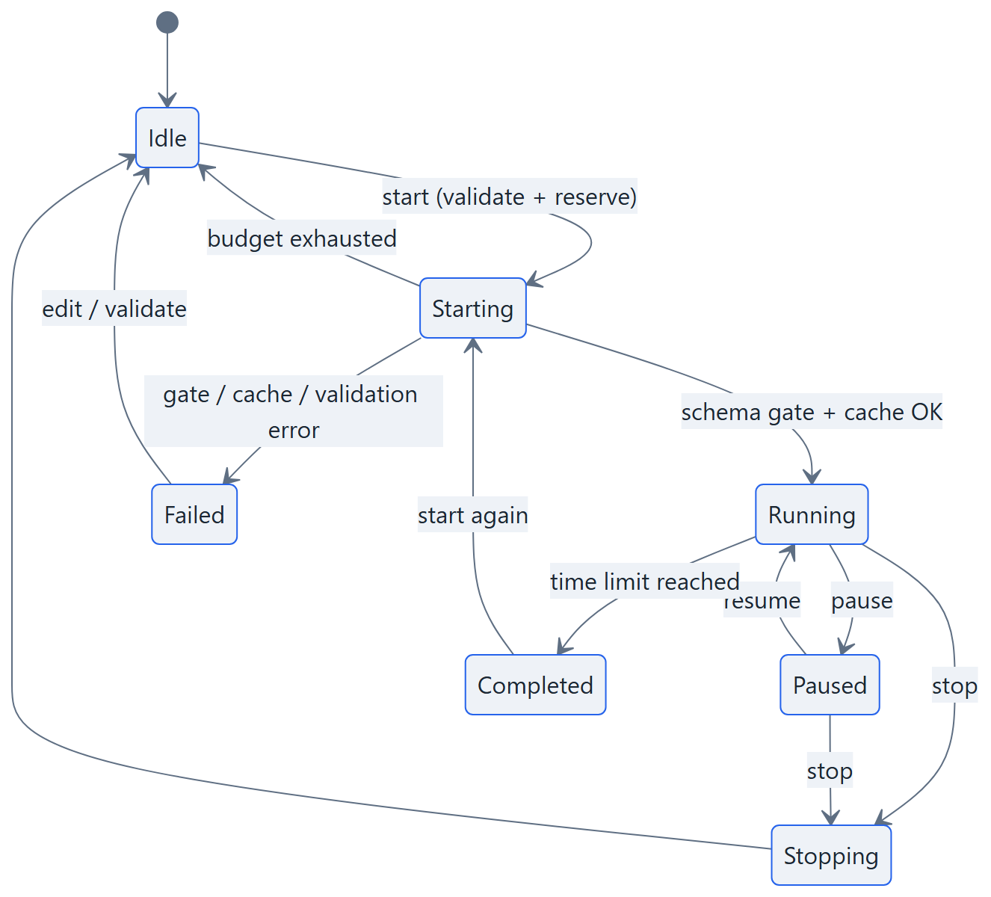
Session lifecycle
Every database in the fleet is a session with an explicit, observable state.
Starting — schema gate + connection-budget reservation
Running — load is being generated; live TPS and latency
Paused — workers and countdown frozen, connections kept
Completed — time limit reached — final metrics retained
Failed — connection or schema problem, reason in lastError
IBSurgeon Firebird Load Generator | 6
Notes:
State machine per session/manager.go. Budget exhaustion returns a session to Idle (recorded as skipped); only gate/cache/validation failures set Failed.

Slide 7
Safety rails & compatibility
Schema gate — a database must be reachable and EMPLOYEE-readable before any load
Built on the IBSurgeon driver
firebirdsql-go — IBSurgeon's maintained fork of the popular Go Firebird driver.
Firebird wire protocol
SRP and legacy authentication
Wire encryption and compression
Registered as driver firebirdsql for Go's database/sql.
Startup lookup cache — preloads valid FK ranges — inserts never guess
Fleet connection budget — maxTotalConns, split evenly, resized live across running sessions
Transaction timeouts — per-session tx timeout; expected business exceptions classified apart from real errors
IBSurgeon Firebird Load Generator | 7
Notes:
Budget: maxTotalConns, even per-DB split, live resize (config/config.go:102). Driver: IBSurgeon firebirdsql-go fork of nakagami/firebirdsql.

Slide 8
Metrics & reports
Live counters in the UI and API; durable artifacts on disk after every run.
TPS & success — transactions per second, per session and fleet-wide
Per-run report directory
reports/db1_EMPLOYEE.FDB/20260829-201952/
results_summary.txt
results_performance.txt
results_operations.txt
results_status.txt
results.csv + results.csv_latency.txt
sql_errors.log
GET /api/sessions/{id}/report/{file}
Latency p50 / p95 / p99 — transaction latency percentiles
Error classification — expected (business) vs unexpected, with top operations
SQL error log — every failed statement logged with context
Download any file over the API — no filesystem access needed.
IBSurgeon Firebird Load Generator | 8
Notes:
Latency percentiles and error classification from worker/metrics; per-run report directories under reports/.

Slide 9
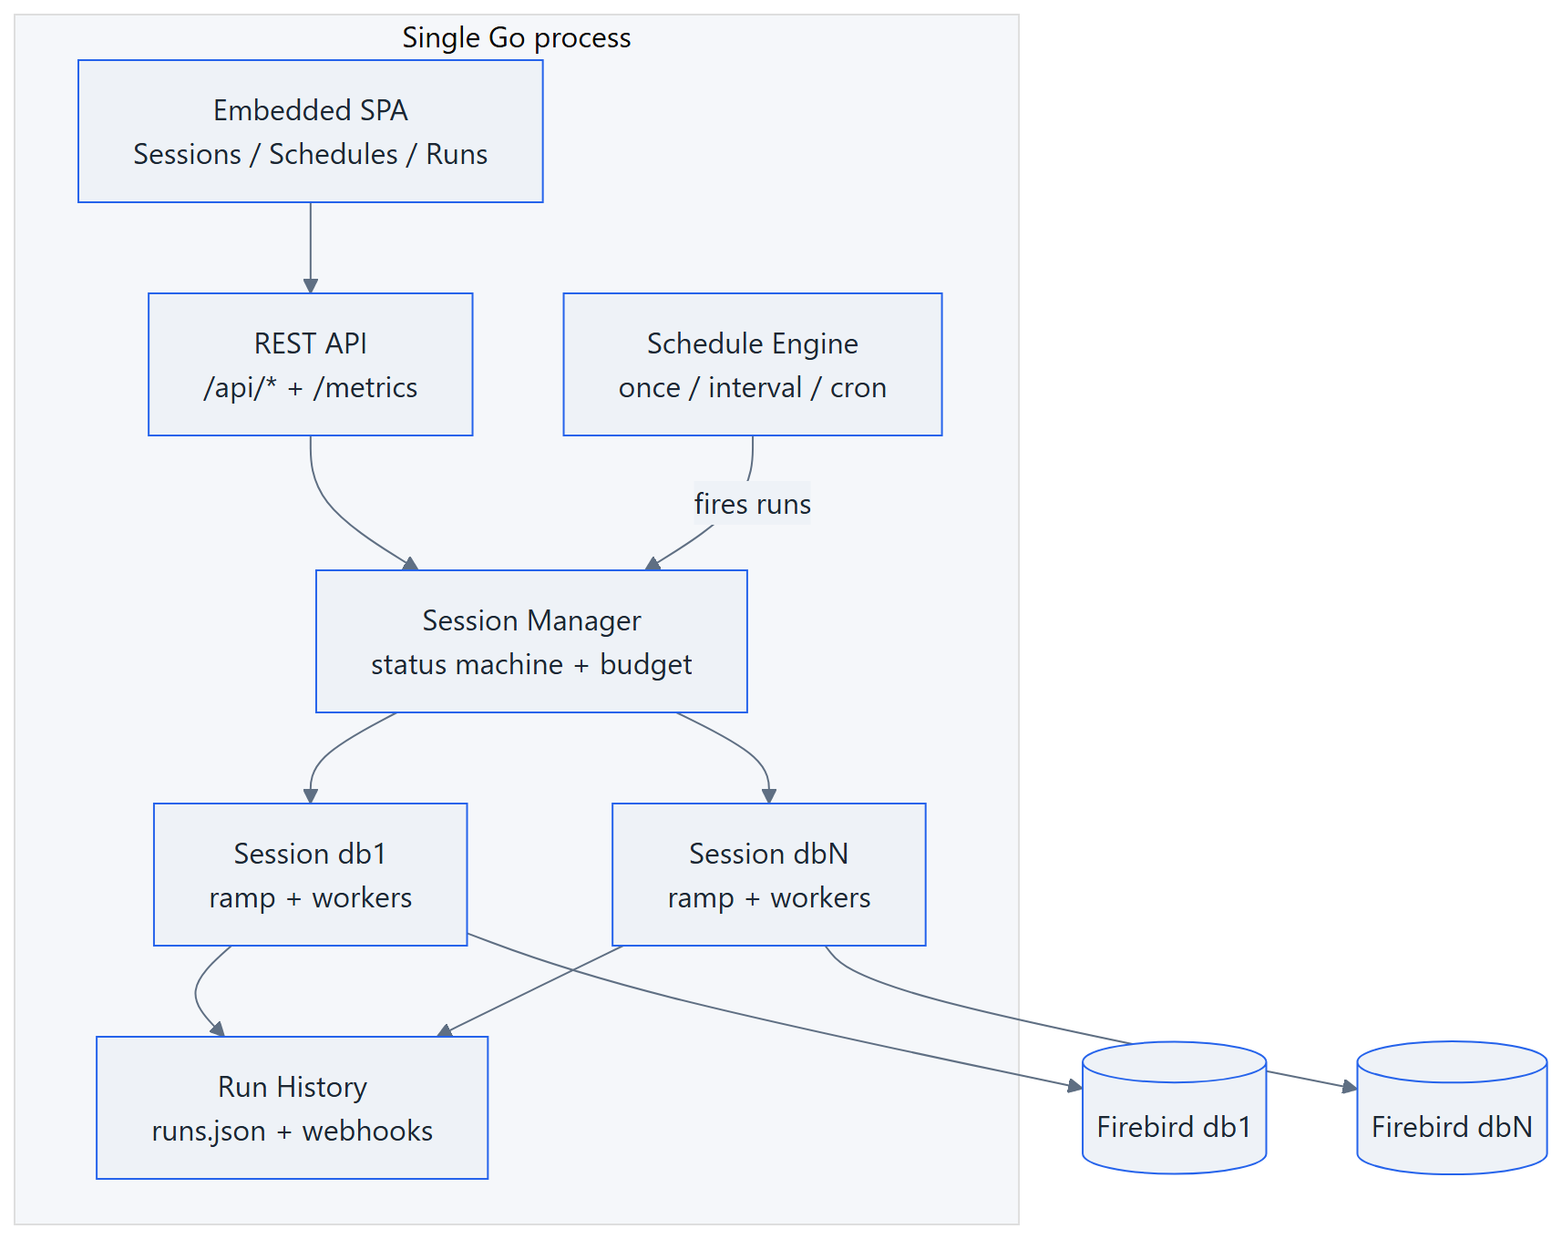
Control plane architecture
One Go process serves the UI, the REST API, the scheduler and the load itself.
▪ Embedded SPA — no separate web server
▪ REST API — same process, same binary
▪ Schedule engine — persisted, restart-safe
▪ Session manager — status + connection budget
▪ Run history — records, webhooks, retention
IBSurgeon Firebird Load Generator | 9
Notes:
Components: ui/ (embedded SPA + handlers), session/ (manager, run history), schedule/ (engine), ramp/ + worker/ (load). Driver: IBSurgeon firebirdsql-go.

Slide 10
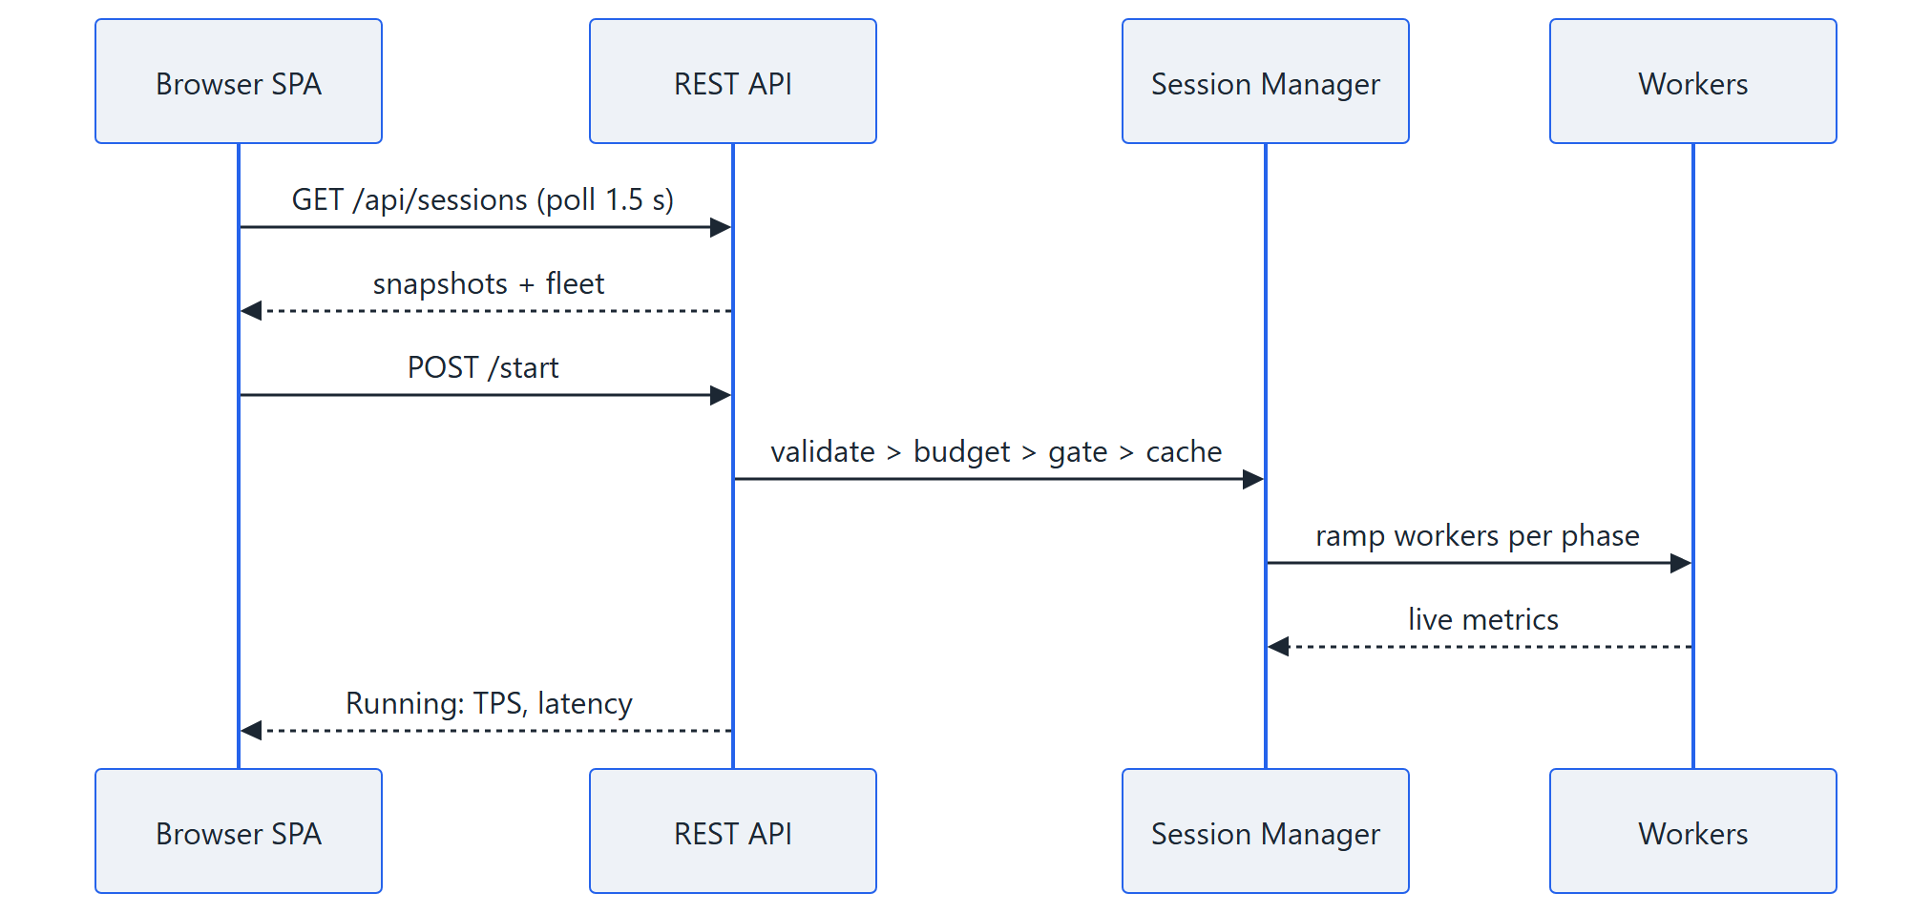
UI approach — a thin client over the API
The UI is just another API client: everything it shows comes from the same REST endpoints.
Embedded, zero-install — vanilla-JS SPA inside the exe — no framework, no build step
Live, not frozen — polls the API every 1.5 s; per-row start/pause/stop
Schedules & Runs tabs — create schedules, run now, inspect per-session outcomes
Operator-friendly — details drawer, light/dark themes, bearer-token prompt
IBSurgeon Firebird Load Generator | 10
Notes:
ui/static: vanilla JS SPA embedded via go:embed; poll interval 1.5 s; tabs Sessions/Schedules/Runs; details drawer; light/dark themes.

Slide 11
API-first: everything is an endpoint
The API is the product surface; the UI proves it. Full guide with curl and PowerShell recipes in API.md.
Sessions
Schedules
GET /api/sessions
GET /api/sessions/{id}
POST …/start stop pause resume
POST …/validate
PATCH /api/sessions/{id}
start-all / stop-all / pause-all
GET /api/schedules
POST /api/schedules
PATCH / DELETE /{id}
POST /{id}/trigger
GET /{id}/runs
Runs & reports
Discovery & ops
GET /api/runs?session=&since=
GET /api/runs/{id}
POST /api/runs/{id}/cancel
GET …/{id}/report/{file}
POST /api/discover
GET/PUT /api/config
GET /api/health /api/version
GET /metrics (Prometheus)
--ui-token — bearer auth
--ui-auth-all — protect GETs too
--api-only — headless for CI
wait:false — async start → 202
--cors-origin — browser clients
IBSurgeon Firebird Load Generator | 11
Notes:
Auth: --ui-token (mutations), --ui-auth-all (GETs too; health and /metrics stay open). --cors-origin for browser clients. Async start: wait:false -> 202.

Slide 12
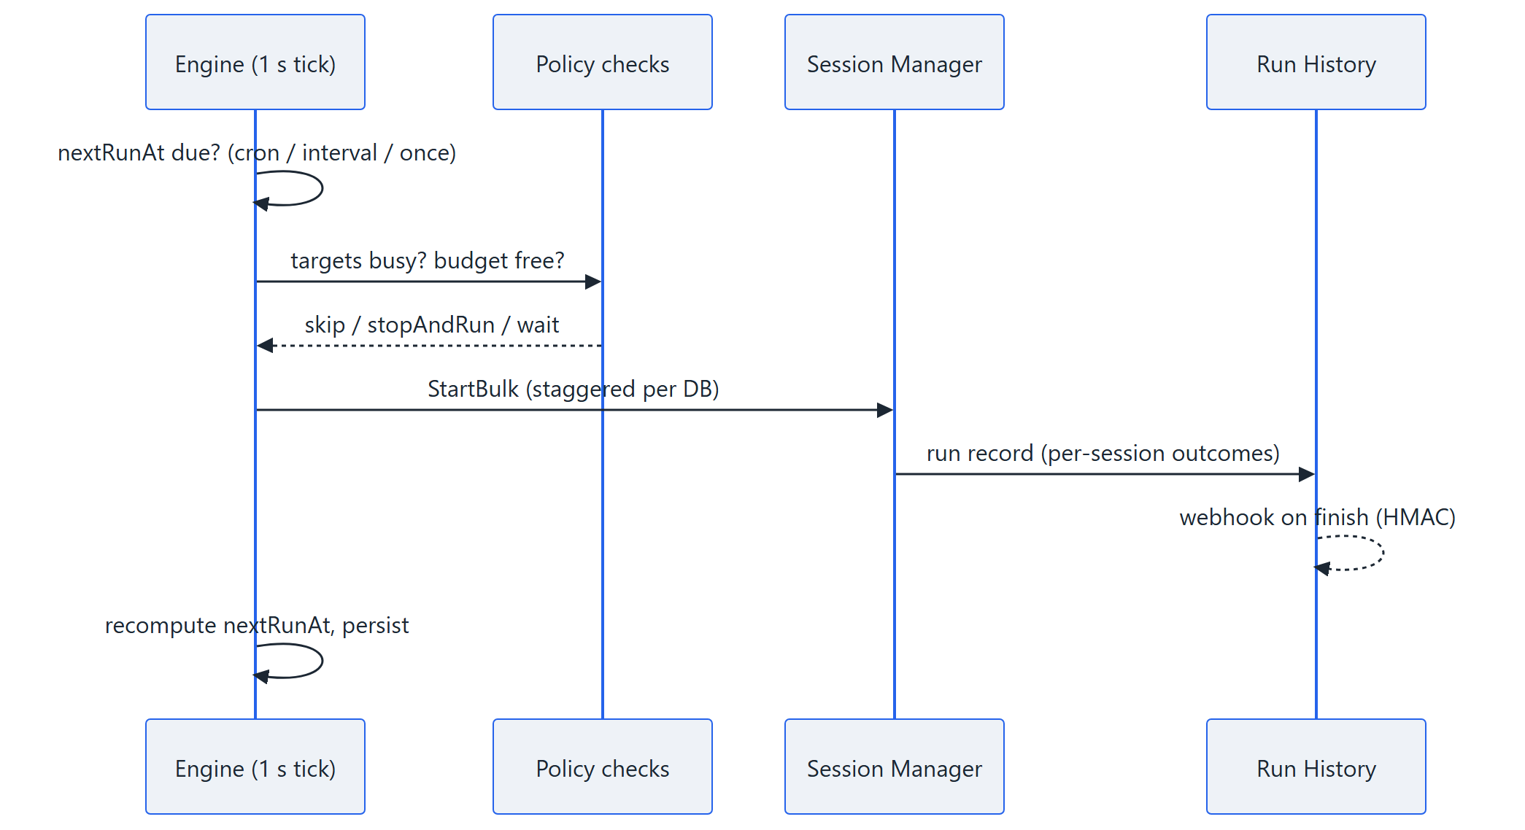
Scheduled runs — load without a human
Persisted schedules fire runs automatically; every fire is recorded, skippable and budget-aware.
once / interval / cron + timezone
ifRunning: skip or stopAndRun
ifBudgetFull: wait (timeout) or skip
staggerSec between per-DB starts
survives restarts; catchUp for missed fires
optional webhook per schedule
IBSurgeon Firebird Load Generator | 12
Notes:
schedule/ package: cron via robfig/cron v3 + tzdata; policies in Policy struct; store fb-loadgen.schedules.json; missed fires recorded (catchUp to force). Recurring triggers require timeLimitMin >= 1.

Slide 13
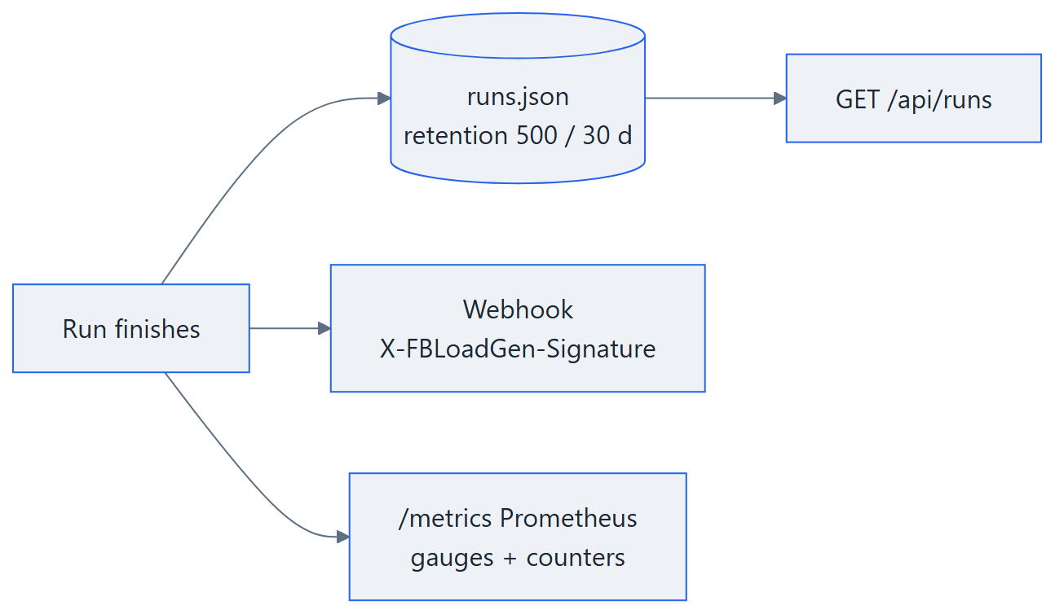
Run history & observability
Every execution — scheduled or manual — becomes a queryable record.
Query it
curl $BASE/api/runs?limit=10
curl $BASE/api/runs/$RUN
curl $BASE/api/schedules
# runs?outcome=ok&since=…
# per-session:
curl $BASE/api/sessions/$ID/runs
Per-session outcomes — status, TPS, success/errors, report dir, skip reasons
Retention — 500 runs / 30 days, atomic writes
Outcome: running / ok / partial / failed / cancelled / skipped
Honest history — process restarted mid-run → run marked cancelled
Webhooks — HMAC-signed JSON on every finished run
Prometheus — fleet, per-session and schedule fire metrics
IBSurgeon Firebird Load Generator | 13
Notes:
session/run.go: retention 500 runs / 30 days, schedule-referenced runs kept; interrupted runs marked cancelled on boot. Webhook HMAC: X-FBLoadGen-Signature.

Slide 14
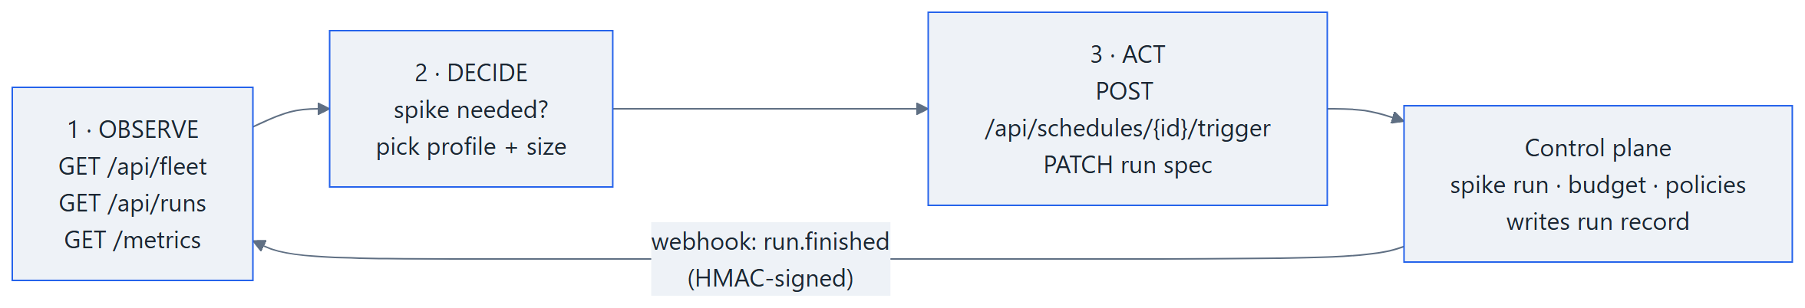
AI in the loop — agents run the load spikes
The API is a machine contract: JSON everywhere, an OpenAPI spec, signed webhooks. An agent can close the loop unattended.
Machine-readable contract — the agent reads api/openapi.yaml — endpoints, schemas and status codes without human docs
Headless by design — --api-only serves JSON only; async start returns 202; /api/health for liveness
Push, not poll — the HMAC-signed run.finished webhook announces every completed run
Bounded autonomy — server-side policies cap every spike: ifRunning, budget wait, time limits
IBSurgeon Firebird Load Generator | 14
Notes:
Concrete loop: the agent watches /metrics (or receives the run.finished webhook), decides a spike is needed, triggers a spike-profile schedule (run.overrides.profile = spike), reads the run record, then adapts thinkMs / txTimeout via PATCH and repeats. The OpenAPI spec (api/openapi.yaml) is the contract agent frameworks consume — no custom integration. Safety stays server-side: ifRunning=skip, budget wait, time limits cap every spike.

Slide 15
OLTP-EMUL — a business process, not just SQL
Borrows the FirebirdSQL oltp-emul model (MIT, Pavel Zotov): a car-service supply business runs inside the database as stored procedures.
Customer order
Supplier order
Supplier invoice
Invoice → stock
The score
stock · creation
stock · creation
stock · creation
successful business actions per minute — weighted random unit mix; warmup grows the database, measurement adds churn.
stock · state_next
Reserve / sale
Pay supplier / customer
Every step cancellable
stock · state_next
payments · creation
removal · state_back
Invariants: stock and money must stay conserved — checked live
Deadlocks and business rejections are expected load events
mon$ memory peaks at 4 levels: db / attachments / transactions / statements
Model & SQL: github.com/FirebirdSQL/oltp-emul (MIT, Pavel Zotov)
20 units, 1 transaction each. The database is the application — the generator decides what happens next.
IBSurgeon Firebird Load Generator | 15
Notes:
Units are executable SPs from the business_ops registry; Go picks them weighted-random and executes one per transaction in READ COMMITTED NO WAIT. Score = successful units per main-phase minute. Invariants: SRV_MAKE_INVNT_SALDO / SRV_MAKE_MONEY_SALDO must hold.

Slide 16
Provision → run → report — one lifecycle
The OLTPEMUL tab drives the whole flow: provision a benchmark database, run it, read the score.
1 · Provision
2 · Run
3 · Report
fb-loadgen provision \
--dsn "127.0.0.1/3055:C:\\data\\olt.fdb" \
--working-mode SMALL_01 \
--init-docs 3000
OLTPEMUL tab → Start
# unit mix editable live
PUT /api/sessions/$ID/emul/weights
results_emul.txt
+ live score, per-unit table,
memory peaks, invariants
create DB → DDL → procedures → settings → dictionaries → documents. Async job with progress; the database self-registers in the fleet.
Schema guard first. Weighted random units, one transaction each, per-unit outcomes: ok / conflict / rejected / failure.
Score (actions/min) frozen into the report dir and run history — compare runs over time.
works headless too: the same REST API drives provisioning, starting and stopping
IBSurgeon Firebird Load Generator | 16
Notes:
Provision: create (page size 8192) + vendored DDL/SP scripts + settings + dictionaries + documents, then the schema guard gates every start. Scripts are verbatim upstream oltp-emul (MIT); the splitter is quote-aware with golden tests.

Slide 17
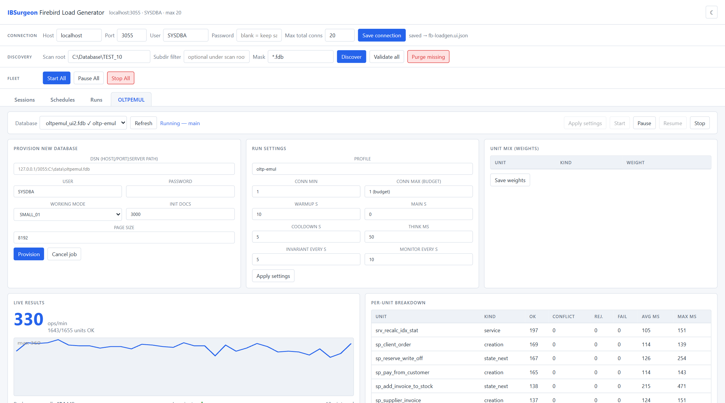
The OLTPEMUL dashboard — truth per unit
Live score, memory peaks, invariant status and the per-unit outcome table — one tab, one database, one click to start.
score sparkline per 10 s interval
memory peaks: db / att / trn / stmt
per-unit ok · conflict · rejected · fail + avg/max ms
last runs: score comparison over time
IBSurgeon Firebird Load Generator | 17
Notes:
Screenshot is the live UI. Per-unit table separates ok / conflict / rejected / failure with avg and max latency. History compares scores across runs.

Slide 18
Extended load mix — stress beyond the business process
Periodic sidecars on top of the regular op mix: heavy reads, mass DML, a replication-style operations log and live DDL churn — each switchable, none touching the score tables.
Heavy JOIN SELECT
Bulk DML
# everything on by default;
# classic comparable score run:
fb-loadgen --extended-load=false
# pick the mix:
--heavy-every 5 --bulk-every 30
--ops-log --ops-log-level all
--plusddl --ddl-every 60
--tx-variants emul-safe
every 5 s: a 3–4 table scan over the business tables with a random id-range filter, aggregation and a sorted cut — cache pressure a plain OLTP mix never builds.
every 30 s: 100–1000 rows inserted, updated and deleted on a dedicated aux table — long transactions and garbage without touching business data.
Operations log
−plusddl (DDL churn)
every transaction — number, parameters, completion, change volume — in the fb_repl_print output format; 50 MB rotation, downloadable via the log API.
ALTER/CREATE/DROP rounds with deliberately rolled-back DDL, verified against the catalog — metadata cache churn under load.
one umbrella switch: the mix changes the score by construction — classic preset for comparable benchmark runs
IBSurgeon Firebird Load Generator | 18
Notes:
All sidecars are part of the extendedLoad config section (CLI flags, UI panel, API). Heavy SELECT and bulk DML run on dedicated objects (EL_BULK_ITEMS); the ops log mirrors the Firebird replication journal printer format with size rotation and a start/terminal pairing check; -plusddl churns its own TST_ columns and verifies rolled-back DDL against rdb$relation_fields.

Slide 19
Transaction variants — every operation draws its transaction
At begin time each transaction draws isolation × read-only × wait resolution and a completion method — the database lives through everything a real application would do.
commit / rollback
COMMIT/ROLLBACK RETAINING
engine-side 2PC
the everyday completions, weighted by config
keeps lock interest after the commit — the retained context holds row locks until the chain ends (capped)
aux database enlisted via EXECUTE STATEMENT … WITH COMMON TRANSACTION; the commit runs as a real two-phase commit
limbo (prepare-then-die)
planned connection drop
--no-limbo
prepare, then the socket dies — a recovery sidecar polls the limbo list every 2 s and resolves commit / rollback / 2PC-recovery via the Services API
the socket is killed on purpose; the worker rebuilds its pool in place and continues
the same mix with limbo generation switched off — for targets that must stay free of prepared transactions (flag, API parameter, UI checkbox)
isolation families × read-only × wait / nowait / lock-timeout draw on top of the completion axis — emul-safe keeps every draw legal for the emul units
IBSurgeon Firebird Load Generator | 19
Notes:
The completion axis: commit, rollback, commit/rollback retaining (chain length capped), engine-side two-phase commit via EXECUTE STATEMENT ... WITH COMMON TRANSACTION against an aux database, limbo (prepare-then-die, resolved by the recovery sidecar through the Services API) and a planned hard connection drop after which the worker rebuilds its pool in place. emul-safe mode never draws infinite-wait transactions. limbo and conn-drop are rate-limited run-wide. --no-limbo runs the same mix with limbo generation switched off entirely.

Slide 20
Field diagnostics — probe and reproduce what support asks for
Two investigation toolkits ship with the generator: an HQbird LightWeight Monitoring probe and a minimal Firebird limbo-crash reproducer.
LWM probe — fb-loadgen lwmprobe
Limbo crash reproducer — cmd/limbocrash
fb-loadgen lwmprobe --dsn "host/3055:db" \
--action select --c 2 --rate 5 --d 60s \
--fblog C:\HQbird\Firebird50\firebird.log
# actions: attach | select | mon | monmem | drop
# --idle N persistent conns, --hold-dsn pins one more
limbocrash -init -host localhost:3095 -db R.FDB
limbocrash -host localhost:3095 -db R.FDB \
-mode die -loops 3
# die = prepare, then close the socket;
# drop / commit are the controls
Reproduces the LightWeight Monitoring shared-memory version clash when several HQbird builds share one host: one fresh attachment per cycle, zero data operations, log watcher counts new LWMon lines — a go/no-go check for a machine.
A prepared transaction whose connection dies crashes Firebird 4.0.7 / 5.0.x (0xC0000005) when replication is on — verified across vanilla and HQbird builds, Super/Classic/SuperClassic, Linux and Windows. Minimal script, build matrix and dump analysis in the repo.
both are read-only for your data — use them to qualify a server before a load campaign; --no-limbo keeps replicated targets safe meanwhile
IBSurgeon Firebird Load Generator | 20
Notes:
lwmprobe: attach-only cycles (no tables, no data) reproduce the HQbird LightWeight Monitoring shared-memory version conflict between mixed builds on one host; a built-in firebird.log watcher turns the result into a go/no-go signal. A pure-Python twin ships in scripts/. limbocrash: a prepared transaction whose connection dies crashes Firebird 4.0.7 / 5.0.x with replication enabled (0xC0000005, every tested build and server mode); the repo carries the minimal reproducer, a build matrix and the investigation plan. Until the engine bug is fixed, --no-limbo keeps replicated targets safe.

Slide 21
Typical scenarios
Nightly soak
CI spike test
Fleet health
curl -X POST $BASE/api/schedules -d '{
"trigger": {"type":"cron",
"cron":"0 2 * * *"},
"run": {"timeLimitMin":30},
"notifyUrl":"https://hooks/…"}'
fb-loadgen --ui --api-only &
curl -X POST $BASE/api/schedules/
$SID/trigger # fire now
curl $BASE/api/runs/$RUN # outcome
# fail the build on outcome != ok
curl $BASE/api/fleet
curl $BASE/metrics | grep fbloadgen
# running, budget, TPS, errors,
# next scheduled fire — in Prometheus
Every night at 02:00, 30 minutes, webhook tells you the outcome
Headless process in CI; build fails if the run fails
One scrape shows the whole fleet's load state
Same API drives all three — the UI, CI and cron are interchangeable clients.
IBSurgeon Firebird Load Generator | 21
Notes:
All three run against the same control plane; recipes adapted from API.md.

Slide 22
Where we are, where we go
Shipped
Next
Scheduled runs (once / interval / cron)
Run history with per-session outcomes
Webhooks + Prometheus /metrics
API hardening: auth, CORS, headless mode
OpenAPI 3.1 spec for the whole API
oltp-emul business-process mode + OLTPEMUL dashboard
Extended load mix: tx variants, operations log,
heavy/bulk sidecars, -plusddl, --no-limbo
Field diagnostics: LWM probe + limbo-crash reproducer
CI (vet + race + 3 OS) and multi-platform releases
IBSurgeon driver fork under the hood
Secure credential storage (no plaintext settings)
Schedule chains (run A, then B)
Your use case here — tell us what you need
Docs: README.md · API.md · IMPROVEMENTS.md Start: fb-loadgen --ui
IBSurgeon Firebird Load Generator | 22
Notes:
Done items shipped with schedules/history; roadmap from IMPROVEMENTS.md.

Slide 23
Appendix — quick reference
# run
fb-loadgen --profile write-heavy --dsn "host/3050:path\db.fdb"
fb-loadgen --ui [--api-only] [--ui-token T] [--ui-addr 127.0.0.1:9000]
# extended load
fb-loadgen --no-limbo # same mix, no limbo generation
PATCH /api/sessions/{id} {"extendedLoad":{"txVariants":{"noLimbo":true}}}
fb-loadgen lwmprobe --action select --fblog <firebird.log>
# control
GET /api/sessions GET /api/fleet
POST /api/sessions/{id}/start {"timeLimitMin": 15, "wait": false}
POST /api/sessions/{id}/stop | pause | resume | validate
# schedule + history
GET|POST /api/schedules PATCH|DELETE /api/schedules/{id}
POST /api/schedules/{id}/trigger
GET /api/runs | /api/runs/{id} | POST /api/runs/{id}/cancel
GET /api/health | /api/version | /metrics
IBSurgeon Firebird Load Generator | 23
Notes:
Full tables live in API.md and README.md.

