Slide 1

Interconnecting Cisco
Networking Devices
Part 1 (ICND1 v1.0)
© 2007 Cisco Systems, Inc. All rights reserved.
ICND1 v1.0—#-<number>

Slide 2
Course Administration Guide

Slide 3
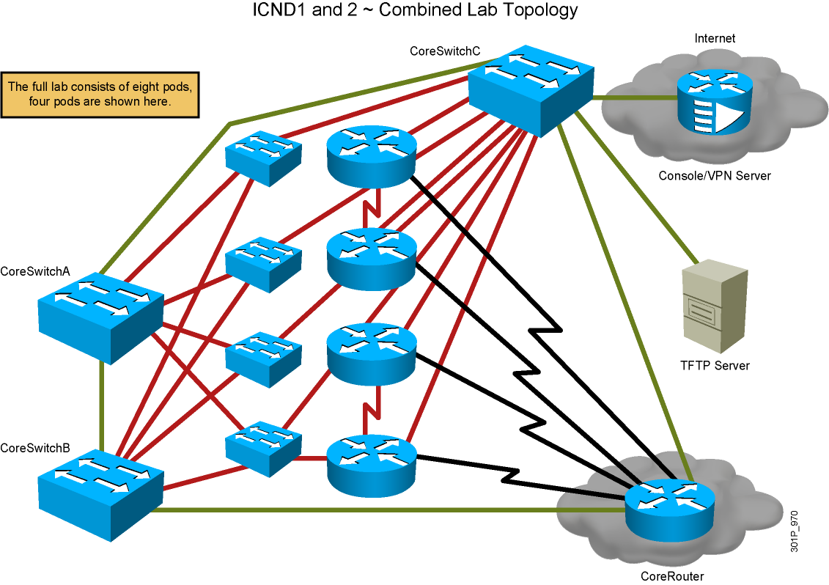
CCNA Lab Topology

Slide 4
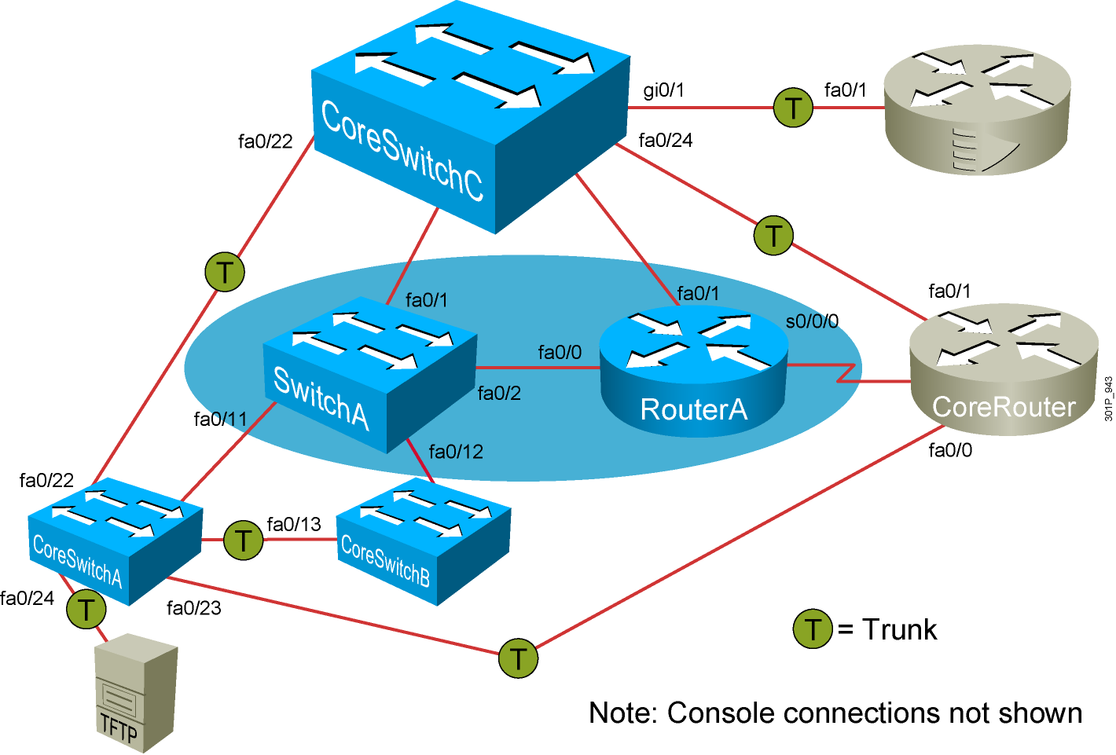
ICND1 Generic Workgroup

Slide 5
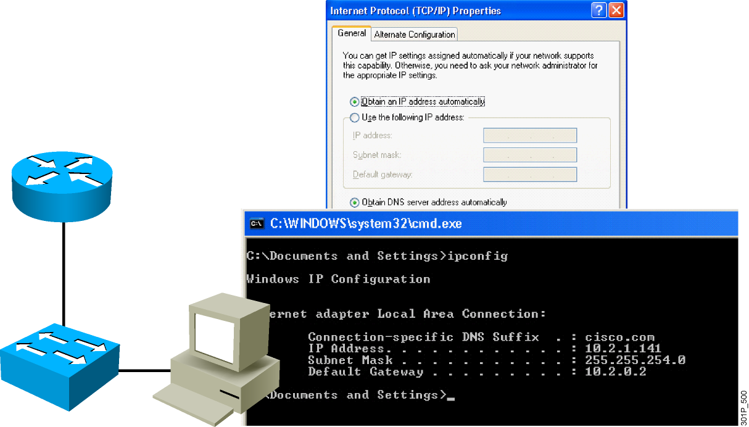
Visual Objective for Lab 1-1
Using Windows Applications as Network Tools

Slide 6
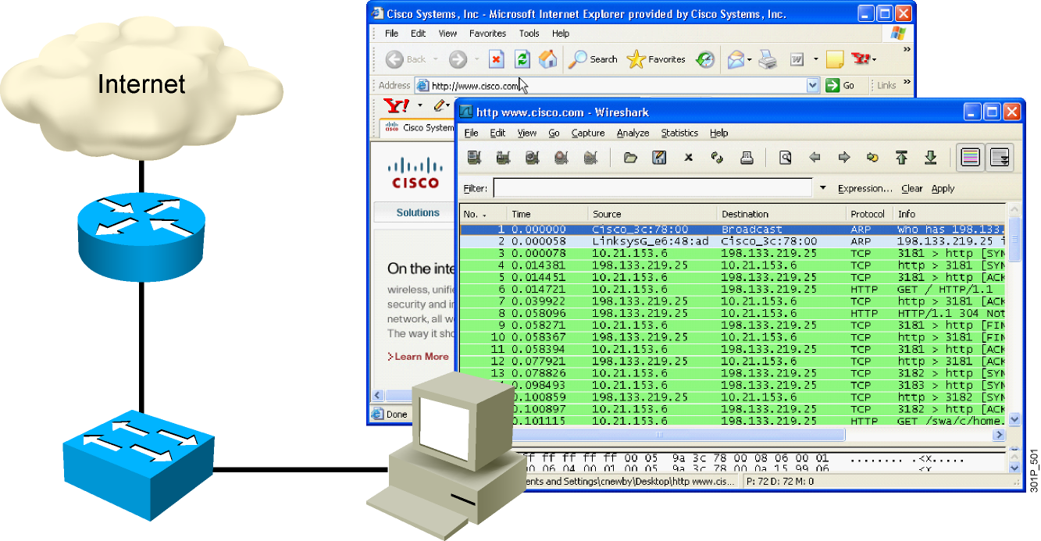
Visual Objective for Lab 1-2
Observing the TCP Three-Way Handshake

Slide 7
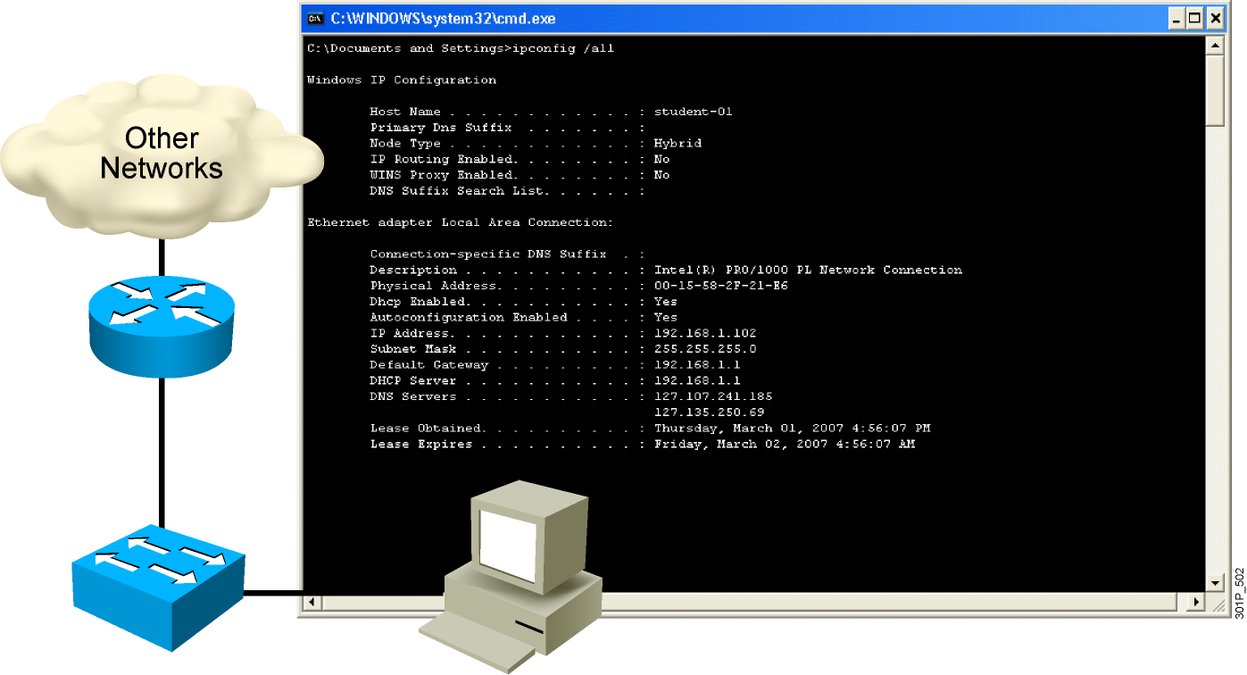
Visual Objective for Lab 1-3
Observing Extended PC Network Information

Slide 8
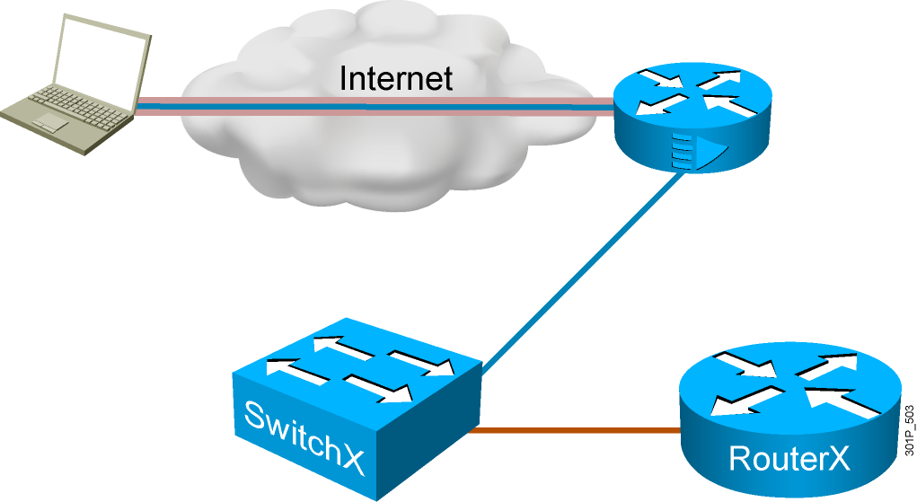
Visual Objective for Lab 2-1
Connecting to Remote Lab Equipment

Slide 9
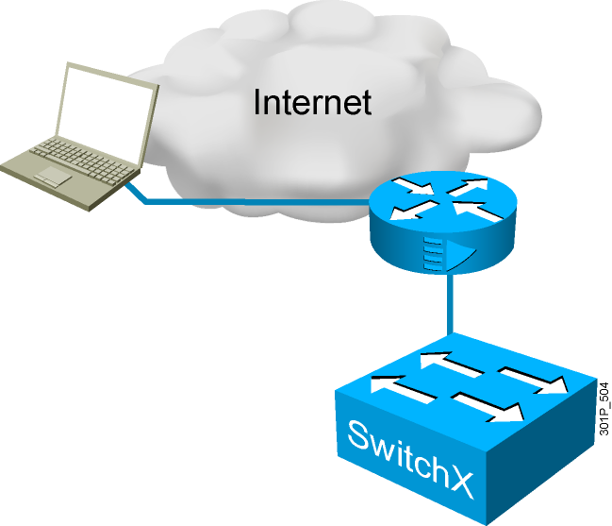
Visual Objective for Lab 2-2 Performing
Switch Startup and Initial Configuration
Workgroup Hostname | Switch IP Address | Subnet Mask
SwitchA | 10.2.2.11 | 255.255.255.0
SwitchB | 10.3.3.11 | 255.255.255.0
SwitchC | 10.4.4.11 | 255.255.255.0
SwitchD | 10.5.5.11 | 255.255.255.0
SwitchE | 10.6.6.11 | 255.255.255.0
SwitchF | 10.7.7.11 | 255.255.255.0
SwitchG | 10.8.8.11 | 255.255.255.0
SwitchH | 10.9.9.11 | 255.255.255.0

Slide 10
Visual Objective for Lab 2-3 Enhancing the Security of Initial Switch Configuration
Workgroup Hostname | Switch IP Address | Subnet Mask
SwitchA | 10.2.2.11 | 255.255.255.0
SwitchB | 10.3.3.11 | 255.255.255.0
SwitchC | 10.4.4.11 | 255.255.255.0
SwitchD | 10.5.5.11 | 255.255.255.0
SwitchE | 10.6.6.11 | 255.255.255.0
SwitchF | 10.7.7.11 | 255.255.255.0
SwitchG | 10.8.8.11 | 255.255.255.0
SwitchH | 10.9.9.11 | 255.255.255.0

Slide 11
Visual Objective for Lab 2-4
Operating and Configuring a Cisco IOS Device
Workgroup Hostname | Switch IP Address | Subnet Mask
SwitchA | 10.2.2.11 | 255.255.255.0
SwitchB | 10.3.3.11 | 255.255.255.0
SwitchC | 10.4.4.11 | 255.255.255.0
SwitchD | 10.5.5.11 | 255.255.255.0
SwitchE | 10.6.6.11 | 255.255.255.0
SwitchF | 10.7.7.11 | 255.255.255.0
SwitchG | 10.8.8.11 | 255.255.255.0
SwitchH | 10.9.9.11 | 255.255.255.0

Slide 12
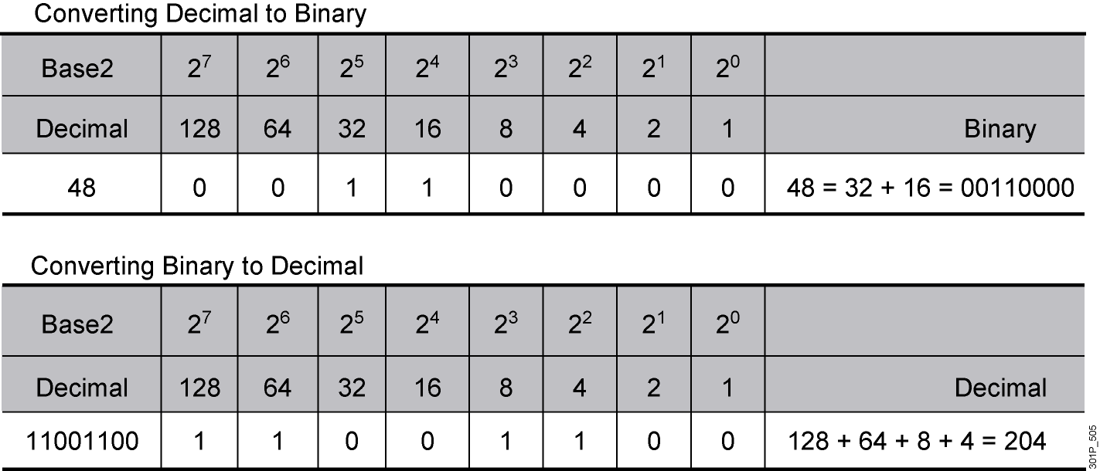
Visual Objective for Lab 4-1 Converting Decimal to Binary and Binary to Decimal

Slide 13
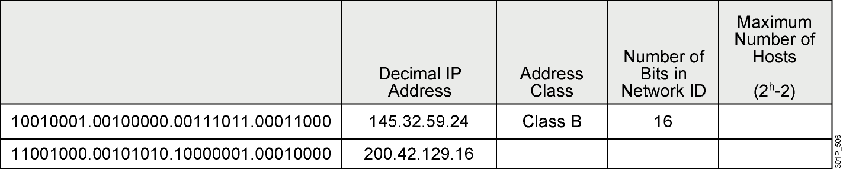
Visual Objective for Lab 4-2
Classifying Network Addressing
Convert decimal IP addresses to binary
  145.32.59.24 = 10010001.00100000.__________.__________
Convert binary IP addresses to decimal
  10010001.00011011.00111101.10001001 = 216.____.____.____
Identifying IP Address Classes
0.124.0.0?
255.255.255.255?
23.75.345.200?

Slide 14
Visual Objective for Lab 4-3
Computing Usable Subnetworks and Hosts
Given:
  Class C network address of 192.168.89.0
  Class B network address of 172.25.0.0
  Class A network address of 10.0.0.0
How many subnets can you create?
How many hosts per subnet can you create?

Slide 15

Visual Objective for Lab 4-4
Calculating Subnet Masks
  Given a network address, determine the number of possible network addresses and the binary subnet mask to use.
  Given a network IP address and subnet mask, determine the range of subnet addresses.
  Identify the host addresses that can be assigned to a subnet and the associated broadcast addresses.

Slide 16
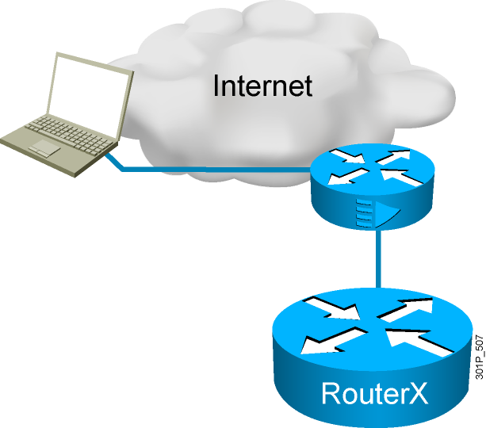
Visual Objective for Lab 4-5
Performing Initial Router Startup
Workgroup Hostname | Router IP Address | Subnet Mask
RouterA | 10.2.2.3 | 255.255.255.0
RouterB | 10.3.3.3 | 255.255.255.0
RouterC | 10.4.4.3 | 255.255.255.0
RouterD | 10.5.5.3 | 255.255.255.0
RouterE | 10.6.6.3 | 255.255.255.0
RouterF | 10.7.7.3 | 255.255.255.0
RouterG | 10.8.8.3 | 255.255.255.0
RouterH | 10.9.9.3 | 255.255.255.0

Slide 17
Visual Objective for Lab 4-6
Performing Initial Router Configuration
Workgroup Hostname | Router IP Address | Subnet Mask
RouterA | 10.2.2.3 | 255.255.255.0
RouterB | 10.3.3.3 | 255.255.255.0
RouterC | 10.4.4.3 | 255.255.255.0
RouterD | 10.5.5.3 | 255.255.255.0
RouterE | 10.6.6.3 | 255.255.255.0
RouterF | 10.7.7.3 | 255.255.255.0
RouterG | 10.8.8.3 | 255.255.255.0
RouterH | 10.9.9.3 | 255.255.255.0

Slide 18
Visual Objective for Lab 4-7 Enhancing the Security of Initial Router Configuration
Workgroup Hostname | Router IP Address | Subnet Mask
RouterA | 10.2.2.3 | 255.255.255.0
RouterB | 10.3.3.3 | 255.255.255.0
RouterC | 10.4.4.3 | 255.255.255.0
RouterD | 10.5.5.3 | 255.255.255.0
RouterE | 10.6.6.3 | 255.255.255.0
RouterF | 10.7.7.3 | 255.255.255.0
RouterG | 10.8.8.3 | 255.255.255.0
RouterH | 10.9.9.3 | 255.255.255.0

Slide 19
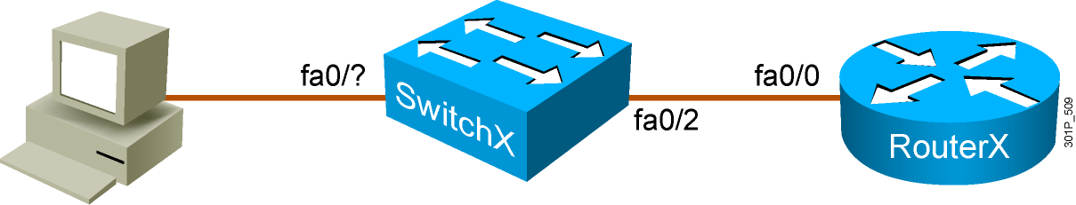
Visual Objective for Lab 4-8 Using Cisco
SDM to Configure DHCP Server Function
Pod | Router IP Address | Switch IP Address
A | 10.2.2.3 /24 | 10.2.2.11 /24
B | 10.3.3.3 /24 | 10.3.3.11 /24
C | 10.4.4.3 /24 | 10.4.4.11 /24
D | 10.5.5.3 /24 | 10.5.5.11 /24
E | 10.6.6.3 /24 | 10.6.6.11 /24
F | 10.7.7.3 /24 | 10.7.7.11 /24
G | 10.8.8.3 /24 | 10.8.8.11 /24
H | 10.9.9.3 /24 | 10.9.9.11 /24

Slide 20
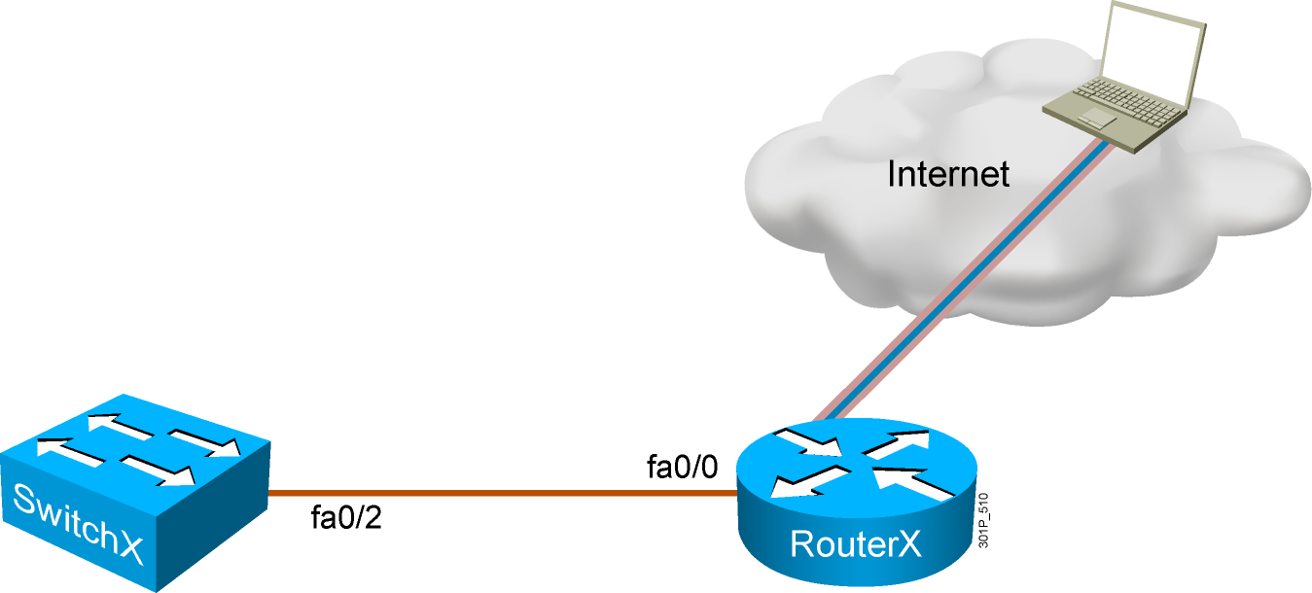
Visual Objective for Lab 4-9
Managing Remote Access Sessions
Pod | Router IP Address | Switch IP Address
A | 10.2.2.3 /24 | 10.2.2.11 /24
B | 10.3.3.3 /24 | 10.3.3.11 /24
C | 10.4.4.3 /24 | 10.4.4.11 /24
D | 10.5.5.3 /24 | 10.5.5.11 /24
E | 10.6.6.3 /24 | 10.6.6.11 /24
F | 10.7.7.3 /24 | 10.7.7.11 /24
G | 10.8.8.3 /24 | 10.8.8.11 /24
H | 10.9.9.3 /24 | 10.9.9.11 /24

Slide 21
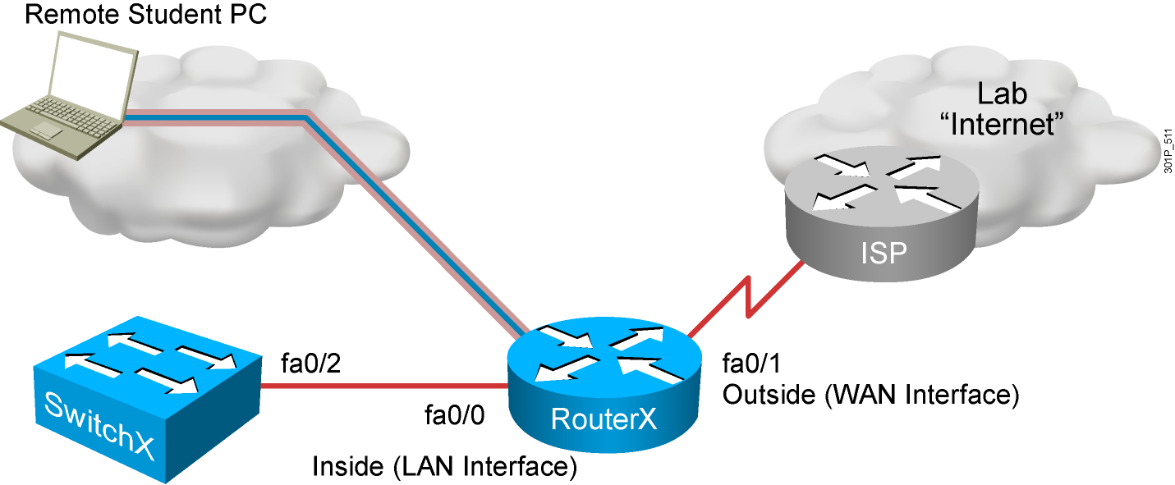
Visual Objective for Lab 5-1
Connecting to the Internet

Slide 22
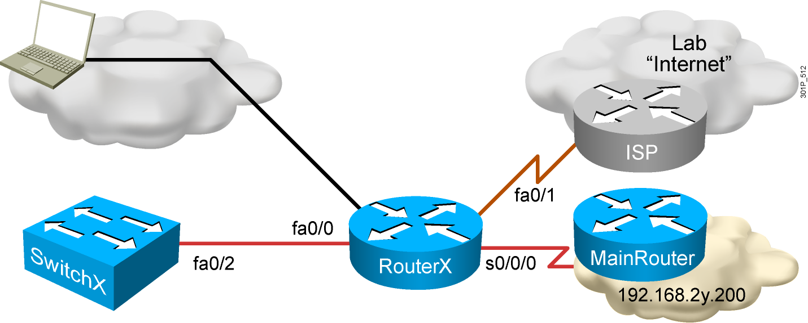
Visual Objective for Lab 5-2
Connecting to the Main Office

Slide 23
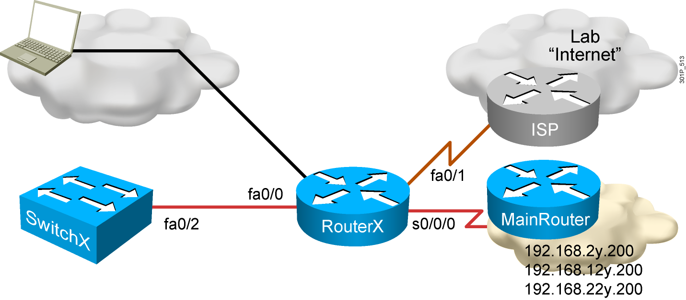
Visual Objective for Lab 5-3
Enabling Dynamic Routing to the Main Office

Slide 24
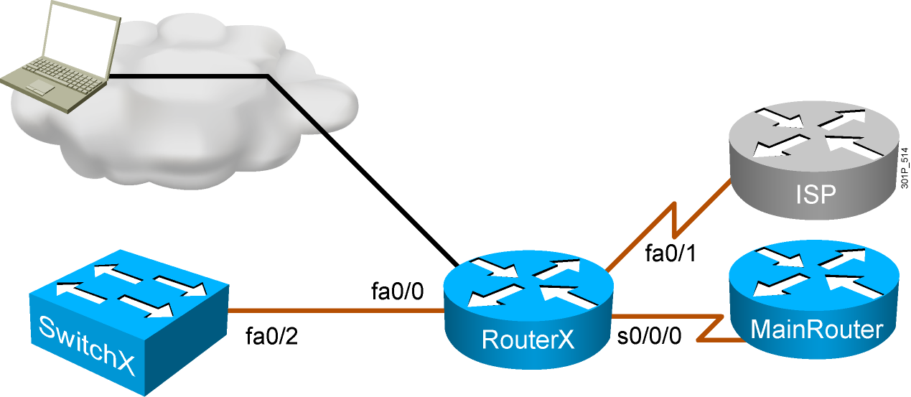
Visual Objective for Lab 6-1
Using Cisco Discovery Protocol

Slide 25
Visual Objective for Lab 6-2
Managing Router Startup Options

Slide 26
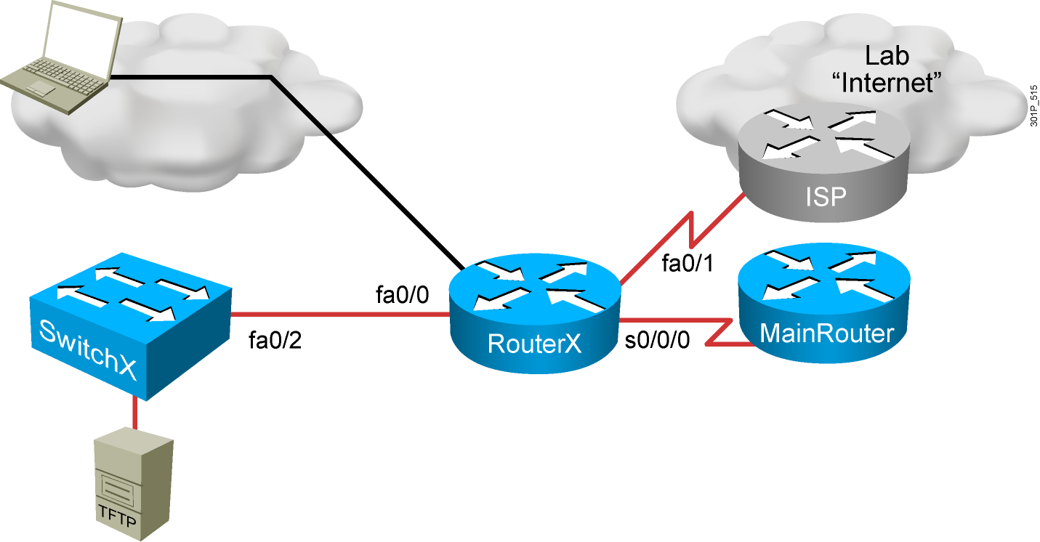
Visual Objective for Lab 6-3
Managing Cisco Devices

Slide 27
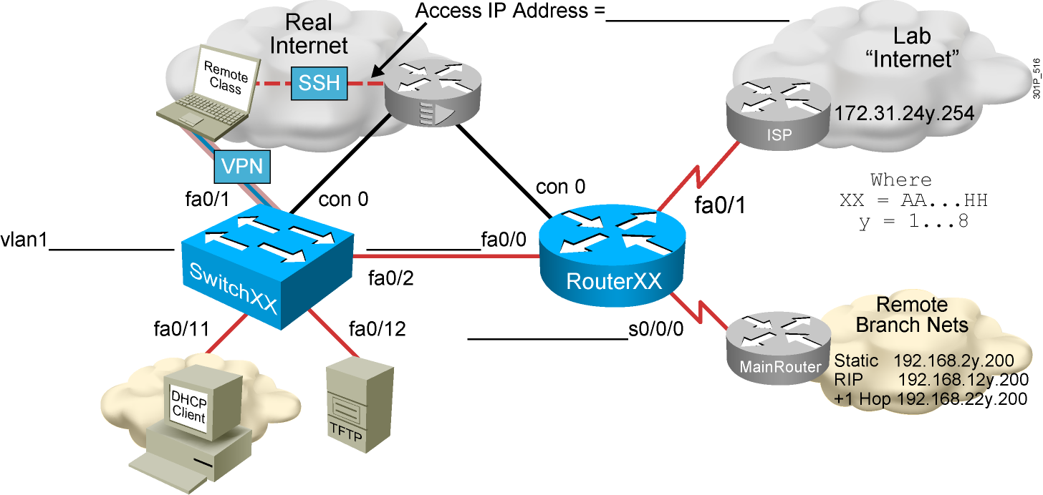
Visual Objective for Lab 6-4 Configuring the Reconfiguration of the Branch Network

