Slide 1

Interconnecting
Cisco Networking
Devices Part 1
(ICND1 v1.0)

Slide 2
Course Introduction

Slide 3
Learner Skills and Knowledge
  Basic computer literacy
  Basic Windows navigation skills
  Basic Internet usage skills
  Basic e-mail usage skills

Slide 4
Course Goal
“To provide you with the knowledge and skills
necessary to install, operate, and troubleshoot
a small network”
Interconnecting Cisco Networking Devices Part 1

Slide 5
General Administration
Class-Related
  Sign-in sheet
  Length and times
  Break and lunch room locations
  Attire
Facilities-Related
  Course materials
  Site emergency procedures
  Rest rooms
  Telephones and faxes

Slide 6
Course Flow
Day 1
Day 2
Day 3
Day 4
Day 5
Course
Introduction
Module 2
Ethernet LANs
Module 4
LAN Connections
Module 5
WAN Connections
Module 6
Network Environment
Management
A
M
Module 1
Building a Simple Network
Lunch
Module 2
Ethernet LANs
Module 3
Wireless LANs
Module 1
Building a Simple Network
Module 4
LAN Connections
Module 5
WAN Connections
Capstone Lab
P
M

Slide 7


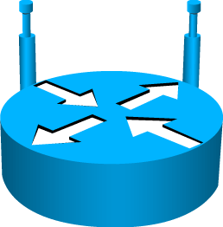

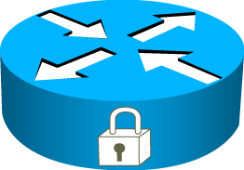





Cisco Icons and Symbols
Router
Wireless
Router
Secure Router
Firewall
Home Office
Workgroup
Switch
Access Point
IP Phone
Mobile
Access
Phone
Small
Business
Wireless
Connectivity
Line: Serial
Line: Ethernet

Slide 8

Cisco Career Certifications
Cisco Certifications
www.cisco.com/go/certifications
Notes:
Cisco provides three levels of general certifications for IT professionals with several different tracks to meet individual needs. Cisco also provides focused certifications for designated areas such as cable communications and security. There are many paths to Cisco certification, but only one requirement—passing one or more exams demonstrating knowledge and skill. For details, go to www.cisco.com/go/certifications.

Slide 9
Cisco Career Certifications
Expand Your Professional Options, Advance Your Career
CCIE
Cisco Certified Network Associate
Expert
Recommended Training Through
Cisco Learning Partners
CCNP
Interconnecting Cisco Networking Devices Part 1
Professional
Interconnecting Cisco Networking Devices Part 2
CCNA
CCENT
Associate
Entry Technician
Cisco Certified Entry Network Technician
Recommended Training Through
Cisco Learning Partners
www.cisco.com/go/certifications
Interconnecting Cisco Networking Devices Part 1

Slide 10
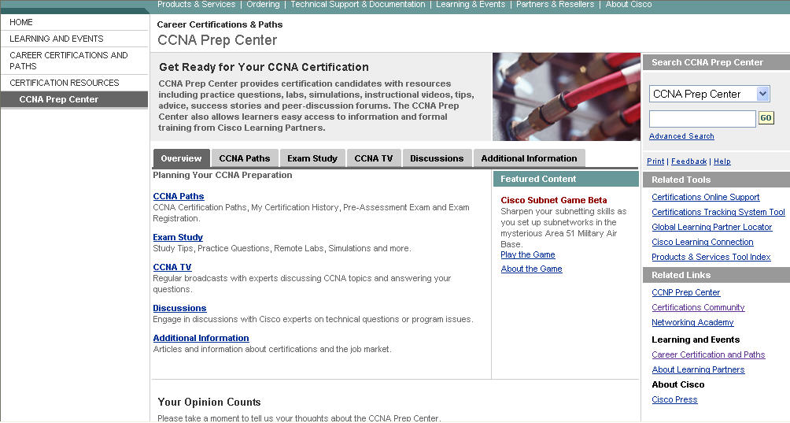
CCNA Prep Center
www.cisco.com/go/prepcenter

Slide 11
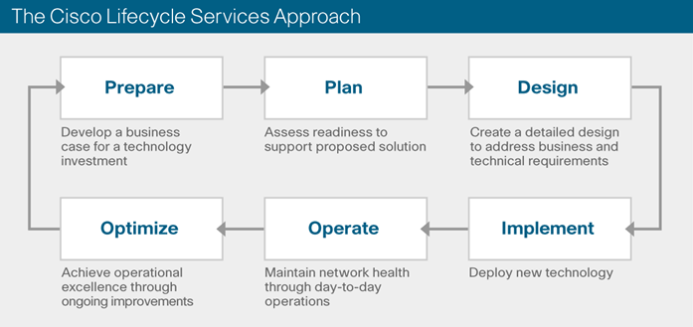
What Is the Lifecycle Services Framework?
The Cisco Lifecycle Services Framework defines the minimum set of activities needed to deploy, operate,
and optimize Cisco technologies successfully throughout the lifecycle of a network.
There are six phases in the network lifecycle: Prepare, Plan, Design, Implement, Operate and Optimize.
Each phase has a set of service components comprising activities and deliverables to help ensure
service excellence. A network service is performed when a service component item is completed.
Notes:
This slide provides a high level introduction to the concept of a network lifecycle and the Cisco Lifecycle Services approach. The whole chain of events needs to coordinate in order for deployed technologies to be successful. These events are sequential, interconnected, and interdependent. The phases are:
Prepare—Make sound financial decisions
Establish financial justification through a business case
Reduce later rework by developing a high-level, conceptual architecture
Plan—Set the stage for smooth, on-time deployment
Assess your network and sites
Develop a project management plan
Design—Reduce risk and rework, speed successful implementation
Develop a comprehensive detailed design that meets business and technical requirements
Implement—Speed return on investment
Integrate devices without disrupting the existing network or creating points of vulnerability
Operate—Maintain high availability, reduce expenses
Maintain network health through day-to-day operations
Optimize—Improve performance, availability, capacity, and security
Achieve operational excellence through ongoing improvement of system performance and functionality
2) Here is an example of a traditional approach for a security solution:
THEN:
Network security has historically been approached as a collection of products used primarily to secure the network perimeter or site-to-site connectivity.
Today, finding and fixing individual network security holes and point problems are not enough because the cost of security breaches or disruptions is high and can take many forms -- network downtime, theft of proprietary information, loss of revenue, diminished goodwill, etc.
NOW:
Security now requires a system-level approach to securing the entire network—the perimeter, data centers, campus LAN, wireless LAN, desktops, and endpoint hosts.
Securing the network is an ongoing process that enables the corporation to help ensure the efficient and effective pursuit of corporate missions and goals.
Every organization needs a comprehensive network security process that aligns business goals with network capabilities and technical requirements.

Slide 12
CCNA Students:
A Focus on “Implement” and “Operate”
Phase | Benefits of the Lifecycle Services Approach
Prepare | Make sound financial decisions by developing a business case that establishes the financial justification for making a technology change.
Plan | Assess the existing environment to determine whether it can support the proposed system sufficiently and securely.
Design | Design a solution that meets business and technical requirements.
Implement | Integrate the new solution without disrupting the network or creating points of vulnerability.
Operate | Maintain network health through day-to-day operations.
Optimize | Achieve operational excellence by adapting the architecture, operation, and performance of the network to ever-changing business requirements and positioning it to reenter the prepare phase of its lifecycle.
Notes:
The Cisco Lifecycle Services Approach
The Cisco Lifecycle Services approach defines the minimum set of activities needed, by technology and by network complexity, to help you successfully deploy and operate Cisco technologies and optimize their performance throughout the lifecycle of your network. The network lifecycle is a beginning-to-end view of the continuum of events that take place in the network lifespan.
The Lifecycle Services approach establishes methodologies that are based on leading practices commonly agreed upon and understood in the networking industry and aligns service and support activities with business and technology requirements throughout the network lifecycle.

Slide 13
A Network Lifecycle Services Approach:
Why Is It Important Now?
In the past, point approaches for the Design, Implement, and Operate phases were sufficient to deploy
and support a network.
Today, network complexity and technology convergence increase the importance of having a network
lifecycle approach that adapts over time to changing business conditions. A coordinated and continual
sequence of lifecycle service activities leads to successful initial implementations and operations as well
as to future optimized performance.
The Cisco Lifecycle Services approach helps meet these new and more complex requirements.
Notes:
This slide conveys the importance of evolving a network configuration and performance over time to meet changing business requirements (new applications, more users, increased traffic, quality of service improvements, etc.).

Slide 14

Learner Introductions
  Your name
  Your company
  Job responsibilities
  Skills and knowledge
  Brief history
  Objective

