Slide 1
Building a Simple Network
Exploring the Functions of Networking

Slide 2
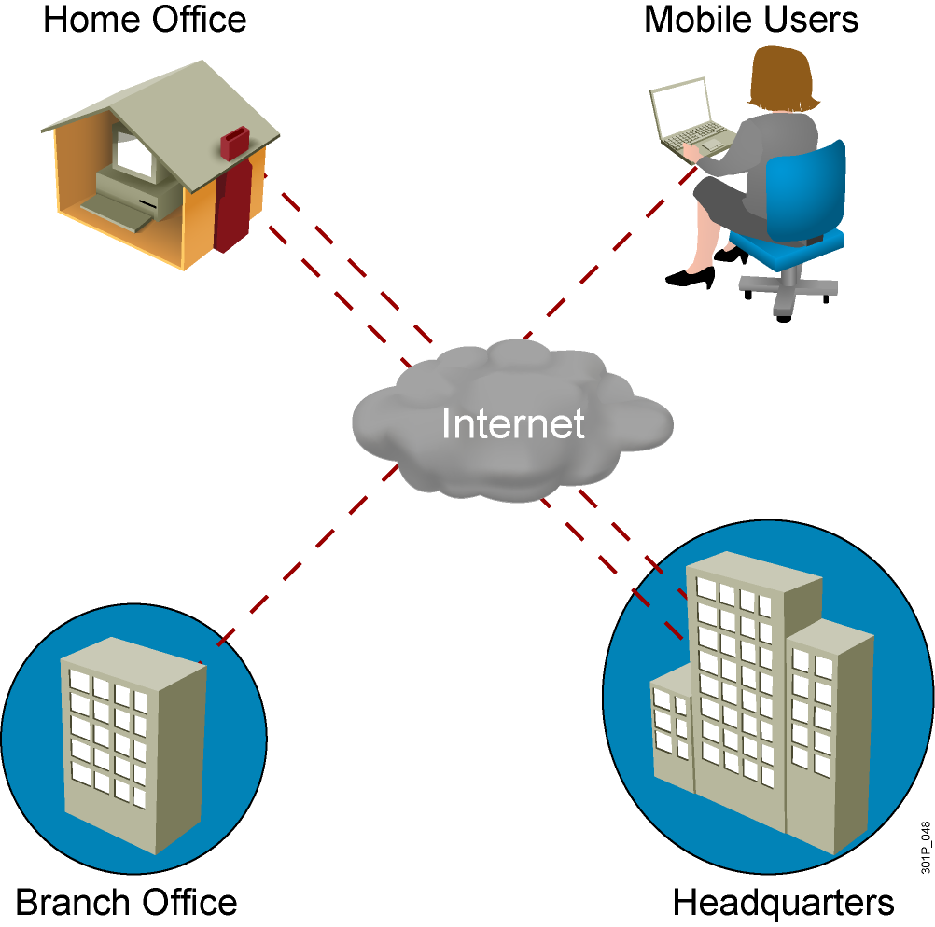
What Is a Network?

Slide 3
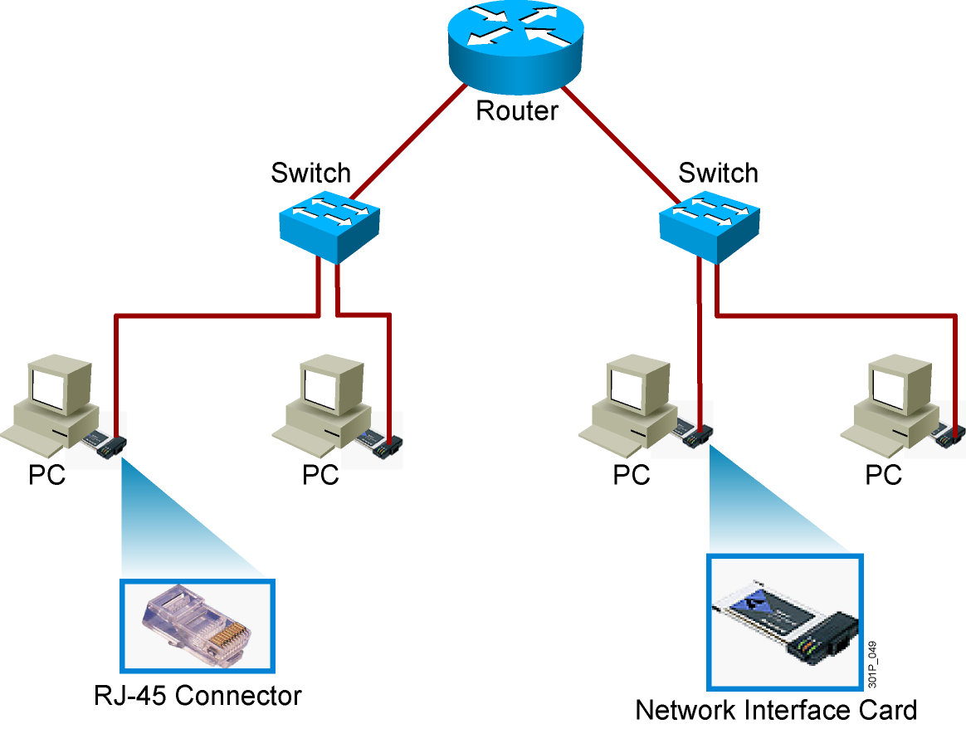
Common Physical Components of a Network

Slide 4
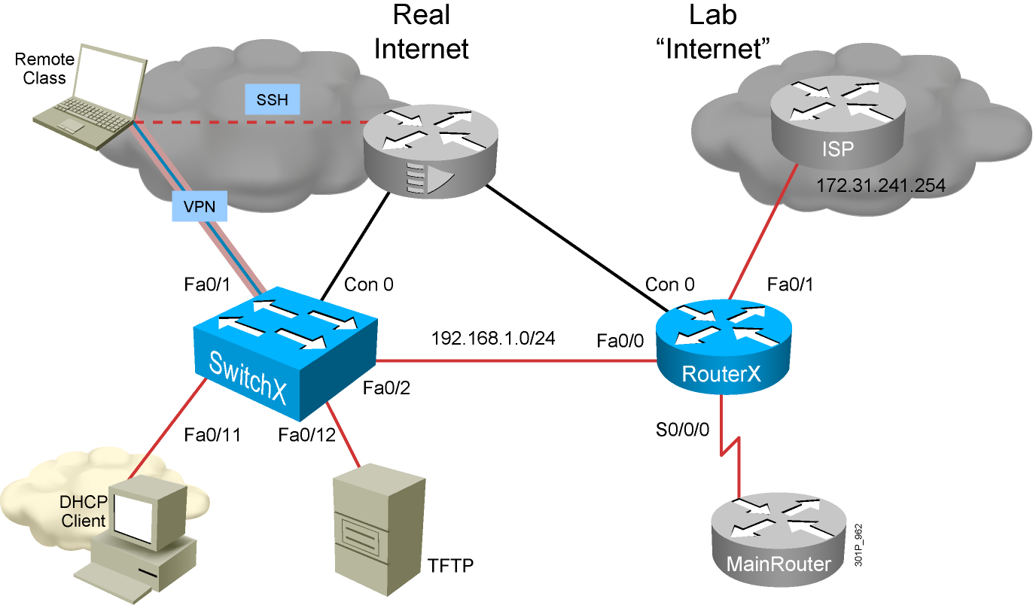
Interpreting a Network Diagram

Slide 5
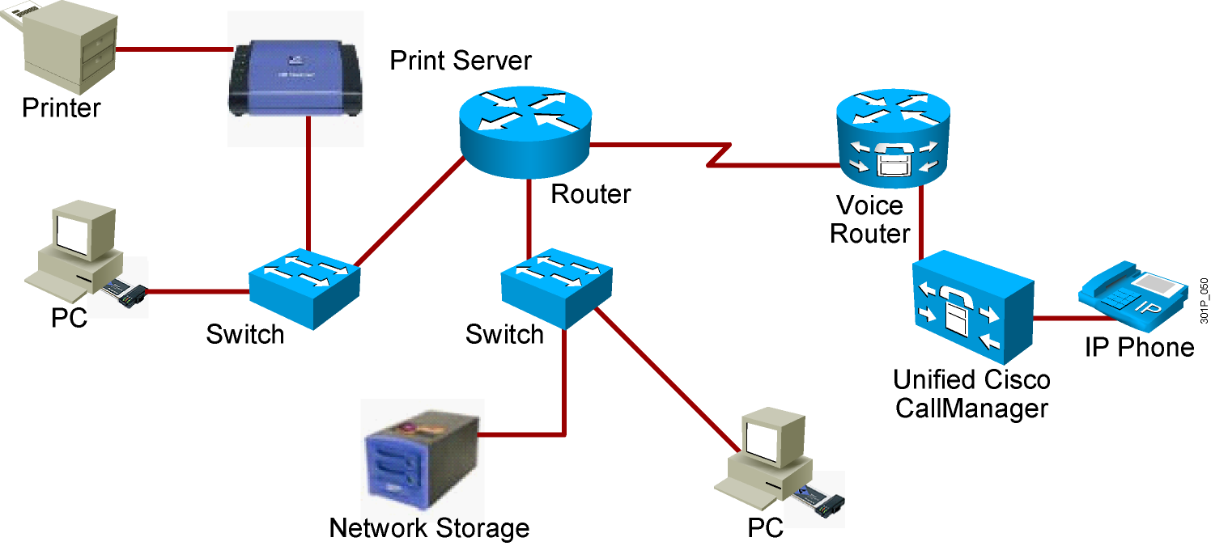
Resource-Sharing Functions and Benefits
  Data and applications
  Resources
  Network storage
  Backup devices

Slide 6
Network User Applications
  E-mail (Outlook, POP3, Yahoo, and so on)
  Web browser (IE, Firefox, and so on)
  Instant messaging (Yahoo IM, Microsoft Messenger, and so on)
  Collaboration (Whiteboard, Netmeeting, WebEx, and so on)
  Databases (file servers)

Slide 7
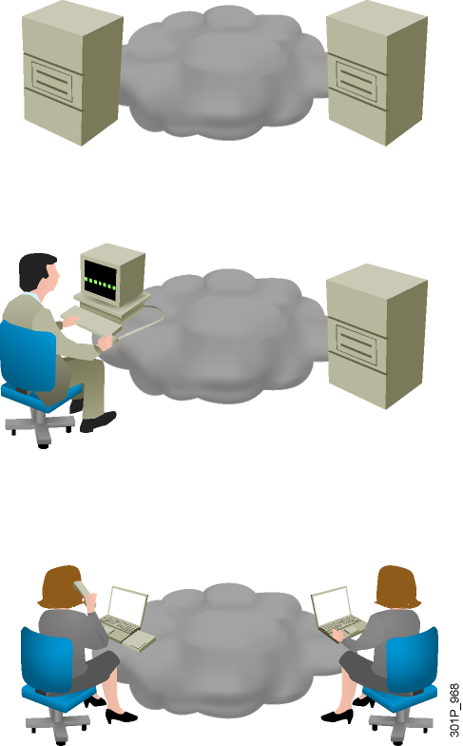
Impact of User Applications on the Network
  Batch applications
    FTP, TFTP, inventory updates
    No direct human interaction
    Bandwidth important, but not critical
  Interactive applications
    Inventory inquiries, database updates.
    Human-to-machine interaction.
    Because a human is waiting for a response, response time is important but not critical, unless the wait becomes excessive.
  Real-time applications
    VoIP, video
    Human-to-human interaction
    End-to-end latency critical

Slide 8
Characteristics of a Network
  Speed
  Cost
  Security
  Availability
  Scalability
  Reliability
  Topology

Slide 9
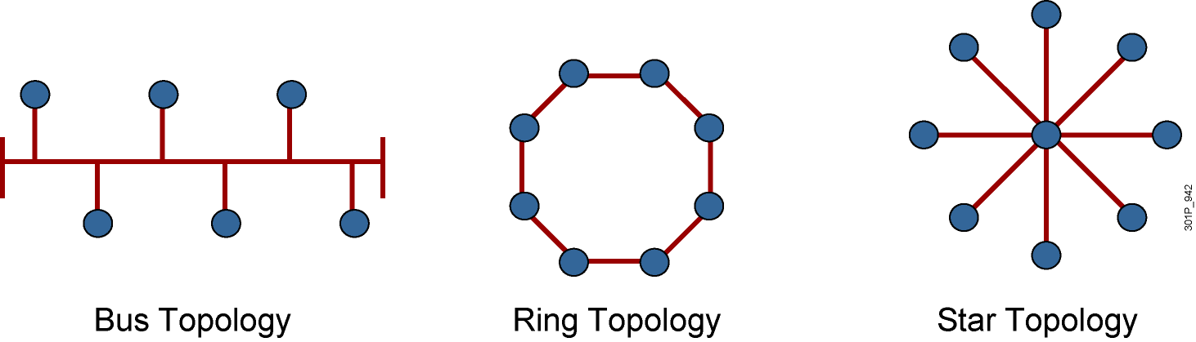
Physical Topology Categories
Notes:
Lesson Aim
<Enter lesson aim here.>

Slide 10
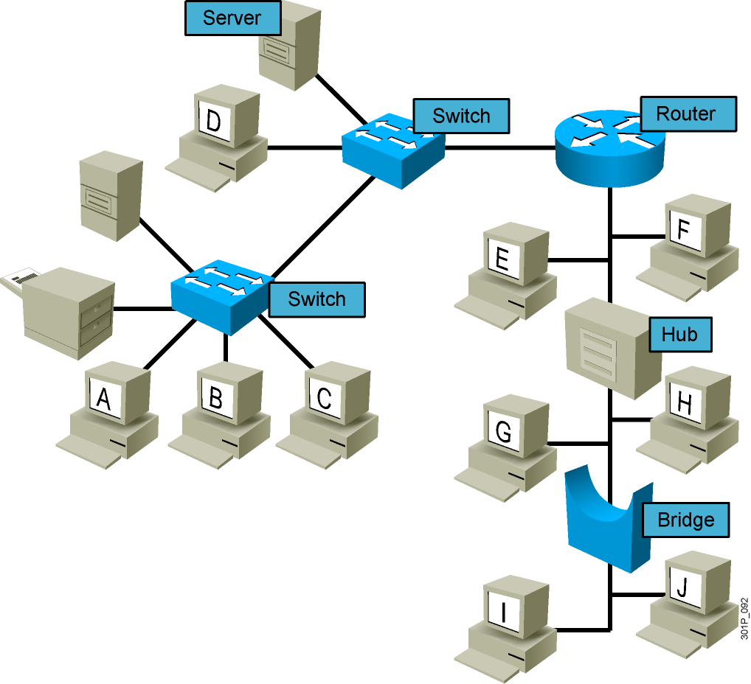
Logical Topologies
Notes:
Lesson Aim
<Enter lesson aim here.>

Slide 11
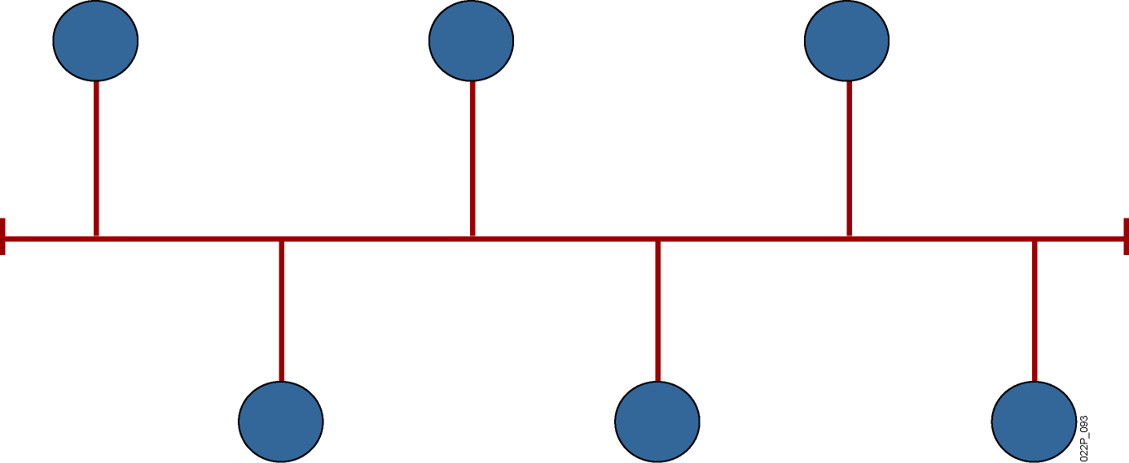
Bus Topology
  All devices receive the signal.
Notes:
Lesson Aim
<Enter lesson aim here.>

Slide 12
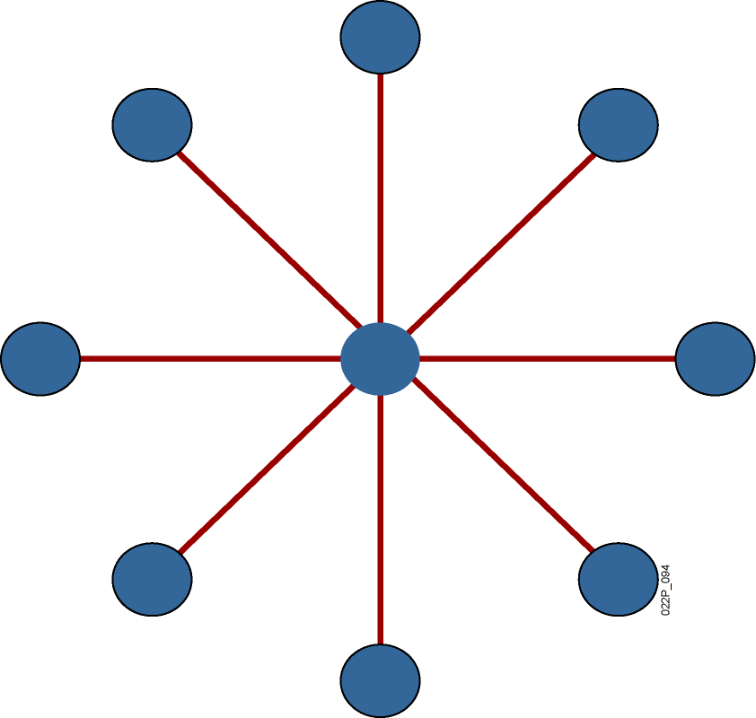
Star Topology
  Transmission through a central point.
  Single point of failure.
Notes:
Lesson Aim
<Enter lesson aim here.>

Slide 13
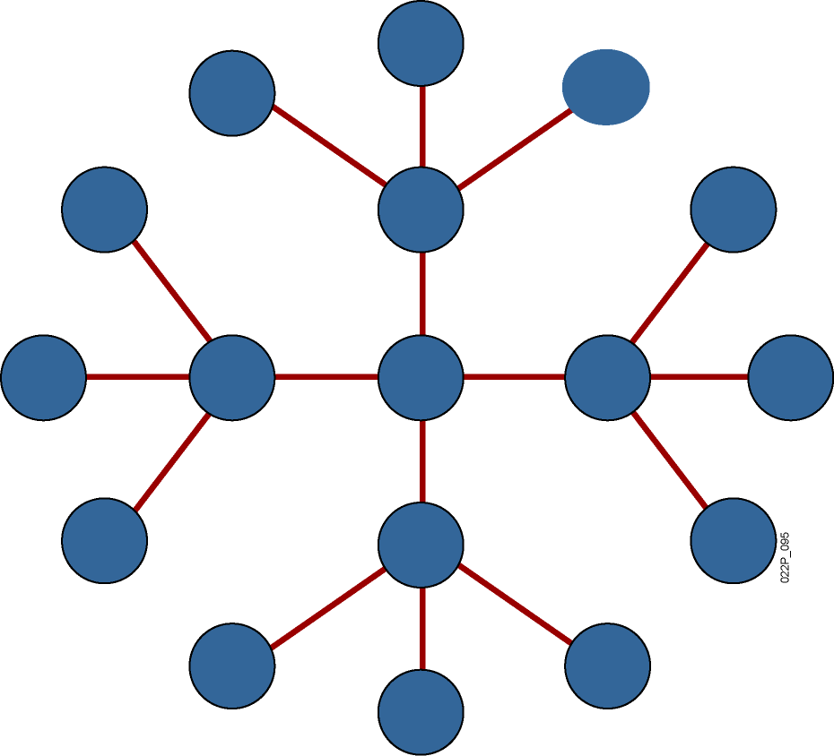
Extended-Star Topology
  More resilient than star topology.
Notes:
Lesson Aim
<Enter lesson aim here.>

Slide 14
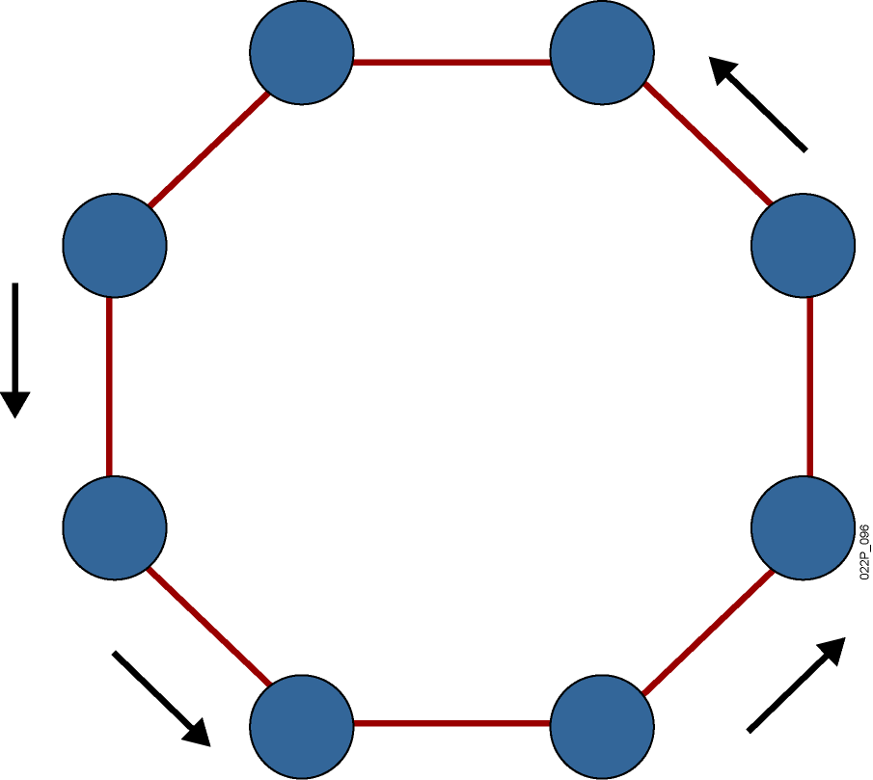
Ring Topology
  Signals travel around ring.
  Single point of failure.
Notes:
Lesson Aim
<Enter lesson aim here.>

Slide 15
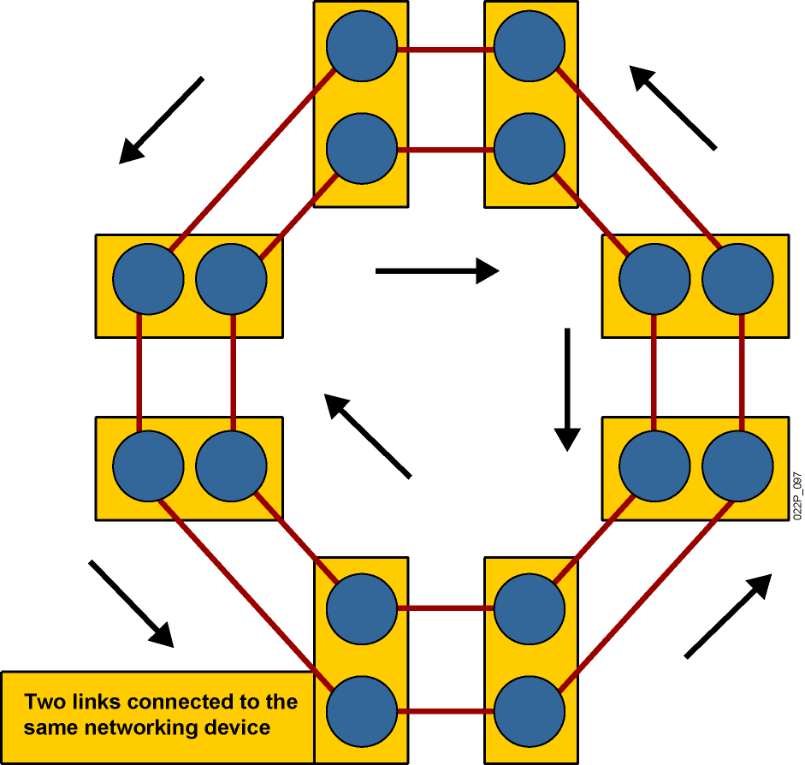
Dual-Ring Topology
  Signals travel in opposite directions.
  More resilient than single ring.
Notes:
Lesson Aim
<Enter lesson aim here.>

Slide 16
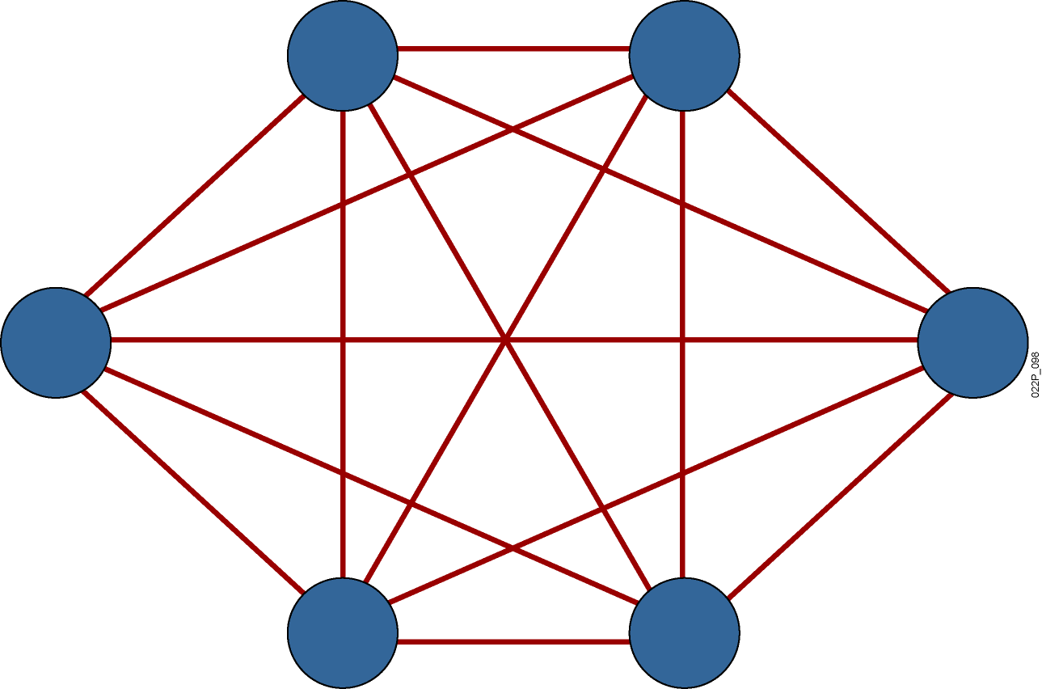
Full-Mesh Topology
  Highly fault-tolerant
  Expensive to implement
Notes:
Lesson Aim
<Enter lesson aim here.>

Slide 17
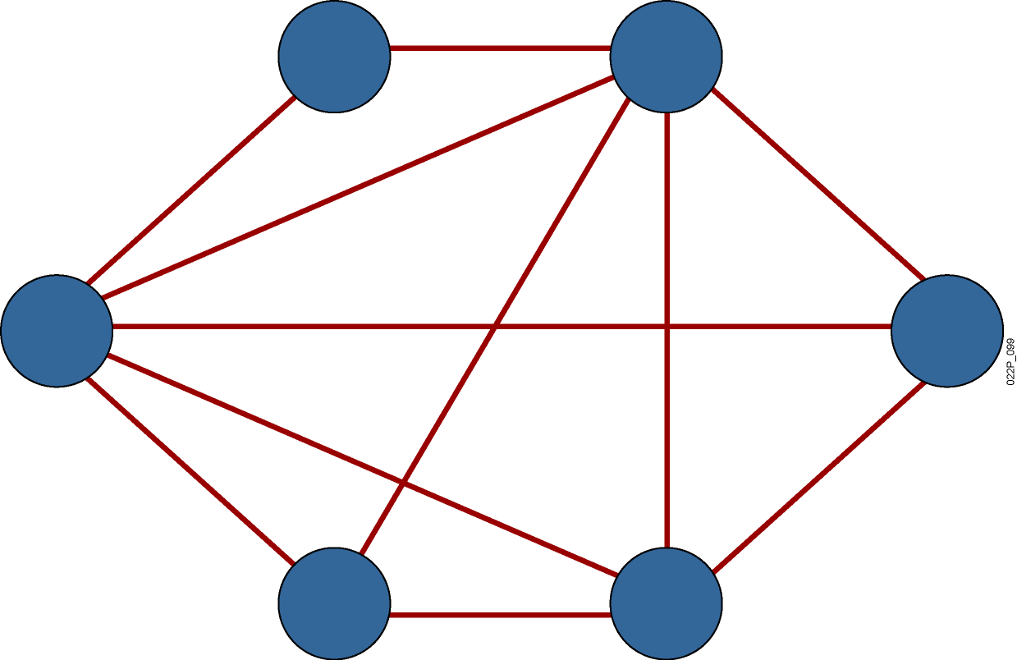
Partial-Mesh Topology
  Trade-off between fault tolerance and cost
Notes:
Lesson Aim
<Enter lesson aim here.>

Slide 18
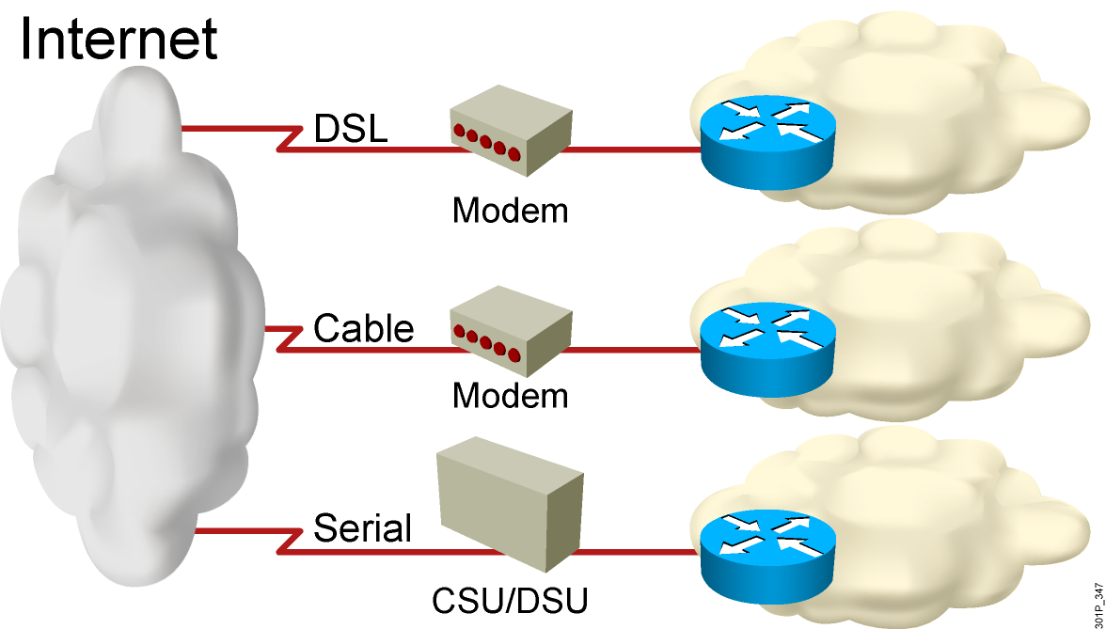
Connection to the Internet

Slide 19
Summary
  A network is a connected collection of devices that can communicate with each other. Networks carry data in many kinds of environments, including homes, small businesses, and large enterprises.
  There are four major categories of physical components in a computer network: the computer, interconnections, switches, and routers.
  Networks are depicted graphically using a set of standard icons.
  The major resources that are shared in a computer network include data and applications, peripherals, storage devices, and backup devices.
  The most common network user applications include e-mail, web browsers, instant messaging, collaboration, and databases.
  User applications affect the network by consuming network resources.

Slide 20
Summary (Cont.)
  The ways in which networks can be described include characteristics that address network performance and structure: speed, cost, security, availability, scalability, reliability, and topology.
  A physical topology describes the layout for wiring the physical devices, while a logical topology describes how information flows through a network.
  In a physical bus topology, a single cable effectively connects all the devices.
  In a physical star topology, each device in the network is connected to the central device with its own cable.
  When a star network is expanded to include additional networking devices that are connected to the main networking device, it is called an extended-star topology.

Slide 21
Summary (Cont.)
  In a ring topology, all the hosts are connected in the form of a ring or circle. In a dual-ring topology, there are two rings to provide redundancy in the network.
  A full-mesh topology connects all devices to each other; in a partial-mesh topology, at least one device has multiple connections to all other devices.
  There are three common methods of connecting the small office to the Internet: DSL using the existing telephone lines, cable using the CATV infrastructure, and serial links using the classic digital local loops.

