Slide 1
Building a Simple Network
Understanding the TCP/IP Internet Layer

Slide 2
Internet Protocol Characteristics
  Operates at network layer of OSI
  Connectionless protocol
  Packets treated independently
  Hierarchical addressing
  Best-effort delivery
  No data-recovery features

Slide 3
Why IP Addresses?
  They uniquely identify each device on an IP network.
  Every host (computer, networking device, peripheral) must have a unique address.
  Host ID:
    Identifies the individual host
    Is assigned by organizations to individual devices
Network.Host
Notes:
Lesson Aim
<Enter lesson aim here.>

Slide 4
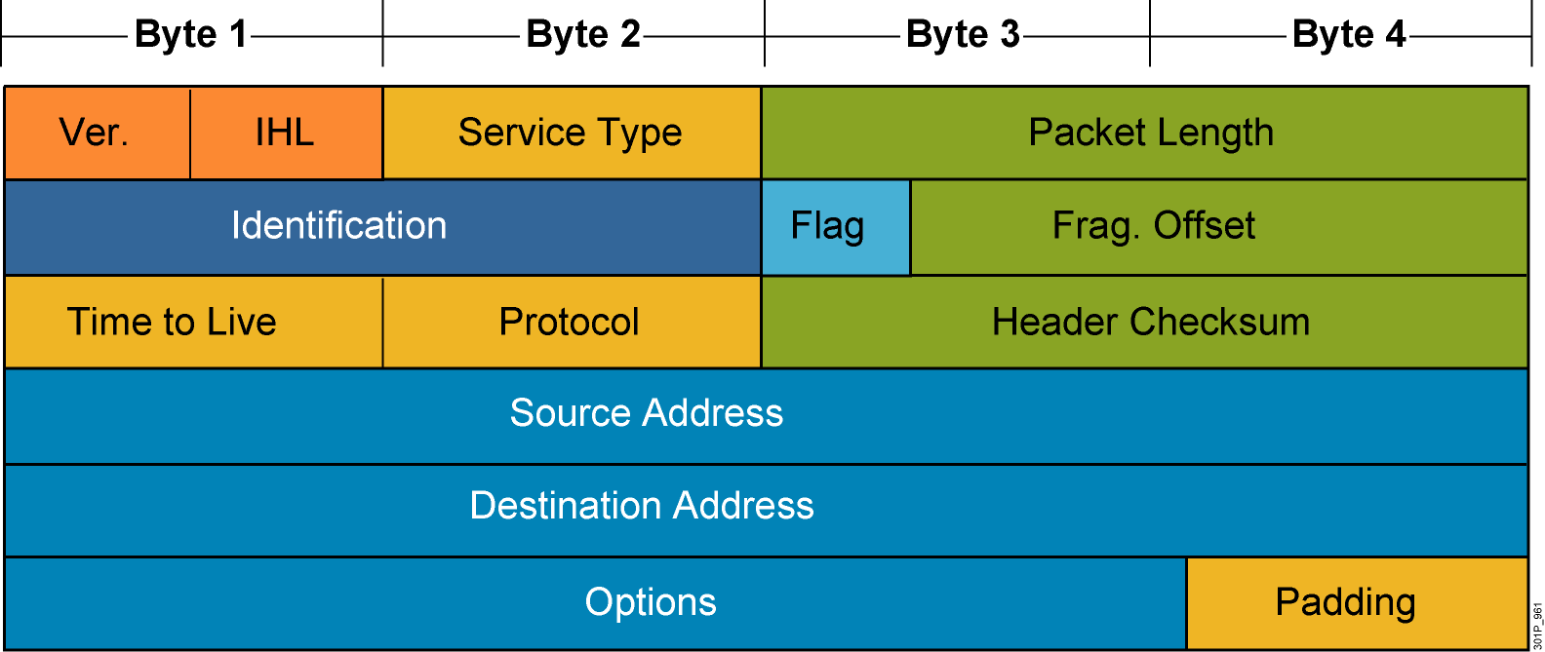
IP PDU Header
Notes:
Lesson Aim
<Enter lesson aim here.>

Slide 5
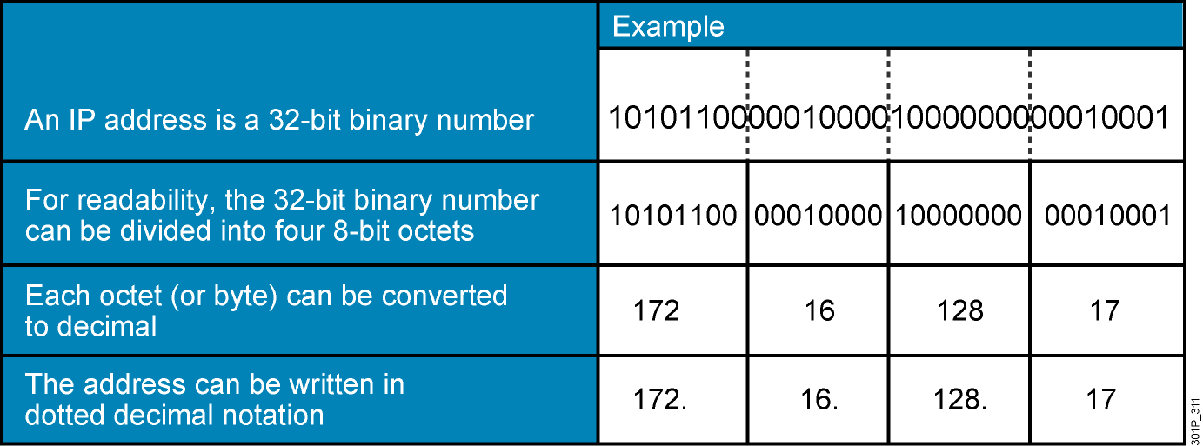
IP Address Format: Dotted Decimal Notation
The binary-to-decimal and decimal-to-binary conversion will be detailed later in this course.
Notes:
Lesson Aim
<Enter lesson aim here.>

Slide 6
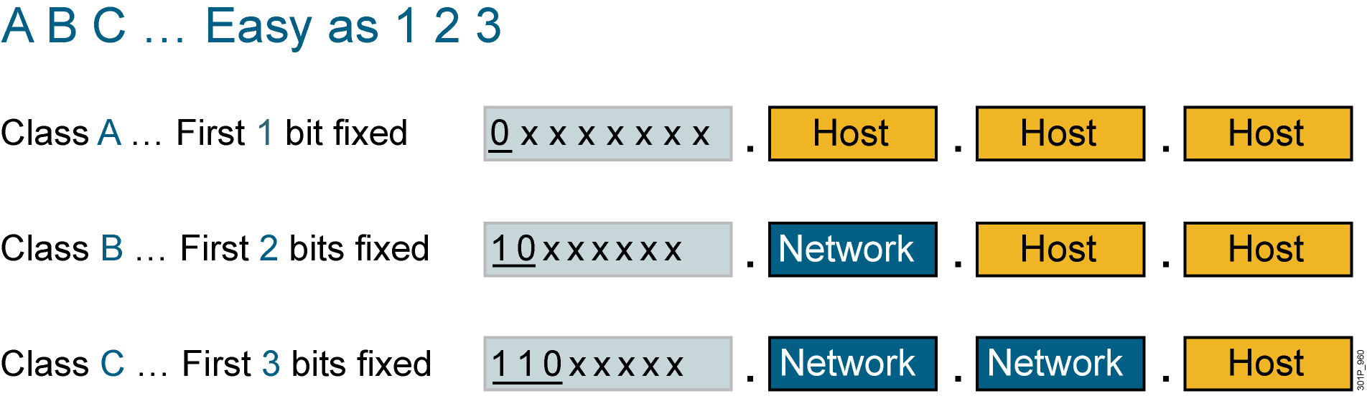
IP Address Classes: The First Octet
Notes:
Lesson Aim
<Enter lesson aim here.>

Slide 7
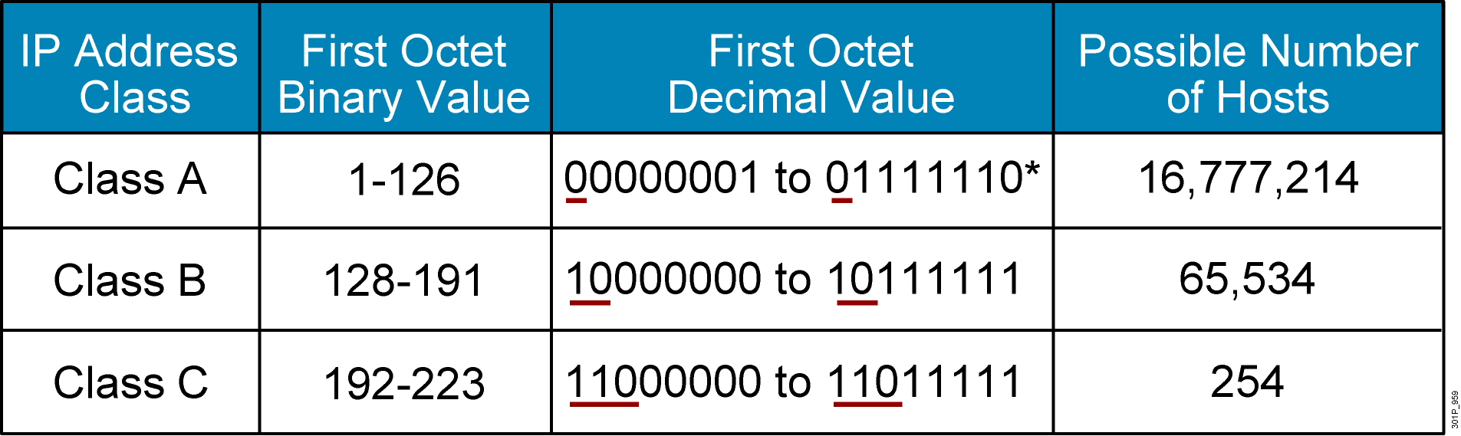
IP Address Ranges
  *127 (01111111) is a Class A address reserved for loopback testing and cannot be assigned to a network.

Slide 8
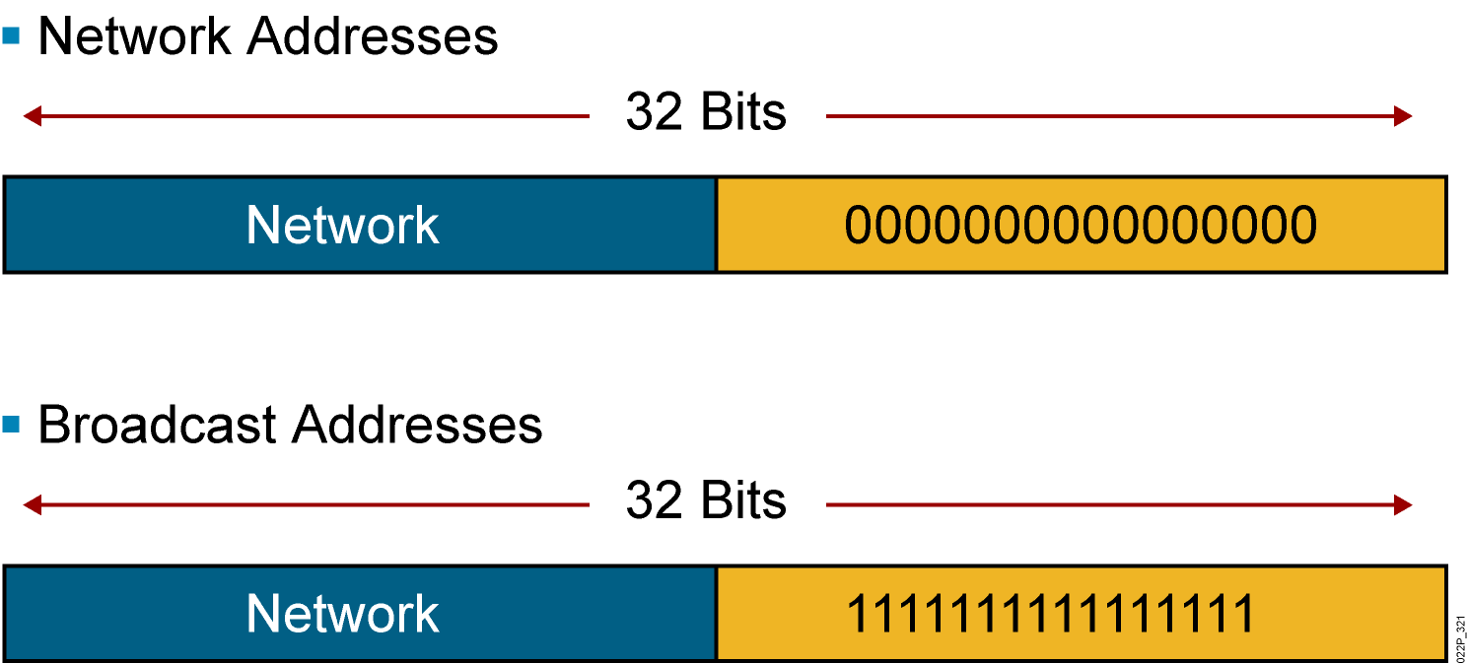
Reserved Address
Notes:
Lesson Aim
<Enter lesson aim here.>

Slide 9
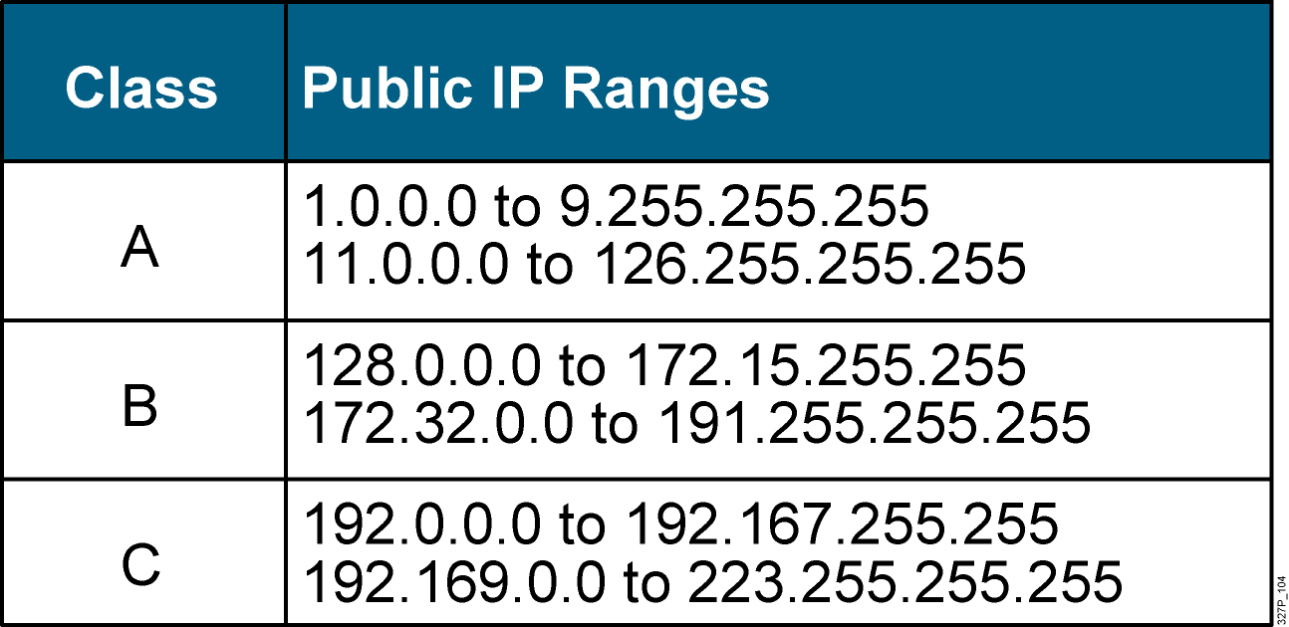
Public IP Addresses

Slide 10
Private IP Addresses
Class | Private Address Range
A | 10.0.0.0 to 10.255.255.255
B | 172.16.0.0 to 172.31.255.255
C | 192.168.0.0 to 192.168.255

Slide 11
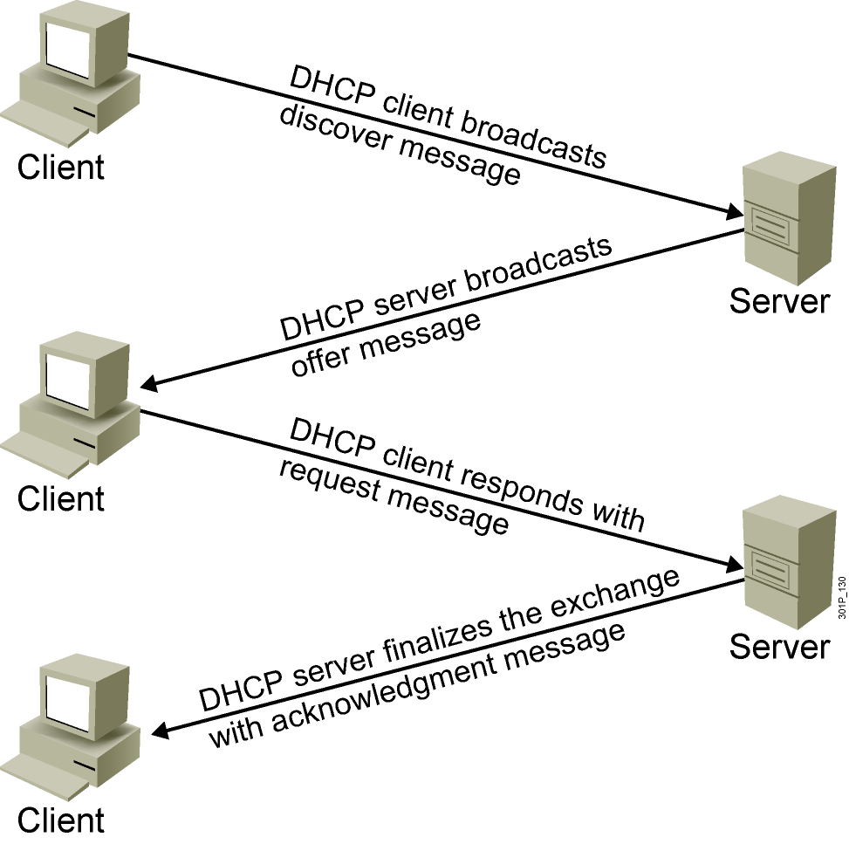
DHCP
Notes:
Lesson Aim
<Enter lesson aim here.>

Slide 12
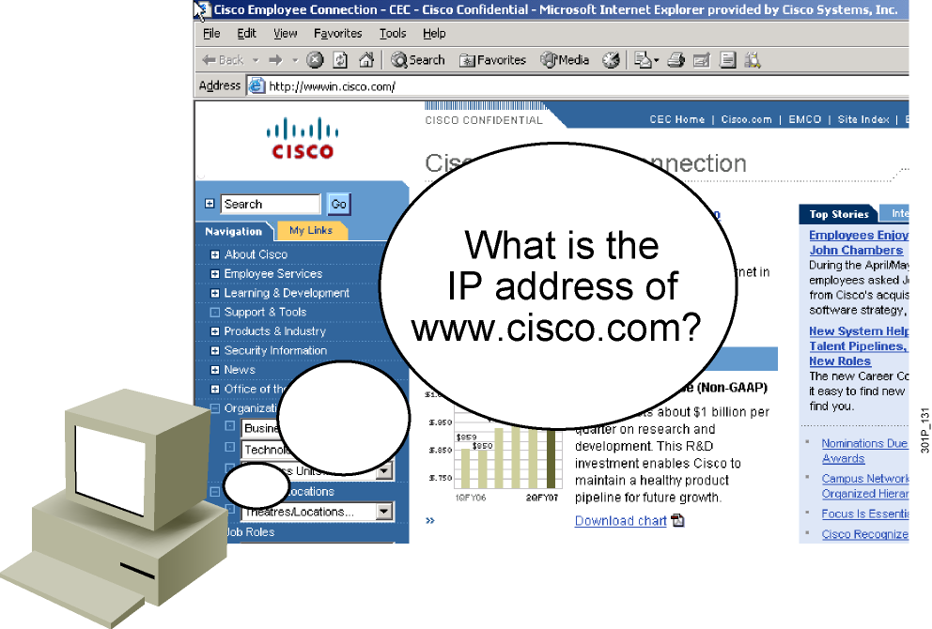
DNS
  Application specified in the TCP/IP suite
  A way to translate human-readable names into IP addresses

Slide 13
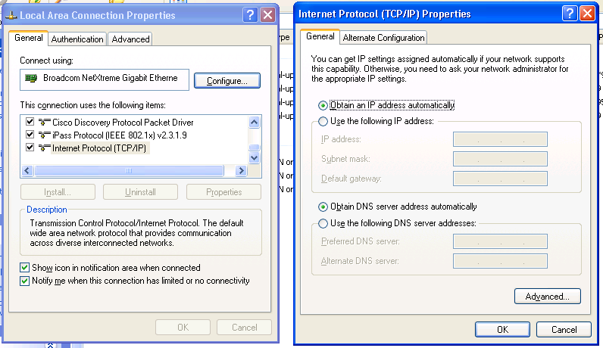
Network Connection

Slide 14
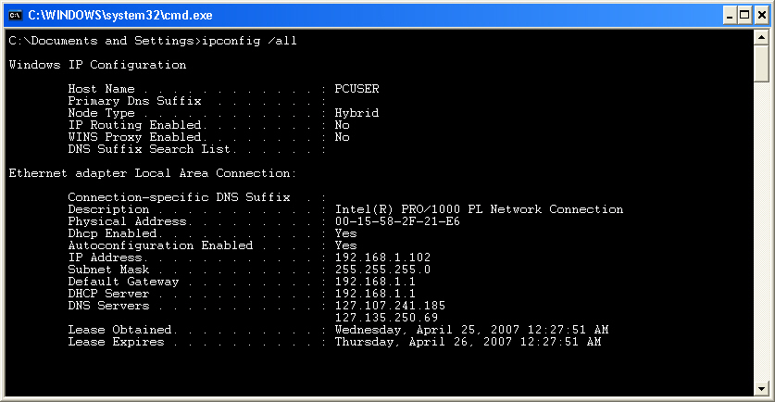
ipconfig

Slide 16
Summary
  IP network addresses consist of two parts: the network ID and the host ID.
  IPv4 addresses have 32 bits that are divided into octets and are generally shown in dotted decimal form (for example, 192.168.54.18).
  When written in a binary format, the first bit of a Class A address is always 0, the first 2 bits of a Class B address are always 10, and the first 3 bits of a Class C address are
  always 110.

Slide 17
Summary (Cont.)
  Certain IP addresses (network and broadcast) are reserved and cannot be assigned to individual network devices.
  Internet hosts require a unique, public IP address, but private hosts can have any valid private address that is unique within the private network.
  DHCP is used to assign IP addresses automatically, and also to set TCP/IP stack configuration parameters such as the subnet mask, default router, and DNS servers.
  DNS is an application that is specified in the TCP/IP suite, providing a means to translate human-readable names into IP addresses.

Slide 18
Summary (Cont.)
  Host provides tools that can be used to verify the IP address of the host:
    Network connections
    IPCONFIG

