Slide 1
Building a Simple Network
Understanding the TCP/IP Transport Layer

Slide 2
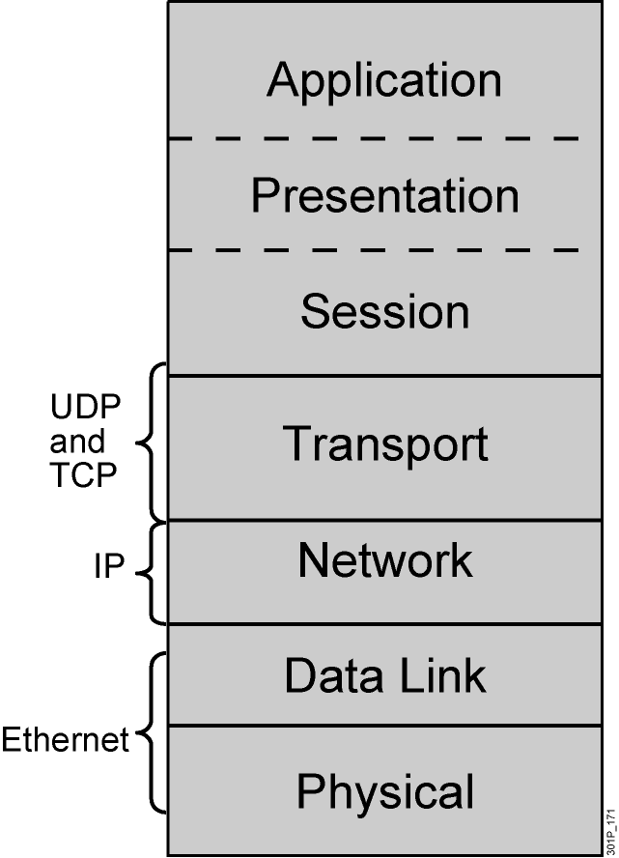
Transport Layer
  Session multiplexing
  Segmentation
  Flow control (when required)
  Connection-oriented
  (when required)
  Reliability (when required)
Notes:
Lesson Aim
<Enter lesson aim here.>

Slide 3
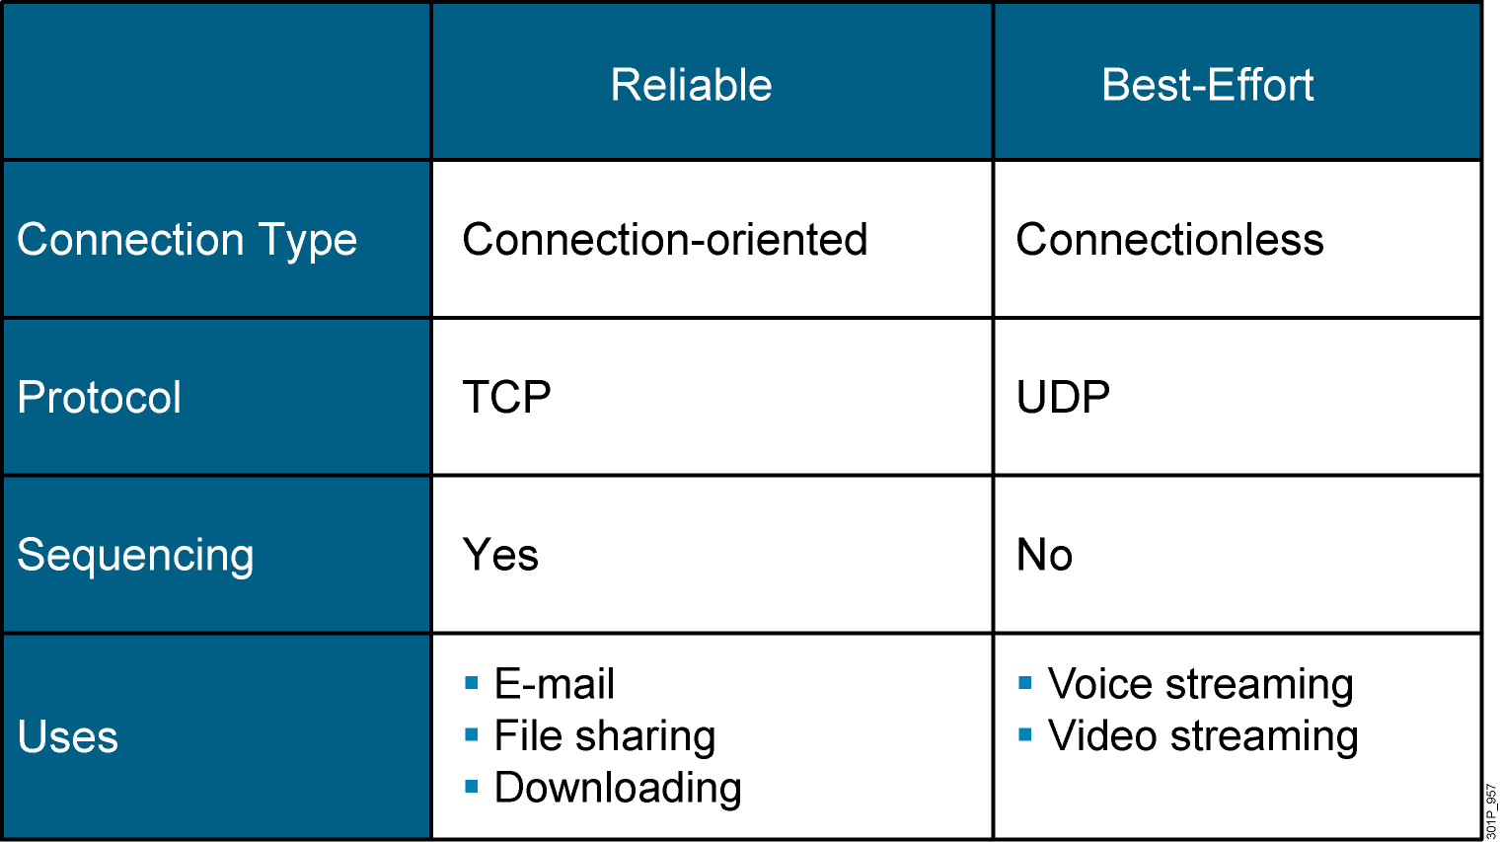
Reliable vs. Best-Effort Comparison

Slide 4
UDP Characteristics
  Operates at transport layer of OSI and TCP/IP models
  Provides applications with access to the network layer without the overhead of reliability mechanisms
  Is a connectionless protocol
  Provides limited error checking
  Provides best-effort delivery
  Has no data-recovery features

Slide 5
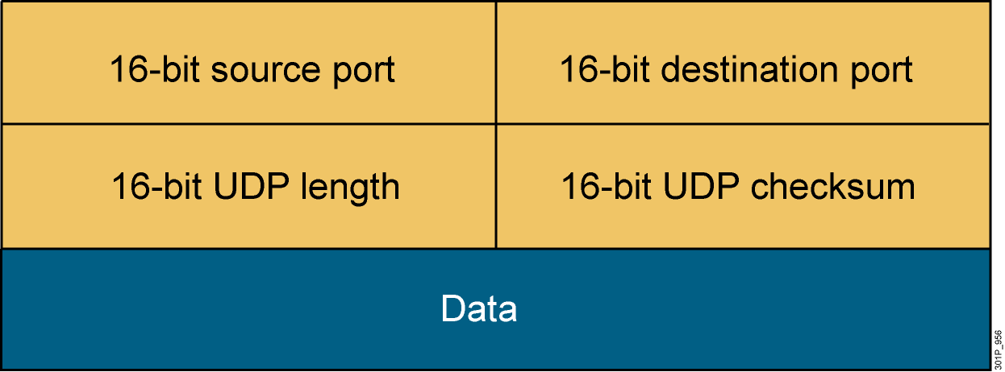
UDP Header
Notes:
Lesson Aim
<Enter lesson aim here.>

Slide 6
TCP Characteristics
  Transport layer of the TCP/IP stack
  Access to the network layer for applications
  Connection-oriented protocol
  Full-duplex mode operation
  Error checking
  Sequencing of data packets
  Acknowledgement of receipt
  Data-recovery features

Slide 7
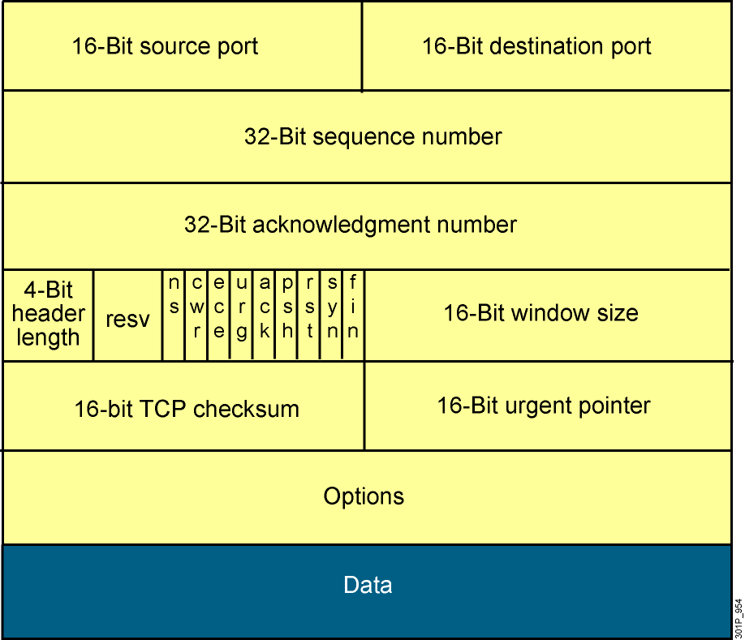
TCP Header
Notes:
Lesson Aim
<Enter lesson aim here.>

Slide 8
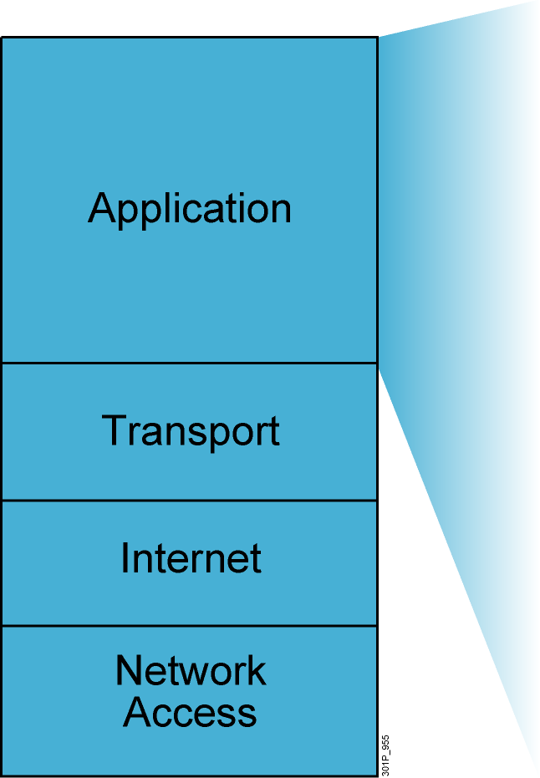
TCP/IP Application Layer Overview
  File transfer
    FTP
    TFTP
    Network File System
  E-mail
    Simple Mail Transfer Protocol
  Remote login
    Telnet
    rlogin
  Network management
    Simple Network Management
    Protocol
  Name management
    Domain Name System
Notes:
Purpose: This figure discusses application-layer protocols.
Emphasize: The common network applications today include file transfer, remote login, network management, and e-mail.
We focus on TCP/IP in this course for several reasons:
TCP/IP is a universally available protocol and you will use it at work.
TCP/IP is a useful reference for understanding other protocols, because it includes elements that are representative of other protocols.
TCP/IP is important because the router uses it as a configuration tool. The router uses Telnet for remote configuration, TFTP to transfer configuration files and operating system images, and SNMP for network management.
Transition: The next section moves down the model to discuss the transport layer.

Slide 9
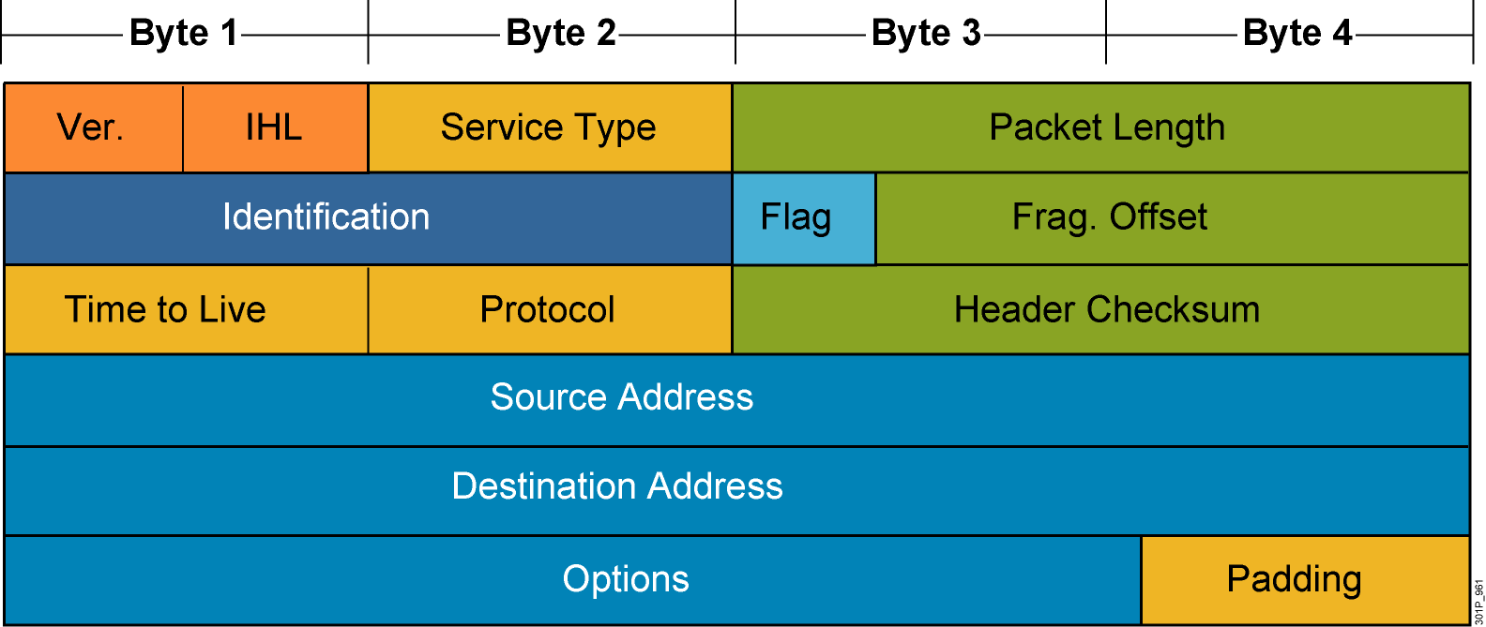
Mapping Layer 3 to Layer 4
Notes:
Lesson Aim
<Enter lesson aim here.>

Slide 10
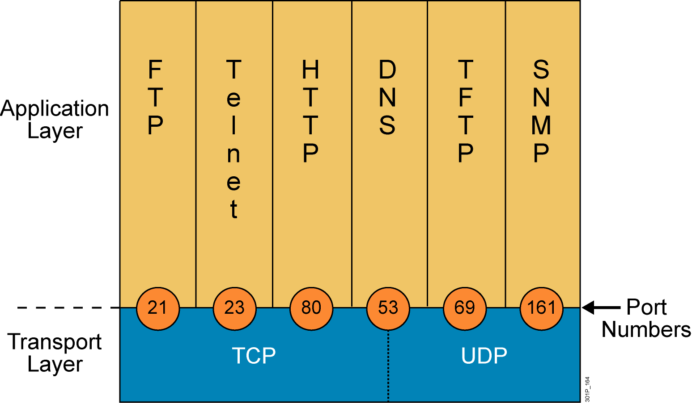
Mapping Layer 4 to Applications
Notes:
Lesson Aim
<Enter lesson aim here.>

Slide 11
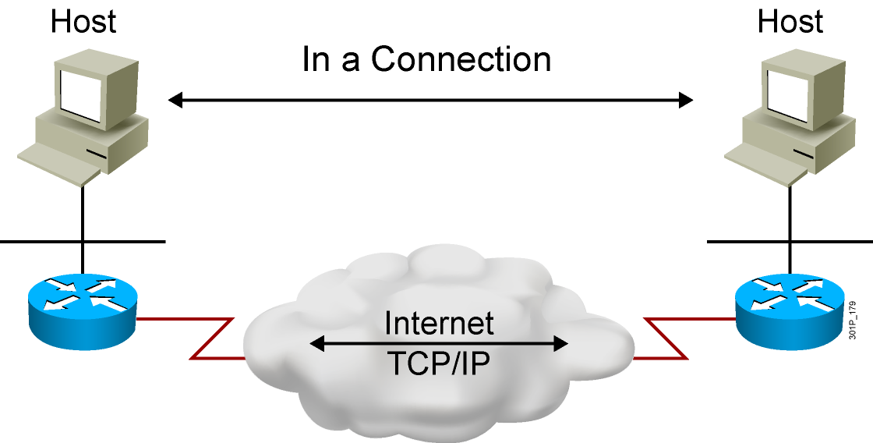
Establishing a Connection
Notes:
Lesson Aim
<Enter lesson aim here.>

Slide 12
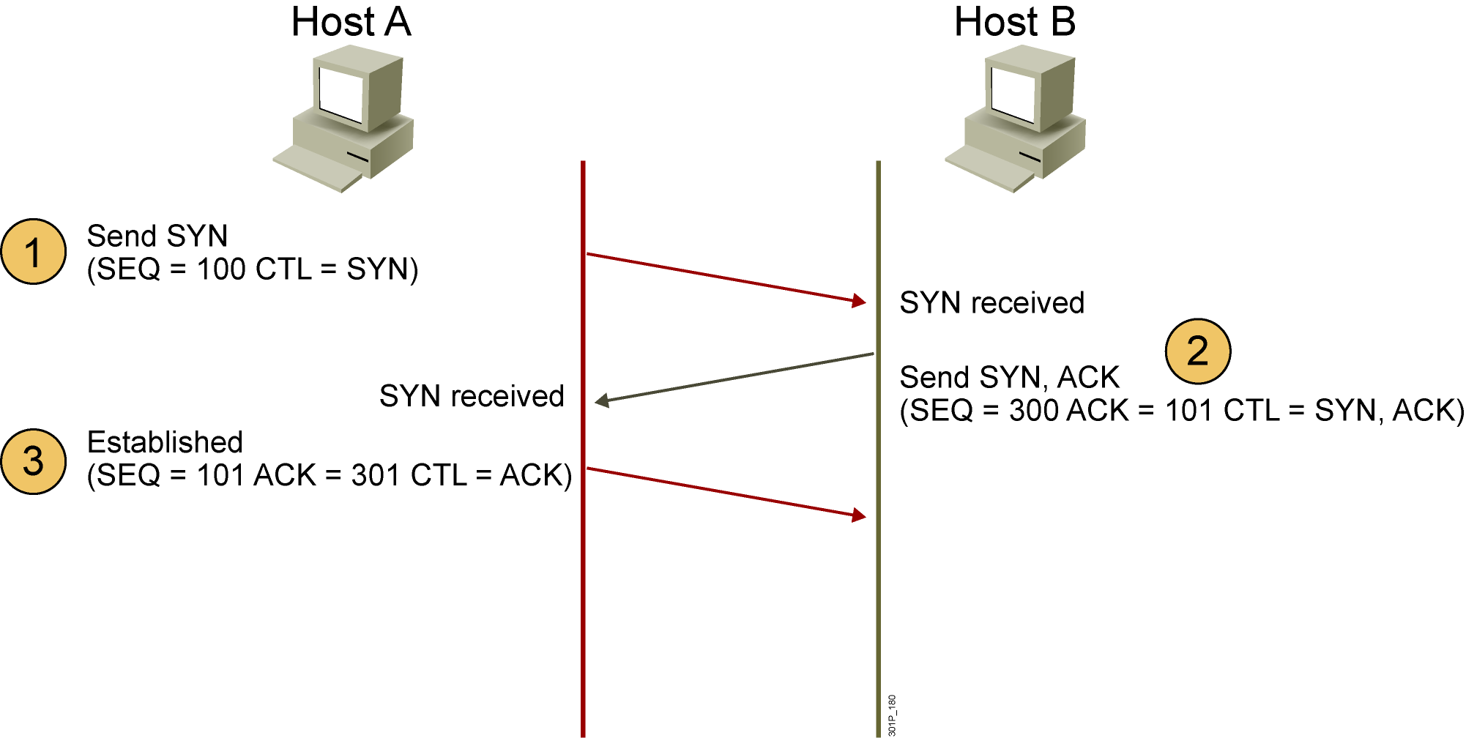
Three-Way Handshake
CTL = Which control bits in the TCP header are set to 1
Notes:
Lesson Aim
<Enter lesson aim here.>

Slide 13
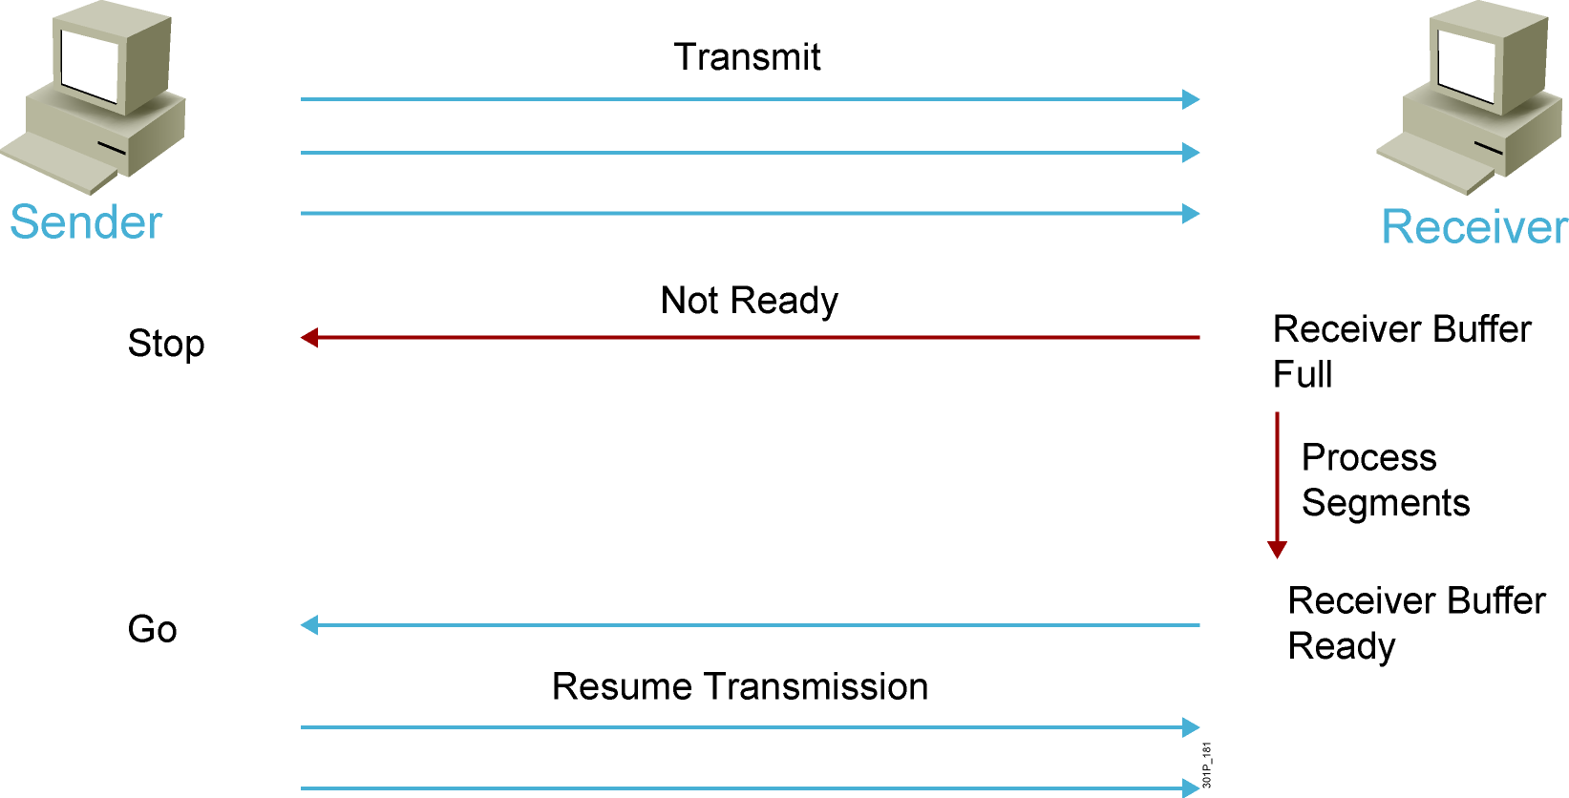
Flow Control
Notes:
Lesson Aim
<Enter lesson aim here.>

Slide 14
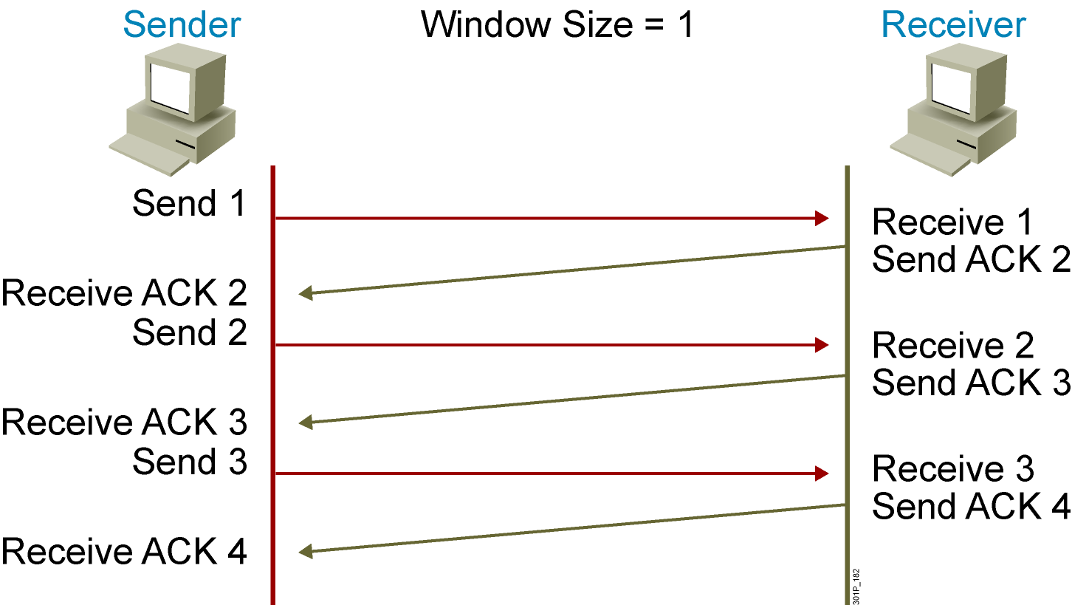
TCP Acknowledgment
Notes:
Lesson Aim
<Enter lesson aim here.>

Slide 15
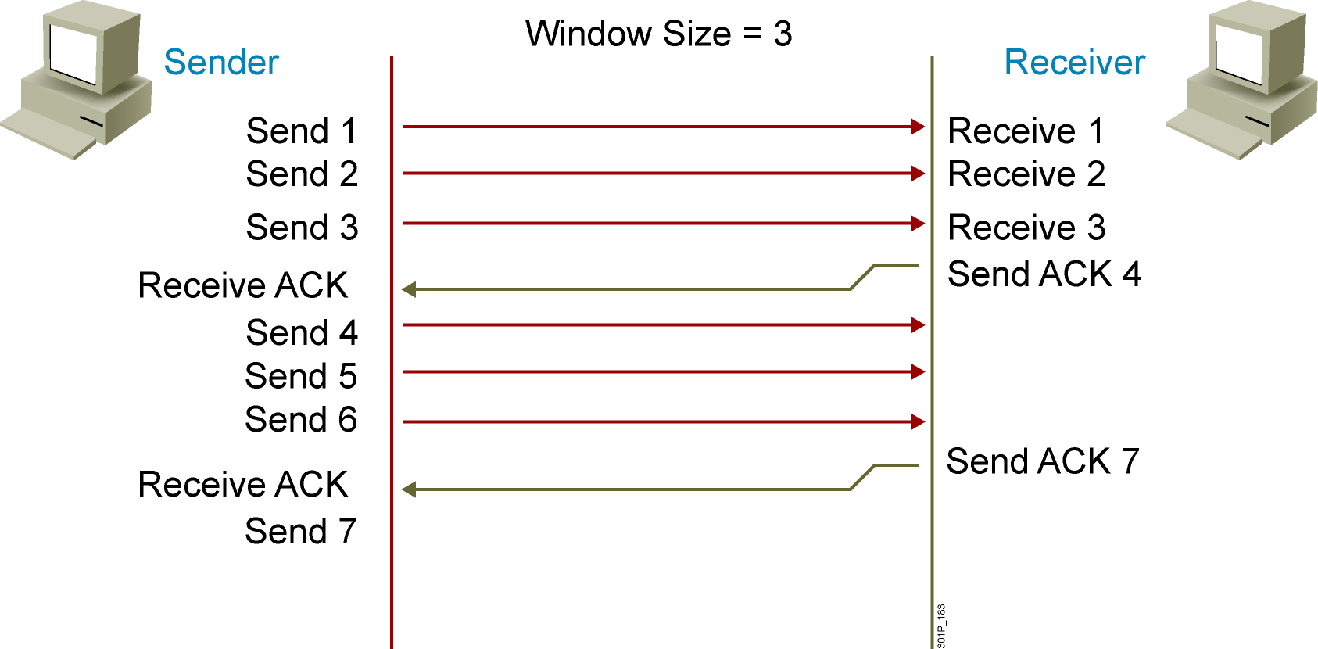
Fixed Windowing
Notes:
Lesson Aim
<Enter lesson aim here.>

Slide 16
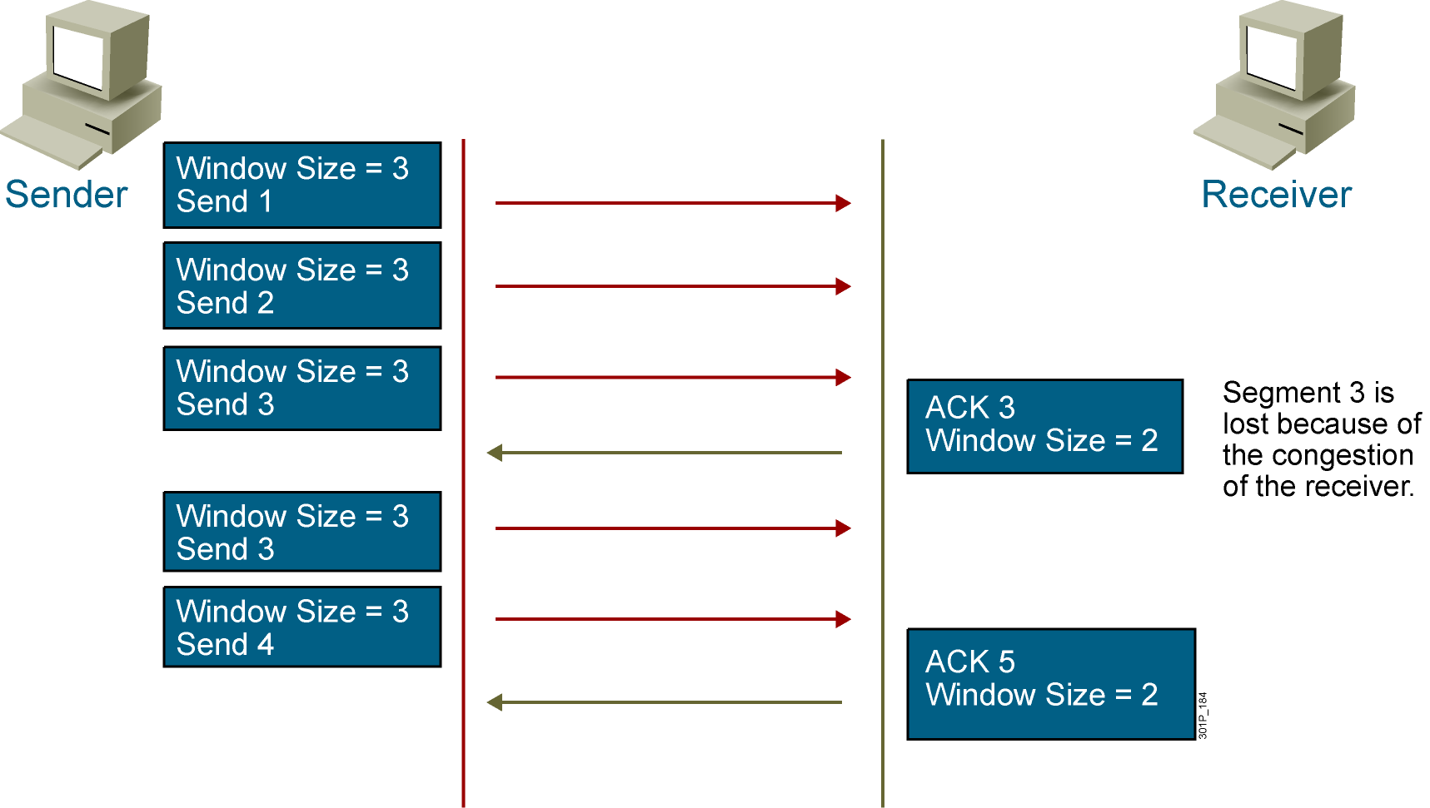
TCP Sliding Windowing
Notes:
Lesson Aim
<Enter lesson aim here.>

Slide 17
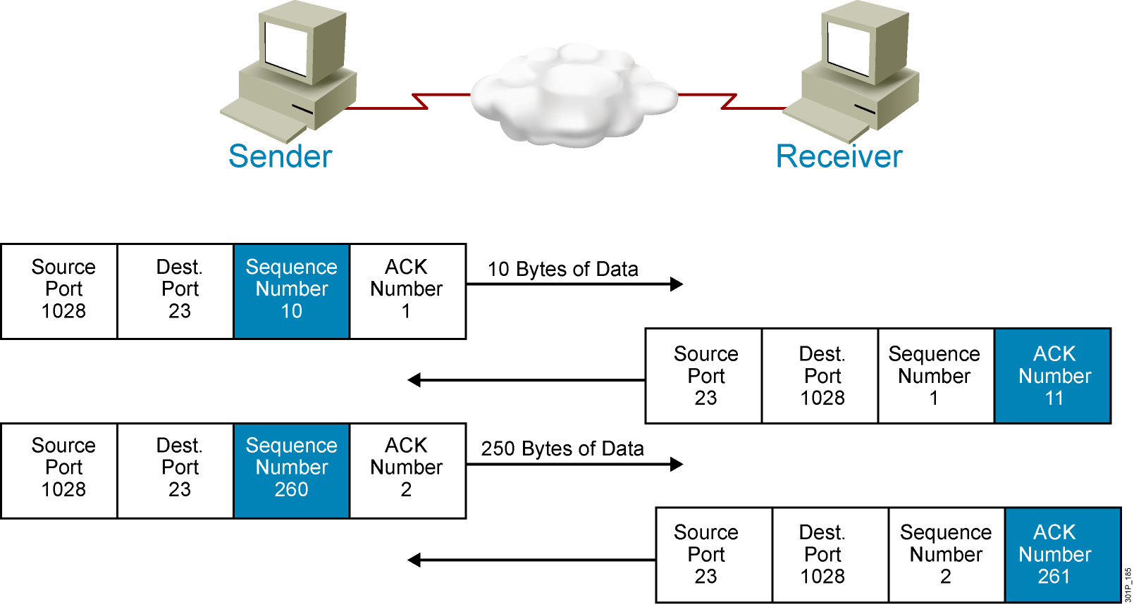
TCP Sequence and Acknowledgment Numbers
Notes:
Lesson Aim
<Enter lesson aim here.>

Slide 18
Summary
  The purpose of the transport layer is to hide the network requirements from the application layer.
  Connection-oriented transport provides reliable transport; connectionless transport provides best-effort transport.
  UDP is a protocol that operates at the transport layer and provides applications with access to the network layer without the overhead of the reliability mechanisms of TCP. UDP is a connectionless, best-effort delivery protocol.
  TCP is a protocol that operates at the transport layer and provides applications with access to the network layer. TCP is connection-oriented, provides error checking, delivers data reliably, operates in full-duplex mode, and provides some data recovery functions.

Slide 19
Summary (Cont.)
  TCP/IP supports a number of applications, including FTP (supports bidirectional binary and ASCII file transfers), TFTP (transfers configuration files and Cisco IOS images), and Telnet (provides capability to remotely access another computer).
  IP uses a protocol number in the datagram header to identify which protocol to use for a particular datagram.
  Port numbers are used to map Layer 4 to an application.

Slide 20
Summary (Cont.)
  Flow control avoids the problem of a transmitting host overflowing the buffers in the receiving host and slowing network performance.
  TCP provides sequencing of segments with a forward reference acknowledgment. When a single segment is sent, receipt is acknowledged and the next segment is then sent.

Slide 21
Summary (Cont.)
  The TCP window size decreases the transmission rate to a level at which congestion and data loss do not occur. The TCP window size allows a specified number of unacknowledged segments to be sent.
  A fixed window is a window with an unchanging size that can accommodate a specific flow of segments.
  A TCP sliding window is a window that can change size dynamically to accommodate the flow of segments.
  TCP provides the sequencing of segments by providing sequence numbers and acknowledgment numbers in TCP headers.

