Slide 1
Building a Simple Network
Understanding Ethernet

Slide 2
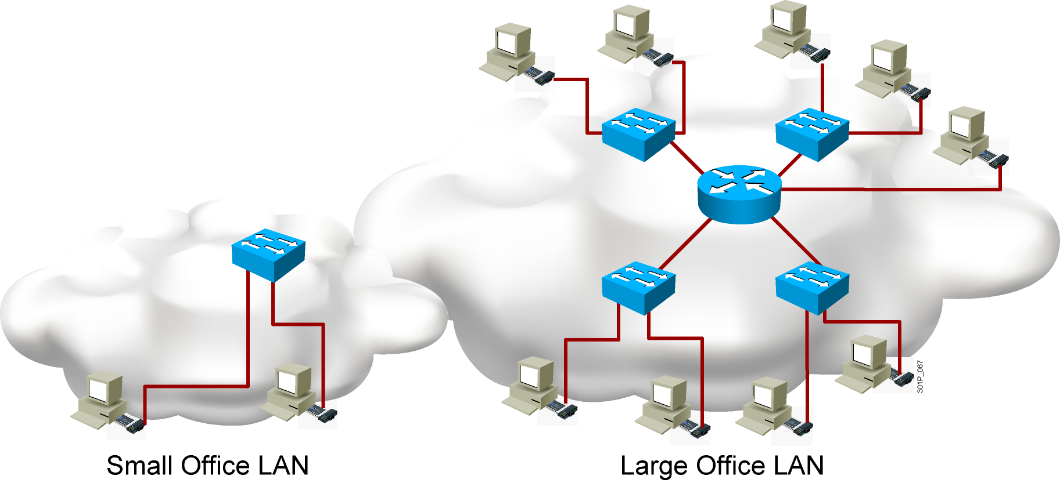
Local Area Network

Slide 3
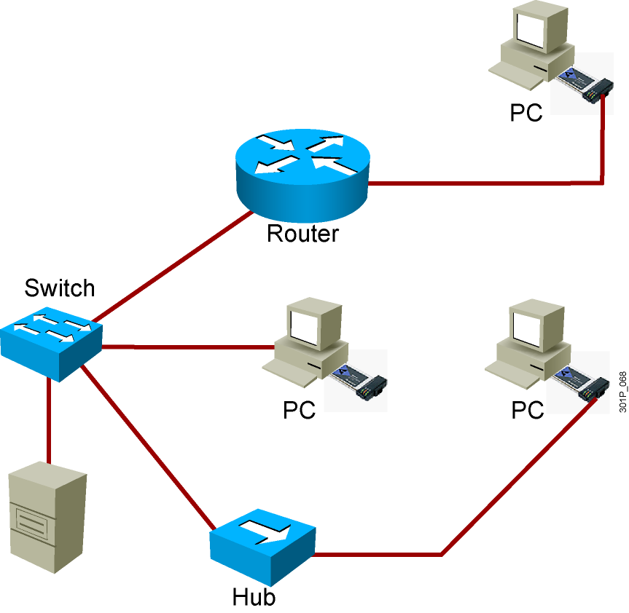
LAN Components
  Computers
    PCs
    Servers
  Interconnections
    NICs
    Media
  Network devices
    Hubs
    Switches
    Routers
  Protocols
    Ethernet
    IP
    ARP
    DHCP

Slide 4
Functions of a LAN
  Data and applications
  Share resources
  Provide communication path to other networks

Slide 5
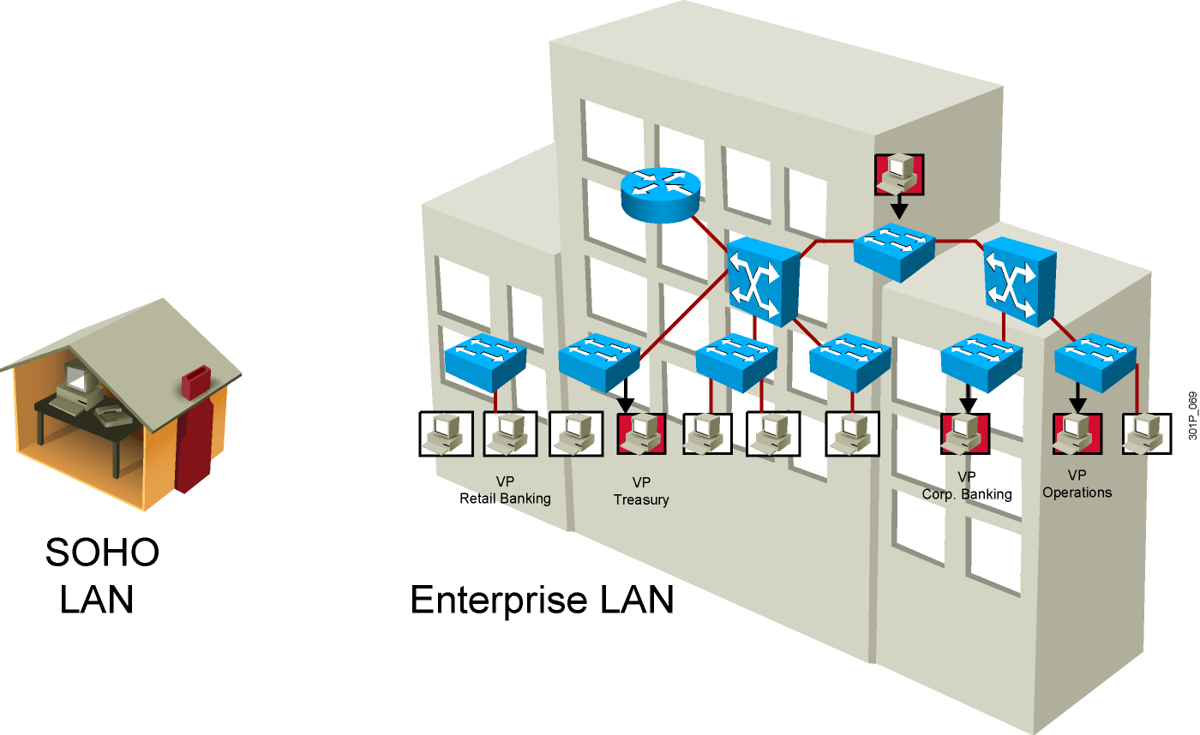
LAN Sizes

Slide 6
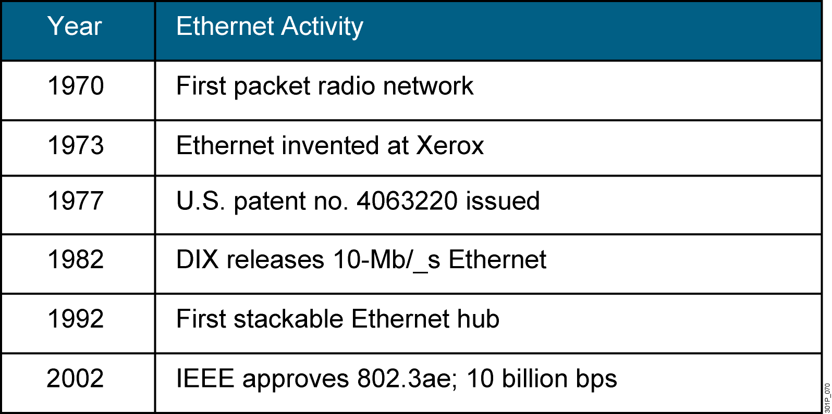
Ethernet Evolution

Slide 7
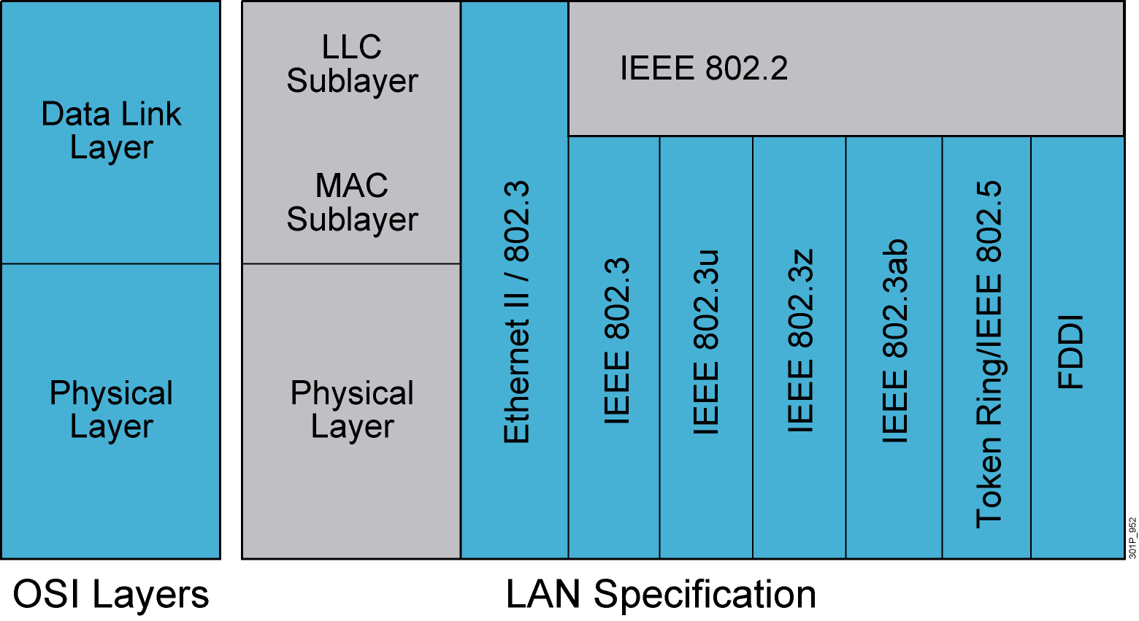
LAN Standards
Notes:
Lesson Aim
<Enter lesson aim here.>

Slide 8
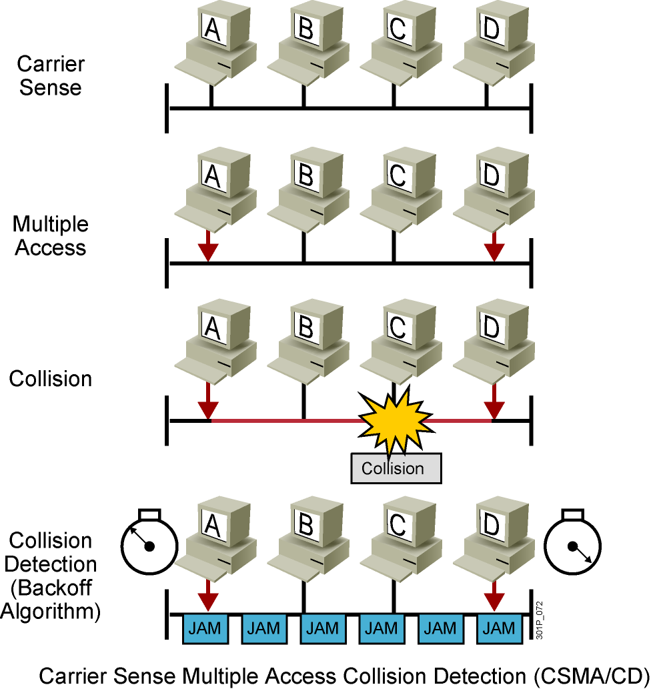
CSMA/CD
Notes:
Lesson Aim
<Enter lesson aim here.>

Slide 9
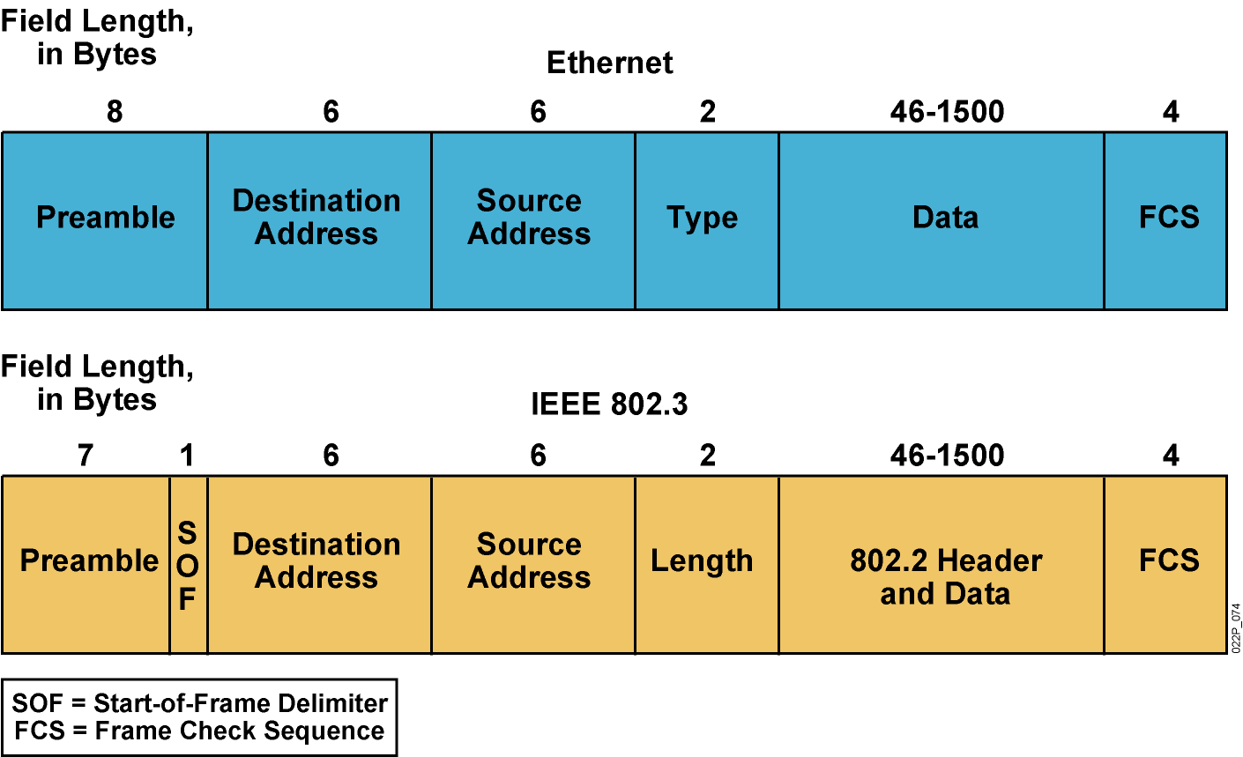
Ethernet Frame Structure

Slide 10
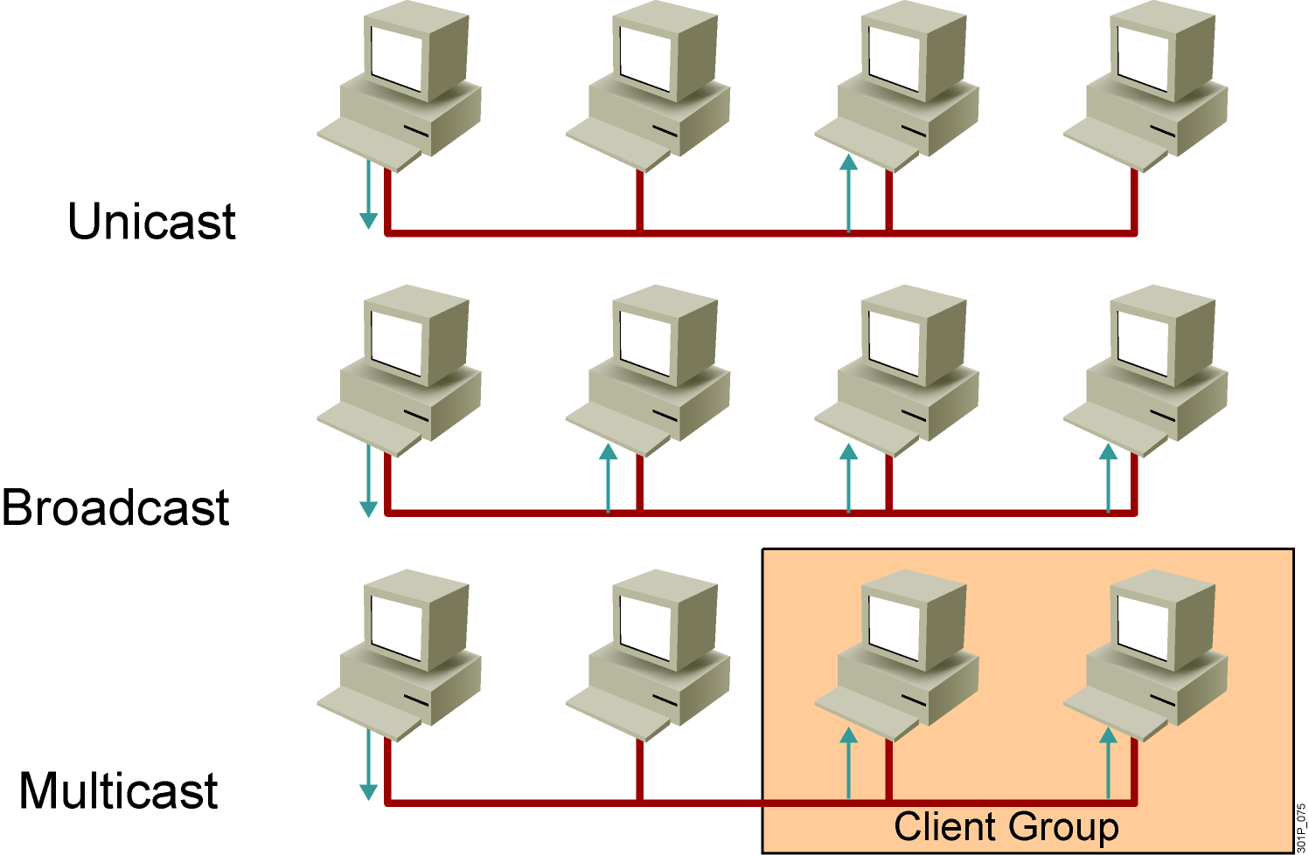
Communicating Within the LAN
Notes:
Lesson Aim
<Enter lesson aim here.>

Slide 11
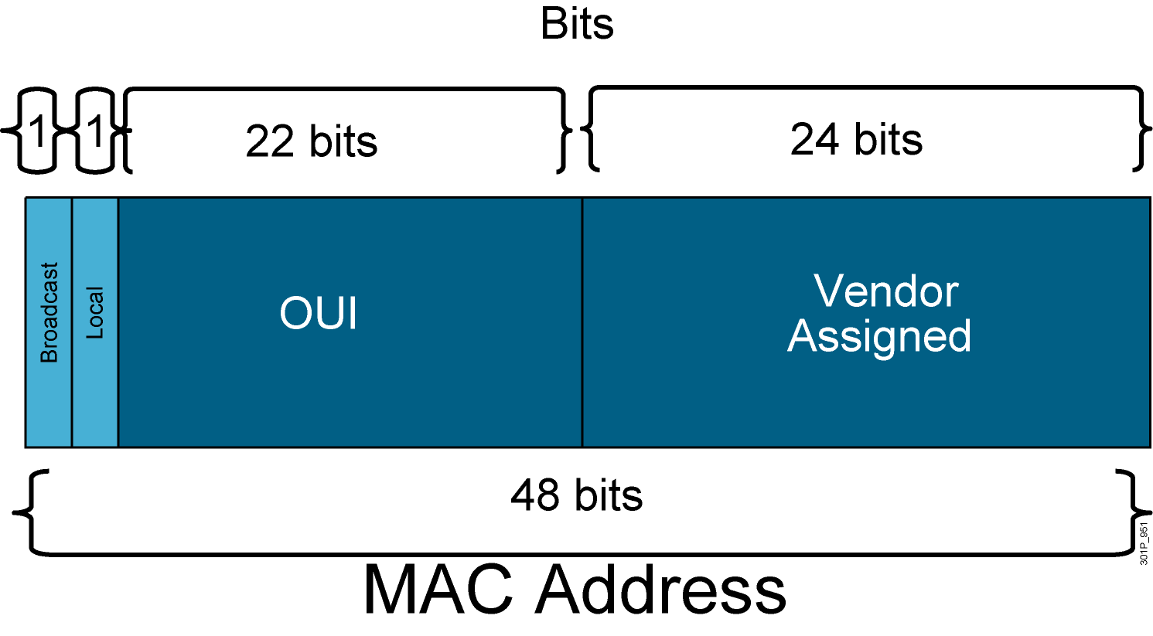
MAC Address Components

Slide 12
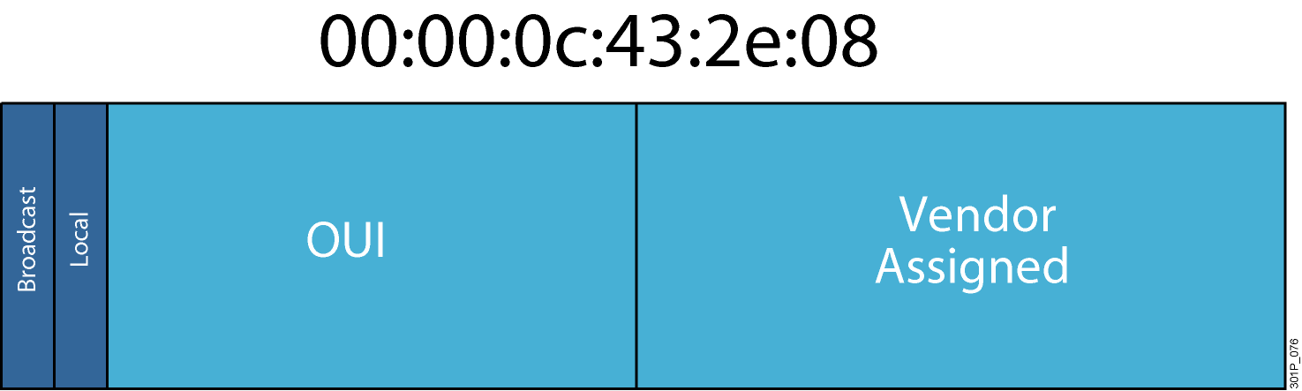
MAC Addresses

Slide 13
Summary
  A LAN is a network that is located in a limited area, with the computers and other components that are part of this network located relatively close together.
  Regardless of its size, several fundamental components are required for the operation of a LAN, including computers, interconnections, network devices, and protocols.
  LANs provide both communication and resource-sharing functions for their users.
  LANs can be configured in various sizes, to accommodate environments from SOHO to enterprise.

Slide 14
Summary (Cont.)
  Ethernet was originally developed in the 1970s by DEC, Intel, and Xerox, and was called DIX Ethernet. When a workgroup of this body (referred to as IEEE 802.3) defined new standards for Ethernet in the mid-1980s to define Ethernet-like networks for public use, the standards were called Ethernet 802.3 and 802.2.
  Ethernet LAN standards specify cabling and signaling at both the physical and data link layers of the OSI model.
  Stations on a CSMA/CD LAN can access the network at any time. Before sending data, CSMA/CD stations listen to the network to determine whether it is already in use. If it is in use, they wait. If the network is not in use, the stations transmit. A collision occurs when two stations listen for network traffic, hear none, and transmit simultaneously.

Slide 15
Summary (Cont.)
  An Ethernet frame consists of fields, including preamble, start-of-frame delimiter, destination address, source address, type/length, data and pad, and frame check sequence.
  There are three major kinds of communications in networks: unicast, in which a frame is sent from one host addressed to one specific destination; broadcast, in which a frame is sent from one address to all other addresses; and multicast, in which a destination addresses a specific group of devices.
  The address used in an Ethernet LAN is the means by which data is directed to the proper receiving location.

Slide 16
Summary (Cont.)
  The MAC sublayer handles physical addressing issues, and the physical address is a 48-bit number usually represented in hexadecimal format.

