Slide 1
Building a Simple Network
Connecting to an Ethernet LAN

Slide 2
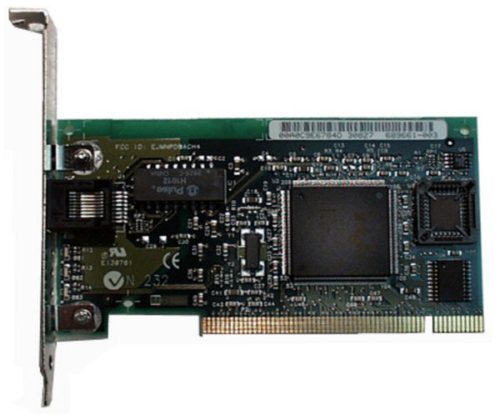
Network Interface Card

Slide 3
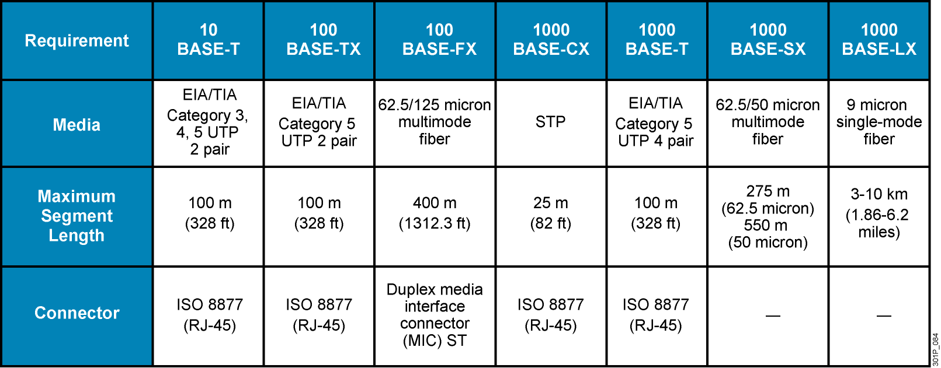
Comparing Ethernet Media Requirements
Notes:
Lesson Aim
<Enter lesson aim here.>

Slide 4
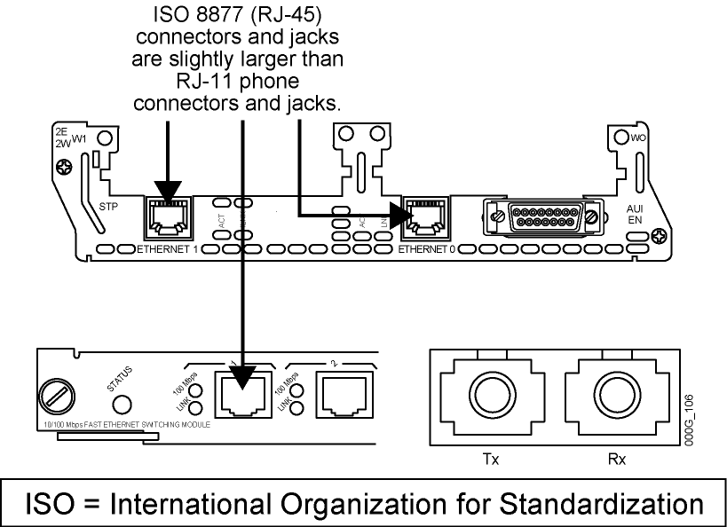
Differentiating Between Connections
Notes:
Lesson Aim
<Enter lesson aim here.>

Slide 5
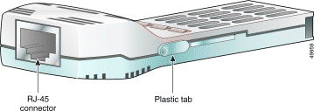
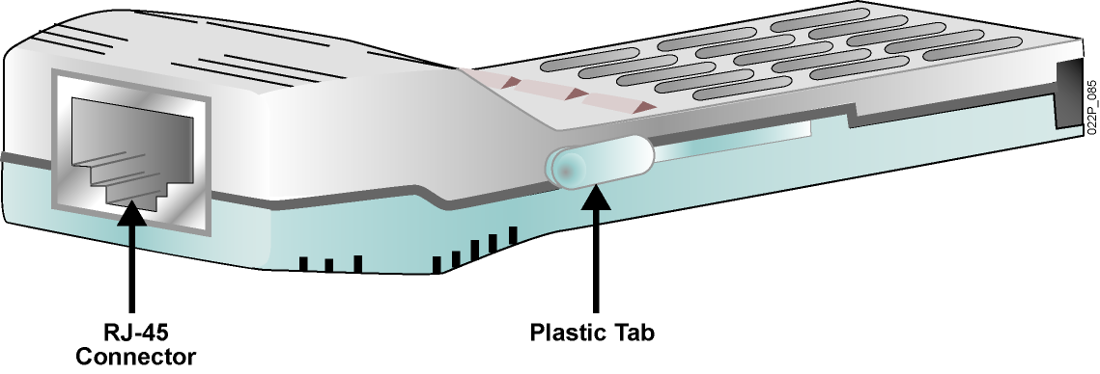
1000BASE-T GBIC
Notes:
Lesson Aim
<Enter lesson aim here.>

Slide 6

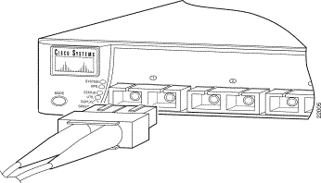
Cisco Fiber-Optic GBICs
  Short wavelength (1000BASE-SX)
  Long wavelength/long haul (1000BASE-LX/LH)
  Extended distance (1000BASE-ZX)
Notes:
Lesson Aim
<Enter lesson aim here.>

Slide 7
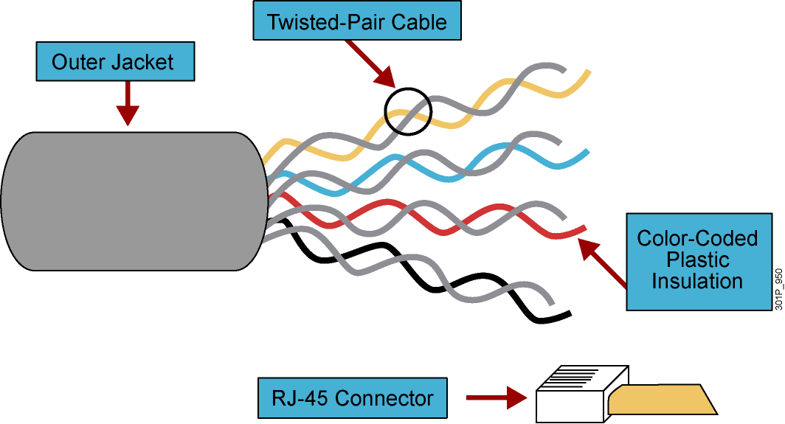
Unshielded Twisted-Pair Cable
  Speed and throughput: 10 to 1000 Mb/s
  Average cost per node: Least expensive
  Media and connector size: Small
  Maximum cable length: Varies
Notes:
Lesson Aim
<Enter lesson aim here.>

Slide 8
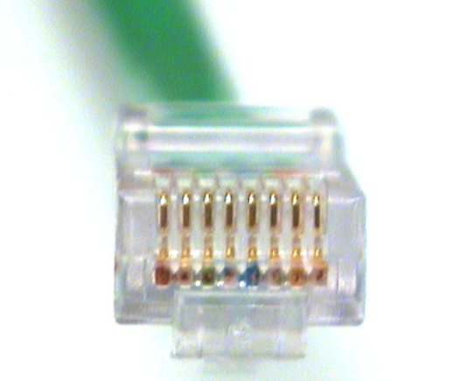
RJ-45 Connector
Notes:
Lesson Aim
<Enter lesson aim here.>

Slide 9
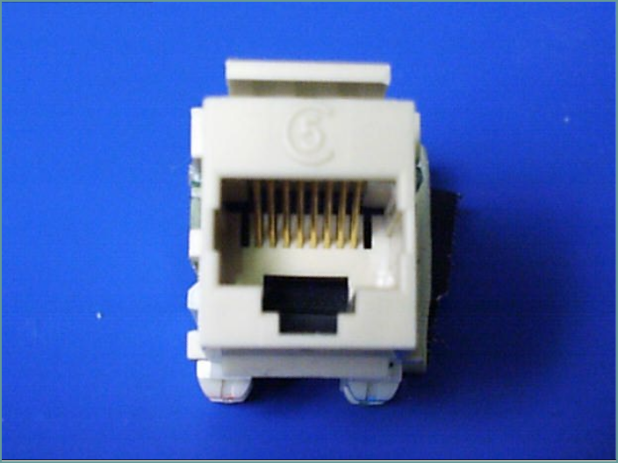
RJ-45 Jack
Notes:
Lesson Aim
<Enter lesson aim here.>

Slide 10
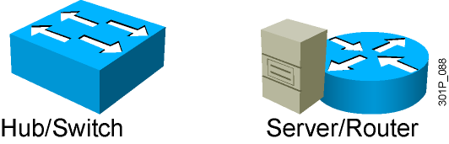
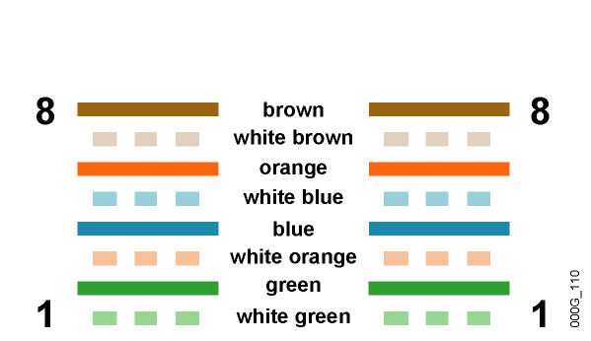
UTP Implementation (Straight-Through)
Cable 10BASE-T/
100BASE-TX Straight-Through
Straight-Through Cable
Pin Label
Pin Label
1
2
3
4
5
6
7
8
TX+
TX-
RX+
NC
NC
RX-
NC
NC
1
2
3
4
5
6
7
8
TX+
TX-
RX+
NC
NC
RX-
NC
NC
Wires on cable ends
are in same order.
Notes:
Lesson Aim
<Enter lesson aim here.>

Slide 11
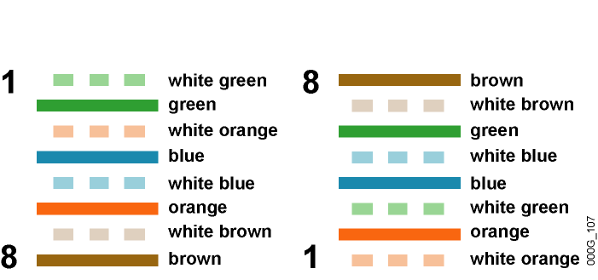
UTP Implementation (Crossover)
Cable 10BASE-T or
100BASE-TX Straight-Through
Crossover Cable
EIA/TIA T568A
EIA/TIA T568B
Pin Label
Pin Label
1
2
3
4
5
6
7
8
TX+
TX-
RX+
NC
NC
RX-
NC
NC
1
2
3
4
5
6
7
8
TX+
TX-
RX+
NC
NC
RX-
NC
NC
Some wires on cable
ends are crossed.
Notes:
Lesson Aim
<Enter lesson aim here.>

Slide 12
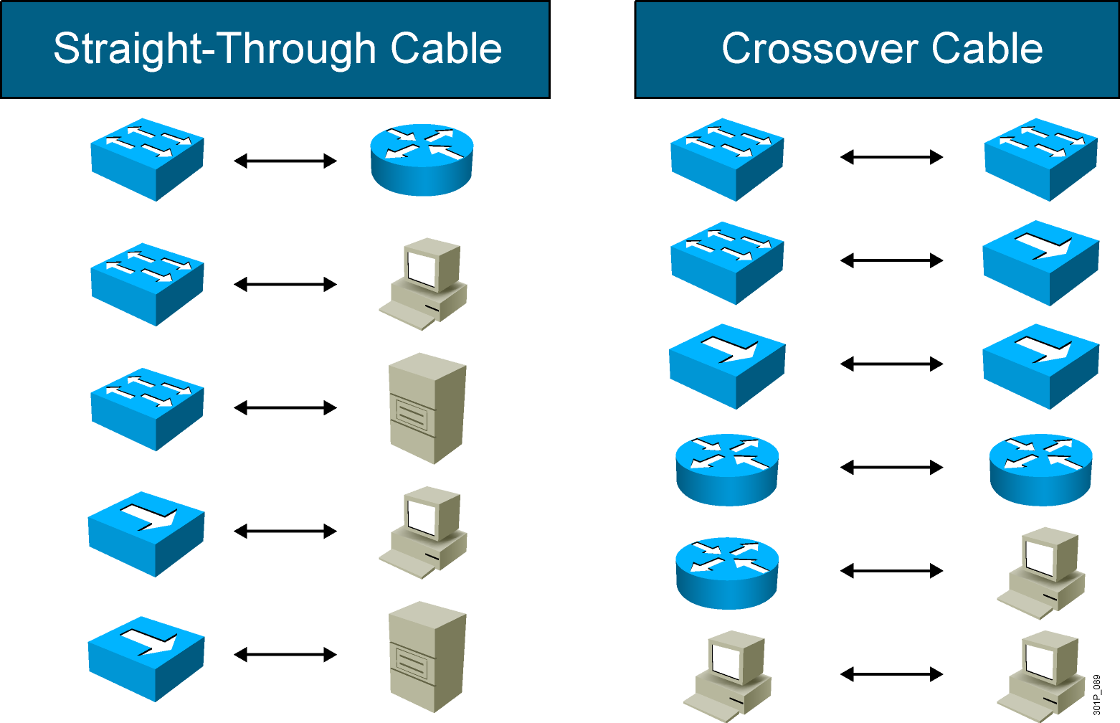
UTP Implementation: Straight-Through vs. Crossover
Notes:
Module 2, Lesson 3 – Replace the existing graphic on slide 14 with this new graphic (align items properly)
Reference – SG Page 2-55

Slide 13
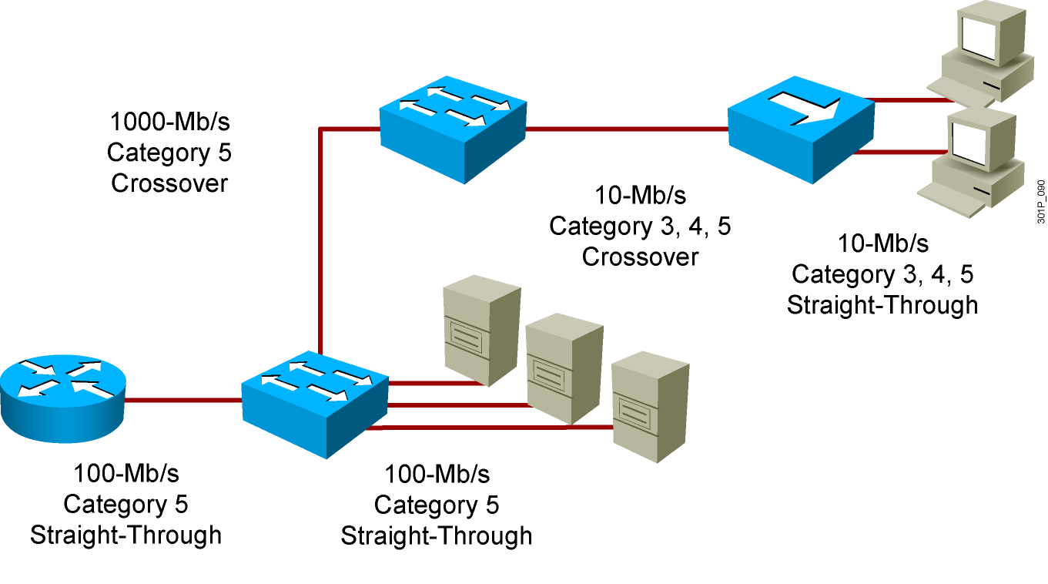
Using Varieties of UTP
Notes:
Lesson Aim
<Enter lesson aim here.>

Slide 14
Summary
  Also called a LAN adapter, the NIC plugs into a motherboard and provides a port for connecting to the network.
  The MAC address is burned onto each NIC by the manufacturer, providing a unique, physical network address that permits the device to participate in the network.
  The cable and connector specifications used to support Ethernet implementations are derived from the EIA/TIA standards body.
  The categories of cabling defined for the Ethernet are derived from the EIA/TIA-568 (SP-2840) Commercial Building Telecommunications Wiring Standards.

Slide 15
Summary (Cont.)
  UTP cable is a four-pair wire. Each of the eight individual copper wires in UTP cable is covered by an insulating material, and the wires in each pair are twisted around each other.
  A crossover cable is used to connect between similar devices (such as switch to switch, router to router, PC to PC, and hub to hub).
  A straight-through cable is used to connect between dissimilar devices (such as switch to router, switch to PC, hub to router, and hub to PC).

