Slide 1
Ethernet LANs
Understanding the Challenges of
Shared LANs

Slide 2
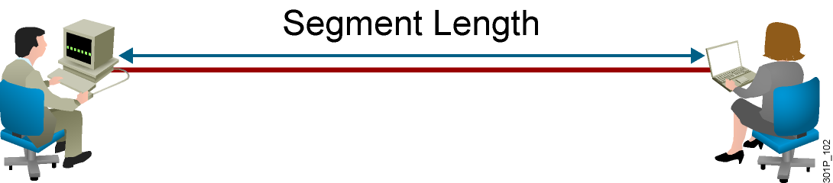
LAN Segment Limitations
  Signals degrade with transmission distance.
  Each Ethernet type has a maximum segment length.
Notes:
Lesson Aim
<Enter lesson aim here.>

Slide 3
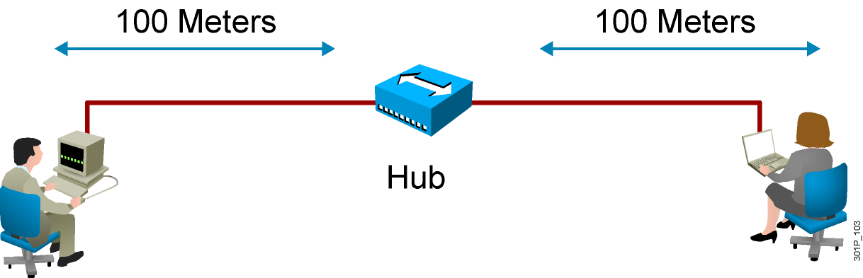
Extending LAN Segments
  Shares bandwidth
  Extends cable distances
  Repeats or amplifies signal
Notes:
Lesson Aim
<Enter lesson aim here.>

Slide 4

Collisions
Notes:
Lesson Aim
<Enter lesson aim here.>

Slide 5
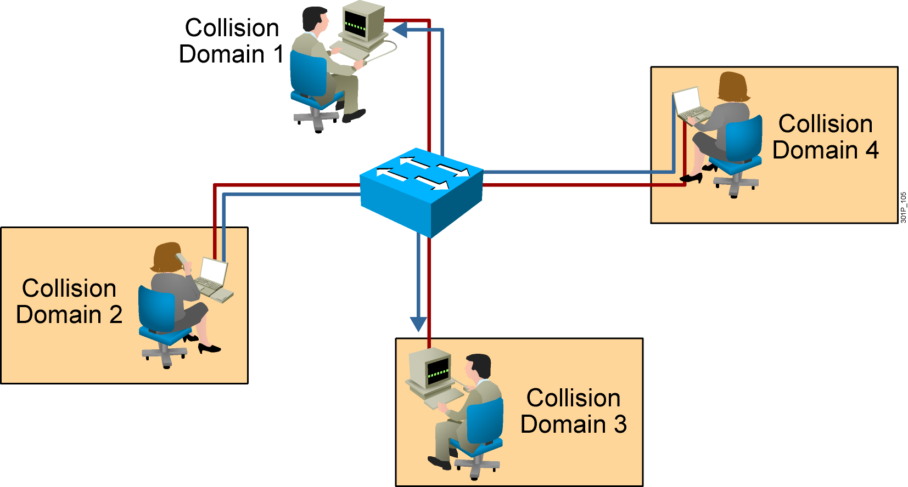
Multiple Collision Domains
Notes:
Lesson Aim
<Enter lesson aim here.>

Slide 6
Summary
  A segment is a network connection made by a single unbroken network cable. Ethernet cables and segments can span only a limited physical distance, after which transmissions become degraded.
  A hub extends network segments by receiving incoming bits, amplifying the electrical signal, and transmitting these bits through all of its ports to the other devices on the network.
  If two or more stations on a segment transmit at the same time, a collision results.

Slide 7
Summary (Cont.)
  The network segments that share the same bandwidth are called collision domains because when two or more devices communicate at the same time, collisions may occur within that segment.
  It is possible to use other network devices operating at Layer 2
  (or above) of the OSI model to divide network segments to reduce the number of devices that are competing for bandwidth on a given segment and to provide more bandwidth to the devices in the segment.

