Slide 1
Ethernet LANs
Solving Network Challenges with Switched LAN Technology

Slide 2
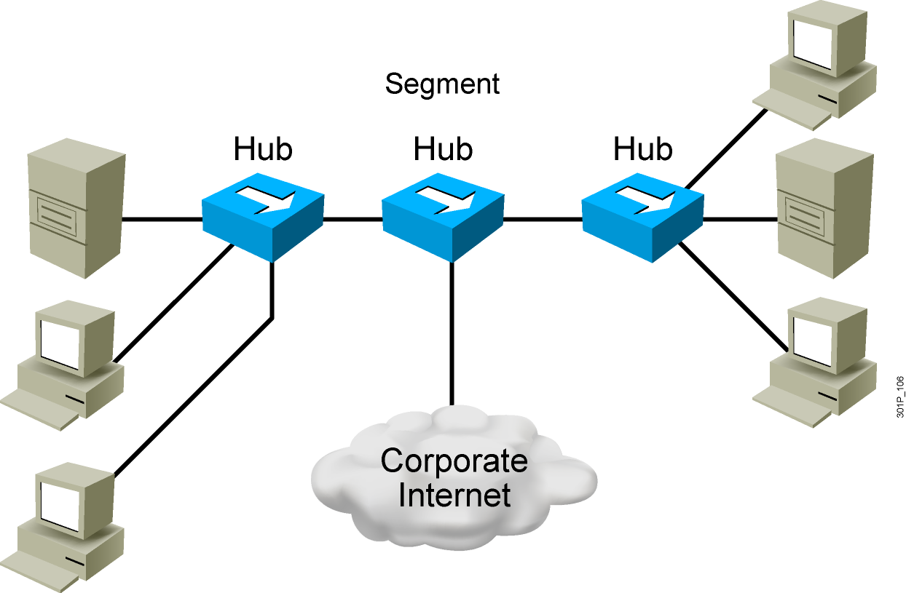
Network Congestion
  High-performance PCs
  More networked data
  Bandwidth-intensive applications
Notes:
Lesson Aim
<Enter lesson aim here.>

Slide 3
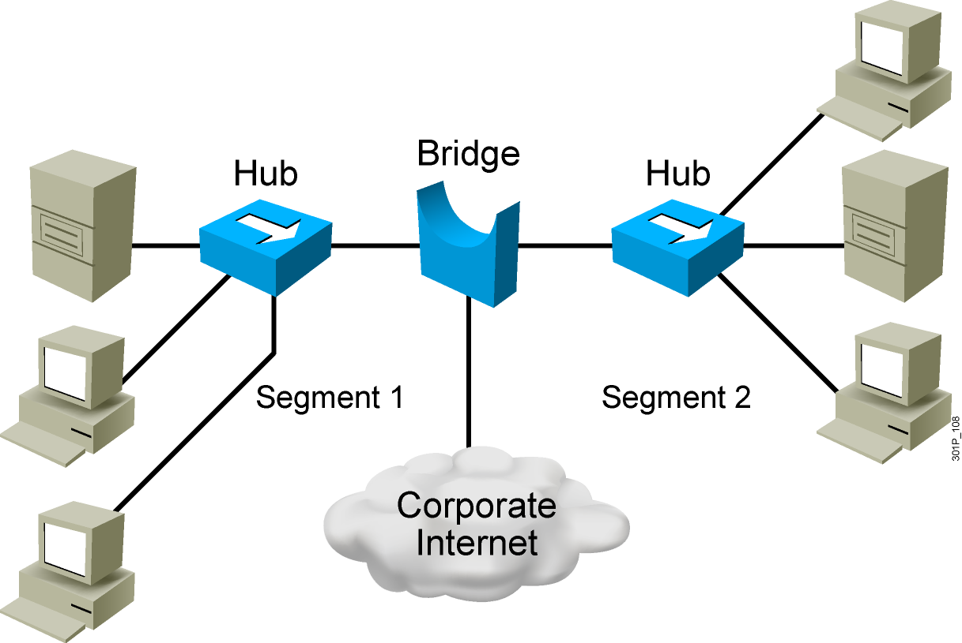
Bridges
  Operate at Layer 2 of the OSI model
  Forward, filter, or flood frames
  Have few ports
  Are slow

Slide 4
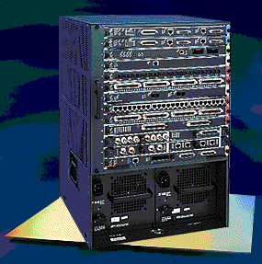
LAN Switch
  High port density
  Large frame buffers
  Mixture of port speeds
  Fast internal switching
  Switching modes:
    Cut-through
    Store-and-forward
    Fragment-free
Notes:
Lesson Aim
<Enter lesson aim here.>

Slide 5
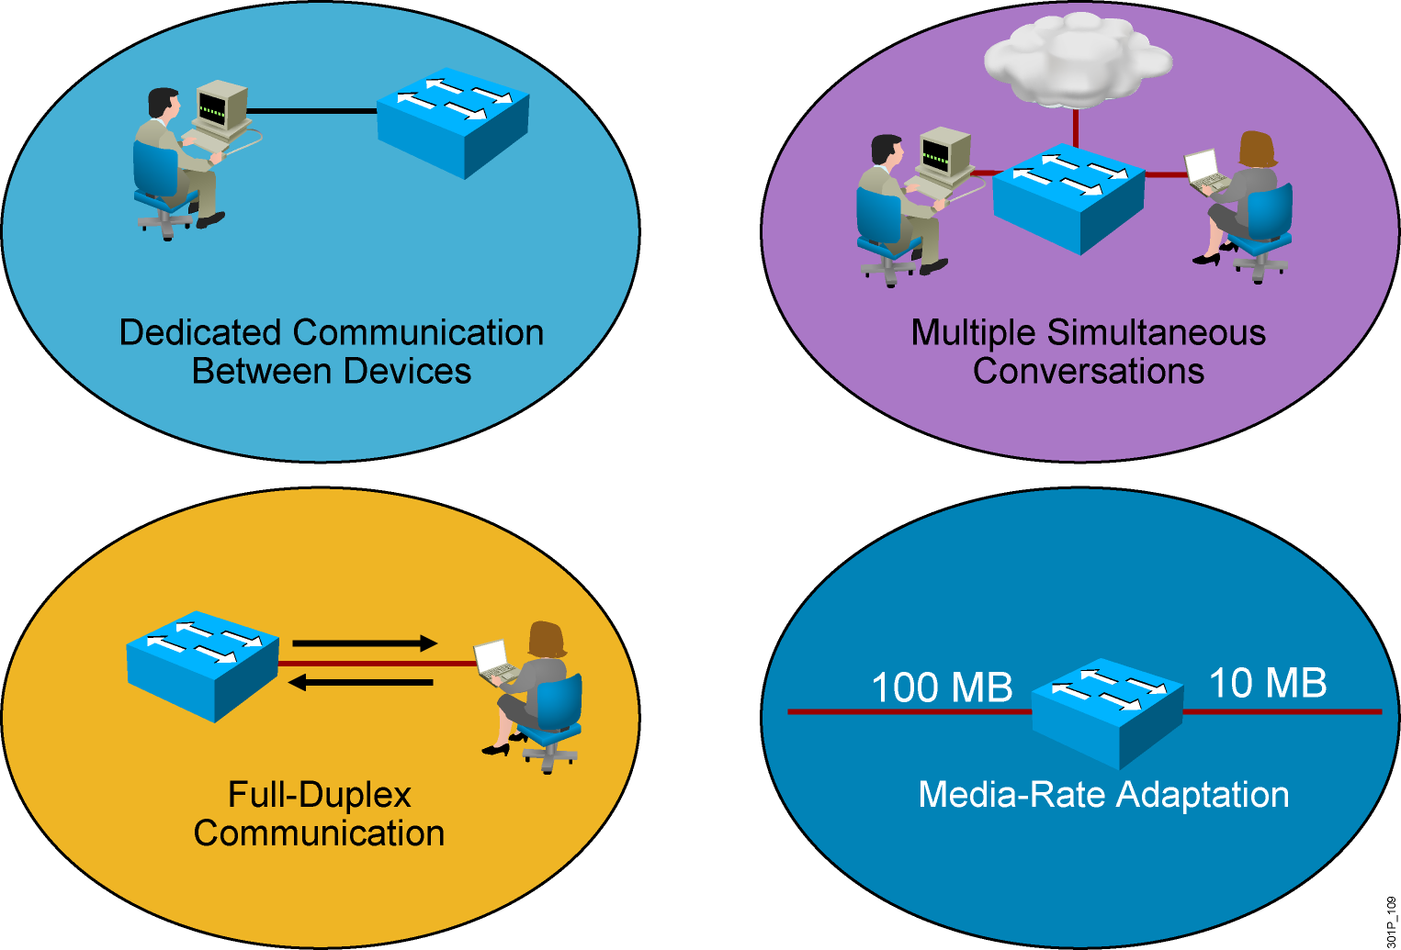
LAN Switch Features
Notes:
Lesson Aim
<Enter lesson aim here.>

Slide 6
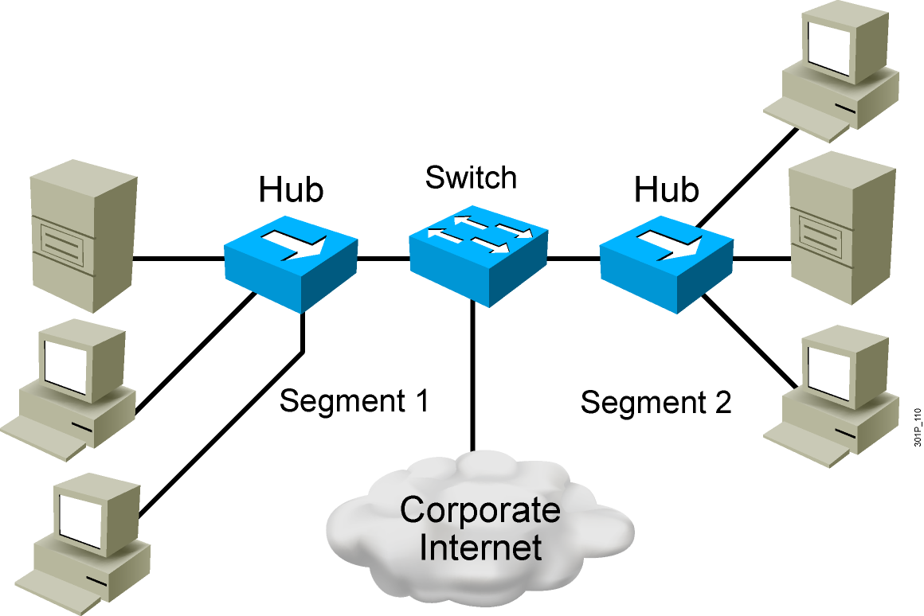
Switches Supersede Bridges
  Operate at Layer 2 of the OSI model
  Forward, filter, or flood frames
  Have many ports
  Are fast

Slide 7
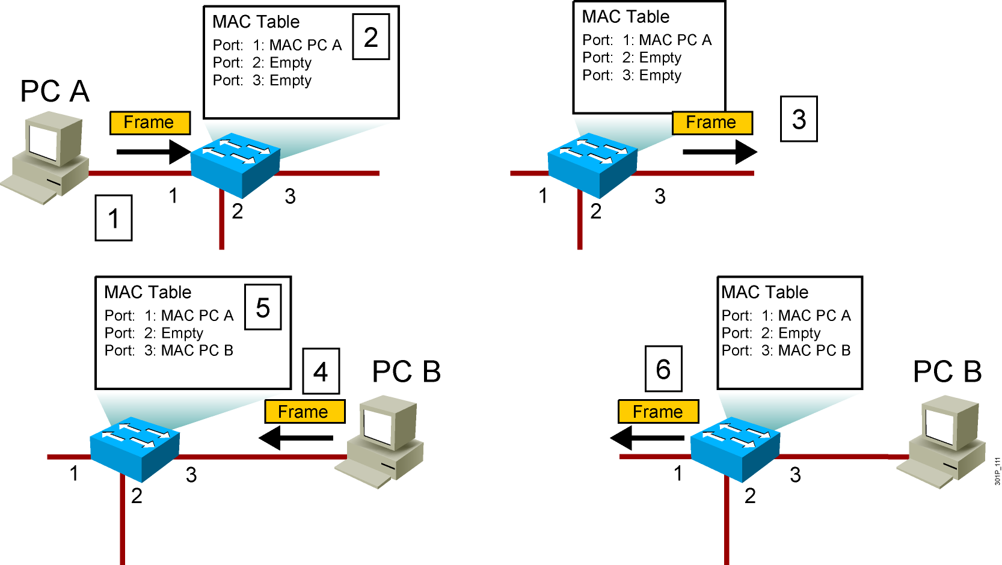
Switching Frames
Notes:
Lesson Aim
<Enter lesson aim here.>

Slide 8
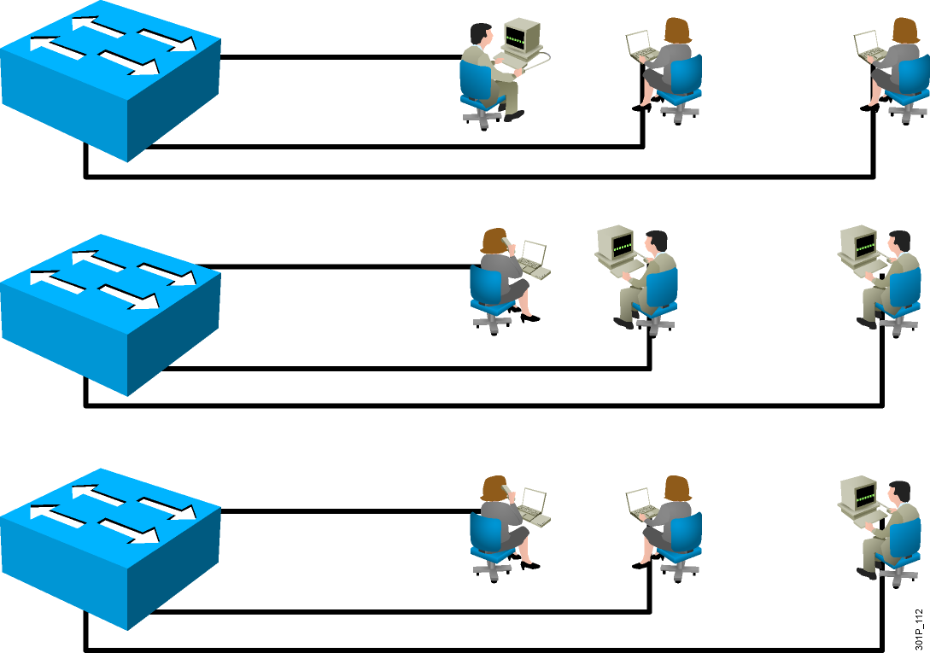
LANs Today
  Users grouped by physical location
  More switches added to networks
  Switches connected by high-speed links

Slide 9
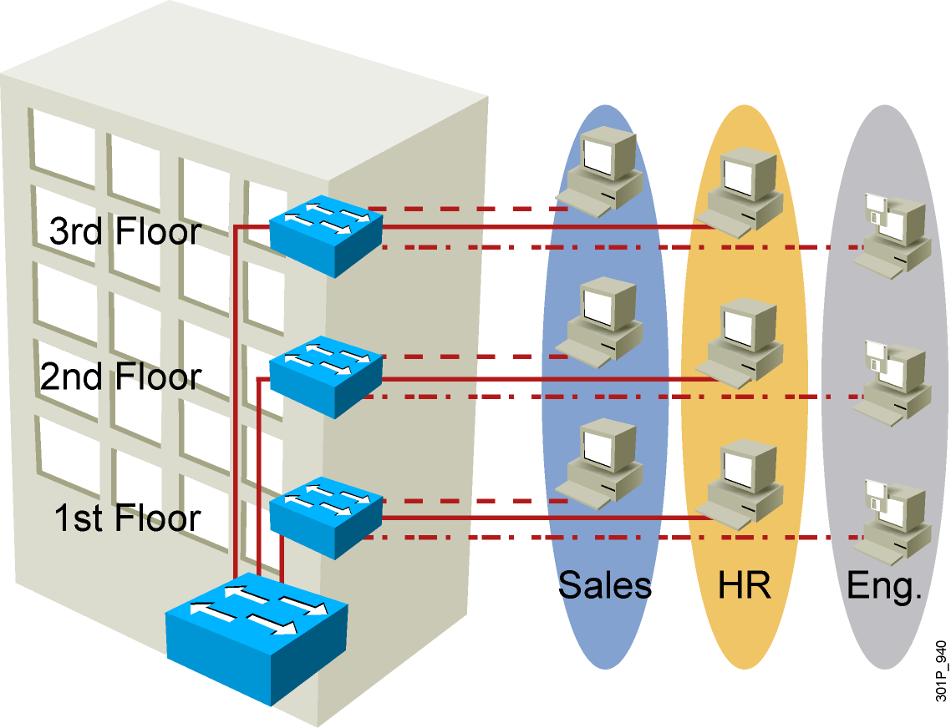
VLAN Overview
  Segmentation
  Flexibility
  Security
VLAN = Broadcast Domain = Logical Network (Subnet)
Notes:
Purpose:
Emphasize: A VLAN is a broadcast domain.
Note: In order to have inter-VLAN communications, a router is required.

Slide 10
Summary
  The most common causes of network congestion on an Ethernet LAN are increasingly powerful computer and network technologies; increasing volume of network traffic; and high-bandwidth applications, such as desktop publishing, e-learning, and streaming video
  Ethernet bridges were used to divide an Ethernet LAN into multiple segments. This arrangement prevented devices connected to one segment from experiencing frame collisions with devices on another segment, and also reduced network congestion
  Switches operate at much higher speeds than bridges, support high port density with large frame buffers, and provide faster internal switching. In addition, switches use one of two forwarding methods for switching data between network ports: cut-through switching or store-and-forward switching

Slide 11
Summary (Cont.)
  Switches offer greater benefits for eliminating network congestion than bridges by providing dedicated communication between devices, multiple simultaneous conversations, full-duplex communication, and media-rate adaptation
  Switches operate at Layer 2 of the OSI model, analyzing incoming frames and forwarding, filtering, or flooding them based on destination address information. Switches also collect and pass frames between two or more LAN segments, increasing the number of collision domains
  Switches build tables of known MAC addresses that are located on network segments and map them to associated ports. Switches then use the MAC addresses as they analyze frames

Slide 12
Summary (Cont.)
  In switched networks, how users are grouped is largely determined by their physical location. Many switches are used to allow each group to access the devices on the network, such as servers. Switches need to be interconnected by high-speed ports to maximize the overall performance of the network

