Slide 1
Wireless LANs
Understanding WLAN Security

Slide 2
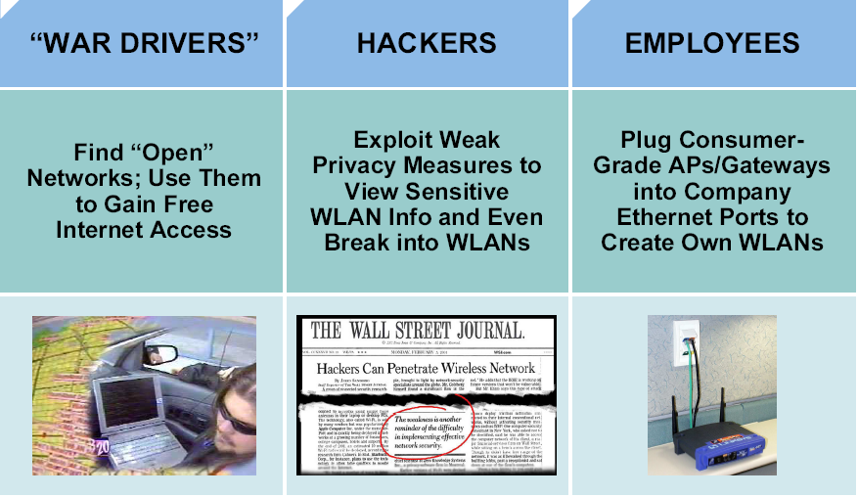
Wireless LAN Security Threats
Notes:
With the lower costs of IEEE 802.11b/g systems, it is inevitable that hackers will have many more unsecured WLANs from which to choose.
Incidents have been reported of people using numerous open source applications to collect and exploit vulnerabilities in the IEEE 802.11 standard security mechanism, Wired Equivalent Privacy (WEP).
Wireless sniffers enable network engineers to passively capture data packets so that they can be examined to correct system problems. These same sniffers can be used by hackers to exploit known security weaknesses.
“War driving” is a phrase that was originally used to describe someone who is using a cellular scanning device looking for cell phone numbers to exploit. War driving also refers to someone driving around with a laptop and an 802.11b/g client card looking for an 802.11b/g system to exploit.
Most wireless devices sold today are wireless network ready. End users often do not change default settings or they implement only standard WEP security, which is not optimal solution for secure wireless networks.
With basic WEP encryption enabled (or, obviously, with no encryption enabled), it is possible to collect data and obtain sensitive network information, such as user login information, account numbers, and personal records.
A rogue AP is an AP that has been placed on a WLAN and that might be used to interfere with normal network operations (DoS attacks, for example). If this rogue AP is programmed with the correct WEP key, client data may be captured. This AP may also be configured to provide unauthorized users with information about the network, such as MAC addresses of clients (both wireless and wired), the ability to capture and spoof data packets, and at worst, access to servers and files. A simple and common version of rogue AP are those employees unknowning install. Employees install access points intended for home use without the necessary security configuration on the enterprize network causing a security risk for the network.

Slide 3
Mitigating the Threats
Control and Integrity | Privacy and Confidentiality | Protection and Availability
Authentication | Encryption | Intrusion Prevention System (IPS)
Ensure that legitimate clients associate with trusted access points. | Protect data as it is transmitted and received. | Track and mitigate unauthorized access and network attacks.
Notes:
To secure a WLAN, the following steps are required:
- Authentication to ensure that legitimate clients and users access the network via trusted access points
- Encryption for providing privacy and confidentiality
- Protection from security risks and availability with intrusion detection and intrusion protection systems for WLANs
The fundamental solution for wireless security is authentication and encryption to protect the wireless data transmission. These two wireless security solution can be implemented in a various degrees, however both apply to SOHO and large enterprise wireless networks. Larger enterprise networks will need additional levels of security offered by Intrusion Detection Systems (IDS) monitor. Current IDS systems can not only detect wireless network attacks, but also provide basic mitigation against foreign clients and access points. Many enterprise networks use IDS not just for protection against outside threats, but mainly for unintentional unsecured access points installed by employees desiring the mobility and benefits of wireless.

Slide 4
Evolution of Wireless LAN Security
1997
2001
2003
2004 to Present
WEP
802.1x EAP
WPA
802.11i / WPA2
  Basic encryption
  No strong authentication
  Static,
  breakable keys
  Not scalable
  MAC filters and SSID-cloaking also used to complement WEP
  Dynamic keys
  Improved encryption
  User authentication
  802.1X EAP (LEAP, PEAP)
  RADIUS
  Standardized
  Improved encryption
  Strong, user authentication (such as, LEAP, PEAP, EAP-FAST)
  AES strong encryption
  Authentication
  Dynamic key management
Notes:
The figure shows the evolution of wireless LAN (WLAN) security.
Initially, IEEE 802.11 security only defined 64-bit static WEP keys for both encryption and if used authentication. The 64-bit key contained the actual 40-bit key plus 24-bit Initialization Vector (IV). The authentication method was not strong and the keys were eventually compromised. Because the keys were administered statically, this method of security was not scalable to large enterprise environments. Enterprise companies tried to supplement this weakness with techniques using SSID and MAC address filtering.
The SSID is a network-naming scheme and configurable parameter that both the client and the AP must share. If the client does not have the proper SSID advertised from the access point configured to not broadcast the SSID (SSID Cloaking), it is unable to associate with the AP and would have no access to the network. The problem with the effort was that 802.11 allows wireless client to use a null string (no value entered into the SSID field) thereby requesting that the AP to broadcast its SSID rendering the security effort ineffective. Access point also supported filtering using a MAC address. Tables are manually constructed on the AP to allow or disallow clients based upon their physical hardware address. However MAC addresses may be relatively easily spoofed and MAC address filtering is not considered a security feature either.
While 802.11 committee then began the process of upgrading the security of the WLAN, Enterprise customers needed wireless security immediately to enable deployment. Driven by customer demand, Cisco introduced early proprietary enhancements to RC4-based WEP encryption. Cisco implemented Cisco’s Temporal Key Integrity Protocol (CKIP) per-packet keying or hashing and Cisco’s Message Integrity Check (CMIC) to protect WEP keys. Cisco also adapted the use of IEEE 802.1X wired authentication protocols on wireless and dynamic keys using Lightweight EAP (LEAP) to a centralized database.
Soon after Cisco wireless security implementation, the Wi-Fi Alliance introduced Wi-Fi Protected Access (WPA) as an interim solution that was a subset of the expected 802.11i security standard for WLANs using 802.1X authentication and improvements to WEP encryption. The newer key hashing (TKIP versus CKIP) and message integrity check (MIC versus CMIC) where similar in feature but not compatible.
Today IEEE 802.11i has been ratified and Advanced Encryption Standard (AES) has replaced Wired Equivalent Privacy (WEP) as the latest and most secure method of encrypting data. Wireless intrusion detection systems are available to identify and protect the WLAN from attacks. The Wi-Fi Alliance certifies 802.11i devices under Wi-Fi Protected Access 2 (WPA2).

Slide 5
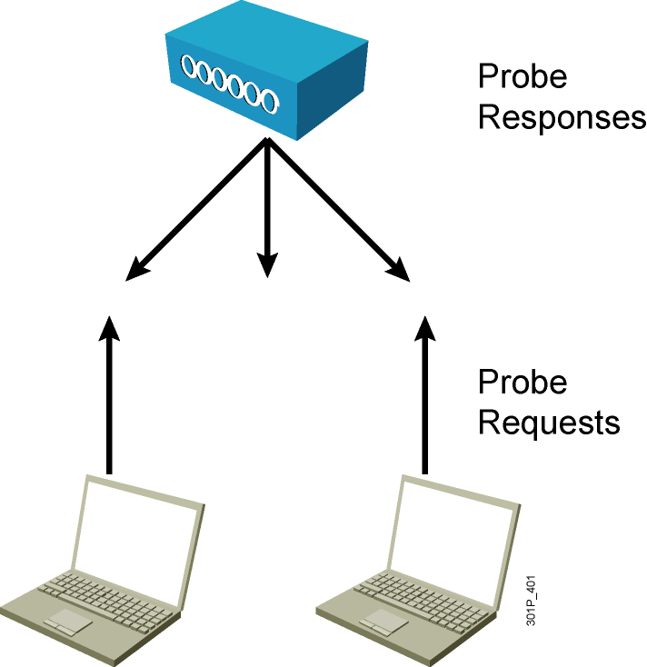
Wireless Client Association
  Access points send out beacons announcing SSID, data rates, and other information.
  Client scans all channels.
  Client listens for beacons and responses from access points.
  Client associates to access point with strongest signal.
  Client will repeat scan if signal becomes low to reassociate to another access point (roaming).
  During association, SSID, MAC address, and security settings are sent from the client to the access point and checked by the access point.
Notes:
Access points send out beacons announcing one or more SSIDs, data rates, and other information. The client scans all the channels and listens for beacons and responses from the access points. The client associates to the access point that has the strongest signal. If the signal becomes low, the client repeats the scan to associate with another access point (roaming). During association, the SSID, MAC address, and security settings are sent from the client to the access point and checked by the access point
Wireless client’s association to a selected access point is actually the 2nd of a two step process. Both authentication and association must occur in that order before an 802.11 client can pass traffic through the access point to another host on the network. Client authentication at this initial process is not the same as network authentication, entering username and password to get access to the network. Authentication is simply the first step (followed by association) between the wireless client and access point only to establish communication. The 802.11 standard only specified two different methods of authentication Open Authentication or Shared Key Authentication. Open authentication is simply the exchange of four hello type packets with no client or access point verification to allow ease of connectivity. Shared Key authentication uses a static defined WEP key know between the client and access point for verification. This same key may or may not be used to encrypt the actual data passing between wireless client and access point based on user configuration.

Slide 6
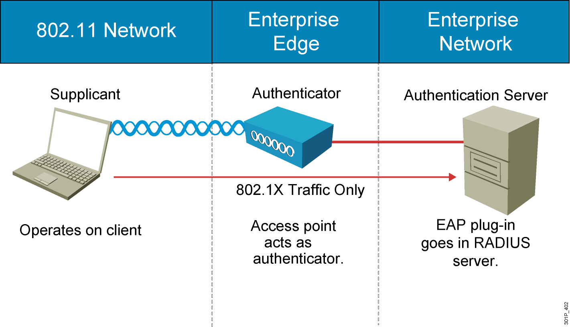
How 802.1X Works on the WLAN
Notes:
The access point, acting as the authenticator at the enterprise edge, allows the client to associate using open authentication. The access point then encapsulates any 802.1X traffic bound for the authentication server and sends it to the server. All other network traffic is blocked, meaning that all other attempts to access network resources are blocked.
Upon receiving RADIUS traffic bound for the client, the access point encapsulates it and sends the information to the client. Although the server authenticates the client as a valid network user, this process allows the client to validate the server as well, ensuring that the client is not logging into a phony server.
While an enterprise network will use a centralized authentication server, smaller offices or business might simply use the access point with preshared keys as the authentication server for wireless clients.

Slide 7
WPA and WPA2 Modes
 | WPA | WPA2
Enterprise mode (Business, education, Government) | Authentication: IEEE 802.1X/EAP Encryption: TKIP/MIC | Authentication: IEEE 802.1X/EAP Encryption: AES-CCMP
Personal mode (SOHO, home and personal) | Authentication: PSK Encryption: TKIP/MIC | Authentication: PSK Encryption: AES-CCMP
Notes:
WPA provides authentication support via IEEE 802.1X and Preshared Key (PSK) (IEEE 802.1X recommended for enterprise deployments). WPA provides encryption support via TKIP. TKIP includes message identity check (MIC) and per-packet keying (PPK) via initialization vector (IV) hashing and broadcast key rotation.
In comparison to WPA, WPA2 authentication is not changed but encryption used is AES-CCMP.
Enterprise Mode
Enterprise Mode is a term given to products that are tested to be interoperable in both PSK and IEEE 802.1x/EAP modes of operation for authentication. When IEEE 802.1x is used, an authentication, authorization, and accounting (AAA) server (the RADIUS protocol for authentication and key management and centralized management of user credentials) is required. Enterprise Mode is targeted to enterprise environments.
Personal Mode
Personal Mode is a term given to products tested to be interoperable in the PSK-only mode of operation for authentication. It requires manual configuration of a pre-shared key on the AP and clients. PSK authenticates users via a password, or identifying code, on both the client station and the AP. No authentication server is needed. Personal Mode is targeted to SOHO environments.

Slide 8
Summary
  It is inevitable that hackers will attack unsecured WLANs.
  The fundamental solution for wireless security is authentication and encryption to protect wireless data transmission.
  WLAN standards evolved to provide more security.
    WEP
    802.1x EAP
    WPA
    802.11i/WPA2
  Access points send out beacons announcing SSIDs, data rates, and other information.

Slide 9
Summary (Cont.)
  With 802.1X, the access point, acting as the authenticator at the enterprise edge, allows the client to associate using open authentication.
  WPA provides authentication support via IEEE 802.1X and PSK.
    Enterprise mode is a term given to products that are tested to be interoperable in both PSK and IEEE 802.1x/EAP modes of operation for authentication.
    Personal mode is a term given to products tested to be interoperable in the PSK-only mode of operation for authentication.

