Slide 1
On My Disk
User Manual & Feature Guide
Your Private Personal Cloud

Slide 2

Privacy First Cloud
A decentralized cloud platform where your data stays with you.
• Private: No corporate servers holding your files.
• Secure: Full control over access and encryption.
• Local: Works directly with your real file system.

Slide 3
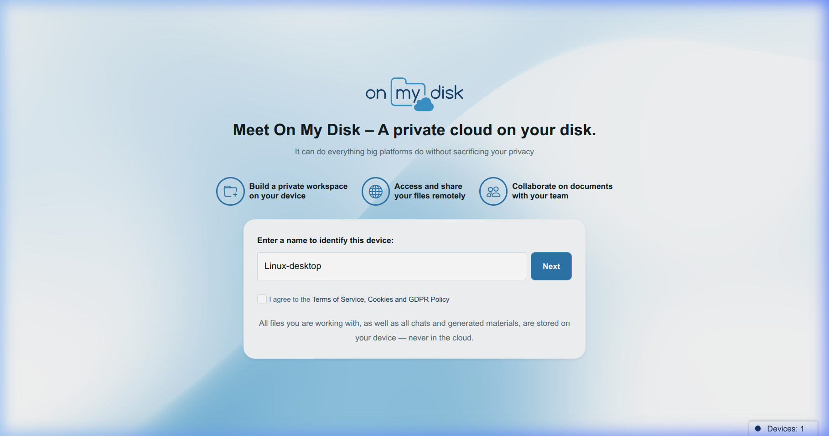
Seamless Onboarding
Three ways to start your journey:
1. Anonymous: Instant setup, browser-based storage.
2. Google OAuth: Reliable cross-device sync.
3. OMD Account: Secure native registration.

Slide 4
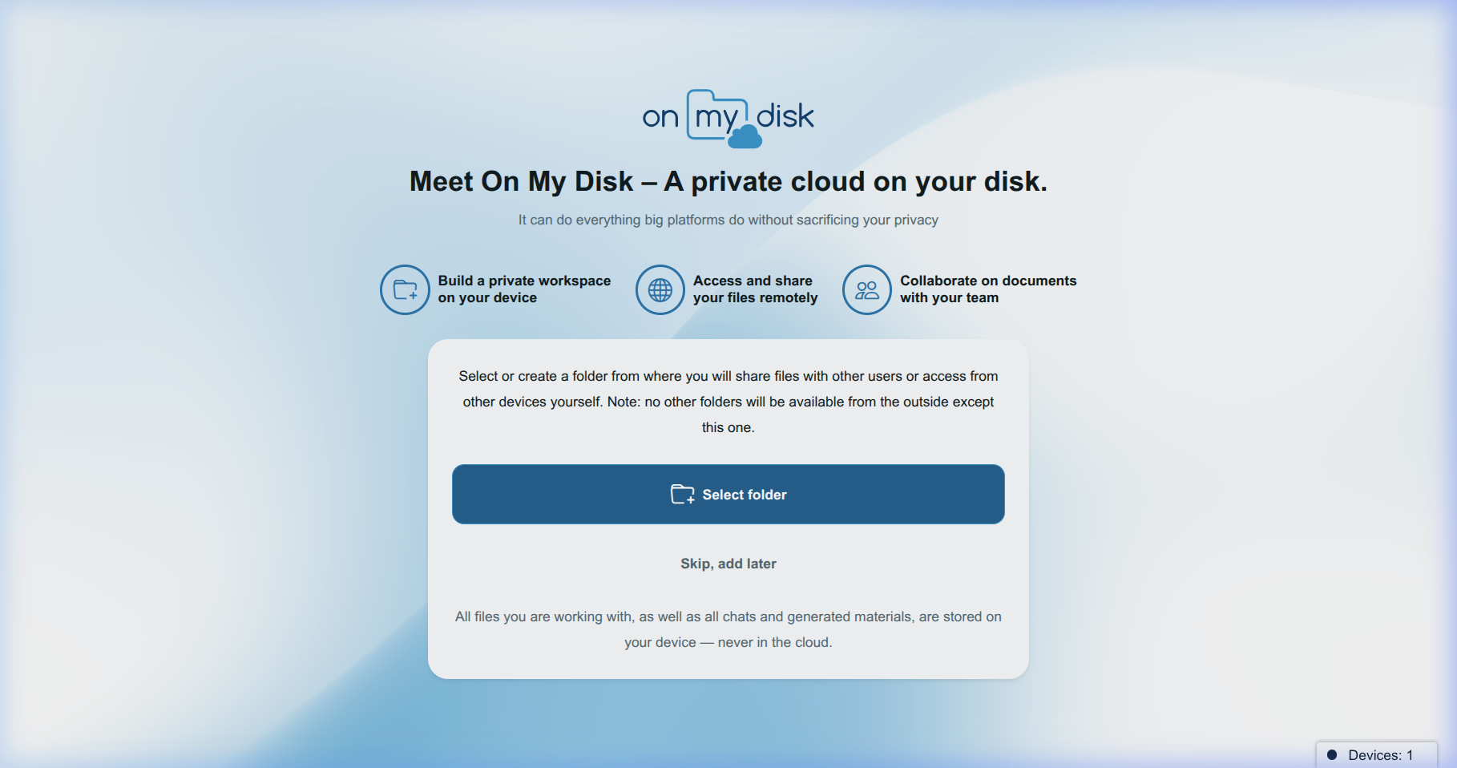
Turn Folders into Cloud
Connect any local folder to your cloud:
• Add folders during setup or via the '+' icon.
• Folders appear instantly on all your devices.
• Native filesystem access – no syncing delays.

Slide 5
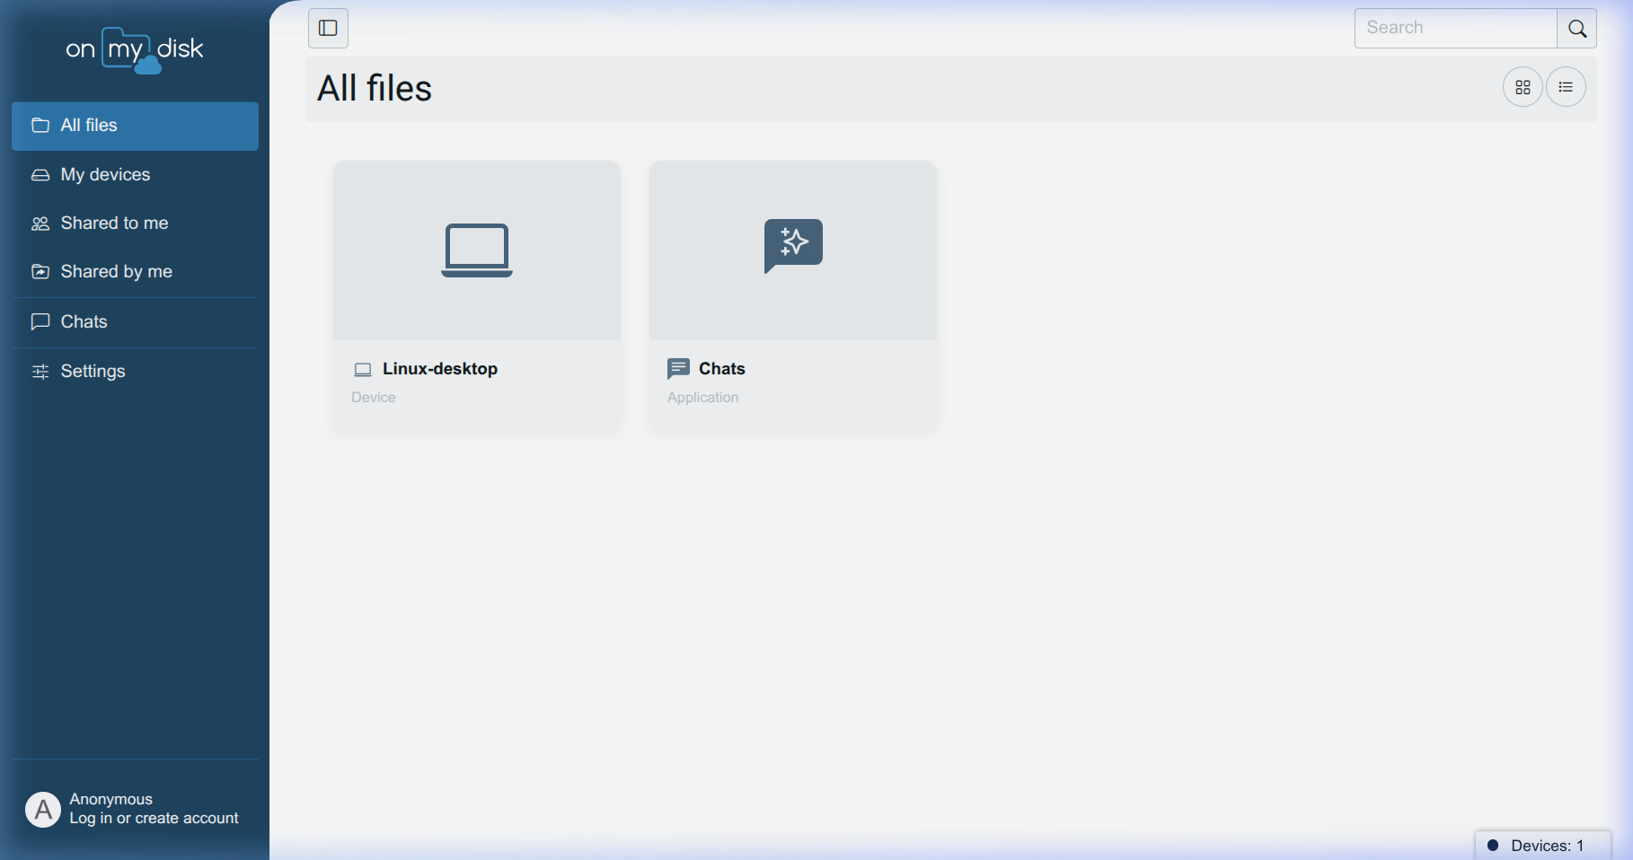
Intuitive File Manager
Manage your data with ease:
• All Files: Unified view of all devices.
• Operations: Right-click for Rename, Move, Copy, Delete.
• Built-in Viewer: PDF, Images, Video, and Docs.

Slide 6
Advanced Link Sharing
Share safely with anyone:
• Password Protection: Secure your sensitive links.
• Expiration Dates: Links auto-revoke after set time.
• Permission Control: Allow view-only or full editing.

Slide 7
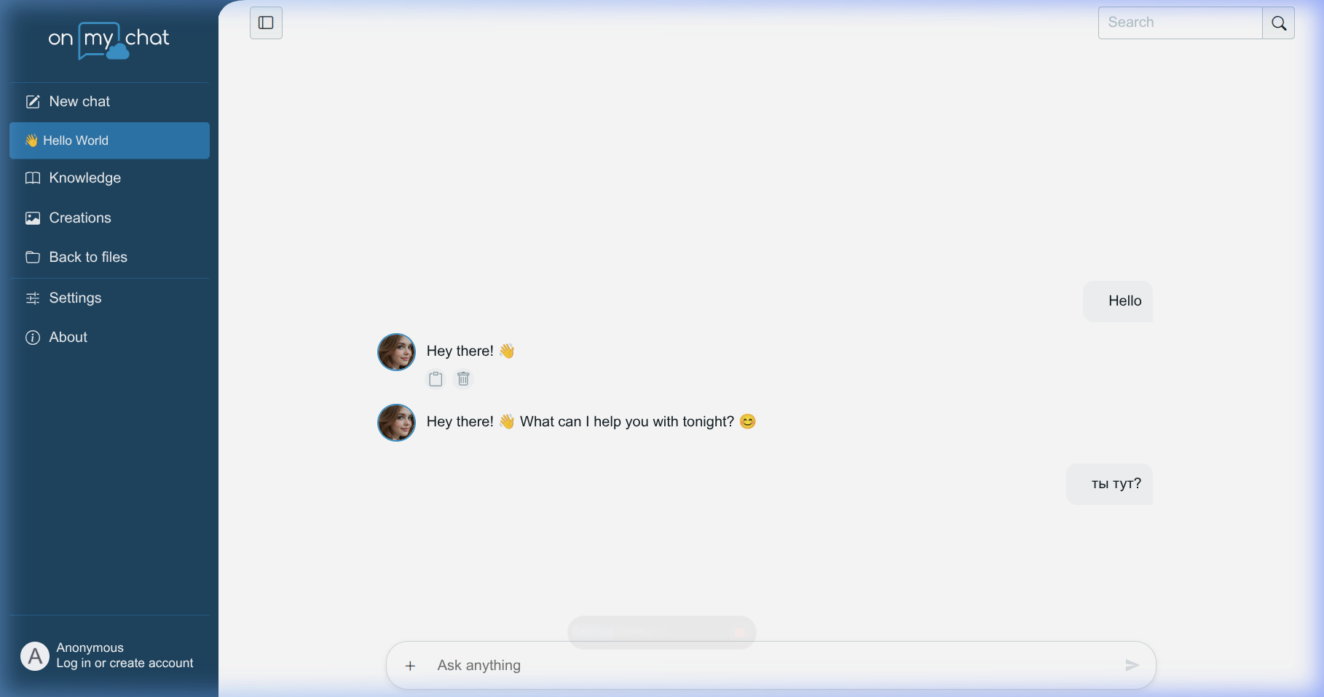
OnMyChat: Your Local AI
AI that lives on your data:
• Knowledge: Ask questions about your own files.
• Creations: Generate images and short videos.
• Private: No data leaves your network for processing.

Slide 8
Summary
Experience the freedom of On My Disk.
• Full Ownership of your data.
• Seamless Access across all devices.
• Empowered by Local AI.

