Slide 1
Microservices architecture
Describes building microservices main points and peculiarities

Slide 2
SOA is Microservices origin
SOA - service oriented architecture:
there isn’t any strict standard;
it is an approach to build information systems;
it alleviates building systems with a complex domain area and helps to add new domains to an existing system.
SOA main principals
independent services, exposing contract and schema;
clients interact to services by means of interfaces;
services interact to internal services by means of interfaces;
services do not share implementation. They share interfaces and schema, so the boundaries are explicit;
each service serves a particular domain area;
services are loosely coupled and autonomous (ideally, interfaces are totally decoupled off their external and internal surroundings. The compromise is that such interface may be more chatting and less scalable).

Slide 3
Microservices
developing an application as a suite of small services;
each service is in its own process;
each service has its own DB (if needed);
really autonomous;
communication happens via a lightweight platform independent RESTful mechanism using an open standard (often via Http);
each service provides a business capability, not a single responsibility, which is the Nanoservice anti-pattern;
deployment is fully automated;
there is a bare minimum of centralized management;
different platforms may be used for different services.

Slide 4
Microservices vs. SOA
Feature | SOA | Microservices
Explicit boundaries | + | +
Services are autonomous | +- (to some extent) | ++ (independent deployment, DB and hosting)
Services share their schema and contract, not an implementation | + | +- (there is no any standard way to share a contact and a schema, however, any implementation is not shared)
Automated deployment and centralized management | ? (optional) | + (fully automated deployment)
Independent deployment | +- (to some extent) | +
Decoupling | + | ++
Cohesion (serving a number of responsibilities, which have a lot in common) | +- | ++

Slide 5
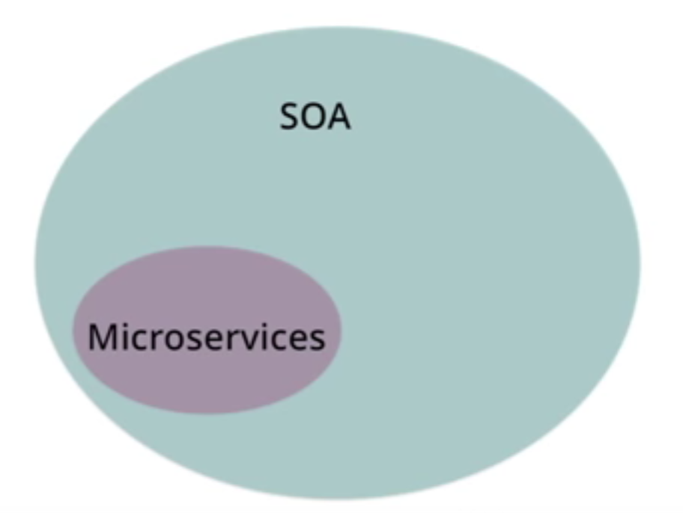
The core differences are in size and scope
A SOA service can be a monolith or can be comprised of multiple microservices. So, SOA is a superset of microservices.
Martin Fowler comparison: https://youtu.be/wgdBVIX9ifA?t=13m10s

Slide 6
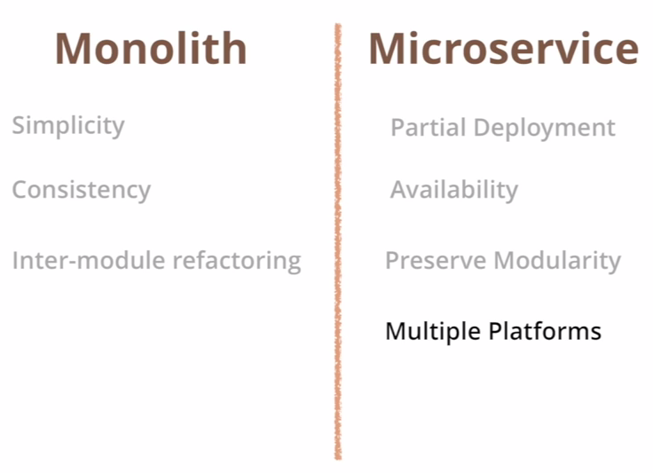
Microservices vs monolith

Slide 7
Decoupling microservices off each other
How services are coupled depends on the form of inter-service communication.
Synchronous - REST HTTP. It is the simplest way to reuse the same end-points and approach, which clients use. May be accelerated by using Protobuff or Messagepack.
Asynchronous - Lightweight messaging
Doable by using a message broker: Redis, RabbitMQ, ZeroMQ. Leads to better decoupling, but has some concerns:
takes more effort to implement;
usually is not transactional, so we deal with temporarily inconsistency.
Has two varieties: choreography and orchestration.

Slide 8
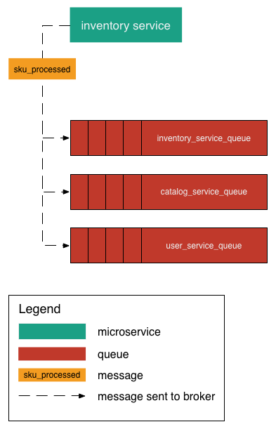
Choreography approach to the communication
One type of message is produced to all queues.
Can be reached by either:
making inventory service aware of all queues it needs to update on incoming SKU;
using message broker’s capabilities for “automatic” dispatching across right set of queues.
Producer of the message doesn’t have to know what other service supposed to do, it just provides an event, to which consumers may respond or may not.

Slide 9
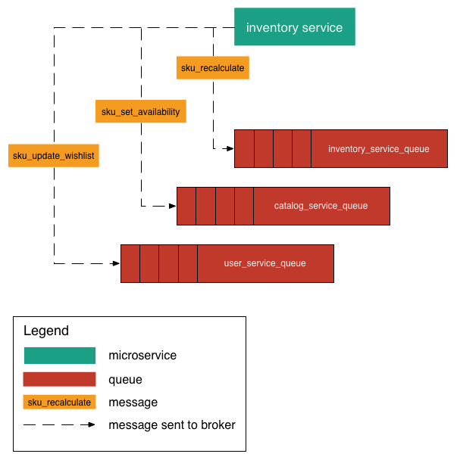
Orchestration approach to the communication
Primary message handler sends different messages to different queues instead of a single one. This approach leads to more coupled design, cause services have some knowledge about what happens on some event.

Slide 10
Microservices guidlines
Overall template guidelines
http://confluence/display/ART/Service+Template
Naming convention
should be: Conf.X.Y where X is the service / clients name and Y is one of Client / Service
http://confluence.firmglobal.com/display/ART/Service+Names
Root route
should be: api/X, where X is the service name. Prefix ‘api’ helps to distinguish Web services off MVC pages.

Slide 11
Root controller
There should be one controller, handling GET requests to the ‘api/X’ URL. It should return service version, description and links to resources.
{
"id": "Conf.RuntimeSurveyVariablesCache.Service",
"links": {
"self": "/api/zzz/",
"spec": "/api/zzz/swagger“,
"warmup": "/api/zzz/warmup“,
“healthcheck": "/api/zzz/health“
}
}
Root should respond to a not identificated user with 401 code and links. Also, swagger should be behind a config setting. HealthCheck should return service status: ready/loaded.

Slide 12
Links
We want to meet maturity “Level 3” requirements, so we return “Links” list from each GET action. If clients relay on them, it facilitates moving of resources without breaking such clients.
http://confluence.firmglobal.com/display/ART/Service+Template
{
"id": "Conf.Reporting.Service",
"links": {
"self": "/api/reporting",
"projects": "/api/reporting/projects",
"projectBoards": "/api/reporting/projectBoards",
"reports": "/api/reporting/reports",
"responses": "/api/reporting/hubs",
"spec": "/api/reporting/swagger",
"warmup": "/api/reporting/warmup"
}
}

Slide 13
Links should be relative. Could be implemented like these:
new UrlHelper(Request).RouteWith("ApiRootRoute", null, "swagger")
public static class UrlHelperExtensions
{
public static string RouteWith(this UrlHelper uri, string routeName, IDictionary<string, object> routeValues, params string[] paths)
{
return paths.Aggregate(uri.Route(routeName, routeValues), (current, path) => string.Format("{0}/{1}", current.TrimEnd('/'), path.TrimStart('/')));
}
}
POST actions add a resource and they should return “Location” header with a link to a new resource:
CreatedAtAction("GetUser", new { id = userId }, userReponseModel) – where “GetUser” is a route name.

Slide 14
Response format
Web API uses content format negotiation. Client passes the header: “Accept: application/json, text/javascript, */*; q=0.01”, Web API has ContentNegotiator service, which finds a supported format with highest priority and returns a formatter.
We are going to support only JSON responses, but with our custom settings.
public class SerializerSettings
{
public static JsonSerializerSettings GetJsonSerializerSettings()
{
var settings = new JsonSerializerSettings
{
Formatting = Formatting.None,
TypeNameHandling = TypeNameHandling.Auto,
DefaultValueHandling = DefaultValueHandling.Include,
NullValueHandling = NullValueHandling.Ignore,
DateFormatHandling = DateFormatHandling.IsoDateFormat,
DateTimeZoneHandling = DateTimeZoneHandling.Utc,
ReferenceLoopHandling = ReferenceLoopHandling.Ignore
};
settings.Converters.Add(new StringEnumConverter { CamelCaseText = false });
settings.ContractResolver = new CamelCasePropertyNamesContractResolver();
return settings;
}
}

Slide 15
To apply that, we have to remove default formatters off HttpConfiguration and add our customized.
config.Formatters.Clear();
config.Formatters.Add(new JsonDefaultFormatter());
config.Formatters.Add(new JsonIdentedFormatter());
I suggest adding Idented and Nonidented formatters and choosing one using a custom ContentNegotiator.
config.Services.Replace(typeof(IContentNegotiator), new JsonContentNegotiator(excludeMatchOnTypeOnly: true));
If a client adds “indented” query string parameter: “http://localhost/RamblerCinema_ApiTest/api?idented=1” we may choose an indented formatter.
It safes some traffic.

Slide 16
public class JsonContentNegotiator: DefaultContentNegotiator
{
public JsonContentNegotiator ()
: this(false)
{
}
public JsonContentNegotiator (bool excludeMatchOnTypeOnly): base(excludeMatchOnTypeOnly)
{
}
public override ContentNegotiationResult Negotiate (Type type, HttpRequestMessage request, IEnumerable<MediaTypeFormatter> formatters)
{
var res = base.Negotiate(type, request, formatters);
if (res.Formatter is JsonDefaultFormatter && request.GetQueryStrings().ContainsKey("idented"))
{
var fmtIdented = formatters.FirstOrDefault(f => f.GetType() == typeof (JsonIdentedFormatter));
if (fmtIdented != null)
res.Formatter = fmtIdented;
}
return res;
}
}

Slide 17
An another important point is setting automatic TypeNameHandling. It facilitates deserializing nested objects and collections when the type is not obvious. E.g. a field has a base type or an interface type, but we serialized a derived type. In this case we may implement a custom type name resolver and custom serializer.
This facilitates receiving deserialized typed object tree instead of a JSON dictionaries hierarchy.
BTW, this concern may be eliminated by means of implementing well-grained DTOs, which use concrete derived types for fields and do not use any base, abstract or interface type.
So, we end up with a choice:
to use well-grained DTOs for requests and responses;
to use a custom serializer and type resolver along with TypeNameHandling = TypeNameHandling.Auto.

Slide 18
Documenting
REST services do not have any standard way to expose their contract and schema unlike to regular RPC Web services, which use WSDL. So, there is a need to expose some documentation for developers. There is an open Swagger standard and it is implemented for .Net in Swashbuckle Nuget package.
Plugging in Swashbuckle is straightforward:
install Swashbuckle.Core package;
plug it in as an OWIN middleware component;
In project properties turn on generation of XML comments.
As the result, we get a rich Html documentation on /YourService/api/swagger/ URL.

Slide 19
static class SwaggerConfig
{
public static void Register (HttpConfiguration config)
{
config.EnableSwagger(c =>
{
c.SingleApiVersion(VersionHelpers.GetProductVersion(Assembly.GetExecutingAssembly()), "Rambler Cinema API")
.Description("REST api serving cinema film sessions")
.Contact(cc => cc.Name("Rambler Team"));
c.RootUrl(req => req.RequestUri.GetLeftPart(UriPartial.Authority) + req.GetRequestContext().VirtualPathRoot.TrimEnd('/'));
c.IncludeXmlComments($"{AppDomain.CurrentDomain.BaseDirectory}\\bin\\{Assembly.GetExecutingAssembly().GetName().Name}.XML");
c.UseFullTypeNameInSchemaIds();
c.ResolveConflictingActions(apiDescriptions => apiDescriptions.First());
})
.EnableSwaggerUi(c => c.DisableValidator());
}
}

Slide 20
Request/response DTOs
Wrapping input arguments and result into DTOs is a good style. It is especially important for response, cause provides some information to Swagger to generate a meaningful documentation. It is important to decorate actions with ResponseType attribute:
[ResponseType(typeof(ServiceInfo))]
public IHttpActionResult Get ()
{
return Ok(new ServiceInfo()
{
ApplicationName = "Rambler.Cinema service",
ApiVersion = VersionHelpers.GetProductVersion(GetType().Assembly),
Links = new { Self = Url.Route("ApiRootRoute", null) }
});
}
It is important to notice that returning IHttpActionResult is a newest recommendend way.

Slide 21
Request model validation
There is a couple of concerns regarding that:
validating values correctness;
validating request model (DTO) constraints;
validating whether route/parameter IDs exist (e.g. /api/customers/225/orders?categoryID=562).
Concern “1” ensures not only that all the arguments have correct values, but in addition it protects off “false” empty arguments. Some parameter binders may return empty value on bad format. To prevent that specify TypeConverterModelBinder:
public IEnumerable<QuestionModel> GetQuestions(
[FromUri] ProjectId projectId,
[FromUri(BinderType = typeof(TypeConverterModelBinder))] bool isAsync = false,
[FromUri(BinderType = typeof(TypeConverterModelBinder))] EntityIds entityIds = null,
[FromUri(BinderType = typeof(TypeConverterModelBinder))] string matchPattern = null,
[FromUri(BinderType = typeof(TypeConverterModelBinder))] string questionTypes = null,
[FromUri(BinderType = typeof(TypeConverterModelBinder))] string variableTypes = null,
int skip = 0,
int take = 50)

Slide 22
If you do not specify BinderType, Web API looks for an existing type convertor, then, if there is no any, uses a default binder (??) .
In the previous example we anticipate ProjectId looking as “p123456”, and to validate that we use a custom type convertor.
[TypeConverter(typeof(ValueObjectConverter<ProjectId>))]
public class ProjectId : ValueObjects.ValueObject<ProjectId>
{
internal static readonly Regex MatchRegEx = new Regex(@"p\d+", RegexOptions.Compiled);
protected override Regex ValidationRegEx { get { return MatchRegEx; } }
public static implicit operator ProjectId(string value) { return new ProjectId { Value = value }; }
public static implicit operator string(ProjectId value) { return value == null ? null : value.Value;}
public override string ToString() { return Value; }
}

Slide 23
Validating request DTO
ComponentModel.DataAnnotations help to enforce constraints:
public class Product
{
[Range(0, 5000)]
public int ProductID { get; set; }
[Required]
public string ProductName { get; set; }
[Min(0.1)]
public double ListPrice { get; set; }
[EnumDataType(typeof(ProductColor))]
public ProductColor Color { get; set; }
}

Slide 24
Model state is available in any action as ModelState.IsValid and it may be used explicitly. In order to not pollute the code we prefer to plug in automatic implicit model validation by means of a message filter.
[AttributeUsage(AttributeTargets.Class | AttributeTargets.Method, AllowMultiple = false, Inherited = true)]
public class InvalidModelStateFilterAttribute: ActionFilterAttribute
{
public override void OnActionExecuting (HttpActionContext actionContext)
{
if (actionContext.ModelState.IsValid)
return;
actionContext.Response = actionContext.Request.CreateErrorResponse(HttpStatusCode.BadRequest, actionContext.ModelState);
}
}
The filter may be plugged in to HttpConfiguration:
static class WebApiConfig
{
internal static void Configure (HttpConfiguration config)
{
//Adding for each action request DTO validator
config.Filters.Add(new InvalidModelStateFilterAttribute());
}
}

Slide 25
Validating route/parameter IDs for existing (route constraint)
May be done explicitly in each action, but we prefer not to pollute the code, so there are two options:
to use routing constraints;
to use dispatchers.
routes.MapRoute(
“Model",
“api/{Make}/{Model}",
new {controller=“Model"}, //defaults
new {makeModelConstraint = new MakeModelRouteConstraint()} //here is the dictionary of constraints
);
Here we need to validate car “Make” and “Mode”. Also, we want to use names instead of IDs to work with human-readable URLs, so, to have it working transparently for the actions, we have not only validate them, but in addition to substitute names by IDs.
To accomplish that we implement a constraint validator listed below.

Slide 26
public class MakeModelRouteConstraint : IRouteConstraint
{
public bool Match(HttpContextBase httpContext, Route route, string parameterName, RouteValueDictionary values, RouteDirection routeDirection)
{
if (routeDirection == RouteDirection.UrlGeneration) return true;
values = Decode(values);
string make = (string)values["Make"];
string model = (string)values["Model"];
using (var db = new CarQuotesDataContext())
{
var any = (from m in db.NewCarModels
where m.NewCarMake.Name == make && m.Name == model && m.IsActive
select m.NewCarModelId).Any();
if (!any) return false;
Routing.SetParameter("Make", make);
Routing.SetParameter("Model", model);
return true;
}
}
}

Slide 27
Validating route/parameter IDs for existing (dispatchers)
Dispatchers are delegating handlers, that are executed before your action. They may be plugged in at Web Api configuring:
HttpMessageHandler affiliateShipmentsPipeline =
HttpClientFactory.CreatePipeline(
new HttpControllerDispatcher(config),
new[] { new AffiliateShipmentsDispatcher() });
routes.MapHttpRoute(
"AffiliateShipmentsHttpRoute",
"api/affiliates/{key}/shipments/{shipmentKey}",
defaults: new { controller = "AffiliateShipments", shipmentKey = RouteParameter.Optional },
constraints: new { key = new GuidRouteConstraint(), shipmentKey = new GuidRouteConstraint() },
handler: affiliateShipmentsPipeline);

Slide 28
public class AffiliateShipmentsDispatcher : DelegatingHandler {
protected override Task<HttpResponseMessage> SendAsync(
HttpRequestMessage request,
CancellationToken cancellationToken) {
// We know at this point that the {key} route variable has
// been supplied. Otherwise, we wouldn't be here. So, just get it.
IHttpRouteData routeData = request.GetRouteData();
Guid affiliateKey = Guid.ParseExact(routeData.Values["key"].ToString(), "D");
IShipmentService shipmentService = request.GetShipmentService();
if (shipmentService.GetAffiliate(affiliateKey) == null) {
return Task.FromResult(
request.CreateResponse(HttpStatusCode.NotFound));
}
return base.SendAsync(request, cancellationToken);
}
}

Slide 29
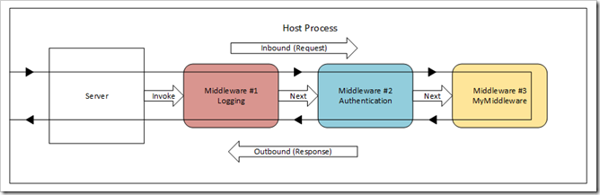
Using Owin Middleware
It is an approach to making a reusable service core. It facilitates plugging your component into Owin pipeline and mapping to an URL.
Owin expects from a component following the interface, shown below.

Slide 30
public class MiddlewareComponent
{
AppFunc _next;
public MiddlewareComponent(AppFunc next)
{
_next = next;
// ...Other initialization processing...
}
public async Task Invoke(IDictionary<string, object> environment)
{
// ...Inbound processing on environment or HTTP request...
// Invoke next middleware component:
await _next.Invoke(environment);
// ...outbound processing on environment or HTTP request...
}
}

Slide 31
To implement your service core as a pluggable Owin component, you have to provide IAppBuilder extension method, which is expected to be used at configuration stage as follows:
[assembly: OwinStartup(typeof(Rambler.Cinema.IisHost.Startup))]
namespace Rambler.Cinema.IisHost
{
public class Startup
{
public void Configuration(IAppBuilder app)
{
app.Map("/api", bld =>
{
bld.UseRamblerCinema(new RamblerCinemaServiceOptions(new WindsorDependencyResolver(container))
{
ExceptionHandler = new WebApiExceptionHandler(),
ExceptionLogger = new WebApiExceptionLogger(container.Resolve<IExtendedLoggerFactory>().CreateExt(LoggerNames.UnhandledExc))
});
});
}
}
}

Slide 32
The key point is that inside you create a scoped HttpConfiguration and configure Web API, filters and routing as you need. And this configuration will not conflict to other components. A second point is that you specify Owin pipeline stage where your component is executed at.
public static class CinemaServiceAppBuilderExtensions
{
public static void UseRamblerCinema (this IAppBuilder app, RamblerCinemaServiceOptions opt)
{
if (app == null)
throw new ArgumentNullException(nameof(app));
var configuration = new HttpConfiguration();
SwaggerConfig.Register(configuration);
app.UseWebApi(configuration);
app.UseStageMarker(PipelineStage.MapHandler);
}
}

Slide 33
Alternative to Owin Middleware
Some teams relay on the bunch: NodeJS + ES6 + Typed Script to implement REST micro-services. The benefit is that NPM packages really thrive and new versions are issued more frequently than NuGet packages. BTW, they have to coupe with poor OOD support in JS and to leverage Typed Script to make classes. However, ES6 significantly improves the situation.

Slide 34
Microservice data base
Microservices should not share a database and should not depend on other databases. It causes leaking out abstractions and violates independent deployment conception. It is a bad style, when one Microservices uses a linked DB server to access other service’s DB directly. The main benefit is in data isolation and independent maintenance and deployment, however, we loose table joins and we have to minimize them and to accomplish programmatically, at the service API level, if we can’t avoid some joins.
Deploying Microservice DB is described in Confluence: http://confluence/display/ART/How+to+deploy+your+Microservice+with+it's+own+database
There is a good solution for DBs, developed by CAT. It involves consuming Conf.DatabaseUpdateUtility and Conf.DatabaseUpdateTest NuGet packages and facilitates maintaining your DB as a Visual Studio DB project. In turn, these utilities build DB-step SQL files against your DB-project and ensure safe resolving of any conflicts when multiple developers work on the project.

Slide 35
Building Microservice
There should be used a build script against Psake build automation PowerShell script.
For today, the PSake tool hasn’t completed yet and configuration hasn’t separated. It is a subject to change.

Slide 36
Monitoring and Load balancing
It is supposed to accomplish by aid of Consul:
https://www.consul.io/
https://github.com/PlayFab/consuldotnet
https://github.com/hashicorp/consul
Services use Consul client to announce themselves, Consul provides a proxy and handles load balancing, service discovering and health monitoring.
For now there is only some probation, so the approach is a subject to change.

Slide 37
Alleviating NuGet packages creation
Each service needs Octopus deployment package. Visual Studio 2015 along with installed ASP.Net 5 RC and Framework 4.6 boosts creation NuGet packages without any third party tools. There is a new “Class Library (package)” template for that.
Here is an example of a package:
Also, we have established our NuGet feeds: http://nugetosl/feeds
Including “conf-beta” and the process for developing new packages locally, with use of a local folder and Octopus local test deployment for Microservices, which is described here:
http://confluence.firmglobal.com/display/ART/Octopus+Deploy+Task+Force
An approval process for new packages has been established:
http://confluence.firmglobal.com/display/ART/Approval+process+for+new+NuGet+packages

Slide 38
Deployment into service containers
Each microservice usually needs some environment such as local DB and so on. Also, there should be a number of equal copies of a service to meet fault tolerance requirement. To alleviate that there was developed the Service Container approach. We suppose to use Docker:
https://www.docker.com/
where the developer can create a service image with configured and initialized environment and all other products, which his service requires. And, then, the service can be distributed via this image.

Slide 39
Security
We aim to use Identity service, which has an Owin middleware for consuming that, which resides in Conf.Identity NuGet package. Plugging in is accomplished by calling coreApp.UseConfBarrierTokenAuthentication() on IAppBuilder. There planned an API extension on August 2016. Anders Johan and Arnulf Krokeide are the persons in charge for.
Only some Oauth scenarios have been implemented yet, so, if you need some extra scenarios wait to August or borrow an experience from xxx , who implemented a facade for Authoring, which supports additional scenarios for Java Script.
Authenticating users in tests is described here: http://confluence/pages/viewpage.action?pageId=30933691

Slide 40
API Versioning
Should be introduced in case of API breaking changes. Should work by means of Accept/ContentType http header.
string.Format("application/vnd.conf.{0}+{1}{2}", vendorSpecifics.Domain, mediaType == MediaType.Json ? "json" : "xml", versionString);
Some actions may change response schema depending on the requested API version. To accomplish that, the client should pass desirable version in Accept/ContentType, actions in turn should parse this header and vary behavior and response schema for different versions.

Slide 41
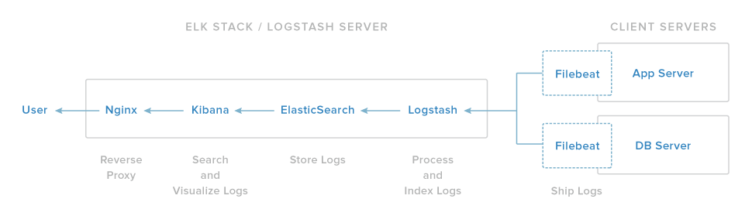
Logging
Involves using Con.Logging package, which keeps text-logs in a predefined folder. That folder will be monitored by Kibana, which should be configured for particular files using Elastic Search queries.
Legacy applications write loosely formatter text logs, new logs are in JSON. ELK provides centralized collecting system to store all the logs from different sources in one location and to search through them and to create instant reports in dashboards.
Logstash – is a light-weight service for parsing and transforming logs, including poorly formatted ones, in order to get them ready for importing into Elastic Search. It has lots of plugins to parse different formats and can connect to many sources: files, syslog, redis and so on. It provides an extensible subset of filters. The most valuable is Grok filter: it is a Regular Expressions engine to handle arbitrary text. Also, LogStash not only may read log from files, it supports many transport protocols, including TCP/IP.

Slide 42
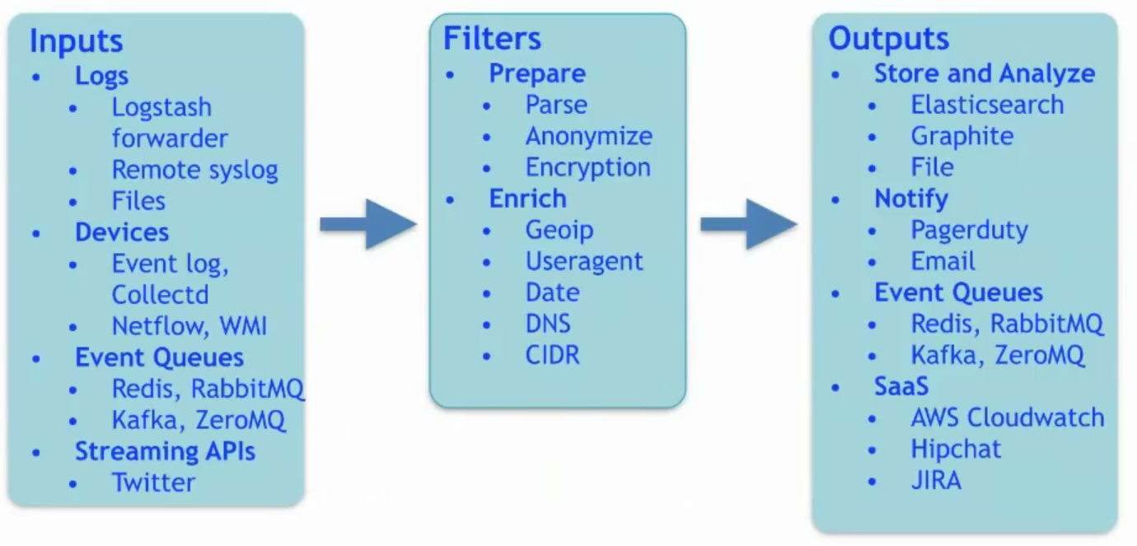

Slide 43
We do not use LogStash to parse our logs, instead, we relay on NxLog shipper, which is installed everywhere near to logs and is configured to send out formatted JSON logs to LogStash. LogStash acts as an relay and resends logs to Elastic Search, which stores them.
NxLog community edition is free and may be installed as a service from here: http://nxlog.org/. It is implemented in “C” and has a modular structure.
To configure it for new Conf JSON logs we need to plug in parsers and shippers:

Slide 44
1. Parsers and shippers
<Extension json>
Module xm_json
</Extension>
<Extension charconv>
Module xm_charconv
AutodetectCharsets utf-8, utf-16, utf-32, iso8859-2
</Extension>
<Output logstash>
Module om_tcp
Host %ConfLogDestinationAddress%
Port %ConfLogDestinationPort%
</Output>
<Output debugout>
Module om_file
File '%ROOT%\data\nxlog_debugout.txt'
</Output>

Slide 45
2. Then, to configure log sources:
<Input access_logs>
Module im_file
File '%ConfLogPath%\services\access_log.json*'
ReadFromLast True
SavePos True
Recursive True
#We use SourceModuleName for naming of the Elasticsearch index. It cannot contain spaces, and must be lowercase.
Exec parse_json(); \
$host = hostname(); \
$ConfSite = lc('%ConfSiteId%'); \
$SourceModuleName = replace(lc($Service),' ','-'); \
$SourceModuleType = "access"; \
to_json();
</Input>

Slide 46
3. Finally, configure our routes:
<Route 1>
Path access_logs => logstash
</Route>
<Route 2>
Path access_logs => debugout
</Route>
This configuration sends gathered and formatted logs. The last step is to point it to our LogStash instance, listening on TCP Socket:
define ConfLogDestinationAddress co-osl-es01.firmglobal.com
define ConfLogDestinationPort 9998

Slide 47
Kibana basics
Kibana is an Angular JS UI for composing Elastic Search queries and to visualize them. It consists of several sections.
Discover – shows ES indexes. Each index contains a set of fields.
Visualize – shows visual components (visualizations), which have been created.
Dashboard contains panels, which are composed off visualizations.

