Slide 1
Predicting Pokémon Types with Clustering and Classification
Justin Zhang, Isaac Baguisa, Alex Faassen

Slide 2
Introduction

Slide 3
Data Description

Slide 4
Dimension Reduction

Slide 5
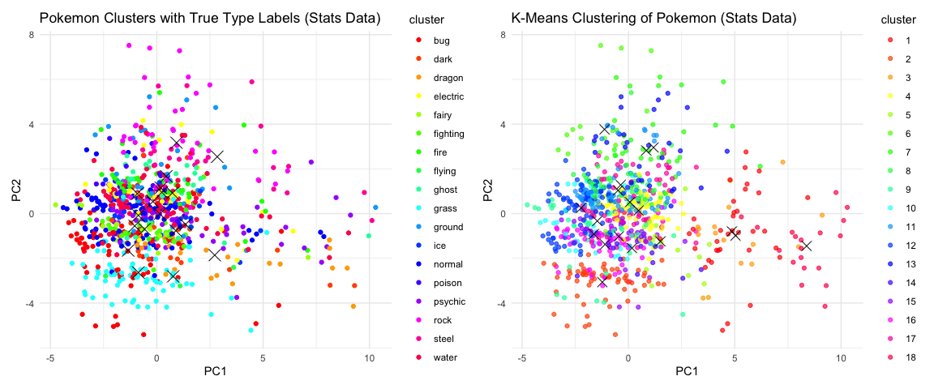
K-Means Clustering

Slide 6
Clustering Accuracies
Method | Accuracy_Stats | Accuracy_Image
K-means | 0.5243446 | 0.1810237
K-means++ | 0.5293383 | 0.1747815
Weighted K-means | 0.2034956 | 0.1423221
Optimal K-means K = 3 | 0.1722846 | 0.1473159
Clustering Accuracy Comparison: Stats vs Image Data

Slide 7
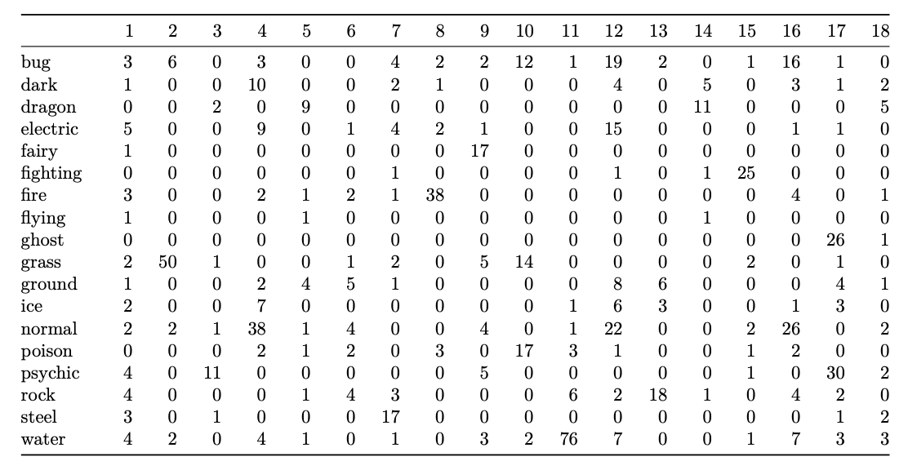
Cluster Assignments for Stats Data

Slide 8
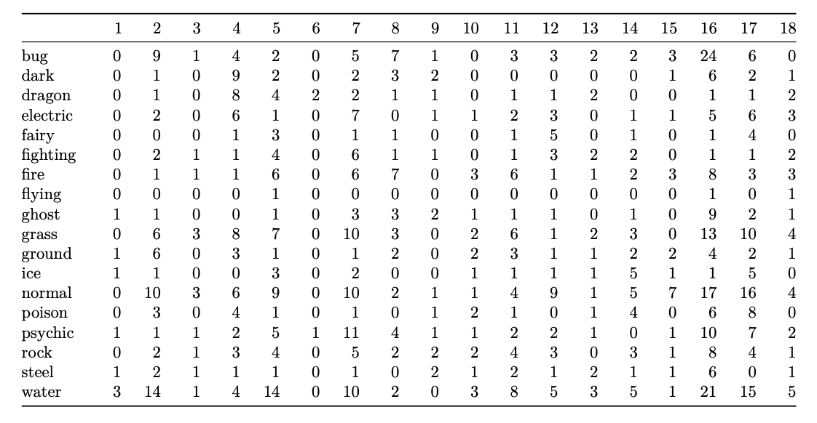
Cluster Assignments for Image Data

Slide 9
Clustering Takeaways
Stats cluster primary types better than images
at best clustering classified 52% of Pokemon type
Limitations include imbalanced data among Pokemon types, which can be accounted for in Supervised Models
Structure of the data may not capture the complexity of the Pokemon types in a way that creates efficient and distinct clusters

Slide 10
Supervised Model

Slide 11
Results

