Slide 1
Predicting Pokémon Types with Clustering and Classification
Justin Zhang, Isaac Baguisa, Alex Faassen

Slide 2
Introduction
Motivation: Nostalgia, popularity, and an interesting, numerically-structured game design.
Pokémon Typing: Game mechanic (i.e. pairwise interactions), but also a conceptual grouping based on traits like colour, strength, and theme.
Can clustering and classification methods uncover or predict a Pokémon’s type based on its image and statistical features?
Notes:
We aim to explore whether these groupings have an underlying statistical structure that can be detected through some of the techniques we’ve learned in class.

Slide 3
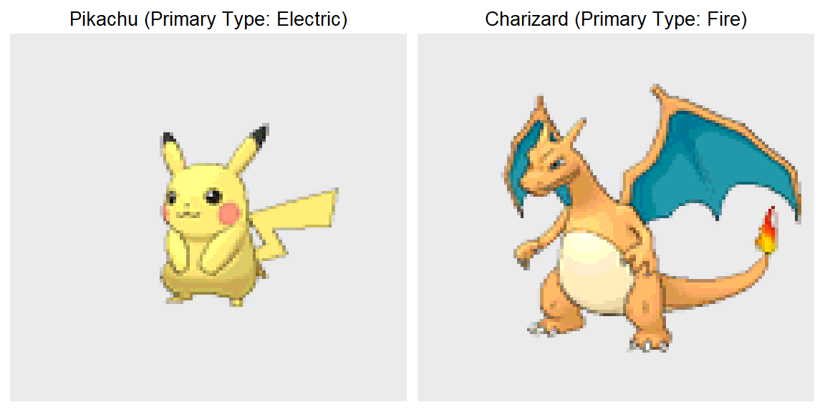
Example: Pikachu and Charizard

Slide 4
Data Description
From generations 1-7:
Image Dataset: 809 Pokémon, 120 x 120 PNGs with RGBA
Stats Dataset: 801 Pokémon, 41 numerical features (e.g. hp, attack, sp_defense, etc.)
Pre-processing: Flattened RGB image vectors (43,200 features); matched and cleaned datasets (801 shared Pokémon).
Notes:
Time: 1:15
HP: hit points.

Slide 5
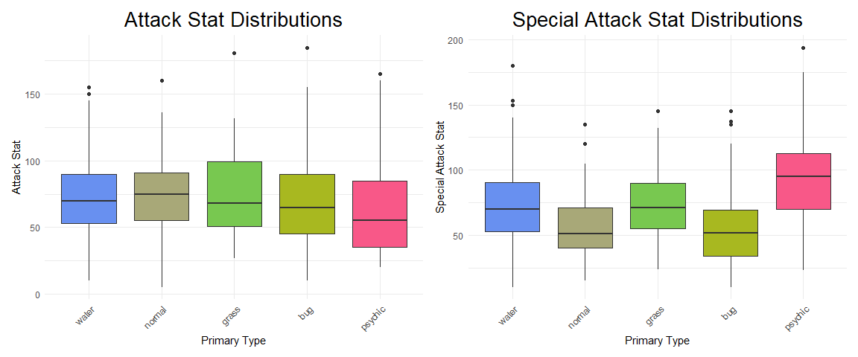
Stats
Notes:
Time: 1:50

Slide 6
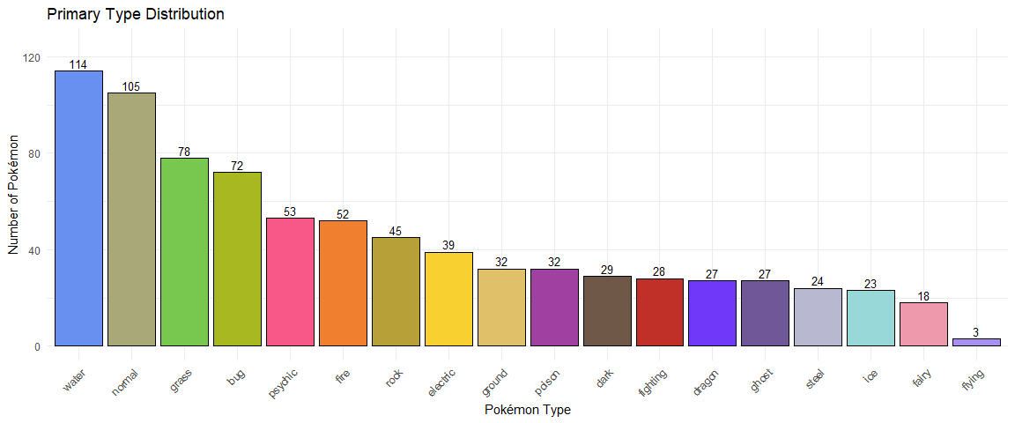
Primary Type Distribution
Notes:
Time: 3min
Ground rules: Biggest report limitation: Only focusing on primary type (type 1) to maintain a single-label classification structure. Ignoring secondary types (type 2).
Big challenge for clustering algorithms.
Note: While technically Pokemon have “primary” types – secondary types have near equal value, making this a big limitation of our study.
Looking at 18 different types.

Slide 7
Methods
Dimension reduction: PCA
Images and Stats
Clustering: k-means
Classification: LDA, Gradient boosting
For comparison
Notes:
Time: 4min

Slide 8
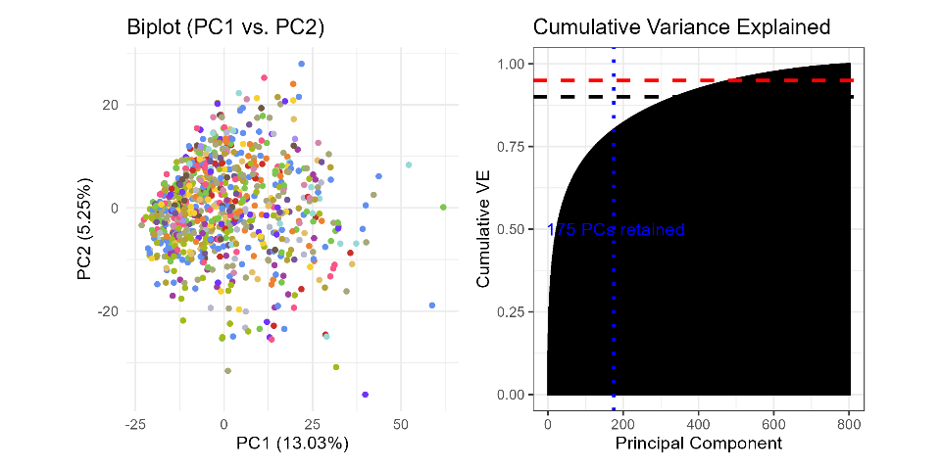
Image Dimension Reduction: PCA
Notes:
Time: 4:20
PC1: height-width stretch = Pokemon area (size); PC2: height-width ratio
Lack of separation is expected.
Inspires a nonlinear/local dimension reduction technique, i.e. UMAP.

Slide 9
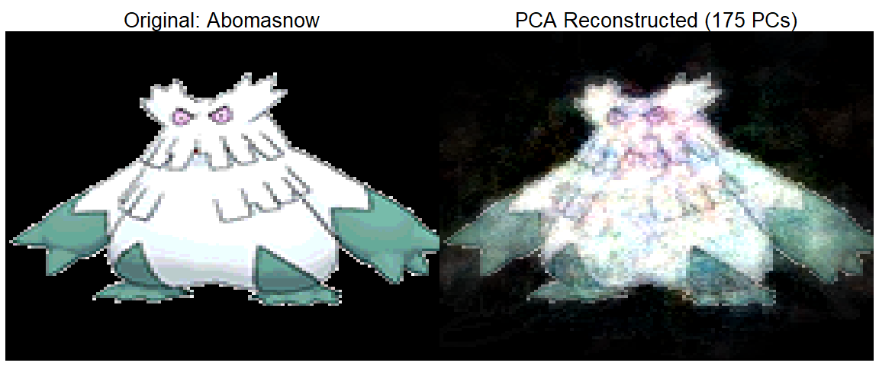
Example: Image Compression
Notes:
Trade-off: Dimension reduction vs. (colour) preservation
- Slightly more emphasis on dimension reduction as colour seems to be relatively well preserved.

Slide 10
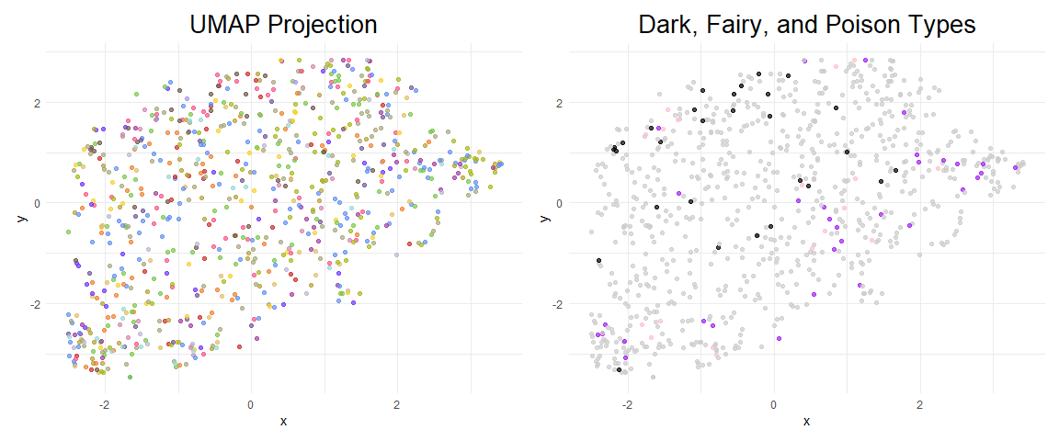
Image Dimension Reduction: UMAP
Notes:
Time: 6min
Dark, Fairy, and Poison types seemed to separate “best” – interesting since they are some of the most colour-specific.
Side notes:
UMAP: Nonlinear dimension reduction technique. Takes high-dimensional data and projects them into 2D or 3D space for visualization or clustering.
Fed UMAP results into K-means to test if a non-linear structure helps.

Slide 11
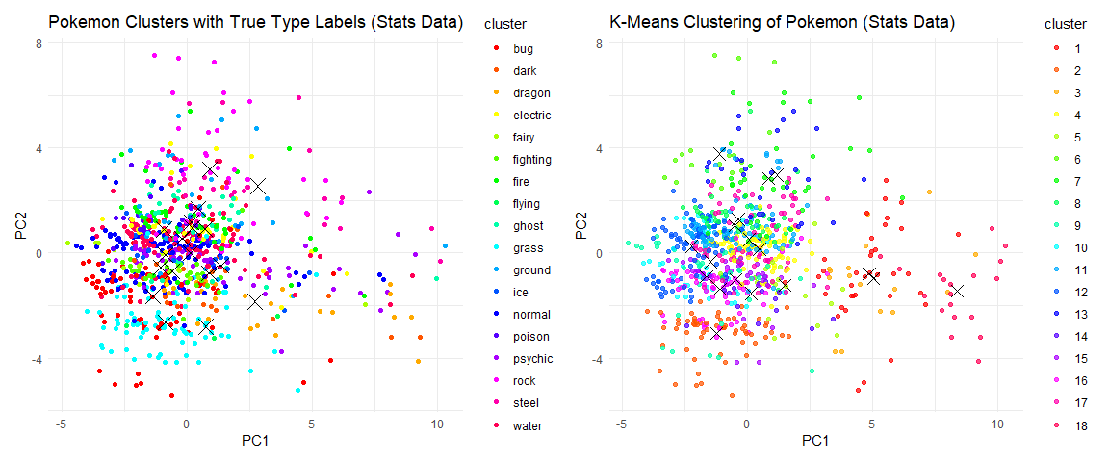
K-Means Clustering

Slide 12
Clustering Accuracies
Method | Accuracy_Stats | Accuracy_Image
K-means | 0.5243446 | 0.1810237
K-means++ | 0.5293383 | 0.1747815
Weighted K-means | 0.2034956 | 0.1423221
Optimal K-means K = 3 | 0.1722846 | 0.1473159
Clustering Accuracy Comparison: Stats vs Image Data

Slide 13
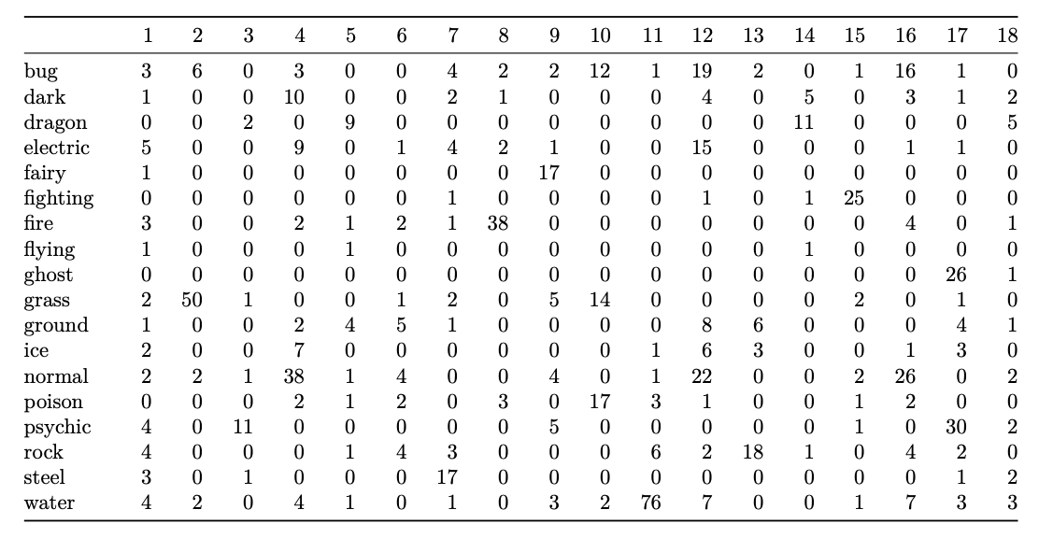
Cluster Assignments for Stats Data

Slide 14
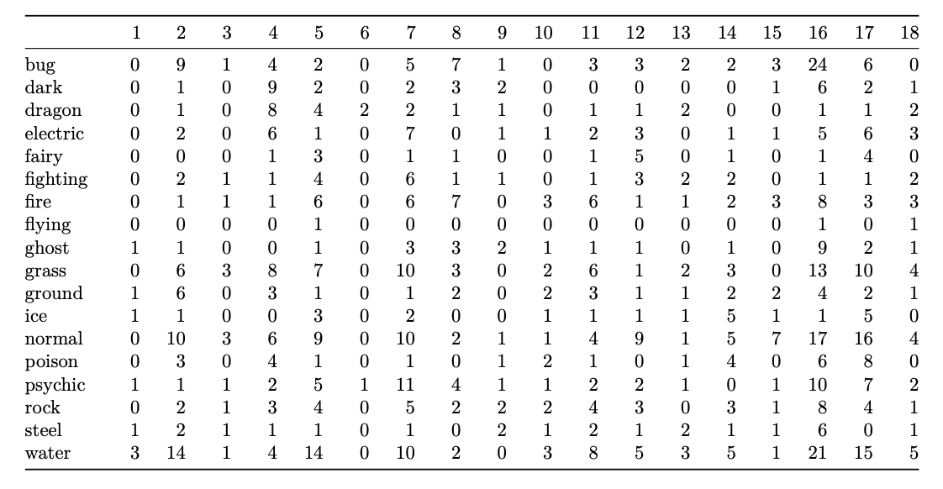
Cluster Assignments for Image Data

Slide 15
Clustering Takeaways
Stats cluster primary types better than images
at best clustering classified 52% of Pokemon type
Limitations include imbalanced data among Pokemon types, which can be accounted for in Supervised Models
Structure of the data may not capture the complexity of the Pokemon types in a way that creates efficient and distinct clusters

Slide 16
Supervised Model

Slide 17
Results

