Slide 1
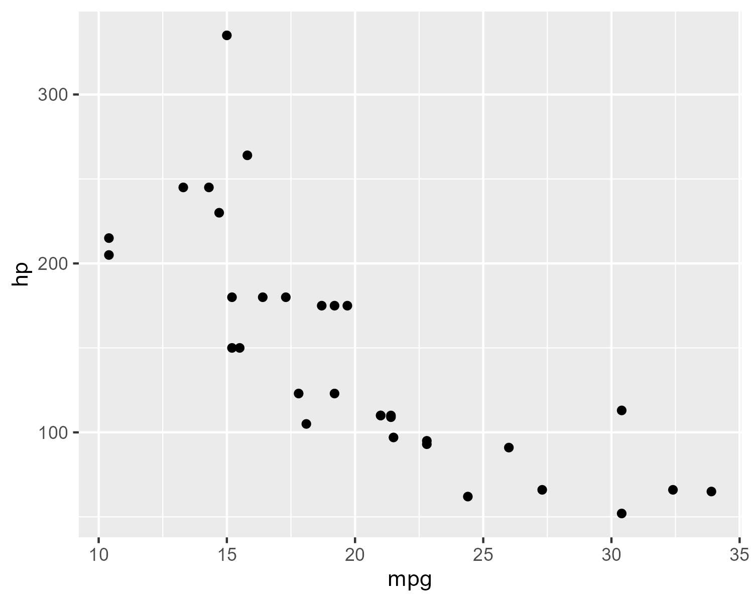
Text and Plot Example
Here's an analysis of MPG vs HP.

