Slide 1
Predicting Pokémon Types with Clustering and Classification
Justin Zhang, Isaac Baguisa, Alex Faassen

Slide 2
Introduction
Motivation: Nostalgia, popularity, and an interesting, numerically-structured game design.
Pokémon Typing: Game mechanic (i.e. pairwise interactions), but also a conceptual grouping based on traits like colour, strength, and theme.
Can clustering and classification methods uncover or predict a Pokémon’s type based on its image and statistical features?

Slide 3

Example: Pikachu and Charizard

Slide 4
Data Description
From generations 1-7:
Image Dataset: 809 Pokémon, 120 x 120 PNGs with RGBA
Stats Dataset: 801 Pokémon, 41 numerical features (e.g. hp, attack, sp_defense, etc.)
Pre-processing: Flattened RGB image vectors (43,200 features); matched and cleaned datasets (801 shared Pokémon).

Slide 5
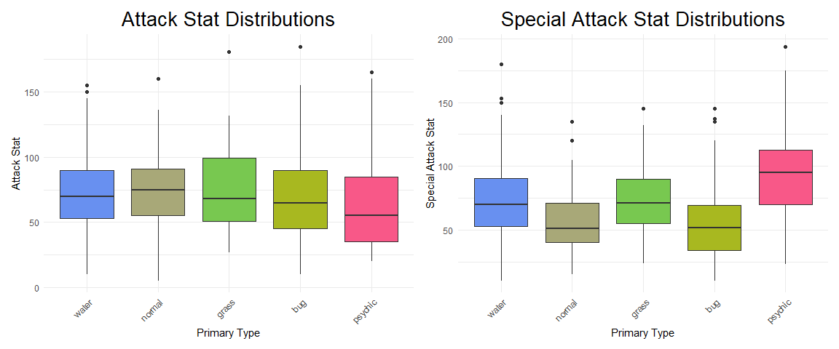
Stats

Slide 6
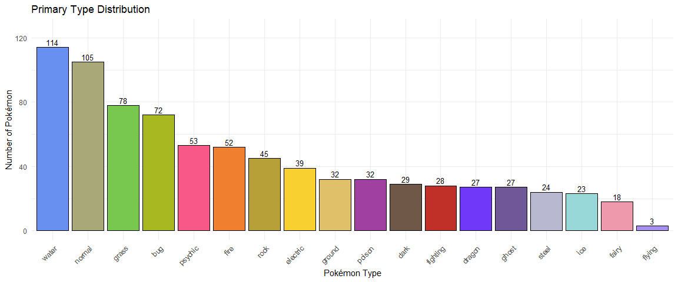
Primary Type Distribution

Slide 7
Methods
Dimension reduction: PCA
Images and Stats
Clustering: k-means
Classification: LDA, Gradient boosting
For comparison

Slide 8
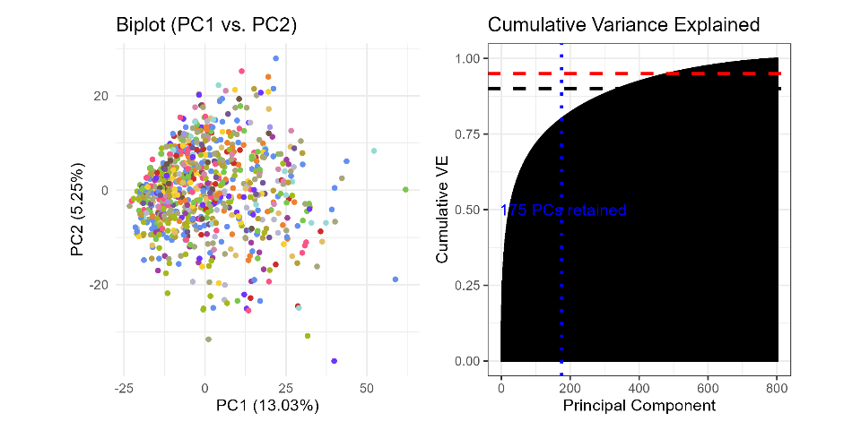
Image Dimension Reduction: PCA

Slide 9
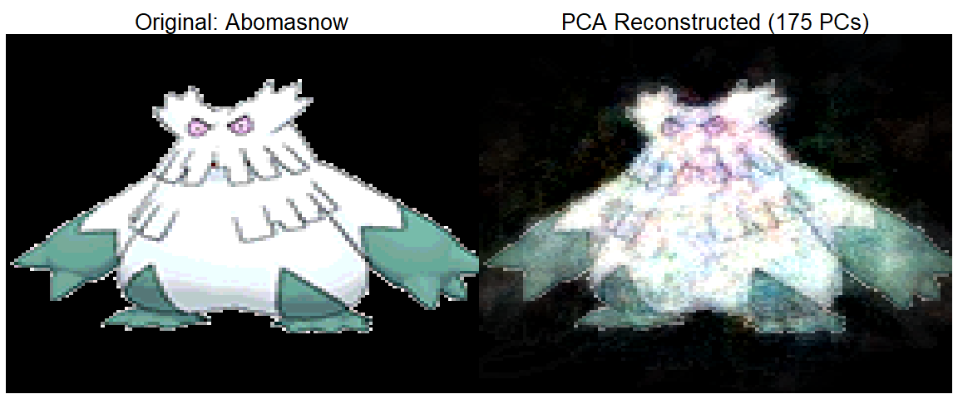
Example: Image Compression

Slide 10
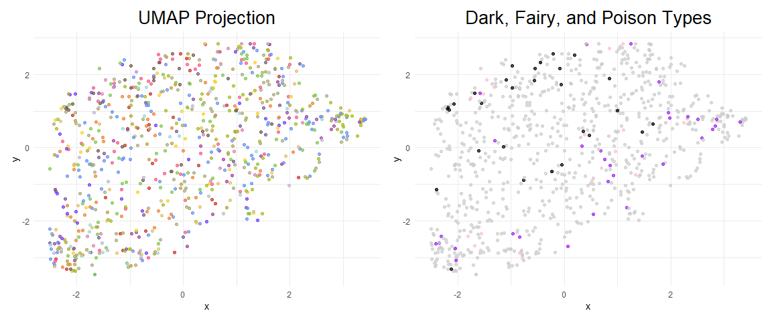
Image Dimension Reduction: UMAP

Slide 11
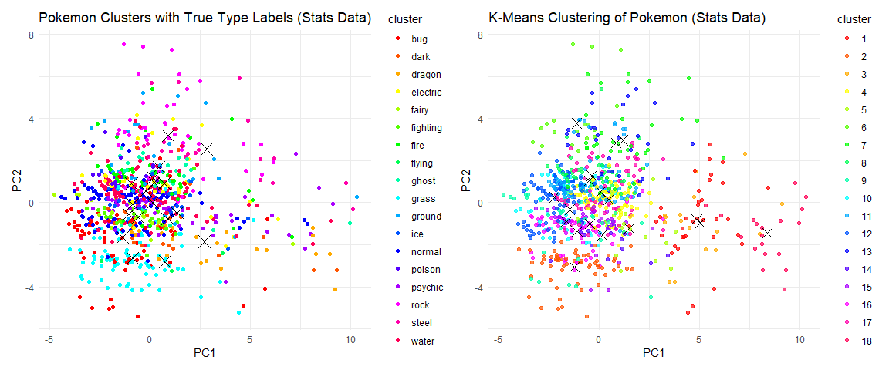
K-Means Clustering

Slide 12
Clustering Accuracies
Method | Accuracy_Stats | Accuracy_Image
K-means | 0.5243446 | 0.1810237
K-means++ | 0.5293383 | 0.1747815
Weighted K-means | 0.2034956 | 0.1423221
Optimal K-means K = 3 | 0.1722846 | 0.1473159
Clustering Accuracy Comparison: Stats vs Image Data

Slide 13
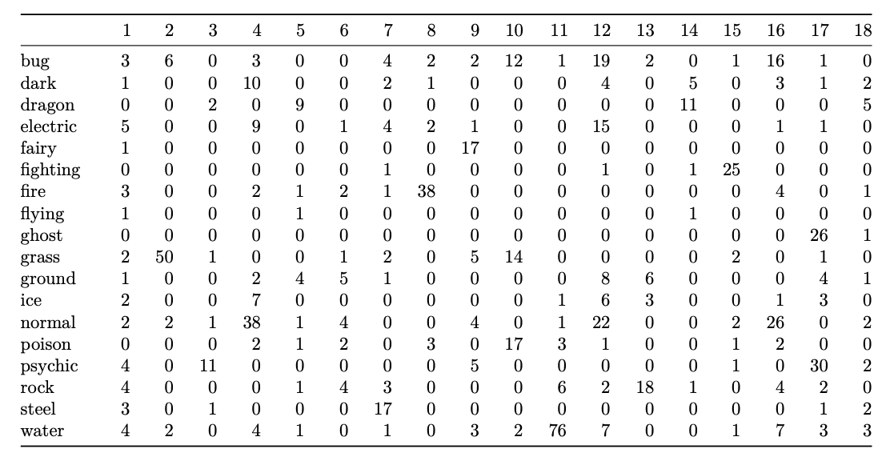
Cluster Assignments for Stats Data

Slide 14
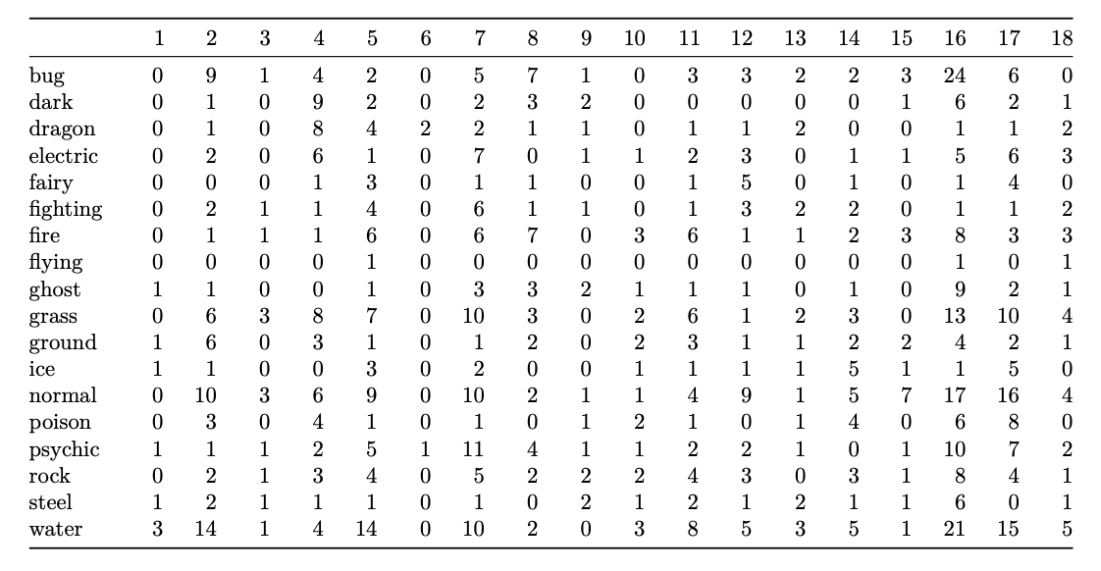
Cluster Assignments for Image Data

Slide 15
Clustering Takeaways
Stats cluster primary types better than images
at best clustering classified 52% of Pokemon type
Limitations include imbalanced data among Pokemon types, which can be accounted for in Supervised Models
Structure of the data may not capture the complexity of the Pokemon types in a way that creates efficient and distinct clusters

Slide 16
Supervised Model
Main purposes:
Baseline accuracy measurement for clustering analysis
Determine whether there are distinguishable features for each type
2 models:
Linear Discriminant Analysis
Gradient Boosting

Slide 17
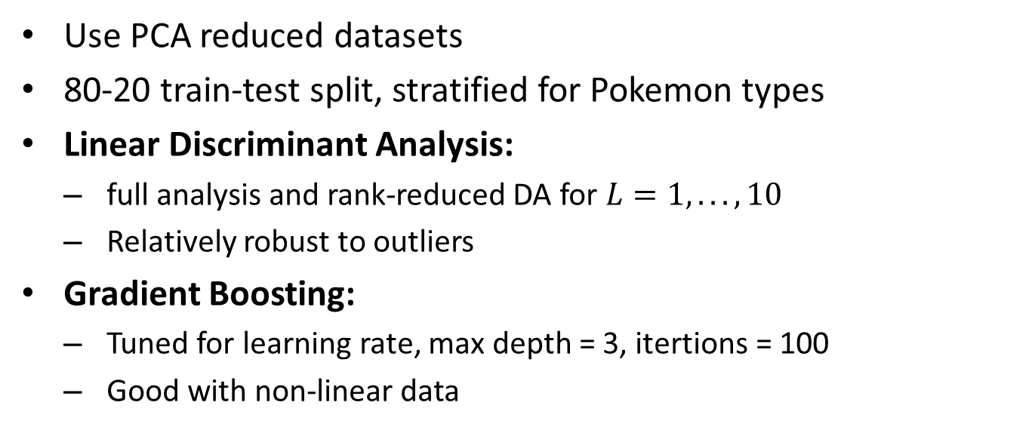
Methods
Use PCA reduced datasets
80-20 train-test split, stratified for Pokemon types
Linear Discriminant Analysis:
full analysis and rank-reduced DA for $L=1,...,10$
Relatively robust to outliers
Gradient Boosting:
Tuned for learning rate, max depth = 3, itertions = 100
Good with non-linear data

Slide 18
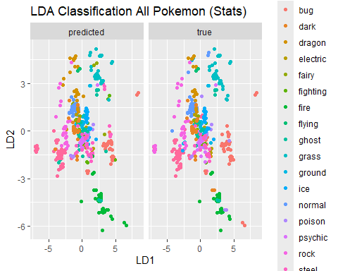
LDA: Full

Slide 19
LDA Accuracy
L | accuracy_train | accuracy_test
1 | 0.4574132 | 0.4371257
2 | 0.6167192 | 0.5808383
3 | 0.7176656 | 0.6886228
4 | 0.8091483 | 0.7904192
5 | 0.8454259 | 0.8263473
6 | 0.8517350 | 0.8383234
7 | 0.8738170 | 0.8622754
8 | 0.8864353 | 0.8862275
LDA Accuracy for Stats Data

Slide 20
LDA Accuracy: By Generation
 | gen1-train | gen2-train | gen3-train | gen4-train | gen1-test | gen2-test | gen3-test | gen4-test
3 | 0.9824561 | 0.9459459 | 0.970297 | 0.9480519 | 0.9189189 | 0.6923077 | 0.7647059 | 0.5333333
4 | 0.9912281 | 1.0000000 | 0.960396 | 0.9870130 | 0.9189189 | 0.7692308 | 0.8235294 | 0.6000000
5 | 0.9912281 | 1.0000000 | 0.970297 | 0.9870130 | 0.9189189 | 0.8076923 | 0.8529412 | 0.6333333
6 | 0.9912281 | 1.0000000 | 0.970297 | 1.0000000 | 0.9189189 | 0.8076923 | 0.8235294 | 0.6333333
LDA Accuracy for Stats Data - by Generation

Slide 21
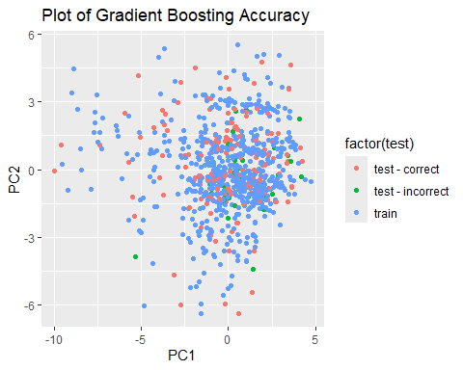
Gradient Boosting: Results

Slide 22
Gradient Boosting Accuracy
shrinkage | train_accuracy | test_accuracy
0.01 | 0.7271293 | 0.6047904
0.10 | 0.9968454 | 0.8143713
0.25 | 1.0000000 | 0.8383234
Gradient Boosting Accuracy

Slide 23
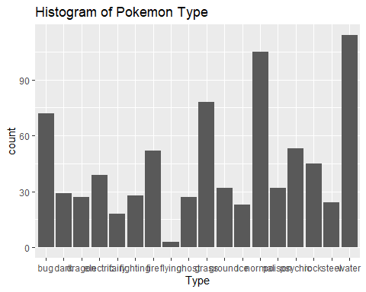
Limitation: Non-uniformity in Pokemon types

Slide 24
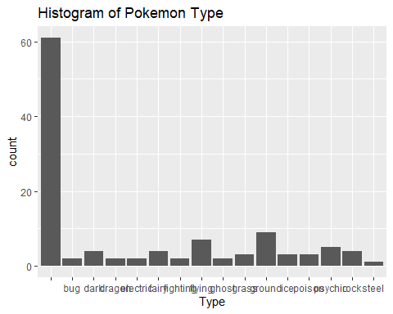
Limitation: Dual Typing

Slide 25
Biases
Computation of classification accuracy
non-uniformity of Pokemon types
Use of ‘against_(type)’ variables -inflates accuracy by ~20%

Slide 26
Recommendations
Tackle the limitations and biases we mentioned
Consider confounding variables with (ex. is_legendary)
Use descriptional image stats rather then image pixels directly
Cross validation on Pokemon generation
Try other models - ex. GMM for clustering

