Slide 1
Markdown & GitHub for collaboration
March 09 2020

Slide 2


10:00 – 11:00
Use GitHub to collaborate on a project
Write markdown
Mary will Introduce the last project
11:00 – 13:00
Github.com

Slide 3
Why use GitHub for collaboration?
Everyone knows where the latest version of the code is and can get it quickly
No single point of failure
Continuous integration
Everyone knows the current state of the project
Easy to show the client the latest version

Slide 4


Collaboration Workflow
Create a new Repository on GitHub.com
Give everyone in the team access

Slide 5


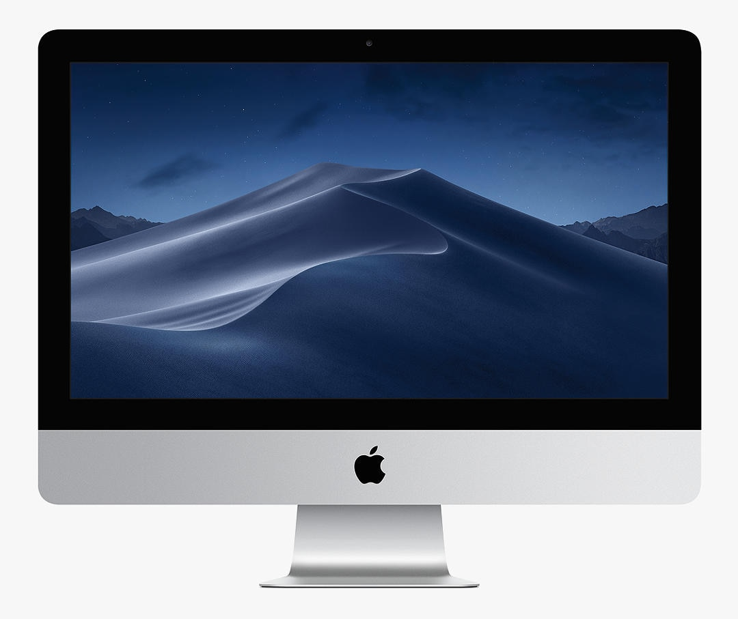

GitHub .com
Clone
Clone
GitHub Desktop
GitHub Desktop
Marys Computer
Toms Computer

Slide 6
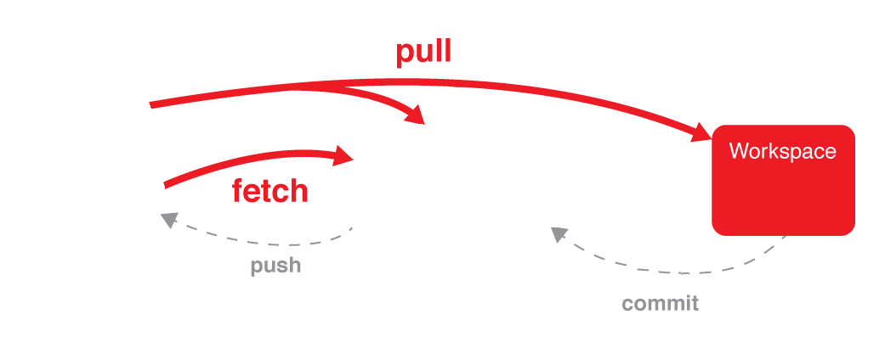



Git commands
GitHub Desktop
GitHub.com
GitHub Desktop
Toms Computer

Slide 7
GitHub .com
Pull
Pull
Push
Push
GitHub Desktop
GitHub Desktop
Marys Computer
Toms Computer

Slide 8
Markdown
lightweight markup language
Uses tags to format text documents
10 minute tutorial :
https://commonmark.org/help/
https://techterms.com/definition/markup_language

Slide 9
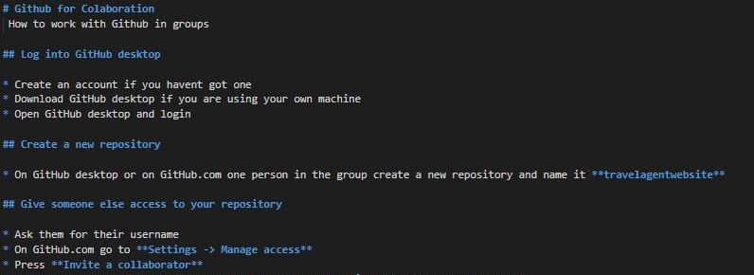
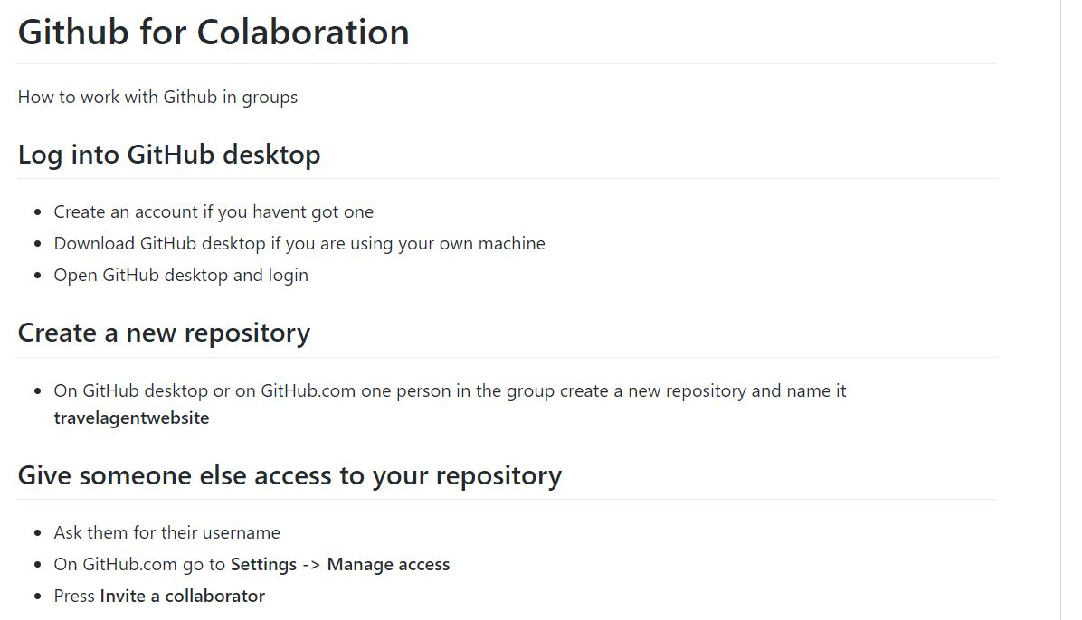
Markdown

Slide 10
Why not just use word or google docs?
Works with version control systems (GitHub)
Light weight = Limited features

Slide 11

Markdown uses
GitHub documentation
https://github.com/davemeckin/Intro_to_Creative_Programming/tree/master/session_01
WordPress
https://en.support.wordpress.com/wordpress-editor/blocks/markdown-block/

Slide 12

Create a markdown file
Make a new file and name it
Something.md

Slide 13
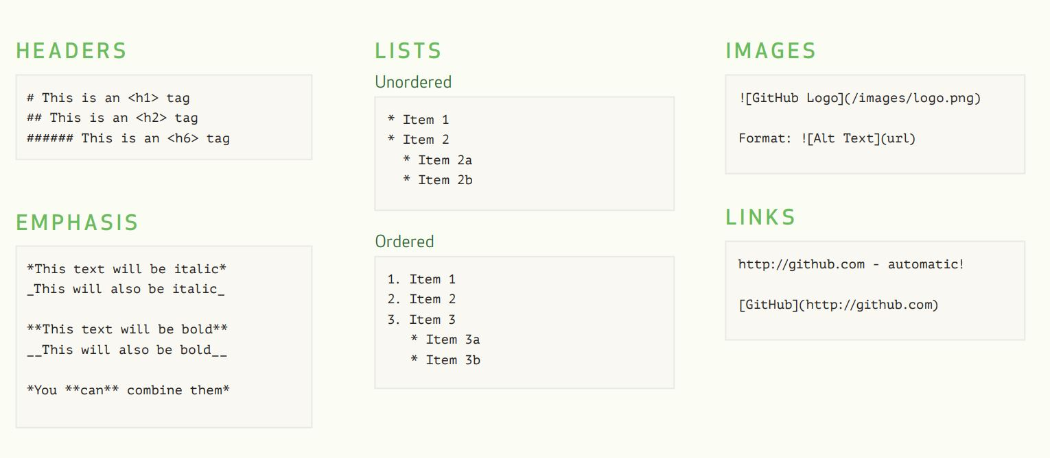
Markdown basics - text
https://guides.github.com/features/mastering-markdown/

Slide 14
Markdown basics – links and images
https://guides.github.com/features/mastering-markdown/

Slide 15
Mini Project
Work in pairs to create a design document
using GitHub and Markdown

Slide 16
Mini Project – Part 1
Find a partner and sit next to them
BOTH login to GitHub desktop
ONE person login to github.com/login and create a new repository
Give your partner access to the repository
Settings -> manage access -> invite collaborator
Clone the repository from GitHub desktop
File -> Clone repository
ONE person create a new file called in the repository
Specifications.md
Commit and push using GitHub desktop

Slide 17
Mini Project – Part 2
Add a title
# Well and good clothing company website
Add a sub title
## Features
1. Store location
Fetch
Pull
Add something to the document
Commit
Pull (?)
Push

Slide 18
Todays task mini Task
Create a design fiction document for a new clothes shop in Bristol specialising in ethically sourced cloths. Imagine you are the client who wants a website designed.
What to include:
Short Description of the website
At least 8 required features (e.g. shopping basket, location of store, about us page)
At least 1 image
2 Links to competitors websites
Each member of the team much make at least 5 commits each
Add mark-up to format the document
Fetch
Pull
Add something to the document
Commit
Pull
Push

Slide 19
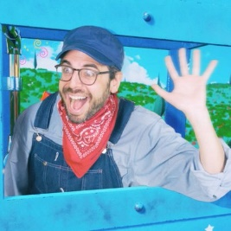
Resolving conflicts?
Dan Shiffman video showing you how to resolve conflicts
https://www.youtube.com/watch?v=JtIX3HJKwfo&list=PLRqwX-V7Uu6ZF9C0YMKuns9sLDzK6zoiV&index=9
Image: https://pbs.twimg.com/profile_images/913100879204556800/Ou9CxY1c_400x400.jpg

Slide 20
Branches
Dan Shiftman video on Branches
https://www.youtube.com/watch?v=oPpnCh7InLY
Create a new branch
Add something to the document
Commit to the new branch
When the branch is finished merge it back into the repository

Slide 21
Other resources
Creating a GitHub repository
https://help.github.jp/enterprise/2.11/user/articles/create-a-repo/
Give others access to your repository
https://help.github.jp/enterprise/2.11/user/articles/inviting-collaborators-to-a-personal-repository/

