Slide 1
Experiment4:
Target Image: LennaBWOrig
Candidate Image: LennaBWOrig_bs

Slide 2
LennaBWOrig vs LennaBWOrig_bs
compare images result image: images/LennaBWOrig.jpeg, Positive cimage: out_images/LennaBWOrig_bs_R_P.png, match_pixel_count: 111562, mismatch_pixel_count: 0, total_pixels: 262144, match percentage: 42.56%
compare images result image: images/LennaBWOrig.jpeg, Negative cimage: out_images/LennaBWOrig_bs_R_N.png, match_pixel_count: 147693, mismatch_pixel_count: 0, total_pixels: 262144, match percentage: 56.34%

Slide 3
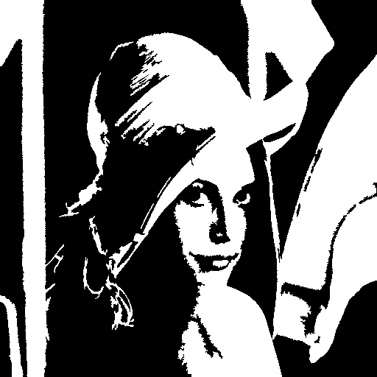
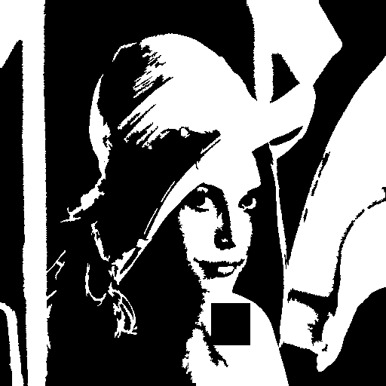
Original Images
Image
Candidate Image

Slide 4


Image VES Slides
Slide_A
Slide_B

Slide 5

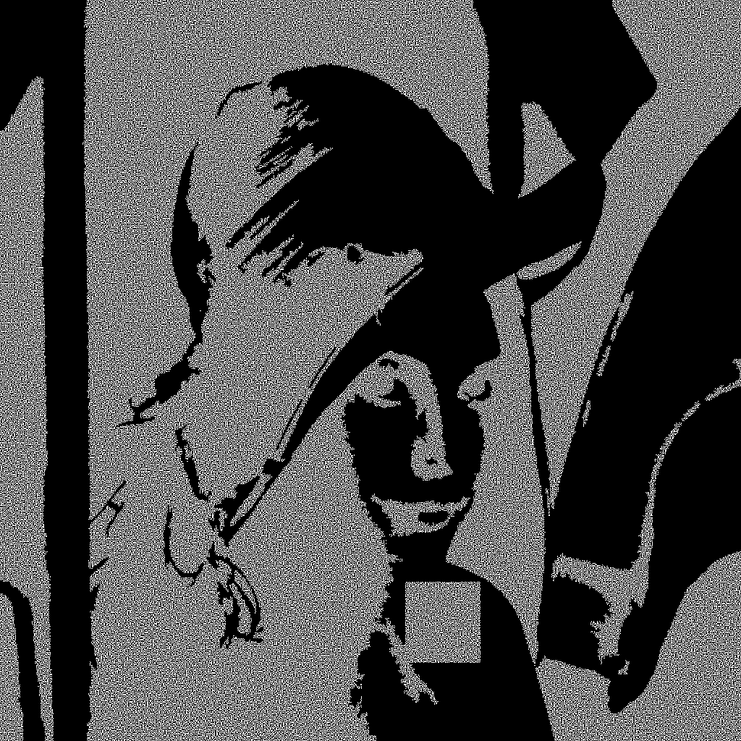
Slide A AND with Candidate Image
Slide_A_P
Slide_A_N

Slide 6

Slide B AND with Candidate Image
Slide_B_P
Slide_B_N

Slide 7

Recovered images
Recovered image - Positive
Recovered image - Negative

