Slide 1
Experiment4A: Identical Target and Candidate Images
Target and Candidate Image: LennaBWOrig

Slide 2
Lenna.jpg
compare images result image: images/Lenna.png, Positive cimage: out_images/Lenna_R_P.png, match_pixel_count: 126965, mismatch_pixel_count: 0, total_pixels: 262144, match percentage: 48.43%
compare images result image: images/Lenna.png, Negative cimage: out_images/Lenna_R_N.png, match_pixel_count: 135179, mismatch_pixel_count: 0, total_pixels: 262144, match percentage: 51.57%

Slide 3
LennaBWOrig.jpg
compare images result image: images/LennaBWOrig.jpeg, Positive cimage: out_images/LennaBWOrig_R_P.png, match_pixel_count: 114451, mismatch_pixel_count: 0, total_pixels: 262144, match percentage: 43.66%
compare images result image: images/LennaBWOrig.jpeg, Negative cimage: out_images/LennaBWOrig_R_N.png, match_pixel_count: 147693, mismatch_pixel_count: 0, total_pixels: 262144, match percentage: 56.34%

Slide 4
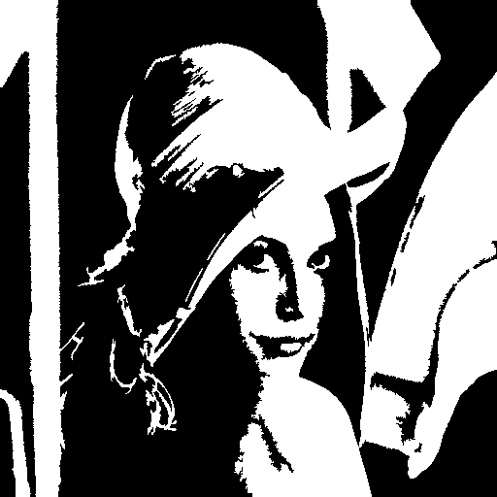
Original Images
Image
Candidate Image

Slide 5


Image VES Slides
Slide_A
Slide_B

Slide 6

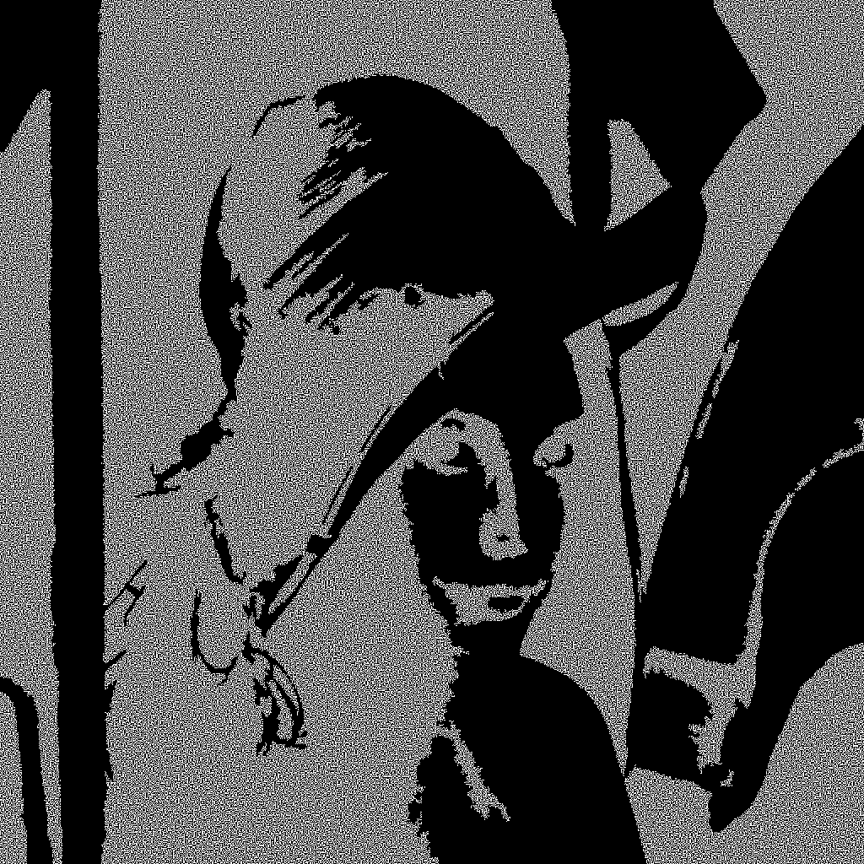
Slide A AND with Candidate Image
Slide_A_P
Slide_A_N

Slide 7

Slide B AND with Candidate Image
Slide_B_P
Slide_B_N

Slide 8

Recovered images
Recovered image - Positive
Recovered image - Negative

