Slide 1
Experiment: Identical Target and Candidate Images
LennaBWOrig

Slide 2
bsquare40x40_wqs10x10
compare images result image: LennaBWOrig.jpeg, Positive cimage: LennaBWOrig.jpeg, match_pixel_count: 147693, total_pixels: 262144, match percentage: 56.34%
compare images result image: LennaBWOrig.jpeg, Negative cimage: LennaBWOrig.jpeg, match_pixel_count: 114451, total_pixels: 262144, match percentage: 43.66%

Slide 3
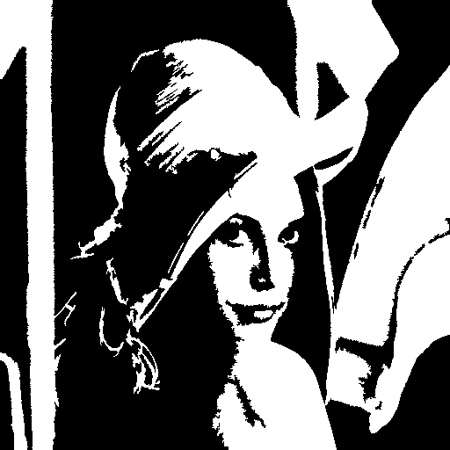
Original Images
Image
Candidate Image

Slide 4


Image VES Slides
Slide_A
Slide_B

Slide 5

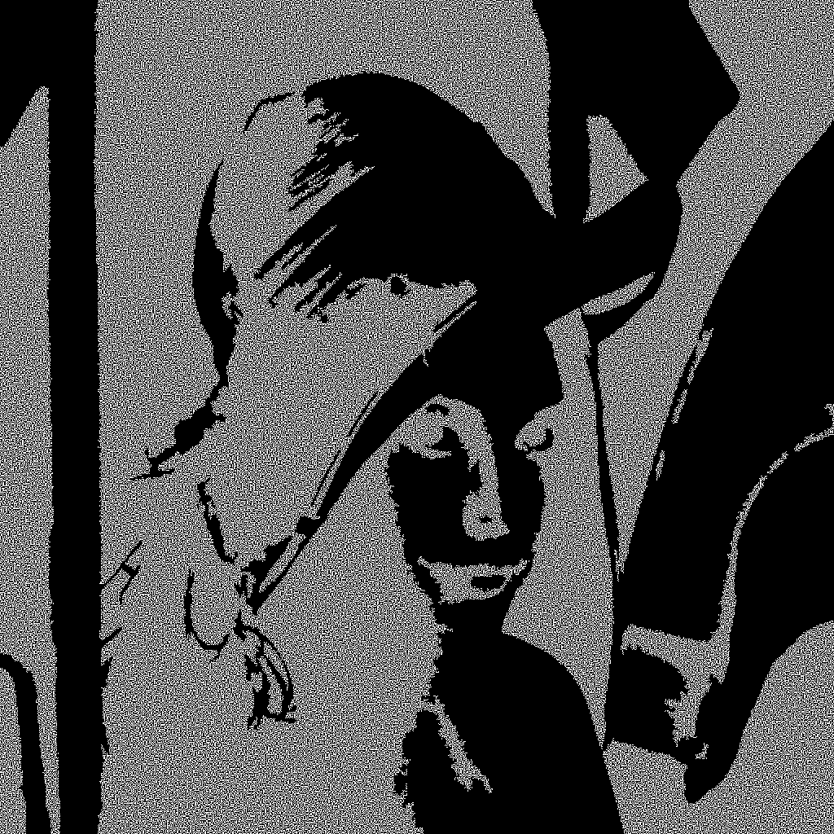
Slide A AND with Candidate Image
Slide_A_P
Slide_A_N

Slide 6

Slide B AND with Candidate Image
Slide_B_P
Slide_B_N

Slide 7

Recovered images
Recovered image - Positive
Recovered image - Negative

