Slide 1
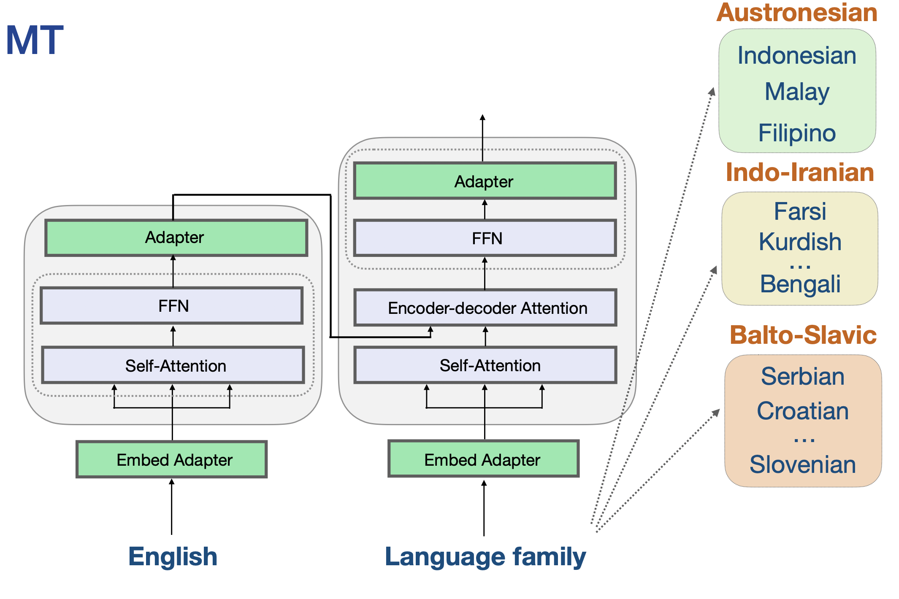
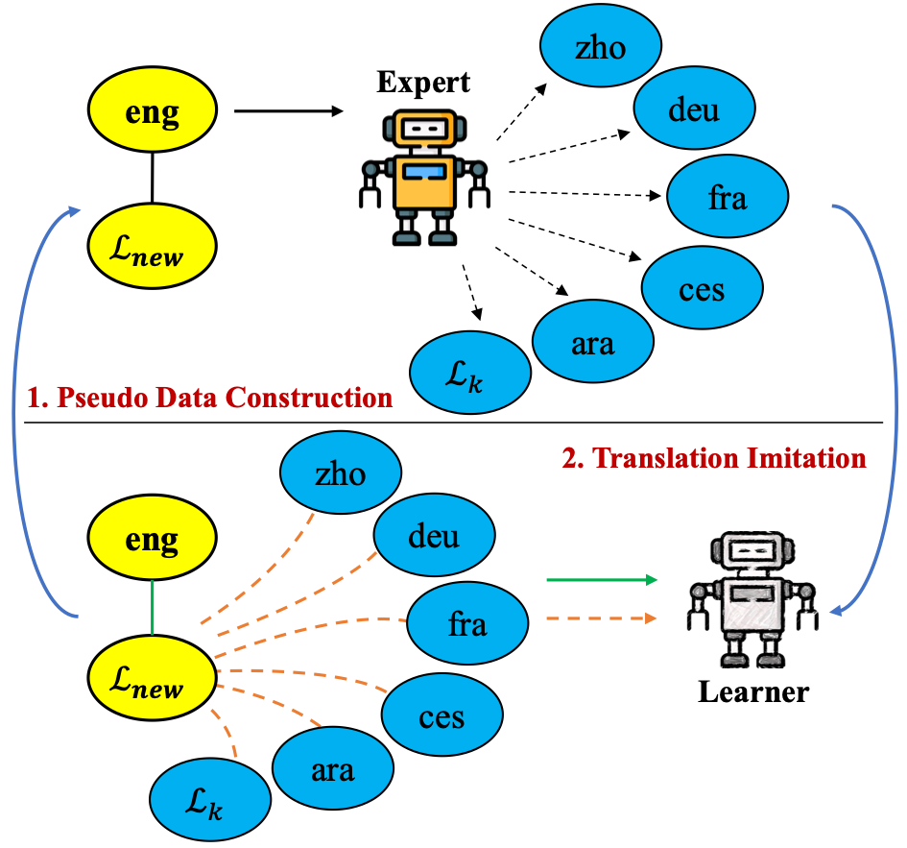
EPICAL (ERC Advanced Grant)
EPICAL: Evaluating and Programming Intelligent Chatbots for Any Language
Intelligent chatbots such as ChatGPT work well for a few languages such as English
But not for most of the 7099 languages currently spoken on Earth
Chatbots are trained on corpora like the Common Crawl
97% of the crawl is top-100 languages, just 3% of the crawl are from the 7000 less-resourced languages
High risk, high return idea:
First create high quality texts in low-resource languages with the help of chatbots
Then use these texts to improve the chatbots (creating a virtuous cycle)
PI: Alexander Fraser, top researcher in machine translation and multilingual natural language processing
Contributions in many areas of machine translation, NLP, machine learning
Work on many low resource languages, for example Upper Sorbian (Germany) and Hiligaynon (Philippines)

