Slide 1
Polish Companies Bankruptcy Data
ALEXANDRE FORESTIER, JULIE PICOT
ESILV A4 – DIA 1

Slide 2
DATA SET INFORMATION
Bankruptcy prediction of polish companies
Analyse in the period of 2000 – 2012 for the bankrupt companies
Analyse in the period of 2007 – 2013 for the still operating companies
5 classification cases about financial rates of the forecasting period and the corresponding class label that indicates bankruptpcy status
This analysis allows companies to evaluate their situation. It is also useful for banks to decide whether or not to grant loans to them.
The objective of our analysis is to find the best bankruptcy forecasting model and the potential anomalies that would affect the company's situation.

Slide 3
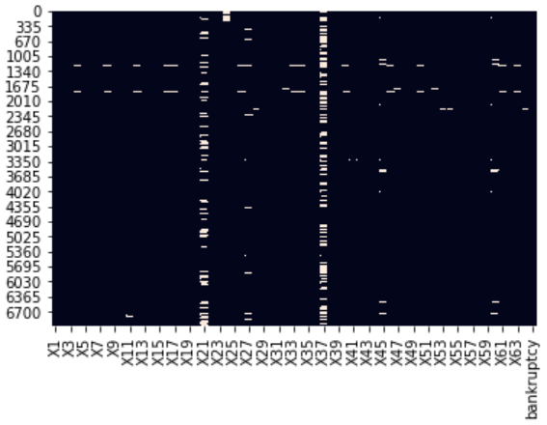
DATA EXPLORATION
After a first exploration of the data, we decided to load a shorter naming system for variables : X1, X2, X3…
Then we plot an heatmap to identify if we can see missing data and yes, we have a lot missing data.

Slide 4
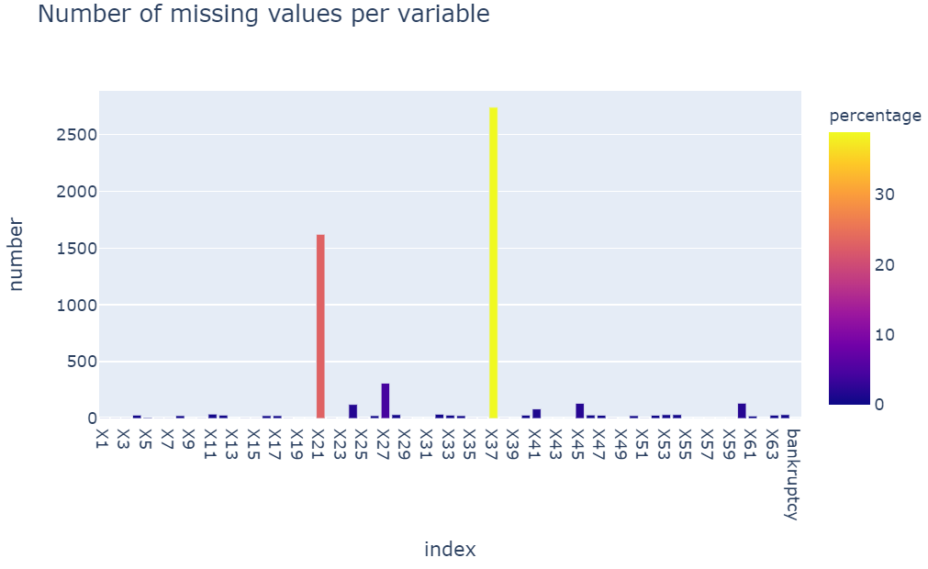
DATA PREPARATION : MISSING DATA
We have a lot of missing data for some variables and we won’t use a median or an average filing for missing values. There is an average of 1.5 missing values per element.
To fill the missing values, we
use a Linear Regression Model
to predict them.

Slide 5
MODELING
We test 7 models and check for each the accuracy and confusion matrix :
Logistic regression
Decision Tree
Gaussian Naive Bayes
Random Forest Classifier
Boosting Classifier
KNN Classifier
Bagging Classifier

Slide 6
ACCURACY
MODEL | ACCURACY
Logistic Regression | 0.9602
Decision Tree | 0.9545
Gaussian Naives Bayes | 0.0718
Random Forest Classifier | 0.9666
Boosting Classifier | 0.9701
KNN Classifier | 0.9609
Bagging Classifier | 0.8962

Slide 7
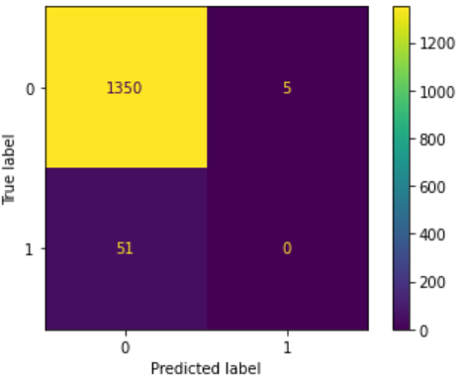
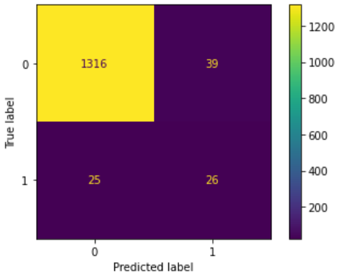
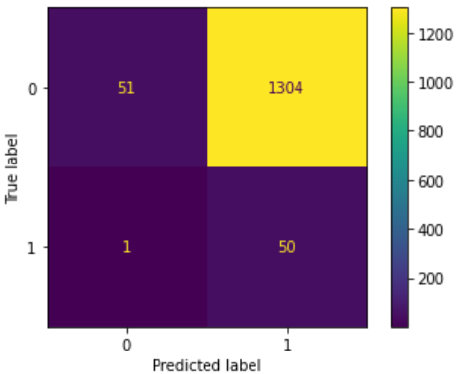
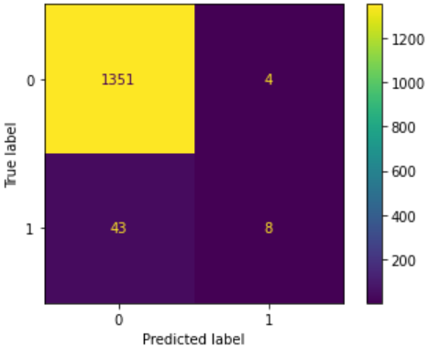
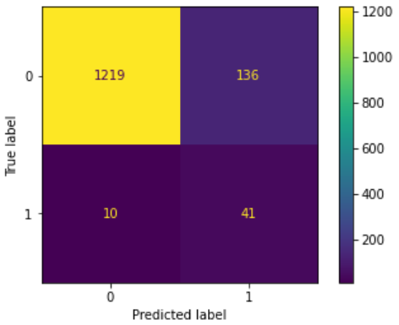
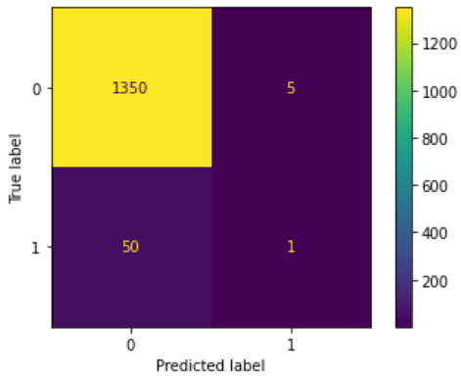
CONFUSION MATRIX
Logistic Regression
Decision Tree
Gaussian
We decided to reject all of this model because of their result weren’t as good as the ones of the boosting tree.
Random Forest
Bagging
KNN

Slide 8
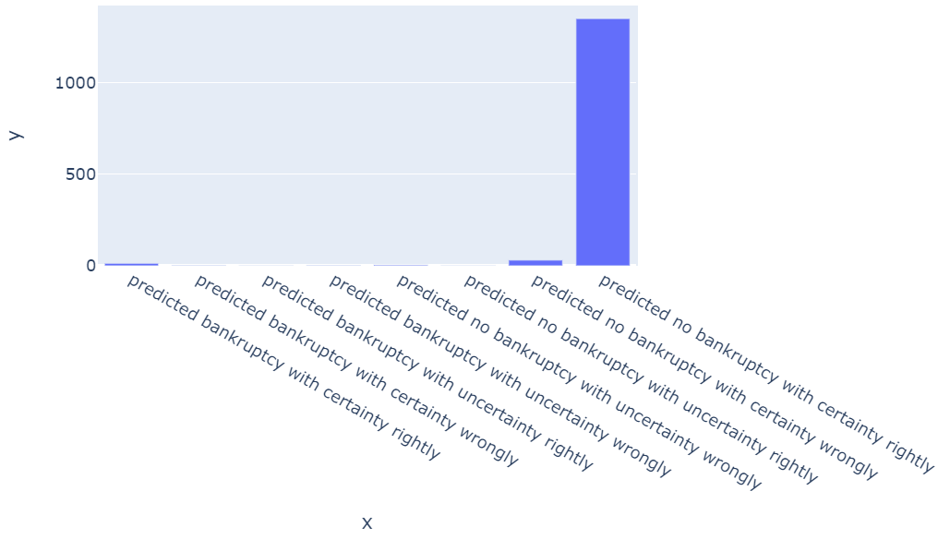

FAVORITE MODEL : BOOSTING
Boosting Tree Classifier achieves a good result but it misses more than half bankruptcies.
Our dataset has some well-defined bankrupted companies, it also has companies in good health and a major part of the bankrupted companies being close from not bankrupted companies.

Slide 9
BOOSTING TREE : PARAMETER TUNIG
To assess during our cross validations, we use balanced accuracy instead of accuracy hence the lower value that you may see.
We first split the dataset in two parts (one for cross validation and one for a final test).
We have chosen kfold cross validation in order to get a better assessment of a model and its parameters. We will do 3 repetition for each parameter couple. 2 seemed not very robust and we found that 4 repetition was too much, 3 seemed to be a great compromise between ETA and Evaluation of the model. We've chosen 5 split to keep the classic ratio of 80% for training and 20% for testing.

Slide 10
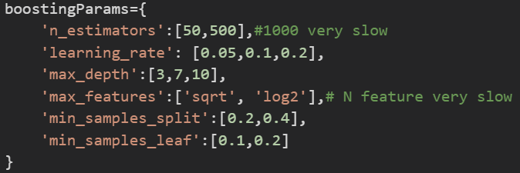
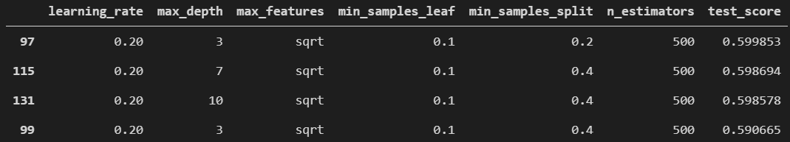
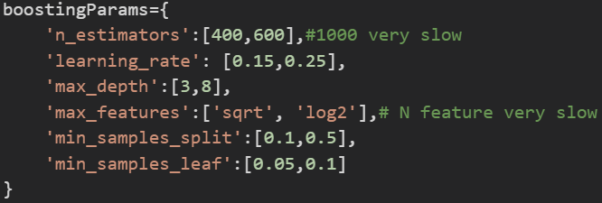
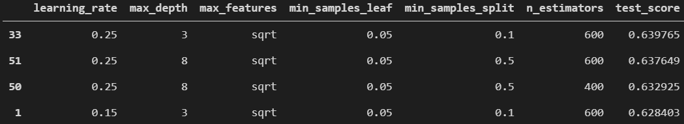
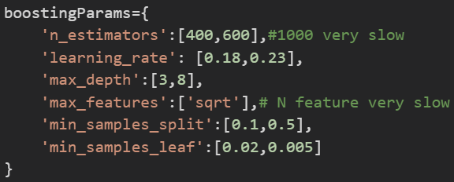
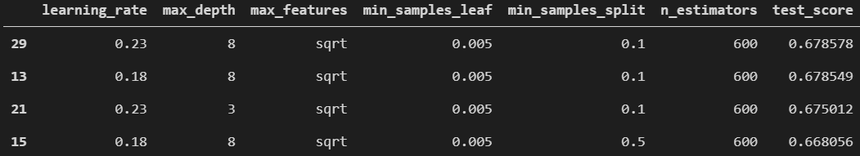
K-FOLD CROSS VALIDATION
TEST 1
TEST 2
TEST 3

Slide 11
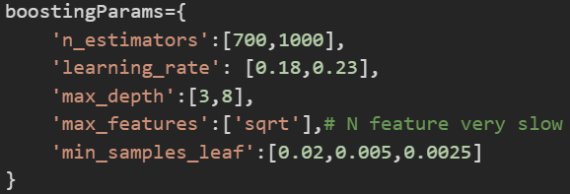
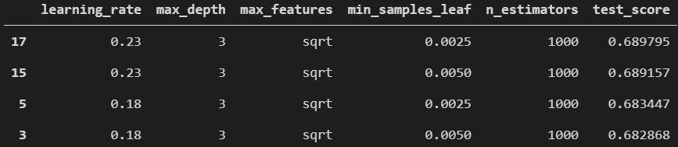
K-FOLD CROSS VALIDATION
TEST 4
ANALYSE
This time we haven't gained accuracy, it is time to stop.
RESULTS

Slide 12
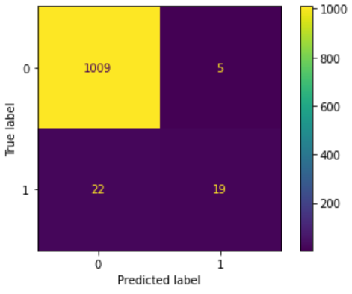
BOOSTING
Finally, with our tuning parameters we test our model and we obtain a very good model with an accuray = 0.9744.

Slide 13
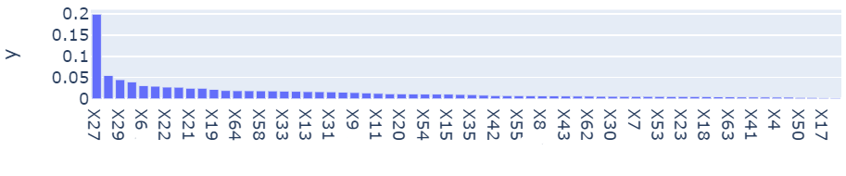
VARIABLES
As we can see, X27 maximize the variable of the model
X27 = profit on operating activites / financial expenses
X29 = logarithm of total assets
X6 = retained earnings / total assets

Slide 14
5 DATASETS
For each data set, we do the same analyse so :
Visualize the number of missing values per variable
Visualize the mean rate and the medium rate of change
Make a cross validation to tune the parameters
Print the accuracy
Visualize the best represented variables
Print the confusion matrix

Slide 15
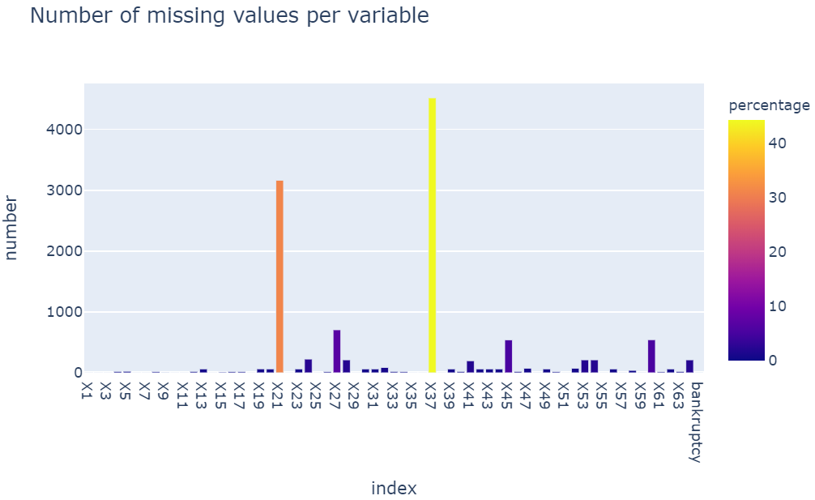
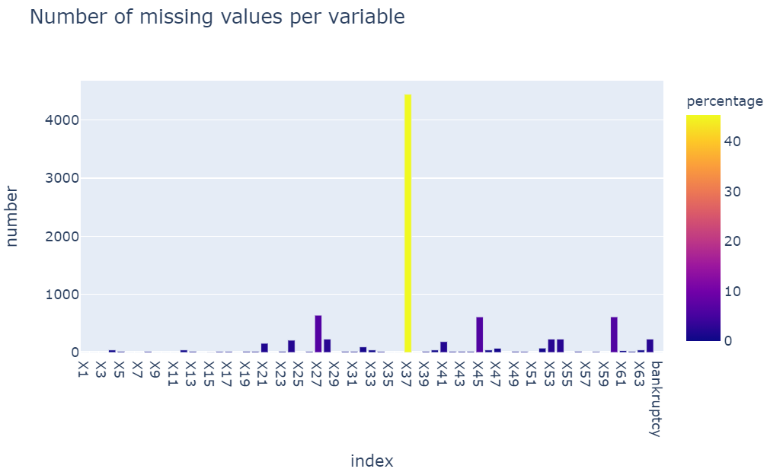
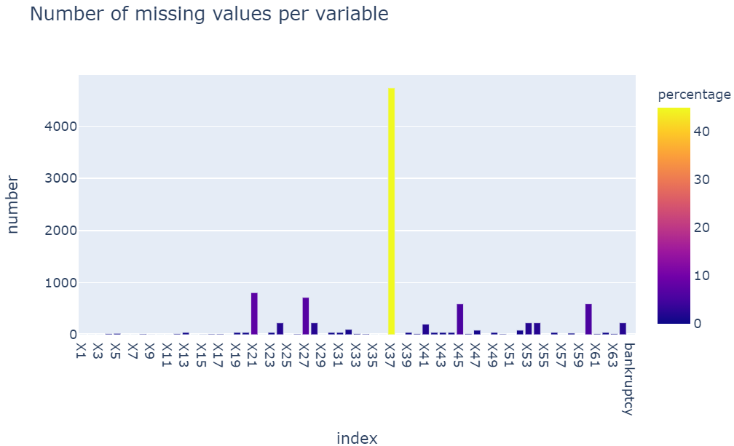
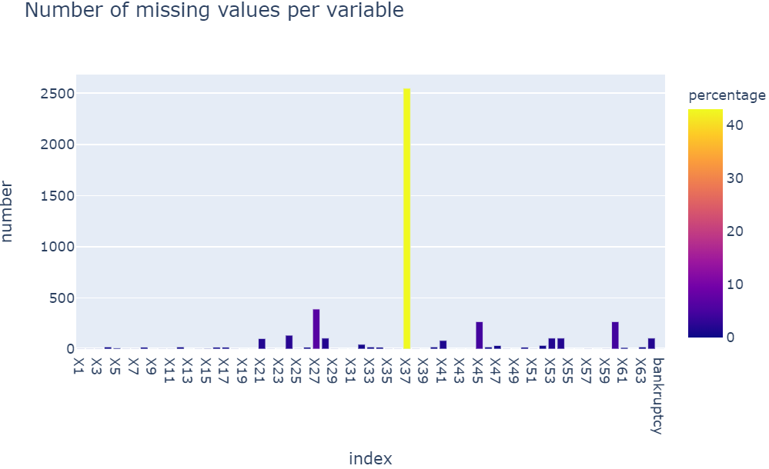
MISSING VALUES
2nd year
4nd year
3nd year
5nd year

Slide 16
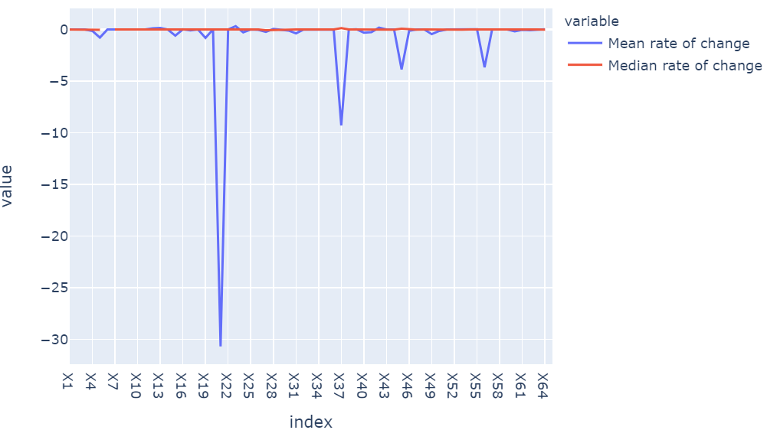
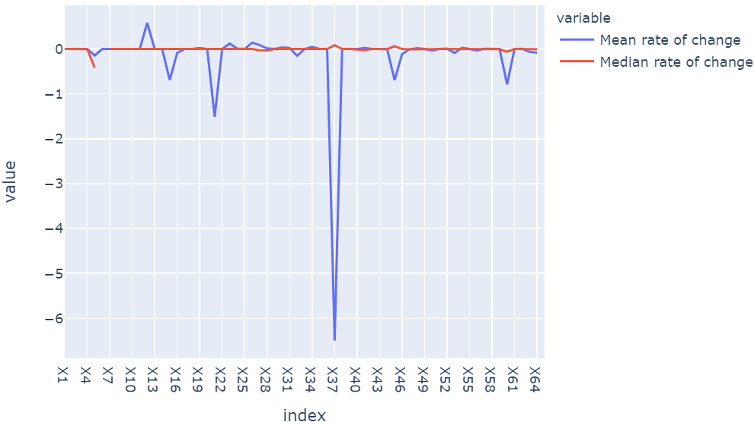
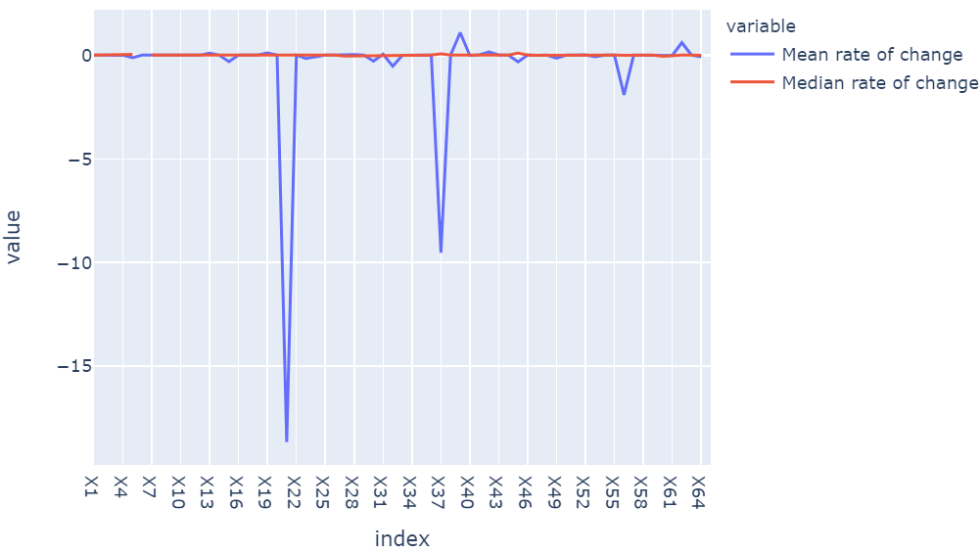
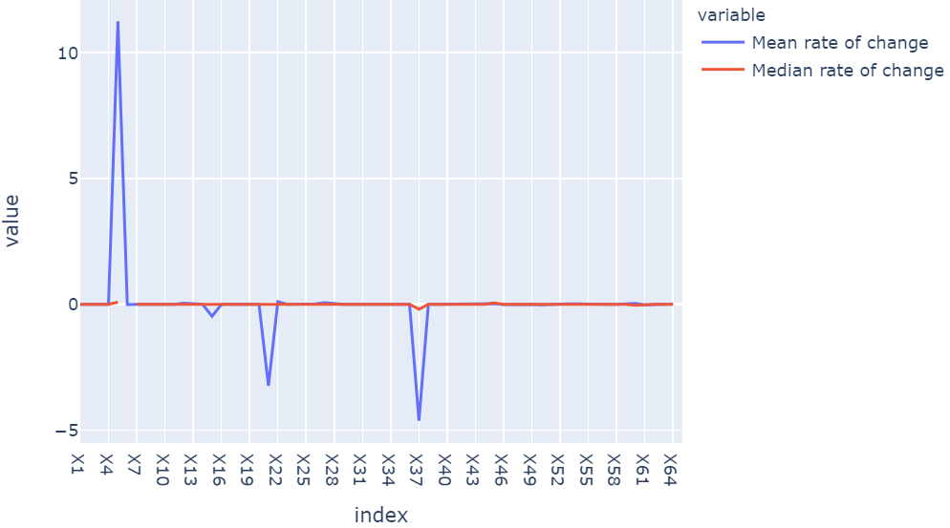
MEAN AND MEDIAN RATE OF CHANGE
2nd year
4nd year
3nd year
5nd year

Slide 17

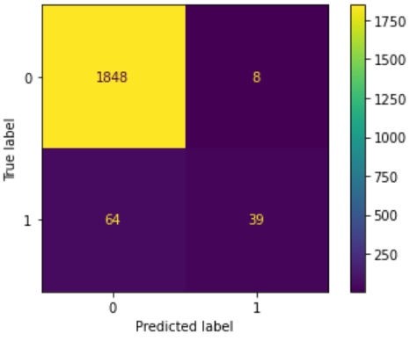
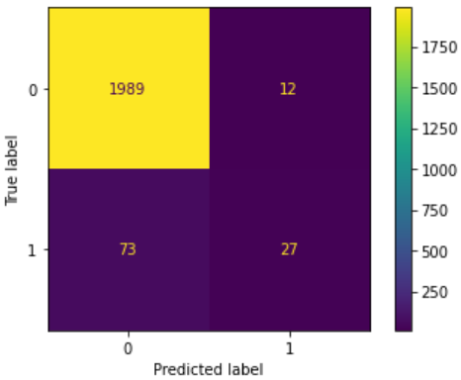
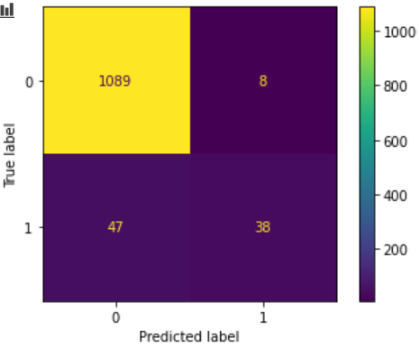
ACCURACY / CONFUSION MATRIX
2nd year
Accuracy = 0,9740
4nd year
Accuracy = 0,9632
3nd year
Accuracy = 0,9595
5nd year
Accuracy = 0,9535

Slide 18
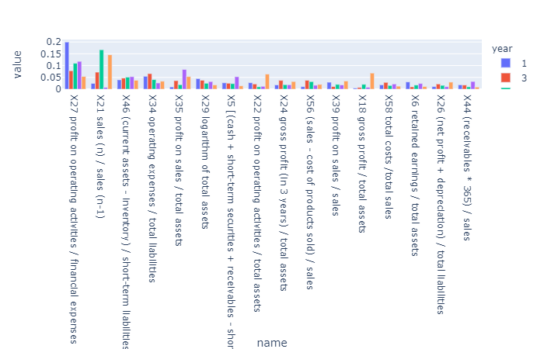

VARIABLES IMPORTANCE

Slide 19
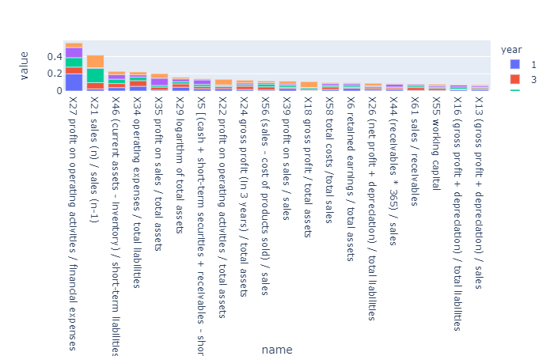
VARIABLES IMPORTANCE

Slide 20
CONCLUSION
This dataset was a challenging dataset
First there was a lot missing data and it took us a lot of time before we could make tests with the integrality of the dataset
Then our data was fragmented in several files depending on the year it was collected, we decided to keep this fragmentation and make 5 analysis (in fact one analysis generalized to all the others datasets in a later time)
This approach was the right one as at the end we can see some differences on the variable importance between the different datasets. We have a great overall accuracy. But as there isn't that much bankrupted companies (thank you god) it is difficult for the model to catch up all the important points.
In the website we do not ask enough variables to user which leads to extremely bad results
Here is a list of things we could have done (better):
Duplicate the bankrupted data and add some noise add weight to this small class
Focus less on hyperparameters optimization it took us a lot of both computational and personal time to get a moderate amelioration
Remove some variables, we're used to remove insignificant variables in regressions but not in classification. This may come from the fact that our tree balances himself alone by choosing were he's cutting and that this step unnecessary.
Thank you for your attention Alexandre and Julie

