Slide 1
Monza e brianza restaurant choice
Applied Data Science Capstone project
Alessandro Fumagalli

Slide 2
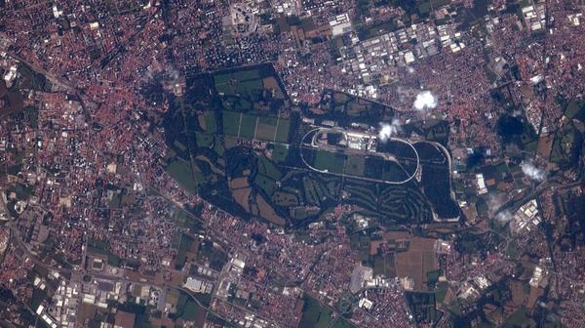
The problem
Aa
Bb
Cc
Part of MB province as seen from ISS by astronaut Reid Wiseman

Slide 3
The problem
Aa
Bb
Cc

