Slide 1

Emoji Prediction: A Survey of Classification Algorithms
Alexandra Gamez

Slide 2



Background
Twitter is a place where valuable information such as sentiments, popularity, and opinions of various topics are located
A perfect place for Natural Language Processing
Emoji prediction is a classification problem
Notes:
I chose from a SemEval 2018 Task
Modified to only use English
Natural Language – Twitter is full of natural language and human interaction
Emojis are classes and a tweet is treated as a document

Slide 3




Problem & General Approach
Task
Emoji prediction
Approach
Get data
Prepare data
Train data
Test
Words Emojis
Tweets
Classification Model
Training
Notes:
Crawler provided by semeval
Tweet emoji extractor provided semeval
Trained with sickit toolkit
Testing – compare predictions to actual
Testing procedure

Slide 4
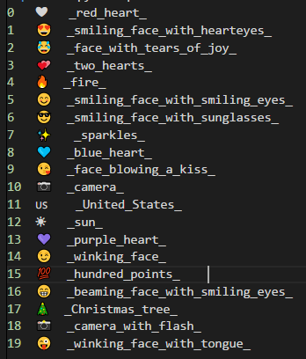
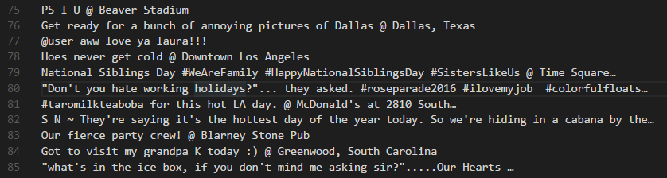

Dataset Example
Emoji Mapping
Tweet content
Emoji Label
Notes:
- After processing

Slide 5
Algorithms Used
Naïve Bayes (Multinomial Naïve Bayes)
Stochastic Gradient Descent
Support Vector Machines
Logistic Regression
K Nearest Neighbors
Decision Tree
Neural Networks
My Naïve Bayes ***
Notes:
Note: Only naïve bayes was implemented by me
First, I wanted to implement algorithms myself, this failed, used sickit classifiers

Slide 6

Naïve Bayes
Naïve Bayes | Documents
Training Set Size | 1k | 5k | 10k | 20k | 30k | 40k | 50k
0-100 | 0.31 | 0.27 | 0.24 | 0.22 | 0.21 | 0.21 | 0.23
100-200 | 0.37 | 0.27 | 0.26 | 0.25 | 0.23 | 0.25 | 0.25
200-300 | 0.23 | 0.2 | 0.19 | 0.2 | 0.18 | 0.2 | 0.2
300-400 | 0.44 | 0.32 | 0.32 | 0.31 | 0.31 | 0.31 | 0.31
400-500 | 0.38 | 0.27 | 0.26 | 0.23 | 0.24 | 0.25 | 0.25
500-600 | 0.31 | 0.27 | 0.25 | 0.22 | 0.23 | 0.24 | 0.25
600-700 | 0.45 | 0.29 | 0.27 | 0.26 | 0.27 | 0.28 | 0.28
700-800 | 0.26 | 0.21 | 0.21 | 0.2 | 0.21 | 0.2 | 0.2
800-900 | 0.27 | 0.15 | 0.15 | 0.14 | 0.14 | 0.13 | 0.15
900-100 | 0.41 | 0.35 | 0.33 | 0.31 | 0.3 | 0.3 | 0.31
Training Time | 0.015 | 0.046 | 0.071 | 0.125 | 0.266 | 0.33 | 0.224
Elaspsed time | 0.171 | 0.171 | 0.188 | 0.205 | 0.161 | 0.63 | 0.268
Likelihood
Class Prior Probability
$$P\left(C | X\right)=\frac{P\left(X | C\right)P\left(C\right)}{P\left(X\right)}$$
Fast training
Fast classification
Terrible results
Predicted prior probability
Notes:
Brief explanation
Key features
Explain table and graph
Then Results

Slide 7
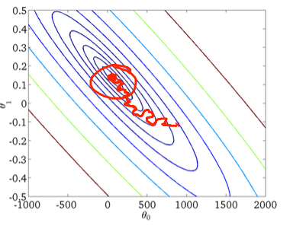
Stochastic Gradient Descent
Stochiastic Gradient Descent | Accuracy
Training Set Size | 1k | 5k | 10k | 20k | 30k | 40k | 50k
0-100 | 0.99 | 0.96 | 0.92 | 0.84 | 0.85 | 0.81 | 0.79
100-200 | 1 | 1 | 0.9 | 0.84 | 0.79 | 0.77 | 0.8
200-300 | 1 | 0.96 | 0.91 | 0.84 | 0.76 | 0.75 | 0.8
300-400 | 1 | 0.98 | 0.91 | 0.84 | 0.75 | 0.76 | 0.72
400-500 | 1 | 0.98 | 0.91 | 0.79 | 0.73 | 0.72 | 0.68
500-600 | 1 | 0.95 | 0.92 | 0.88 | 0.83 | 0.86 | 0.8
600-700 | 1 | 0.95 | 0.92 | 0.82 | 0.82 | 0.81 | 0.76
700-800 | 0.98 | 0.98 | 0.93 | 0.9 | 0.83 | 0.83 | 0.8
800-900 | 0.99 | 0.97 | 0.86 | 0.77 | 0.74 | 0.71 | 0.72
900-100 | 1 | 0.98 | 0.92 | 0.84 | 0.82 | 0.81 | 0.81
Training Time | 0.032 | 0.141 | 0.328 | 0.702 | 1.105 | 1.569 | 1.827
Elaspsed time | 0.017 | 0.174 | 0.213 | 0.233 | 0.253 | 0.266 | 0.296
Trained by assigning weights and then updating iteratively until convergence at a maximum
Fast training
Fast classification
Sufficiently accurate
Notes:
Brief explanation
Key features
Explain table and graph
Then Results

Slide 8
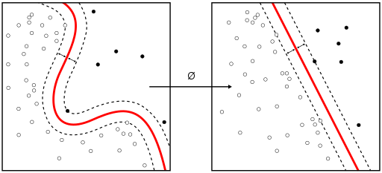
Support Vector Machines
Vector Machines | Accuracy
Training Set Size | 1k | 5k | 10k | 20k | 30k | 40k | 50k
0-100 | 0.19 | 0.19 | 0.19 | 0.19 | 0.19 | 0.19 | 0.19
100-200 | 0.21 | 0.21 | 0.21 | 0.21 | 0.21 | 0.21 | 0.21
200-300 | 0.15 | 0.15 | 0.15 | 0.15 | 0.15 | 0.15 | 0.15
300-400 | 0.25 | 0.25 | 0.25 | 0.25 | 0.25 | 0.25 | 0.25
400-500 | 0.19 | 0.19 | 0.19 | 0.19 | 0.19 | 0.19 | 0.19
500-600 | 0.15 | 0.15 | 0.15 | 0.15 | 0.15 | 0.15 | 0.15
600-700 | 0.23 | 0.23 | 0.23 | 0.23 | 0.23 | 0.23 | 0.23
700-800 | 0.18 | 0.18 | 0.18 | 0.18 | 0.18 | 0.18 | 0.18
800-900 | 0.1 | 0.1 | 0.1 | 0.1 | 0.1 | 0.1 | 0.1
900-100 | 0.25 | 0.25 | 0.25 | 0.25 | 0.25 | 0.25 | 0.25
Training Time | 0.674 | 14.68 | 58.409 | 253.598 | 572.56 | 1041.821 | 1344.291
Elaspsed time | 0.673 | 2.44 | 5.304 | 9.736 | 18 | 19.182 | 21.89
Points in space where categories are separated by gaps
Slow training
Slow classification
Miserable results
Notes:
50k takes 20 minutes
Brief explanation
Key features
Explain table and graph
Then Results

Slide 9
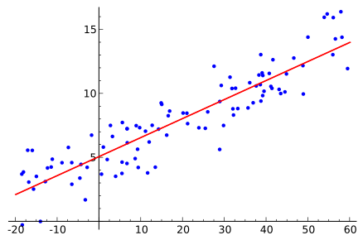
Logistic Regression
Logistic Regression | Accuracy
Training Set Size | 1k | 5k | 10k | 20k | 30k | 40k | 50k
0-100 | 0.38 | 0.36 | 0.37 | 0.38 | 0.43 | 0.41 | 0.4
100-200 | 0.46 | 0.39 | 0.39 | 0.4 | 0.4 | 0.42 | 0.39
200-300 | 0.38 | 0.38 | 0.39 | 0.38 | 0.35 | 0.34 | 0.33
300-400 | 0.55 | 0.52 | 0.53 | 0.53 | 0.52 | 0.52 | 0.51
400-500 | 0.46 | 0.45 | 0.4 | 0.42 | 0.42 | 0.39 | 0.4
500-600 | 0.42 | 0.41 | 0.43 | 0.42 | 0.41 | 0.39 | 0.37
600-700 | 0.58 | 0.46 | 0.42 | 0.39 | 0.42 | 0.38 | 0.4
700-800 | 0.39 | 0.38 | 0.41 | 0.41 | 0.42 | 0.43 | 0.43
800-900 | 0.43 | 0.39 | 0.36 | 0.35 | 0.35 | 0.36 | 0.35
900-100 | 0.51 | 0.46 | 0.46 | 0.44 | 0.44 | 0.43 | 0.42
Training Time | 0.212 | 1.12 | 2.4 | 6.08 | 13.339 | 18.722 | 20.227
Elaspsed time | 0.085 | 0.078 | 0.078 | 0.094 | 0.309 | 0.107 | 0.082
Multinomial logistic regression also known as MaxEnt
Features, scores, weights
Fast training
Fast classification
Subpar results
Notes:
Brief explanation
Key features
Explain table and graph
Then Results

Slide 10
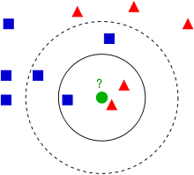
K Nearest Neighbors
K Nearsest Neighbors | Accuracy
Training Set Size | 1k | 5k | 10k | 20k | 30k | 40k | 50k
0-100 | 0.32 | 0.31 | 0.31 | 0.36 | 0.36 | 0.35 | 0.33
100-200 | 0.35 | 0.38 | 0.41 | 0.42 | 0.42 | 0.48 | 0.47
200-300 | 0.31 | 0.31 | 0.36 | 0.35 | 0.36 | 0.4 | 0.4
300-400 | 0.44 | 0.44 | 0.46 | 0.49 | 0.54 | 0.48 | 0.51
400-500 | 0.37 | 0.44 | 0.33 | 0.29 | 0.32 | 0.4 | 0.4
500-600 | 0.35 | 0.39 | 0.35 | 0.38 | 0.39 | 0.41 | 0.32
600-700 | 0.43 | 0.41 | 0.43 | 0.42 | 0.41 | 0.39 | 0.39
700-800 | 0.37 | 0.34 | 0.35 | 0.41 | 0.46 | 0.39 | 0.35
800-900 | 0.43 | 0.37 | 0.39 | 0.35 | 0.32 | 0.32 | 0.3
900-100 | 0.33 | 0.47 | 0.4 | 0.44 | 0.45 | 0.45 | 0.5
Training Time | 0 | 0 | 0 | 0.016 | 0.019 | 0.031 | 0.031
Elaspsed time | 0.155 | 0.625 | 1.078 | 1.983 | 3.31 | 4.045 | 4.59
Classified by a majority vote of its neighbors n nearest neighbors
Really fast training
Relatively fast classification
Pretty bad results
Notes:
Brief explanation
Key features
Explain table and graph
Then Results

Slide 11
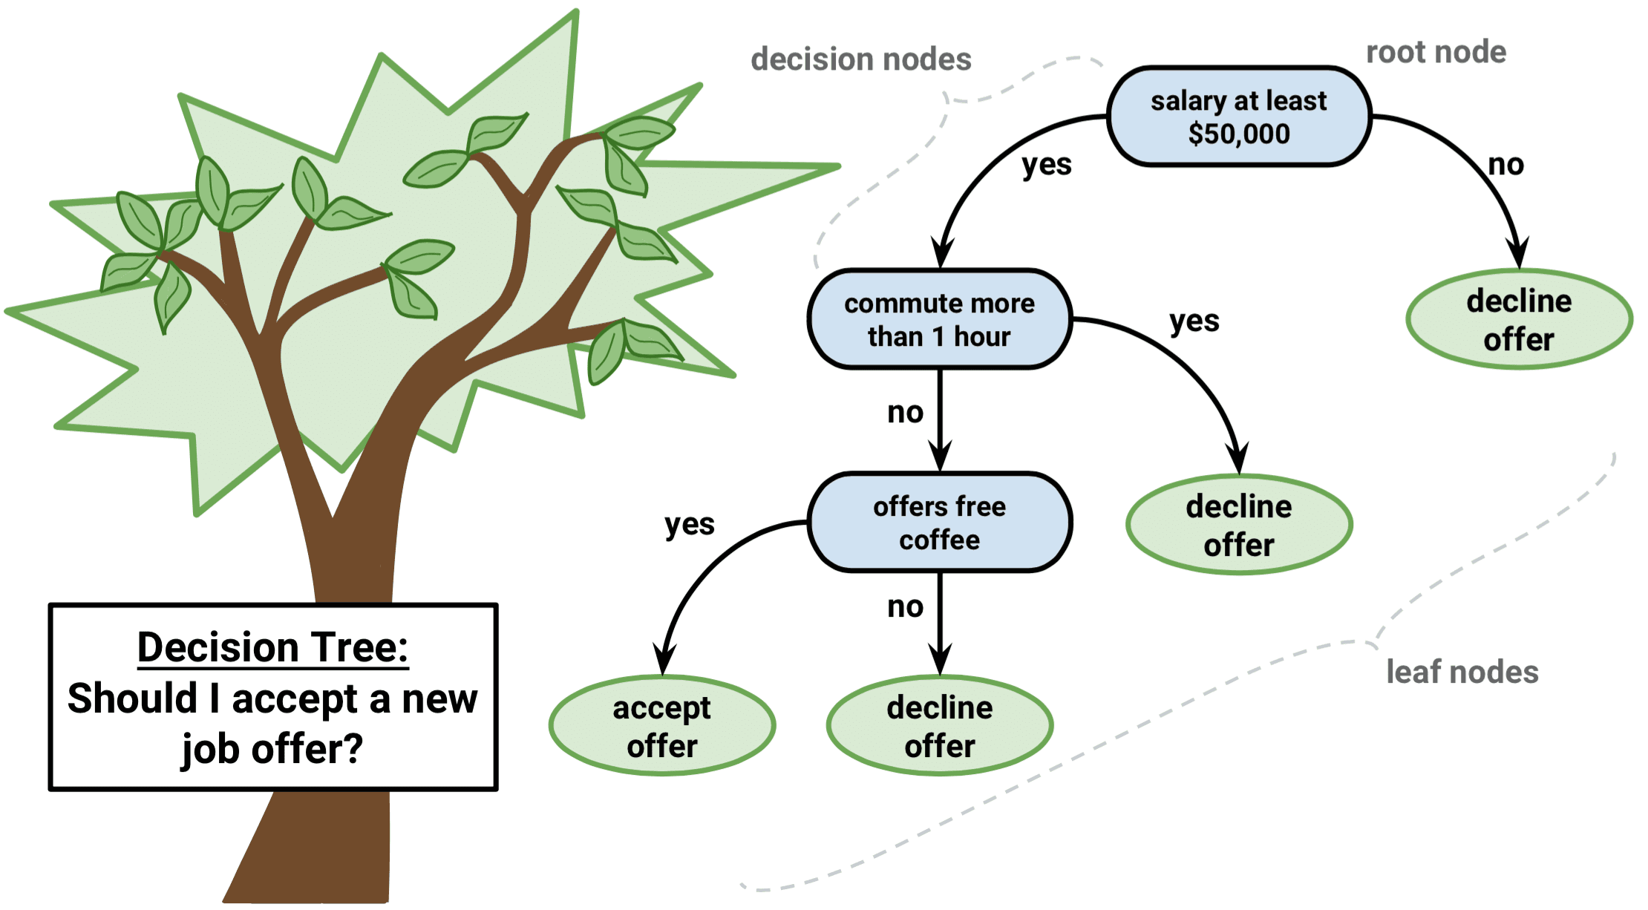
Decision Tree
Decision Tree | Accuracy
Training Set Size | 1k | 5k | 10k | 20k | 30k | 40k | 50k
0-100 | 1 | 1 | 1 | 1 | 1 | 1 | 1
100-200 | 1 | 1 | 1 | 1 | 1 | 1 | 1
200-300 | 1 | 1 | 1 | 1 | 1 | 1 | 1
300-400 | 1 | 1 | 1 | 0.99 | 0.99 | 0.99 | 0.98
400-500 | 1 | 1 | 1 | 1 | 1 | 1 | 1
500-600 | 1 | 0.99 | 0.99 | 0.99 | 0.99 | 0.99 | 0.99
600-700 | 1 | 1 | 1 | 1 | 1 | 1 | 1
700-800 | 0.99 | 0.99 | 0.99 | 0.99 | 0.99 | 0.99 | 0.99
800-900 | 0.99 | 0.99 | 0.99 | 0.99 | 0.99 | 0.99 | 0.99
900-100 | 1 | 1 | 1 | 1 | 1 | 1 | 1
Training Time | 0.806 | 7.974 | 23.993 | 56.48 | 99.828 | 159.71 | 198.07
Elaspsed time | 0.075 | 0.092 | 0.154 | 0.078 | 0.102 | 0.094 | 0.0899
Data into subsets
Decision nodes
Slowish training
Fast classification
Really good results
Notes:
Brief explanation
Key features
Explain table and graph
Then Results

Slide 12
Neural Networks
Neural Networks | Accuracy
Training Set Size | 1k | 5k | 10k | 20k | 30k | 40k | 50k
0-100 | 1 | 1 | 1 | 1
100-200 | 1 | 1 | 1 | 1
200-300 | 1 | 1 | 1 | 1
300-400 | 1 | 1 | 1 | 0.99
400-500 | 1 | 1 | 1 | 1
500-600 | 1 | 0.99 | 0.99 | 0.99
600-700 | 1 | 1 | 1 | 1
700-800 | 0.99 | 0.99 | 0.99 | 0.98
800-900 | 0.99 | 0.99 | 1 | 1
900-100 | 1 | 1 | 1 | 1
Training Time | 56.315 | 435.316 | 1506.819 | 10349.03
Elaspsed time | 0.026 | 0.105 | 0.25 | 0.15
Process samples one by one
Compare result to actual label
Errors are from classification are used to make modifications
Backwards prorogation, tuning
Slowest training I ever did see
Fast classification
Great results
Notes:
Brief explanation
Key features
Explain table and graph
Then Results

Slide 13

My Naïve Bayes
MyNB | Accuracy
Training Set Size | 1k | 5k | 10k | 20k | 30k | 40k | 50k
0-100 | 0.94 | 0.71 | 0.64 | 0.56 | 0.48
100-200 | 0.87 | 0.72 | 0.67 | 0.62 | 0.59
200-300 | 0.94 | 0.7 | 0.62 | 0.56 | 0.54
300-400 | 0.88 | 0.72 | 0.69 | 0.66 | 0.6
400-500 | 0.88 | 0.71 | 0.62 | 0.54 | 0.53
500-600 | 0.91 | 0.75 | 0.67 | 0.57 | 0.6
600-700 | 0.84 | 0.7 | 0.6 | 0.56 | 0.51
700-800 | 0.84 | 0.7 | 0.64 | 0.61 | 0.55
800-900 | 0.93 | 0.72 | 0.63 | 0.56 | 0.5
900-100 | 0.87 | 0.78 | 0.72 | 0.67 | 0.63
Training Time | 0.16 | 0.944 | 2.713 | 14.99 | 24.331
Elaspsed time | 132.059 | 877.13 | 2418.075 | 3427.908 | 41635.77
Made by me
Bag of words method
$$P\left(C | X\right)=\frac{P\left(X | C\right)P\left(C\right)}{P\left(X\right)}$$
Fast training
SLOW classification
Good then terrible results
Notes:
Brief explanation
Key features
Explain table and graph
Then Results

Slide 14
Algorithm Comparison

Slide 15





My NB In Action
Emoji Mapping
Notes:
Brief explanation
Key features
Explain table and graph
Then Results

