Slide 1
Basic patterns of reliable microservice architecture
@alexgaas

Slide 2
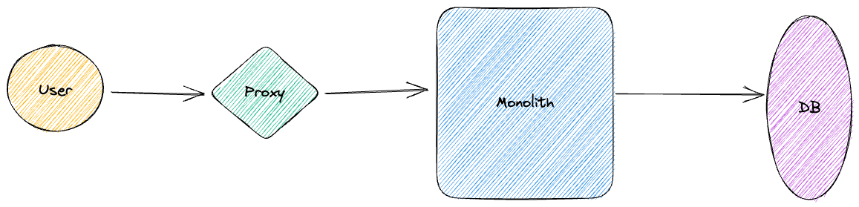
Gear Store – that’s going to be our example
Gear Store is a system to delivery any gear you want from our gear store to your front porch
We have this service as classic monolith already with simple schema – there is proxy/gateway in front of monolith and database behind it to store any data
As engineers we decided to make any new features as separate microservices

Slide 3
What we will look in aspect of reliable architecture patterns
Retry
Deadlines
Rate limiting
Circuit breaker
Idempotency keys

Slide 4

RETRY
We as engineers getting request from solution owner to implement system of dynamic rating for any slalom gear product (currently ratings for products been hardcoded in database)
We need to implement a service to calculate rating dynamically for each product based on user feedback and use that rating numbers later to sort out product list
Great! We understand this feature could be great candidate to build our first microservice out of monolith!

Slide 5
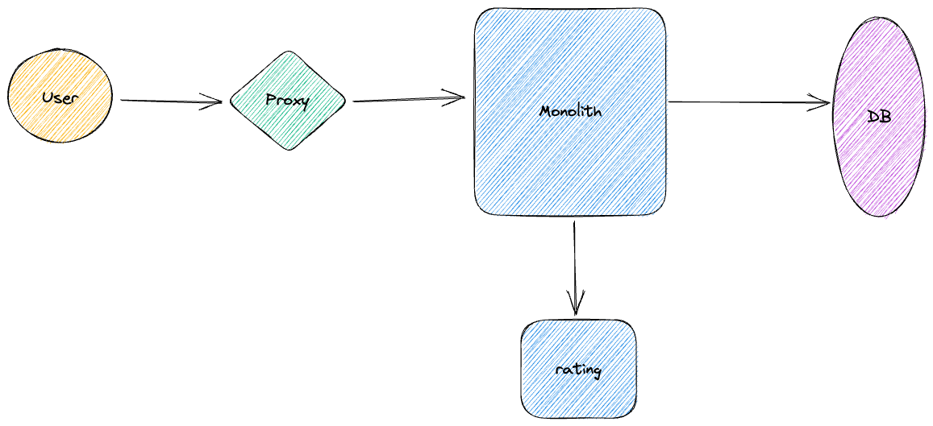
If rating service not responding for some reason, we show no rating on landing page and enable default sorting (and sure, we will work hard to make it available ASAP)

Slide 6
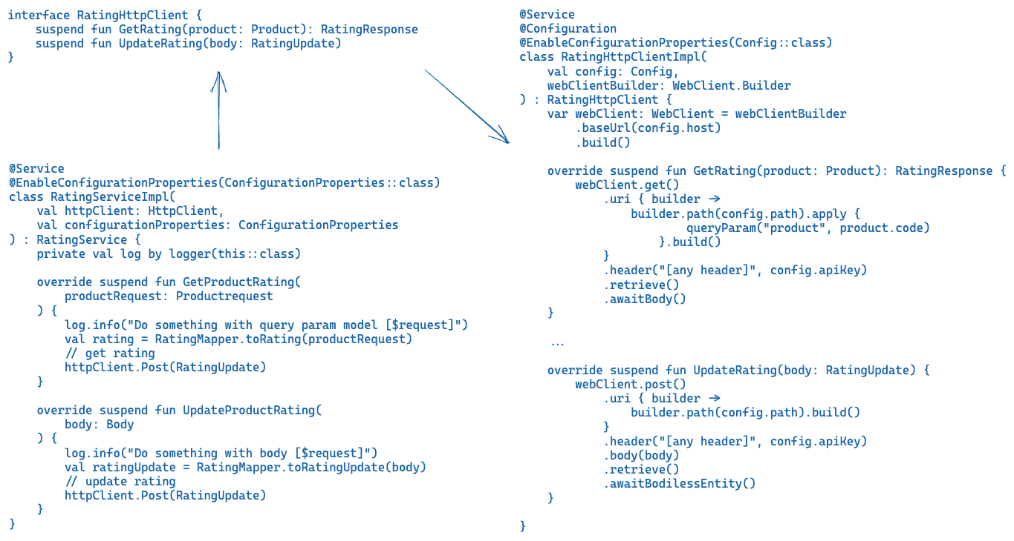

Slide 7
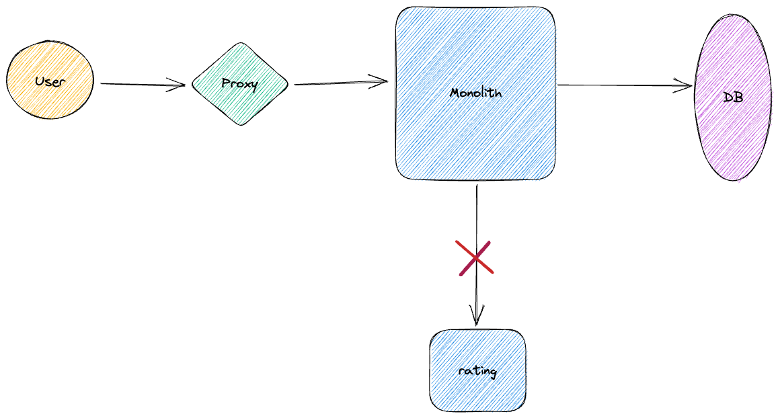
After some time of usage our excellent service we notice users see time to time nullable ratings and degradation of Sorting in our landing page.
We looking into logs / app insights and notice most of the
errors been result of timeouts.
What the issue here?

Slide 8
Problem:
Network errors
110 Connection timed out / …
100 Network is down / 101 Network is unreachable
111 Connection refused / …
Service timeout and errors:
Timeout: 504 Gateway Timeout / 408 Timeout occurred
Retry-after: 503 Service Unavailable / 429 Too many requests
500 Internal service error (we all “love” this error!!)

Slide 9
Solution
RETRY request (we do not ask user make refresh every time when it fails, we just do it for him, and he even will not notice that!)
With restriction of number of requests (we will strictly try 3 times by example)
With restriction of general awaiting time (we ready to await rating by example 200ms including maximum number of retry attempts)
Exponential backoff and jitter - https://aws.amazon.com/blogs/architecture/exponential-backoff-and-jitter/
Follow http standard – pull out headers and find for Retry-After

Slide 10
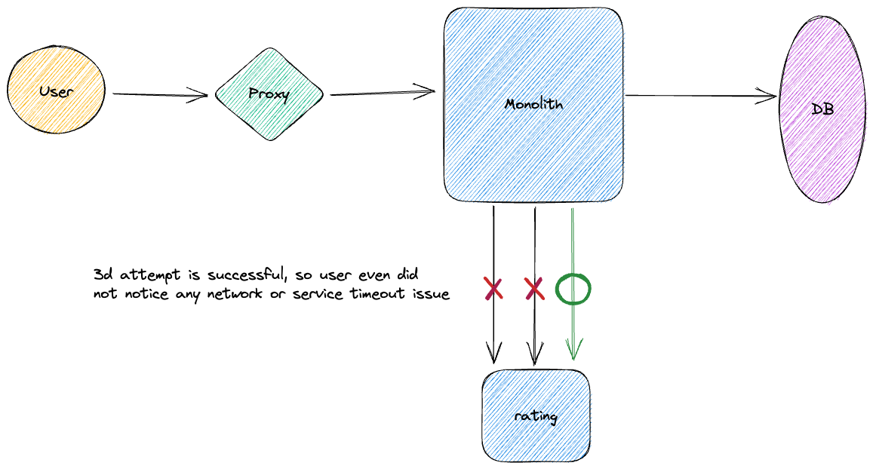

Slide 11
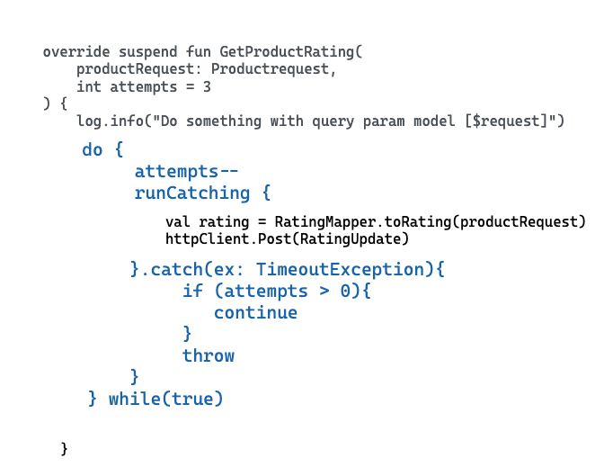
Spring Boot Retry implementation - https://github.com/spring-projects/spring-retry

Slide 12

Idempotency key
Our solution owner produces new idea – multi-basket which allow few users to share one order!
That’s amazing opportunity for us to make a new service Order. Microservice design in action comes true!!!
We keep in mind to implement retries for Order service is worth based on our previews experience with rating service. We using same code with 3 attempts as for rating service

Slide 13
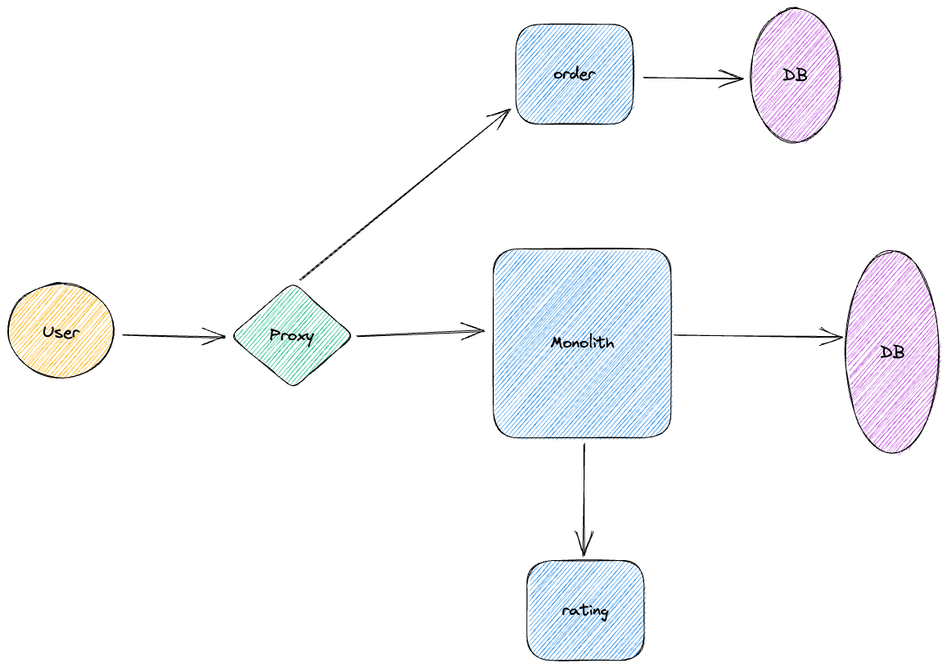

Slide 14
Problem
User makes order first time and some error happen on the route between order service and proxy. But service successfully saves order
User makes attempt again with same result. No 200k response but order been saved successfully by service
User trying third time and getting back 200k. Success!
But as result users gets three same purchases and money withdrawal 3 times
User is NOT happy, he calls to customer support

Slide 15
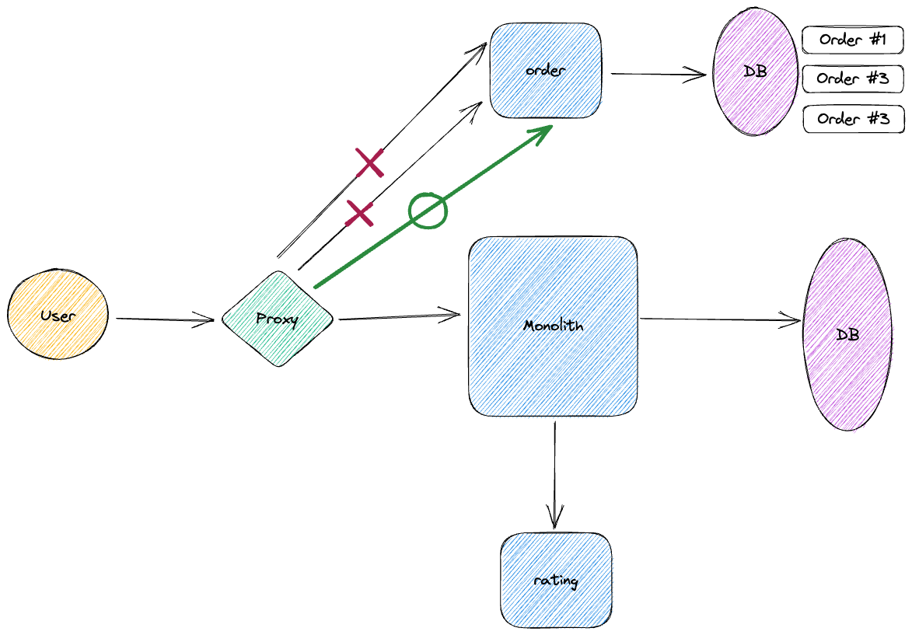

Slide 16
Solution
- What’s happened? Network can fail not only on sending but also on receiving of data and that’s usual situation.
As solution we must ask our user/frontend to generate any random string (idempotency key)
Order service just validates by idempotency key and do not create any duplicate of order in case of failure
As outcome just adding one key between frontend and service, we implement semantic “at most once”
Look on this short article from Stripe about their IK implementation findings - https://stripe.com/blog/idempotency

Slide 17
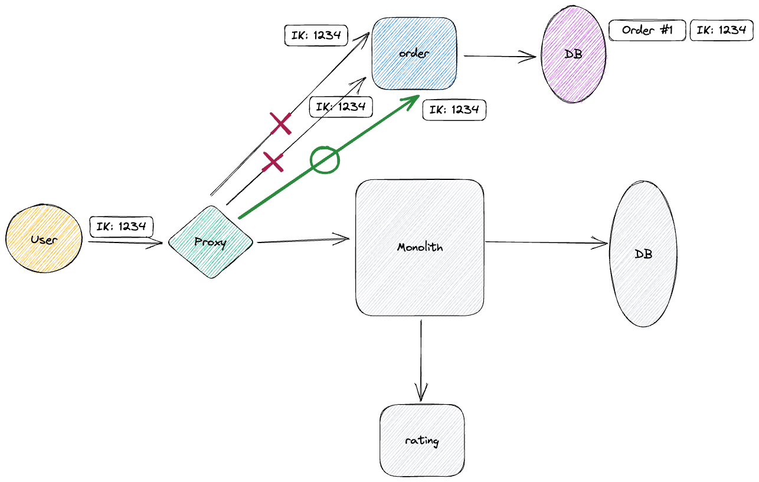

Slide 18
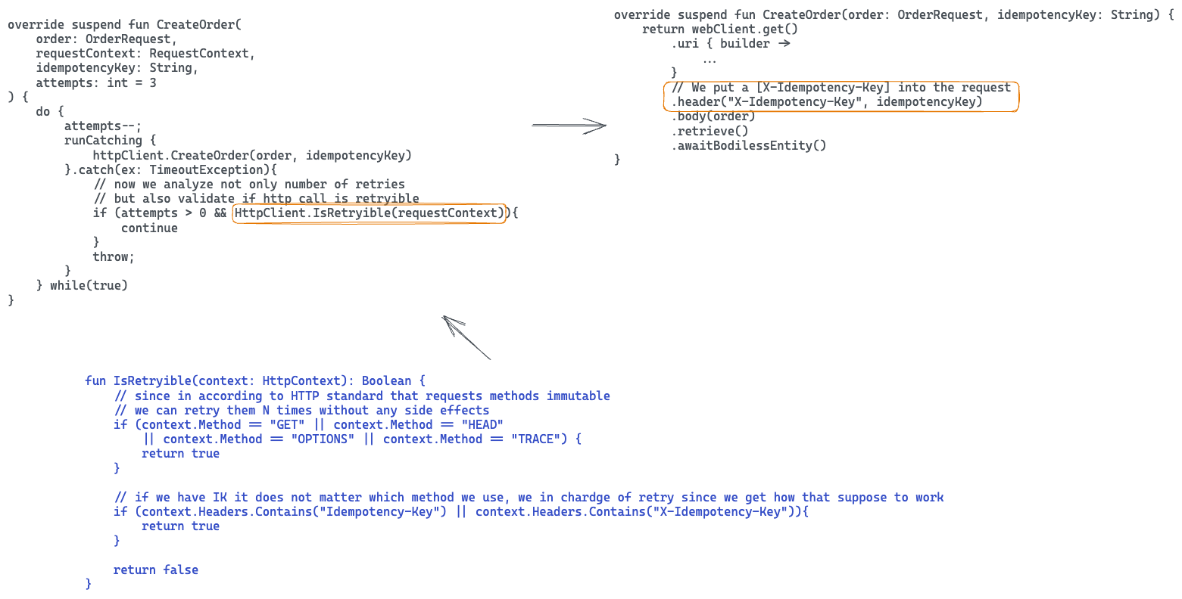

Slide 19

Deadlines
(“Deadlines” as a term been introduced by Google when they released grpc framework)
New feature from solution owner – user statistics. That statistics from user suppose to provide us data about user’s favorite gear!
In fact, that’s aggregation of user statistics
So far so good - as outcome of discuss with SO we make a new service “user_stat”

Slide 20
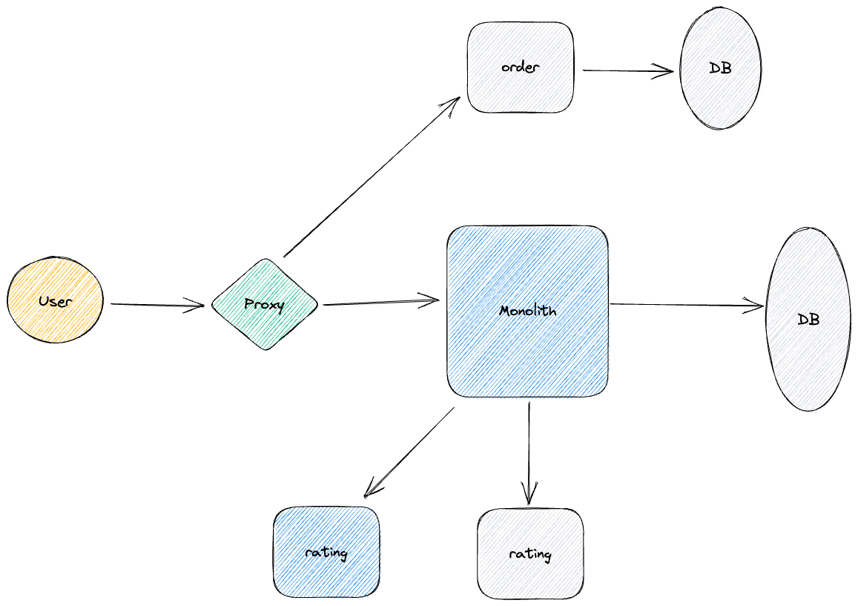

Slide 21
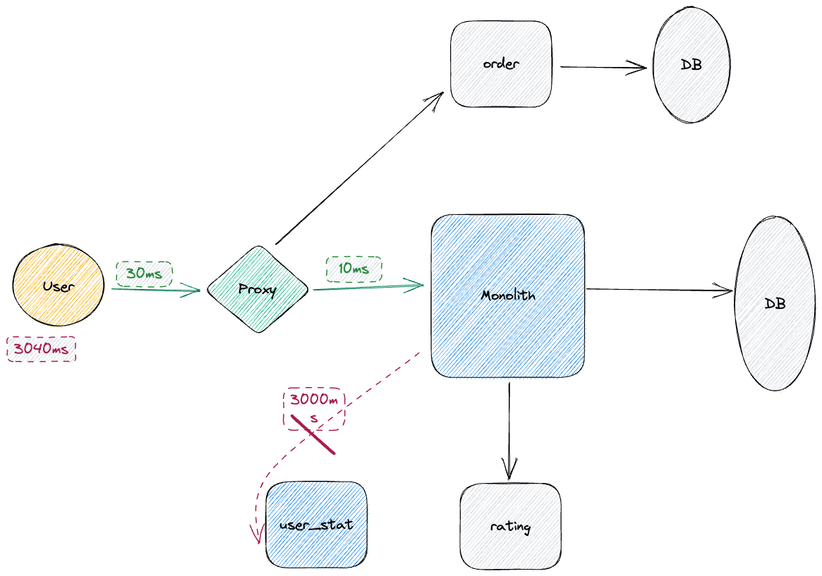

Slide 22
Problem
Network timeouts
Connection drop
Instance/pod issue (issue with container or cloud, problem with your source code)
Requested resource is not available

Slide 23
Solution
Define await time on client side (we on monolith as client ready to wait no more then 100ms by example. If time of awaiting is more then 100ms we break up connection and try again)
Setup deadline propagation. We explicitly say to requester service how long we expect to await response from him. Using that information requester server can fallback to simpler workflow based on estimation / etc.
As part of solution, we may setup only for one retry or either general time based on our strategy (we ready to wait 100ms per request or 300ms in general to await response)
Configure timeouts based on service demand. Each service must have his own configurable timeouts depends on use case
In addition, setup deadlines by 99% percentile .

Slide 24
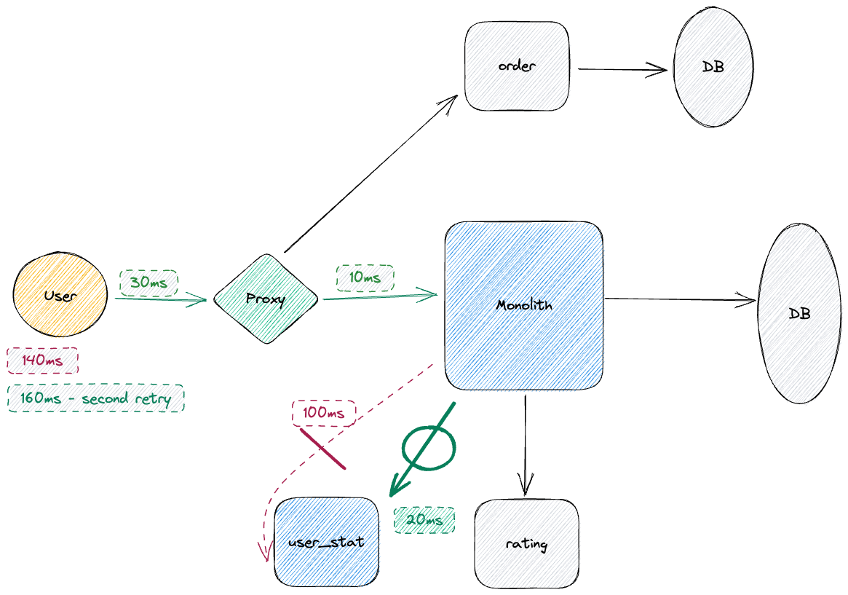

Slide 25
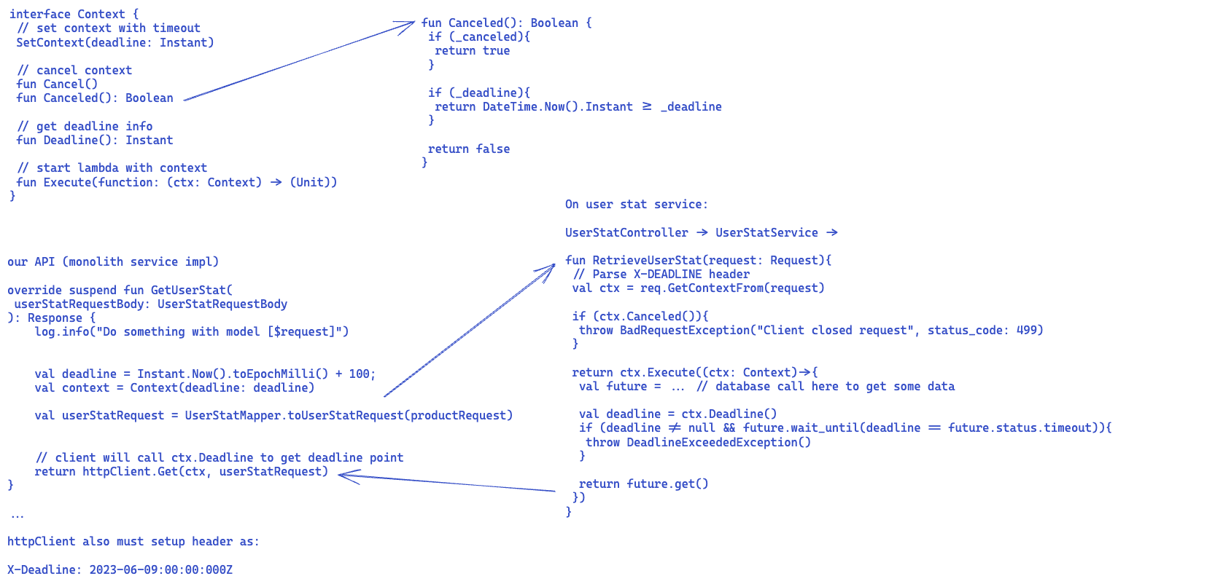

Slide 26

Rate limiting
New use case from our solution owner – we need to predict time of delivery of our gear to provide best customer expectations. Wow Slalom Gear Store looks like Uber or Doordash now, so exciting!!
We decided to have two new microservices – time_predictor and road_graph. Time Predictor provides user average time of delivery from Slalom Store. Road Graph behind Time Predictor will calculate for us real delivery time from point A to point B on the city map.

Slide 27
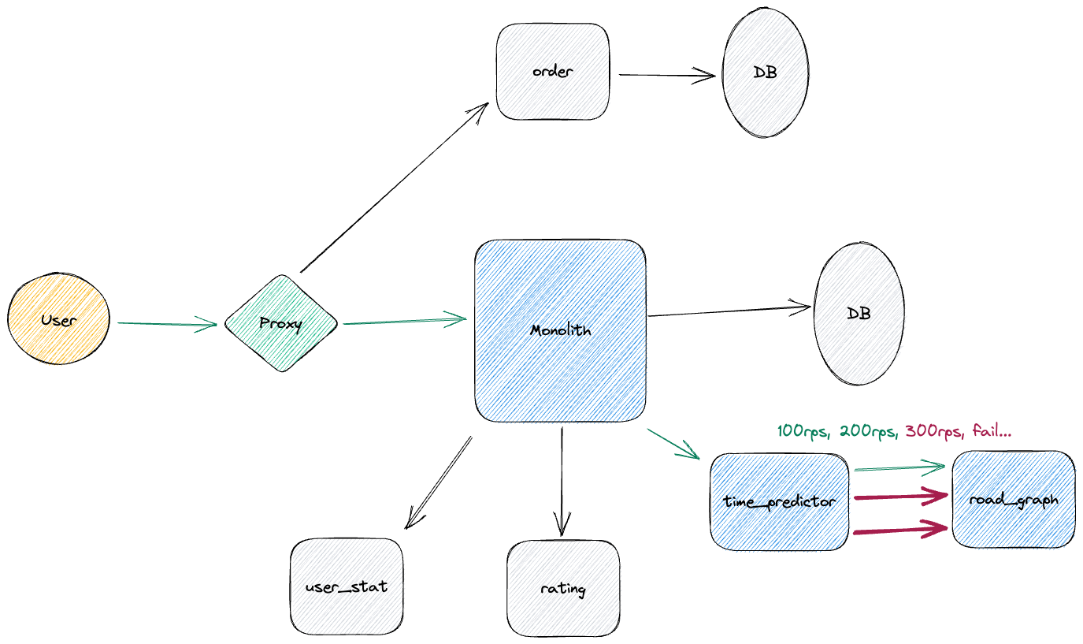

Slide 28
Problem
Service (hardware) resource limits
Spike traffic growing (one of data centers outage as the reason)
Unplanned traffic growing: DDOS attack or just natural growing
Broken client (like infinite loop in client)

Slide 29
Solution
Rate limiting – client or server side (limit by quote like 2000rps per 3 seconds or limit by rate – no more then 3 requests per sec by example)
Limit rates by number of parallel requests
Quote for rate limits (X-RateLimit-Limit, X-RateLimit-Remaining, X-RateLimit-Reset)
Standard HTTP code is 429 Too Many Requests
Burst limiting
Limit correctly spikes

Slide 30
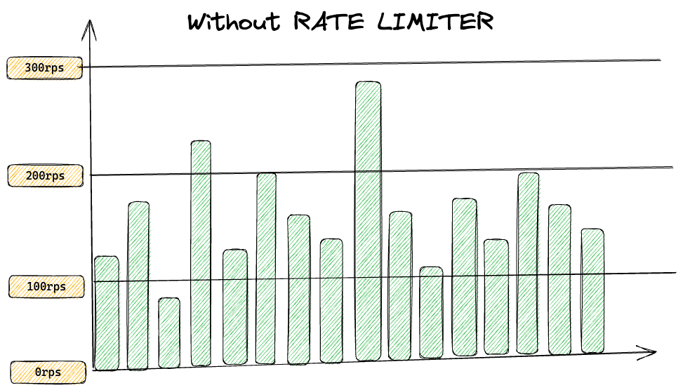
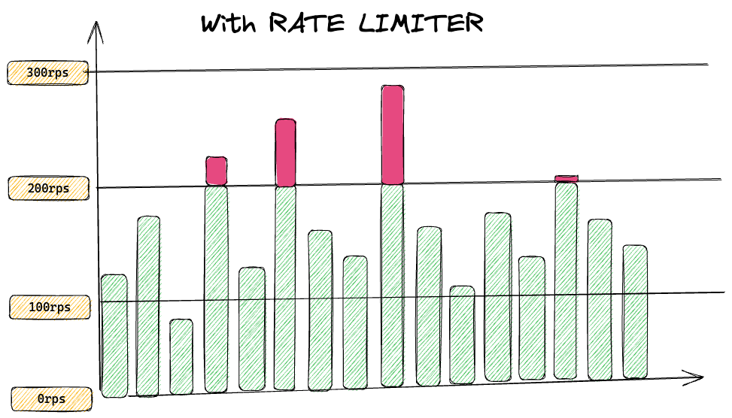
As you may notice if request just a little bit bigger than rate limit, request will be rejected, and user will need to make retry. To avoid this issue, we may apply burst limiting

Slide 31
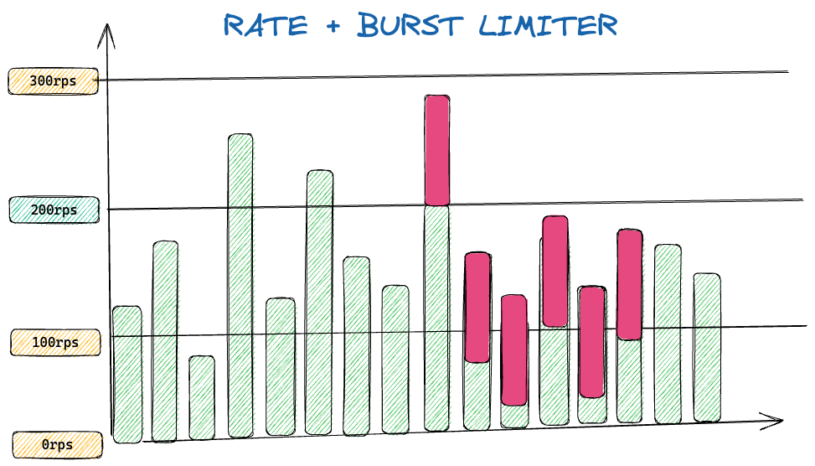
When we use rate + burst limiting, we define two limits – common rate limit which defined usually not as simple 100rps
but 1k requests per 10 seconds. In other word we increase period of rate calculation.
Second limit (burst limiting itself) stricter – if request trying to pass that limit, we immediately must reject that request.
As outcome here – even if user over limited some small time he can “take in debt” assuming his activity will be reduced later.
But he going out of the quote or even going out the burst we decrease his possibility to make requests per time.
Rate + Burst limiting distributes our loading more evenly what in most time make user happier (except he is going out of
Burst limit).

Slide 32
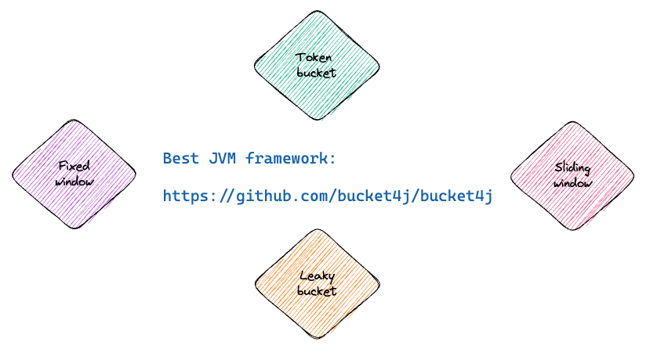

Slide 33
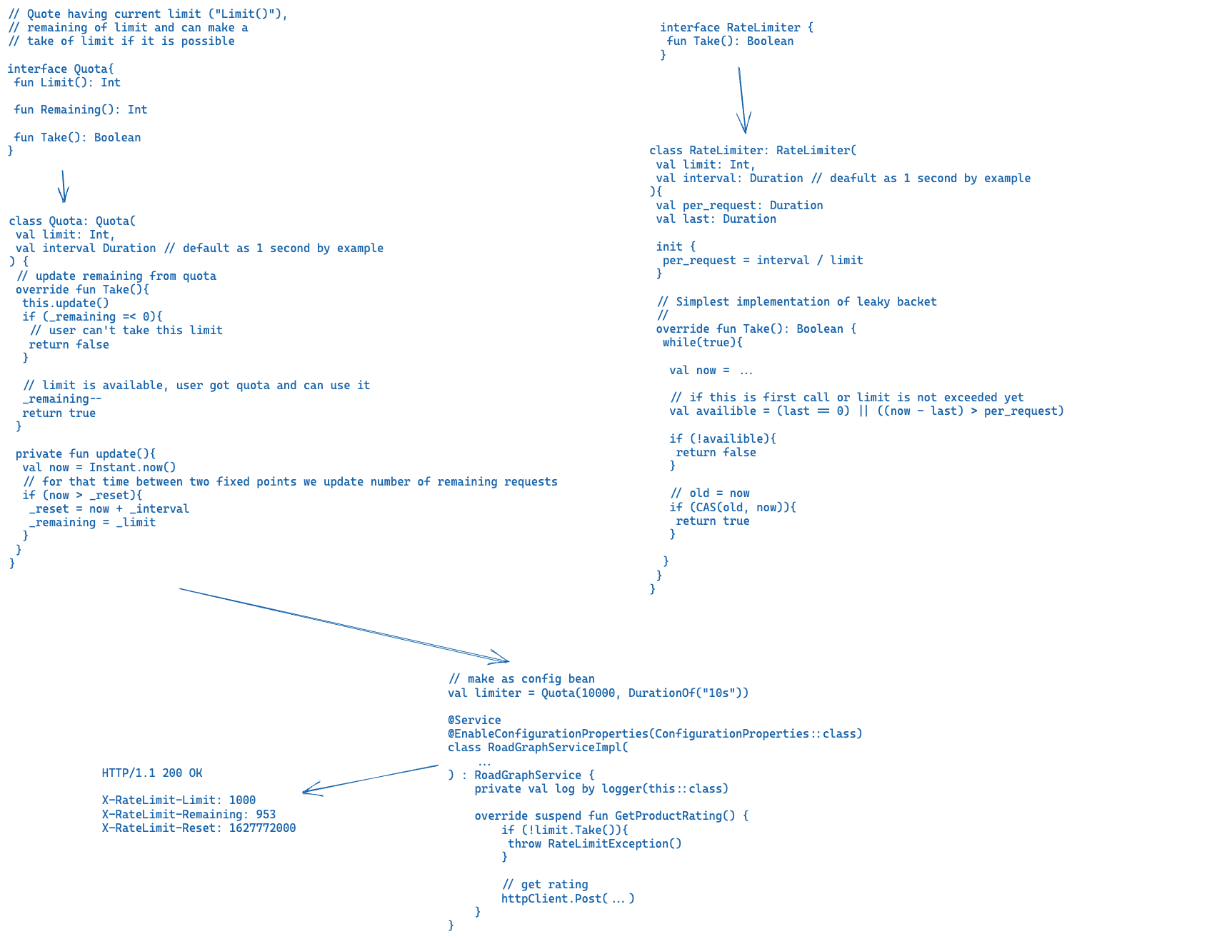

Slide 34
Rate liming finalization
There is one problem you can meet building your own rate limiting system - if you have many instances of service as part one big system (k8s as example), quotes and remaining of limits should distribited evenly between instances.
As outcome here - if you making rate limit system you must distribute it evenly between all nodes of your system.
There are plenty of proxies and cloud solution which provide you rate liming out of box – NGINX, Envoy.

Slide 35
Circuit breaker
Ok I got pulled by my solution owner again and he said – our Slalom Build ML department wants add to Slalom Gear new amazing ML service to calculate rating of gear using AI
Wait what? AI? Have you consulted with Elon already regarding it? He got concerns though…
Ok but now I’m going to setup retries, make deadlines, settle down rate limiter – all past lessons learnt perfectly.
But something again not right…

Slide 36
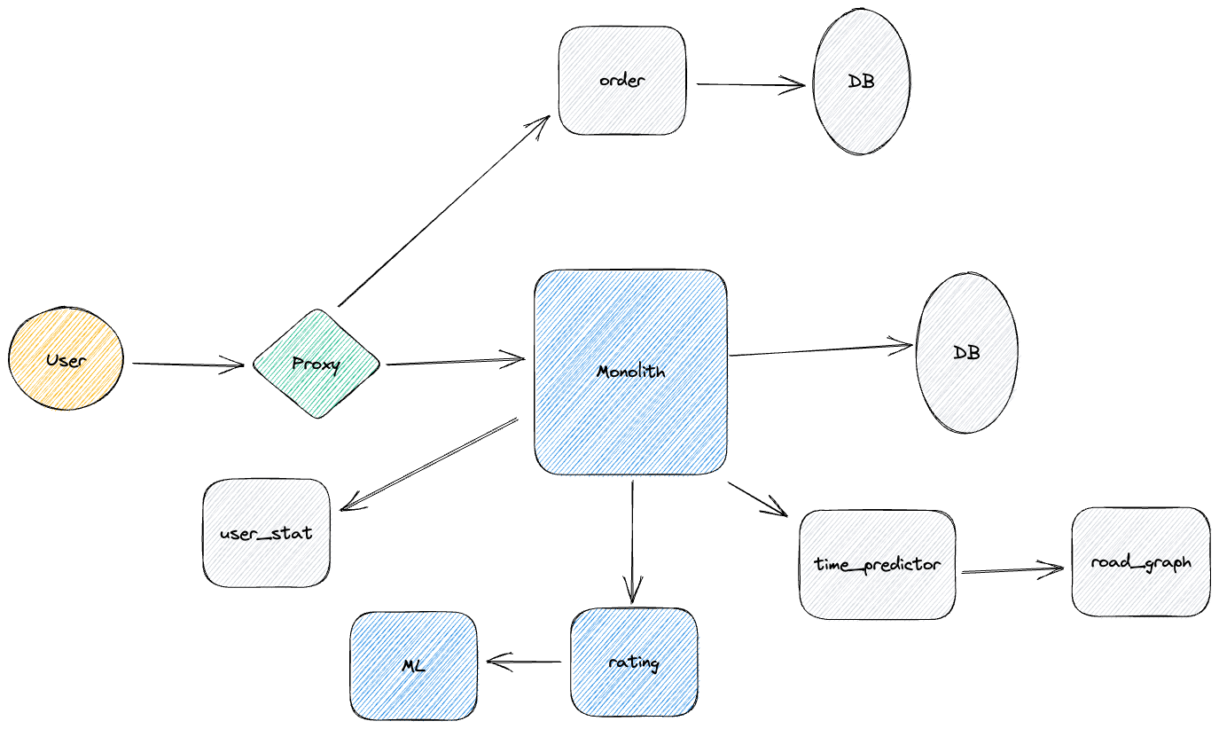

Slide 37
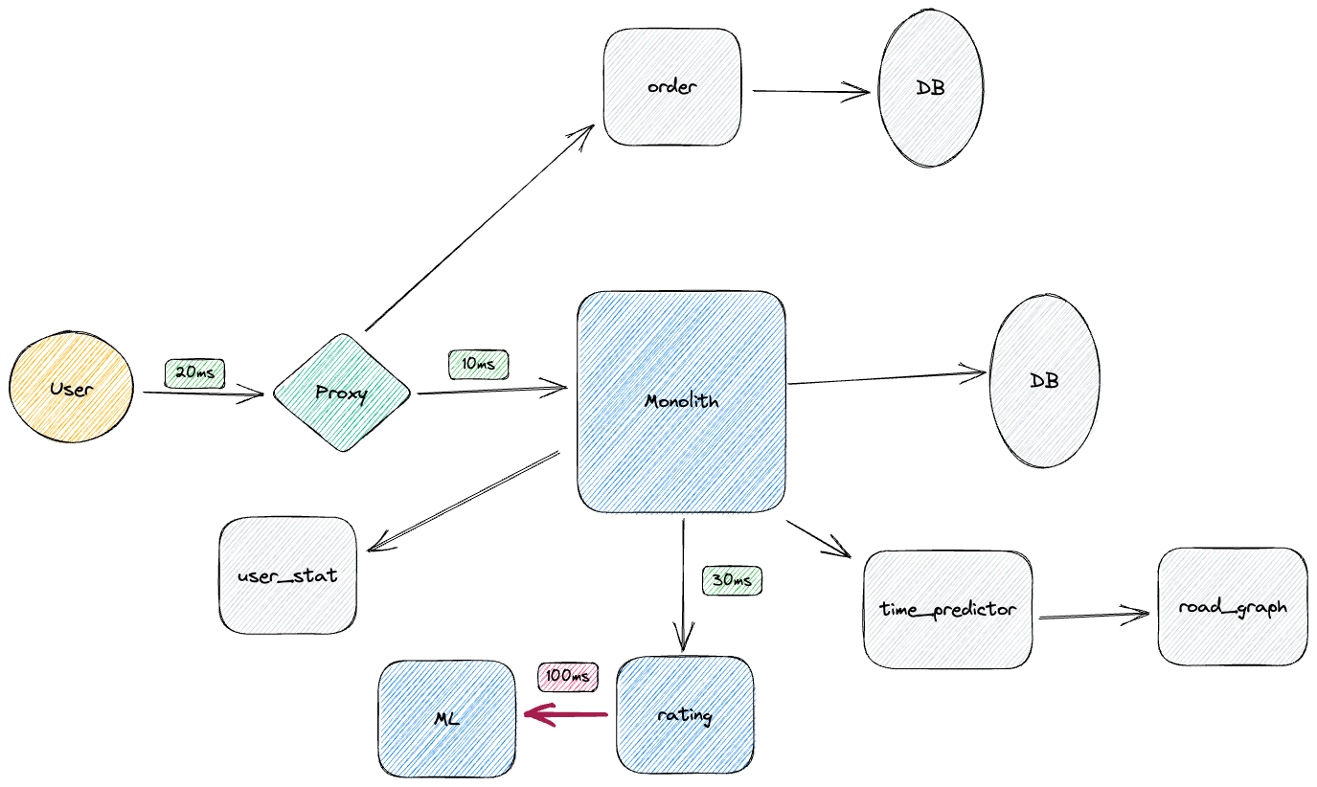

Slide 38
Problem
ML service just going down. All requests return back 500 errors
As result our user is waiting for +100ms just to recognize something is wrong
And keep and keep add requests to the ML service overloading already broken service
Every retry in this will make it worst

Slide 39
Solution – circle breaker
Turn off service/dependency in case of spike / repeatable errors
Validation of service/dependency recovery
By timeout
Network / traffic probe
Health checking

Slide 40
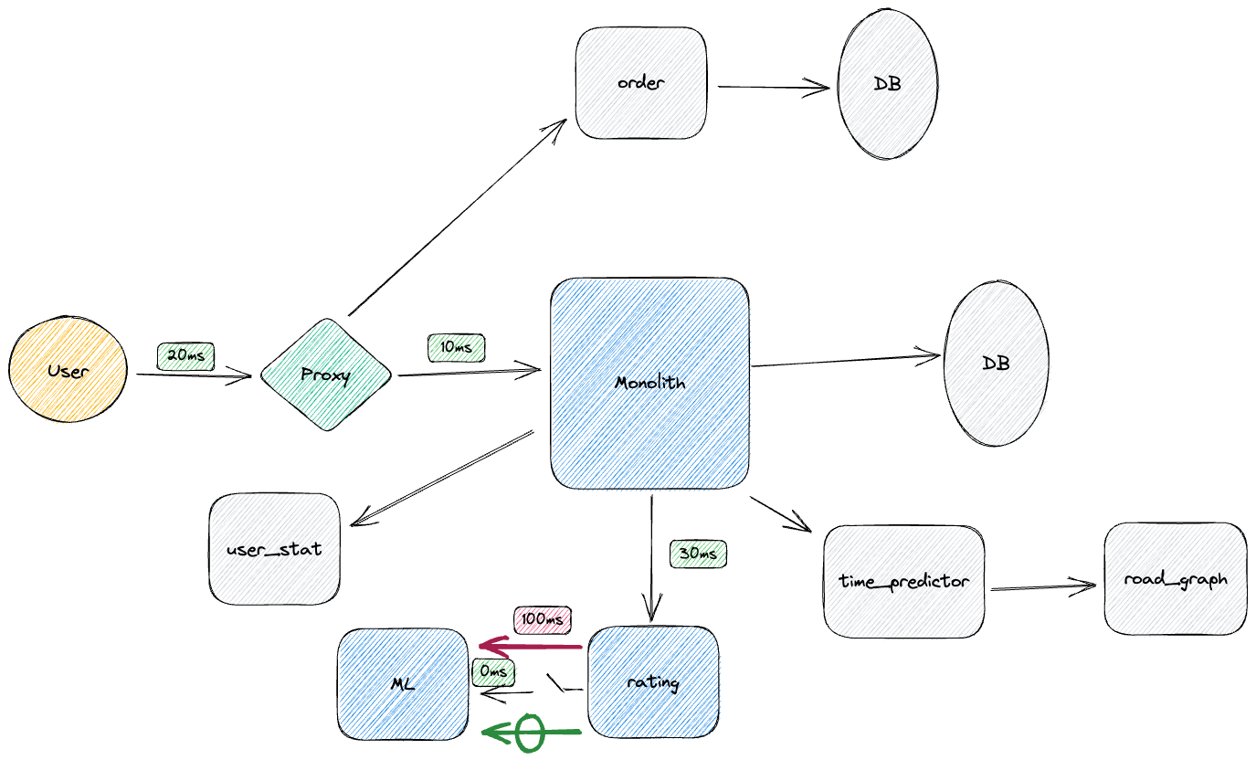

Slide 41
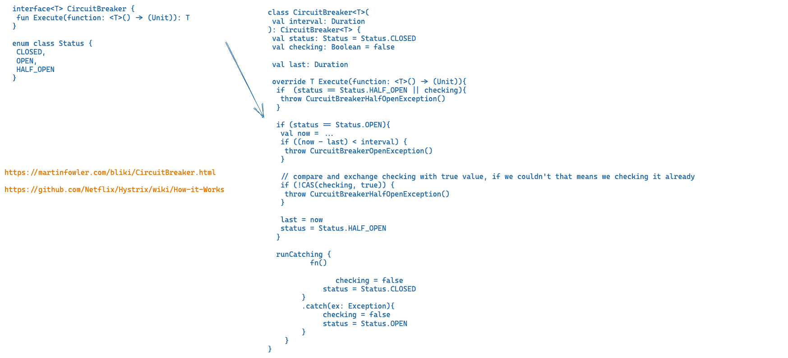

Slide 42
Thank you!
Summary
Out of context:
Rich Client pattern
Dummy/failover pattern
Health checking (nginx, envoy, consul, custom service discovery)
Exponential backoff and jitter
Caching and failover caching
Dynamic configuration (consul, custom paxos/raft based client)
Service Mesh patterns
Devops patterns and practices (blue green deployment, canary, etc, sidecar solutions)
Detailed analysis of solutions in cloud environments and what can offer other frameworks (such as https://github.com/resilience4j/resilience4j)
Integration with web frameworks

