Slide 1
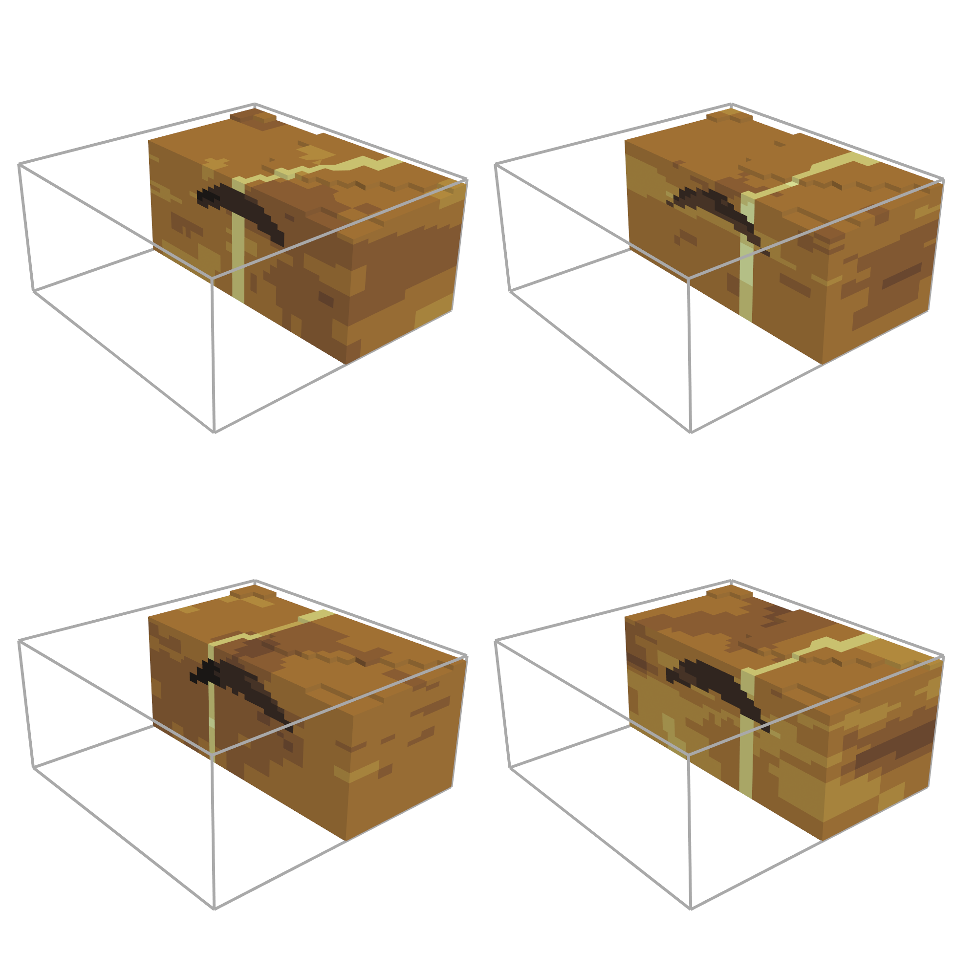

Slide 2
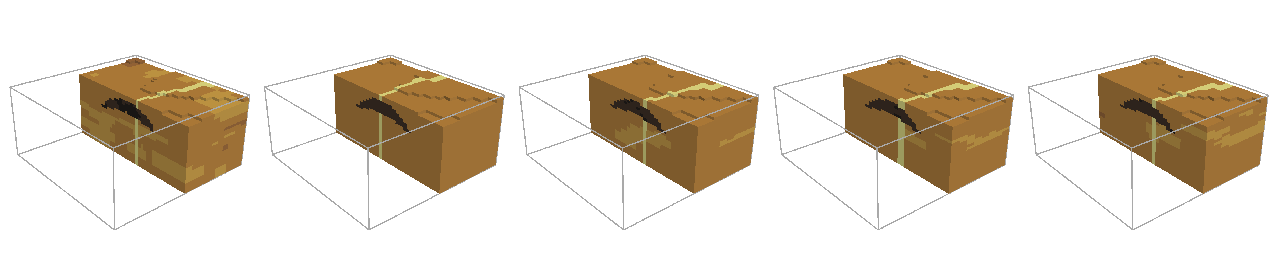
Truth
Prior Mean
EKI
EKI (Localisation)
EKI (Inflation)

Slide 3
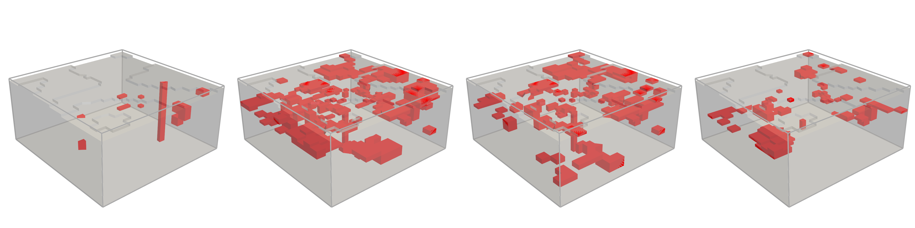
Prior
EKI
EKI (Localisation)
EKI (Inflation)

