Slide 1

Zen
programming

Slide 2
Not-Zen programming

Slide 3
A tale on non-zen programming

Slide 4
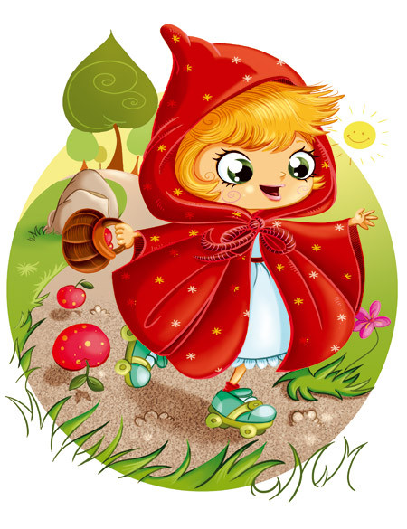
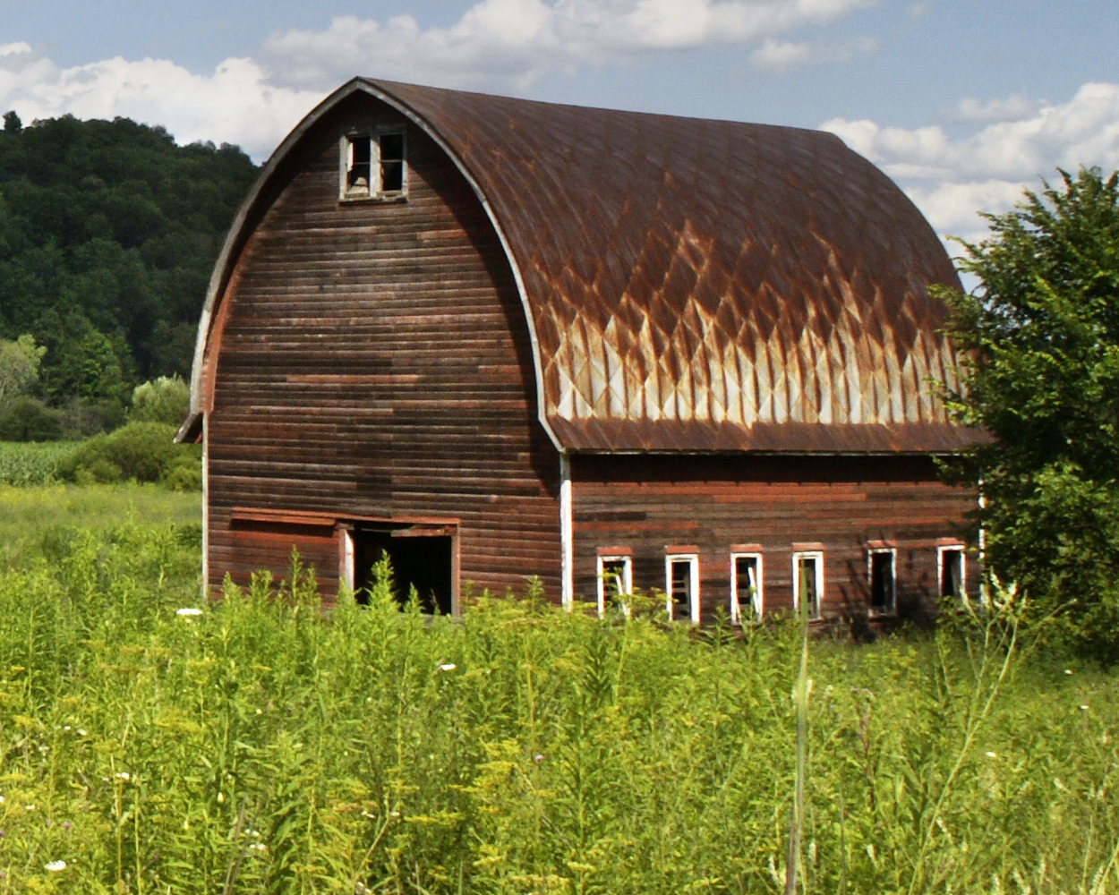
A tale on non-zen programming

Slide 5
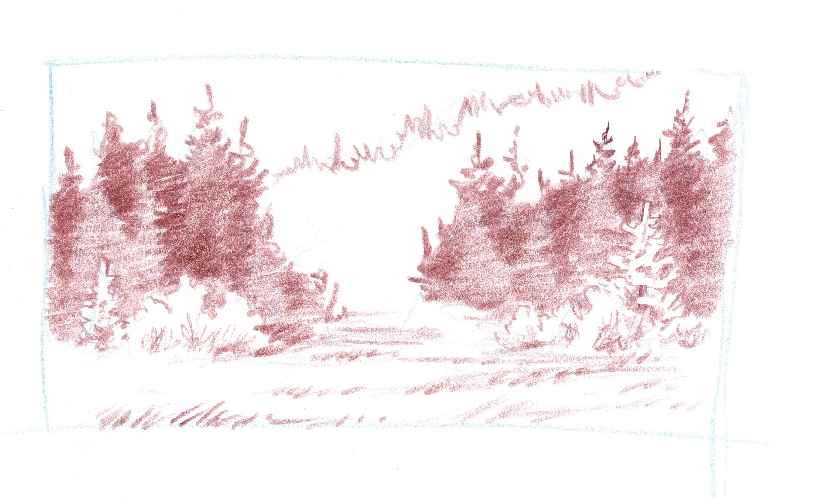
A tale on non-zen programming

Slide 6
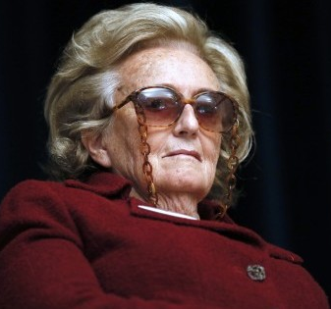
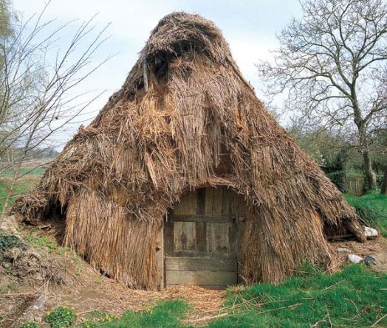
A tale on non-zen programming
A tale on non-zen programming

Slide 7
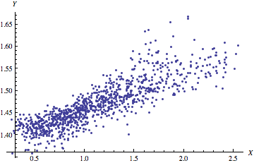
Let's talk on the 18th !
Nice

Slide 8


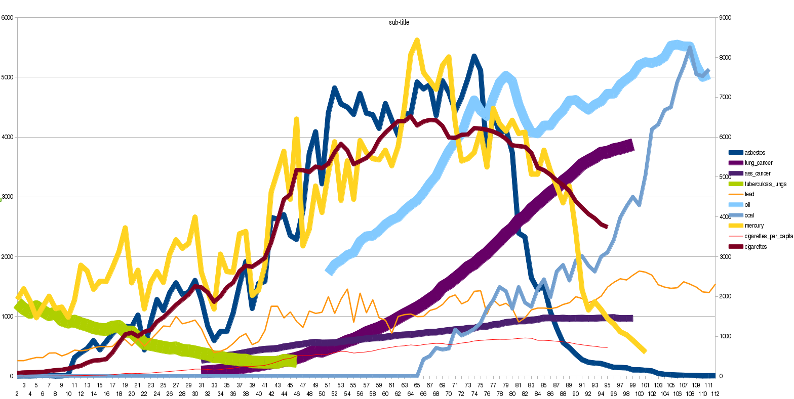
Not Nice

Slide 9
8

Slide 11
«
- Hey check this out
Nice
- Nice ! Great job !
- Wait, can you remind me what the axes are ?
- No problem, let me just add some labels !
- @#*”é”[[{#
Not Nice
- Oh là là

Slide 12
Non-Zen Programming
- Touch one thing: everything breaks
- Something stops working: no way to reverse changes
- Cryptic, untractable errors

Slide 13
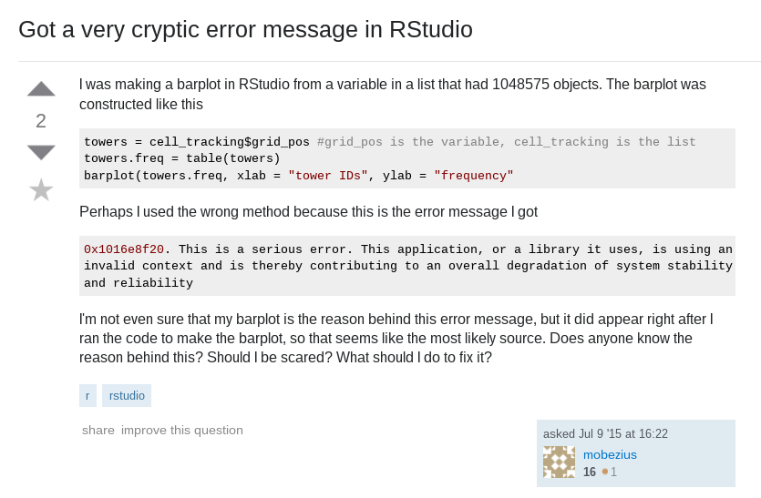

Slide 14
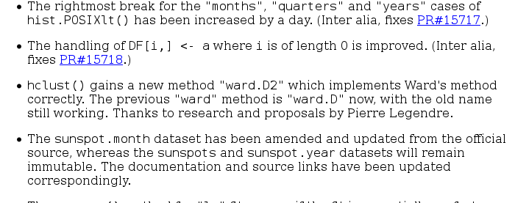
Non-Zen Programming
- Touch one thing: everything breaks
- Something stops working: no way to reverse changes
- Cryptic, untractable errors
- Things never work on others' computers
- Unsure about what your program does ?
New stuff in
R 3.1.0 (2014)

Slide 15
Why do we program ?
Why not using all-in-one software ?
glm
α, β, ...
Data
f(x)
Α', β', ...
x 1000

Slide 16
Why do we use R ?
< This page is intentionally left blank >

Slide 17
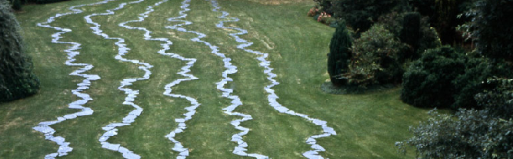
Five ways to zen programming
Organize your work
Write readable code
Choose the right data
structures
Programming paradigms
Recognize analysis
patterns

Slide 18
Organize !
Do not
One project – one folder
Example : plos biology
Time to resuming

Slide 19
Know your data structures
Do not : e.g. use matrix instead of df
Which ones do you know ?
Review of what we have in base R
What would you use ?
- A set of field work sampling on different sites
-
Type stability
Type stability

Slide 20
Write readable code
Do not
Writing: keyboard (}, suppr on macs), text editors
Write with style
Write a story
Adapt to your public: do not use gadgets
Be expressive: good names, good `[`
Situations:

Slide 21
Recognize patterns
Do not
Break it down into functions
Linear analysis
Repeat - combine
Split – apply - combine
Moving window

Slide 22
Programming paradigms
History of languages
OOP: methods, polymorphism, inheritance
Functional programming

