Slide 1
Dynamic weighted majority
Alejandro González
Notes:
I am gonna present the algorithm Dynamic weighted majority

Slide 2
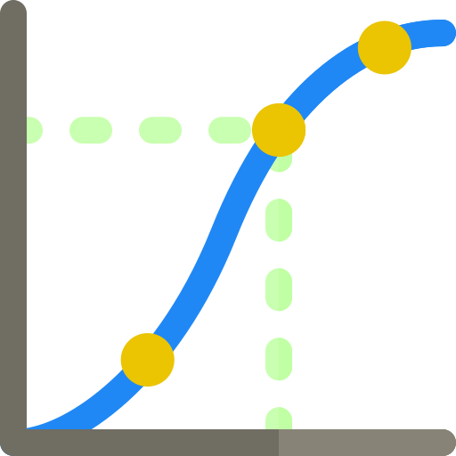
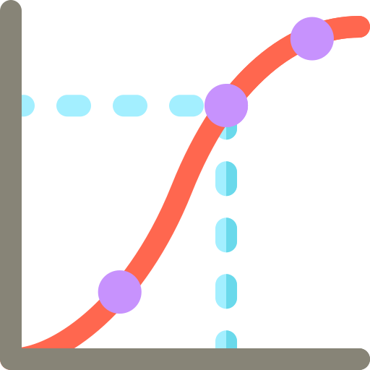
Concept drift
t
¡Data changes over the time!
Notes:
DWM is an algorithm used to handle concept drift.
Concept drift is the phenomena that occurs when data variables, attributes or labels change over the time in unexpected ways. Concept drift with standard machine learning and analytics techniques leads to lower the accuracy.
Some examples of concept drift are:
Weather data: The meaning of warm is different in each season, therefore the threshold for temperature value that indicates warm or cold is different throughout the year.
Email relevance depending in the time of the year. Advertisement email might be more interesting for customers close to christmas or black friday.
Many data presents concept drift problem.
In this work I have built two artificial datasets to test the algorithm that are:
STAGGER
SEA

Slide 3




Concept drift
Weather data
Email relevance
Summer
15 ºC
Winter
15 ºC
t
2 artificial datasets: STAGGER and SEA

Slide 4
DWM algorithm
Weighted ensemble classifier
Online learners
Naive Bayes...
β: Weight scaling factor
θ: Weight threshold
P
Notes:
Algorithm:
DWM is an weighted ensemble classifier made up by online learners. Online learners are able to constantly learn from new samples arriving from the datastream.
For every new sample that arrives the learners predict the expected label. If the prediction of the learner is wrong the weight of the learner is decreased by a factor “Beta”. Besides, if the overall prediction of the ensemble is wrong, a new learner is appended to the ensemble with weight 1. However, before adding the new learner the weights of the rest of the learners are normalized to 1 in order to given excessive power to the new learner. Then, all the learners from the classifier are trained with the sample. Whenever one of the weights of the learner goes below a certain threshold “theta” the learner is removed from the ensemble. This allows to progressively eliminate old learners that were trained for other concepts
DWM allows some variants to speed up the process. For instance, a parameter “p” allows to update the ensemble model and the weights of the learners every “p” samples. Also, there is a variant of DWM that restricts the maximum number of learners in the ensemble. In that approach, when the maximum number of learners is reached the learners with lower weight is replaced by a new learners. Learners are not discarded by weight threshold.

Slide 5
DWM algorithm
Train first learner
Predict input sample
Update weights
Normalize weights
Remove learners (if necessary)
6. If global prediction wrong: Add new Learner
7. Train learners with input sample
8. Repeat from 2
Notes:
STAGGER
Stagger concept explain.
The dataset built has 120 samples and every 40 samples the concept changes.
In order to validate the performance of DWM we compared it to a Naive Bayes perfect forgetting (Best case) and a Naive bayes that learns over all the data (Standard algorithm).
Since the data is discrete I one hot the attributes and used a Bernoulli Naive Bayes classifier. Having only 120 samples I set the p to 1 meaning that the model would be updated at each step.
The Beta and the Theta were set to 0.5 and 0.01 respectively.
In order to evaluate the model after predicting the incoming sample the model predicted other 100 random generated samples from the same concept.
The results are presented.

Slide 6
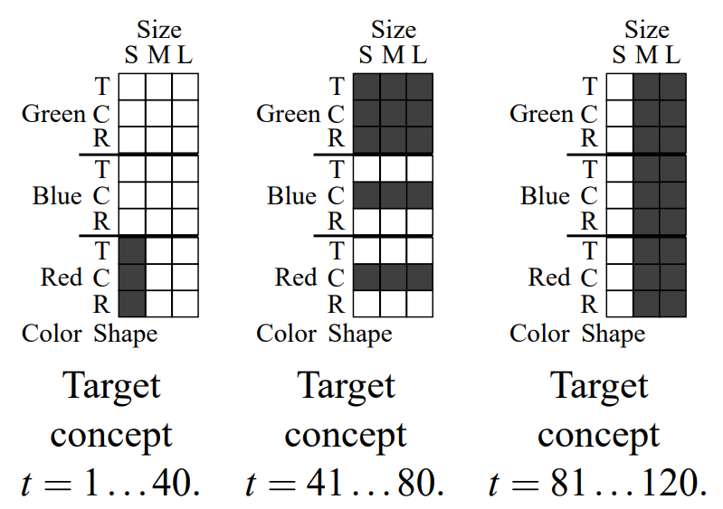
STAGGER concepts
Stagger dataset
3 attributes
2 labels (1 or 0)
3 concepts
Processing
One hot encode attributes
120 samples for streaming (40 samples per concept)
Use of Bernoulli NB classifier
Notes:
STAGGER
Stagger concept explain.
The dataset built has 120 samples and every 40 samples the concept changes.
In order to validate the performance of DWM we compared it to a Naive Bayes perfect forgetting (Best case) and a Naive bayes that learns over all the data (Standard algorithm).
Since the data is discrete I one hot the attributes and used a Bernoulli Naive Bayes classifier. Having only 120 samples I set the p to 1 meaning that the model would be updated at each step.
The Beta and the Theta were set to 0.5 and 0.01 respectively.
In order to evaluate the model after predicting the incoming sample the model predicted other 100 random generated samples from the same concept.
The results are presented.

Slide 7
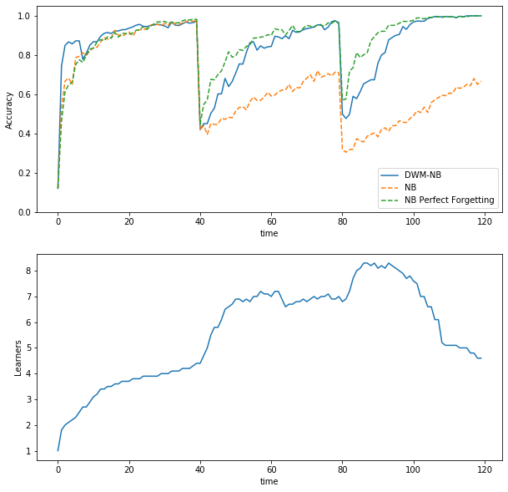
STAGGER evaluation
DWM model
NB Perfect forgetting (Perfect case)
Standard NB
¡ Averaging results 10 times !

Slide 8

SEA concepts
Stagger dataset
3 continuous attributes (1 irrelevant)
2 labels (1 or 0)
4 concepts
X1 = [0,10] X2 = [0,10] X3 = [0,10]
X1 + X2 > 8
X1 + X2 > 9
X1 + X2 > 7.5
X1 + X2 > 9.5
Processing
One test-set for each concept
50000 samples for streaming (12500 samples per concept)
Use of Gaussian NB classifier
Notes:
SEA
Explain sea dataset.
In this case a dataset of 50000 samples was used to test the algorithm on larger data.
Since the variables were continuous A Gaussian Naive Bayes classifier was used as online learner. The model was evaluated with a separate dataset for each of the concepts. In that way I avoided generating new data every step.
The p was set to 50 so the model was updated every 50 samples allowing to speed up the process without having big impact in performance.
Two different approaches were compared:
The standard one with no max number of learners.
The approach with maximum number of learners which allowed to train the model much faster without decreasing performance.
Comment figures.

Slide 9
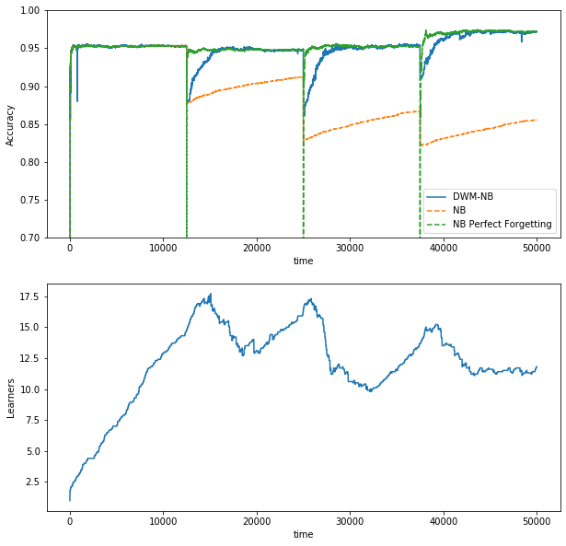
SEA evaluation

Slide 10
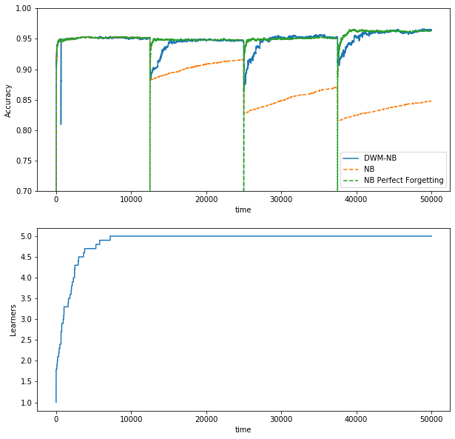
SEA evaluation
Parameter k: Maximum number of learners
Faster computation
Similar performance
K = 5

Slide 11
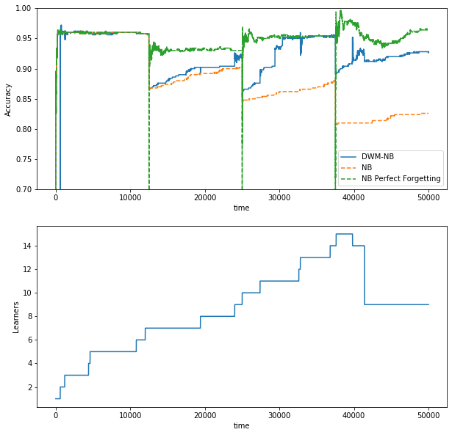
SEA evaluation
P = 200

Slide 12
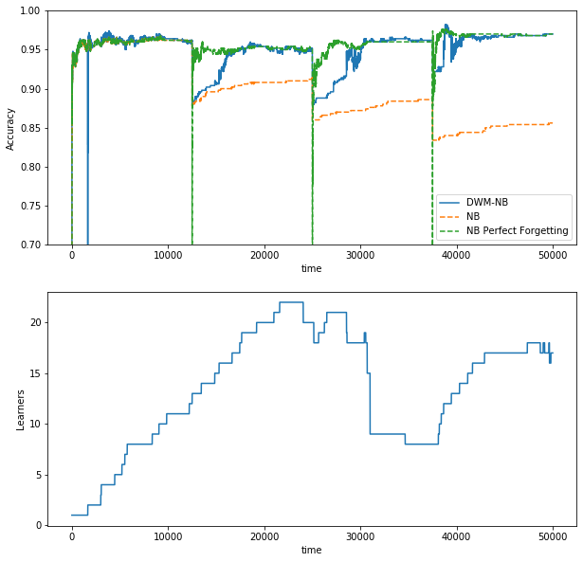
SEA evaluation
β = 0.7

Slide 13
DEMO TIME!

Slide 14
Questions?

