Slide 1
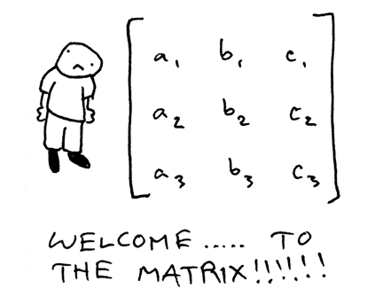
Project goal
Creating a user friendly MATLAB function to manage matrix multiplication across available resources on the device, including GPUs CPU and FPGAs

Slide 2
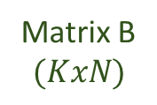
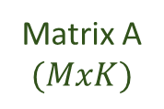
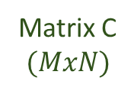
Method
Step 1: Distribute workload between GPUs and CPU/FPGAs
CPU+FPGA
The matrixes are divided by cublasXt logic
Load distribution is passed as a parameter and should be optimized per system
Matrix A $$(MxK)$$
Matrix B $$(KxN)$$
Matrix C $$(MxN)$$
GPUs
CPU+FPGA
FINAL RESULT
GPUs
CPU+FPGA
GPUs

Slide 3
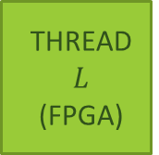

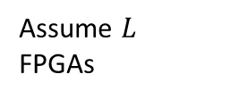
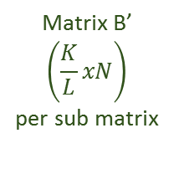


Method: CPU FPGA
Step 2: Distribute workload between CPU and FPGAs
Distribution between threads could be different
Matrix B’ $$\left(\frac{K}{L}xN\right)$$
per sub matrix
Matrix C’ $$\left(Mx\frac{N}{L}\right)$$
per sub matrix
Matrix A’ $$\left(MxK\right)$$
THREAD 0 (CPU)
THREAD 1 (FPGA)
THREAD $$L$$ (FPGA)
THREAD 0 RESULT
THREAD 1
RESULT
THREAD $L$
RESULT
Matrix A
Assume $L$ FPGAs

Slide 4
Performance
2x speedup over CPU performance
1.5x speedup over GPU only performance
Best performance achieved at 40% CPU, 60% GPU
Consider low performance GPU were used
Matrix size exceeds available memory on GPU!
Better speedup with larger matrixes

Slide 5
Nsight Analysis
Data transfer from host to GPU device
Data transfer form GPU device to host
GPU device calculation

Slide 6
Conclusions
The project goals were achieved, we have successfully created a simple to use MATLAB function which invokes all the system resources.
Our project, as well as many others, show that heterogeneous systems are the future.
Our project to harness this power via a friendly MATALB function.

