Slide 1




USPTO Citation Recommender System
TAU, IBM, UCB, JHU

Slide 2
Citation Recommender System
Examiners need to find related patents:
assess quality of applications
supply additional citations
Current search capabilities are limited
standard Boolean search
not much else?

Slide 3
Lots of Existing Information
Information in the form of:
Linguistic information (abstracts, full text, etc)
Citation information
Coauthorship/collaboration
Categorization
Examiner names

Slide 4


System Diagram
Query Application
Build Citation Graph
Featurization
Retrieval and Reranking
Featurization
Query Results

Slide 5
Detail: Retrieval
First pass: LSH on feature vectors (using LLHash)
Retrieves candidate matches
Second pass: neighborhoods of LSH matches
Incorporates citation information
Refinement/reranking:
Metric learning to rank (MLR); link prediction
Positive examples already exist: Examiner citations

Slide 6
Detail: Featurization
Patent abstracts mapped to feature vectors
Stemming, removal of stop-words, etc.
code from January Hackathon
Dimensionality reduction using lib-Skylark SVD

Slide 7
Link Prediction: Baseline
Task: predict whether two patents share an edge
Balanced training set of 25K examples
Positive examples: from citation graph
Negative examples: random pairs
Balanced test set of 5K examples
83% link prediction accuracy

Slide 8
Stochastic Block Modeling
Embeds vertices of graph into Euclidean space
Communities manifest as clusters in Euclidean space
spokes suggest strong community structure
vertices with low degree mapped near origin

Slide 9

Stochastic Block Modeling
Full citation graph (~600K nodes)

Slide 10

Stochastic Block Modeling
After fitting SBM (k=600 blocks)

Slide 11
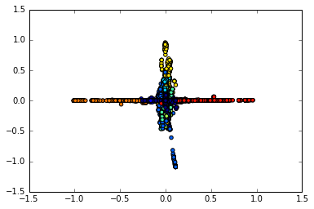
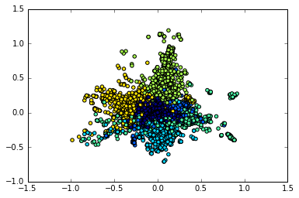
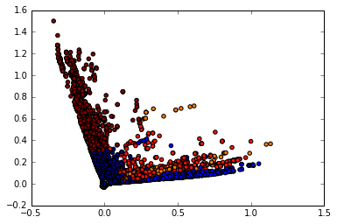
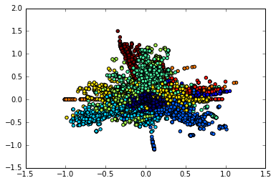
Stochastic Block Modeling
Projections of k=10 blocks in 10 dimensions

Slide 12
Issue: Data Wrangling
Messy data!
Numbers can appear with/without punctuation
Collisions between different national systems
Many missing fields
Citation graph is very sparse
~300 edges in all of H04 from 2002 to 2015

Slide 13
(Partial) Solutions
Cleaning the data:
Normalize patent numbers (e.g., remove punctuation)
Creates new set of collisions
Desparsify citation graph:
Join patents/applications that cite the same document
~33M edges for 670K nodes in all of category H
1e-4 sparsity factor-- still very sparse!
Vast majority of effort went into data cleaning

Slide 14
Next Steps
Construct train/dev/test split
and additional cleaning of data set
Train classifier and complete system
subsystems need to be chained together
Improve features
PLSA, topic modeling (e.g., R ‘stm’ package)
Additional features from citation graph
e.g., spectral embedding

