Slide 1




Patent Citation Recommender System
Haim Avron, Ken Clarkson, Kimon Fountoulakis, Alex Gittens, Georgios Kollias, Disa Mhembere

Slide 2
Citation Recommender System
Examiners need to find related patents:
assess quality of applications
supply additional citations
recall (much) more important than precision
Current search capabilities are limited
standard Boolean search
not much else?

Slide 3
Lots of Existing Information
Information in the form of:
Linguistic info (abstracts, full text, etc)
Citation information
Coauthorship/collaboration
Categorization
Examiner names
…

Slide 4


System Diagram
Query Application
Build Citation Graph
Featurization
Retrieval and Reranking
Featurization
Query Results

Slide 5
Recommendation Process
First pass: LSH on feature vectors (using LLHash)
Retrieves candidate matches
Second pass: communities in citation graph
Expands results using citation information
Refinement/reranking:
Metric learning to rank (MLR); link prediction
Positive examples already exist: Examiner citations

Slide 6
Featurization
Patent abstracts mapped to feature vectors
Stemming, removal of stop-words, etc.
code from January Hackathon
Generate TF-IDF vectors
Latent Semantic Analysis using libSkylark SVD
Future work: more advanced methods (word embedding, etc.)

Slide 7
Link Prediction: Proof-of-Concept
Task: predict whether two patents are potentially relevant.
Balanced training set of 25K examples
Positive examples: from citation graph
Negative examples: random pairs (for now)
Kernel RLSC using Gaussian Kernel
Balanced test set of 5K examples
83% link prediction accuracy (67% with linear classifier)
Did not check precision/recall yet

Slide 8
Stochastic Block Modeling
Embeds vertices of graph into Euclidean space
Communities manifest as clusters in Euclidean space
Spikes suggest strong community structure
Vertices with low degree mapped near origin

Slide 9

Stochastic Block Modeling
Full citation graph for IPCR section H (~600K nodes)

Slide 10

Stochastic Block Modeling
After fitting SBM (k=600 blocks)

Slide 11
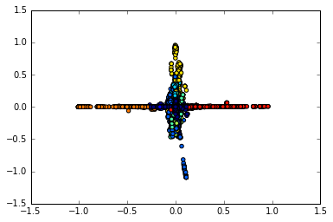
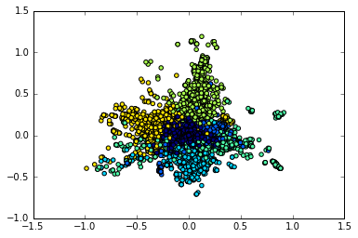
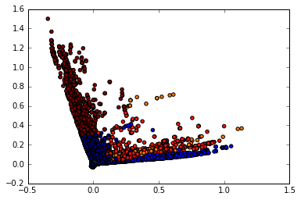
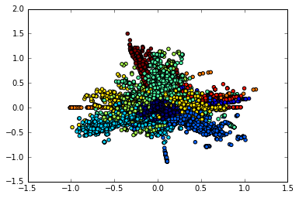
Stochastic Block Modeling
Projections of k=10 blocks in 10 dimensions

Slide 12
Challenges: Data Wrangling
Messy data!
Numbers can appear with/without punctuation
Collisions between different national systems
Many missing fields
Citation graph is very sparse
~300 edges in all of H04 from 2002 to 2015

Slide 13
(Partial) Solutions
Cleaning the data:
Normalize patent numbers (e.g., remove punctuation)
Creates new set of collisions
Desparsify citation graph:
Join patents/applications that cite the same document
~33M edges for 670K nodes in all of category H
1e-4 sparsity factor-- still very sparse!
Vast majority of effort went into data cleaning

Slide 14
Next Steps
Construct larger and better train/dev/test split
and additional cleaning of data set
Better negative example set?
Test the filtering step (i.e. using LSH)
subsystems need to be chained together
Improve features
PLSA, topic modeling (e.g., R ‘stm’ package)
Not just abstract
Additional features from citation graph
e.g., spectral embedding

