Slide 1

Receipt-to-Cashback
Alex Goldbaum

Slide 2
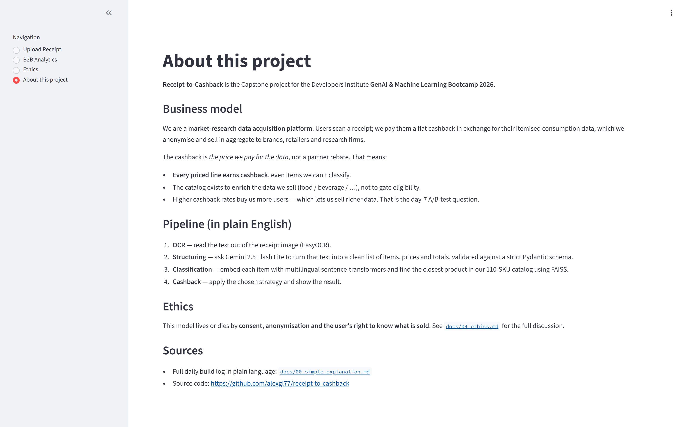
Scan a receipt. Get cashback. We sell the data.
A market-research data-acquisition app.
Users scan a receipt → we pay flat cashback in exchange for the itemised consumption data → we anonymise it and sell it in aggregate to brands, retailers and research firms.
Solves a real gap: no one today has a cross-merchant, item-level picture of what consumers actually buy. We get it by paying the consumer directly.

Slide 3
Stack
OCR + extraction — Gemini 2.5 Flash Vision (image → structured JSON, one call)
Schema validation — Pydantic (strict + retry on malformed output)
Vector search — FAISS + multilingual sentence-transformer
Clustering & A/B — scikit-learn KMeans + scipy Welch's t-test
Data wrangling — pandas, matplotlib, seaborn
Web app — Streamlit (4 pages: Upload · B2B · Ethics · About) — SELF-TAUGHT
Code style — Python OOP + dataclasses + type hints (bootcamp Weeks 1–9)

Slide 4
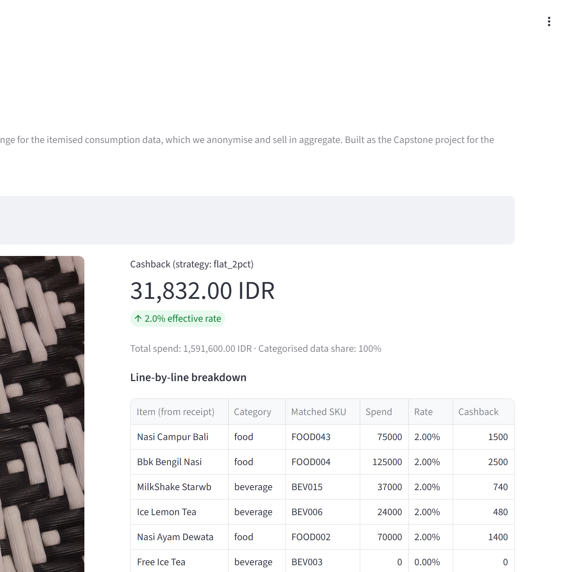
Upload → 32,000 IDR in 8 seconds.
Upload page (live demo on the right):
• photo of receipt → cashback number end-to-end in ~8 s
• every item classified into food / beverage / bakery / …
• raw Gemini JSON visible for debugging
B2B Analytics page:
• A/B-test simulation of two cashback rates
• K-Means user clustering with PCA projection
Ethics tab — surfaced in the app, not buried in a doc.

Slide 5
Difficulties
Original 'partner-rebate' model rejected most receipts → pivoted to market-research data acquisition (all priced lines pay out).
English-only embedding rejected Indonesian items → multilingual sentence-transformer fixed it (100 % classification).
Two-step OCR → LLM pipeline misread the grand total → replaced with single Gemini Vision multimodal call.
Next steps
Real users (replace synthetic population)
Postgres warehouse + image-level PII redaction
K-anonymity floor before any data sale
MCP 'spend search' agent

Slide 6
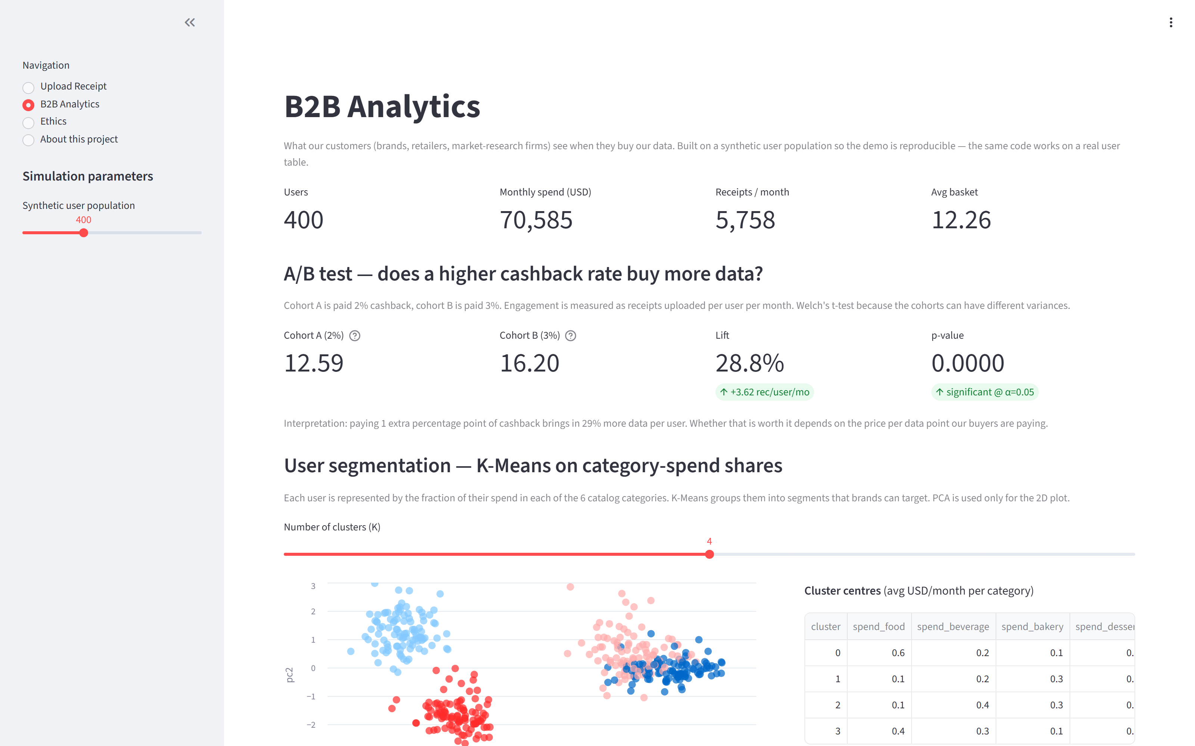
See it work
Live app → https://huggingface.co/spaces/alexgl77/receipt-to-cashback
Demo video → https://www.loom.com/share/b10268c4694f4a8f8cf5e7292aef7a21 (2:53)

Slide 7
Links (For PSTB Team Only – Not for Presentation)
GitHub (public): https://github.com/alexgl77/receipt-to-cashback
Live app: https://huggingface.co/spaces/alexgl77/receipt-to-cashback
Loom video (2:53): https://www.loom.com/share/b10268c4694f4a8f8cf5e7292aef7a21
Medium: not planned

Slide 8
Job (For PSTB Team Only – Not for Presentation)
CV: [REPLACE WITH YOUR CV URL]
LinkedIn: https://www.linkedin.com/in/alex-goldbaum/

