Slide 1
EFFECT OF PAID FAMILY LEAVE POLICY ON LABOR MARKET OUTCOMES OF MOTHERS
A Thesis by Alex Goldsmith

Slide 2
Presentation Outline
Research Question
Literature Review
Policy Landscape
Theory
Data
Methodology
Results
Conclusion
Notes:
A quick outline of this presentation: I will go over my research question, review the economic literature, and overview the policies of interest. I will then go over the economic theory and the data, present the methodology used and the results, then end with my conclusion.

Slide 3
Research Question
How does Paid Family Leave Policy affect labor-force participation, employment, and unemployment of mothers in the time period surrounding childbirth?
Notes:
Starting with the research question: In my thesis I work to answer the question of how paid family leave policy affects the labor-force participation, employment, and unemployment of mothers in the time frame of two years surrounding birth.

Slide 4
Literature Review
Paid Parental Leave Laws in the United States: Does Short-Duration Leave Affect Women’s Labor-Force Attachment? (Byker 2016)
The Effects of California’s Paid Family Leave Program on Mothers’ Leave-Taking and Subsequent Labor Market Outcomes (Rossin-Slater, Ruhm, Waldfogel 2013)
The Effects of Paid Family Leave in California on Labor Market Outcomes (Baum and Ruhm 2014)
Unanticipated Effects of California’s Paid Family Leave Program (Das and Polachek 2015)
Evaluating Workplace Mandates with Flows Versus Stocks: An Application to California Paid Family Leave (Curtis, Hirsch, and Schroeder 2016)
Paid Family Leave, Fathers’ Leave-Taking, and Leave-Sharing in Dual-Earner Households (Bartel et al. 2018)
Notes:
Besides the work of Tanya Byker upon which this thesis is based, are five other publications that serve to inform and contextualize the results presented here.

Slide 5
Tanya Byker
Paid Parental Leave Laws in the United States: Does Short-Duration Leave Affect Women’s Labor-Force Attachment? (2016)
Data: Survey of Income and Program Participation
Panels from 1996, 2001, 2004, 2008
Methodology: Difference-in-difference estimation
Findings:
Positive and significant effect on labor-force participation of all mothers in the period of 3 months before birth to three months after birth.
Positive but insignificant effect on employment of mothers without college degrees in the period of six months after birth to twelve months after birth.
Negative and significant effect on unemployment of mothers without college degrees in the period of six months after birth to twelve months after birth
Notes:
I think it would be prudent to start with a brief overview of the work of Tanya Byker in 2016.
The data Byker used to conduct her analysis was sourced from four panels of the Survey of Income and Program Participation, specifically the years 1996, 2001, 2004, and 2008.
Using data from the four panels, Byker constructed a sample of all women aged 24 to 45 who gave birth during the time coverage of the SIPP panel and lived within one of the treatment or control states.
She used difference-in-difference analysis to estimate the effect of paid family leave policy on the labor-force participation, employment, and unemployment outcomes of women in the period of 24 months before childbirth to 24 months after childbirth. Byker’s main findings are a positive effect of paid family leave policy on labor-force participation and employment of women without college degrees, and a negative effect on their unemployment.
And of course, I will continue to talk about Byker’s work in more detail throughout my presentation.

Slide 6
Rossin-Slater, Ruhm, and Waldfogel
The Effects of California’s Paid Family Leave Program on Mothers’ Leave-Taking and Subsequent Labor Market Outcomes (2013)
Data: March Current Population Survey
Annual data from years 1999 to 2010
Methodology: Difference-in-difference estimation
Individual level data
Findings:
Increase of maternity leave use from three weeks to six weeks
10 to 17 percent increase in usual weekly work hours of employed women 1 to 3 years after childbirth
Notes:
Rossin-Slater, Ruhm, and Waldfogel used data from the March Current Population Survey to investigate the effect of the California Paid Family Leave policy on mother’s leave taking. The authors find an increase in leave-taking of mothers from three weeks on average to six weeks. They also find a 10 to 17 percent increase in weekly work hours of employed women in the second year after childbirth.

Slide 7
Charles Baum and Christopher Ruhm
The Effects of Paid Family Leave in California on Labor Market Outcomes (2014)
Data: National Longitudinal Survey of Youth: 1997 Cohort
Methodology: Difference-in-difference estimation
Findings:
Increased use of maternity leave by three weeks
Increased use of paternity leave by one week
Increased probability of mothers’ return to work one year after birth
Increased hours and weeks of work of mothers between one and two years after birth
Notes:
Baum and Ruhm use a similar method to Rossin-Slater et al., but make use of longitudinal data to track outcomes of individuals over time. Specifically, the authors use data from the 1997 cohort of the National Longitudinal Survey of Youth. The authors corroborate the findings of Rossin-Slater et al. as well as finding a positive effect of the California Paid Family Leave policy on the probability of mothers’ return to work one year after giving birth. Baum and Ruhm also find that the policy increased raised maternal hours and weeks of work by 11 to 19 percent during the second year of the child’s life.
(“There is consistent evidence that CA-PFL increased the likelihood that mothers have returned to work by a year after birth and raised maternal hours and weeks of work by 11 to 19 percent during the second year of the child’s life. Paid leave is also predicted to raise hourly wages at the end of the first year by 7 percent, but this estimate is imprecise and statistically insignificant”)

Slide 8
Tirthatanmoy Das and Solomon Polachek
Unanticipated Effects of California’s Paid Family Leave Program (2015)
Data: March Current Population Survey
Annual data from years 1999 to 2010
Methodology: Difference-in-difference estimation
Sub-group segmentation by age and gender
Aggregate level data
Findings:
Increase of labor-force participation of young women by 1.5 percentage points
Increase in unemployment of young women by between 0.3 and 1.5 percentage points
Increase in duration of unemployment of young women by between 4 to 9 percent
Notes:
Das and Polachek, like Rossin-Slater et al., use data from the March Current Population Survey to study the impact of the California Paid Family Leave Policy. However, unlike Rossin-Slater, Das and Polachek use aggregate data in place of individual level data. They also investigate a number of outcomes not analyzed by Rossin-Slater. The authors report a number of findings, including an increase of labor-force participation of young women, as well as an increase in the probability and duration of their unemployment.
“Our final dataset consists of 34,270 observations. The unit of observation is a state, gender, age group, and year average value.”

Slide 9
Curtis, Hirsch, and Schroeder
Evaluating Workplace Mandates with Flows Versus Stocks: An Application to California Paid Family Leave (2016)
Data: Quarterly Workforce Indicators
Methodology: Difference-in-difference estimation
Triple difference: Analysis of effect on new hires of young women relative to other demographic groups, relative to differences in other states
Findings:
Increase in new hires, separations, and recalls of young women
No significant change in wages of young women
Notes:
Curtis, Hirsch, and Schroeder apply novel data to create new insights to the effect of the California Paid Family Leave policy. Specifically, the authors use data from the Quarterly Workforce Indicators to compare labor-market churn under the effect of paid family leave policy to labor-market churn in control states. The authors find a statistically significant positive effect of the policy on new hires, separations, and recalls of young Californian women. They also investigate the effect of the policy on wages of young women, but do not find a statistically significant effect.
“The magnitude of the coefficients for new hires, separations, and recalls in Table 5 are roughly similar, approximately 0.03, 0.025, and 0.03, respectively.”

Slide 10
Bartel, Rossin-Slater, Ruhm, Stearns, Waldfogel
Paid Family Leave, Fathers’ Leave-Taking, and Leave-Sharing in Dual-Earner Households (2018)
Data: American Community Survey and 2000 Census
2000 to 2013 Waves of the ACS
Methodology: Difference-in-difference-in-difference
Employed fathers of infants vs employed fathers of toddlers relative to difference in other states
Employed mothers of infants vs employed mothers of toddlers relative to difference in other states
Findings:
California Paid Family Leave Policy increased paternal leave-taking from 1 week to 1.5 weeks
Increase of paternal leave taking is greater for first-time fathers than existing fathers
Notes:
Bartel and coauthors expand the literature by investigating the effect of the California Paid Leave Policy on fathers’ leave-taking as well as mothers. Bartel et al. use data from the 2000 to 2013 waves of the American Community Survey and a triple-difference methodology to estimate the effect of the policy on parental leave-taking. The authors estimate that that the policy increased paternal leave-taking by 46% and that the effect is greater for first-time fathers than for fathers that already have children.
(“Our preferred DDD specification compares employed fathers of infants in California to employed fathers of children aged 1 to 3, relative to corresponding fathers of the same age children in other states, before and after the introduction of CA-PFL. We perform an analogous analysis of mothers to enable comparisons of effects across parental gender within the same data set.”
Mothers take 9 weeks of leave on average; CA-PFL is estimated to increase this by two days)

Slide 11
California Paid Family Leave Policy
Came into effect July 2004
Both mothers and fathers entitled to 6 weeks of paid leave
Benefit provides 55% of average weekly pay capped at $1,163 a week in 2014
Leave must be taken within 12 months following birth of child
Leave may be taken concurrently or intermittently
Policy is funded by a payroll tax on all state workers
Notes:
Now some brief information about the Paid Family Leave policies studied in this paper.
California’s Paid Family Leave Policy entitles both mothers and fathers to 6 weeks of paid leave to be taken within 12 months following the birth of their child. The benefit provides 55% of average weekly pay up to a cap set at 1,163 dollars in 2014.

Slide 12
New Jersey Paid Family Leave Policy
Came into effect July 2009
Both mothers and fathers entitle to 6 weeks of paid leave
Benefit provides 2/3 of average weekly pay capped at $643 a week in 2014
Leave must be taken within 12 months following birth of child
Leave may be taken concurrently or intermittently
Policy is funded by a payroll tax on all state workers
Notes:
While the New Jersey Paid Family Leave Policy is structured similarly to that of California’s, it differs mainly by the amount that it pays. Rather than 55% of weekly pay up to a cap of around 1200 dollars a week, the New Jersey version grants two thirds of weekly up to a cap of 643 dollars a week.

Slide 13
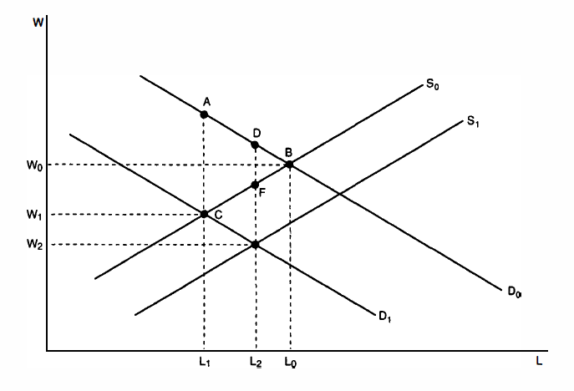
Theory of Mandated Benefits
Figure sourced from Gruber, Jonathan (2000) “Payroll Taxation, Employer Mandates, and the Labor Market”
Notes:
Now I will review theoretical background of mandated benefits.
According to the simple model, the payroll tax creates a wedge between labor supply and demand, reducing both wages and employment of workers, and creating deadweight loss. In the diagram, this can be seen by the shift of the demand curve from D0 to D1.
The conferral of benefits to workers, monetary or otherwise, increases the total value of employment for workers and accordingly increases labor supply and reduces the wedge imposed by the tax. This is illustrated by the shift in labor supply from S0 to S1.
Except for the special case in which employees value benefits at exactly the value of lost wages, there will remain a residual wedge between supply and demand, resulting in lower employment than equilibrium in the absence of the tax.
This diagram illustrates the case in which workers value benefits at less than the cost to employers, so wages fall from W0 to W2, and employment falls from L0 to L2.

Slide 14
Theory of Mandated Benefits
Application to California and New Jersey Paid Family Leave
Tax is applied to all workers
Benefits are conferred only to some workers
There may be additional costs besides the payroll tax
There may be additional benefits to mothers
Notes:
The simple theory is complicated by a number of factors. Although the tax is imposed upon all workers, the benefits are conferred only to those planning to start families. Additionally, considering the findings by Slater et al. (2012), and Baum and Ruhm (2014), that women take paid family leave for longer periods of time and in greater proportion than men, the benefits yielded are likely to be greater for young women than for any other demographic group.
It is also possible that the mandate may impose costs other than the strict monetary cost of the tax. When workers take leave, firms may be required to hire temporary, less productive, replacement labor. Furthermore, if the employee’s firm-specific skills depreciate during leave, firms may also have to bear the cost.
These costs may cause firms to reduce demand for labor of young women in favor of older women and men. This could have implications for employment outcomes, as the increased labor-force participation of young women in combination with reduced demand for their labor could result in an increase in their unemployment.
However, just as there may be additional costs of the mandate for young women, there may be additional benefits. The economic literature suggests that paid family leave policies may increase job-continuity of young mothers, and lead to associated positive effects on their labor-participation, employment, and wages.

Slide 15
Survey of Income and Program Participation
SIPP Panel | Number of Waves | First Month | Last Month
1996 | 12 | Dec 1996 | Feb 2000
2001 | 8 | Oct 2000 | Dec 2003
2004 | 12 | Oct 2003 | Dec 2007
2008 | 16 | May 2008 | Dec 2013
Notes:
Now we proceed into the data section. Pictured is Table 1 from my Thesis.
The data in this paper originates from four panels of the Survey of Income and Program Participation. Each panel covers a national stratified sample of the U.S. civilian non-institutionalized population and uses a 4-month recall period. Respondents are divided into rotation groups with each group interviewed during one month of the four-month period. Each four-month period constitutes a wave of the survey.

Slide 16
Byker’s Dataset of Mothers
 | California | Florida | New Jersey | New York | Texas
Year |  |  |  |  |  | Total
1995 | 62 | 23 | 19 | 43 | 48 | 195
1996 | 319 | 105 | 76 | 166 | 211 | 873
1997 | 318 | 107 | 74 | 162 | 216 | 873
1998 | 303 | 97 | 68 | 151 | 208 | 823
1999 | 283 | 87 | 64 | 140 | 185 | 758
2000 | 282 | 95 | 58 | 145 | 207 | 787
2001 | 207 | 76 | 48 | 106 | 149 | 583
2002 | 201 | 77 | 44 | 96 | 144 | 562
2003 | 341 | 139 | 91 | 162 | 234 | 963
2004 | 204 | 99 | 59 | 103 | 143 | 604
2005 | 201 | 96 | 56 | 103 | 146 | 597
2006 | 197 | 91 | 52 | 98 | 140 | 576
2007 | 127 | 69 | 27 | 71 | 80 | 372
2008 | 222 | 86 | 74 | 86 | 150 | 618
2009 | 225 | 85 | 75 | 91 | 160 | 631
2010 | 220 | 86 | 73 | 90 | 163 | 630
2011 | 218 | 83 | 69 | 83 | 161 | 612
2012 | 148 | 51 | 41 | 52 | 103 | 395
Total | 1002 | 389 | 276 | 485 | 707 | 2817
Notes:
Pictured here is Table 2.
Using data from the four panels, Byker constructed a sample of 2,817 unique persons and 103,624 person-month observations containing all women aged 24 to 45 who gave birth during the time coverage of the SIPP panel and lived within one of the treatment or control states. The highlighted values describe persons affectected by a Paid Family Leave mandate.

Slide 17
Employment Outcomes
Employment / Labor-force Status | Person-Months | Proportion
With a job entire month, worked all weeks (includes individuals on paid leave) | 57,373 | 55.4%
With a job entire month, absent from work without pay 1+ weeks, absence not due to layoff | 2,595 | 2.51%
With a job entire month, absent from work without pay 1+ weeks, absence due to layoff | 450 | 0.43%
With a job at least 1 but not all weeks, no time on layoff and no time looking for work | 1148 | 1.11%
With a job at least 1 but not all weeks, remaining weeks on layoff or looking for work | 523 | 0.51%
No job all month, on layoff or looking for work all weeks | 3,323 | 3.21%
No job all month, at least one but not all weeks on layoff or looking for work | 440 | 0.44%
No job all month, no time on layoff and no time looking for work. | 37,756 | 36.4%
Missing data | 16 | 0.02%
Notes:
Pictured here is Table 3.
Information on labor-force participation and employment is derived from a categorical SIPP variable encoding the employment status of an individual for a given month. Following Byker’s methodology, I reduced this information into three binary variables describing whether a person is in or out of the labor-force, working or not working, and searching for work or not searching for work. An important note is that if an individual is away on paid leave, she is encoded by the SIPP as employed and working all weeks.

Slide 18
Segmentation by Occupational Group
Pre-birth Occupation Group | White Collar / Blue Collar | Count | Proportion | Percent College Graduate
Management | White Collar | 131 | 7.06% | 51.1%
Office and Administrative Support | White Collar | 424 | 22.9% | 20.8%
Education, Training, and Library | White Collar | 195 | 10.5% | 79.2%
Food Preparation and Serving | Blue Collar | 89 | 4.80% | 6.00%
Personal Care and Service | Blue Collar | 78 | 4.2% | 14.3%
Protective Service | Blue Collar | 78 | 0.70% | 28.5%
Notes:
Pictured here is an abbreviated version of Table 4.
To allow for analysis based on occupation of the individual, I matched employment information from the full Survey of Income and Program Participation to each person-month observation in Byker’s dataset. I then grouped these occupations according the Standard Occupational Classification system. An important note, each individual was placed into an occupational group based on their occupation most recently recorded before childbirth. On Professor Gorry’s suggestion, I then codified each occupation group as either ‘white collar’ or ‘blue collar’ to allow for larger sample sizes while still investigating differential effects of paid family leave policy on workers of different occupations.

Slide 19
Cross-tabulations of Sub-populations
Person-months | White collar | Blue collar | Totals
Less than College | 29101 (69.2%) | 12722 (30.8%) | 41823 (100%)
College Educated | 25484 (95.1%) | 1208 (4.9%) | 26692 (100%)
Totals | 54585 | 13930 | 68515
Persons | White collar | Blue collar | Totals
Less than College | 807 (70.4%) | 340 (29.6%) | 1147 (100%)
College Educated | 685 (94.9 %) | 37 (5.1%) | 722 (100%)
Totals | 1445 | 370 | 1815
Notes:
Pictured here are Tables 5 and 6.
On the advice of Professor Simon, I cross-tabulated the dataset by occupational type and by educational achievement to ascertain that these categories divided the sample in different ways. While it is true that most college-educated women work in white-collar professions, it is not true that most high school educated women work in blue-collar occupations. I believe that the cross tabulations indicate that the two segmentations indeed divide the sample differently.

Slide 20
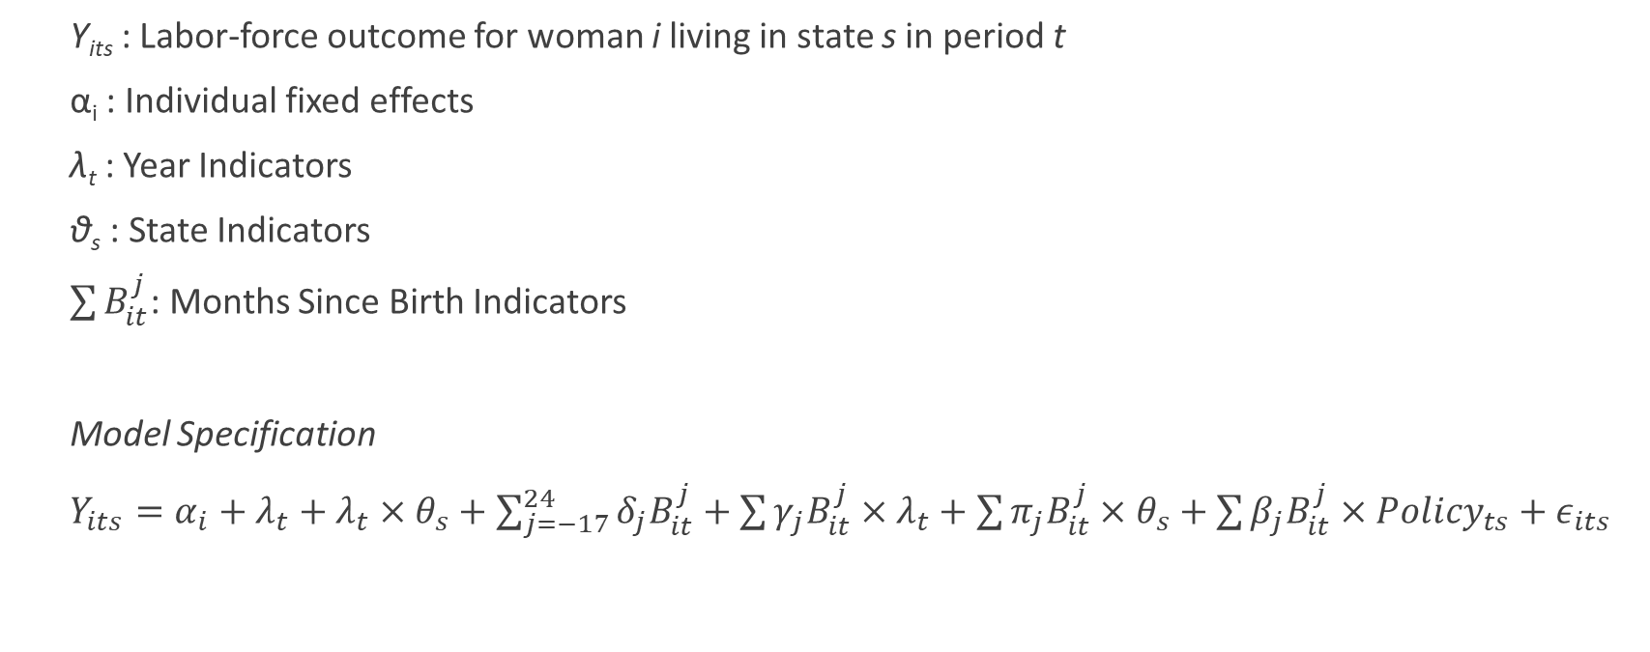
Methodology
Y_{its} : Labor-force outcome for woman i living in state s in period t
α_{i} : Individual fixed effects
λ_{t} : Year Indicators
θ_{s} : State Indicators
$\sum{B_{it}^{j}}$: Months Since Birth Indicators
Model Specification
$Y_{its}={α_{i}+λ}_{t}+λ_{t}×θ_{s}+\sum_{j=−17}^{24}{δ_{j}B_{it}^{j}}+\sum{γ_{j}B_{it}^{j}}×λ_{t}+\sum{π_{j}B_{it}^{j}×θ_{s}+\sum{β_{j}B_{it}^{j}×{Policy}_{ts}+ε_{its}}}$
Notes:
Now we proceed into the methodology section.
The equation shown here represents the specification used by Byker in her 2016 work, and used by myself in this study. The beta j vector contains the estimates of interest, and represents the effect of paid family leave policy on the labor-market outcome for each month relative to birth. The individual fixed effects control for confounding from unobserved characteristics of each individual. The interacted year and state indicators control for time trends in each state that may confound the estimation of the effect of the policy on the outcome of interest. The year X months since birth dummies control for differences in the pattern of the outcome variable across years, while the state X months since birth dummies control for differences in the pattern of the outcome variable across states.
The regression is run on each of three outcome variables described in the data section: labor-force participation, working, and searching for work. For each labor-market outcome, the regression is run on the full sample of mothers, a subsample of mothers with college degrees, mothers without college degrees, white-collar workers, and blue-collar workers. I also include results from regressions run on three specific occupational groups: management occupations, office and administrative support occupations, and education, training, and library occupations.
For each regression, I present plots of point estimates as well as probability values from joint tests of significance for 15 distinct windows. I also report sums of coefficients to represent the estimated effect for each window. Tables reporting the probability values for the tests of sums of coefficients are not presented here but are reported in my Thesis.

Slide 21
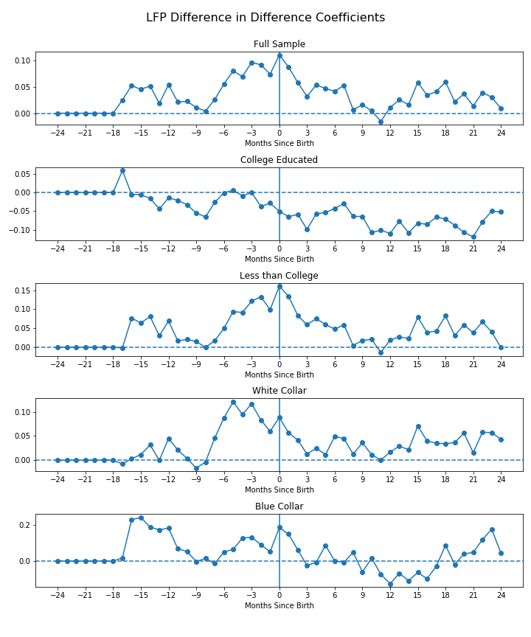
Months Since Birth | Full Sample | College Educated | Less Than College | White Collar | Blue Collar
-17 to -12 | 0.26 | 0.33 | 0.12 | 0.42 | 0.20
-15 to -9 | 0.22 | 0.52 | 0.36 | 0.28 | 0.31
-12 to -6 | 0.36 | 0.55 | 0.55 | 0.12 | 0.36
-9 to -3 | 0.16 | 0.71 | 0.27 | 0.02** | 0.82
-6 to 0 | 0.12 | 0.95 | 0.03** | 0.11 | 0.31
-3 to +3 | 0.04** | 0.75 | 0.02** | 0.17 | 0.16
0 to + 6 | 0.16 | 0.51 | 0.25 | 0.36 | 0.14
+3 to +9 | 0.55 | 0.56 | 0.68 | 0.59 | 0.36
+6 to +12 | 0.41 | 0.62 | 0.49 | 0.59 | 0.34
+9 to +15 | 0.13 | 0.56 | 0.20 | 0.31 | 0.51
+12 to + 18 | 0.15 | 0.63 | 0.13 | 0.46 | 0.51
+15 to +21 | 0.24 | 0.93 | 0.14 | 0.68 | 0.65
+18 to +24 | 0.29 | 0.72 | 0.24 | 0.63 | 0.35
-17 to 0 | 0.11 | 0.58 | 0.01** | 0.08* | 0.14
0 to 24 | 0.05* | 0.63 | 0.07* | 0.37 | 0.18
Months Since Birth | Full Sample | College Educated | Less Than College | White Collar | Blue Collar
-17 to -12 | 0.25 | -0.03 | 0.32 | 0.08 | 1.03
-15 to -9 | 0.23 | -0.19 | 0.30 | 0.10 | 0.90
-12 to -6 | 0.19 | -0.22 | 0.19 | 0.18 | 0.35
-9 to -3 | 0.34 | -0.15 | 0.39 | 0.45 | 0.37
-6 to 0 | 0.58 | -0.12 | 0.75 | 0.65 | 0.70
-3 to +3 | 0.55 | -0.34 | 0.79 | 0.46 | 0.64
0 to + 6 | 0.43 | -0.43 | 0.62 | 0.29 | 0.45
+3 to +9 | 0.25 | -0.41 | 0.32 | 0.19 | 0.04
+6 to +12 | 0.12 | -0.52 | 0.15 | 0.17 | -0.20
+9 to +15 | 0.12 | -0.65 | 0.17 | 0.19 | -0.48
+12 to + 18 | 0.25 | -0.60 | 0.31 | 0.25 | -0.40
+15 to +21 | 0.27 | -0.62 | 0.37 | 0.29 | -0.03
+18 to +24 | 0.21 | -0.56 | 0.32 | 0.30 | 0.49
-17 to 0 | 0.91 | -0.35 | 1.14 | 0.78 | 1.84
0 to 24 | 0.90 | -1.88 | 1.26 | 0.90 | 0.38
Notes:
Pictured here on the left is the plot of point estimates for the effect of paid family leave policy on labor-force participation of mothers. Months -24 to -17 were omitted for use as a reference period, so their point estimates on each figure are set to zero.
Top right is the table containing probability values for the joint tests of significance. One asterisk indicates significance at the 10% level and two asterisks indicates significance at the 5% level. Bottom right is the table containing sums of coefficients.
If you look at the table on the top right in the window of three months before birth to three months after birth you can see the p-value of 0.02 that Byker reports for women without college degrees. You can also see that there is joint significance for the preceding window of six months before birth to month of birth. There is also joint significance for white-collar workers in the window of nine months before birth to three months after birth.
(Figure 1, Tables 7 and 8)

Slide 22
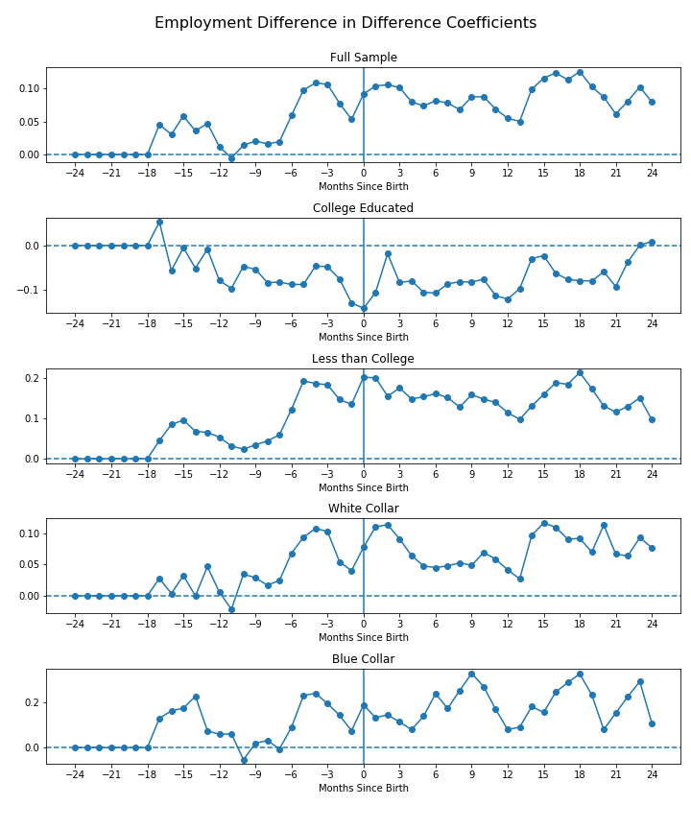
Months Since Birth | Full Sample | College Educated | Less Than College | White Collar | Blue Collar
-17 to -12 | 0.63 | 0.27 | 0.76 | 0.84 | 0.72
-15 to -9 | 0.74 | 0.71 | 0.82 | 0.70 | 0.44
-12 to -6 | 0.79 | 0.69 | 0.49 | 0.62 | 0.77
-9 to -3 | 0.21 | 0.88 | 0.02** | 0.58 | 0.26
-6 to 0 | 0.21 | 0.62 | 0.02** | 0.67 | 0.28
-3 to +3 | 0.35 | 0.52 | 0.08* | 0.57 | 0.62
0 to + 6 | 0.83 | 0.58 | 0.32 | 0.85 | 0.43
+3 to +9 | 0.77 | 0.96 | 0.33 | 0.96 | 0.18
+6 to +12 | 0.67 | 0.89 | 0.33 | 0.97 | 0.13
+9 to +15 | 0.25 | 0.67 | 0.50 | 0.36 | 0.14
+12 to +18 | 0.28 | 0.72 | 0.34 | 0.45 | 0.36
+15 to +21 | 0.54 | 0.95 | 0.46 | 0.59 | 0.32
+18 to +24 | 0.52 | 0.93 | 0.26 | 0.73 | 0.13
-17 to 0 | 0.41 | 0.55 | 0.08* | 0.80 | 0.52
0 to 24 | 0.80 | 0.93 | 0.41 | 0.95 | 0.19
Months Since Birth | Full Sample | College Educated | Less Than College | White Collar | Blue Collar
-17 to -12 | 0.23 | -0.15 | 0.41 | 0.12 | 0.82
-15 to -9 | 0.18 | -0.34 | 0.37 | 0.13 | 0.56
-12 to -6 | 0.13 | -0.53 | 0.37 | 0.16 | 0.20
-9 to -3 | 0.43 | -0.49 | 0.82 | 0.44 | 0.80
-6 to 0 | 0.59 | -0.62 | 1.16 | 0.55 | 1.15
-3 to +3 | 0.64 | -0.61 | 1.19 | 0.59 | 0.99
0 to + 6 | 0.64 | -0.65 | 1.19 | 0.55 | 1.03
+3 to +9 | 0.57 | -0.63 | 1.07 | 0.40 | 1.32
+6 to +12 | 0.52 | -0.67 | 1.00 | 0.36 | 1.50
+9 to +15 | 0.56 | -0.55 | 0.94 | 0.46 | 1.27
+12 to + 18 | 0.68 | -0.49 | 1.08 | 0.58 | 1.36
+15 to +21 | 0.73 | -0.48 | 1.16 | 0.66 | 1.47
+18 to +24 | 0.64 | -0.34 | 1.01 | 0.58 | 1.41
-17 to 0 | 0.88 | -1.13 | 1.77 | 0.75 | 2.03
0 to 24 | 2.22 | -1.84 | 3.79 | 1.89 | 4.66
Notes:
The layout here is the same as the previous slide. On the left is the plots of point estimates for the effect of paid family leave policy on employment. Top right is the table of probability values for the joint tests. Bottom right is the table of sums of coefficients.
In her work, Byker reports positive point estimates but no joint significance for the effect of paid family leave policy on women without college degrees in the window of six to twelve months after birth. Looking at the expanded windows however, it can be seen that there is indeed significance for other windows. For example the estimated effect of paid family leave policy on the employment of women without college degrees is an increase of 1.16 person months for the window of six months before birth to month of birth, and the joint test of the coefficients for this window yields a probability value of 0.02.
(Figure 2, Tables 10 and 11)

Slide 23
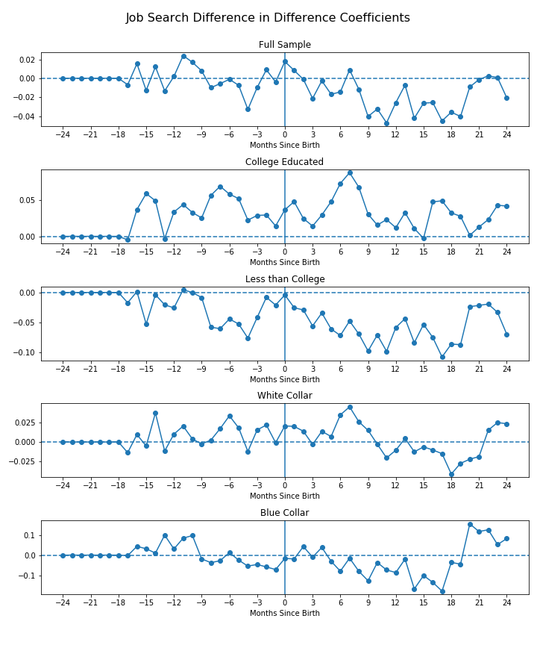
Months Since Birth | Full Sample | College Educated | Less Than College | White Collar | Blue Collar
-17 to -12 | 0.34 | 0.19 | 0.34 | 0.19 | 0.83
-15 to -9 | 0.57 | 0.29 | 0.69 | 0.40 | 0.51
-12 to -6 | 0.76 | 0.33 | 0.43 | 0.63 | 0.42
-9 to -3 | 0.28 | 0.56 | 0.11 | 0.17 | 0.86
-6 to 0 | 0.07* | 0.43 | 0.18 | 0.06* | 0.74
-3 to +3 | 0.11 | 0.34 | 0.21 | 0.24 | 0.65
0 to + 6 | 0.37 | 0.18 | 0.21 | 0.61 | 0.60
+3 to +9 | 0.06* | 0.13 | 0.07* | 0.61 | 0.12
+6 to +12 | 0.07* | 0.13 | 0.04** | 0.50 | 0.14
+9 to + 15 | 0.07* | 0.93 | 0.02** | 0.63 | 0.25
+12 to + 18 | 0.22 | 0.61 | 0.11 | 0.83 | 0.26
+ 15 to + 21 | 0.81 | 0.45 | 0.28 | 0.94 | 0.15
+18 to +24 | 0.53 | 0.75 | 0.16 | 0.44 | 0.38
-17 to 0 | 0.18 | 0.31 | 0.27 | 0.11 | 0.55
0 to 24 | 0.08* | 0.39 | 0.04** | 0.70 | 0.28
Months Since Birth | Full Sample | College Educated | Less Than College | White Collar | Blue Collar
-17 to -12 | 0.00 | 0.17 | -0.12 | 0.03 | 0.21
-15 to -9 | 0.04 | 0.24 | -0.11 | 0.05 | 0.33
-12 to -6 | 0.03 | 0.32 | -0.19 | 0.09 | 0.14
-9 to -3 | -0.06 | 0.31 | -0.34 | 0.07 | -0.20
-6 to 0 | -0.03 | 0.24 | -0.25 | 0.10 | -0.26
-3 to +3 | 0.00 | 0.20 | -0.19 | 0.09 | -0.18
0 to + 6 | -0.03 | 0.27 | -0.28 | 0.11 | -0.07
+3 to +9 | -0.10 | 0.35 | -0.44 | 0.14 | -0.30
+6 to +12 | -0.16 | 0.31 | -0.51 | 0.09 | -0.50
+9 to + 15 | -0.22 | 0.12 | -0.51 | -0.03 | -0.61
+12 to + 18 | -0.21 | 0.18 | -0.51 | -0.09 | -0.72
+ 15 to + 21 | -0.18 | 0.17 | -0.45 | -0.14 | -0.22
+18 to +24 | -0.10 | 0.18 | -0.34 | -0.05 | 0.45
-17 to 0 | 0.00 | 0.64 | -0.49 | 0.17 | 0.05
0 to 24 | -0.43 | 0.83 | -1.43 | 0.07 | -0.64
Notes:
Again on the left we have plots of point estimates, this time for the effect of paid family leave policy on unemployment. Top right is the table of probability values for the joint tests, and bottom right is the table of sums of coefficients.
Byker reports a significant negative effect on unemployment for women without college degrees in the window of six months post-birth to twelve months post-birth. The table shows that the effect is actually significant in both the preceding and following window, so there is a bit of longevity to the effect. The point estimates for the effect on unemployment for college educated women are all positive, but there is no joint significance for any of the windows.
There is joint significance of coefficients for white-collar workers in the window of six months before birth to month of birth, but the magnitude of the effect is small, and the test of the sums of coefficients does not yield significance (p-value of 0.64).
A final note on this section, the analysis did not reveal significance for the effect of paid family leave policy on any labor-market outcomes for the blue-collar worker group.
(Figure 3, Tables 13 and 14)

Slide 24
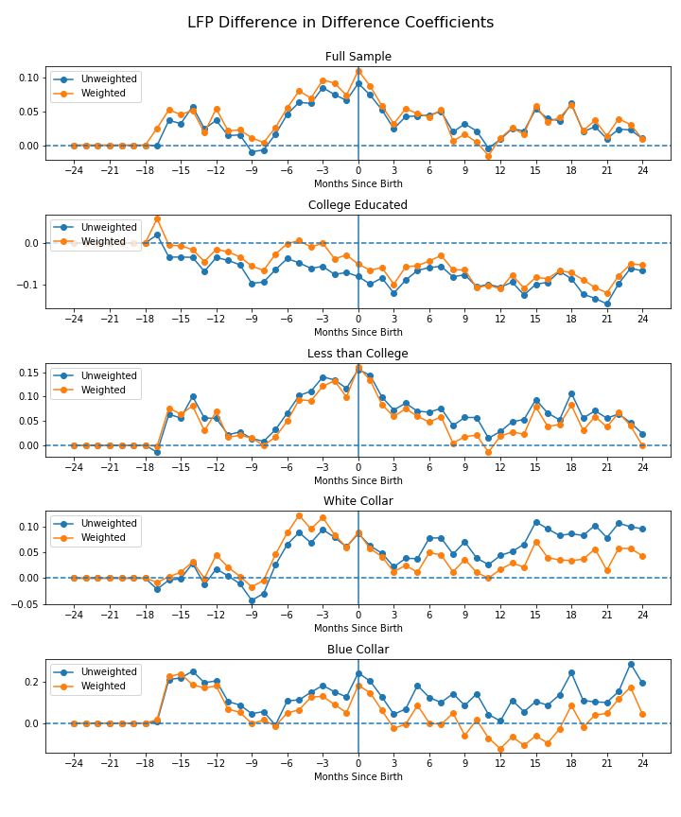
Notes:
On the advice of Professor Simon, I included checks for robustness of the estimates by repeating the regressions without weighting. Although it is a judgement call, I think the figures show relative closeness of the estimates and similarity of the patterns.
Pictured here are the plots of point estimates of the effect of paid family leave on labor-force participation yielded from both the weighted and unweighted regressions.
(Figure 4)

Slide 25
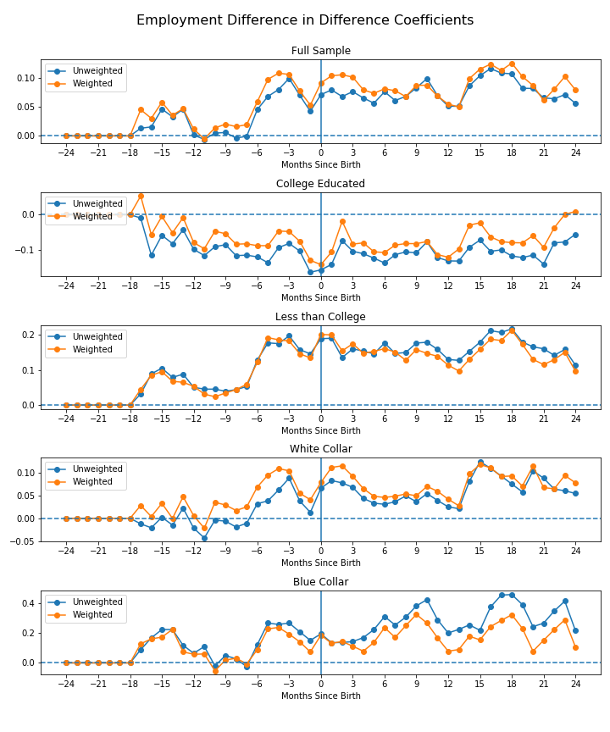
Notes:
Here is the results from comparison of the two sets of estimates for the effect on employment.
(Figure 5)

Slide 26
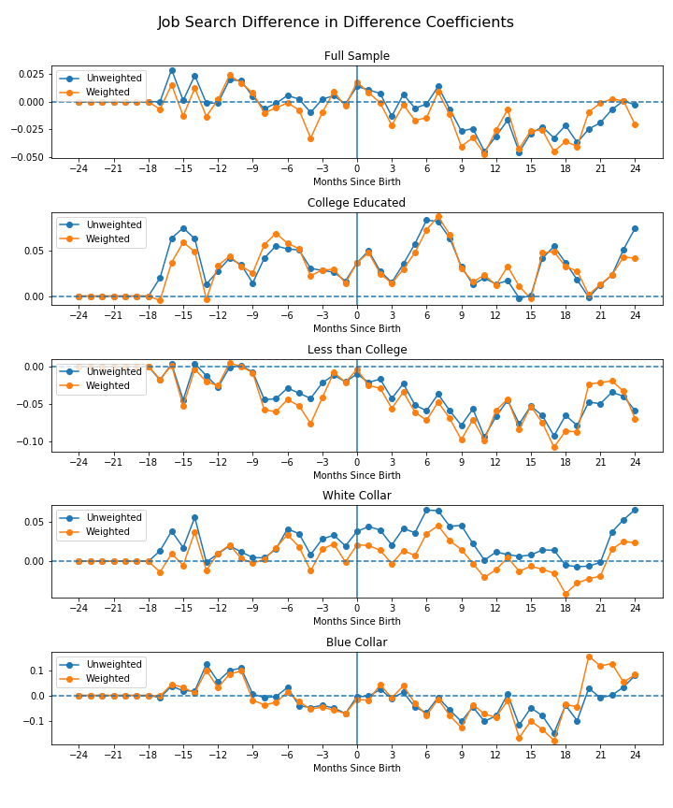
Notes:
And finally, pictured here are the plots of estimates for the effect on unemployment. Now without knowing the true parameters, there is no way to scientifically prove that the estimates are unbiased, but I believe that the robustness check provides some evidence for the correctness of the specification.
(Figure 6)

Slide 27
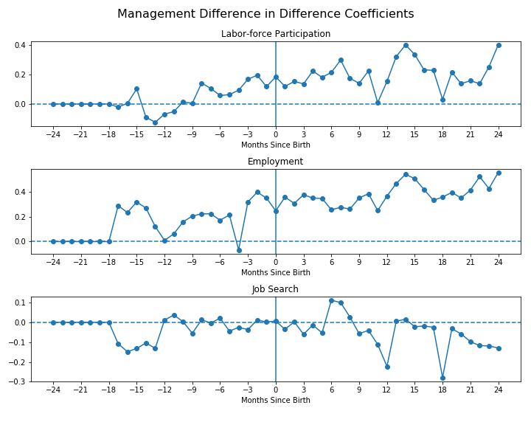
Months Since Birth | Labor-force Participation | Working | Looking
-17 to -12 | 0.32 | 0.13 | 0.55
-15 to -9 | 0.63 | 0.29 | 0.59
-12 to -6 | 0.72 | 0.86 | 0.73
-9 to -3 | 0.52 | 0.53 | 0.80
-6 to 0 | 0.73 | 0.40 | 0.90
-3 to +3 | 0.82 | 0.36 | 0.65
0 to + 6 | 0.67 | 0.58 | 0.40
+3 to +9 | 0.40 | 0.72 | 0.43
+6 to +12 | 0.19 | 0.44 | 0.48
+9 to + 15 | 0.09* | 0.07* | 0.69
+12 to + 18 | 0.21 | 0.26 | 0.52
+ 15 to + 21 | 0.33 | 0.42 | 0.71
+18 to +24 | 0.35 | 0.43 | 0.81
-17 to 0 | 0.55 | 0.25 | 0.87
0 to +24 | 0.12 | 0.33 | 0.58
Months Since Birth | Labor-force Participation | Working | Looking
-17 to -12 | -0.19 | 1.24 | -0.61
-15 to -9 | -0.21 | 1.14 | -0.37
-12 to -6 | 0.20 | 1.05 | 0.03
-9 to -3 | 0.63 | 1.29 | -0.13
-6 to 0 | 0.88 | 1.63 | -0.07
-3 to +3 | 1.07 | 2.35 | -0.11
0 to + 6 | 1.21 | 2.24 | -0.04
+3 to +9 | 1.36 | 2.21 | 0.05
+6 to +12 | 1.21 | 2.14 | -0.19
+9 to + 15 | 1.58 | 2.86 | -0.43
+12 to + 18 | 1.69 | 2.98 | -0.55
+ 15 to + 21 | 1.33 | 2.77 | -0.53
+18 to +24 | 1.33 | 3.02 | -0.83
-17 to 0 | 0.90 | 3.74 | -0.68
0 to +24 | 5.04 | 9.40 | -1.23
Notes:
Testing the hypothesis that paid family leave policies may have differential effects across occupations, I estimate the effect for each occupational group, and report the results from three such occupational groups: management, office and administrative support, and education, training, and library occupations.
Pictured here on the left are the plots of the point estimates of the effect of paid family leave policy on labor-market outcomes of mothers in management occupations. On the top right is the table of probability values from the joint tests of significance. On the bottom right is the table of coefficient sums.
We see here generally positive estimates of the effect of paid family leave policy of the labor-force participation and employment of women in management occupations, with negative estimates of the effect on unemployment in a few windows. Joint tests yield significance at the 10% level for the effect on both labor-force participation and employment in the window of nine to fifteen months after birth.
(Figure 7, Tables 16 and 17)

Slide 28
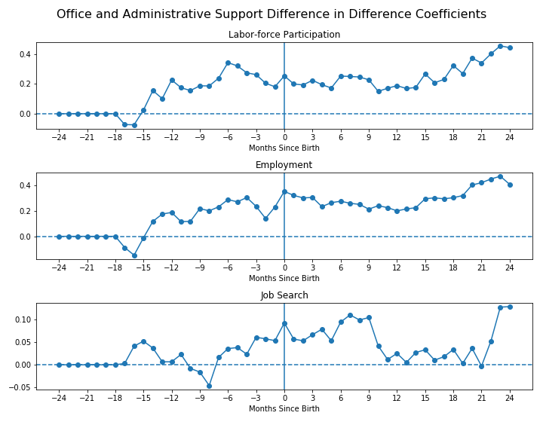
Months Since Birth | Labor-force Participation | Working | Looking
-17 to -12 | 0.06* | 0.09* | 0.88
-15 to -9 | 0.18 | 0.60 | 0.80
-12 to -6 | 0.34 | 0.61 | 0.55
-9 to -3 | 0.41 | 0.70 | 0.42
-6 to 0 | 0.34 | 0.17 | 0.53
-3 to +3 | 0.32 | 0.23 | 0.62
0 to + 6 | 0.24 | 0.59 | 0.55
+3 to +9 | 0.51 | 0.68 | 0.76
+6 to +12 | 0.35 | 0.83 | 0.60
+9 to + 15 | 0.19 | 0.82 | 0.68
+12 to + 18 | 0.35 | 0.79 | 0.73
+ 15 to + 21 | 0.04** | 0.48 | 0.57
+18 to +24 | 0.02** | 0.32 | 0.25
-17 to 0 | 0.11 | 0.09* | 0.77
0 to +24 | 0.09* | 0.93 | 0.62
Months Since Birth | Labor-force Participation | Working | Looking
-17 to -12 | 0.36 | 0.23 | 0.15
-15 to -9 | 1.03 | 0.92 | 0.10
-12 to -6 | 1.52 | 1.36 | 0.01
-9 to -3 | 1.82 | 1.76 | 0.11
-6 to 0 | 1.85 | 1.83 | 0.36
-3 to +3 | 1.52 | 1.89 | 0.44
0 to + 6 | 1.50 | 2.06 | 0.49
+3 to +9 | 1.57 | 1.81 | 0.61
+6 to +12 | 1.49 | 1.67 | 0.49
+9 to + 15 | 1.35 | 1.62 | 0.25
+12 to + 18 | 1.57 | 1.84 | 0.15
+ 15 to + 21 | 2.02 | 2.35 | 0.13
+18 to +24 | 2.61 | 2.79 | 0.38
-17 to 0 | 3.15 | 2.95 | 0.48
0 to +24 | 6.40 | 7.58 | 1.36
Notes:
Next are the results from the regressions run on women in office and administrative support occupations. Again we have plots of point estimates on the left, a table of probability values from the joint tests of significance in the top right, and a table of coefficient sums on the bottom right.
If you look at the tables you can see that there is a positive and significant effect on both labor-force participation and employment in the period of 17 to 12 months before birth. There is also a positive and significant effect on labor-force participation in later time periods. The main difference between this occupational group and the management occupational group is that the estimates of the effect on unemployment are positive across all windows. However, none of the estimates are significant.
(Figure 8, Tables 19 and 20)

Slide 29
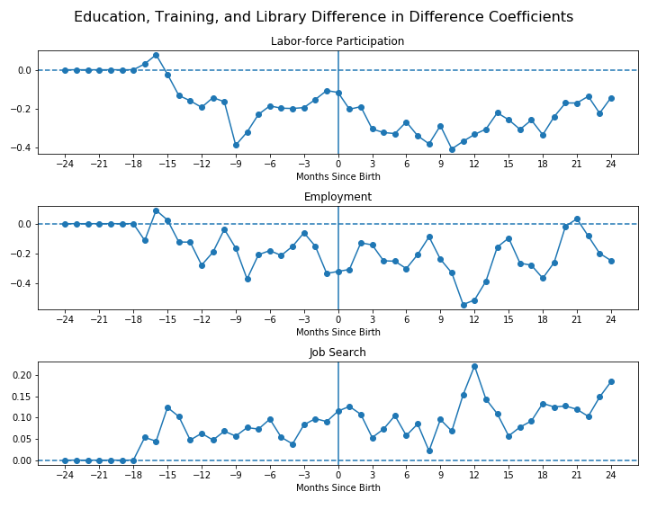
Months Since Birth | Labor-force Participation | Working | Looking
-17 to -12 | 0.32 | 0.35 | 0.38
-15 to -9 | 0.09* | 0.31 | 0.59
-12 to -6 | 0.06* | 0.10 | 0.49
-9 to -3 | 0.22 | 0.18 | 0.52
-6 to 0 | 0.78 | 0.35 | 0.53
-3 to +3 | 0.22 | 0.54 | 0.64
0 to + 6 | 0.30 | 0.63 | 0.40
+3 to +9 | 0.20 | 0.36 | 0.56
+6 to +12 | 0.06* | 0.14 | 0.38
+9 to + 15 | 0.17 | 0.05* | 0.24
+12 to + 18 | 0.41 | 0.09* | 0.23
+ 15 to + 21 | 0.38 | 0.32 | 0.42
+18 to +24 | 0.34 | 0.20 | 0.62
-17 to 0 | 0.21 | 0.16 | 0.82
0 to +24 | 0.18 | 0.03 | 0.86
Months Since Birth | Labor-force Participation | Working | Looking
-17 to -12 | -0.40 | -0.52 | 0.43
-15 to -9 | -1.21 | -0.89 | 0.51
-12 to -6 | -1.63 | -1.42 | 0.48
-9 to -3 | -1.72 | -1.34 | 0.48
-6 to 0 | -1.16 | -1.41 | 0.57
-3 to +3 | -1.27 | -1.44 | 0.67
0 to + 6 | -1.74 | -1.69 | 0.64
+3 to +9 | -2.24 | -1.47 | 0.49
+6 to +12 | -2.39 | -2.21 | 0.70
+9 to + 15 | -2.19 | -2.25 | 0.85
+12 to + 18 | -2.02 | -2.05 | 0.83
+ 15 to + 21 | -1.75 | -1.25 | 0.73
+18 to +24 | -1.43 | -1.14 | 0.94
-17 to 0 | -2.81 | -2.90 | 1.33
0 to +24 | -6.64 | -5.92 | 2.70
Notes:
The final occupational group I investigate in depth is that of education, training, and library occupations. The layout of the slide is the same, plots of point estimates on the left, results from joint tests on the top right, and sums of coefficients on the bottom right.
The results from this occupational group stands out from the rest as the direction of the estimates are inverted. The estimated effect on labor-force participation and employment is negative across al windows, while the estimated effect on unemployment is positive. Joint tests reveal significance in a number of windows for labor-force participation and employment, however non of the joint tests of the effect on unemployment yield significance.
I believe that these findings provide evidence to support the hypothesis that occupation is an important determinant of the effect of paid family leave policy on labor-market outcomes of mothers.
(Figure 9, Tables 22 and 23).

Slide 30
Conclusion
Confirmation of Byker’s Findings
Robustness of Estimates
Occupational Group Findings
Further Research
Notes:
This study reproduces and extends the work of Tanya Byker. There are indeed positive effects of paid family leave policy on the labor-force participation and employment of mothers without college degrees, as well as negative effects on their unemployment. Results from the analysis on white-collar workers mirrored those from the full sample, while analysis on blue-collar workers did not yield any statistically significant effects.
Tests for robustness to weighting yielded estimates close in proximity and similar patterns of the outcome variable over months relative to birth, suggesting correctness of the specification.
Finally, in my analysis of individual occupational groups, the regressions on women in management occupations as well as those in office and administrative support occupations yielded estimates similar to those of the full sample. However, the estimated effect of paid family leave policy on women in education, training, and library occupations is opposite of that of the full sample. These results suggest that occupation is indeed an important factor in determining the effect of paid family leave policy on labor-force participation, employment, and unemployment outcomes of mothers.
As more states adopt paid family leave policies and more data becomes available, future studies may make use of larger sample sizes to obtain more accurate estimates for both the general population and particular sub-groups. I believe that research investigating ties of mothers to specific employers may also help illuminate the mechanism by which paid family leave policy affects the labor-market outcomes of mothers.

Slide 31
Thank you for listening!
Notes:
Thank you all for your time and counsel, It truly is appreciated. Are there any final questions?

