Slide 1
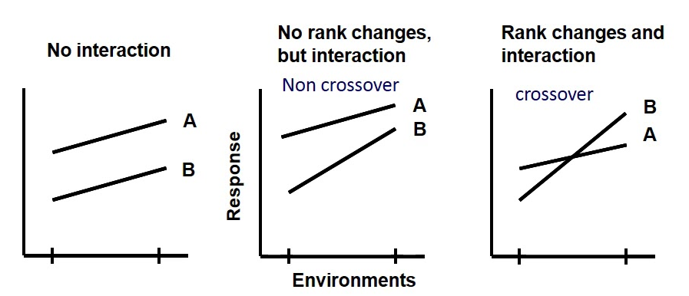
Mendelian vs complex
Mendelian: as simple as monogenic
We deal with phenotypes influenced by:
Multiple genetic factors
SNV (SNPs), indels, CNV...
Environmental factors
Their interaction: GxG, ExE, GxE
A/B: genetic groups (genotypes)
y axis: response variable

Slide 2
Genome-wide approach
From gene-candidate to genome-wide hypothesis free studies (in the study of mental disorders)
Considerable genetic contribution (heritability, familial aggregation)
Highly polygenic (frequency vs impact)
The disappointment of GWAS studies
+ clinical issues: diagnosis instability, lack of biomarkers, subjective perception, lack of resources…

Slide 3
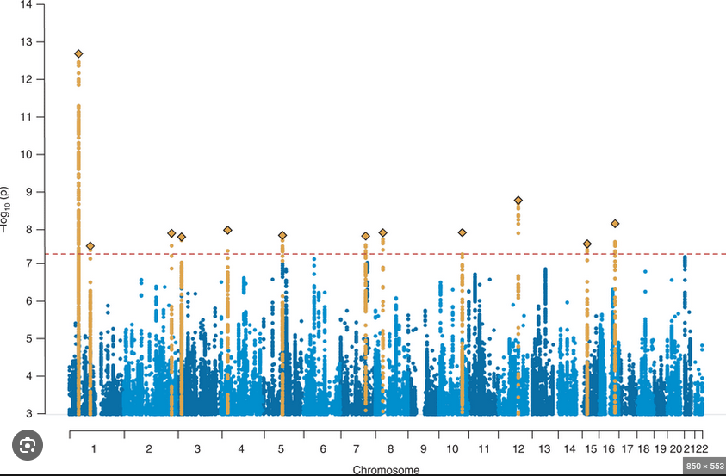
Manhattan plot

Slide 4

Genome-wide approach
Other uses of highly-powered GWAS results
Molecular studies, mendelian randomization studies, heritability assessment…
Polygenic risk scores!
Reliable external information to use in our sample

Slide 5
PRS
Per-individual PRS
PRS = β₁X₁ + β₂X₂ + β₃X₃ + ... + β_{k}X_{k}
X: number of risk alleles of the SNP
β: estimated risk
k: number of included SNPs
Polygenic risk scores (or PGS)
Individual
Unidimensional
Adimensional, quantitative
Unique for our sample
Two sources of information, two separate jobs
GWAS summary results preparation (β, k)
Genotyping information preparation (X, k)

Slide 6
Pipeline overview
DNA extraction
DNA genotyping
(~800k SNPs)
Respository download;
Reformating [.vcf]
Imputation
(QC and reformating [per-chr .vcf.gz] required)
PRS construction
QC
Download, unzip

Slide 7
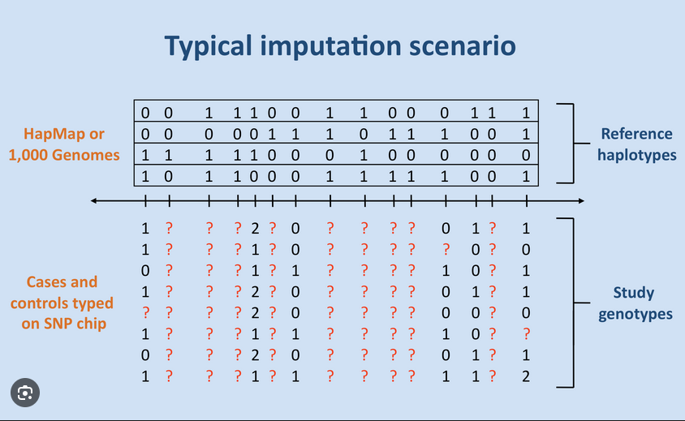
Genotyping data processing
Imputation
Increases SNPs available
Processing through a server
External reference sample
QC: INFO score

Slide 8
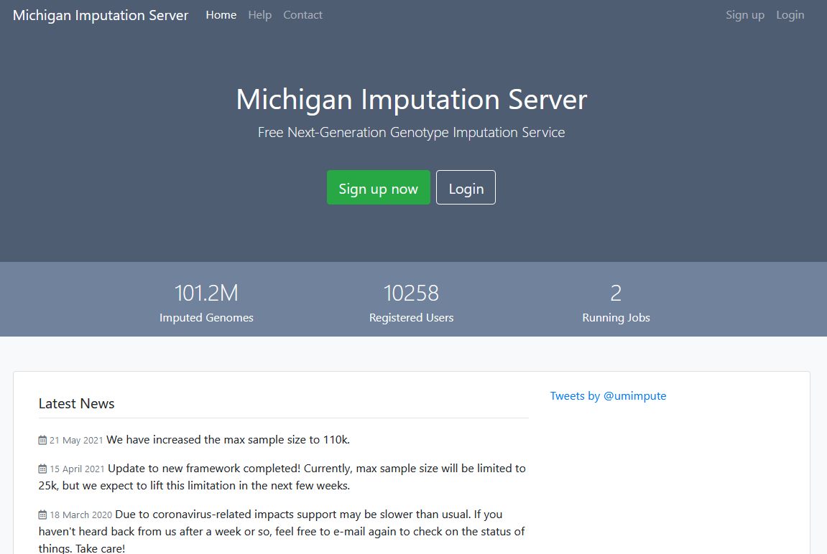
Genotyping data processing
Michigan imputation server
Build, ancestry
Previous pre-defined QC
Per-chromosome .vcf.gz
…and a time-consuming download/unzip/reformat/annotate process

Slide 9
Pipeline overview
DNA extraction
DNA genotyping
(~800k SNPs)
Respository download;
Reformating [.vcf]
Imputation
(QC and reformating [per-chr .vcf.gz] required)
PRS construction
QC
Download, unzip

Slide 10
Quality control
Quality control: PLINK
Reliability of SNPs
MAF
Missingness
Hardy-Weinberg equilibrium
Heterozigosity
Reliability of samples
Missingness
Relatedness
Sex concordance
Raw genotyping file
.bed
.bim
.fam
SNP QC
Sample QC
QCed genotyping file

Slide 11
Pipeline overview
Find GWAS paper
Download summary statistics
Summary statistics QC
PRS-CS

Slide 12
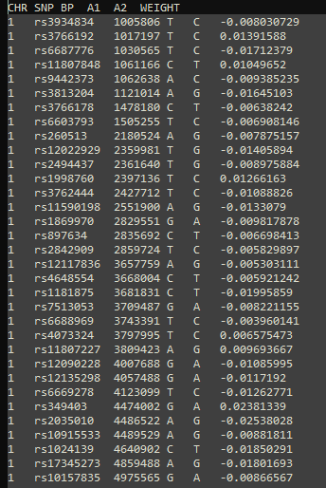
GWAS sumstats
[Caotic] GWAS info of results
SNP ID
SNP loc
Risk allele
Estimated effect on phenotye
+ QC

Slide 13
Pipeline overview
Find GWAS paper
Download summary statistics
Summary statistics QC
PRS-CS

Slide 14
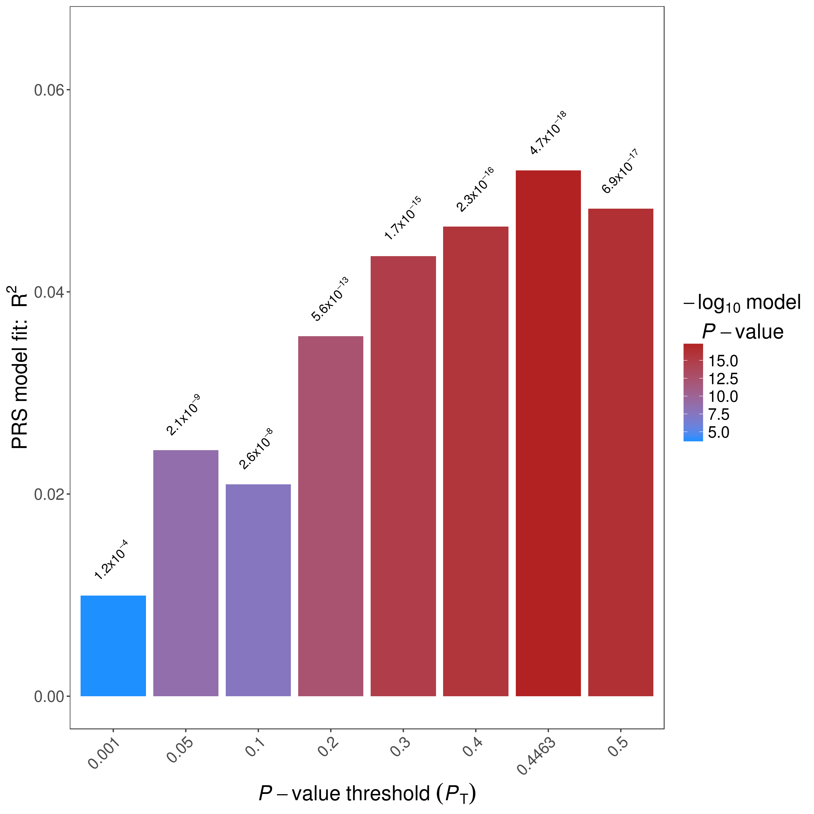
PRS-CS
The problem of p thresholding
The relief of PRS-CS
Mathy apporach to recalculate beta values. Needs:
Sumstats formatted
Reference for LD
Effective sample size (Neff)
Patience

