Slide 1

Cyclistic Customer Analysis
From casual rider to annual member

Slide 2
Purpose How can we increase profit by converting casuals to members?

Slide 3






Key findings
Synopsis
The busiest period of the year is June to September.
Casuals use Cyclistic mostly for leisure activities.
Members use Cyclistic mostly for commuting.
Top three recommendations
1 Target group and campaign content
Market to local casuals that rent bikes after work or on weekends to visit parks or the coast.
2 Campaign timing
Launch a campaign in May, when activity starts increasing.
3 Long-term planning
Improve future decision making by collecting better quality data.

Slide 4




Agenda
Purpose
When do casuals and members use Cyclistic?
Where do casuals and members use Cyclistic?
Why do casuals and members use Cyclistic?
Key findings and recommendations

Slide 5
Purpose Who are casuals and members and what is our aim?
Background
Who are our customers?
Casuals buy single-ride or full-day passes.
Members pay $119 for a yearly subscription.
Aim
Convert casuals to members.
Why?
Members are our most profitable customers.
Casuals and members in numbers
Total bike rides
2,199,527 vs 3,116,655
Average ride duration
22.4 vs 12.9 min
Rides longer than 45 min
10.7% vs 1.7%
Electric bike rides
43.8% vs 37.1%

Slide 6
Section 1
When do casuals and members rent bikes?

Slide 7
When do casuals and members rent bikes? Daily fluctuations
Notes:
Members most active in the middle of the week, least active on weekends
Casuals least active in the middle of the week, most active on weekends
Weekend = leisure activity; Weekdays = commute ?

Slide 8
When do casuals and members rent bikes? Daily fluctuations
Notes:
Members most active in the middle of the week, least active on weekends
Casuals least active in the middle of the week, most active on weekends
Weekend = leisure activity; Weekdays = commute ?

Slide 9
When do casuals and members rent bikes? Daily fluctuations
30% of customers use Cyclistic to commute to work. Are they mostly members?
Notes:
Members most active in the middle of the week, least active on weekends
Casuals least active in the middle of the week, most active on weekends
Weekend = leisure activity; Weekdays = commute ?

Slide 10
When do casuals and members rent bikes? Hourly fluctuations

Slide 11
When do casuals and members rent bikes? Hourly fluctuations
Afternoon commute and after-work leisure
Morning commute
Notes:
Members most active before and after standard working hours.
Casuals relatively active even during working hours.

Slide 12
When do casuals and members rent bikes? Hourly fluctuations
Afternoon commute and after-work leisure
Morning commute
A large portion of members use Cyclistic for their daily commute.
Casuals use our bikes mainly for leisure activities.
Notes:
Members most active before and after standard working hours.
Casuals relatively active even during working hours.

Slide 13
When do casuals and members rent bikes? Monthly fluctuations
Notes:
Member activity is more spread out throughout the year.
Casuals are barely active in winter.

Slide 14
When do casuals and members rent bikes? Monthly fluctuations
Peak season is between June and September.

Slide 15
When do casuals and members rent bikes? Monthly fluctuations
Peak season is between June and September.
Member activity is more spread out throughout the year.
Notes:
Member activity is more spread out throughout the year.
Casuals are barely active in winter.

Slide 16
Takeaway 1 – Campaign Timing
In order to maximize our reach, we should start our marketing campaign at the start of the season in May.

Slide 17
Section 2
Where do casuals and members rent bikes?

Slide 18
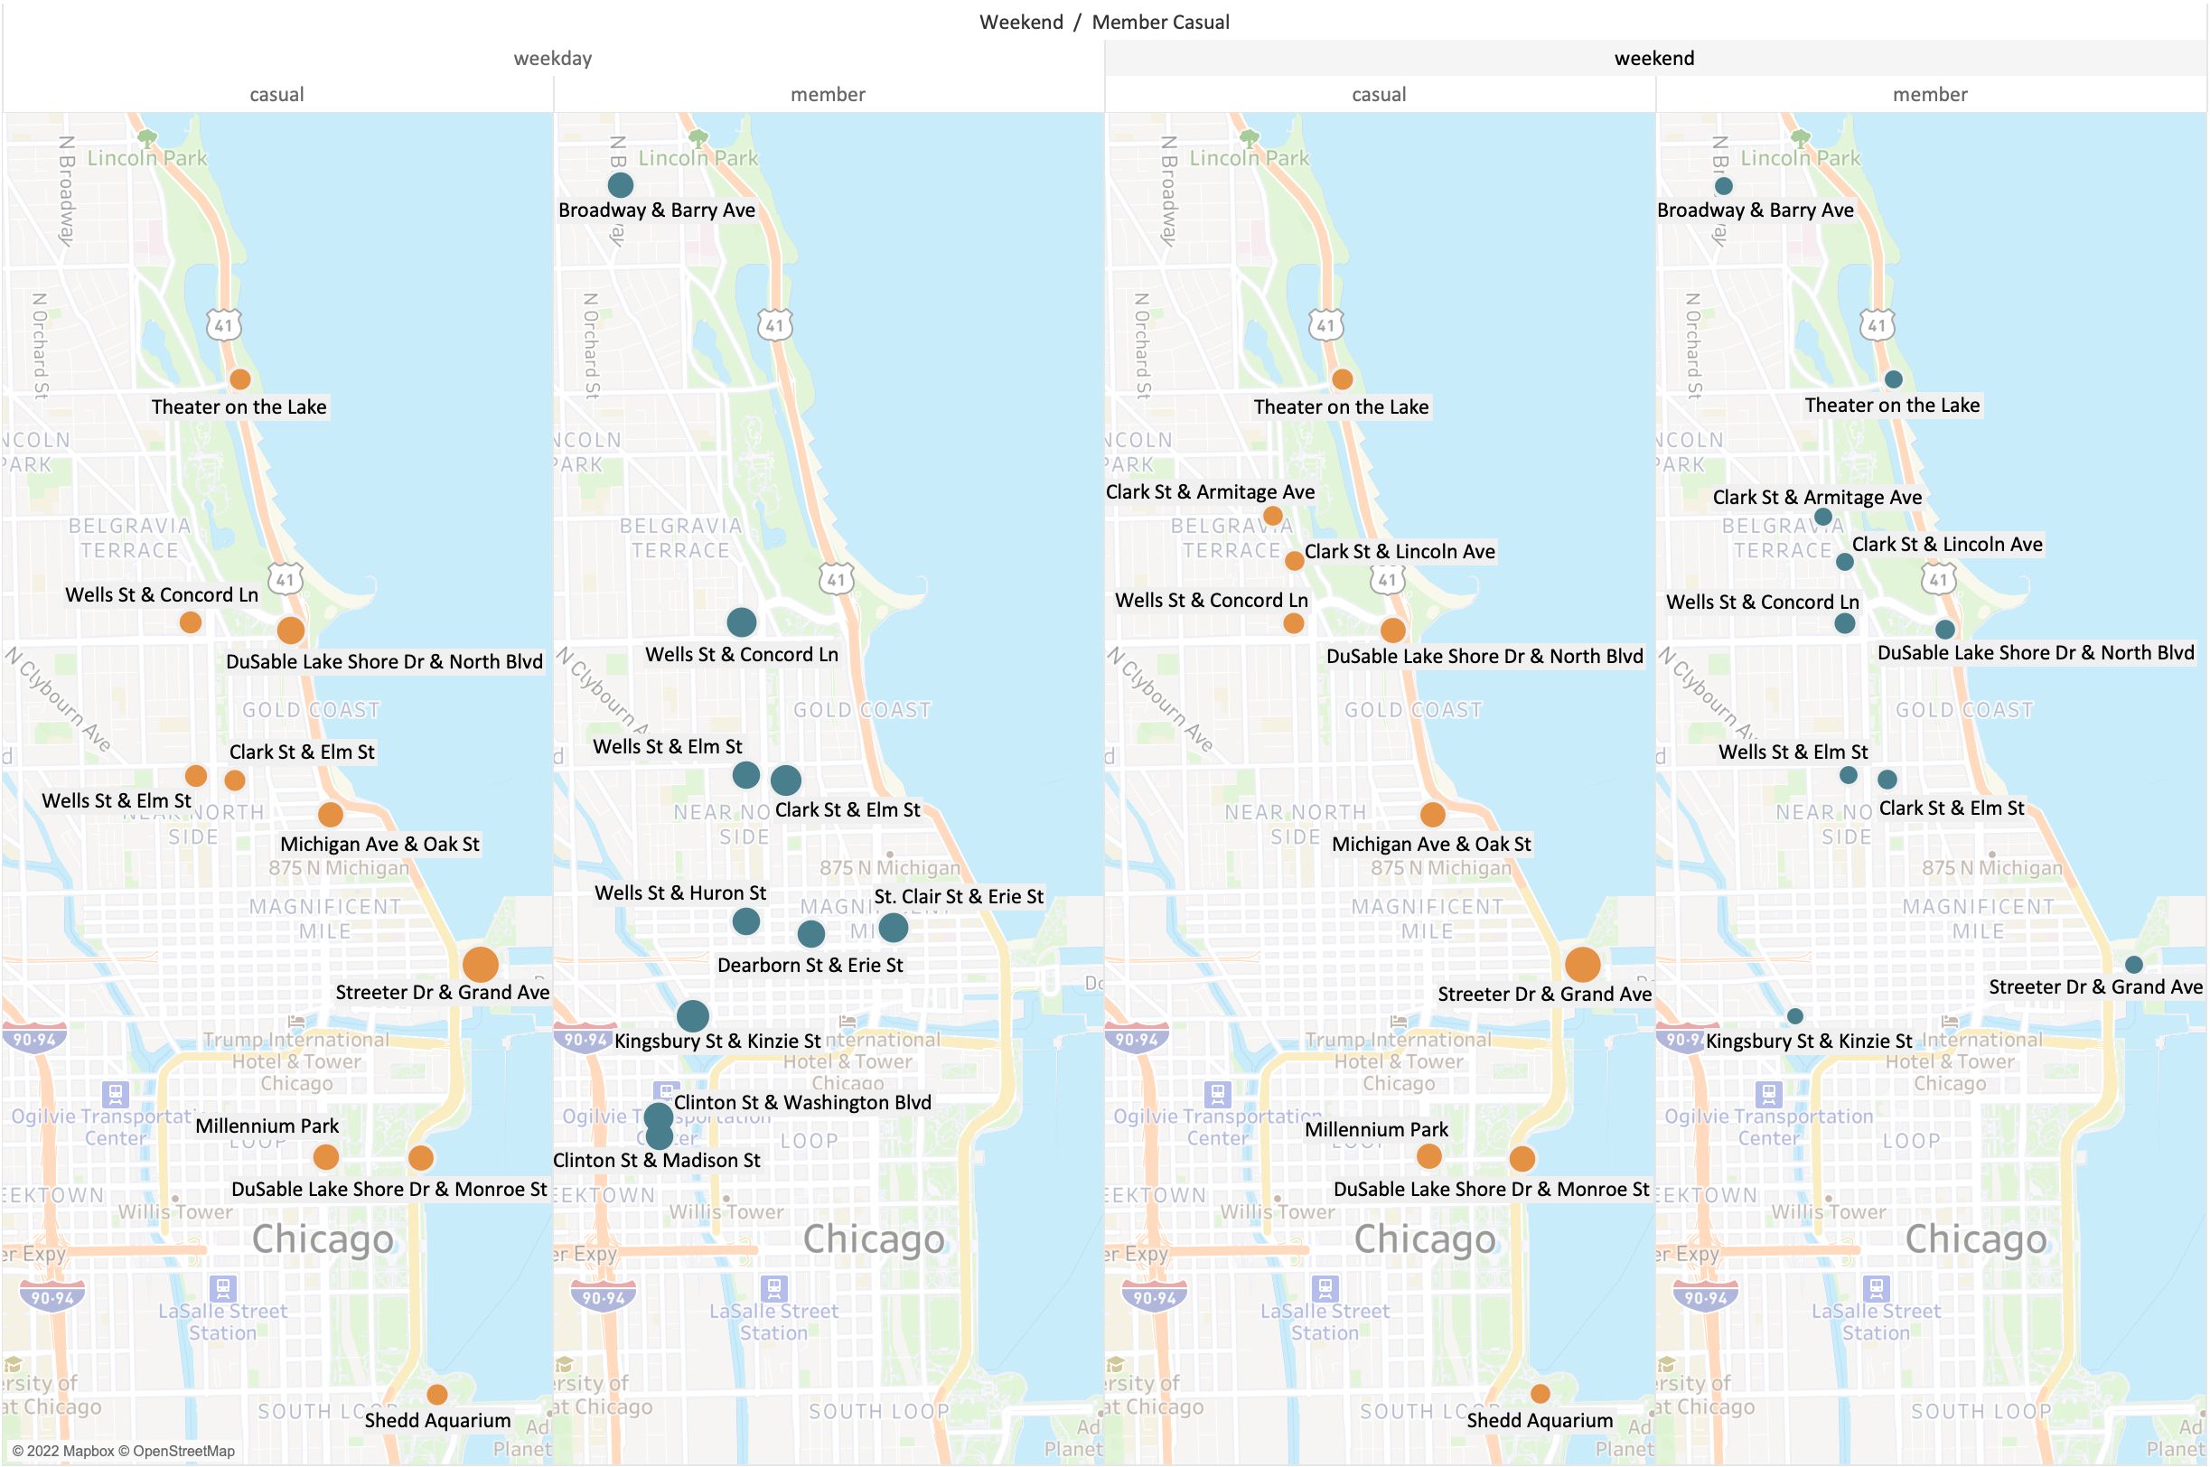
Where do casuals and members rent bikes? Top 10 most popular stations by group
Weekday
Weekend
Similar between weekdays and weekends.
Mostly parks and coast.
Different between weekdays and weekends.
City center/business district on weekdays.
More parks and coast on weekends.
Supports hypothesis about bike usage.
Informs where and what to advertise.
Notes:
Different between weekdays and weekends -> different behaviours (commute vs leisure)
Similar between weekdays and weekends -> similar behaviours (predominantly leisure even during the week)
First intuition: Advertise at busiest casual stations and focus advertising content on leisure activities, but is there more to it?

Slide 19
Takeaway 2 – Cyclistic use cases
Casuals pursue mostly leisure activities around the coast and parks. Members also pursue leisure activities on weekends but are more active in the city center, especially on weekdays when they use Cyclistic for their daily commute.

Slide 20
Section 3
Why do casuals and members rent bikes?
Notes:
Better understand reasons for bike usage -> more targeted marketing

Slide 21
Why do casuals and members rent bikes? Not all stations are the same, not all casuals are the same
Streeter Dr & Grand Ave
DuSable Lake Shore Dr & North Blvd
Clark St & Elm St
→ Mostly touristic
→ Mostly leisure activity
→ Mostly commutes
Notes:
Looked at activity patterns from top 10 stations and recognized three patterns

Slide 22








Why do casuals and members rent bikes? Three reasons to use Cyclistic
Demographic | Destinations | Busiest days | Busiest time of day on weekdays | Casual frequency | Member frequency
Tourists | Sights | Weekends | 12pm to 5pm
Locals | Parks and coast | Evenly distributed | 5pm to 6pm
Locals | Business district | Weekdays | 4pm
Tourism
Leisure
Commute
Target group: Local casuals that use Cyclistic bikes for leisure
Notes:
Unfortunately, we don’t have data on customer demographics (particularly residents vs tourists)
Also don’t know anything about recurring rides because no user ID
We have to try to infer from activity patterns

Slide 23
Takeaway 3 – Campaign Content:
Our target group are local casuals that use Cyclistic bikes for leisure activities. We need to convince them to
1) get annual membership for leisure activities
or
2) use Cyclistic for commuting.

Slide 24
Section 4
Key findings and recommendations

Slide 25






Key findings
Our target group
There are three reasons to use Cyclistic – tourism, leisure and commuting.
Use cyclistic for leisure activities.
Target specific stations around parks, the coast and the city center.
Casuals use Cyclistic mostly for touristic and leisure activities.
Are most active on weekends between 12pm and 6pm.
Members use Cyclistic mostly for commuting and leisure activities.
Are also highly active on weekdays after 4pm.
Daily, weekly and yearly activity patterns reflect these tendencies.
Are most active from June to September.
So do station preferences.
Notes:
We identified key patterns regarding where, when and why casuals and members use stations
We identified our target group based on those patterns and our assumptions regarding demographics (tourists vs locals)

Slide 26
Top three recommendations
1 Target group and campaign content
Market to local casuals that rent bikes after work or on weekends to visit parks or the coast.
2 Campaign timing
Launch a campaign in May, when activity starts increasing.
3 Long-term planning
Improve future decision making by collecting better quality data.
Notes:
Actionable steps

Slide 27
Recommendation 1 Market to local casuals that use Cyclistic after work and on weekends to visit parks or the coast.
Approach 1
Highlight benefits of annual membership for regular leisure activities.
Approach 2
Highlight benefits of extending bike use to commuting.
Advertise at the right stations
Don’t base decision solely on overall casual activity but keep identified target group in mind
Notes:
Benefits for regular leisure activities: More flexibility, Rides up to 45 minutes are free, Take a bike without thinking twice, Active and healthy lifestyle
Benefits for commuting: Ecological, Cheaper and less stressful than alternatives (public transport or driving), Healthy
Target stations with permanent adds and possibly even events for most popular stations

Slide 28
Recommendation 2 Launch a campaign in May, when activity starts increasing.
Three months for free
Pay only $1 for the first three months if you sign up for an annual membership before the end of June.
Market towards target group
Spend the summer outdoors in parks and with your friends.
Advertise at the right stations
Keep target group in mind
Notes:
Customers will be able to save a lot of money in the next three months, however we are going to profit long-term
Customers are motivated
Right content
Right stations

Slide 29
Recommendation 3 Improve future decision making by collecting better quality data.
1 Differentiate between single-ride and full-day passes.
2 Connect ride data to anonymous customer IDs.
3 Give customers an incentive to provide anonymous demographic data.
4 Use the app to sporadically ask customers about the purpose of a trip and give an incentive for answering.
Notes:
Data quality vital for making informed decisions
One of the limitations of this analysis
Less data -> more inferences and speculations, fewer and less precise answers

Slide 30
Recap
1 Target group and campaign content
Market to local casuals that rent bikes after work or on weekends to visit parks or the coast.
2 Campaign timing
Launch a campaign in May, when activity starts increasing.
3 Long-term planning
Improve future decision making by collecting better quality data.
Notes:
Actionable steps

Slide 31
Thank you for your attention Any questions?

