Slide 1
Software development
Introduction chapter
Oleksandr (Sasha) Hubanov
alex@0x0h.com

Slide 2
Disclaimer
Everything said in this cource is based on my personal expirince and collected feedback of my friends and colleagues.

Slide 3
Who am I
"Who am I?" is a question we ask ourselves when we desire to have a better sense of who we are.
Me :
Master in Biomedical engineering, left PhD in Biomechanics on 3rd year
Senior software engineer
Electronic and 3d printing geek
And You?

Slide 4
Course goals
You will get:
understanding on “what is worth learning”
sense of how to solve one or other typical problem
knowledge level of junior software developer
While I hope to get achievement “helped few more people with their career”

Slide 5
Course content
Introduction - How and what we learn
Your tools – Git, Jenkins, Scripts, IDE
Agile – style of life
Code lifecycle
Library and Application
Memory – Data structures
Processor – Algorithms and complexity
Defensive programming
Classes and abstraction
Refactoring
Design patterns
Persistent storage overview
Architecture – Microservices or not
How to tune your program
Best practices & Reading code

Slide 6
Course layout
Lecture -> Coding task -> Code review -> Questions
You can skip the chapter – just answer few questions from the topic
github.com will be used as storage of tasks and solutions
Timing – once a week? For 45 mins? 60 mins?
Zoom or Webex or Discord??

Slide 7
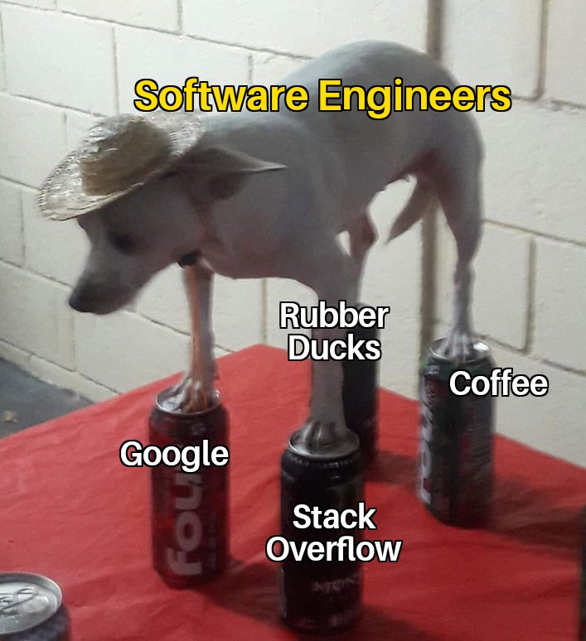
How we learn
Study the documentation
stackoverflow, google and youtube
Seek for open-source examples
Keep notes, everything to be noted

Slide 8
What we learn
Learn patterns and ideas, not libraries and frameworks
Do not think “one language will serve me forever”
Continuous improvement is the developer life
Do not attach to one set of tools, be flexible

Slide 9
Market requests
Software developer VS Software engineer
5+ years of experience for 2 years old language
English is must, learn to listen difficult accents
Soft skills – polite answers, etc

Slide 10
Languages overview
C – the only language used by NASA for satellites, lowest level != fastest
C++ - the father of 90% of nowadays languages, good as basement knowledge
C# / Java – mainly used for cross platform development, maintainability > speed
Assembler – good to know basics and ideas how it works
MATLAB / R / python (numpy) – any kind of science POC can be done
LaTeX – forget about MS Word
Bash / python / groovy – automation of every kind
JavaScript – mainly web development, also Electron for desktop applications
Go / Rust / Ruby / Swift – something very specific == skip, unless you very need it

Slide 11
Sources to study
Code Complete: McConnell, Steve - https://github.com/media-lib/prog_lib/blob/master/general/Steve%20McConnell%20-%20Code%20Complete%20(2nd%20edition).pdf
Uncle Bob lessons -https://www.youtube.com/watch?v=7EmboKQH8lM&list=PLmmYSbUCWJ4x1GO839azG_BBw8rkh-zOj
Clean Code: Robert C. Martin - https://github.com/jnguyen095/clean-code/blob/master/Clean.Code.A.Handbook.of.Agile.Software.Craftsmanship.pdf
Official documentation set for your language/framework/library

Slide 12
The task
Register at github.com and send me your nickname / email

