Slide 1
Software development
Memory and Data structures
Oleksandr (Sasha) Hubanov
alex@0x0h.com

Slide 2

Disclaimer
Everything said in this cource is based on my personal expirince and collected feedback of my friends and colleagues.

Slide 3
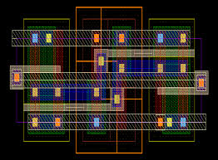
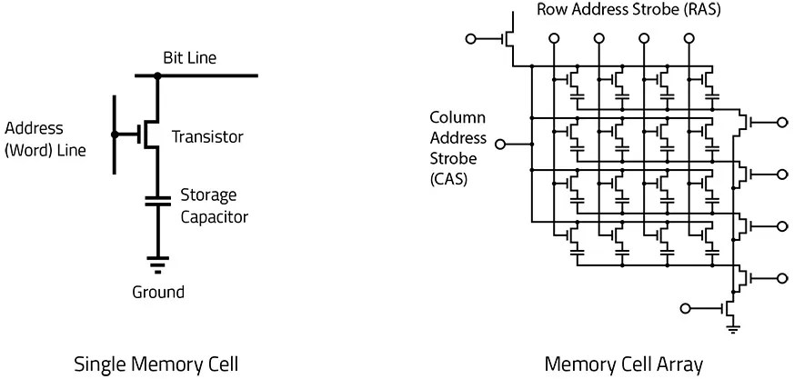
What is Computer Memory?
Computer memory refers to the electronic storage space in a computer system where data, instructions, and programs are stored for processing.
Each cell store minimum one bit with 0 or 1
Cells arranged in arrays, while can be addressed individually
Set of cells can be accessed by CPU at once - bytes

Slide 4
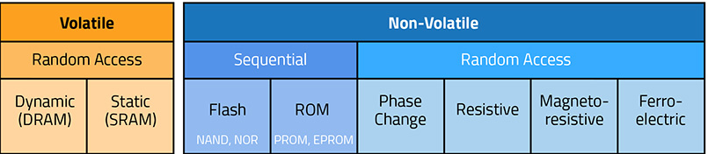
Types of Memory
Primary Memory (RAM) - the main memory used by the computer to store data and program instructions that are currently being executed
Secondary Memory - hard drives, solid-state drives (SSDs), optical drives, and other external storage media
Cache Memory - a small and fast memory located close to the CPU
Notes:
Primary Memory (RAM) - It is volatile memory, meaning its contents are lost when the power is turned off.
Secondary Memory - Unlike primary memory, secondary memory retains data even when the power is turned off. It is used for long-term storage of data and programs.
Cache Memory - Its purpose is to temporarily store frequently accessed data and instructions, which helps improve the overall performance of the system.

Slide 5
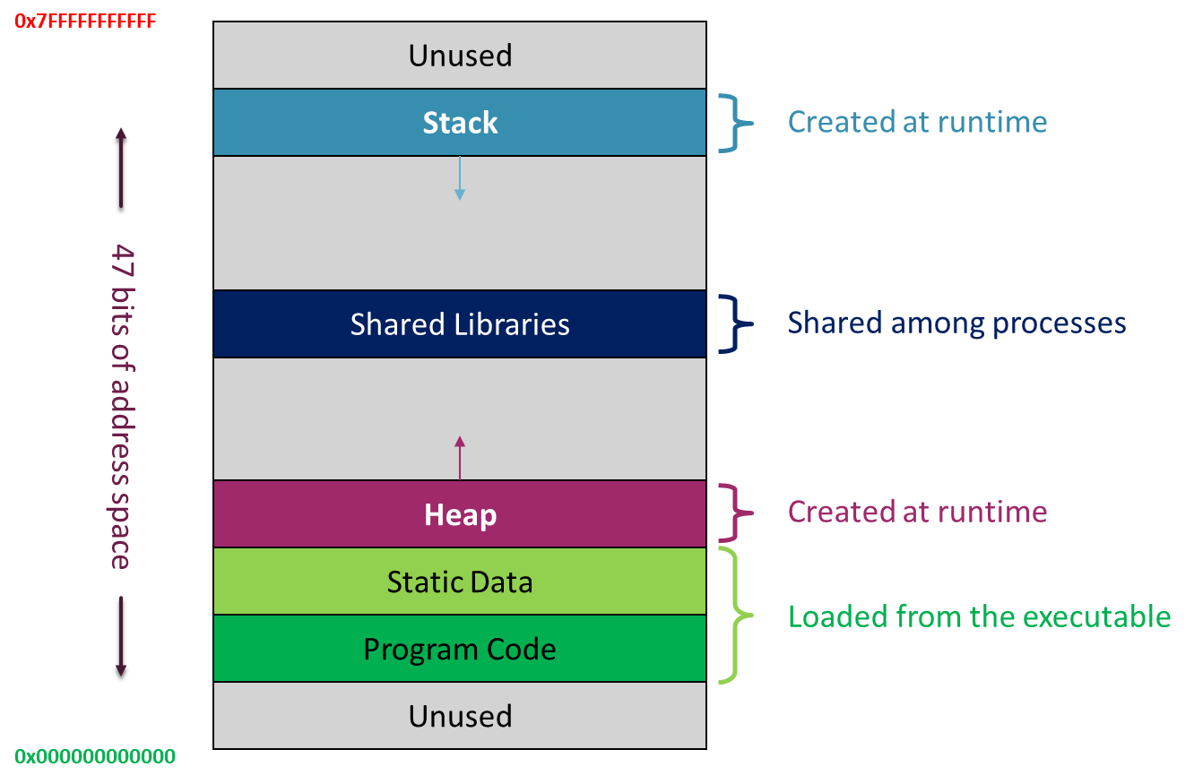
Memory Accessible by an Application
Depend from access application has, it can R/W any type of memory available, perhaps exclude CPU cache
But the 99% of time application works with RAM
OS allocates an block/s of memory for application to use

Slide 6
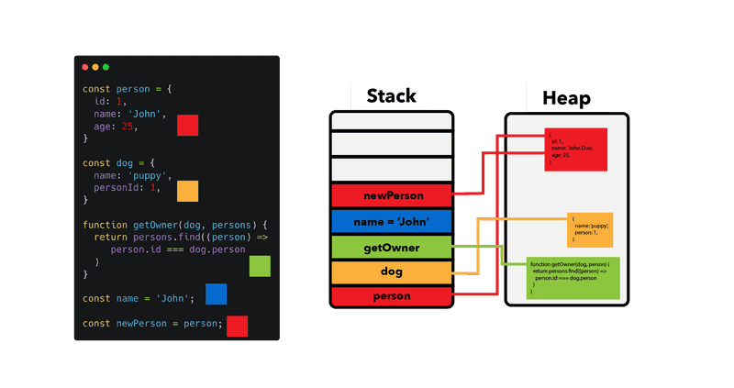
Memory Segments
Memory Segments:
stack memory
heap memory
global/static memory.

Slide 7
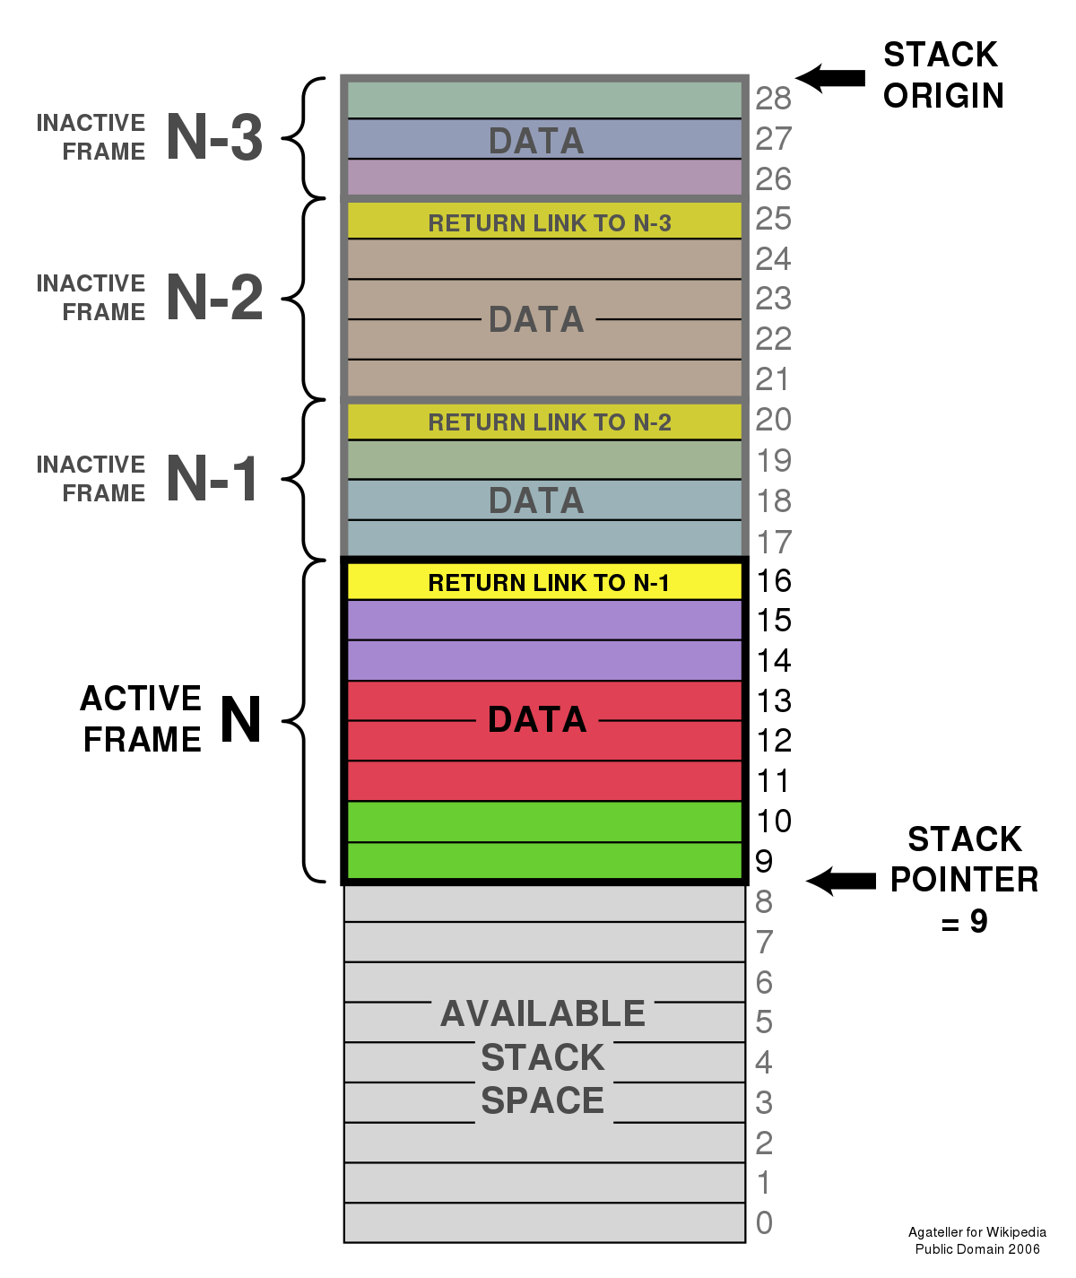
Stack Memory
Region of memory used by programs to manage local variables, function calls, and function parameters.
Stack is Last-In-First-Out (LIFO) structure, where the most recently added items are accessed first. Stack pointer keeps track of the current position in the stack.

Slide 8
Heap Memory
Region of memory used for dynamic memory allocation.
Programs can request memory from the heap using functions like malloc() or new, and release the memory when it is no longer needed using free() or delete.
Need to keep track of used blocks - memory management, to avoid memory leaks.
Used to store dynamically allocated objects – classes, linked lists, trees, or resizable arrays.

Slide 9
Global/Static Memory
Region of memory used to store global variables and static variables.
Lifetime of global variables - typically the entire program execution, allowing them to be accessed from any part of the code.
Static variables have a limited scope within their enclosing block or function.
Potential issues with global variables causing tight coupling, and the need for careful management to avoid unintended side effects.
Notes:
These variables have a longer lifetime compared to local variables and retain their values throughout the program execution.

Slide 10
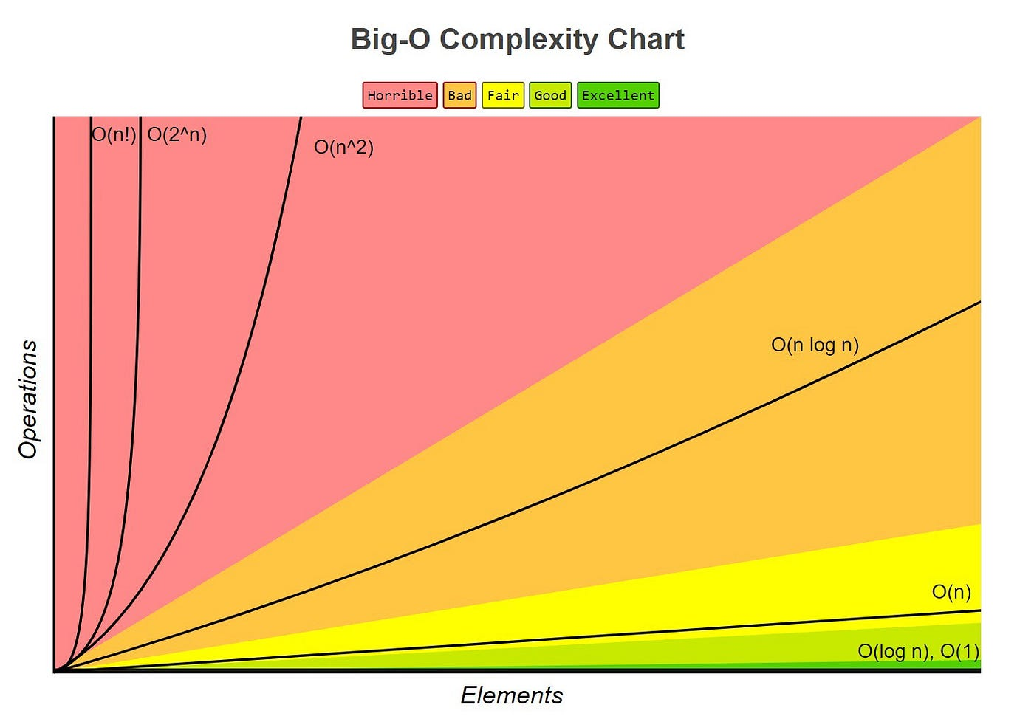
Big O Notation
Big O notation is used to describe the asymptotic behavior of an algorithm in terms of its time complexity or space complexity as the input size grows.
Time Complexity: Big O notation provides an upper bound on the worst-case time complexity of an algorithm. It represents the maximum number of operations the algorithm will perform as a function of the input size.
Space Complexity: Big O notation describes the amount of additional space (memory) an algorithm requires relative to the input size.
Notes:
These variables have a longer lifetime compared to local variables and retain their values throughout the program execution.

Slide 11
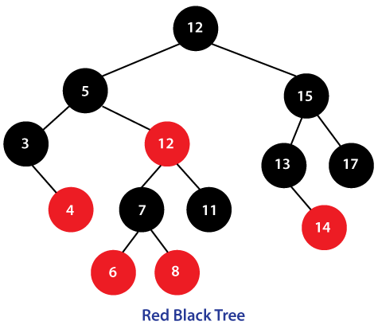
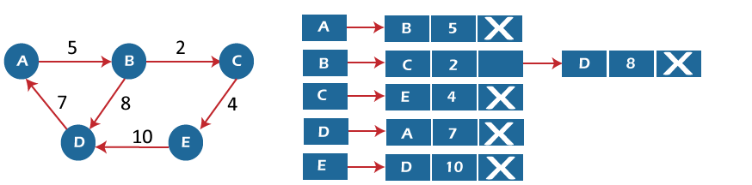
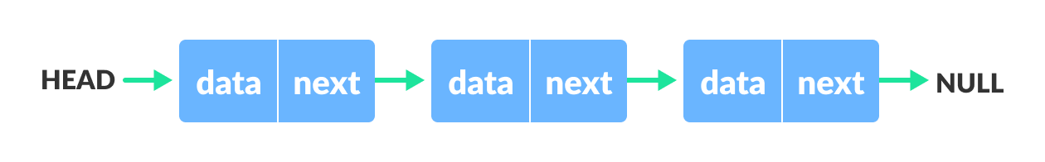
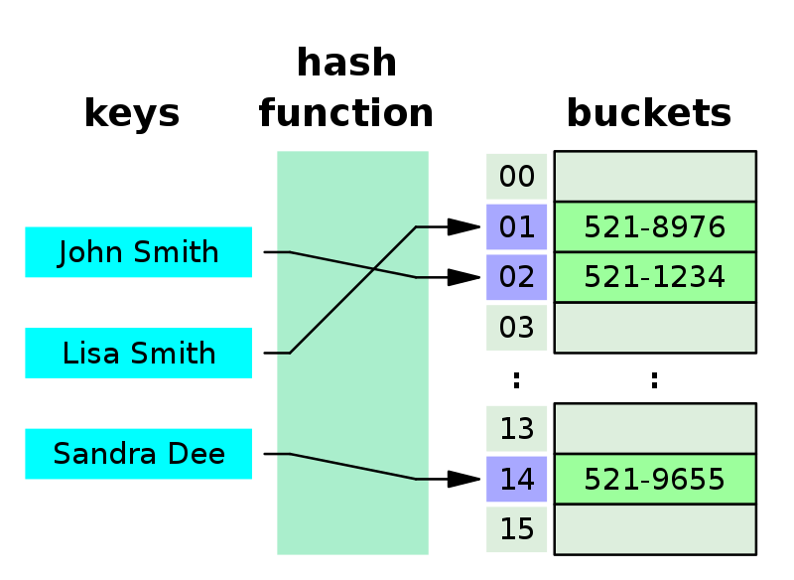
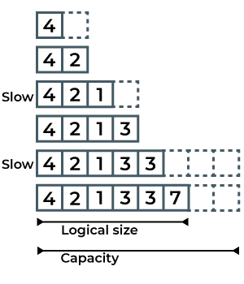
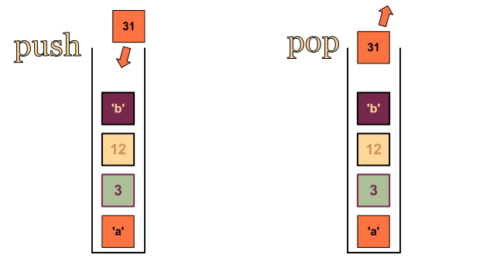
Data Structures
A way to organize and store data effectively.

Slide 12
Array
An array is a linear data structure that stores a fixed-size sequence of elements of the same type.
Contiguous memory allocation: Elements are stored in adjacent memory locations.
Index-based access: Elements can be accessed using their index.

Slide 13
Array
Operations and Common Use Cases:
Accessing elements O(1)
Inserting/deleting elements at the end O(1)
Inserting/deleting elements at arbitrary positions O(n)
Searching for a specific value: Time complexity: O(n)
Storing collections of data that require random access, implementing algorithms like sorting or searching.
Advantages:
Constant-time access to elements.
Efficient memory utilization.
Disadvantages:
Fixed size: Resizing an array requires creating a new, larger array and copying elements.
Limited flexibility for insertion and deletion in the middle of the array.
Inefficient for large-scale resizing.

Slide 14
Linked List
A linear data structure consisting of nodes, where each node contains data and a reference (or link) to the next node.
Non-contiguous memory allocation: Nodes can be scattered in different memory locations.
Dynamic size: Linked lists can grow or shrink as elements are added or removed.

Slide 15
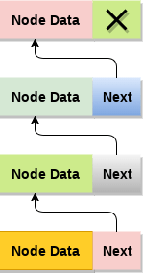
Linked List
Operations and Common Use Cases:
Accessing elements: Time complexity: O(n)
Inserting/deleting elements at the beginning: O(1)
Inserting/deleting elements at the end: O(n) (or O(1) with a tail reference)
Inserting/deleting elements at arbitrary positions: O(n)
Searching for a specific value: O(n)
Implementing stacks, queues, or other dynamic data structures, efficient memory management when frequent insertions or deletions are required.
Advantages:
Dynamic size: Linked lists can grow or shrink as needed.
Efficient insertion/deletion at the beginning (with O(1) time complexity).
Disadvantages:
Non-constant time access to elements, requiring traversal from the head node.
Higher memory overhead due to storing node references.

Slide 16
Stack
An abstract data type that follows the Last-In-First-Out (LIFO) principle. Elements are added and removed from the same end called the "top."

Slide 17
Stack
Operations and Common Use Cases:
Push: Adding an element to the top. Time complexity: O(1)
Pop: Removing the top element. Time complexity: O(1)
Function call stack, expression evaluation, backtracking algorithms.
Advantages:
Efficient insertion and deletion at the top (with O(1) time complexity).
Provides access to the most recently added elements.
Disadvantages:
Limited access to elements other than the top.
Elements deeper in the stack require multiple pops to access.

Slide 18
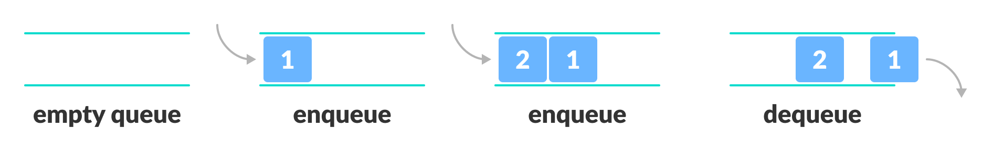
Queue
An abstract data type that follows the First-In-First-Out (FIFO) principle. Elements are added at one end called the "rear" and removed from the other end called the "front."

Slide 19
Queue
Operations and Common Use Cases:
Enqueue: Adding an element to the rear. Time complexity: O(1)
Dequeue: Removing an element from the front. Time complexity: O(1)
Process scheduling, breadth-first search, message passing.
Advantages:
Maintains order and allows efficient insertion and deletion at both ends (with O(1) time complexity).
Disadvantages:
Limited access to elements in the middle of the queue.
Elements at the front require dequeuing all previous elements.

Slide 20
Bonus - Advanced data structures
Binary trees
Hash tables
Graph - Adjacency Lists

Slide 21
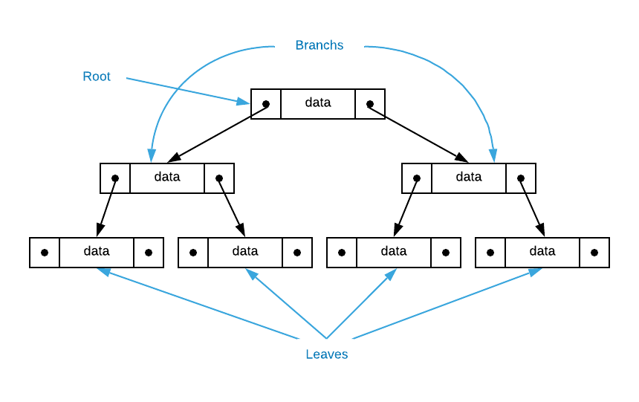
Binary trees
A hierarchical data structure consisting of nodes connected by edges. It has the following characteristics:
Root: The topmost node of the tree.
Parent and Child: Each node (except the root) has a parent node and can have zero or more child nodes.
Leaf: Nodes with no children.
Depth and Height: Depth refers to the level of a node in the tree, while height is the maximum depth of any node in the tree.

Slide 22
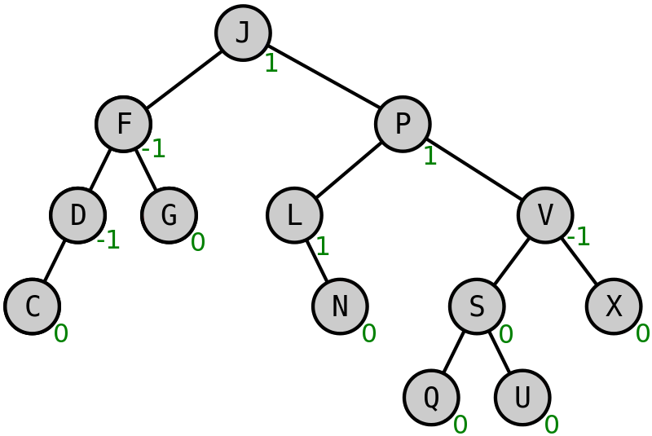
Types of Binary Trees
AVL Tree: A self-balancing binary search tree where the heights of the left and right subtrees differ by at most one.
Red-Black Tree: A self-balancing binary search tree where nodes are colored red or black, and it satisfies specific properties to maintain balance.

Slide 23
Binary trees
Operations and Common Use Cases:
Traversals (e.g., pre-order, in-order, post-order): O(n)
Search, insertion, and deletion - depends on the tree type and its balance.
Common Use Cases:
File systems: Representing directories and files in a hierarchical structure.
Organization charts: Representing the hierarchical structure of an organization.
Family trees: Representing genealogical relationships within a family.
Expression evaluation: Constructing expression trees for arithmetic or logical operations.

Slide 24
Binary trees
Advantages:
Efficient for hierarchical data representation and organization.
Enables efficient search, insertion, and deletion operations based on the tree type and its balance.
Disadvantages:
Requires appropriate tree balancing techniques for optimal performance.
Complex implementation compared to linear data structures.

Slide 25
Hash Tables
A data structure that allows efficient retrieval and storage of key-value pairs. It utilizes a hash function to compute an index or bucket where the value is stored.
a hash function takes the input key and maps it to a specific index or bucket in the hashtable. Multiple keys may hash to the same index, leading to collisions.
Collision Resolution:
chaining (using linked lists or other data structures within each bucket)
open addressing (probing to find the next available slot).

Slide 26
Stack
Operations and Common Use Cases:
Insertion: O(1) on average, but can degrade to O(n) in the worst case due to collisions.
Retrieval: O(1) on average, but can degrade to O(n) in the worst case due to collisions.
Efficient lookup of values based on unique keys, caching, symbol tables.
Advantages:
Efficient retrieval of values based on keys with a constant-time complexity (on average).
Ability to handle large datasets with good performance when collision resolution is effectively implemented.
Disadvantages:
Performance can degrade if there are many collisions or the hash function is poorly designed.
Additional memory overhead to handle potential collisions.

Slide 27
Graph - Adjacency Lists
A non-linear data structure consisting of nodes (vertices) connected by edges. In the context of graph representation, adjacency lists are used to store the relationships between vertices.

Slide 28
Graph - Adjacency Lists
Operations and Common Use Cases:
Adding an edge: depends on the implementation, usually O(1) or O(V), where V is the number of vertices.
Removing an edge: depends on the implementation, usually O(degree(V)), where degree(V) is the number of adjacent vertices of V.
Traversing adjacent vertices: Time complexity depends on the number of adjacent vertices, usually O(degree(V)).
Efficient lookup of values based on unique keys, caching, symbol tables.
Advantages:
Efficient representation for sparse graphs where the number of edges is relatively small.
Memory-efficient as it only stores information about existing edges.
Disadvantages:
Less efficient for dense graphs where the number of edges is close to the maximum possible.
Slower access to determine the presence of an edge between two vertices compared to adjacency matrices.

Slide 29
Sources to study
Code Complete: McConnell, Steve - https://github.com/media-lib/prog_lib/blob/master/general/Steve%20McConnell%20-%20Code%20Complete%20(2nd%20edition).pdf
Uncle Bob lessons -https://www.youtube.com/watch?v=7EmboKQH8lM&list=PLmmYSbUCWJ4x1GO839azG_BBw8rkh-zOj
Clean Code: Robert C. Martin - https://github.com/jnguyen095/clean-code/blob/master/Clean.Code.A.Handbook.of.Agile.Software.Craftsmanship.pdf
Official documentation set for your language/framework/library

Slide 30
The task
Read the literature, watch Uncle Bob on youtube

