Slide 1
Software development
Your tools – Git, Scripts, automation
Continuous Integration
Oleksandr (Sasha) Hubanov
alex@0x0h.com

Slide 2

Disclaimer
Everything said in this cource is based on my personal expirince and collected feedback of my friends and colleagues.

Slide 3
What are Developer Tools
Essential for streamlining the software development process, improving productivity, and enhancing code quality.
Facilitate collaboration among team members by providing version control systems, code review tools, and project management platforms.
Today we have a lot of code analysis tools, linters, and static code analysers that help maintain code quality and adhere to coding standards.
Continuous integration and deployment tools like Jenkins enable automating the entire delivery pipeline, ensuring faster and more reliable software releases.

Slide 4
Version control
Version control is a system that enables developers to manage changes to their codebase over time.
Benefits are:
Capturing a complete history of code changes
Collaboration among developers
Code Integrity and Safety
Code reusability by enabling the sharing of code between projects, teams, and organizations

Slide 5
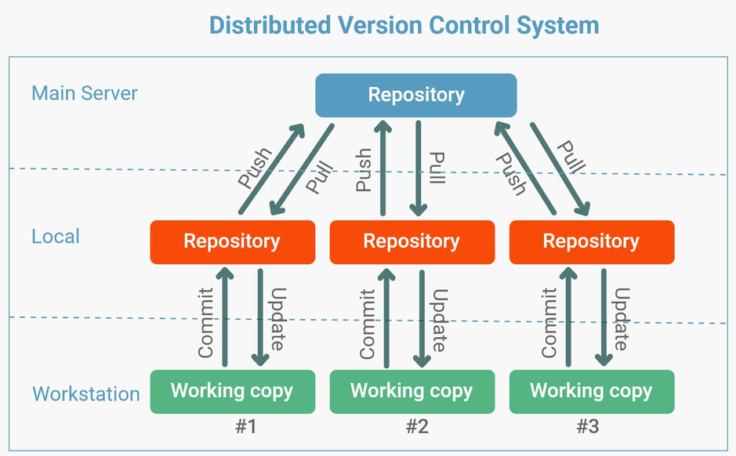
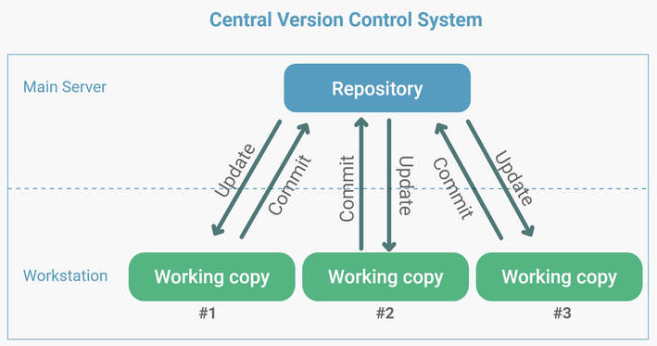
Types of Version Control
Centralized Version Control (CVCS):
Central server stores the entire codebase, and developers check out files to work on them locally
Distributed Version Control (DVCS):
DVCS allows each developer to have a complete copy of the codebase, including its history. Changes can be made locally, and repositories can be synchronized with others.

Slide 6
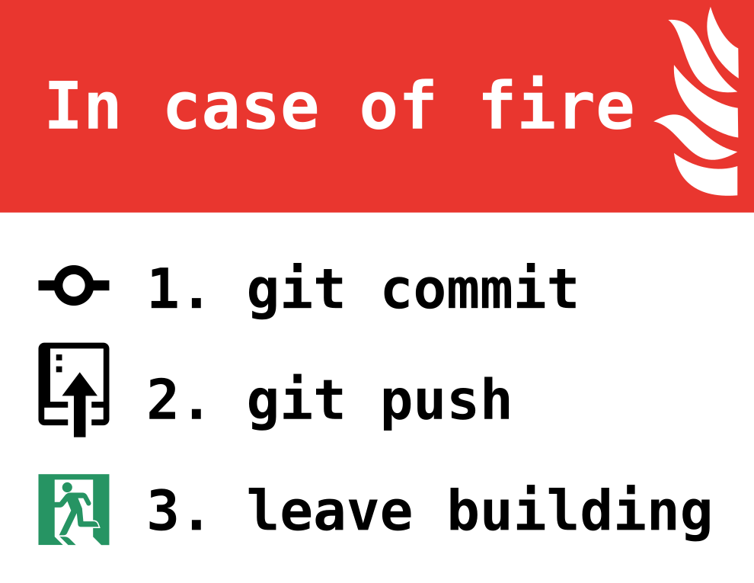
GIT – nothing be loosed
Always commit your changes
Describe why you did it, not what was done
Learn how much to be committed

Slide 7

GIT – more branches to god of branches
Always must be a stable branch
If not sure – branch-out, keep it safe
Cherry-pick is your friend, not always

Slide 8
Git – Live example
Showcase of collaborative work (branching, reviewing, merging, conflict resolving)
To do:
Login to github.com
Navigate to SD_L2_live_example repo
Create branch
Do changes, spawn file or edit any existing one
Commit changes
Open Pull Request (PR)

Slide 9
Git – console commands
Only two commands I personally use (rest of things can be done at any GUI):
git reset --hard
git push -f

Slide 10
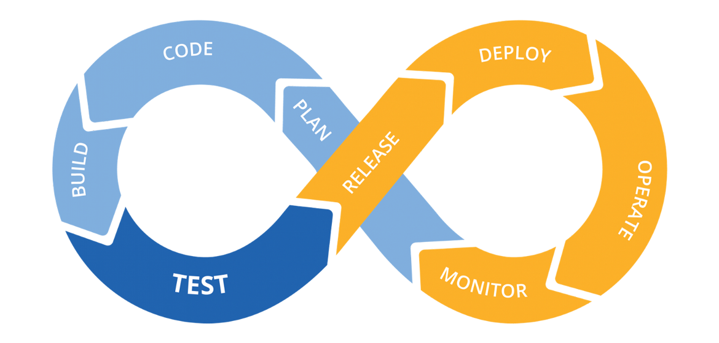
Continuous Integration and Build Automation
Continuous Integration (CI) benefits:
Early Detection of Integration Issues
Faster Feedback Loops
Improved Code Quality
Continuous Deployment (CD) benefits:
Reduced Human Error
Continuous Feedback and Improvement

Slide 11

CI/CD – SHOWCASE
Showcase of an CI/CD in real life
Paper plane development:
Plan
Design
Assembly
Test
Customer feedback
Repeat

Slide 12
Scripting and automation
Everything can be automated, but should it be?
Bash and python are most used
Automation == no human error == predictable result

Slide 13
Jenkins – automate your daily
Automatically builds and tests code changes upon commits to the version control system
Extensive plugin ecosystem
Test reporting and notifications

Slide 14
Code quality – the QA
Always have a stable regression testing:
modifications or enhancements do not unintentionally break existing features

Slide 15
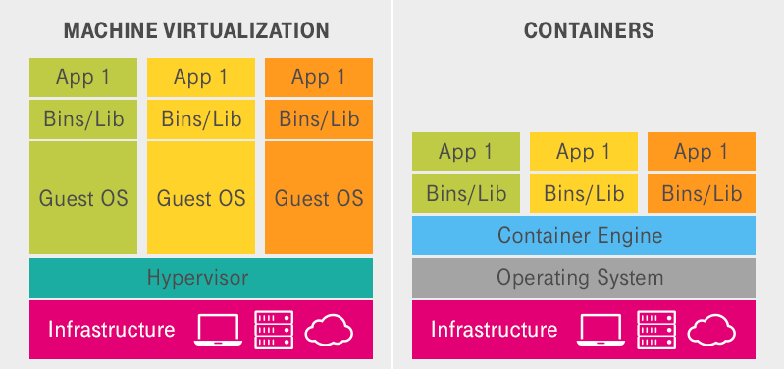
Containers – hard to start, easy to run

Slide 16
Sources to study
Code Complete: McConnell, Steve - https://github.com/media-lib/prog_lib/blob/master/general/Steve%20McConnell%20-%20Code%20Complete%20(2nd%20edition).pdf
Uncle Bob lessons -https://www.youtube.com/watch?v=7EmboKQH8lM&list=PLmmYSbUCWJ4x1GO839azG_BBw8rkh-zOj
Clean Code: Robert C. Martin - https://github.com/jnguyen095/clean-code/blob/master/Clean.Code.A.Handbook.of.Agile.Software.Craftsmanship.pdf
Official documentation set for your language/framework/library

Slide 17
The task
Finish github activities, if any left

