Slide 1
Software development
Agile – Style of life
Oleksandr (Sasha) Hubanov
alex@0x0h.com

Slide 2

Disclaimer
Everything said in this cource is based on my personal expirince and collected feedback of my friends and colleagues.

Slide 3
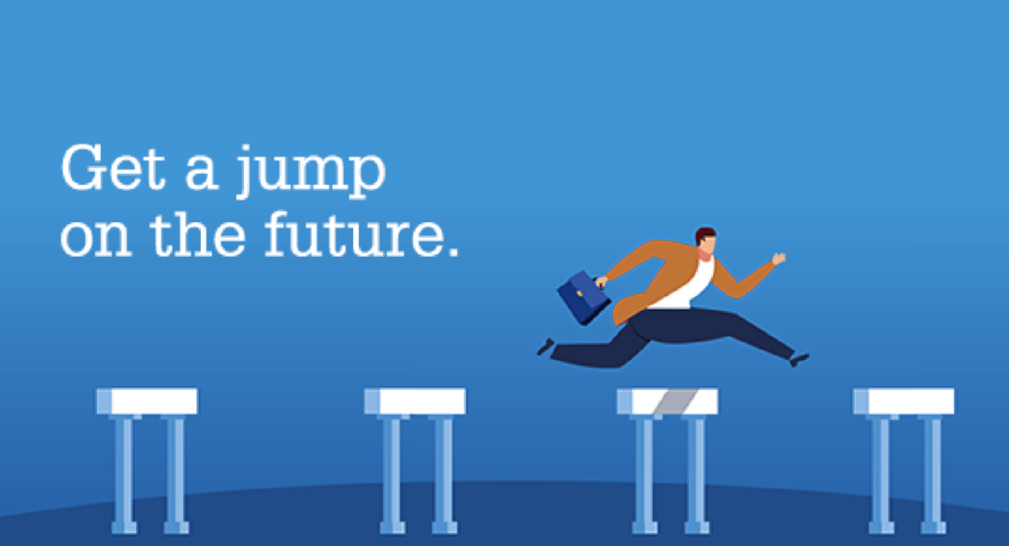
Introduction
Agile is a project management methodology
It is a style of life in the software development world
Adaptive planning, early delivery, and continuous improvement

Slide 4
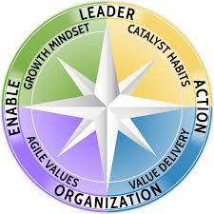
Agile Manifesto
Individuals and interactions over processes and tools
Working software over comprehensive documentation
Customer collaboration over contract negotiation
Responding to change over following a plan

Slide 5

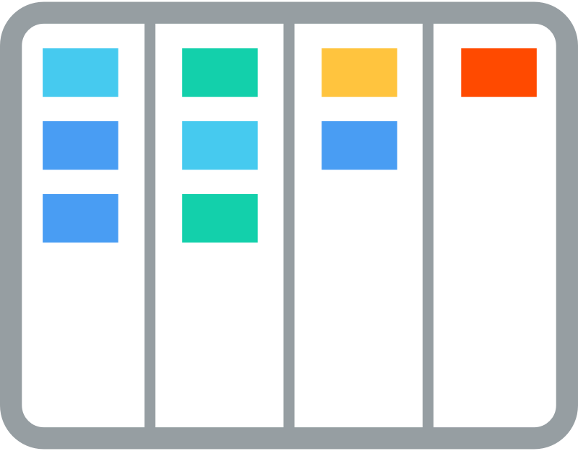

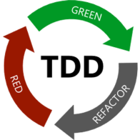
Agile Methodologies
Scrum (divides projects into small, manageable units called sprints)
Kanban (uses a Kanban board to visualize tasks and their progress, limiting work in progress)
Extreme Programming (test-driven development (TDD), pair programming, and short development iterations)
Lean Software Development (adopts principles from Lean manufacturing to eliminate waste and optimize value delivery)
Feature-Driven Development (focuses on building software incrementally by feature)
Notes:
Scrum:
Scrum is an iterative and incremental Agile methodology that focuses on delivering value in short iterations called sprints.
It involves roles such as the Product Owner, Scrum Master, and Development Team.
Scrum artifacts include the Product Backlog, Sprint Backlog, and Increment.
Key practices in Scrum include daily stand-up meetings, sprint planning, sprint reviews, and retrospectives.
Kanban:
Kanban is an Agile methodology that visualizes work on a Kanban board to manage workflow and limit work in progress (WIP).
It emphasizes a pull-based system and promotes continuous flow and optimization of the development process.
Kanban boards typically have columns representing various stages of work, such as "To Do," "In Progress," and "Done."
Extreme Programming (XP):
Extreme Programming is an Agile methodology that emphasizes close collaboration, fast feedback, and continuous improvement.
Key practices include pair programming, test-driven development (TDD), continuous integration, and regular releases.
XP promotes simplicity, communication, and delivering high-quality software through frequent iterations.
Lean Software Development:
Lean Software Development applies principles from Lean manufacturing to software development.
It focuses on eliminating waste, optimizing flow, and delivering value to customers.
Lean practices include value stream mapping, just-in-time development, and continuous improvement.
Feature-Driven Development (FDD):
Feature-Driven Development is an Agile methodology that revolves around delivering features incrementally.
It involves domain walkthroughs, feature-based planning, and regular inspections to ensure progress and quality.
FDD emphasizes team collaboration and delivering tangible results.

Slide 6
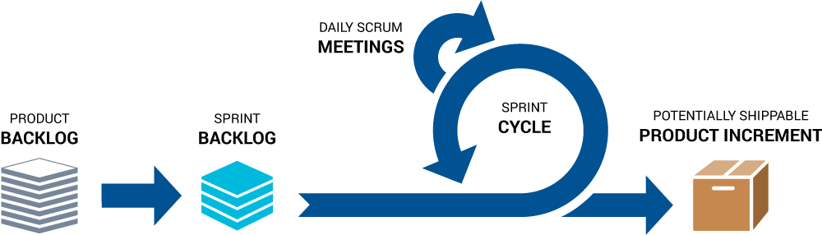
Agile Practices - Scrum
User stories and backlog grooming
Sprint planning and execution
Daily stand-up meetings
Retrospectives
Continuous integration/delivery (CI/CD)
Notes:
User stories and backlog grooming:
User stories are concise descriptions of functionality from the perspective of an end-user.
Backlog grooming involves refining and prioritizing user stories in the product backlog.
This practice ensures that the product backlog is well-defined, detailed, and ready for implementation.
Sprint planning and execution:
Agile projects are divided into iterations called sprints.
Sprint planning involves selecting user stories from the product backlog for implementation during the sprint.
The team collaboratively estimates effort, defines tasks, and sets a sprint goal.
During sprint execution, the team works on the selected user stories, frequently collaborating and delivering incremental results.
Daily stand-up meetings:
Daily stand-up meetings, also known as daily scrums, are short, focused meetings held by the team.
Team members share updates on their progress, discuss any challenges or blockers, and synchronize their efforts.
The stand-up format encourages quick problem-solving and promotes effective communication among team members.
Retrospectives:
Retrospectives are regular meetings held at the end of each sprint to reflect on the team's recent work.
The team discusses what went well, what could be improved, and actions to enhance future sprints.
Retrospectives foster a culture of continuous improvement, allowing the team to adapt and optimize their processes.
Continuous integration and continuous delivery (CI/CD):
Continuous integration involves frequently integrating code changes into a shared repository.
It ensures that the changes are tested, and any conflicts or integration issues are detected early.
Continuous delivery focuses on automating the software release process, enabling frequent and reliable deployments.

Slide 7





Sprint Simulation
You have a designated time limit for each sprint ~3min.
We have only two roles “Developer” and ”QA”
Define each member role for upcoming sprint
Workflow:
plan upcoming sprint - 30 sec
develop & test - 1min
grooming - 30sec
develop & test - 1min
sprint review – calculate your points
Notes:
Instead of enjoying Eifel tower, had to fix the bug via editing code on iPhone in webrowser. Mistakes cost you twice or more.

Slide 8
Mr. stickman game
To pass test, each figure must have:
one head, one body, pair of hand and pair of legs
each body part must be different color
figures shall not touch other figures, nor borders of space
QA must be performed - check mark near by (may touch figure) - figure meets test:
good figure worth plus 1 point
bad marked as passed QA worth minus 2 points
not tested figure worth minus 1 point
Notes:
Instead of enjoying Eifel tower, had to fix the bug via editing code on iPhone in browser. Mistakes cost you twice or more.

Slide 9
1 | 2
3 | 4

Slide 10
Retrospective Simulation
What went well during the sprint?
What could be improved or done differently?
What action items can we take for the next sprint?
Notes:
Retrospective is NOT only about work, we often complain about personal life or conratz with good things.

Slide 11
Sources to study
Code Complete: McConnell, Steve - https://github.com/media-lib/prog_lib/blob/master/general/Steve%20McConnell%20-%20Code%20Complete%20(2nd%20edition).pdf
Uncle Bob lessons -https://www.youtube.com/watch?v=7EmboKQH8lM&list=PLmmYSbUCWJ4x1GO839azG_BBw8rkh-zOj
Clean Code: Robert C. Martin - https://github.com/jnguyen095/clean-code/blob/master/Clean.Code.A.Handbook.of.Agile.Software.Craftsmanship.pdf
Official documentation set for your language/framework/library

Slide 12
The task
Read the literature, watch Uncle Bob on youtube

