Slide 1
Software development
APPLICATION – From design to running process
Oleksandr (Sasha) Hubanov
alex@0x0h.com

Slide 2

Disclaimer
Everything said in this cource is based on my personal expirince and collected feedback of my friends and colleagues.

Slide 3
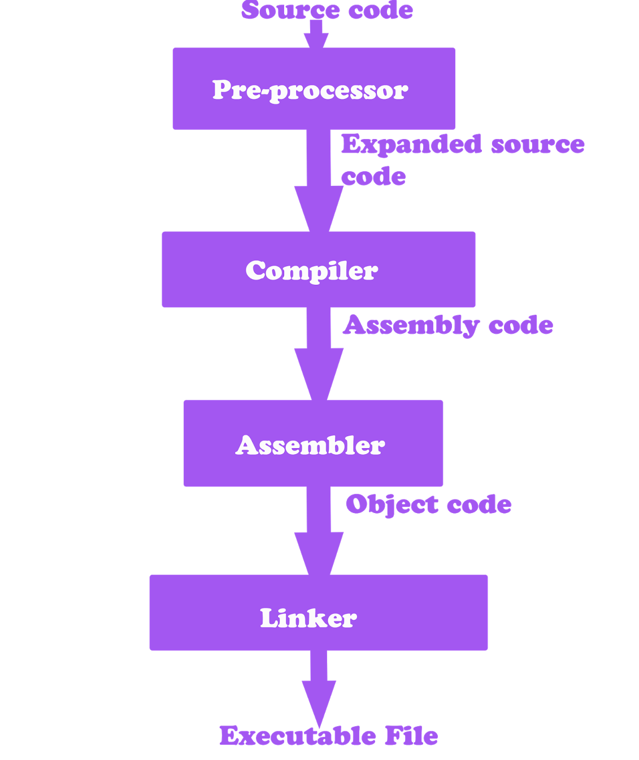
Build Process Overview
Design
Write code
Compile - involves translating high-level source code into low-level machine code
Assemble - the object code produced during compilation is converted into machine code
Linkage - combining multiple object files and libraries to create a single executable program
Notes:
Compilation Phase:
The compilation phase involves translating high-level source code into low-level machine code.
Compiler programs, such as GCC (GNU Compiler Collection) or Clang, are responsible for this translation process.
During compilation, the source code is checked for syntax errors and analyzed for semantic correctness.
The output of this phase is typically object code, which represents the compiled version of individual source files.
Assembly Phase:
In the assembly phase, the object code produced during compilation is converted into machine code.
The assembler, a specialized program, is responsible for this translation process.
Assembly code, written using mnemonic instructions specific to the target architecture, is transformed into machine instructions.
The output of this phase is typically object files, which contain the machine code representation of the program.
Linkage Phase:
The linkage phase involves combining multiple object files and libraries to create a single executable program.
The linker, a program included in the build toolchain, performs this task.
During linkage, unresolved symbols and references are resolved, and memory addresses are assigned.
The output of this phase is an executable file that can be run on the target platform.
By understanding the build process's three phases, developers can gain insights into the transformation of their code from source to executable, ensuring a smooth and successful build.

Slide 4
Build TOOLS
make / Cmake – any language, but best for C/C++
maven / gradle – mostly for Java
dotnet – C# and other Microsoft…
custom script based builds

Slide 5
Compilation Phase
The purpose of compilation is to convert human-readable source code written in high-level programming languages (such as C, C++, Java) into machine-readable object code or machine code.
Precompiler:
Lexical Analysis – the source code is divided into individual tokens (keywords, identifiers, literals, operators) during lexical analysis. This step also eliminates white spaces and comments.
Syntax Analysis – the tokens are analyzed based on the language's grammar rules to build a syntax tree or parse tree. This tree represents the hierarchical structure of the source code.
Semantic Analysis – the syntax tree is further analyzed to ensure semantic correctness. This step checks for type compatibility, variable declarations, function signatures, and other language-specific rules.

Slide 6
Compilation Phase
Compiler:
Intermediate Code Generation – an abstract representation of the program, often in a lower-level language like three-address code or bytecode.
Optimization – aim to reduce code size, improve execution speed, and eliminate redundancies.
Code Generation – the intermediate code is transformed into target-specific machine code or object code
Symbol Table Management – stores information about variables, functions, and other program entities
Error Handling – Identifies and reports any syntax errors, semantic errors, or warnings in the source code

Slide 7
Assembly Phase
The assembler is a specialized program that translates assembly code into machine code.
Lexical Analysis – identifies tokens such as labels, instructions, operands, and comments.
Symbol Resolution – symbols can represent memory addresses, constants, or labels defined in the code.
Instruction Translation – translates assembly instructions into their binary machine code counterparts.
Memory Allocation – assigns memory addresses to variables, labels, and other program entities defined in the assembly code. It determines the appropriate memory locations for data and instructions.
Object Code Generation – the output of the assembly phase is typically object code.

Slide 8
Object Files
Object files contain the translated machine code, symbol tables, relocation information, and other necessary metadata.
Object files serve as building blocks for the final executable during the linkage phase.
They can be combined with other object files and libraries to create a complete and executable program.

Slide 9
Linkage Phase
The purpose of the linkage phase is to resolve references and dependencies between object files and libraries. It ensures that all necessary components are brought together to create a functional and executable program.
Symbol Resolution – looks for definitions of symbols and updates the references accordingly
Relocation – adjusting memory addresses and references within the object code. It ensures that the final executable can be loaded and executed correctly at the target memory location.
Symbol Table Management – contains information about symbols used in the program. It tracks the definitions and references to symbols across different object files.
Library Management – searches for functions or code that are referenced but not defined in the object files and links them with the appropriate library.
Executable File Generation: The linker combines the resolved object files, libraries, and other necessary components to create an executable file. The executable file is ready to be loaded into memory and executed by the target platform.
Notes:
The purpose of the linkage phase is to resolve references and dependencies between object files and libraries. It ensures that all necessary components are brought together to create a functional and executable program.

Slide 10
Live Demo
review makefile
run make
observe object files and resulted exe

Slide 11
Assembler vs High-Level Languages
Abstraction Level: Assembly language operates at a lower level of abstraction, providing direct control over hardware, while high-level languages abstract away hardware details.
Readability and Expressiveness: High-level languages are generally more readable and expressive due to their human-friendly syntax and built-in abstractions.
Portability: High-level languages are more portable as they can be compiled or interpreted on different platforms without requiring extensive modifications.
Development Time: High-level languages often result in shorter development time due to their high-level abstractions, libraries, and productivity tools.
Performance: Assembly language programs can be highly optimized and offer better performance control, while high-level languages provide a trade-off between ease of development and performance.

Slide 12
PROS of Assembler
Low-Level Control: Assembly language provides direct control over the hardware, allowing developers to manipulate registers, memory, and other system components at a granular level
Efficiency: Assembly language programs can be highly optimized for performance. By working at a low-level, developers can fine-tune code to minimize resource usage and maximize execution speed.
Debugging Capabilities: Assembly language allows for more detailed debugging and troubleshooting. Developers have direct visibility into the low-level execution and can closely analyze and track the program's behavior, making it easier to identify and fix issues.
Notes:
Low-Level Control: Assembly language provides direct control over the hardware, allowing developers to manipulate registers, memory, and other system components at a granular level. This level of control is beneficial in scenarios that require precise hardware interactions or performance optimizations.
Efficiency: Assembly language programs can be highly optimized for performance. By working at a low-level, developers can fine-tune code to minimize resource usage and maximize execution speed. This efficiency is especially crucial in areas such as embedded systems or real-time applications.
Portability: Assembly language programs can be written to be platform-specific, leveraging the unique features and capabilities of a particular hardware architecture. While this may seem limiting, it can also lead to highly efficient code that fully exploits the capabilities of the target system.
Debugging Capabilities: Assembly language allows for more detailed debugging and troubleshooting. Developers have direct visibility into the low-level execution and can closely analyze and track the program's behavior, making it easier to identify and fix issues.

Slide 13
CONS of Assembler
Steeper Learning Curve: Learning assembly language requires a deeper understanding of computer architecture and low-level programming concepts. It can be more challenging for developers accustomed to high-level languages, as it involves working directly with registers, memory addresses, and low-level instructions.
Lack of Portability: Assembly language programs are often platform-specific, written to target a specific hardware architecture. This lack of portability can make it difficult to migrate code between different platforms or architectures without significant modifications.
Reduced Maintainability: Assembly language code tends to be more complex and harder to read and understand compared to high-level languages. As a result, maintaining and updating assembly code can be more challenging and error-prone, especially as the size and complexity of the codebase increase.
Time-Intensive Development: Writing code in assembly language can be a time-consuming process compared to high-level languages. The need for fine-grained control and optimization requires developers to spend more time on code development, debugging, and performance tuning.
Limited Abstractions and Productivity Tools: Assembly language lacks the high-level abstractions, libraries, and productivity tools available in modern high-level languages. This can lead to longer development cycles and increased development effort for implementing common programming tasks.
Reduced Community Support: Assembly language has a smaller community and fewer resources compared to popular high-level languages. Finding help, support, or ready-made solutions for specific assembly language challenges may be more difficult.

Slide 14
PROS OF High-Level Languages
Productivity: High-level languages are designed to increase developer productivity. They provide a more expressive and readable syntax, along with built-in abstractions and libraries. This allows developers to write code more quickly and with fewer lines of code compared to assembly language.
Abstractions: High-level languages offer powerful abstractions that simplify complex operations. These abstractions, such as classes, functions, and data structures, enable developers to modularize code, reuse components, and improve code organization and maintainability.
Portability: High-level languages are typically platform-independent or have extensive cross-platform support. This means that code written in a high-level language can be executed on different platforms with minimal or no modifications, providing greater flexibility and portability.
Rapid Development: High-level languages provide a wide range of productivity tools, integrated development environments (IDEs), and frameworks that facilitate rapid development. These tools include features like automated code completion, debugging support, testing frameworks, and package managers.
Community and Resources: High-level languages have large and active developer communities, offering extensive resources, online forums, and libraries. This community support enables developers to find solutions, share knowledge, and leverage existing code libraries, accelerating development and problem-solving.
Readability and Maintainability: High-level languages prioritize code readability, making it easier for developers to understand and maintain code over time. This improves code maintainability, reduces the chance of introducing bugs, and enhances collaboration among team members.

Slide 15
CONS OF High-Level Languages
Performance Overhead - due to the additional layers of abstraction, runtime environments, and automatic memory management, which can impact the execution speed and resource usage.
Less Control over Hardware: High-level languages abstract away hardware details, limiting the developer's direct control over low-level system resources.
Execution Environment Dependencies: High-level languages may have dependencies on specific runtime environments, libraries, or frameworks. This can introduce compatibility issues when deploying the code on different platforms or ensuring consistent execution across different environments.

Slide 16
JIT Languages
JIT languages, such as Java, C#, and JavaScript, utilize a Just-In-Time compilation approach.
In JIT languages, the source code is initially translated into an intermediate representation, often bytecode, which is not directly executable by the hardware.
During runtime, a Just-In-Time compiler dynamically translates the bytecode into machine code just before it is executed, optimizing it for the specific hardware and current program state.

Slide 17
Interpreted Languages
In an interpreted language, the source code is executed directly by an interpreter without prior compilation to machine code.
The interpreter reads and executes the code line by line during runtime, performing operations such as lexical analysis and parsing on the fly.
Interpreted languages offer simplicity and ease of use, as there is no need for a separate compilation step.
Examples of interpreted languages include Python, Bash, JavaScript, Ruby, and Perl.

Slide 18
BONUS – Compilable VS JIT
Performance - Compilable languages often provide faster startup times and optimized performance. Since the code is fully compiled before execution, there is minimal runtime overhead. JIT languages may have slower startup times due to the initial interpretation and JIT compilation overhead. However, JIT compilers can dynamically optimize the code during runtime based on runtime profiling and information, potentially achieving better overall performance in long-running applications.
Control and Optimization - Compilable languages provide low-level control over hardware resources, allowing for fine-grained optimization and efficient resource utilization. JIT provide less control over hardware, they offer higher-level abstractions and dynamic features that facilitate rapid development and ease of use.
Portability and Platform Independence - Compilable languages may require recompilation or modification to support different hardware architectures or operating systems. JIT languages – the same bytecode can be executed on different platforms with the appropriate JIT compiler, reducing the need for platform-specific modifications.

Slide 19
Sources to study
Code Complete: McConnell, Steve - https://github.com/media-lib/prog_lib/blob/master/general/Steve%20McConnell%20-%20Code%20Complete%20(2nd%20edition).pdf
Uncle Bob lessons -https://www.youtube.com/watch?v=7EmboKQH8lM&list=PLmmYSbUCWJ4x1GO839azG_BBw8rkh-zOj
Clean Code: Robert C. Martin - https://github.com/jnguyen095/clean-code/blob/master/Clean.Code.A.Handbook.of.Agile.Software.Craftsmanship.pdf
Official documentation set for your language/framework/library

Slide 20
The task
Read the literature, watch Uncle Bob on youtube

