Slide 1
Turning Data Into Information: Examining Reimbursements
Connor Dunn, Devinaa Mangal, Alex Wise
April 28th, 2021

Slide 2



Why We Chose This Topic
The Opportunity
The Solution
1 | Every day, manufacturers deny ~1% of reimbursement claims
2 | Denial data is available in the form of a flat table extracted from SAP
3 | This data would be more useable with the help of visualizations
4 | We can even try to see what predictions can be made from the data with classifier models
Pull and clean a data set that contains sufficient records for training and testing
Create visualizations using HV Plot, Plotly Express, and other Python packages
Build classifier models that can possibly predict write offs and identify the most important feature indicators

Slide 3









Why Reimbursements Exist
Customer
Prices, items, customers dates
Supplier
Prices, items, customers, dates
negotiations
EDI
E-mails
Hard Copies
EDI
E-mails
Hard Copies
McKesson Contracts Team
Drug A:
Drug A:
Drug A:
Drug A:
Drug A:
Wholesale Cost: $100
Rite Aid Cost: $90
Reimbursement: $10
Wholesale Cost: $100
Walmart Cost: $85
Reimbursement: $15
Wholesale Cost: $100
HEB Cost: $91
Reimbursement: $9
Wholesale Cost: $100
Costco Cost: $88
Reimbursement: $12
Wholesale Cost: $100
VA Cost: $70
Reimbursement: $30
Notes:
A contract is entered into between a customer and manufacturer, however the product is purchased from McKesson. The contract price is less than McKesson’s acquisition cost, leading to the need for a reimbursement. The reimbursement amount can vary from customer to customer

Slide 4







Reimbursement Process Overview
Reimbursement = Acquisition Cost – Contract Cost
> 99.0%
Initial
Chargeback
Accuracy
Customer
Contract
Purchase
Reimbursement Created (WAC less Contract Cost)
Reimbursement Transmitted to Supplier
Supplier
Validates and Pays Reimbursement
Vendor Denies Initial Reimbursement
Research Reimbursement Denial
Partner with Suppliers to Resolve Discrepancies
Write off or Resubmit for Payment
Notes:
Reimbursements are created at time of customer purchase. ~99% of the time, the reimbursement is paid without issue, but sometimes they are denied.

Slide 5
Our Data
> 56k
Rows
20
Features
~60/40 split
“zeros and ones”
3 Months
of Transactions
Identifiers
Masked
Outcomes
Pre-labeled
Danger… Overfitting Ahead
7 Rejection Reasons
26 Distribution Centers
79 Manufacturers
86 Customer Groups
2 – 183 Days to Resolve
1,264 Pharmaceuticals
17,296 Unique Customers
($21,408) - $46,475 Claim Amount
Low Variability
High Variability
Notes:
$5.6M in denied claims
$3.9M in resubmissions
$1.7M in write offs
Spend ~$250k in annual labor to reconcile these transactions
5

Slide 6
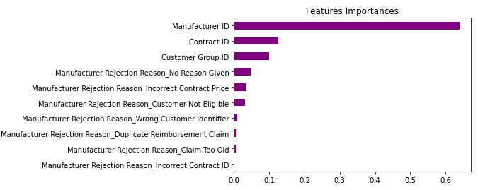
Classifier Model After Three Iterations
 | Actual Resubmit | Actual Write Off
Predicted Resubmit | 8,590 | 480
Predicted Write Off | 359 | 4,663
 | Precision | Recall | F1–score | Support
Resubmit | 0.96 | 0.95 | 0.95 | 9,078
Write Off | 0.91 | 0.93 | 0.92 | 5,022
Accuracy |  |  | 0.94 | 14,100
Accuracy = (True negative + True Positive) / ALL
Recall = true positive/(true positive + False negative)
Precision = true positive/ (true positive + false positive)
Notes:
After three iterations, we created a parsimonious data set that only needed four features (manufacturer, contract, customer, and rejection reason) which didn’t sacrifice too much accuracy
In our data set, false negatives are actually the most damaging. We want to avoid suggesting a write off should be taken, when we actually should have resubmitted the claim for payment.
So we want a good recall score for our write off activity
Precision – What proportion of positive identifications were actually correct?
Recall – What proportion of actual positives were identified correctly?
Didn’t use PCA to make sure data is easy to interpret by management
Used feature importance to keep scaling down

Slide 7
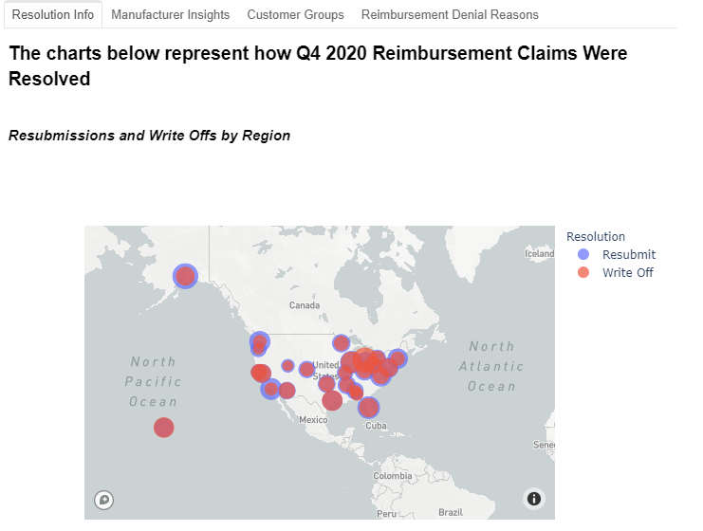
Placeholder – Visualizing the Data
Visualizations across four feature categories were created
Each tab provides quick insight into
How quickly reimbursements are being resolved
Which manufacturers have the most opportunity for improvement
Which customer contracts may need attention

Slide 8
Conclusions
Our Visuals and Models Enable Meaningful Action
Working Capital Improvement Can Easily be Made
Using Our Model, With 96% Certainty...
Management can quickly see which manufacturers are driving the most write offs, and which are needlessly delaying payment
Our model allows for faster resubmissions of incorrectly denied payments
Contracts that have reimbursement discrepancies can be quickly identified and corrected
McKesson can resubmit $3.9M in quarterly denied claims at Day 1 vs. an average current resolution timeframe of 35 days
Manufacturers take an average of 5 days to respond
McKesson could improve its cash conversion cycle by 30 days
An improvement of 86%
If We Had More Time
Apply our visualizations and models to other business units (one of four represented)
See if our model accuracy remains high across different time periods

Slide 9
Q&A

