Slide 1


NMR50 Single Channel Thermal-hydraulic Analysis
Alex Hagen, Shanbin Shi, Qingzi Zhu
Advisor: Prof. Yang
May 9th, 2014
School of Nuclear Engineering
Purdue University
West Lafayette, IN 47907

Slide 2
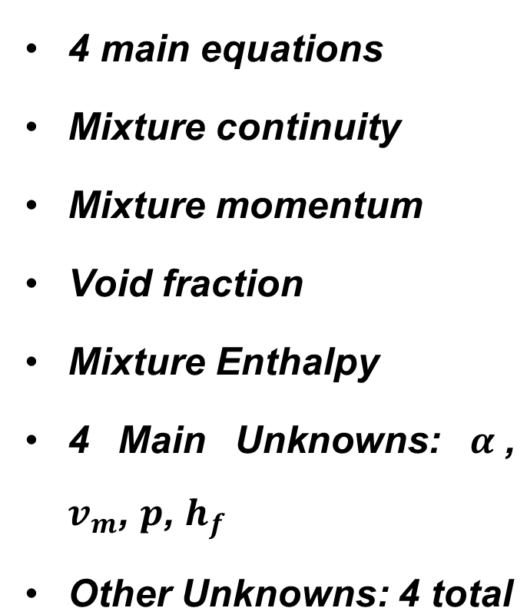
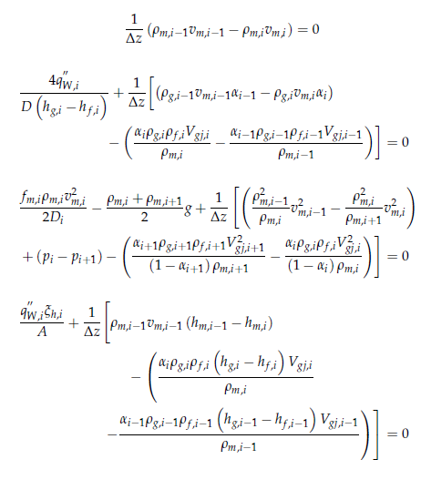
Steady State DF Solution

Slide 3
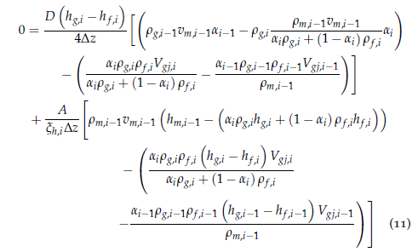

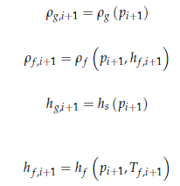
Conversion to Solveable Form
Set two equations equal to wall flux to get one equation.
Insert constitutive relations

Slide 4
Algorithm for D-F Calculation
Assume an inlet pressure
  Assume a fluid temperature
  Calculate wall heat flux
  Use Newton-Raphson method to determine node values
  See if wall flux calculated from node values equals the wall flux calculated with fluid temperature
  If not, iterate
See if outlet pressure matches the known outlet pressure
If not, iterate

Slide 5
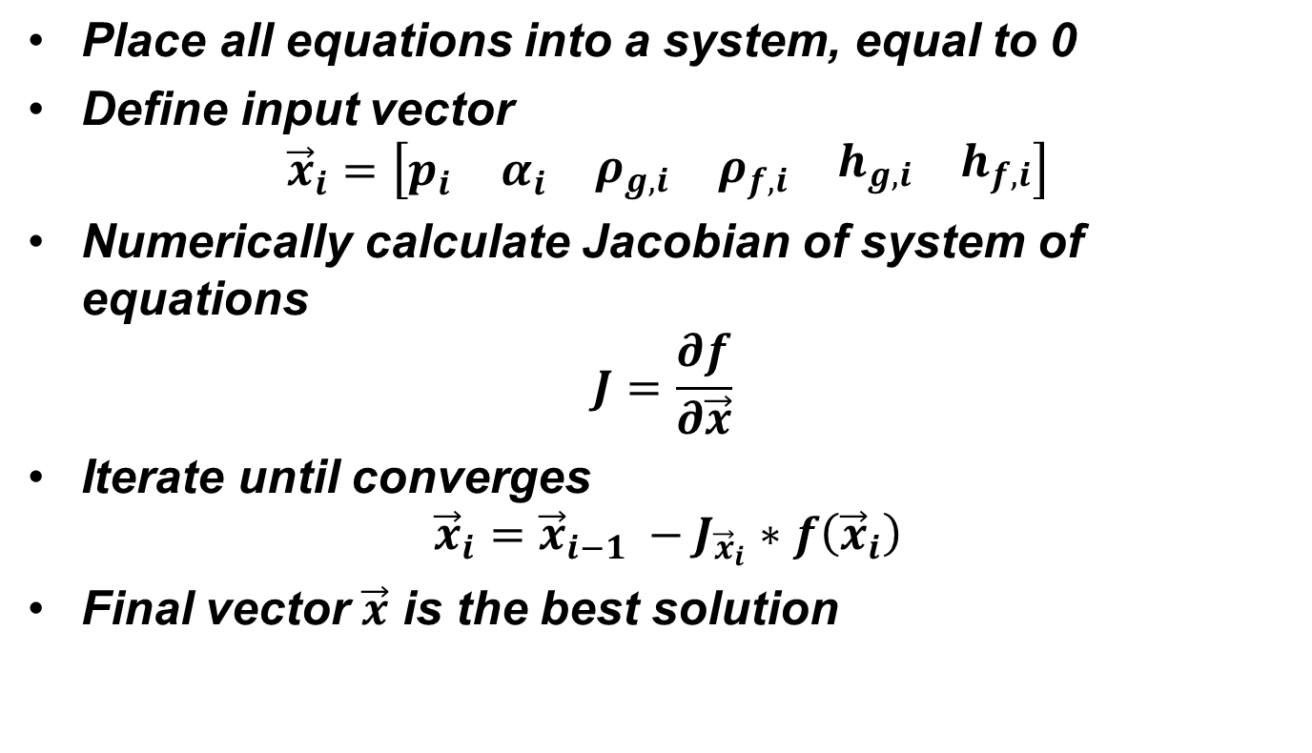
Newton-Raphson Method

Slide 6
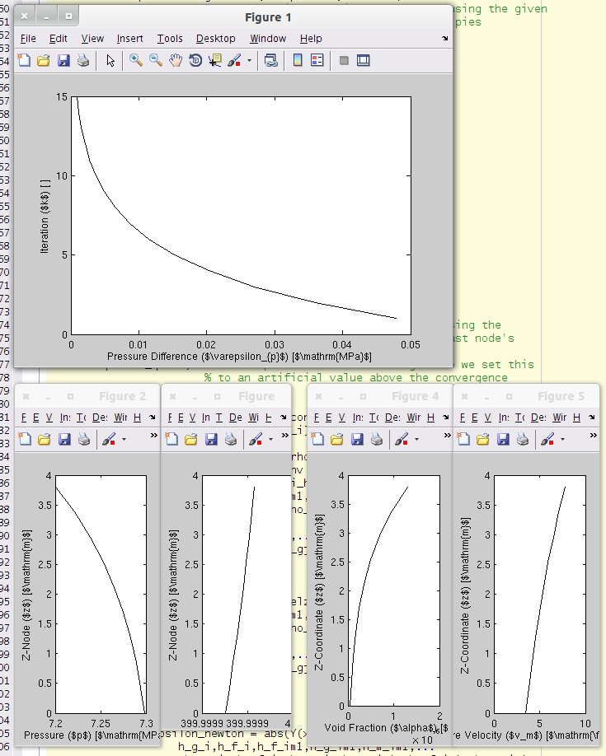
Results

