Slide 1


NMR50 Power Response using Adiabatic Assumption with Single Time Constant for Heat Release
Faisal Odeh, Ching-Sheng Lin, Alex Hagen, Shanbin Shi, Qingzi Zhu, Xiang Li
Advisor: Prof. Yang
May 9th, 2014
School of Nuclear Engineering
Purdue University
West Lafayette, IN 47907

Slide 2
Project Definition
Desired was to determine the power shape in temporal space of a NMR50 Single Channel
Required for this task was
  PKE Solver
  Diffusion (Flux Shape solver)
  Conduction Heat Transfer Solver
  Drift Flux Fluid Heat Transfer Solver
  Cross Section Generation solver using Temperature Profile and Void
For final solution, T-H parts were replaced with Adiabatic Approximation with improved Single Time Constant for Heat Release because of complexity

Slide 3
NMR50 Single Channel Thermal-hydraulic Analysis
Alex Hagen, Shanbin Shi, Qingzi Zhu, Xiang Li
Advisor: Prof. Yang
May 9th, 2014
School of Nuclear Engineering
Purdue University
West Lafayette, IN 47907

Slide 4
Contents
Background
1-D Drift Flux Model
Spatial and Temporal Discretization
Numerical Methods to Solve 1-D DFM
Heat Conduction
Summary and Future Work

Slide 5
Background
Develop a single channel thermal-hydraulic model coupled with neutron kinetics for a BWR fuel assembly
Apply 1-D drift flux model for the coolant
Consider void reactivity feedback and Doppler feedback

Slide 6
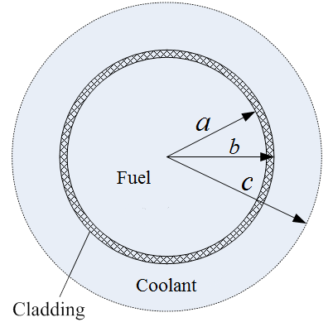
Background
Single channel fuel model
Item | unit | Value
Fuel rod outside diameter | mm | 12.27
Fuel rod cladding thickness | mm | 0.8126
Coolant channel outside diameter | mm | 16.256

Slide 7
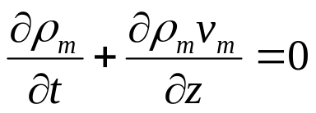
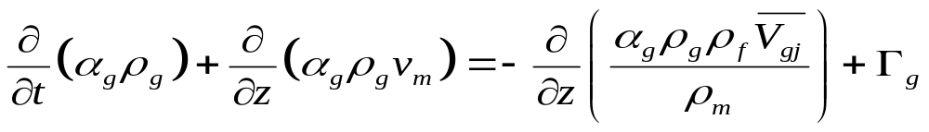
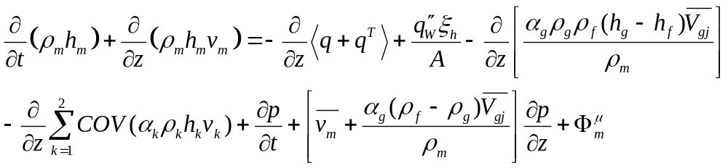
1-D Drift Flux Model
Mixture continuity equation:
Continuity equation for gas phase:
Mixture momentum equation:
Mixture energy equation:

Slide 8
1-D Drift Flux Model
Assumptions and simplifications
  Neglect covariance term Ishii (2010) . The covariance terms represent the difference between the average of a product and the product of the average of two variables. If the profile of either variable is flat, then the covariance term reduces to zero.
  Neglect the axial heat conduction and shear forces due to velocity gradient in the fluid, because these terms are 2nd order and has little contribution to heat and momentum transfer.
  Neglect the energy variation due to pressure changes and frictional dissipation because they are very small compared with heat addition term and enthalpy change term in the energy equation.

Slide 9
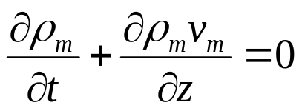

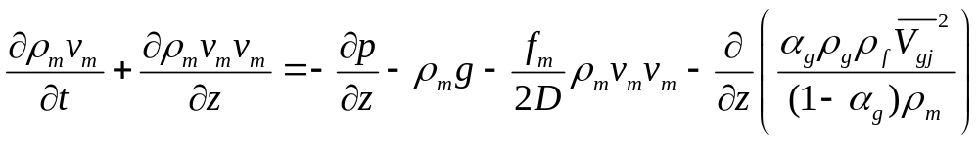
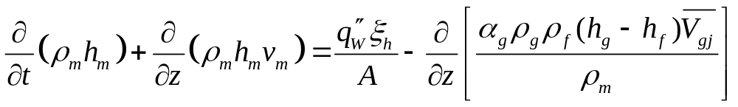
1-D Drift Flux Model
Simplified equations

Slide 10
1-D Drift Flux Model
Four main unknowns
  Void fraction
  Mixture velocity
  Liquid enthalpy
  Pressure
More relations are needed to make the equations close.

Slide 11

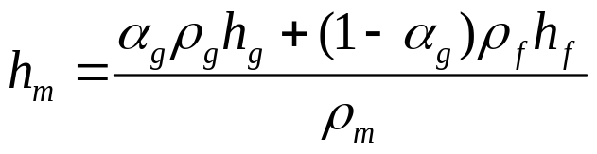






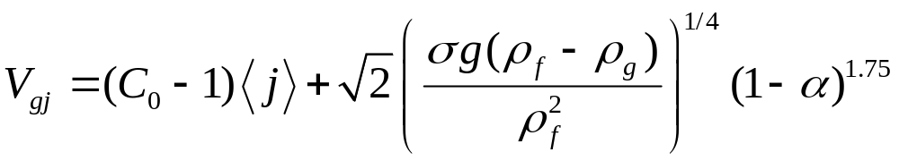


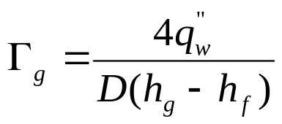

1-D Drift Flux Model
Constitutive relations
Thermal-equilibrium assumption for gas phase
( For simplicity, use )

Slide 12
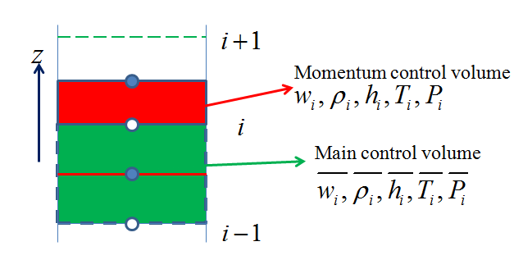
1-D Drift Flux Model
Spatial discretization using control volume method
  Mass, momentum and energy will be exactly conserved over any group of control volumes, and over the whole calculation domain.
  Integral conservation does is not dependent on mesh number. Course-mesh solution would also give reasonable physical results.

Slide 13
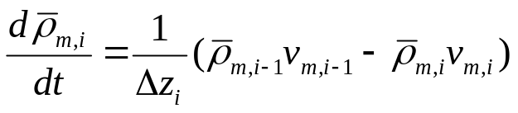
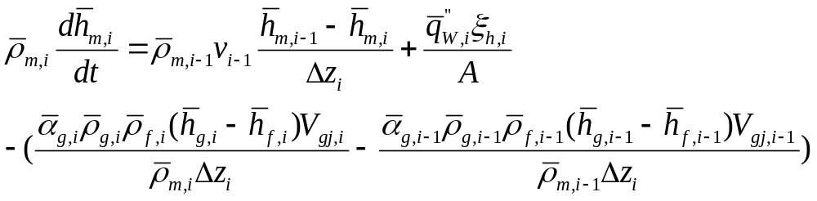
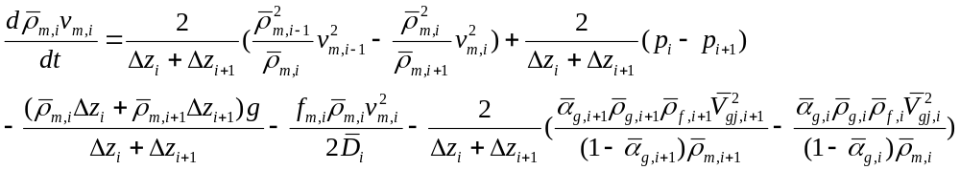
1-D Drift Flux Model

Slide 14
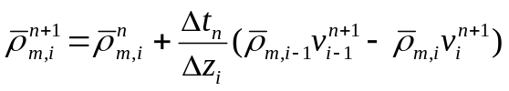
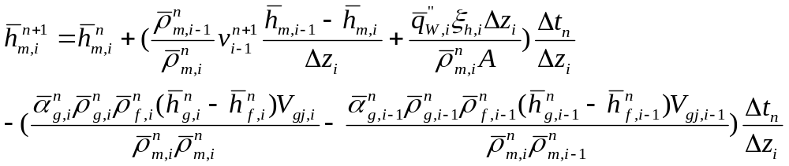
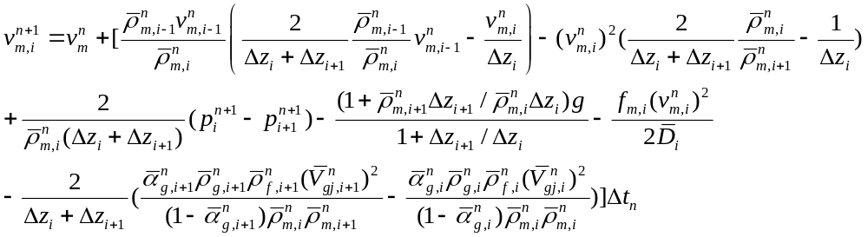
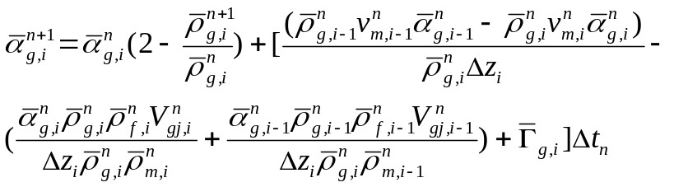
1-D Drift Flux Model
Temporal discretization using semi-implicit method

Slide 15
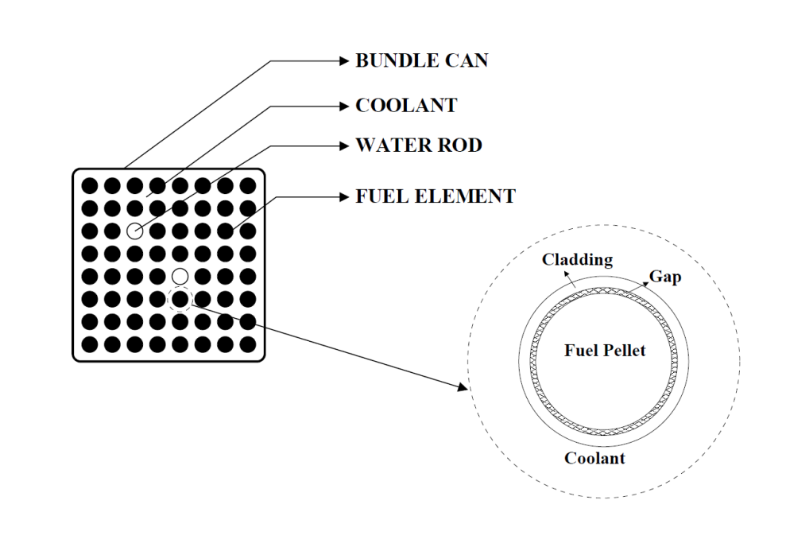
Heat Conduction Model
Typical BWR fuel bundle
 | NMR-50
Fuel Pellet Outer Radius (mm) | 4.585
Cladding Outer Radius (mm) | 5.276
Number of rods | 23,296
Pellet Thermal Conductivity (W/m/K) | 3.4
Cladding Thermal Conductivity (W/m/K) | 14.3
Gap Conductance (W/m²/K) | Varied (500-5000)

Slide 16
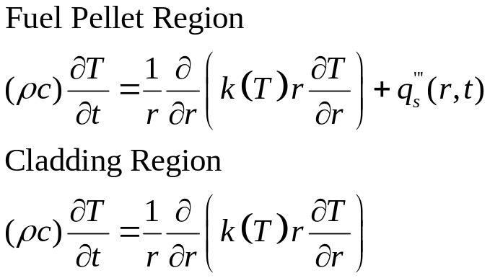
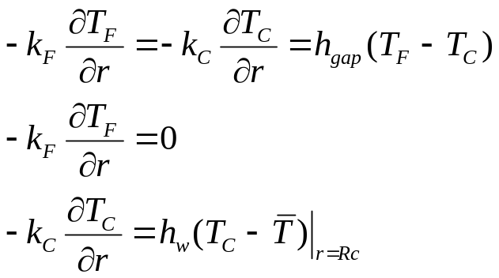
Heat Conduction Model
Governing Equations
Boundary conditions

Slide 17
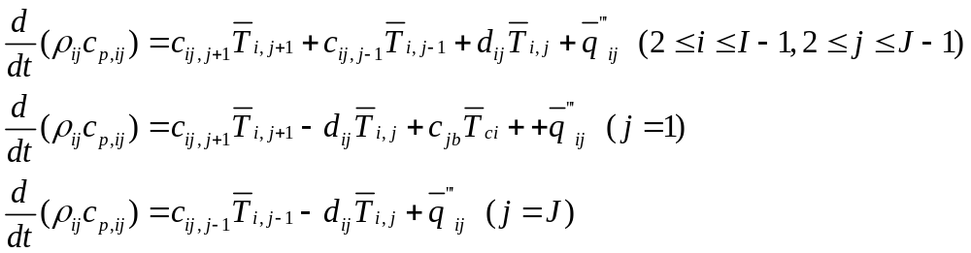
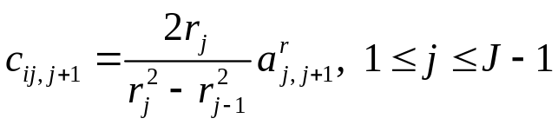
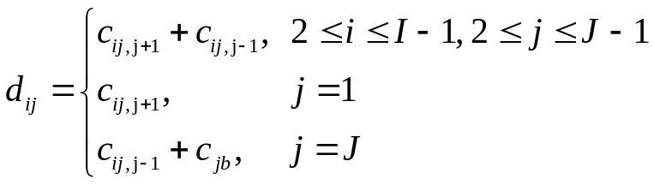
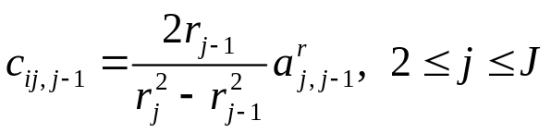
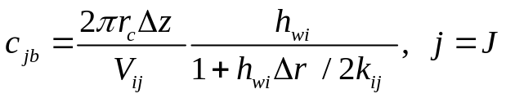
Heat Conduction Model
Discretized heat conduction equations

Slide 18
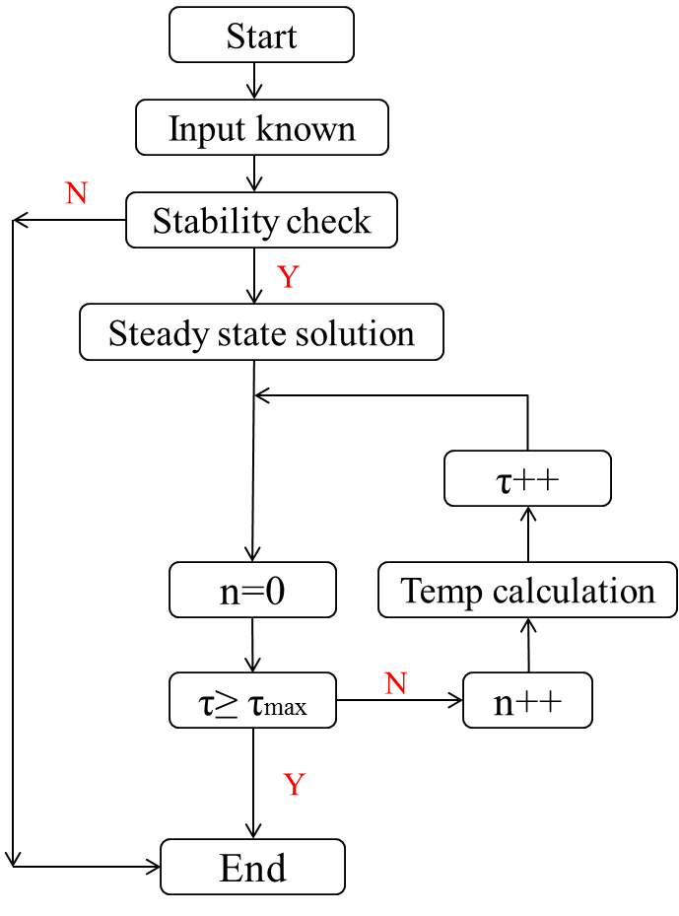
Heat Conduction Model
Solution procedure

Slide 19
Summary
Work accomplished
  1-D drift flux model
  1-D drift flux model steady state numerical solution
  Heat conduction numerical scheme
Future work
  Code coupled with neutronics
Report to be delivered
  Single channel thermal-hydraulic and neutronics coupling analysis

Slide 20
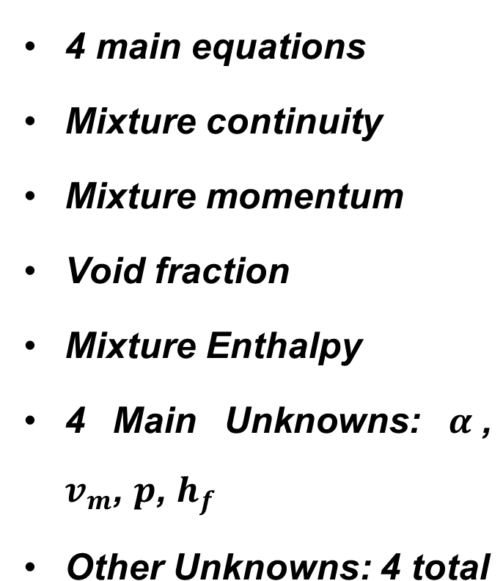
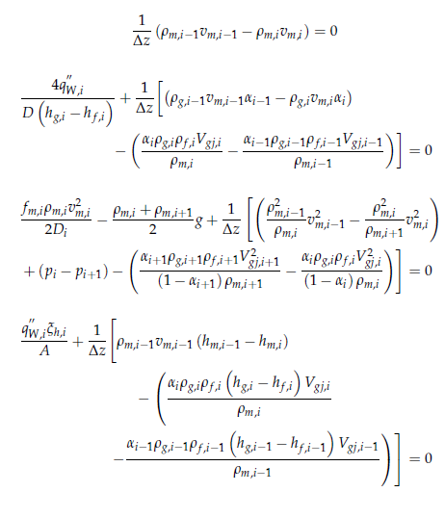
Steady State DF Solution

Slide 21
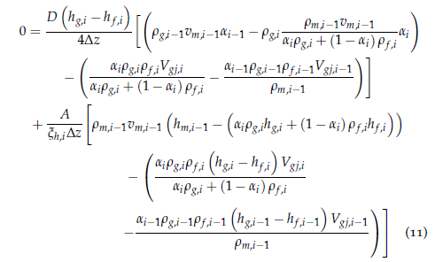

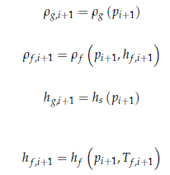
Conversion to Solveable Form
Set two equations equal to wall flux to get one equation.
Insert constitutive relations

Slide 22
Algorithm for D-F Calculation
Assume an inlet pressure
  Assume a fluid temperature
  Calculate wall heat flux
  Use Newton-Raphson method to determine node values
  See if wall flux calculated from node values equals the wall flux calculated with fluid temperature
  If not, iterate
See if outlet pressure matches the known outlet pressure
If not, iterate

Slide 23
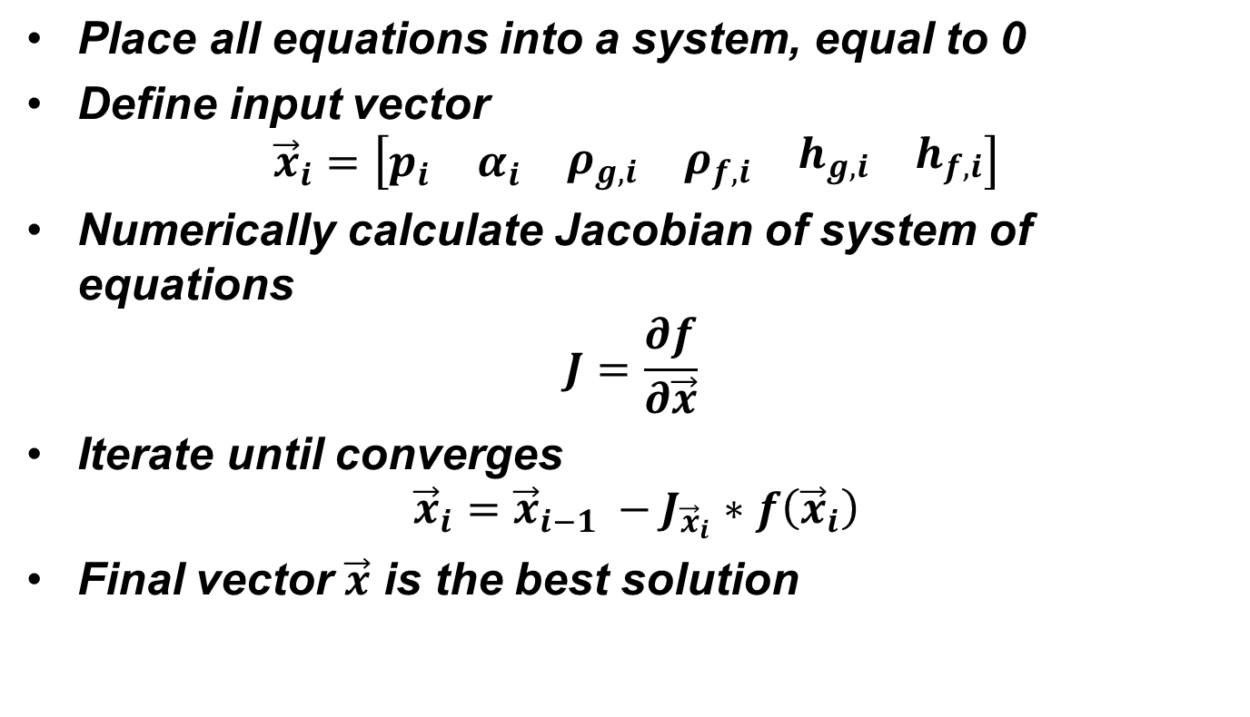
Newton-Raphson Method

Slide 24
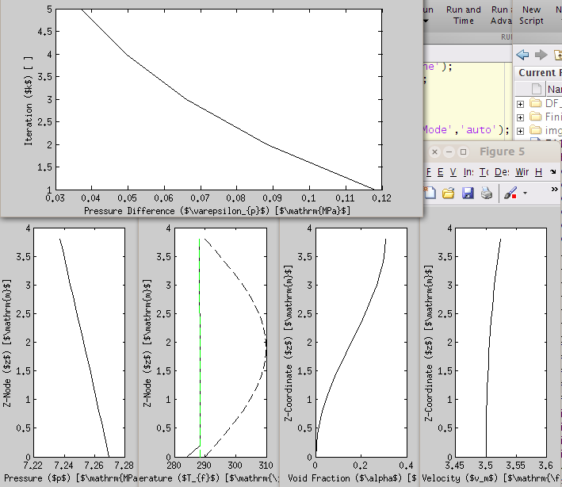
Results

Slide 25
NMR50 Axial Neutronics Analysis
Faisal Odeh, Ching-Sheng Lin, Alex Hagen
Advisor: Prof. Yang
May 9th, 2014
School of Nuclear Engineering
Purdue University
West Lafayette, IN 47907

Slide 26


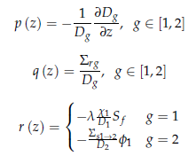
Steady State Diffusion and Discretization
Diffusion equation used as
Must assume a positionally dependent diffusion constant
Discretization performed using Dirichelet Boundary Conditions and Finite Difference Method

Slide 27
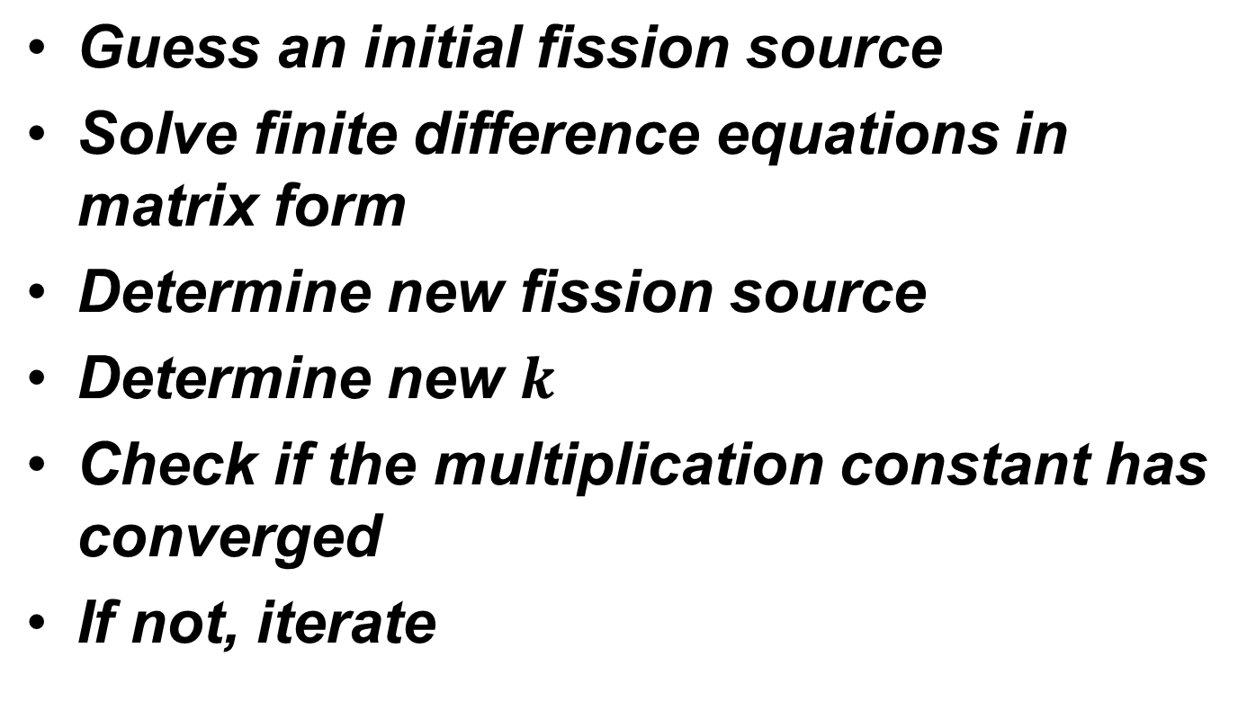
Algorithm for Diffusion Solution

Slide 28
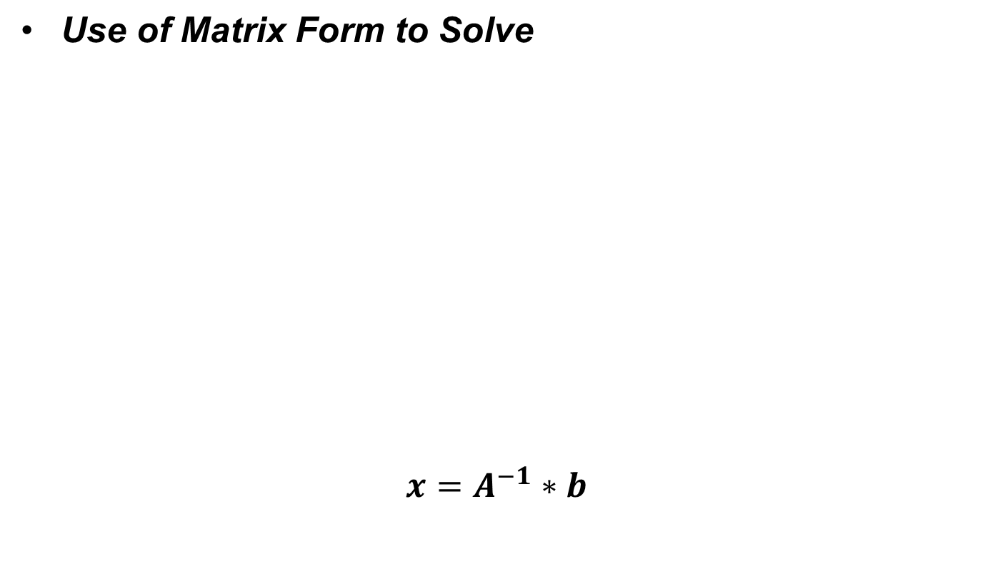
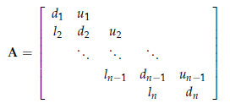
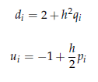

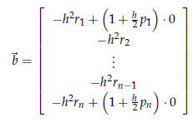
Solution of Diffusion Equation

Slide 29
Algorithm for D-F Calculation
Assume an inlet pressure
  Assume a fluid temperature
  Calculate wall heat flux
  Use Newton-Raphson method to determine node values
  See if wall flux calculated from node values equals the wall flux calculated with fluid temperature
  If not, iterate
See if outlet pressure matches the known outlet pressure
If not, iterate

Slide 30
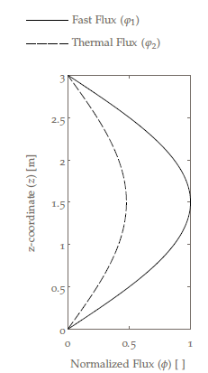
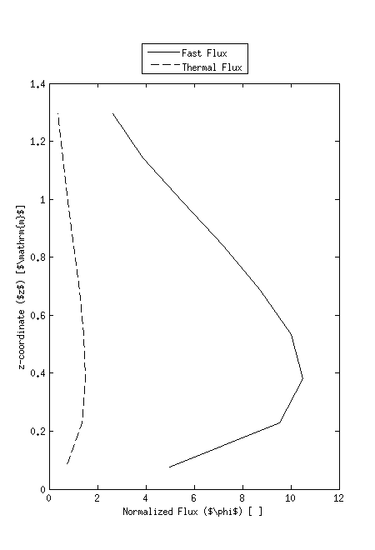
Results
Validation Test
Constant Parameters – Void BC
Initial Flux for PKE
Determined XS – Void BC

Slide 31
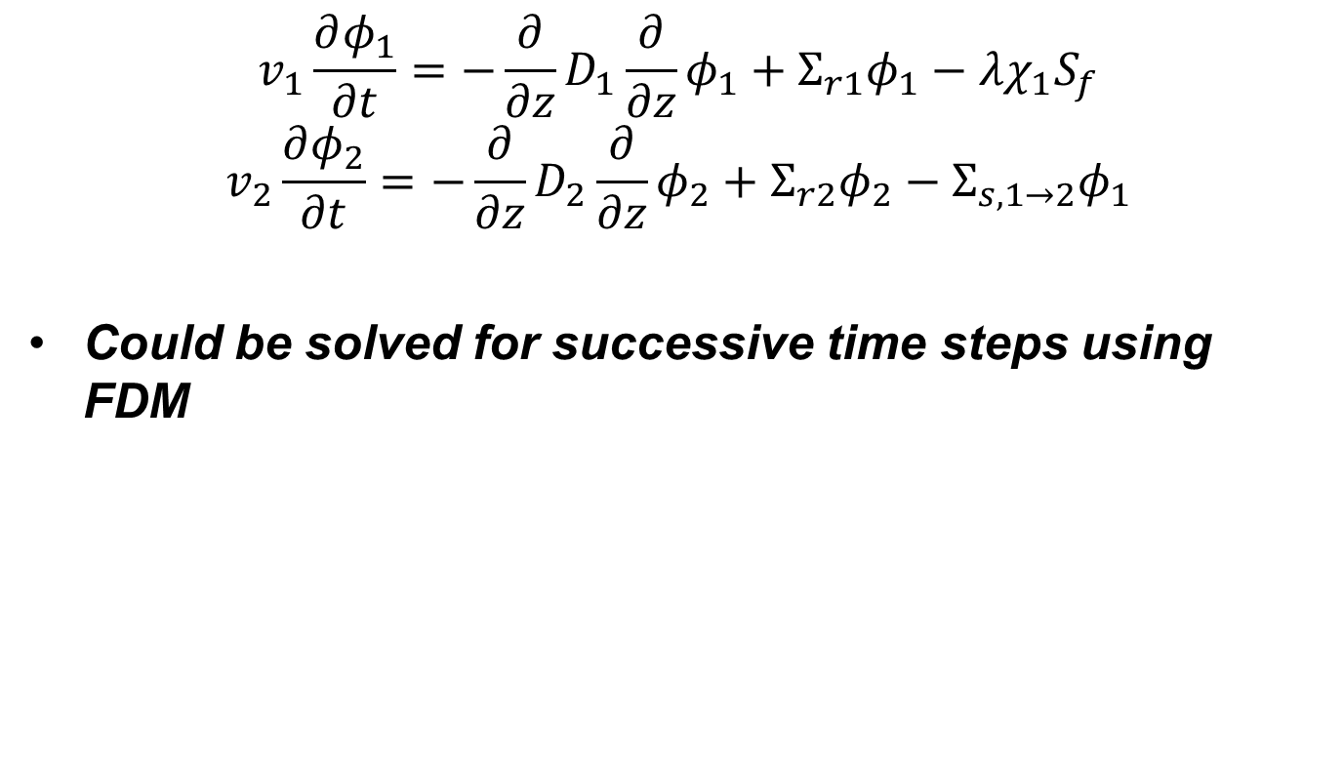
Transient Diffusion Equation

Slide 32
Point Kinetics
Use of arrowhead form using reactivity from shape solver to determine flux amplitude and feedback
Use of explicit Euler method to determine solution to flux amplitude
Solver was used 10 times for every run of T-H and flux shape solver

Slide 33
Cross Section Generation
boron concentration (B, in ppm)
square root of the effective fuel temperature
moderator temperature and density
void fraction (α)
effective rodded fractions (ξ)
Parameter P |  | Notation in MATLAB code |  | Cross section functionalization
D1 | D2 | G1 | G2 | Σ(T_{f}, α)= Σ₀ x (1 + c₁(√T_{f}-√T_{f0}) + c₂(Δα) + c₃(Δα²))
Σ_{a,1} | Σ_{a,2} | Sigma_a_g1 | Sigma_a_g2
νΣ_{f,1} | νΣ_{f,2} | nuSigma_f_g1 | nuSigma_f_g2
Σ_{1→2} |  | Sigma_s_g1_2

Slide 34
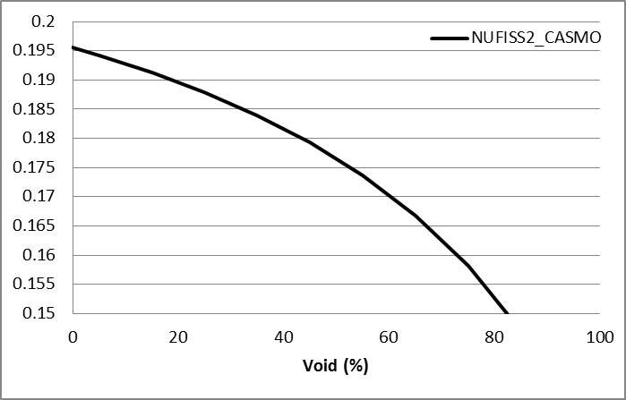
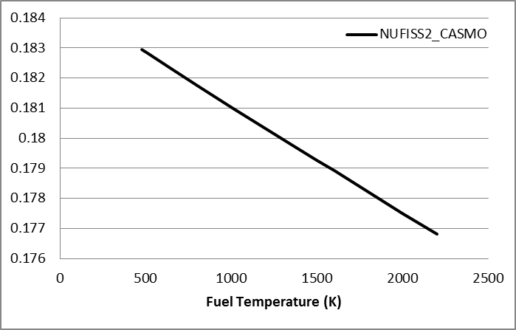
Cross Section Generation
Atrium10 fuel in NMR50
piecewise linear interpolation
Void = 10%, 30%, 50%, and 70%
TFU = 560K, 810K, and 1500K

Slide 35
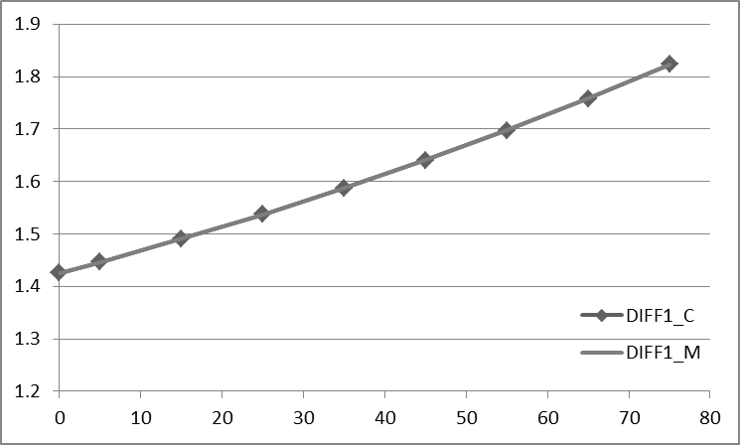
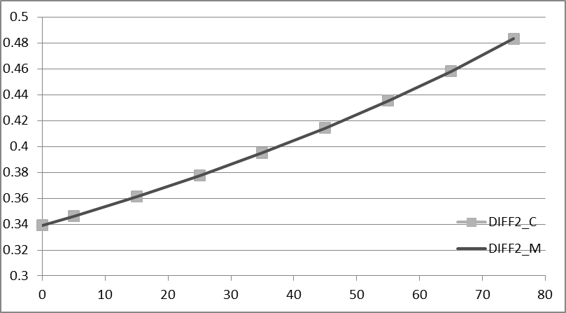
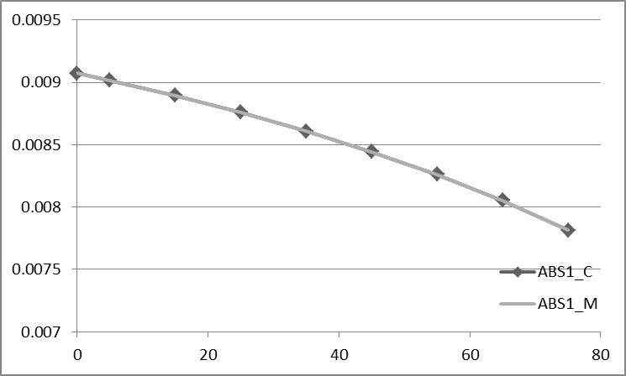
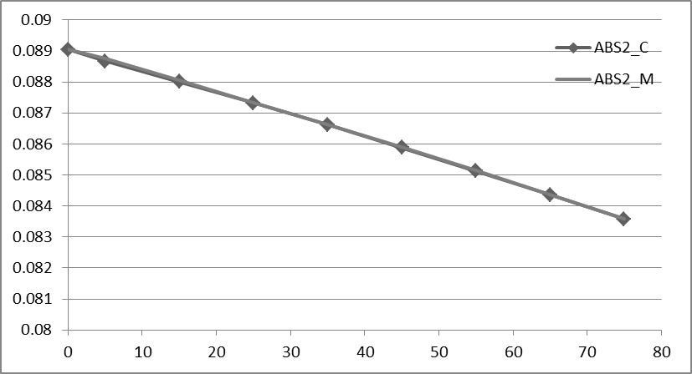
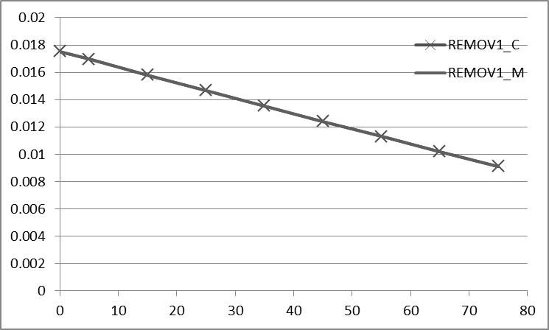
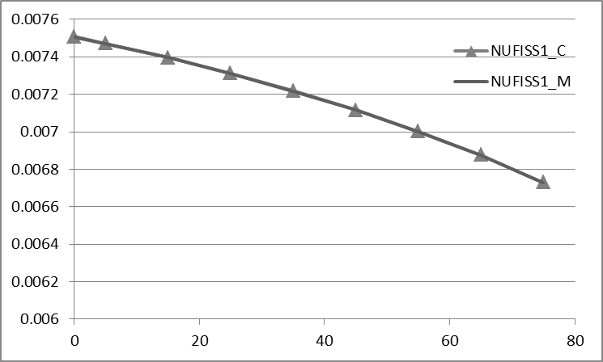

XS at Temperature 560K

Slide 36







XS at Void=30

Slide 37


XS Verify
Test XS based on the SIMULATE axial temperature and void distribution
The XS generated by the two codes were essentially identical. The largest relative error is less than 0.06%

Slide 38
 |  | XS calculated by MATLAB |  | XS calculated by CASMO |  | Difference (MA-CA/CA, %)
T_{f} =700 K, Void=0%
D1 | D2 | 1.4267E+00 | 3.3916E-01 | 1.4267E+00 | 3.3913E-01 | 0.00% | 0.01%
Σ_{a,1} | Σ_{a,2} | 9.1330E-03 | 8.8926E-02 | 9.1354E-03 | 8.8976E-02 | -0.03% | -0.06%
νΣ_{f,1} | νΣ_{f,2} | 7.5009E-03 | 1.0873E-01 | 7.4999E-03 | 1.0876E-01 | 0.01% | -0.03%
Σ_{1→2} |  | 1.7494E-02 |  | 1.7493E-02 |  | 0.01%
T_{f} =740 K, Void=10%
D1 | D2 | 1.4696E+00 | 3.5366E-01 | 1.4697E+00 | 3.5362E-01 | -0.01% | 0.01%
Σ_{a,1} | Σ_{a,2} | 9.0326E-03 | 8.8253E-02 | 9.0333E-03 | 8.8302E-02 | -0.01% | -0.06%
νΣ_{f,1} | νΣ_{f,2} | 7.4278E-03 | 1.0783E-01 | 7.4262E-03 | 1.0785E-01 | 0.02% | -0.02%
Σ_{1→2} |  | 1.6333E-02 |  | 1.6333E-02 |  | 0.00%
T_{f} =755 K, Void=30%
D1 | D2 | 1.5633E+00 | 3.8621E-01 | 1.5634E+00 | 3.8619E-01 | -0.01% | 0.01%
Σ_{a,1} | Σ_{a,2} | 8.7633E-03 | 8.6861E-02 | 8.7631E-03 | 8.6868E-02 | 0.00% | -0.01%
νΣ_{f,1} | νΣ_{f,2} | 7.2557E-03 | 1.0589E-01 | 7.2553E-03 | 1.0589E-01 | 0.01% | 0.00%
Σ_{1→2} |  | 1.4056E-02 |  | 1.4056E-02 |  | 0.00%
T_{f} =740 K, Void=40%
D1 | D2 | 1.6145E+00 | 4.0471E-01 | 1.6146E+00 | 4.0461E-01 | -0.01% | 0.02%
Σ_{a,1} | Σ_{a,2} | 8.5947E-03 | 8.6129E-02 | 8.5980E-03 | 8.6145E-02 | -0.04% | -0.02%
νΣ_{f,1} | νΣ_{f,2} | 7.1609E-03 | 1.0489E-01 | 7.1593E-03 | 1.0487E-01 | 0.02% | 0.02%
Σ_{1→2} |  | 1.2936E-02 |  | 1.2935E-02 |  | 0.01%
T_{f} =725 K, Void=50%
D1 | D2 | 1.6694E+00 | 4.2480E-01 | 1.6694E+00 | 4.2468E-01 | 0.00% | 0.03%
Σ_{a,1} | Σ_{a,2} | 8.4154E-03 | 8.5400E-02 | 8.4160E-03 | 8.5408E-02 | -0.01% | -0.01%
νΣ_{f,1} | νΣ_{f,2} | 7.0537E-03 | 1.0382E-01 | 7.0525E-03 | 1.0379E-01 | 0.02% | 0.03%
Σ_{1→2} |  | 1.1822E-02 |  | 1.1824E-02 |  | -0.02%
T_{f} =700 K, Void=60%
D1 | D2 | 1.7280E+00 | 4.4669E-01 | 1.7279E+00 | 4.4659E-01 | 0.01% | 0.02%
Σ_{a,1} | Σ_{a,2} | 8.2096E-03 | 8.4650E-02 | 8.2102E-03 | 8.4658E-02 | -0.01% | -0.01%
νΣ_{f,1} | νΣ_{f,2} | 6.9353E-03 | 1.0271E-01 | 6.9345E-03 | 1.0267E-01 | 0.01% | 0.04%
Σ_{1→2} |  | 1.0728E-02 |  | 1.0727E-02 |  | 0.01%

Slide 39

Results:
Instantaneous reactivity insertion of 0.35$

Slide 40

Temperature Results

Slide 41

Reactivity Results

Slide 42

Results:
Ramp reactivity insertion with no removal
Thus a 0.5$ is inserted at 0.01 then held constant

Slide 43

Temperature Results

Slide 44

Reactivity Results

Slide 45

Questions?

Slide 46

Results:
Burst insertion 2400$/s in 0.0005s (ρ_0.0005=1.2$)
Removal is instantaneous after time 0.0005s.

Slide 47

Temperature Results

Slide 48

Reactivity Results

