Slide 1
CIS 530 Final Project Presentation
Xiaozhuo Cheng, Boyi He

Slide 2
Introduction
Task: to predict the relative difficulty of a text
Focused on extracting lexical and syntactic features from corpus
Final System = POS tags + NER labels + Brown Cluster

Slide 3
Methods
NLTK – word tokenize, sent tokenize, FreqDist
Stanford CoreNLP
Brown Cluster files
scikits.learn.SVR
scipy.stats.spearmanr

Slide 4
Final System
Model = POS tags + NER labels + Brown Cluster
Local validation score: 0.341134698426
Score: 0.391568018354
Mapped tokens to tags/clusters
Calculated distribution over the tags/clusters
Generated vectors and concatenated
SVR as ML model

Slide 5
Experiments - Local Validation
Spearman Correlation + Cross Validation
2-fold cross validation
Repeat multiple times and compute the average

Slide 6
Experiments - Features
Classical features
Vector space models
Language models
Syntactic features
Combinations

Slide 7
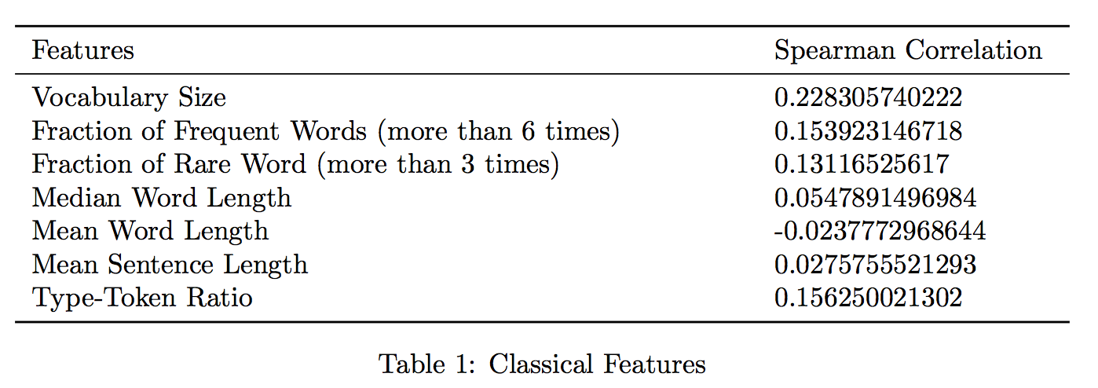
Experiments - Classical features

Slide 8
Analysis - Classical features
Does not work well
Simple and coarse

Slide 9
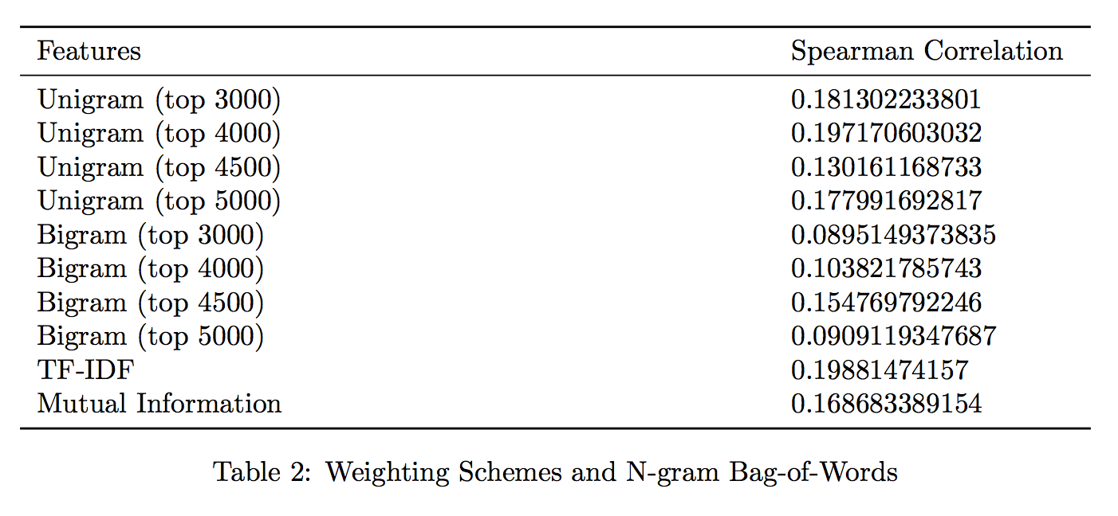
Experiments - Language models

Slide 10
Analysis - Language models
Expected to be helpful, but does not work well
Small size of training set
Lemmatization may help

Slide 11
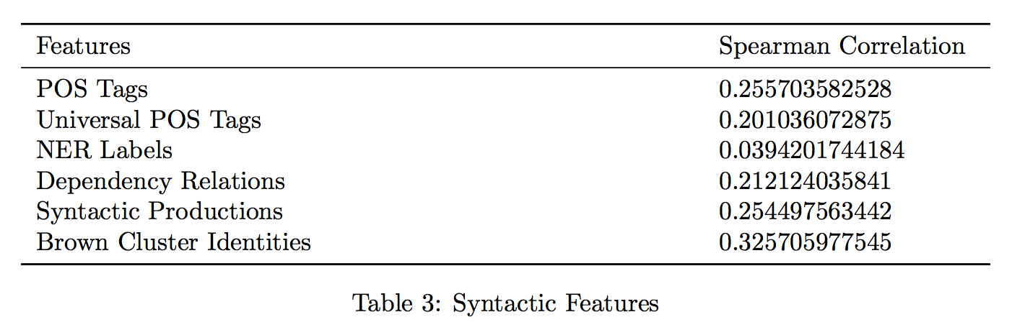
Experiments - Syntactic features

Slide 12
Analysis - Brown Cluster
Highest estimated score as a single feature
“Hard words” with the same types tend to be clustered together
Higher ratio for the new cluster → more uncommon words

Slide 13
Analysis - POS tags, NER
Works moderately well alone
Similar to Brown Cluster
Word difficulty
Unknown words

Slide 14
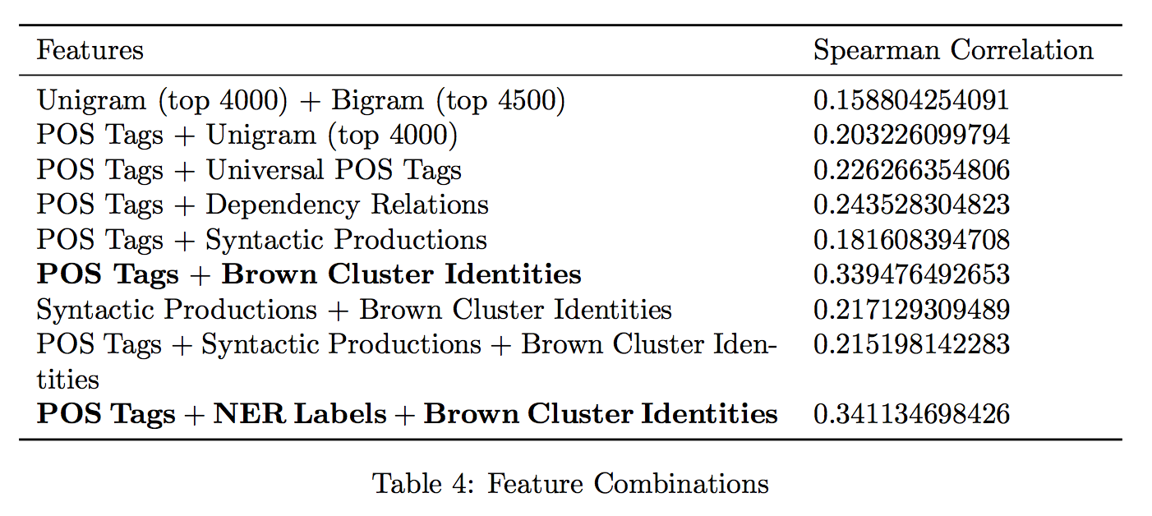
Experiments - Combinations

Slide 15
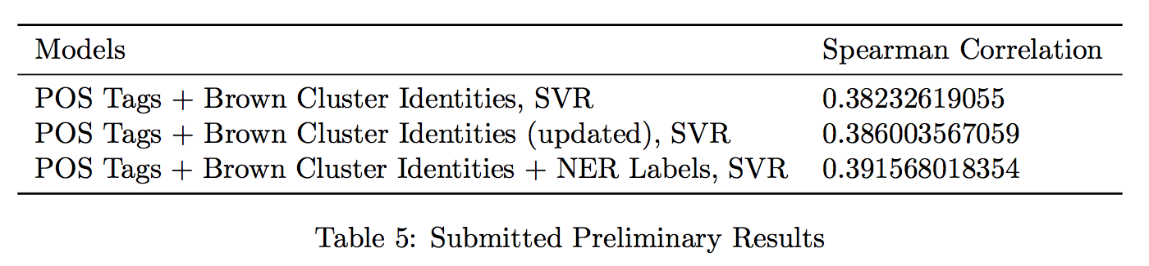
Submission

Slide 16
Optional Set
Did not use
Validation test: does not match with the training set
How to coordinate with the training set

Slide 17
Future Improvement
Lemmatization
Relationship between each single word and text readability
Filter out noise data
Coordinate the optional data set with the training set

