Slide 1

Arbol rojo-negro
Red-Black
Tree
Alejandro Hahn
Hugo Valencia
Yessica Hernandez
Alejandro Hahn
Hugo Valencia
Yessica Hernandez

Slide 2
¿What it is?
A Red-Black tree is a biniary search tree with an extra node attribute, the node color, which can be either RED or BLACK.
The colors, following Red-Black principles, ensure that the longesth path from the root to a last element is not larger tan the double of the shortest one. This means that this tree is strongly balanced.

Slide 3


TREE PROPIERTIES
F
Every node is either red or black
The root is black
Every leaf (null) is black
If a node is red, then both childrens are black
For each node, all simple paths from the node to descendant leaves contain the same number of black nodes
B
G
A
D
H
C
E

Slide 4
STRUCTURE COMPLEXITY
 | Complexity
Space | O(n)
Search | O(log n)
Insert | O(log n)
Delete | O(log n)
Height | 2 log(n+1)

Slide 5
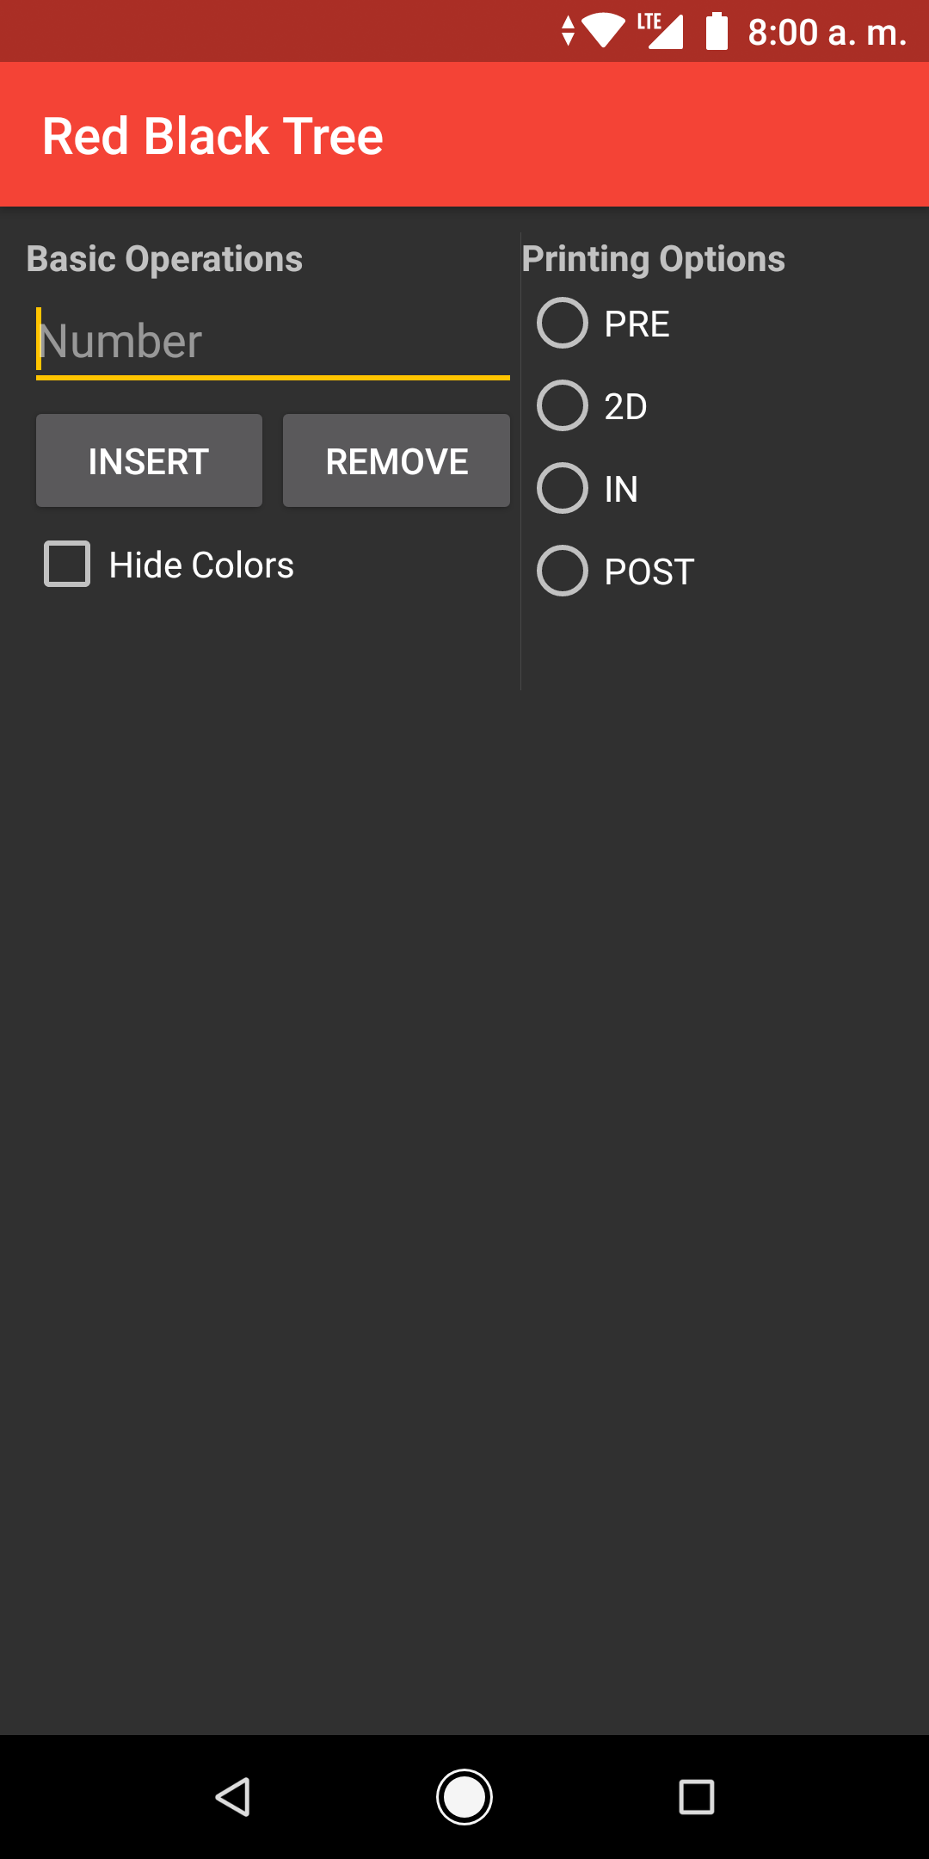
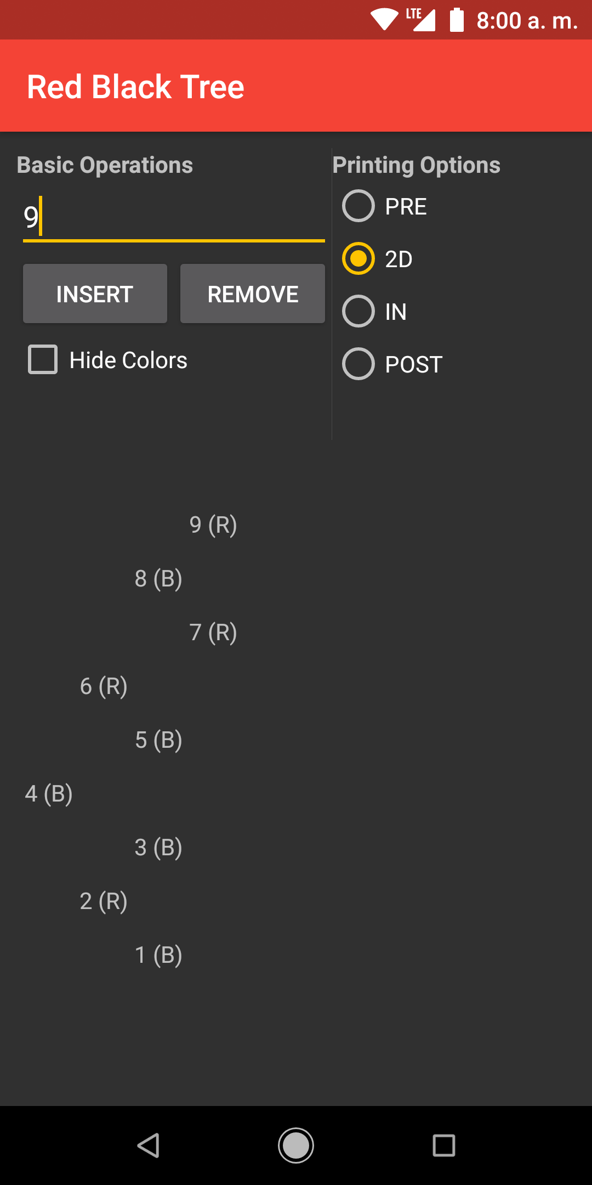

THE APP

Slide 6
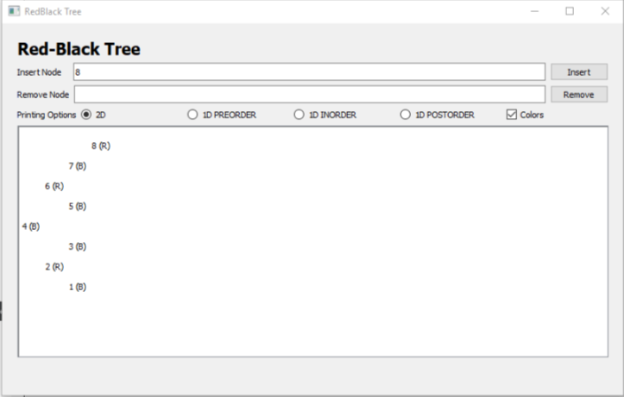
THE APP

Slide 7
THE CODE
class RedBlackNode { T value = {}; Color color = BLACK; RedBlackNode<T>* left = nullptr; RedBlackNode<T>* right = nullptr; RedBlackNode<T>* parent = nullptr; static void RotateLeft(RedBlackTree<T>* t, RedBlackNode<T>* x) {} static void RotateRight(RedBlackTree<T>* t, RedBlackNode<T>* x) {} };

Slide 8
THE CODE
class RedBlackTree { public: RedBlackNode<T>* root = nullptr; void Insert(T value) {} void Delete(RedBlackNode<T>* x) {} void Delete(T value) {} RedBlackNode<T>* Search(T key) {} int Size() {} int Height() {} virtual std::vector<RedBlackNode<T>*> ToList(WalkOrder x) {} virtual void Print(WalkOrder x, bool c) {} virtual void Print(WalkOrder x, RedBlackNode<T>* n, bool c) {} virtual void PrintDefault(bool c) {} virtual void PrintDefault(RedBlackNode<T>* n, bool c) {} virtual void Print2D(bool c){} virtual void Print2D(RedBlackNode<T>* n, bool c) {} void InsertNode(RedBlackNode<T>* z) {}
void DeleteNode(RedBlackNode<T>* z) {} void DeleteNodeV2(RedBlackNode<T>* z) {} void InsertRepair(RedBlackNode<T>* z) {} void DeleteRepair(RedBlackNode<T>* x) {} void Swap(RedBlackNode<T>* x, RedBlackNode<T>* y) {} RedBlackNode<T>* Minimum(RedBlackNode<T>* x) {} int HeightRecursive(RedBlackNode<T>* x) {} int SizeRecursive(RedBlackNode<T>* n) {} void ToListPreOrder(RedBlackNode<T>* n, std::vector<RedBlackNode<T>*>* list) {} void ToListInOrder(RedBlackNode<T>* n, std::vector<RedBlackNode<T>*>* list) {} void ToListPostOrder(RedBlackNode<T>* n, std::vector<RedBlackNode<T>*>* list) {} virtual void PrintPreOrder(RedBlackNode<T>* n, bool c) {} virtual void PrintInOrder(RedBlackNode<T>* n, bool c) {} virtual void PrintPostOrder(RedBlackNode<T>* n, bool c) {} virtual void Print2DUtil(RedBlackNode<T>* root, int space, bool c) {} };

Slide 9
THE PROBLEMS
Logic failure at books at which it try to access propierties of a null pointer
We has to learn how to use Android NDK and QT

Slide 10
THAT’ S ALL
Questions? Comments?

