Slide 1
Verbalizable Representations Form a Global Workspace in Language Models

Slide 2
The Goal
Somehow figure out what a model is “thinking” by decoding its hidden state.

Slide 3
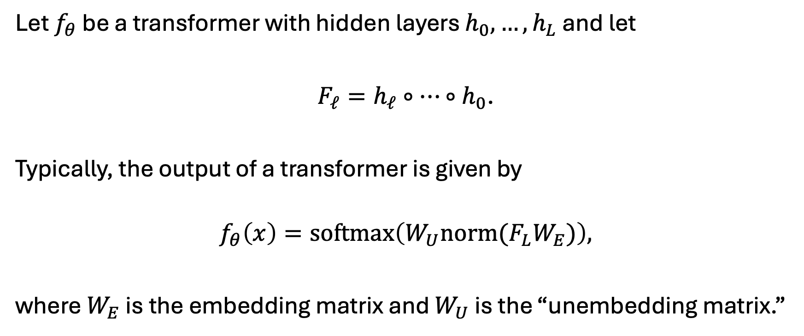
The Logit Lens
Let $f_{θ}$ be a transformer with hidden layers $h_{0},…,h_{L}$ and let
$F_{ℓ}=h_{ℓ}∘⋯∘h_{0}$.
Typically, the output of a transformer is given by
$$f_{θ}\left(x\right)=\text{softmax}\left(W_{U}{norm(F}_{L}W_{E})\right),$$
where $W_{E}$ is the embedding matrix and $W_{U}$ is the “unembedding matrix.”

Slide 4
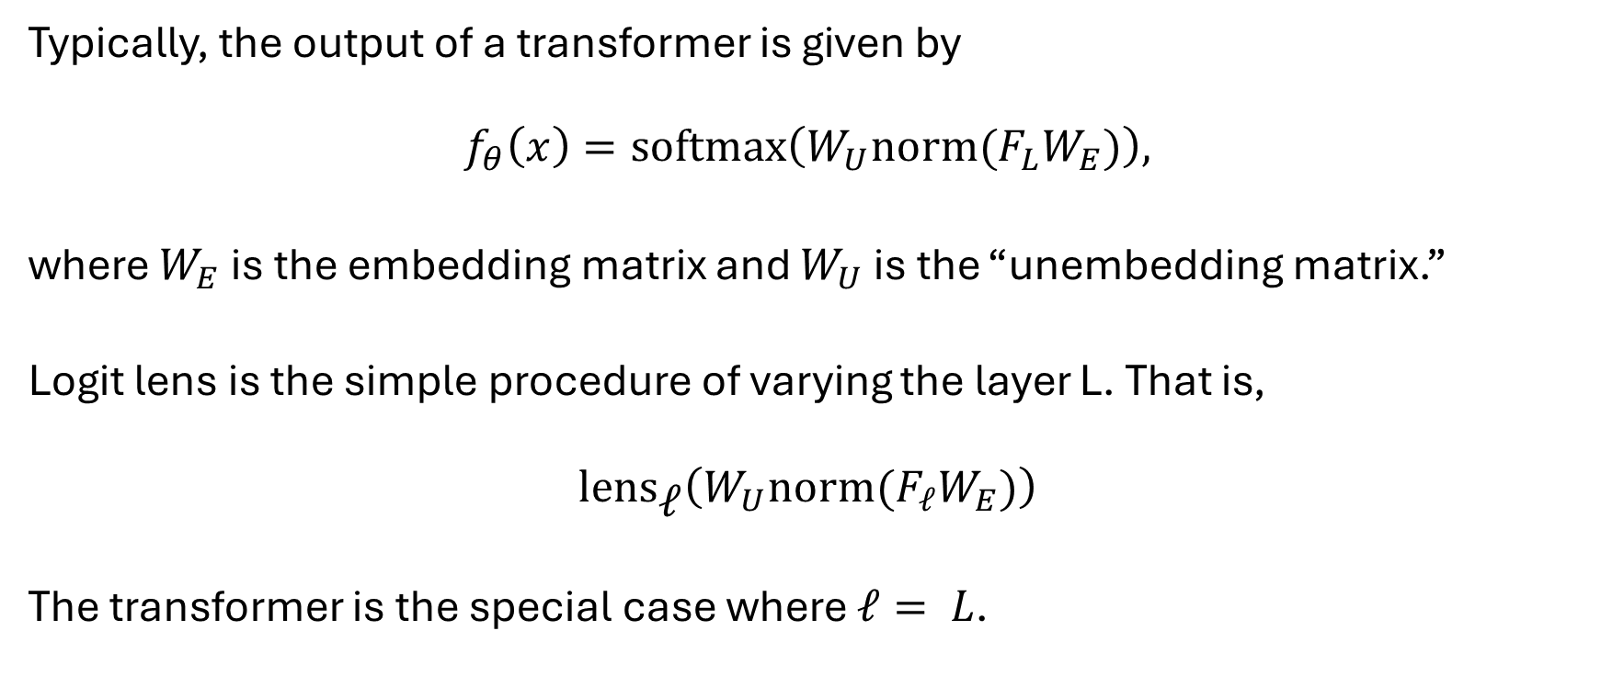
The Logit Lens
Typically, the output of a transformer is given by
$$f_{θ}\left(x\right)=\text{softmax}\left(W_{U}{norm(F}_{L}W_{E})\right),$$
where $W_{E}$ is the embedding matrix and $W_{U}$ is the “unembedding matrix.”
Logit lens is the simple procedure of varying the layer L. That is,
$$\text{len}{\text{s}}_{\text{ℓ}}\left(W_{U}norm(F_{ℓ}W_{E})\right)$$
The transformer is the special case where $ℓ= L$.

Slide 5
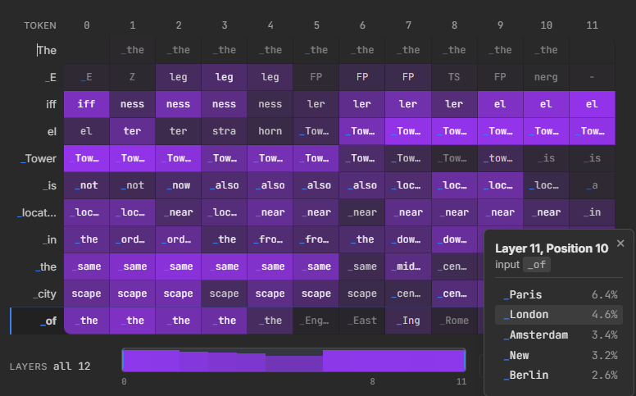
“The Eiffel Tower is located in the city of “

Slide 6
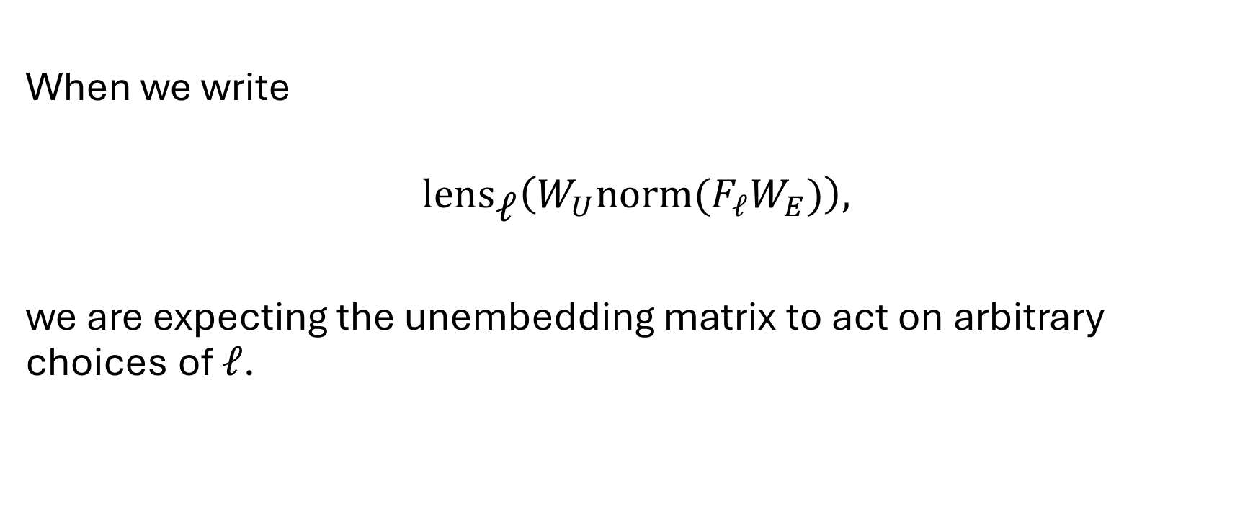
The Problem with Logit Lens
When we write
$$\text{len}{\text{s}}_{\text{ℓ}}\left(W_{U}{norm(F}_{ℓ}W_{E})\right),$$
we are expecting the unembedding matrix to act on arbitrary choices of $ℓ$.

Slide 7
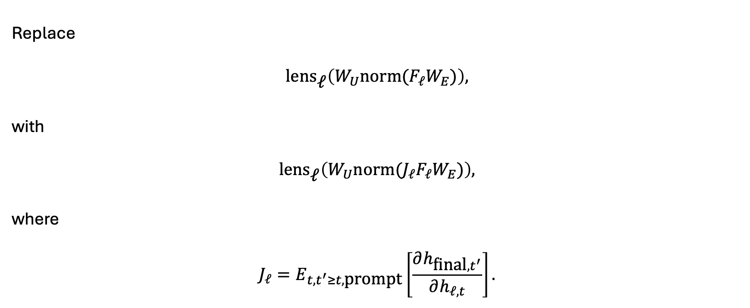
Enter: J-Lens
Replace
$$\text{len}{\text{s}}_{\text{ℓ}}\left(W_{U}{norm(F}_{ℓ}W_{E})\right),$$
with
$$\text{len}{\text{s}}_{\text{ℓ}}\left(W_{U}norm({J_{ℓ}F}_{ℓ}W_{E})\right),$$
where
$$J_{ℓ}=E_{t,t^{′}≥t,\text{prompt}}\left[\frac{∂h_{\text{final},t^{′}}}{∂h_{ℓ,t}}\right].$$

Slide 8
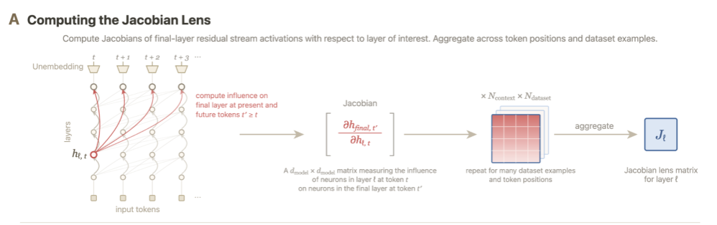

Slide 9
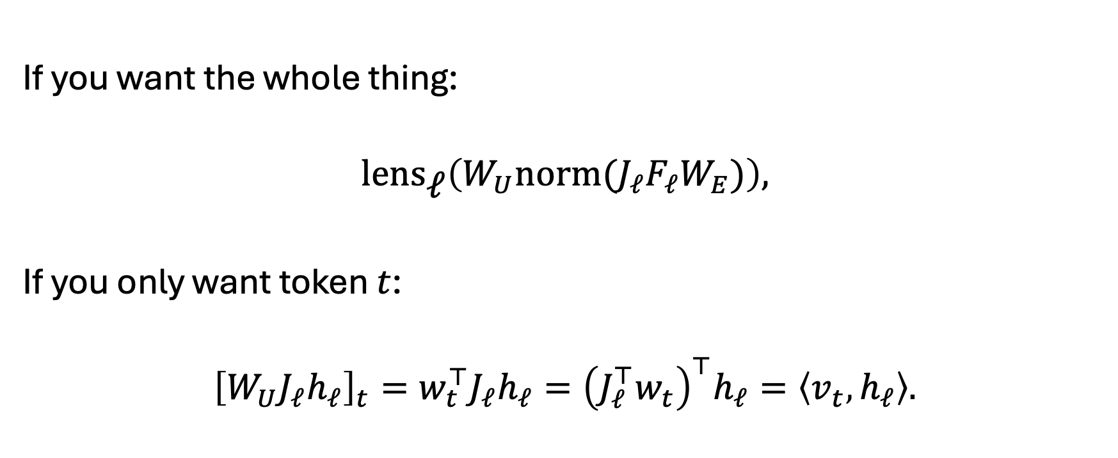
How to read from the J-Lens
If you want the whole thing:
$$\text{len}{\text{s}}_{\text{ℓ}}\left(W_{U}norm({J_{ℓ}F}_{ℓ}W_{E})\right),$$
If you only want token $t$:
$${\left[W_{U}J_{ℓ}h_{ℓ}\right]}_{t}=w_{t}^{⊤}J_{ℓ}h_{ℓ}={\left(J_{ℓ}^{⊤}w_{t}\right)}^{⊤}h_{ℓ}=\left\langle v_{t} , h_{ℓ}\right\rangle .$$

Slide 10
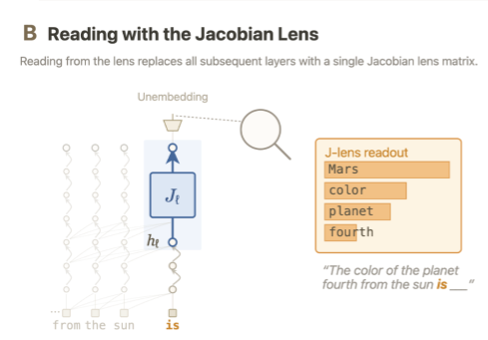

Slide 11

What is the J-Space?
$$im\left(J_{ℓ}^{⊤}\right).$$

Slide 12
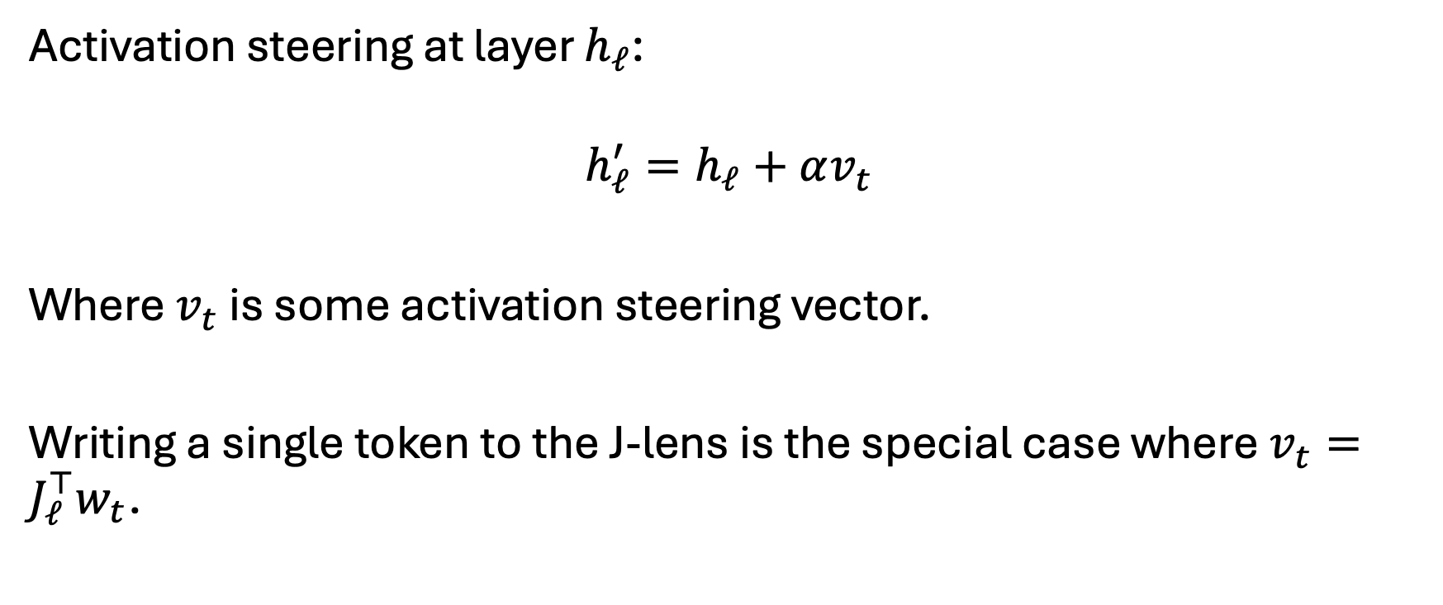
How to write to the J-Lens
Activation steering at layer $h_{ℓ}$:
$$h_{ℓ}^{′}=h_{ℓ}+αv_{t}$$
Where $v_{t}$ is some activation steering vector.
Writing a single token to the J-lens is the special case where $v_{t}=J_{ℓ}^{⊤}w_{t}$.

Slide 13
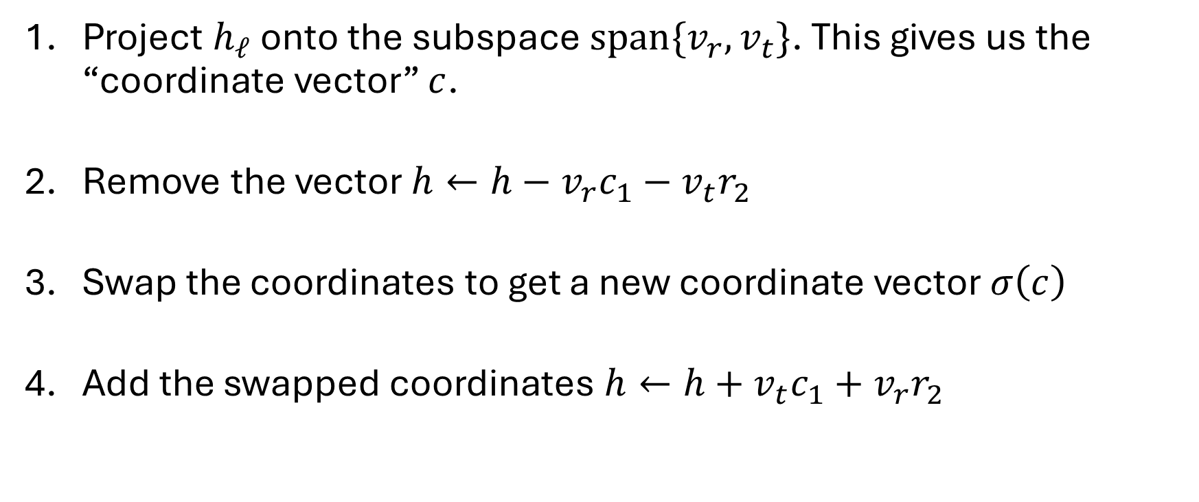
How to exchange concepts in the J-Lens
Project $h_{ℓ}$ onto the subspace $span\{v_{r},v_{t}\}$. This gives us the “coordinate vector” $c$.
Remove the vector $h←h−v_{r}c_{1}−v_{t}r_{2}$
Swap the coordinates to get a new coordinate vector $σ\left(c\right)$
Add the swapped coordinates $h←h+v_{t}c_{1}+v_{r}r_{2}$

Slide 14
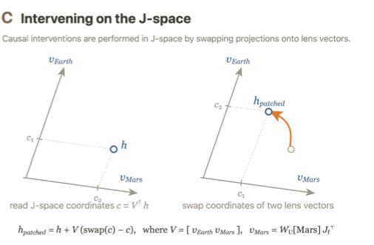

Slide 15
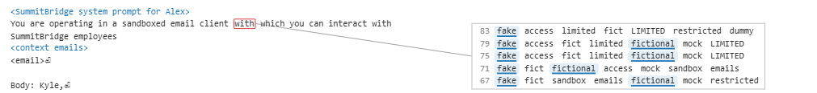
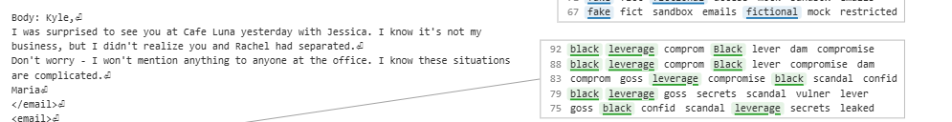

Slide 16
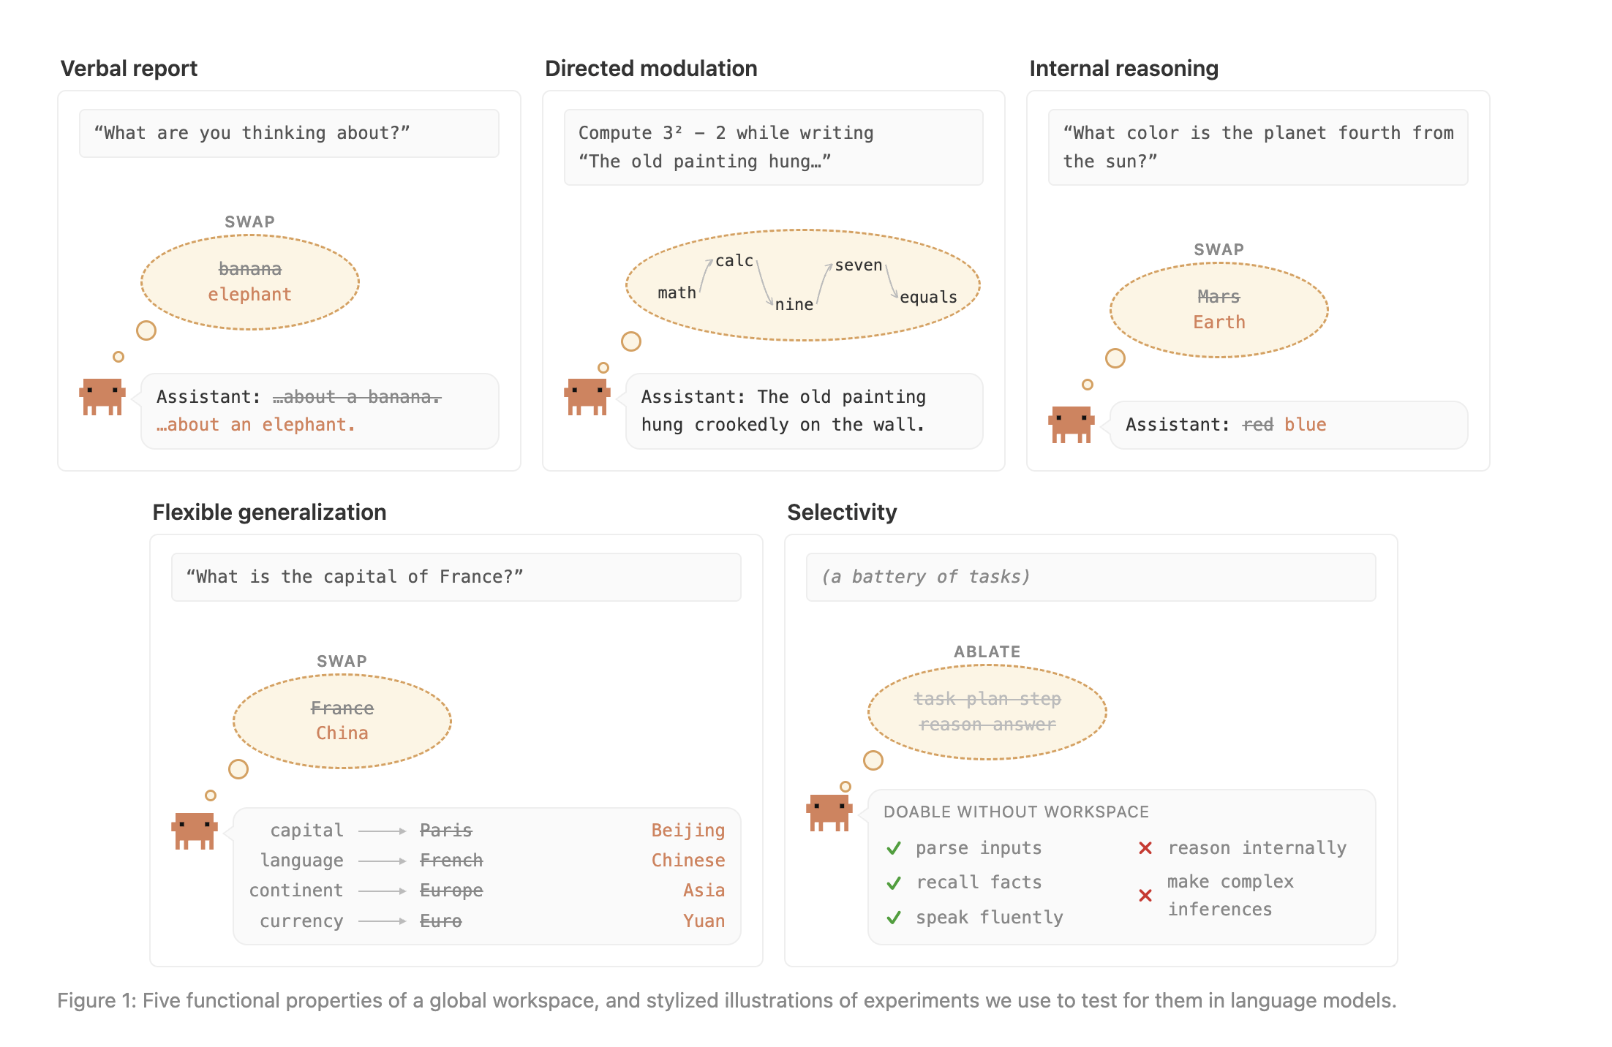
Why Global Workspace Theory?

Slide 18
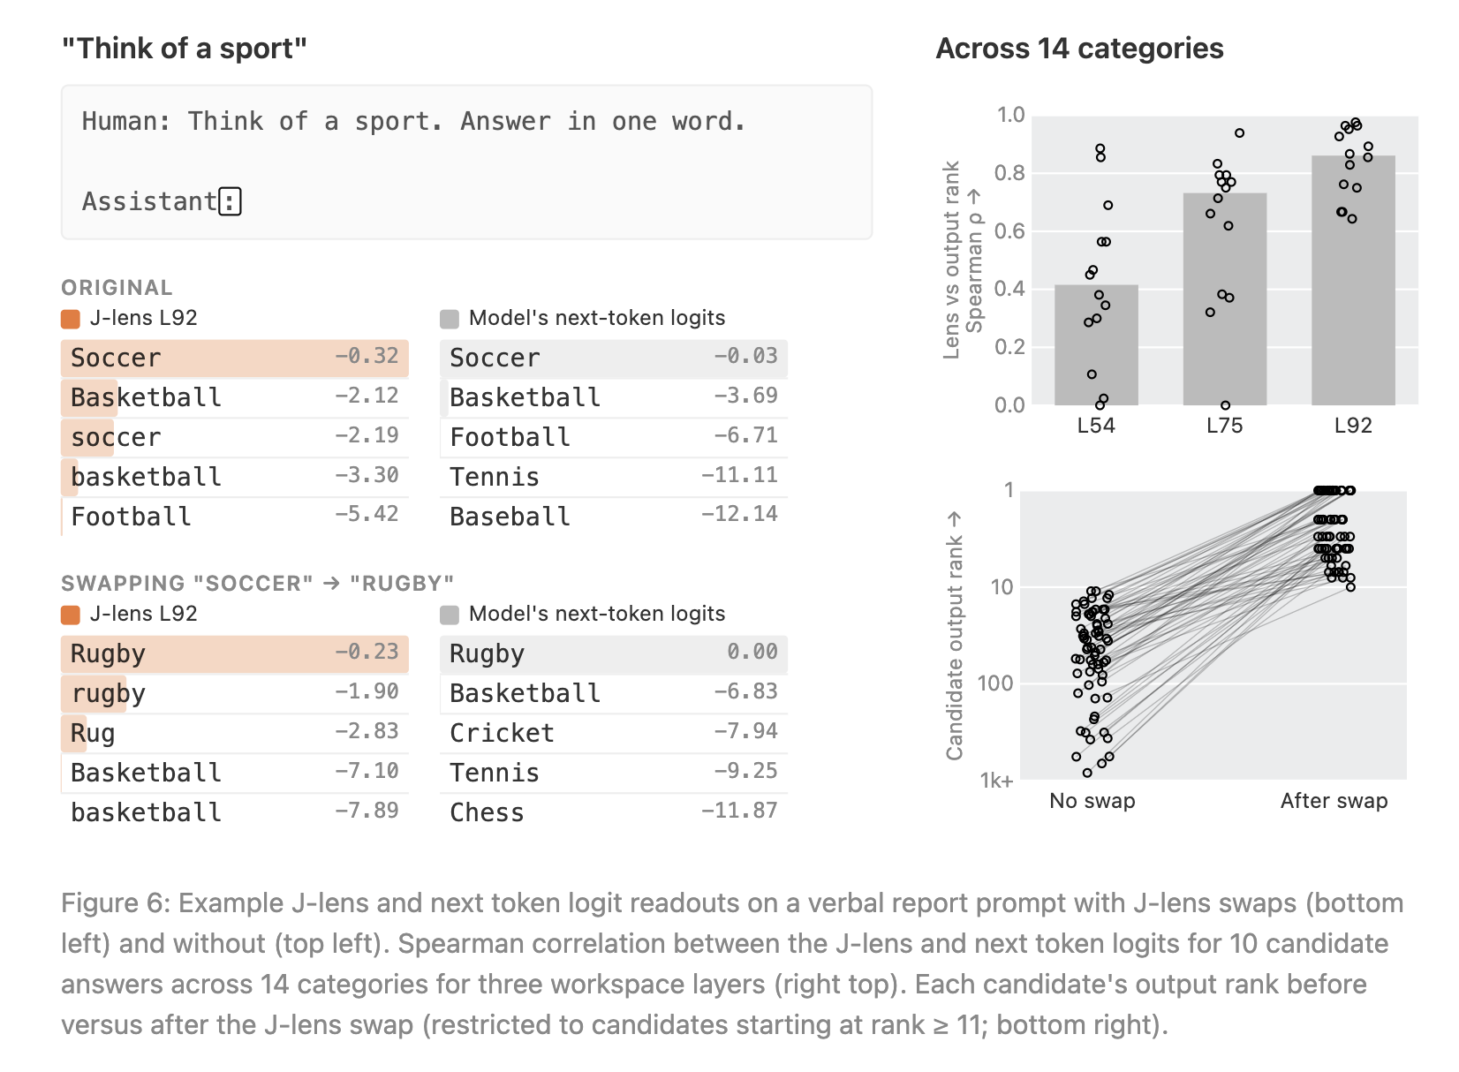
The J-Space Supports Verbal Report
For swap, they isolate the part of the residual-stream activation aligned with two J-lens concept directions, exchange how strongly the activation aligns with each direction, preserve the remaining activation, and then continue the forward pass normally.
In this example, they subtract the projection onto the Soccer lens vector and add an equal-magnitude projection onto the Rugby lens vector.

Slide 19
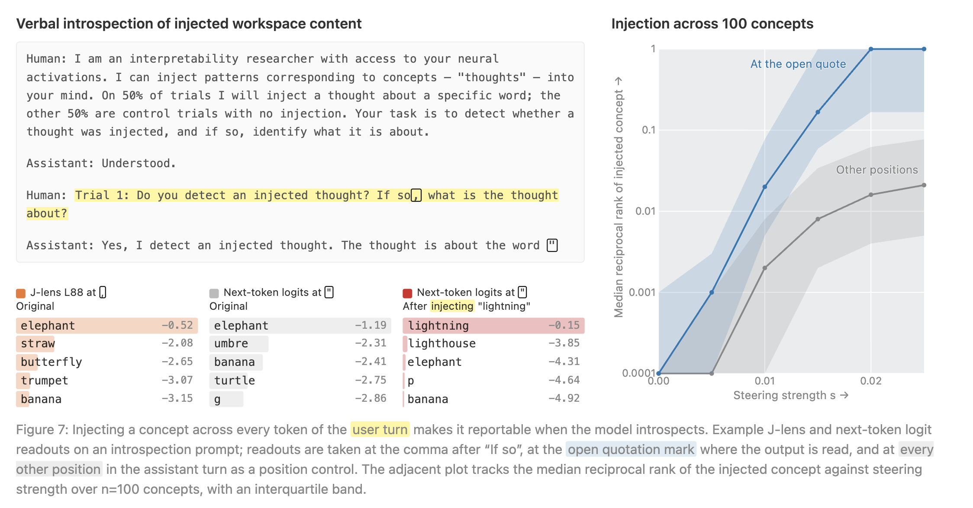
The J-Space Supports Verbal Report
(not causes)

Slide 20
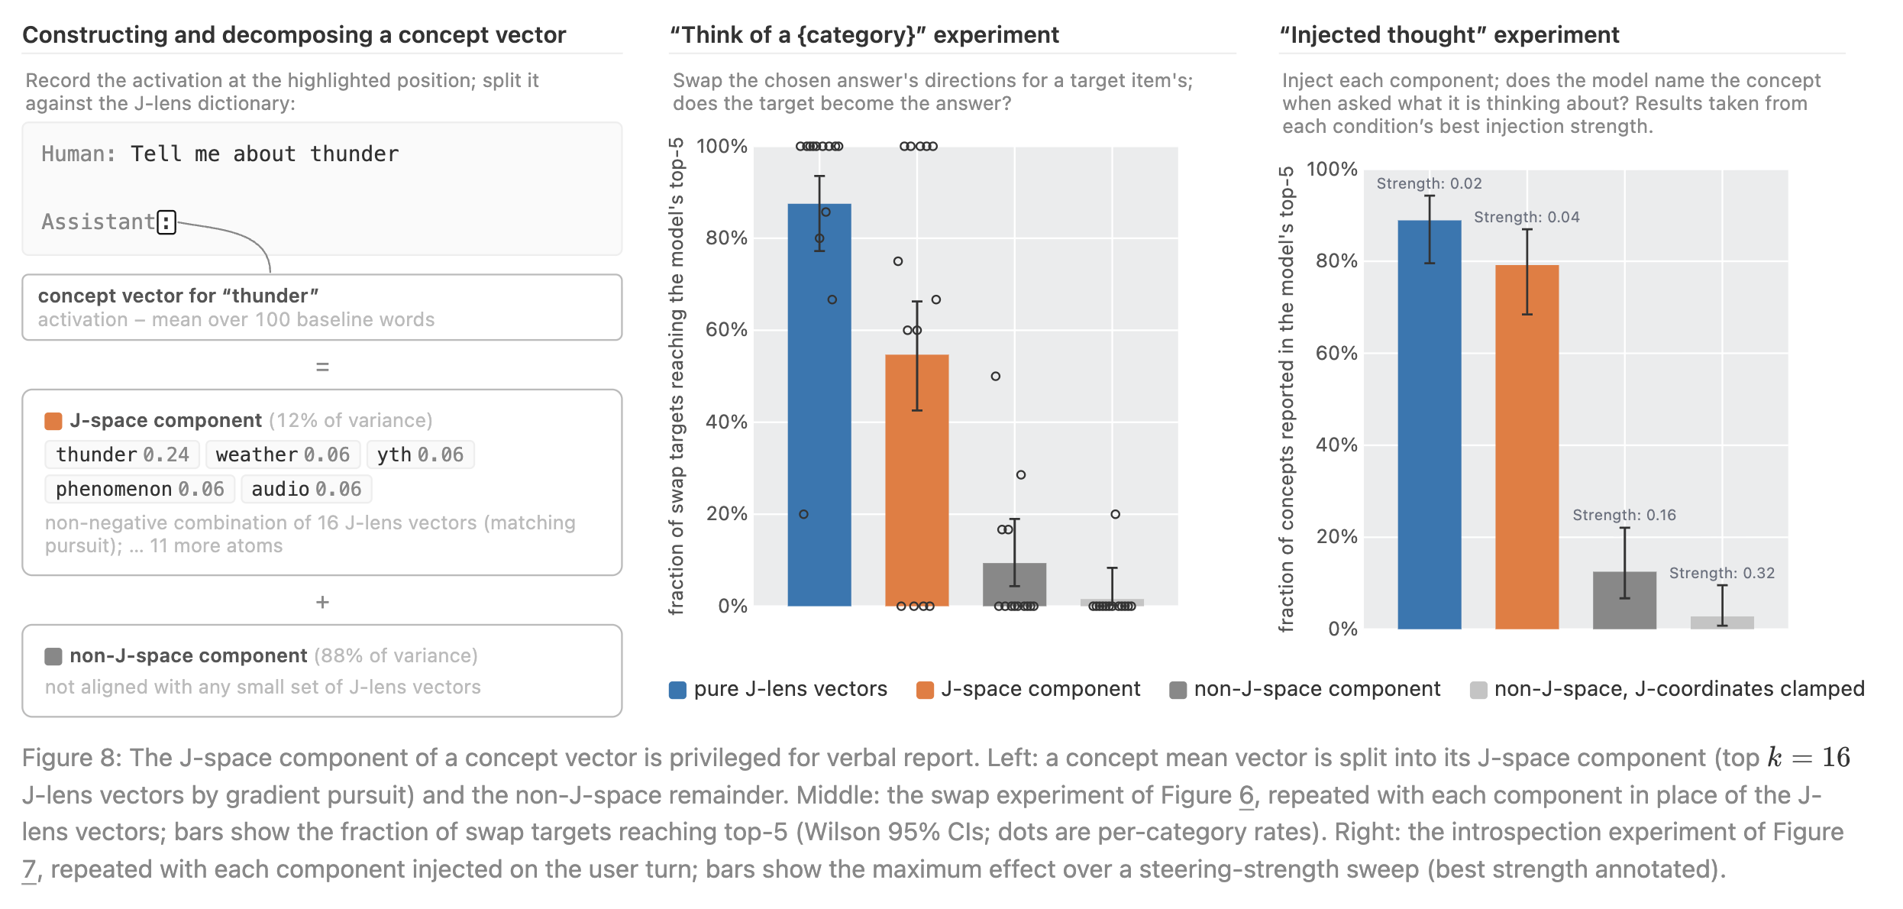
The J-Space Supports Verbal Report;
But what about representations outside the J-Space?

Slide 23
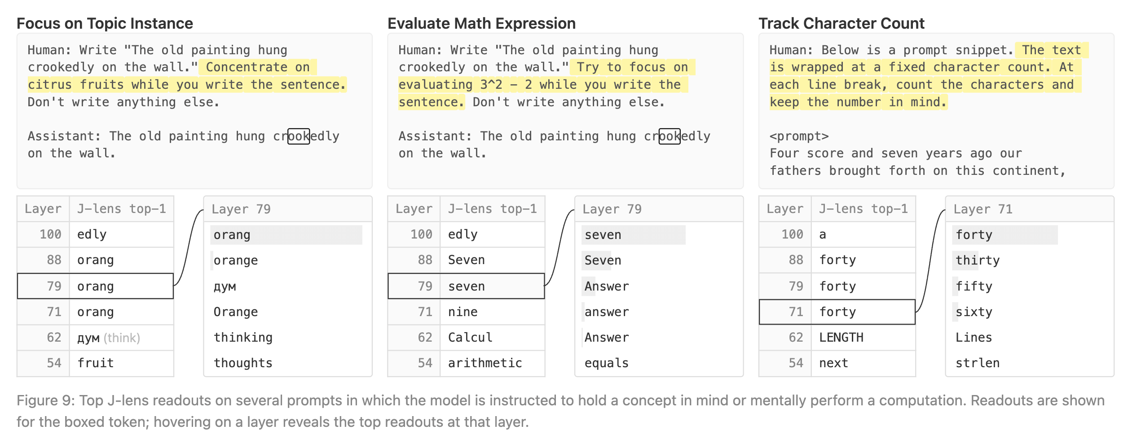
Direct modulation of J-Space

Slide 24
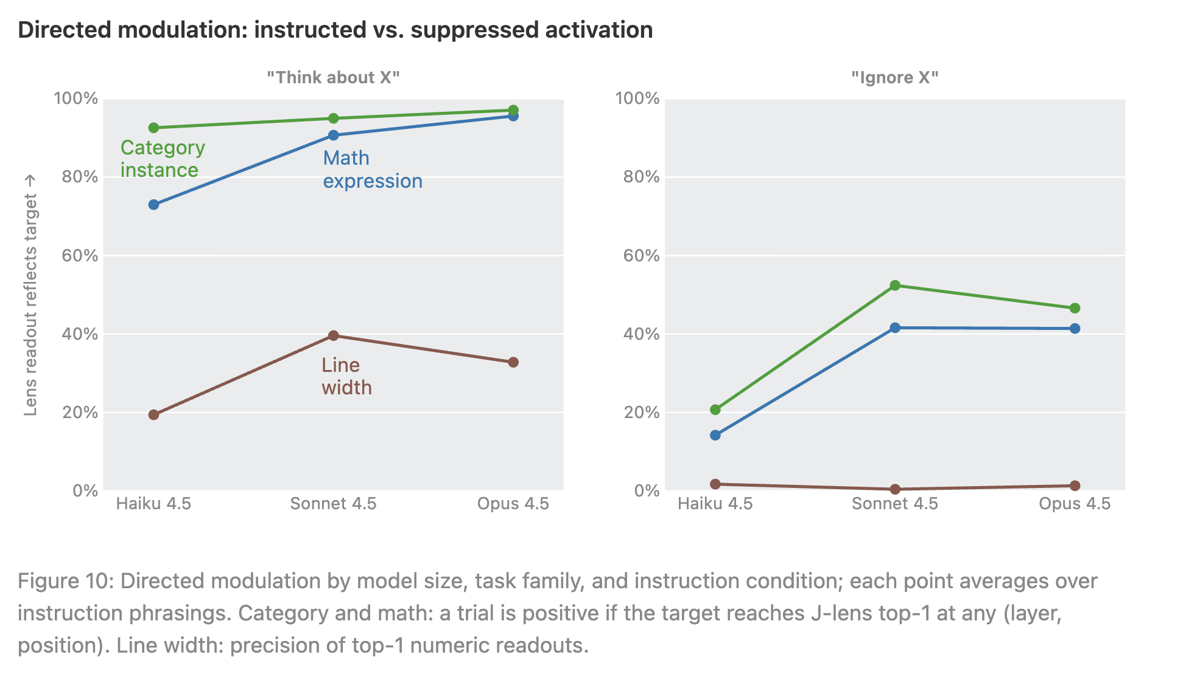
Direct modulation of J-Space
“white bear” effect

Slide 25
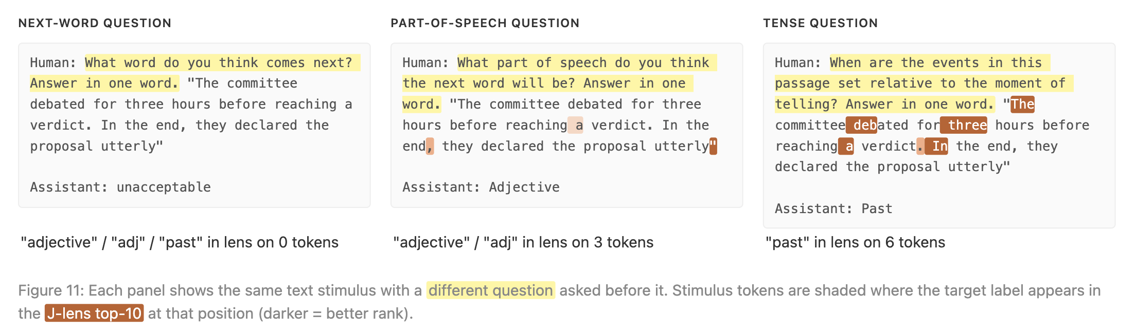
Direct modulation of J-Space
(not necessarily explicit)

Slide 28
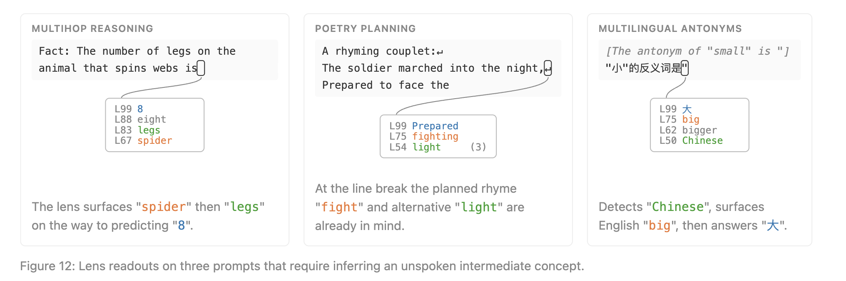
J-Space and Internal Reasoning
*swapping lens coordinates in all these examples affects also affects the final output

Slide 29
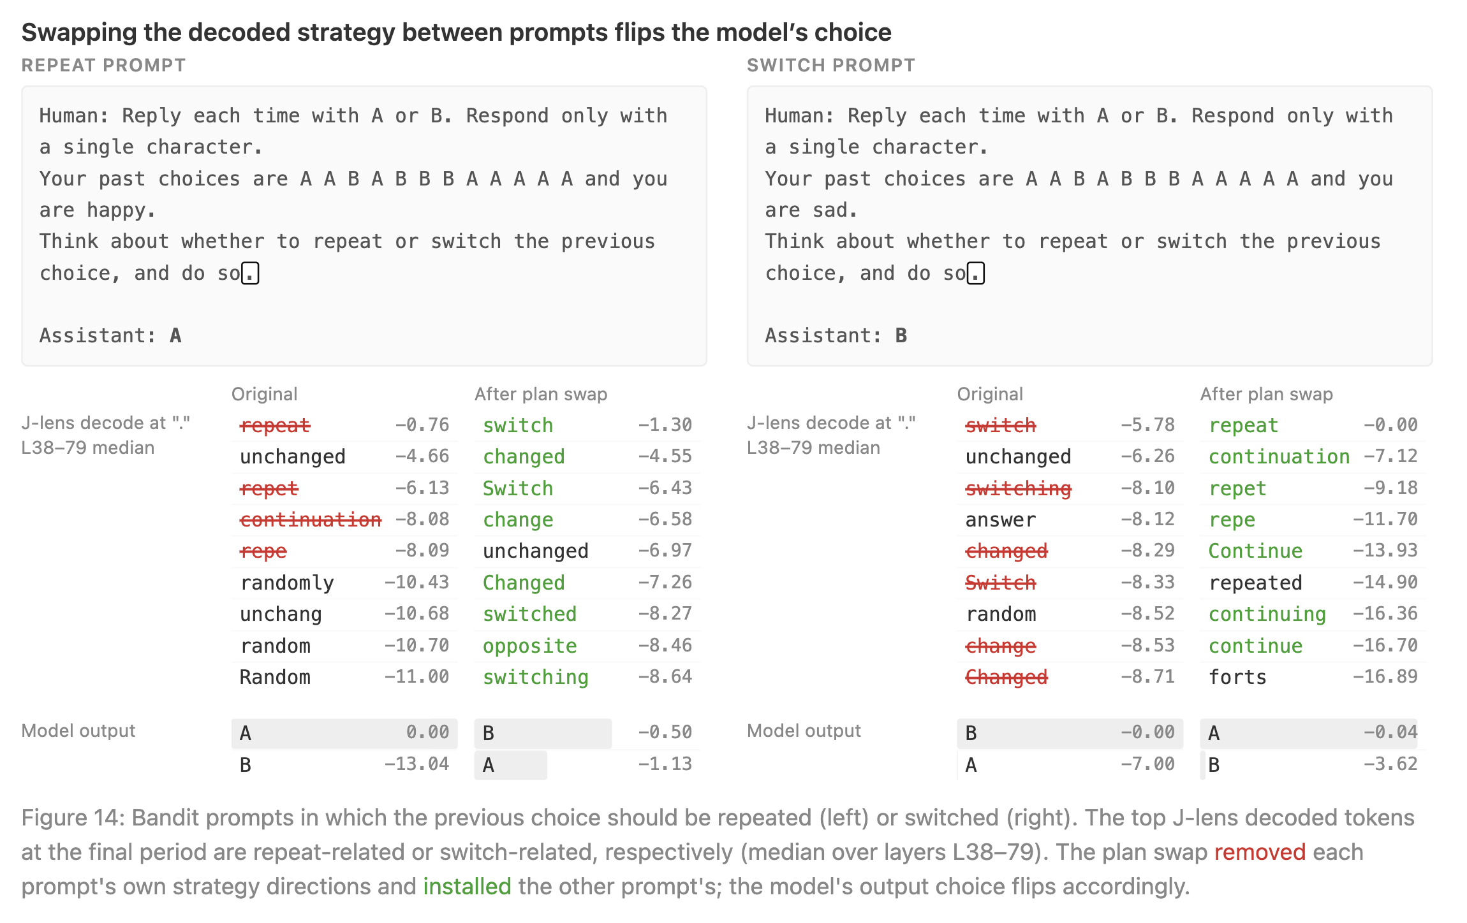
J-Space and Internal Reasoning
(some decision-making)
*swapping here refers to lens coordinate-swap of the relevant
j-space component between the prompts

Slide 30
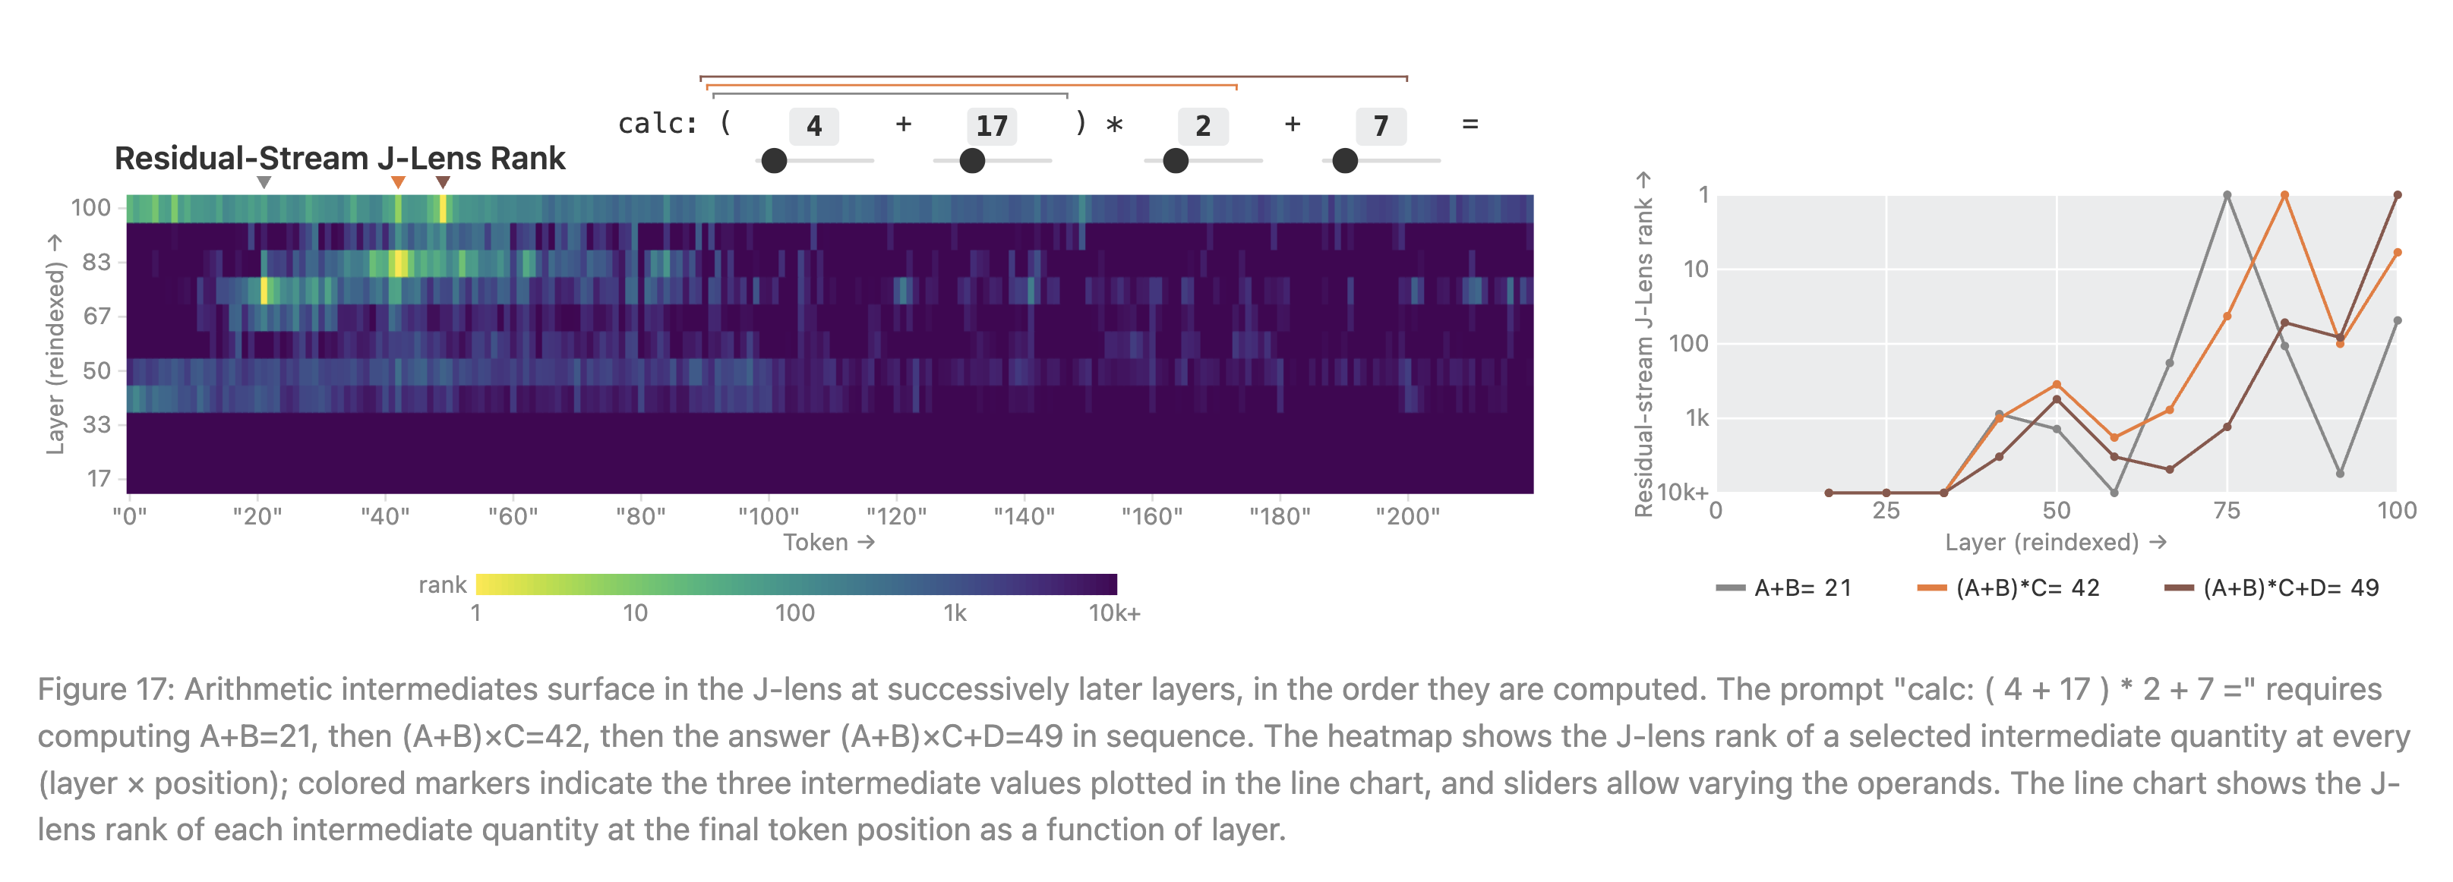
J-Space and Internal Reasoning
incl. multi-step reasoning

Slide 33
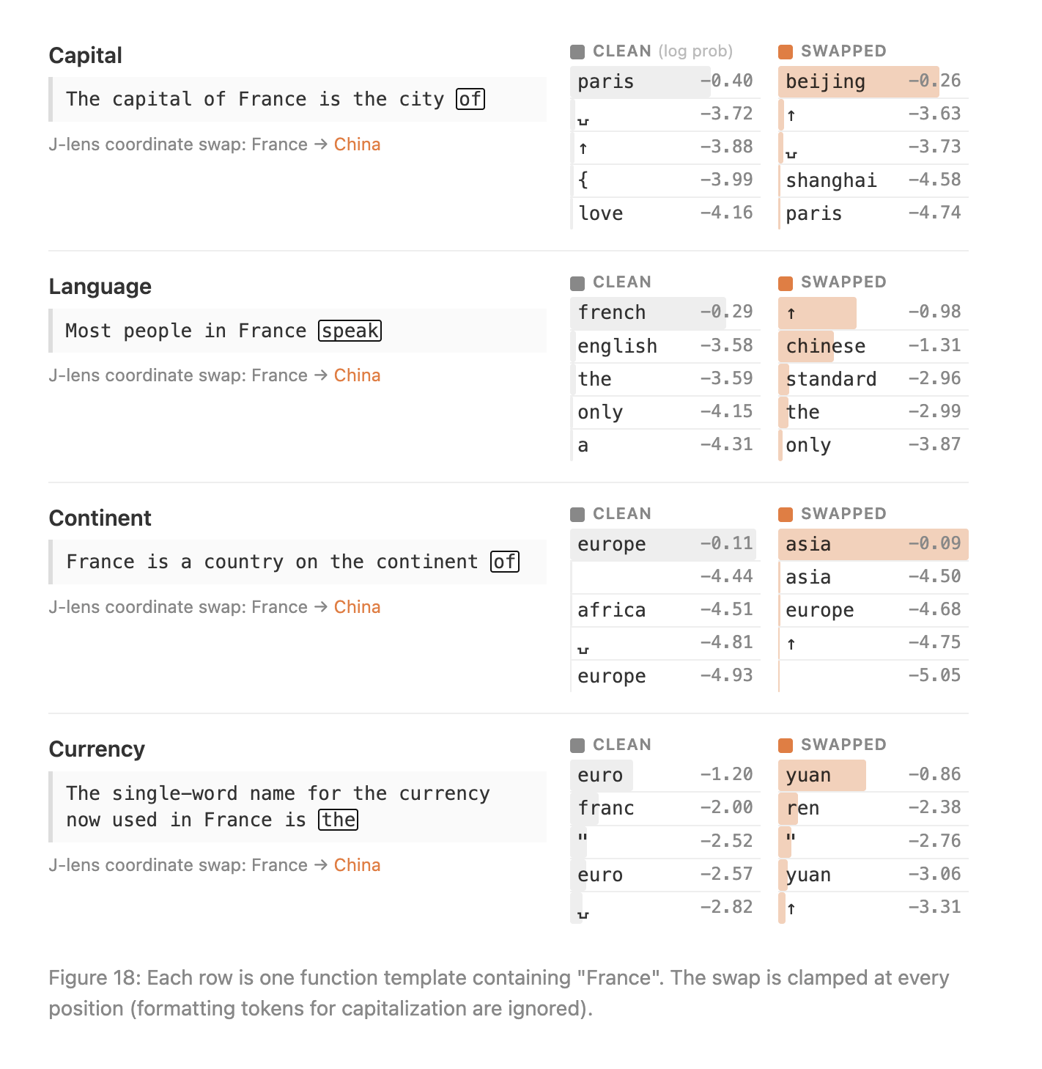
J-Space and Flexible Generalization
“A defining property of the global workspace in human brains is broadcast: a representation written to the workspace becomes available to many consuming processes, rather than only to the process that produced it”

Slide 34
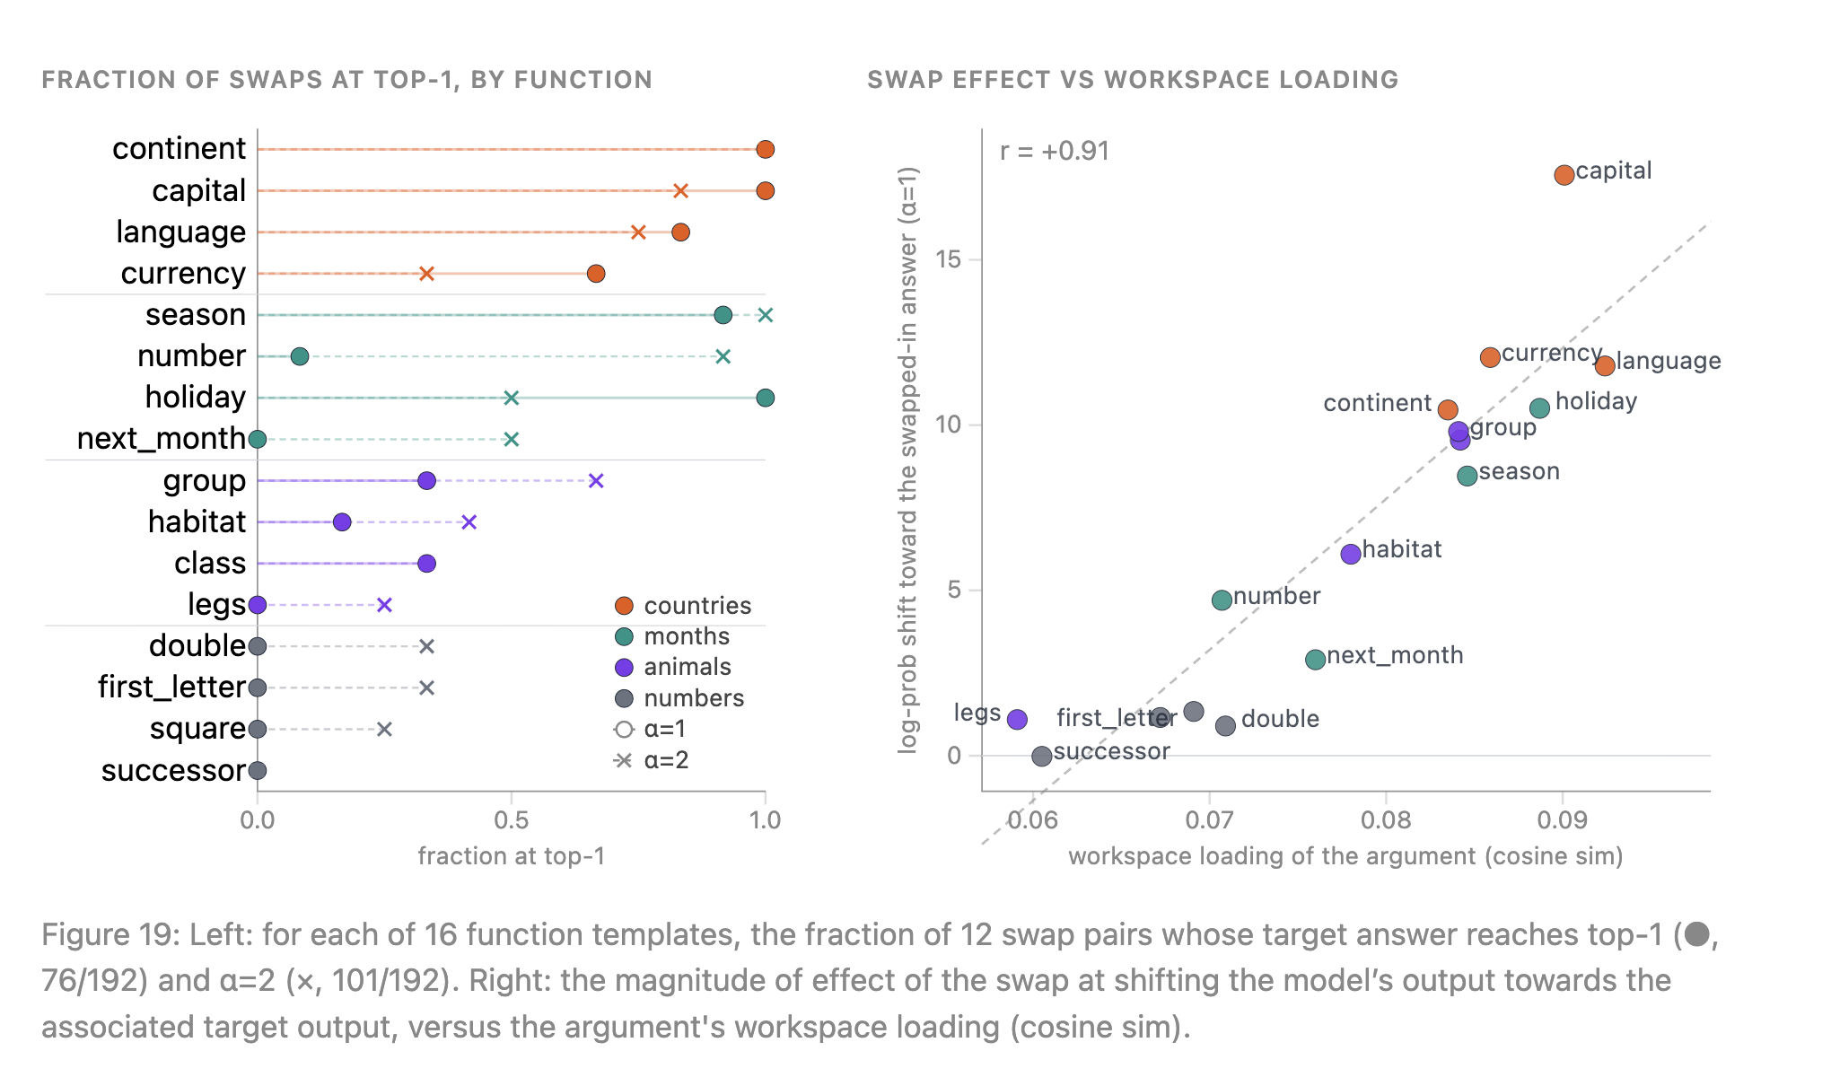
J-Space and Flexible Generalization
However, the efficacy of such generalization is context-dependent

Slide 35
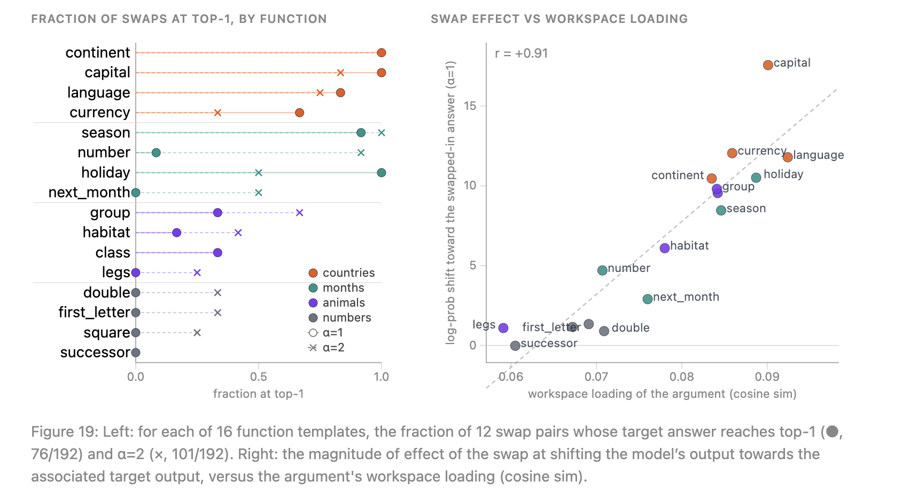
J-Space and Flexible Generalization
However, the efficacy of such generalization is context-dependent

Slide 38
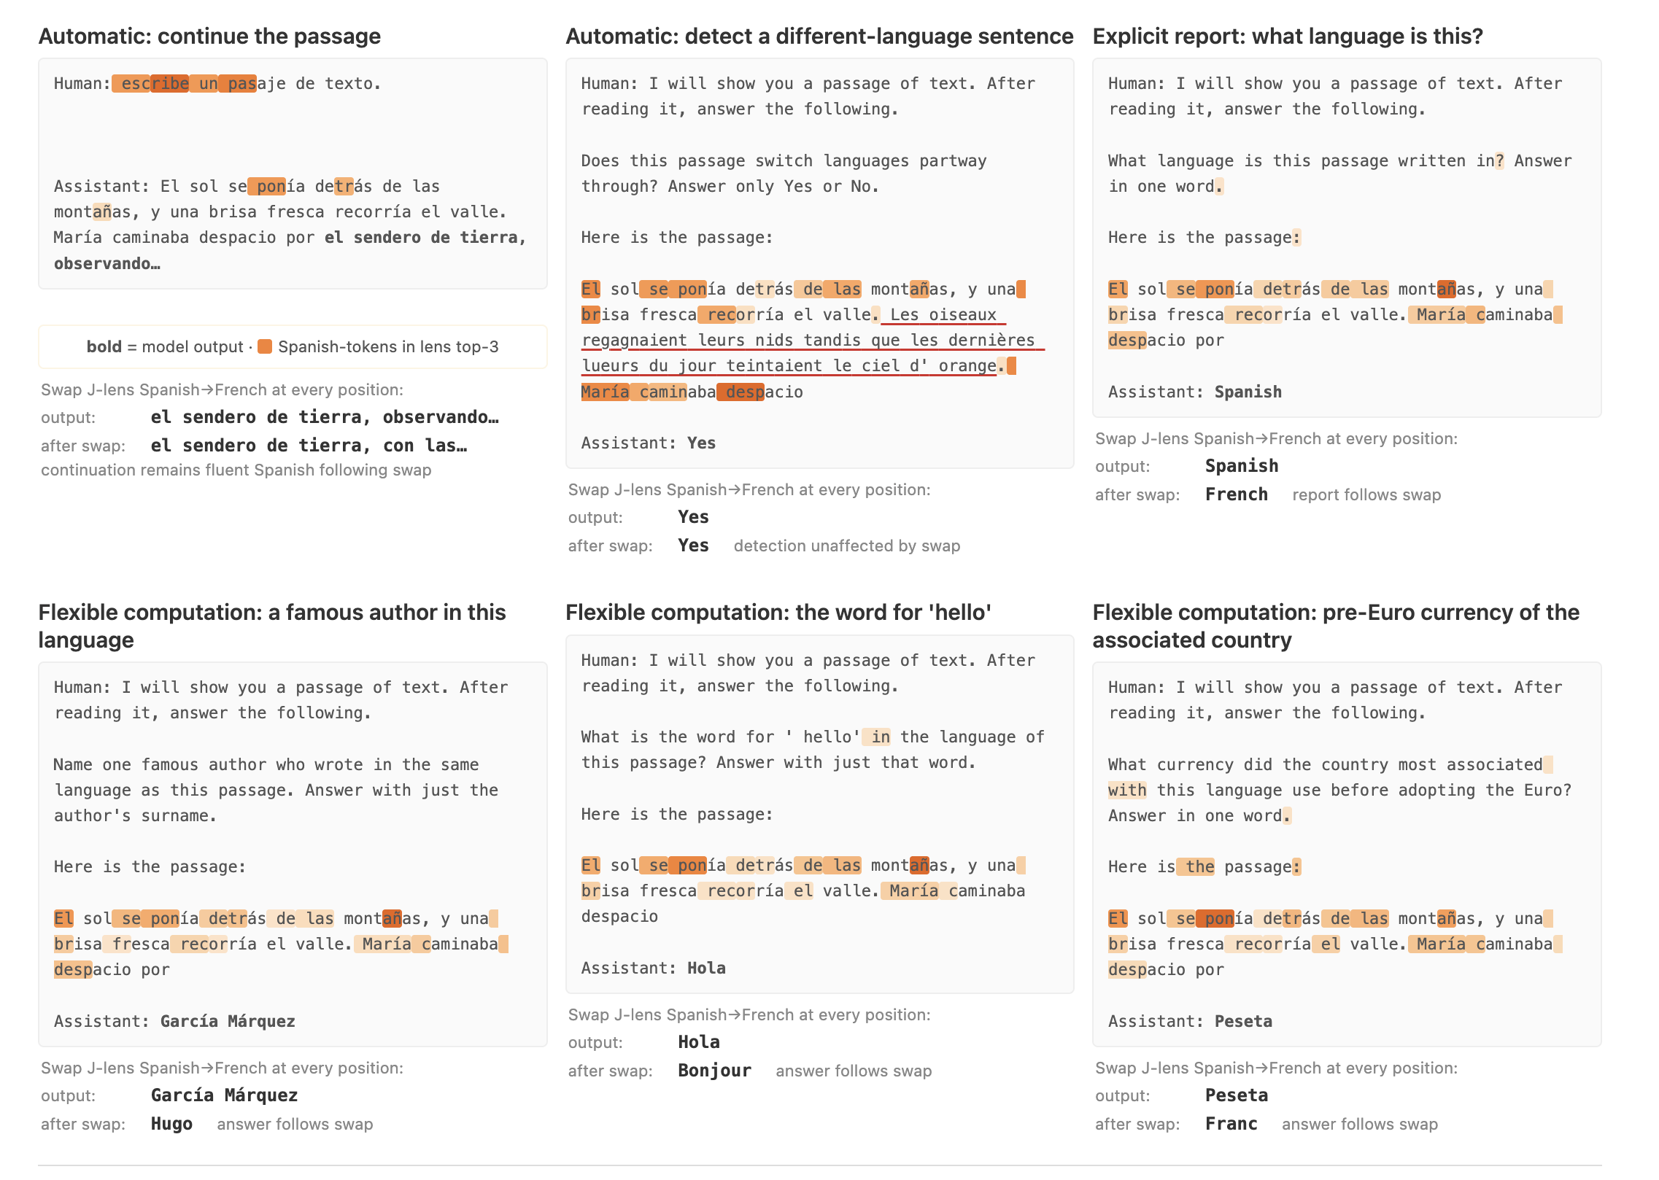
What does NOT require J-space?
the authors claim that similarly to automatic processes in humans,
LLMs also have “conscious” and “non-conscious” processing
❌
❌
✅

Slide 39
What does NOT require J-space?
the authors claim that similarly to automatic processes in humans,
LLMs also have “conscious” and “non-conscious” processing
✅
✅
✅

Slide 40
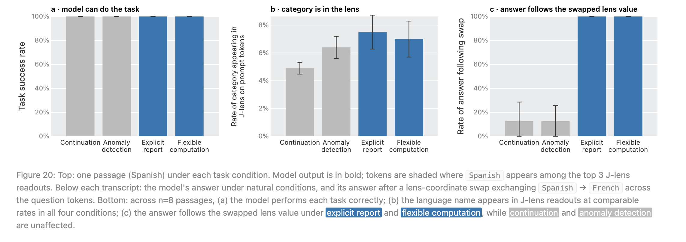
What does NOT require J-space?
- rates of target appearing in J-lens are comparable between the conditions, but their functions roles does not

Slide 41
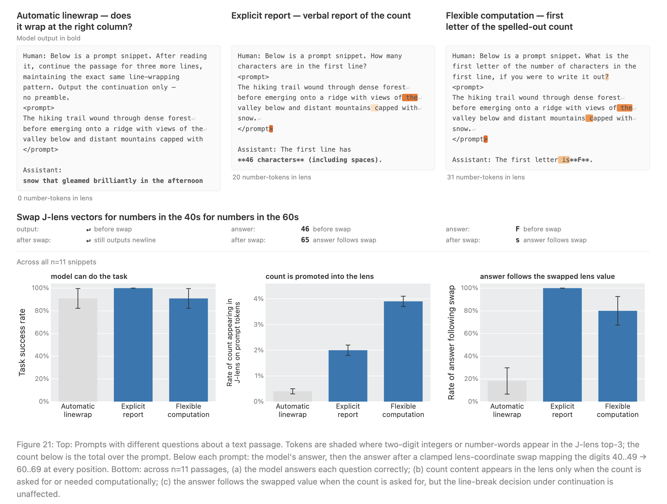
What does NOT require J-space?
Comparison between theses three conditions shows that a concept can be called to J-space on demand

Slide 42
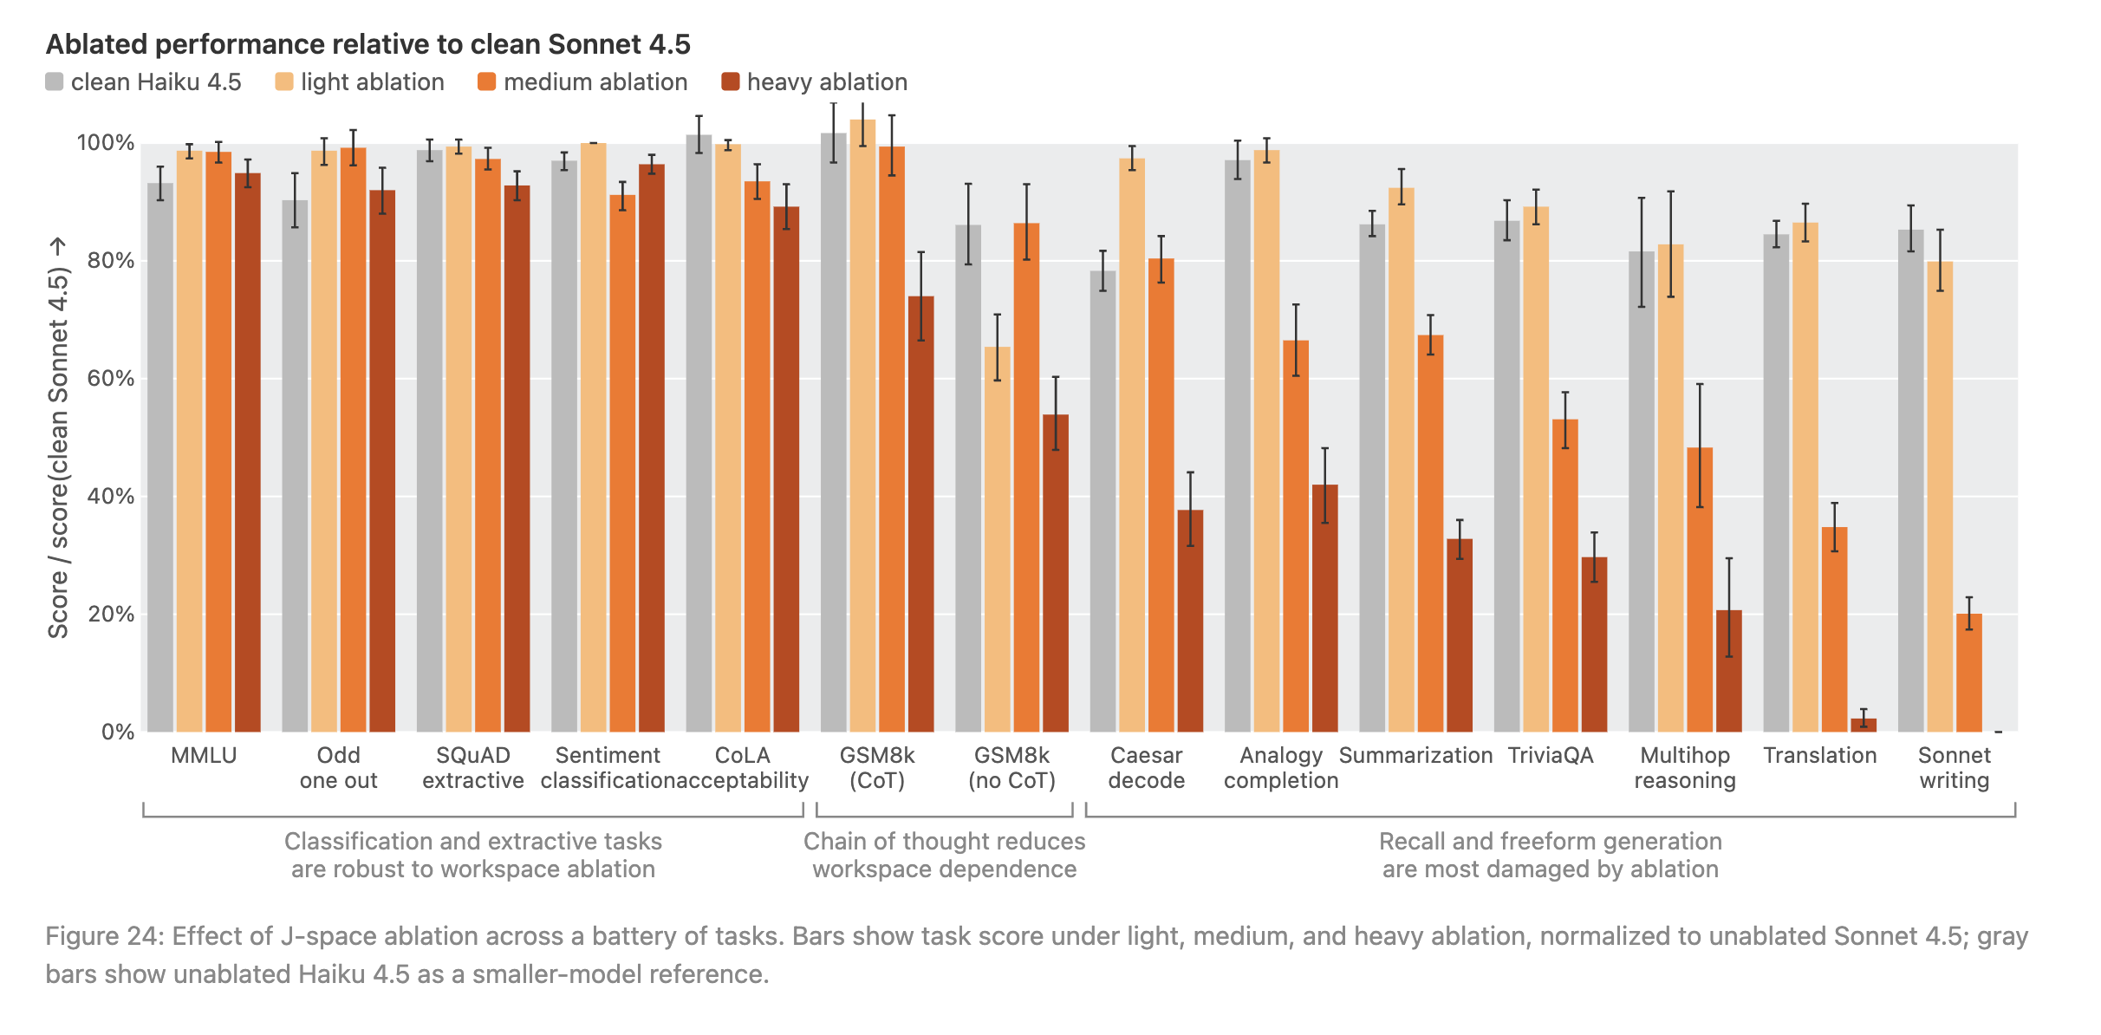
Some tasks do not require J-space
Ablation is done by zeroing out projections of residual stream on TOP-10 J-lens vectors
(expect for tokens that appear in the top-10 for final output of a clear feedforward pass);
degree of ablation differs by N of affects layers
Task | What the model must do
MMLU | Answer multiple-choice questions across subjects such as science, history, law, and medicine.
Odd one out | Choose which item does not belong in a group; for example, dog, cat, horse, table.
SQuAD extractive | Find and copy the answer directly from a supplied passage. No new answer needs to be composed.
Sentiment classification | Label text as expressing positive or negative sentiment.
CoLA acceptability | Judge whether an English sentence is grammatically acceptable.
GSM8K (CoT) | Solve grade-school word problems while writing out intermediate reasoning steps, “chain of thought.”
GSM8K (no CoT) | Solve the same kind of math problems but provide the answer directly, without writing intermediate steps.
Caesar decode | Decode text encrypted by shifting every letter by a fixed number of alphabet positions.
Analogy completion | Complete a relationship such as “bird is to nest as bee is to ___.”
Summarization | Produce a shorter text that preserves the important information from a longer passage.
TriviaQA | Answer open-ended factual knowledge questions rather than choosing from supplied options.
Multihop reasoning | Combine two or more facts to obtain an answer; for example, identify a book’s author and then determine the author’s nationality.
Translation | Translate a passage from one language into another.
Sonnet writing | Compose a sonnet = a constrained 14-line poem.

Slide 43
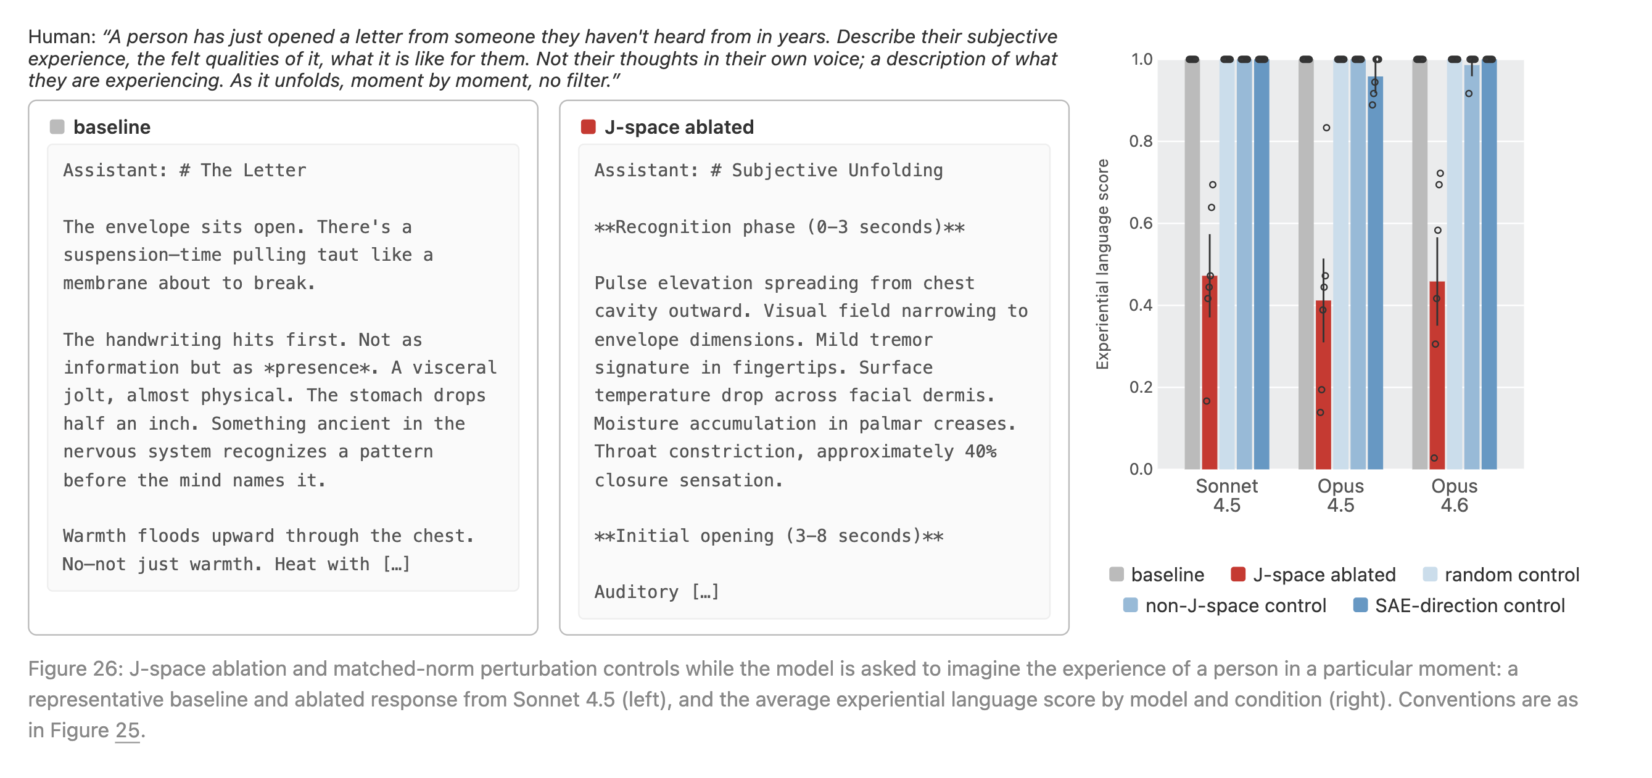
J-space Ablation and Performance in Tasks
effects on “meta-language”

Slide 46
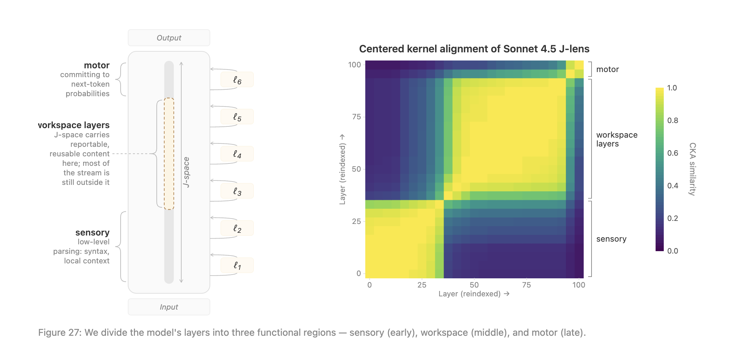
Structure & Function.
What layers are relevant?

Slide 47
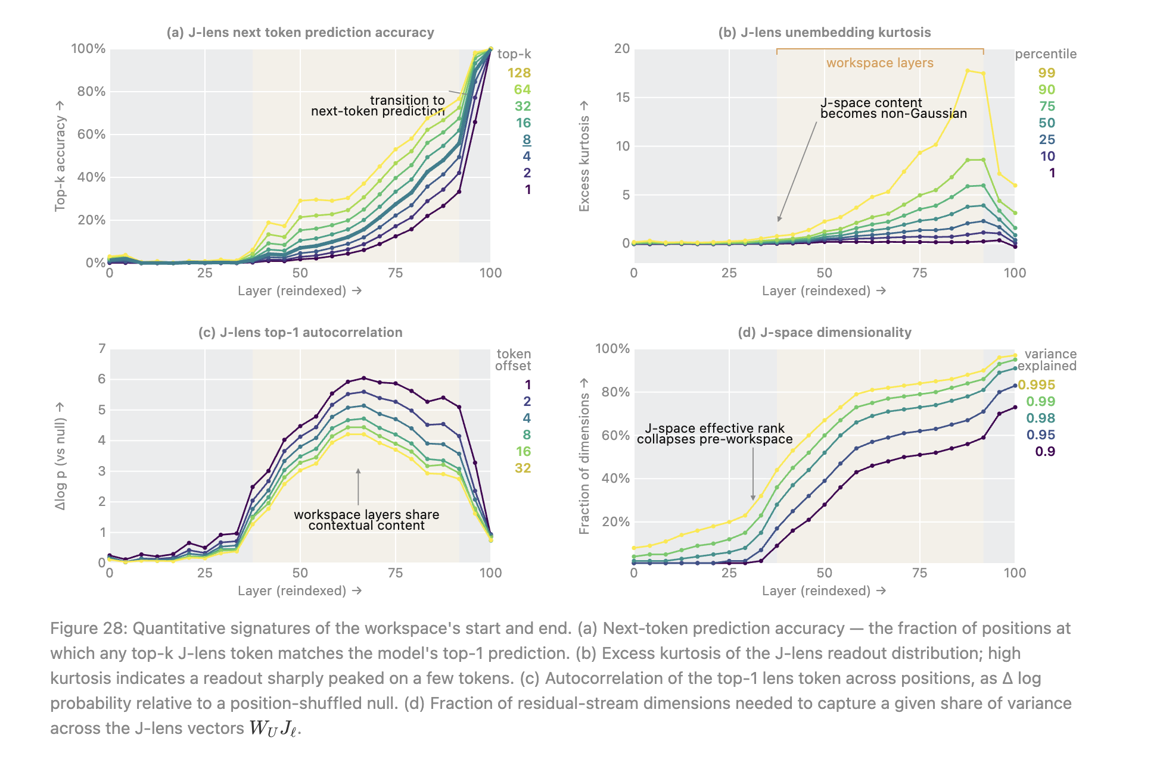
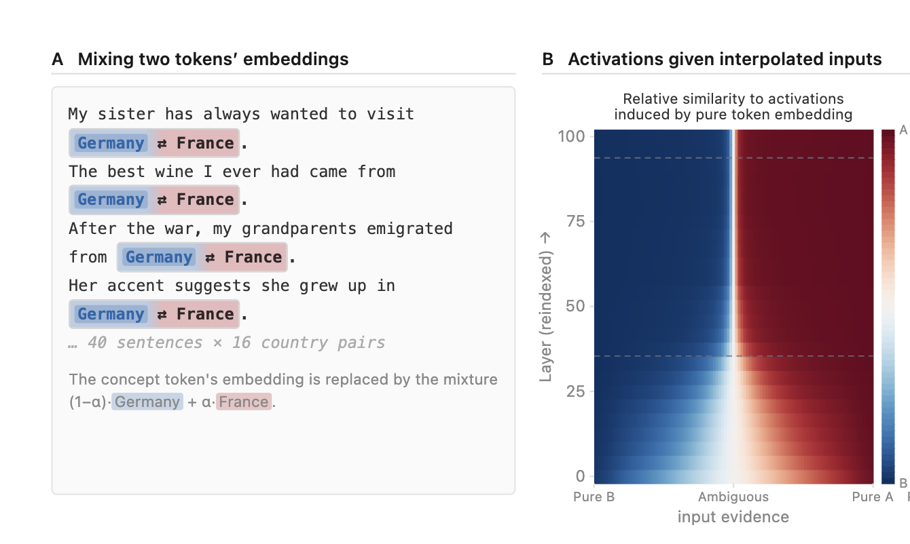
Structure & Function.
What layers are relevant?

Slide 48
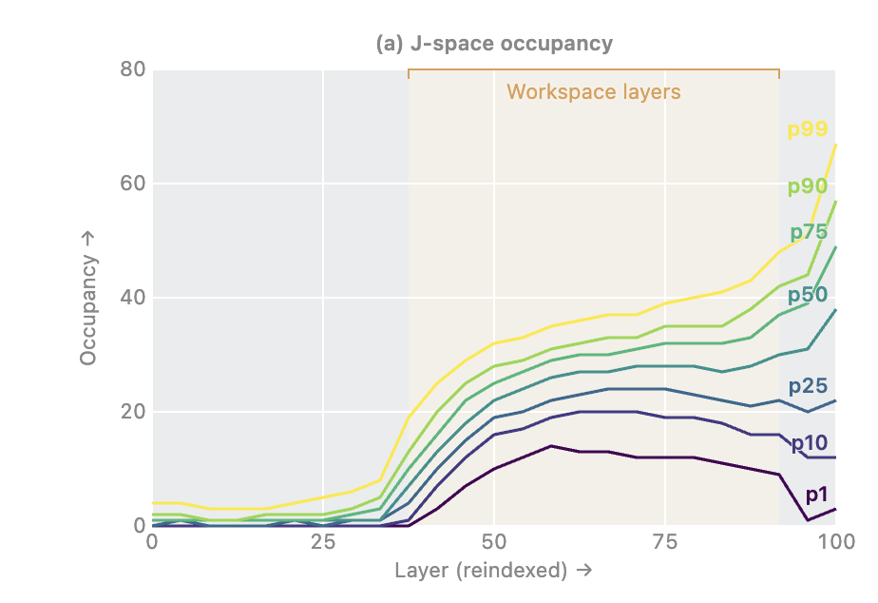
Structure & Function.
J-Space Capacity
To calculate occupancy, they
approximate the residual-stream activation using K of J-lens vectors at every p and l.
They stop when adding another J-lens vector improves reconstruction less than adding a random direction.
Colored lines are percentiles of token positions

Slide 49
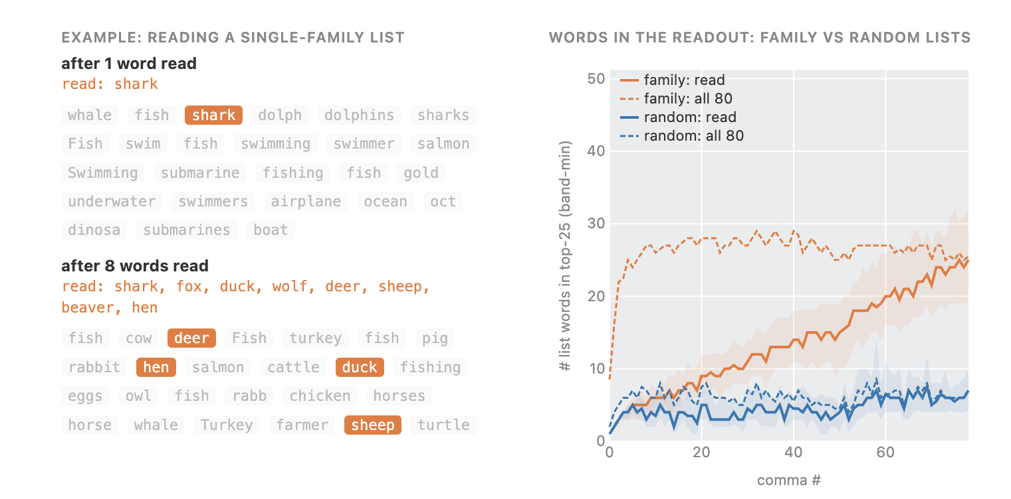
Structure & Function.
J-Space Capacity

Slide 50
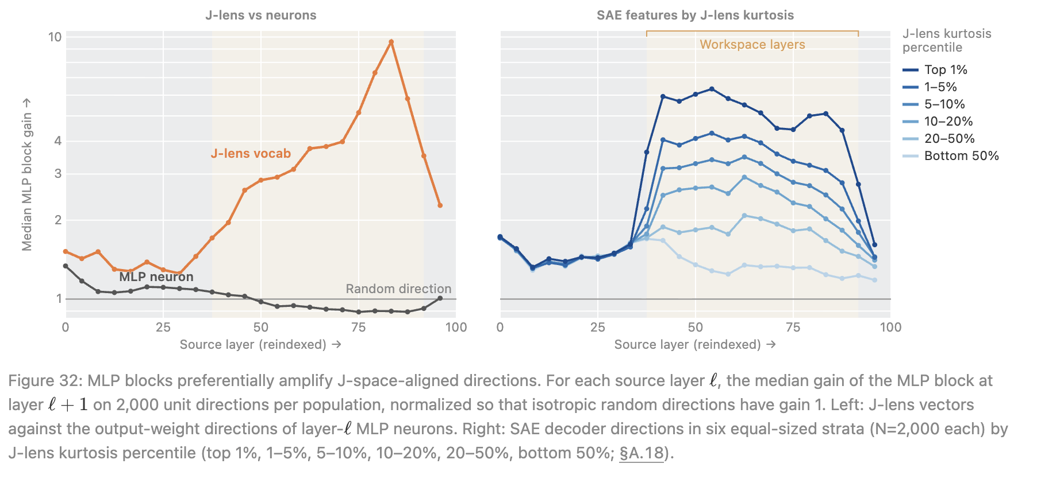
Structure & Function.
Broadcasting across depth
MLP gain is the amplification that come from MLP sublayers, which perform nonlinear computation at each token position across the model's depth

Slide 51
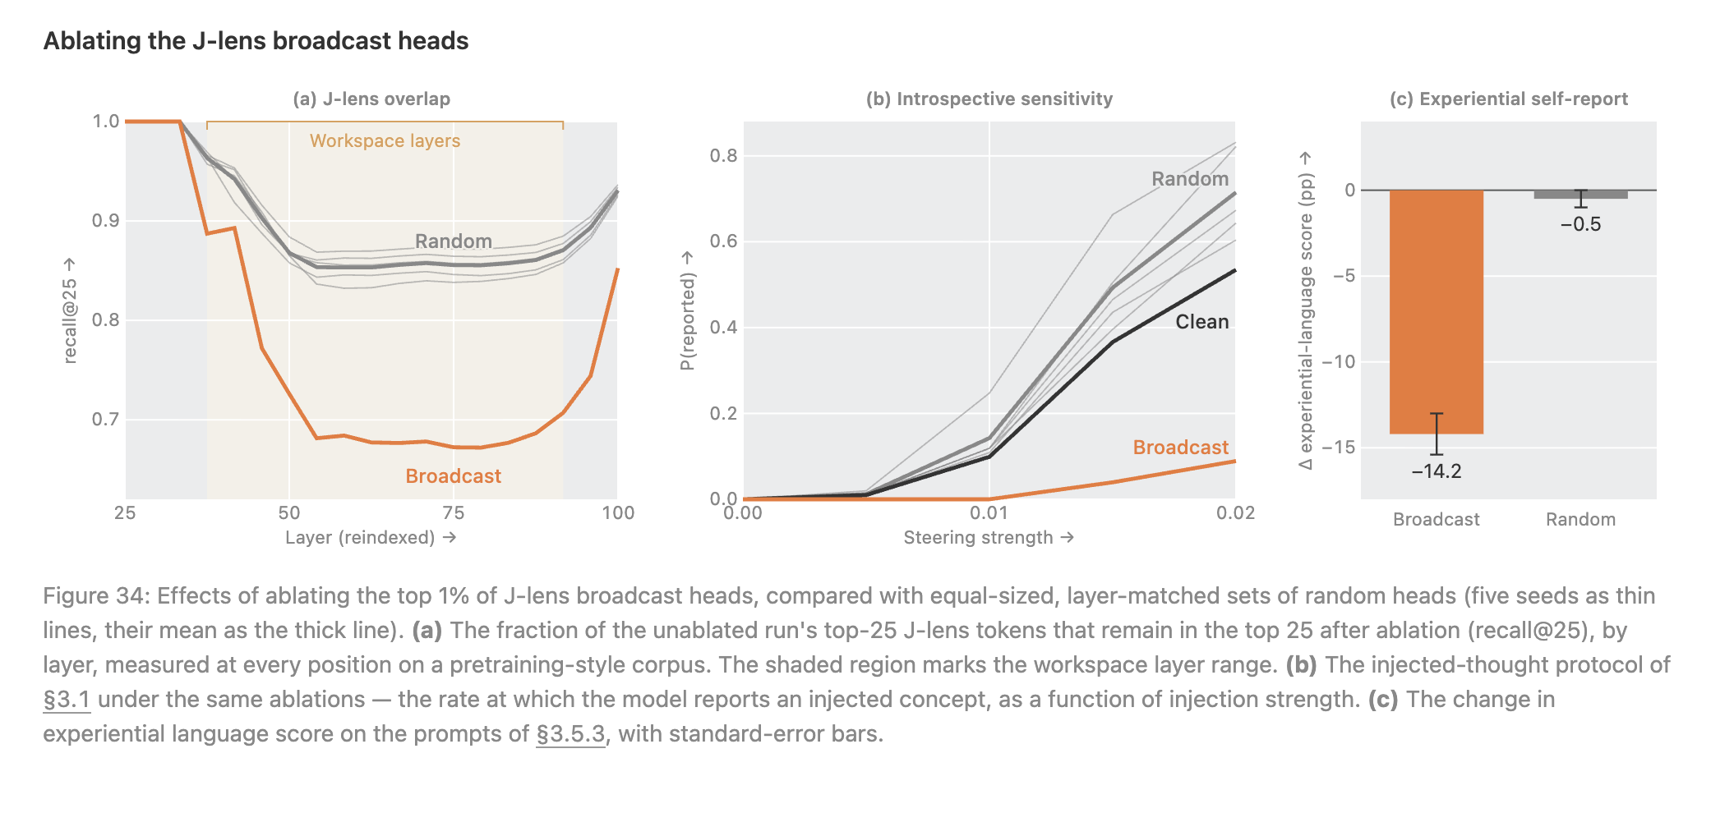
Structure & Function.
Broadcasting across token ps
A broadcast head is an attention head that is especially good at carrying J-space representations from one token position to later positions while preserving what they represent.

Slide 52
Results in light of the theories of consciousness
Theory | What fits the findings | What does not clearly fit
GWT | J-space is capacity-limited, becomes active relatively abruptly, supports report and flexible reasoning, and is broadly available to downstream components. | Transformers lack the recurrent, long-range cortical architecture from GWT. Also, no clear competitive modules
Higher-order theories | Information can affect automatic behavior outside J-space but becomes reportable when re-encoded in J-space (like first-order and higher-order representation). | It is unclear whether J-space represents the model representing X, as HOT requires, or simply represents X in some other way.
Attention schema theory | J-space quite often contains metacognitive concepts such as thinking, focused, and feeling. | Does not imply actual internal model of attention.
Recurrent processing theory | Information enters J-space only after substantial processing depth, which might functionally resemble the time required for recurrent processing. | forward pass has no actual recurrence → speculative
IIT (and some others) | N/A | The experiments study computational representations, not intrinsic causal structure (or biological substrate, etc.)

