Slide 1
Tech Stack Lab
Dr. Kurz
Ronan Kearns
Jeff Turner

Slide 2
Review Assignment 2
https://github.com/kearns-cu/Blockchain_Course_Repo/tree/main/Assignments/Solutions

Slide 3
Requirements
Github Account
VS Code
Solidity Extension – Download in Class
Node
Homebrew for macOS and chocolatey for Windows or install via browser

Slide 4
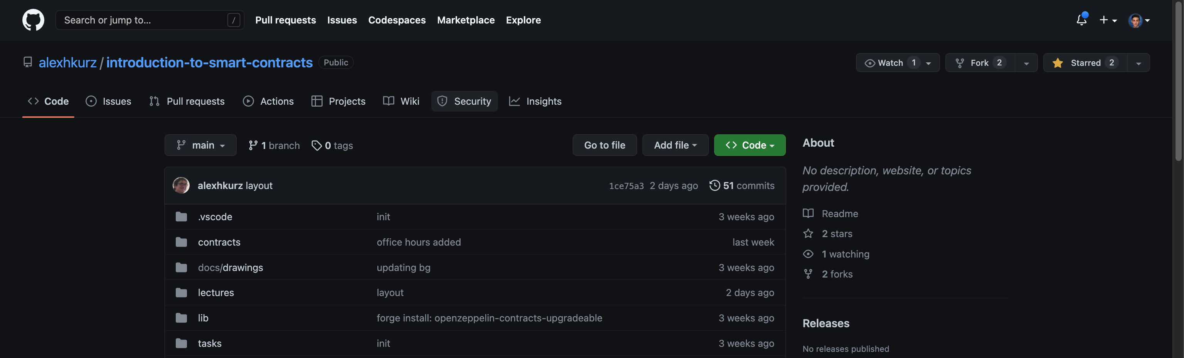
Forking Repo – In Class

Slide 5
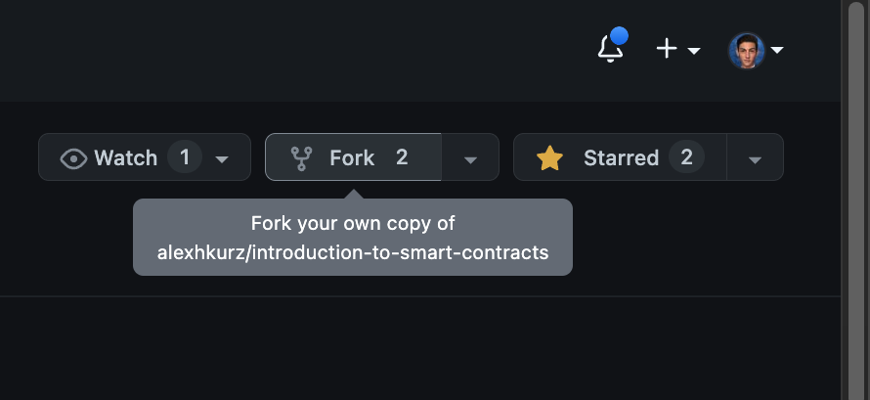
Forking Repo – In Class

Slide 6
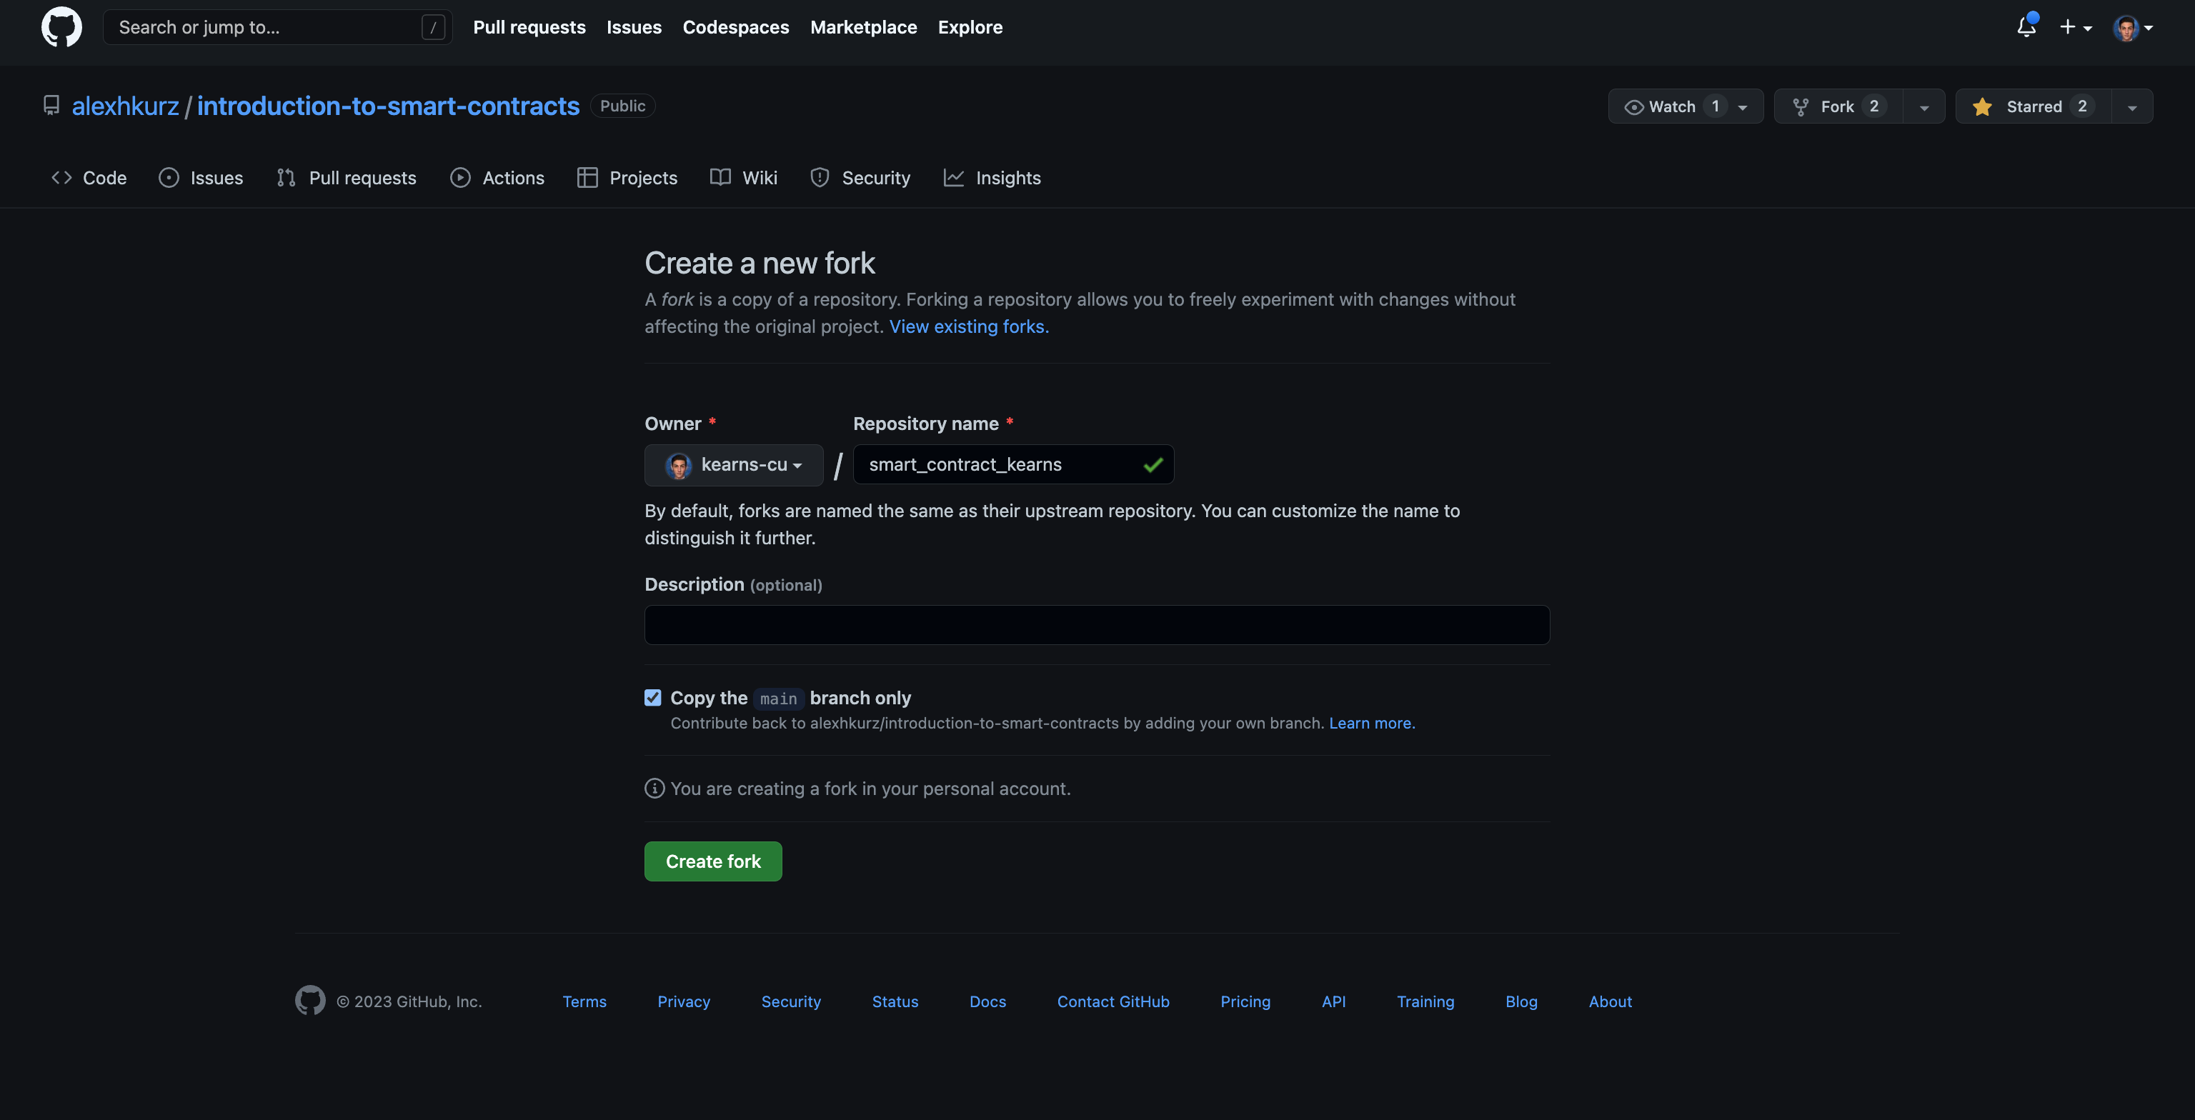
Forking Repo – In Class

Slide 7
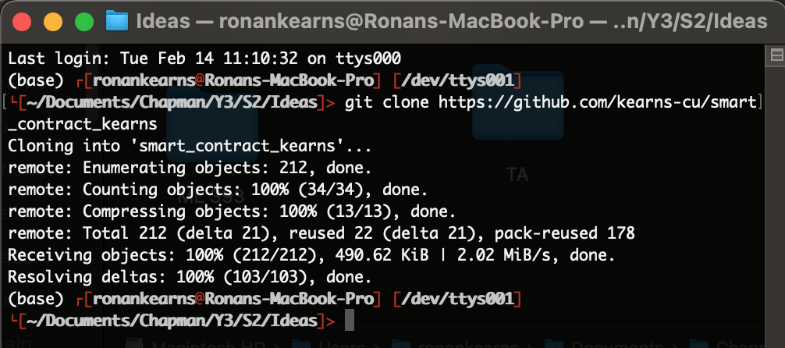
Cloning Repo to System – In Class
git clone *your personal repository url*
Remove unused files in contracts and test directories if need

Slide 8
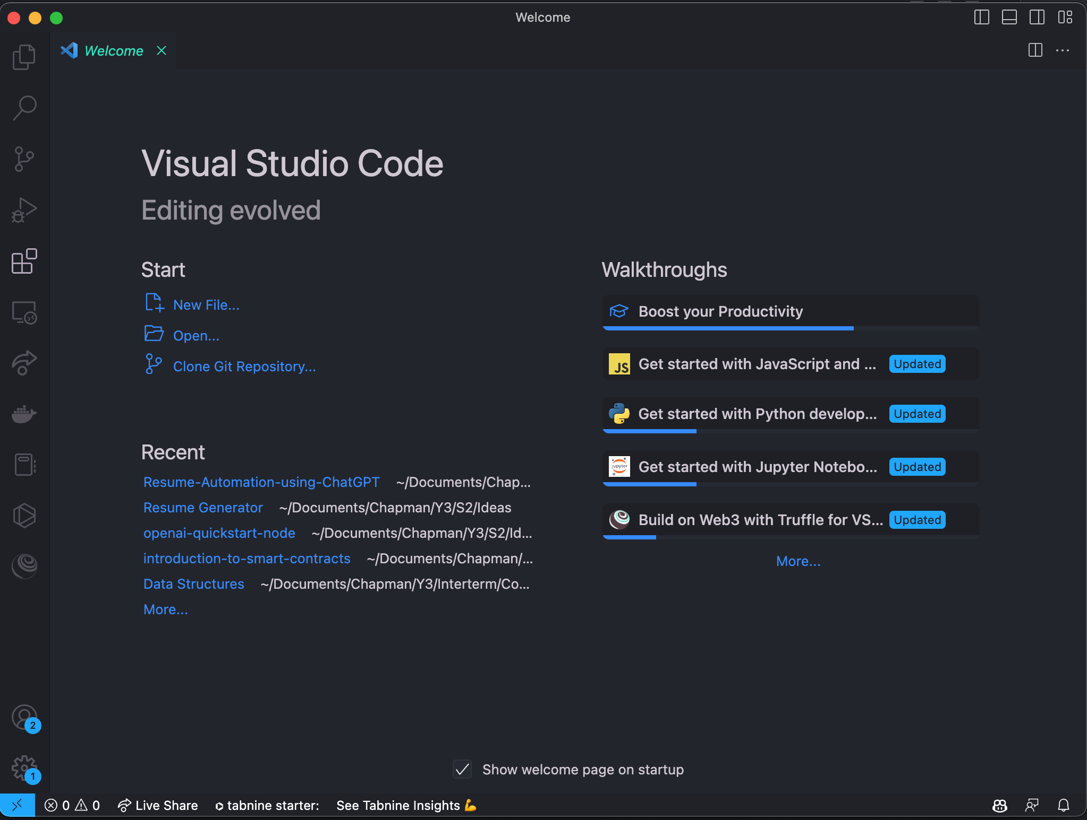
Visual Studio Code (VSCode)
https://code.visualstudio.com/download
Use this link to download the app

Slide 9
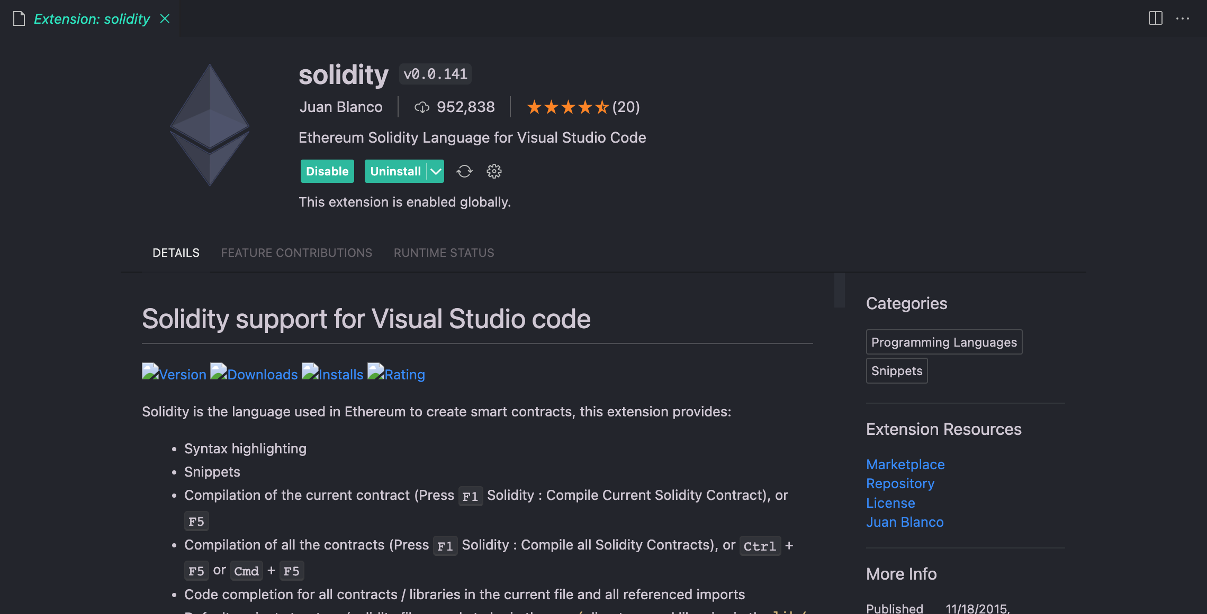
Visual Studio Code (VSCode)

Slide 10
Follow Github README
Install Foundry -> https://book.getfoundry.sh/getting-started/installation.html
npm i
forge install

Slide 11
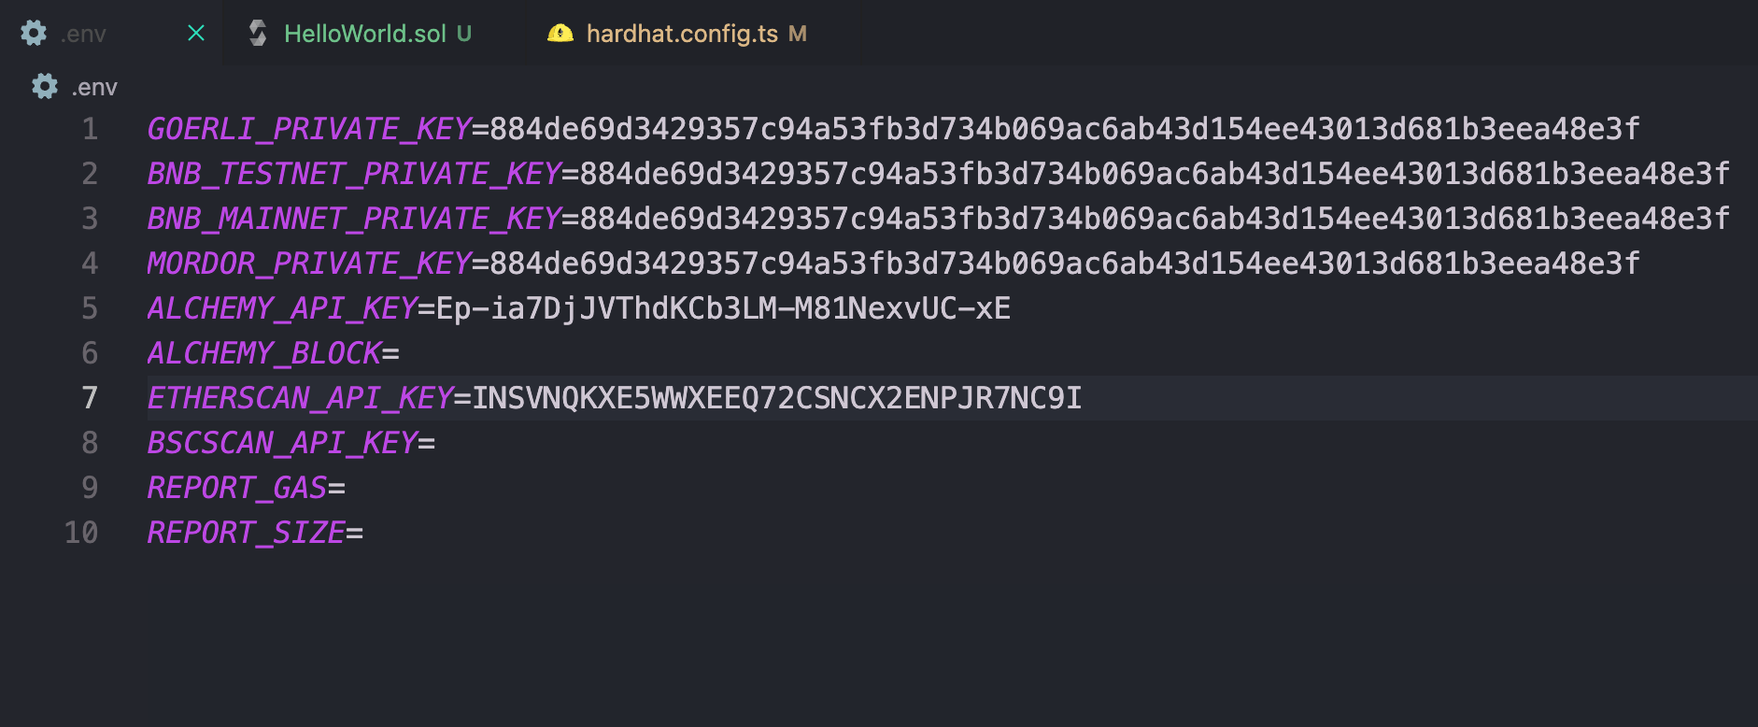
Populate ENV File
Export private keys from your Metamask
Etherscan API is used for verifying contracts via command line

Slide 12
Don’t Forget to Use Faucet for test ETH
https://goerlifaucet.com/
Sign Up for Alchemy account and use account to sign into Goerli faucet
https://www.alchemy.com/

Slide 13
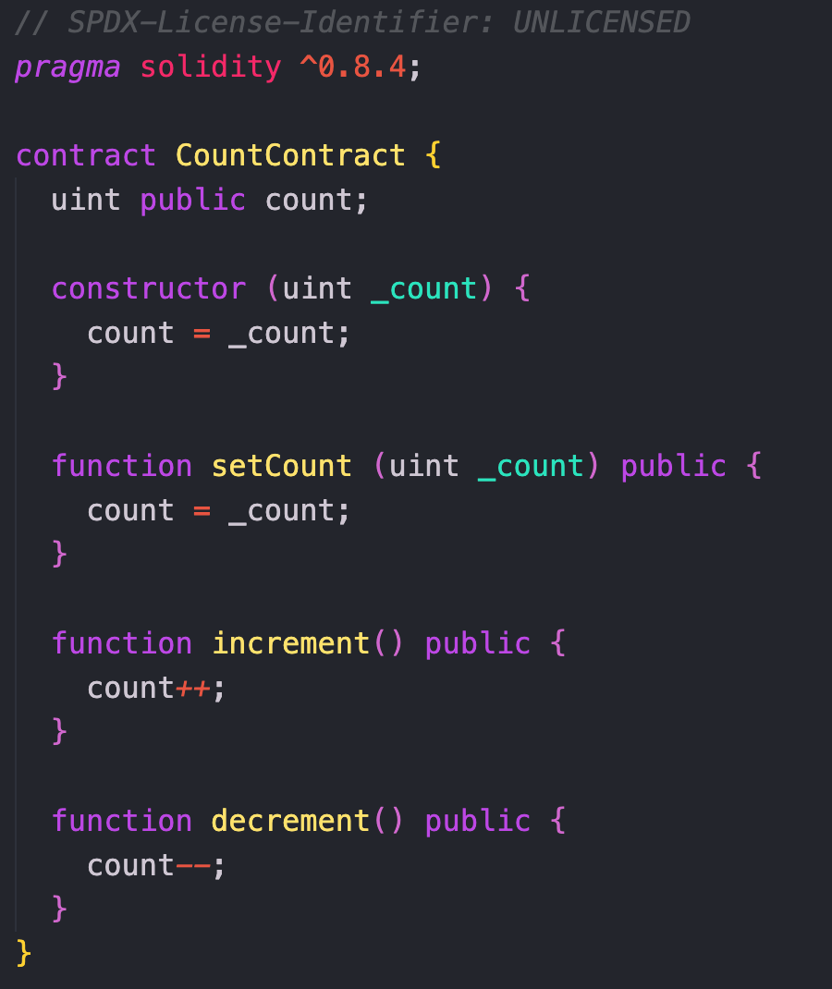
Contract Structure
Solidity Documentation
https://docs.soliditylang.org/en/v0.8.18/structure-of-a-contract.html
Cheatsheet
https://docs.soliditylang.org/en/v0.8.18/cheatsheet.html

Slide 14
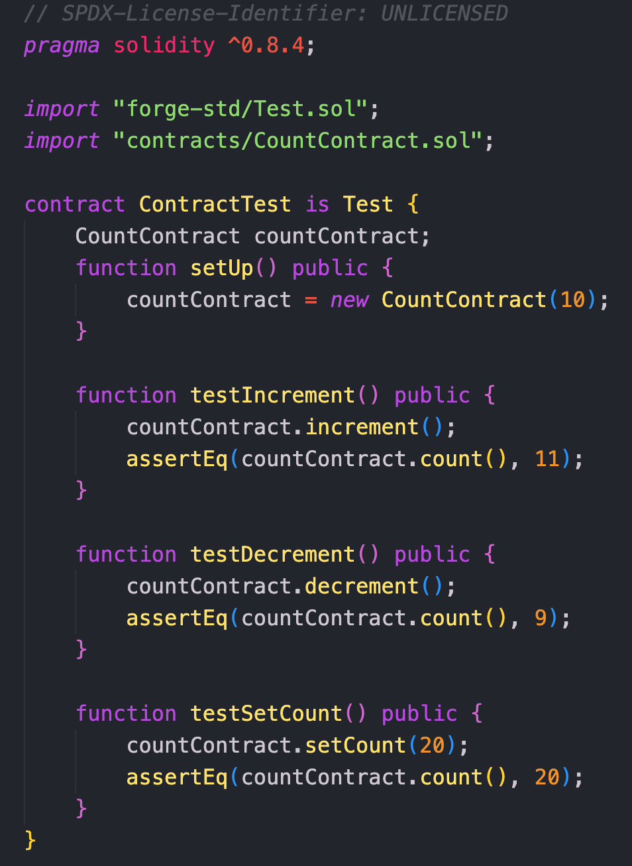
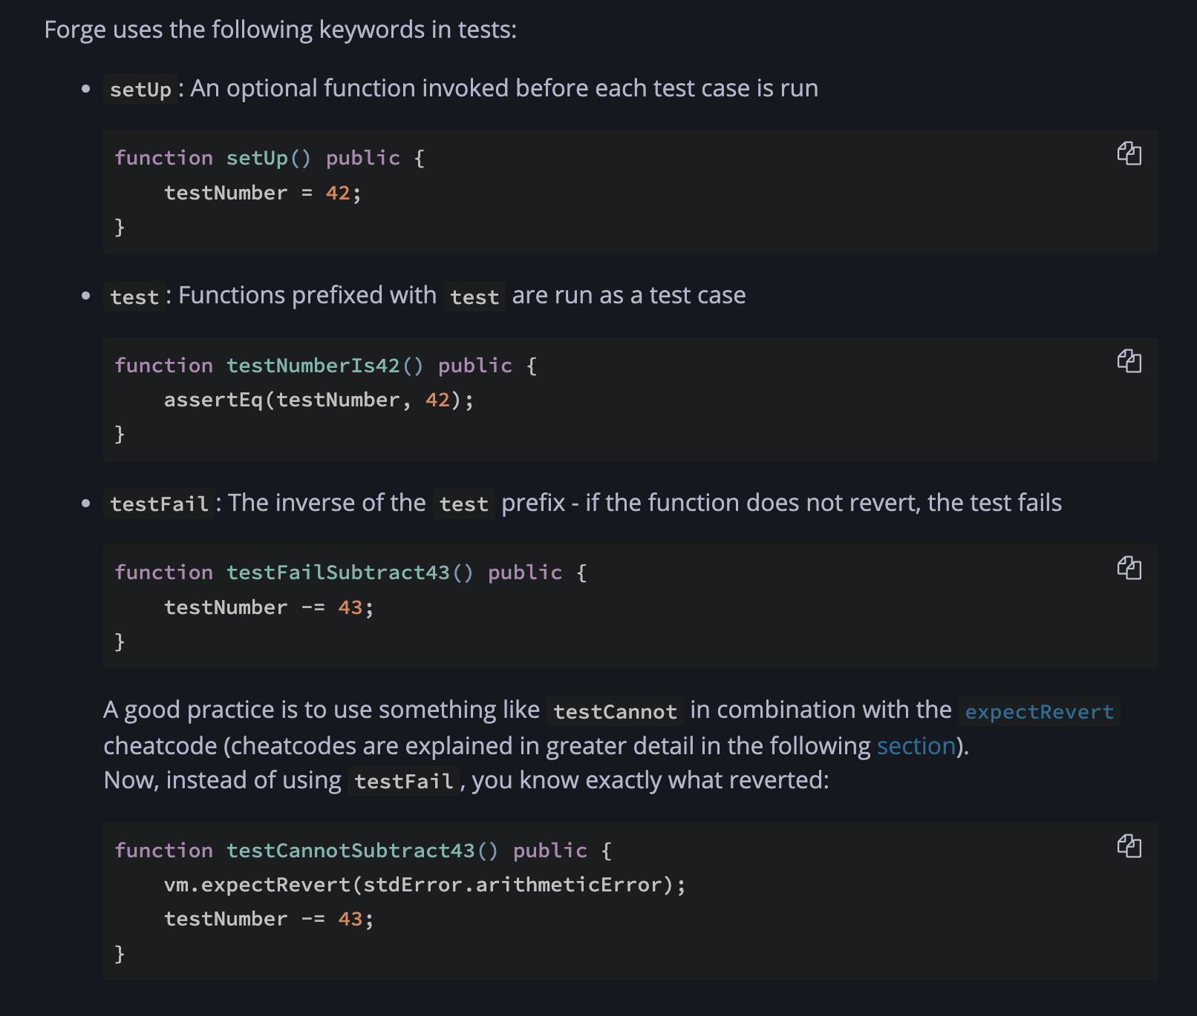
Writing Unit Tests

Slide 15
Assignment 3
Write a getCount() function for the CountContract.sol
Alter the CountContract.t.sol to add a test for your getCount function you added
Compile your contract using npm run compile
Test your contract with npm run test
Once you have finished development and testing your solution, you will deploy it to the Goerli chain
npx hardhat --network goerli deploy --contract CountContract
Make sure contract name is the same name defined inside of your contract
Ensure your .env file is populated
Verify smart contract with the command:
npx hardhat --network goerli verify <deployed_contract_address>

